Slide 1

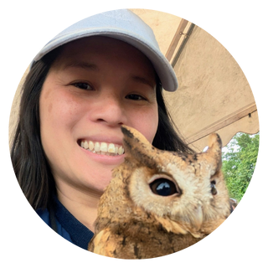
Using Moodle groups for learning and assessment
Workshop facilitators:
Please visit Learning & Teaching Hub Past Events for a recording.
Rachel Applegate
Lynn Cheong-White
tel@bath.ac.uk
teachinghub.bath.ac.uk

Slide 2
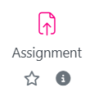


Session Overview
Preparing for group work
Using groups and groupings in an assignment
  Group Peer Evaluation
Setting up restrictions with groups
Using groups with forums
Recap: Creating and housekeeping ​Moodle groups and groupings recording – see also Past events
Notes:
In today's session, we will focus in on a few key tools and features in Moodle
These are some of the most commonly used features for supporting group work in Moodle, but it's not an exhaustive list
We held a webinar last week where we introduced Moodle Groups and Groupings, and looked at how you can create groups and manage enrolments
There's a link to the recording in these slides, if you need to catch up on that session
You can book a one-to-one session with a member of the Instructional Design team for help getting activities set up for groups

Slide 3
Preparing for group work
Ensure group assessment tasks include a clear explanation of:
the purpose of group work
expectations around collaboration
how individual and group contributions will be recognised or assessed
Reasonable Adjustment L1 – A key part in successful groupwork. Find out more recommendations to productive groupwork in our Groupwork Guide.

Slide 4
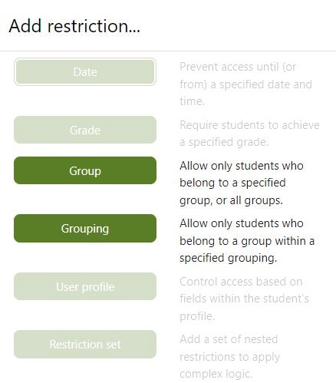
Demonstrations
DEMO 1: Using groups and groupings in an assignment
DEMO 2: Setting up restrictions with groups
DEMO 3: Using groups with forums
Focus today
Brief spotlight
Brief spotlight

Slide 5
Groups and Groupings in Moodle Assignment: Scenarios
Some example scenarios
Students work in a group, and make an individual submission
Students work in a group, and make a group submission
  Students receive a group mark for their submission
  Students complete a Group Peer Review activity to evaluate peer contribution to groupwork, and receive a peer weighted mark
  Students receive an individual mark for their submission
Focus today
Moodle Assignment and Group Peer Review give options for different scenarios. You can also use features such as Ranged Rubrics or Marking Guides to help with marking.
Contact TEL Team (tel@bath.ac.uk) to help choose the best settings for your assessment

Slide 6





Groups and Groupings in Moodle Assignment: Overview & Demo 1
Grouping
Group 1
Teacher
Adds marks and / or feedback
Apply to entire Group or individuals*
Group 2
How to create a group assignment
Marking a group assignment
Notes:
LIVE DEMO
Go to Groups overview – show Product Review Assignment Groups (3 groups)
Show how you would add an assignment
Go to assignment already created (Settings)
Highlight Group Submission settings
Students submit in groups: Yes
Grouping for student groups: selected
Save and Display
Grading summary screen – how many groups are you expecting?
Note there are 4 Groups in the summary!
Note warning re: Default groups
View Submissions tab – check all students are in groups / not in Default group
Note one student (test olivia) is not in a group so has gone in to Default group
Go to Participants – add student to group (PR-3)
Go back to assignment – Note there are now 3 Groups (as expected) / warning message has gone
Go back to Submissions tab – Note all students are now in groups
Demo 2: group assignment submission point
Submission by students in one group
A single student uploads the file and it populates for all students in the group
Note submission timestamp and file name
To mark, go to Grade – add grade, workflow status, feedback comment
Scroll to bottom of grading panel: Default = Apply Grades and feedback to all students Yes
NOTE: Default setting for 'Apply feedback to Group' - highlight this reverts to Default YES each time you save
Can use Grading worksheet for Group submission with individual marks

Slide 7
Checking your Group assignment (1)
Check your assignment set-up on creation. Once students submit, you can't change the settings!
1. In the Grading Summary, check the number of groups
2. Check for any Warning messages (red banner)
3. In the Submissions tab, check that all students are listed in a Group
4. Use the Groups Overview tab to make sure all students are in a Group

Slide 8
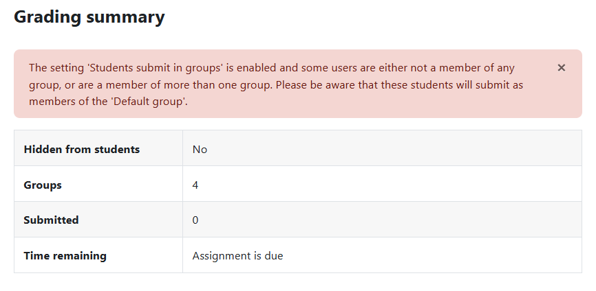
Checking your Group assignment (2)

Slide 9
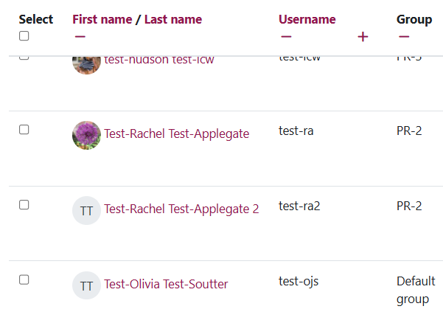
Checking your Group assignment (3)

Slide 10
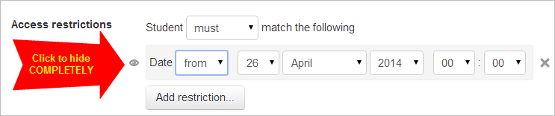

Restricting access by groups:
Overview & Demo 2
Restrict access to make Resources or Activities visible to a Group (or Grouping)
  For multiple unit cohorts in one Moodle space
  For restricting access to assignments
Can apply to whole Topics, or individual activity or resource
Option to Hide completely from students not in a group
Using restrict access
TEL Nybbles – Restrict access in Moodle
Notes:
Live demo
Go to Course Page
Turn Editing on
Go to Edit Topic (Topic 2)
Restrict Access
Group
Select Cohort Group
Show difference between Displayed or Hidden – choose Hide completely
Save and display
Go to Course page and show condition for Teacher

Slide 11
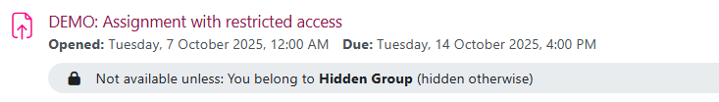
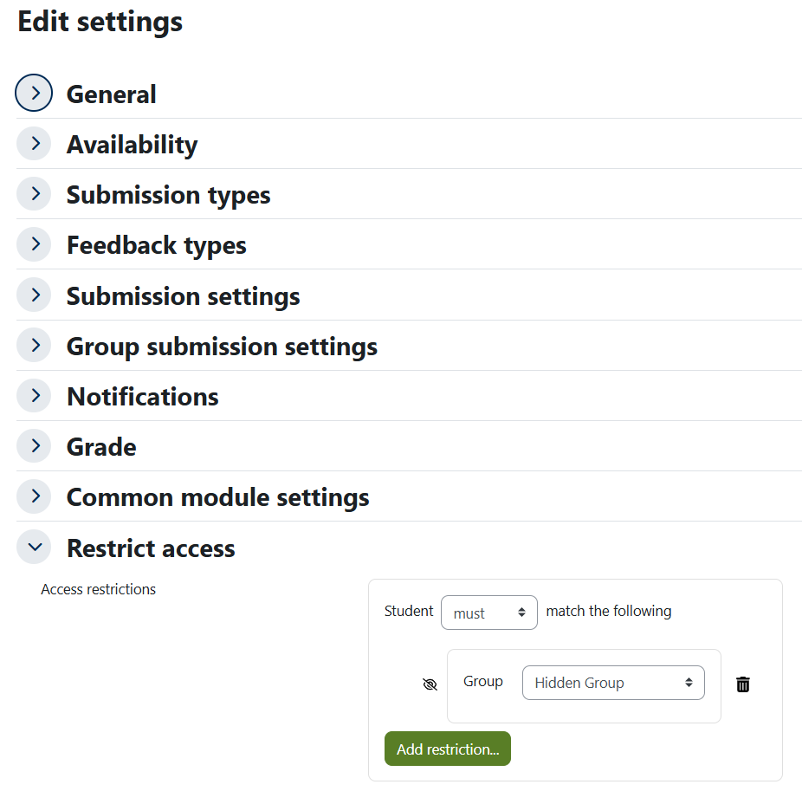
Example: Restricted access for reassessment
Using Hidden Group, restriction automatically set to Hide entirely
Students not in the Group won't see the activity
Digital assessment workflow - reassessment
TEL-Nybble – Hidden Groups

Slide 12
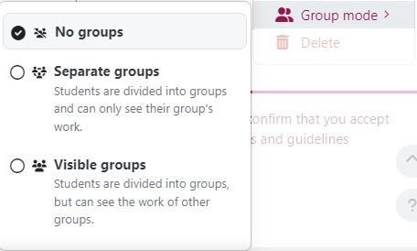
Groups and Groupings in forums:
Overview & Demo 3
Separate groups
Group 1
Group 2
Using groups with forums
TEL Nybbles –Forums with Groups
Visible groups
Group 1
Group 2

Slide 13
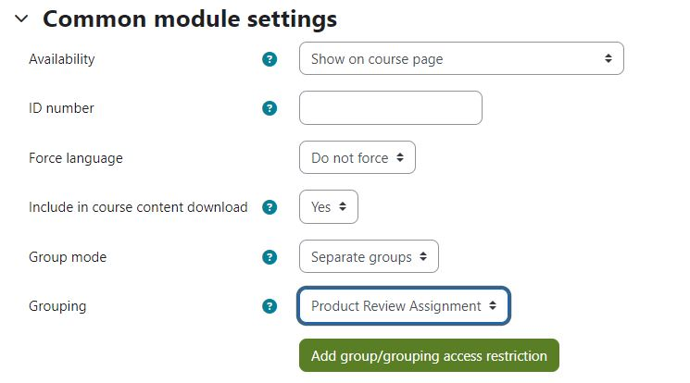
Groups and Groupings in forums (1)
Teacher view
Notes:
In the forum settings, set the Group mode to Separate groups or Visible groups
Select your Grouping to link your forum to a set of groups

Slide 14
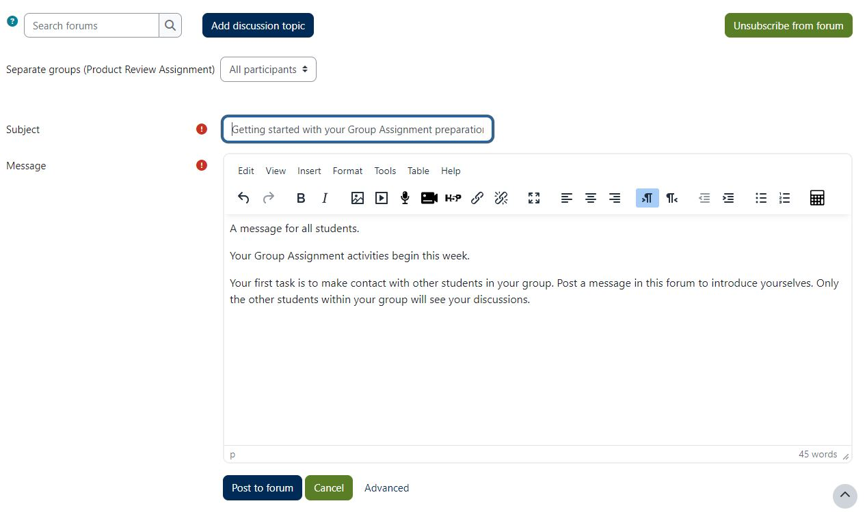
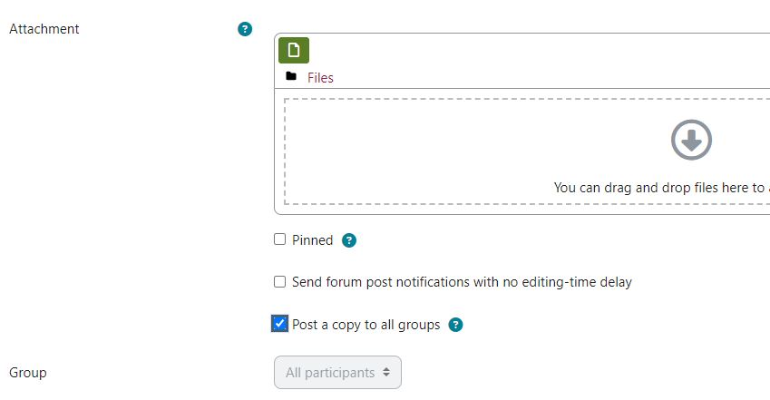
Groups and Groupings in forums (2)
Teacher view
Notes:
Select All participants or a group to post to students
Under Advanced settings you can Post a copy to all groups
All students can see your post, but they can only reply within their groups

Slide 15
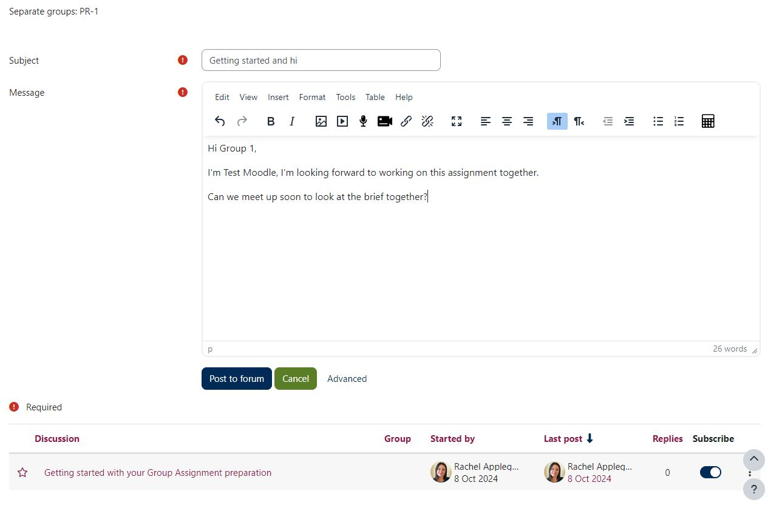
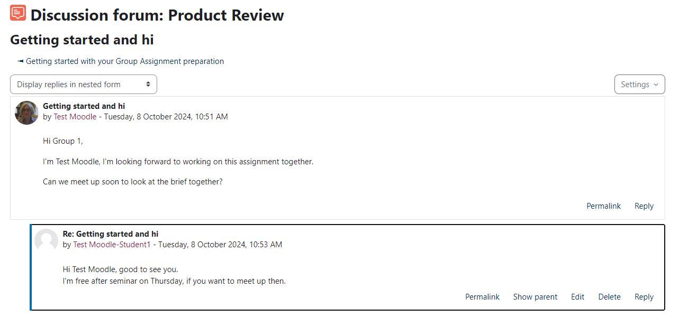
Groups and Groupings in forums (3)
Student view
Notes:
Students can view posts made to All participants (by a Teacher)
Students can only make a post within their group
Students can reply to discussions within their groups

Slide 16
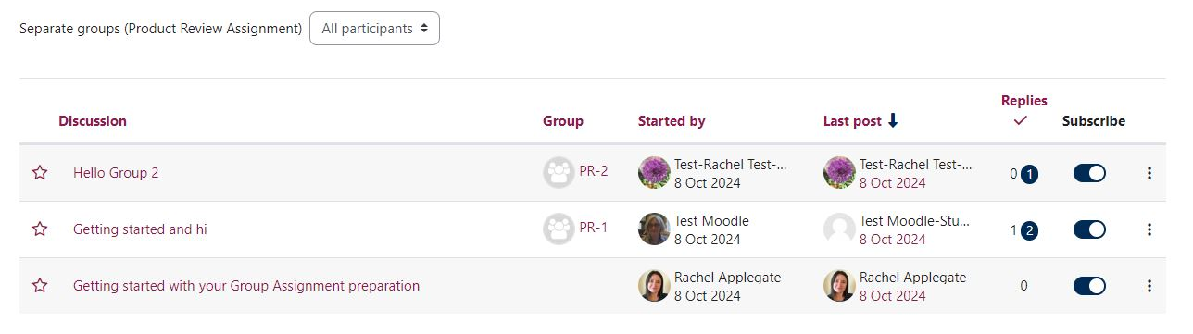
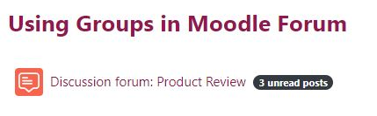

Groups and Groupings in forums (4)
Teacher view
Notes:
Teacher can view discussions by all groups
Teacher can filter by group
Unread posts are flagged (on Moodle page and within forum)

Slide 17

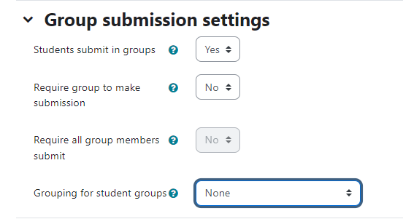
Groups & Groupings top tips – Group assignments
Troubleshooting Groups & Groupings:
Students belong to more than one group; how do I get Moodle assignment to know which groups I want to mark?
Remember to put your groups into groupings. When setting up your assignment, as well as setting up “students submit in groups”, select the appropriate “Grouping for student groups”.

Slide 18
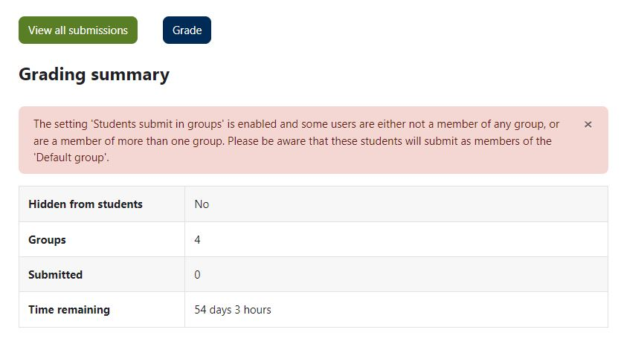
Groups & Groupings top tips – Assignment set-up error
Troubleshooting Groups & Groupings:
Last time I ran a Group Assignment, a student submitted to a Default Group and it caused problems for the group submission
Once you have created your assignment, go to the Assignment submission point and view the Grading Summary and Submissions tab.
Check for any warning (e.g. students are not in a group or are in multiple groups). Check the number of groups and student group allocations.
Adjust group memberships if needed before submissions begin.

Slide 19
Groups & Groupings top tips - Extensions
Troubleshooting Groups & Groupings:
I have used groups to distinguish which students have an extension, but I don’t want other students to see these groups, how do I hide them?
Make sure you have created a “hidden” group. Please note once a group has members you cannot change the visibility so you may have to create a new group.

Slide 20
Groups & Groupings top tips - Forums
Troubleshooting Groups & Groupings:
I posted a message to students in a group forum. Students say they cannot reply to my post. I want them to be able to reply and discuss within their groups.
When you post to a group forum, and you want students to reply within their groups, you need to choose Advanced and Post a copy to all groups
Your post will appear as a separate post within each group, and students can reply and discuss within groups
If you post to All participants without posting a copy to all groups, all students can see your post, but they cannot reply

Slide 21
Useful Resources
Learning & Teaching Hub
Managing Groups and Groupings guidance
Past events:
Recordings to past CLT workshops and events

Slide 22
Feedback
Thank you for attending today’s session.
Please take a few minutes to fill in our TEL-Bytes webinars: September 2026 – December 2026 feedback form
We will use the feedback to assist in the planning of future webinars and may use comments for future promotional materials.

Slide 23
Closing slide

