Slide 1


Creating and housekeeping Moodle groups and groupings
Workshop facilitators:
Please visit Learning & Teaching Hub Past Events for a recording.
Lynn Cheong-White
Rachel Applegate
tel@bath.ac.uk
teachinghub.bath.ac.uk

Slide 2
Session Overview
What are groups and groupings?
Setting up Groups
Setting up Groupings
Removing and moving participants from Groups
Removing groups from groupings

Slide 3




What is a group?
A group is a collection of students.
Usually this is created for group activities where grades are shared amongst members, or to allow / restrict access to materials to certain students.
Group 1
Group 2
Notes:
In a SAMIS Mapped Moodle space Groups and groupings will exist.

Slide 4
What is a grouping?
A grouping is a collection of groups within your Moodle space.
Using groupings allows you to direct tasks to a set of groups.
Grouping
Group 1
Group 2
Notes:
In a SAMIS Mapped Moodle space Groups and groupings will exist.

Slide 5
What are Groups & Groupings? Infographic
Assignment
Grouping
Assignment
Group 1
Assignment
Group 1
Assignment
Group 2
Students
Assignment
Group 2
Notes:
Group and grouping workflow:
Put your students into groups.
Put your groups into a grouping.
Groupings may be new to some. With the changes in Moodle 4.3 you will now need to put your groups into a grouping.

Slide 6
Why would you use groups and groupings?
Groups and Groupings are used to manage student cohorts, facilitate group work and/or restrict access to activities, resources or topics within a Moodle space.
Notes:
In a SAMIS Mapped Moodle space Groups and groupings will exist.

Slide 7
SAMIS Group
SAMIS Group: LC12345 2026/7 S1 cohort
Notes:
New with Moodle 4.5
In a SAMIS Mapped Moodle space Groups and groupings will exist.
In this example imagine these 4 figures represent your cohort. When they are brought into the space from SAMIS they will automatically be put into a group.

Slide 8
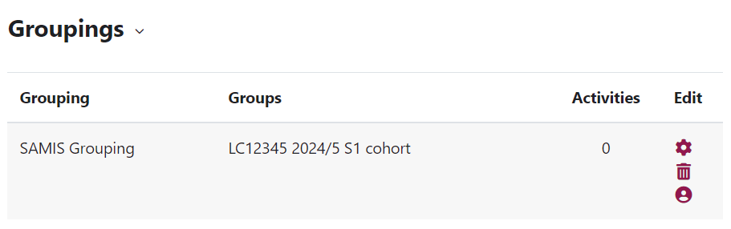
SAMIS Grouping screenshot
Moodle automatically puts its SAMIS cohort group into a grouping called “SAMIS Grouping”.
Notes:
Just as Moodle automatically puts SAMIS cohorts into groups they also put the SAMIS cohort groups into a grouping.

Slide 9
What are Groups & Groupings?
Assignment Group 1
Assignment Group 2
Notes:
You can also create your own groups, for example for a group assignment.
In this example the 4 students have been put in pairs.

Slide 10
Multiple Groupings
SAMIS Grouping
LC12345 2024/5 S1 cohort
LC12345 2024/5 S1 cohort
LC12345 2024/5 S1 cohort
LC12345 2024/5 S1 cohort
Assignment Grouping
Assignment
Group 1
Assignment
Group 1
Assignment
Group 2
Assignment
Group 2
Notes:
Yours students now belong in two different groups. When you try to do any group activity Moodle will not know which set of groups you want to use. This is when you use groupings.

Slide 11
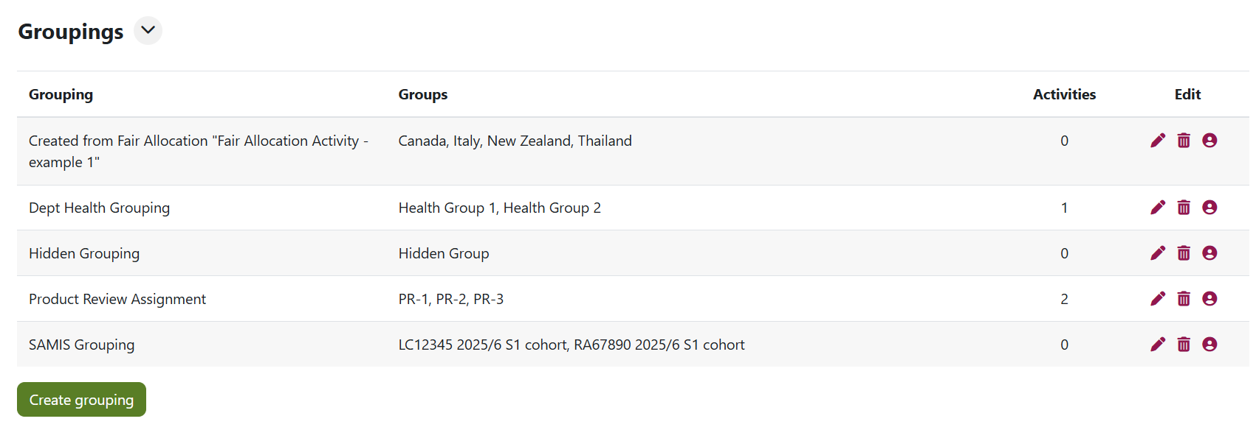
Multiple Grouping screenshot
Notes:
Another examples of groupings with groups.

Slide 12
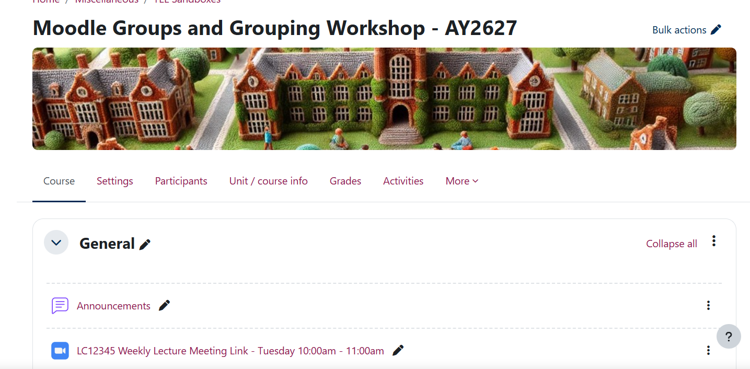
Setting up Groups & Groupings

Slide 13

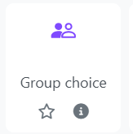
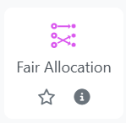
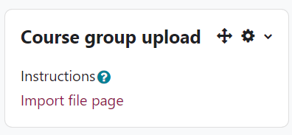
Creating Groups
Teacher created groups
Student created groups
Reasonable Adjustment L1 – A key part in successful groupwork. Find out more recommendations to productive groupwork in our Groupwork Guide. Or take our Which group selection approach is best for your activity? quiz to find out the method best for you.
Notes:
Consider group composition to avoid foreseeable barriers to participation.
Ensure group assessment tasks include a clear explanation of:
the purpose of group work
expectations around collaboration
how individual and group contributions will be recognised or assessed.

Slide 14
Course Group Upload
Allows you to create groups by uploading a .csv file.
Can create the groups and groupings in Moodle.
Participants must already exist on the Moodle space.
Adding a new .csv will create new groups not update existing ones.
How to use Course Group Upload.
Notes:
Quickest way to create groups if you already know which students need to be in which group.

Slide 15
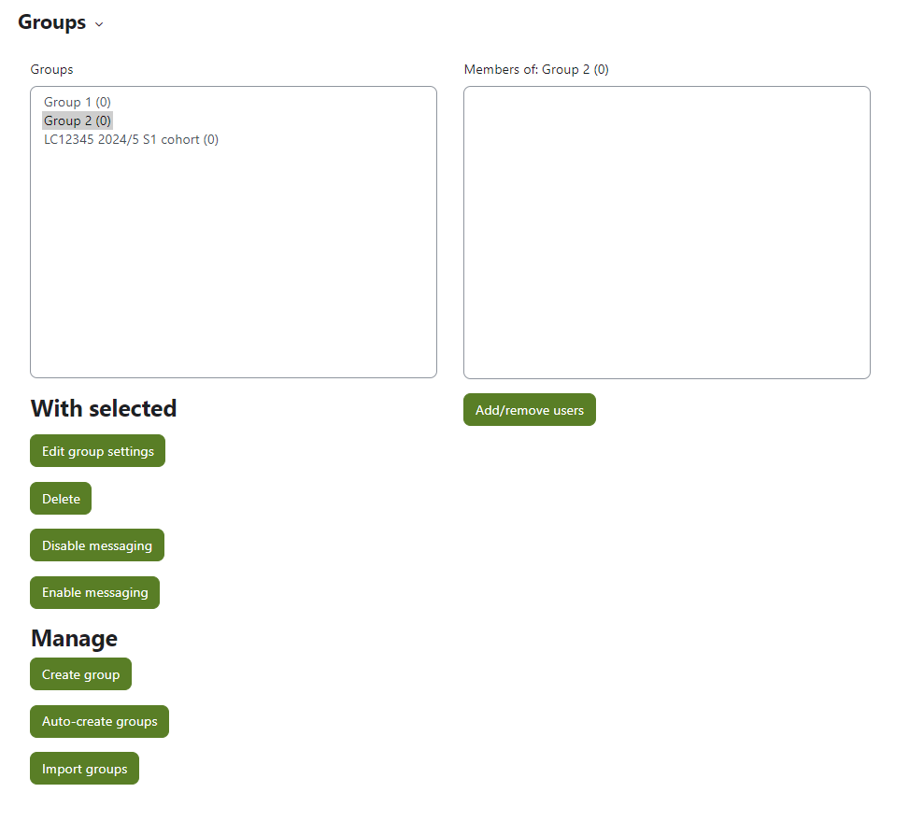
Create Groups (manually)
Can create new groups.
Can edit existing groups.
Can change membership of groups.
How to create groups manually.

Slide 16
Group Choice
Teacher must create the empty groups before setting up the activity.
Students select the group they want to join.
Moodle allocates students into the groups.
How to set-up Group Choice.
Notes:
Can’t use without creating groups first.
Explain them and student view screen shot, link to hub guidance

Slide 17
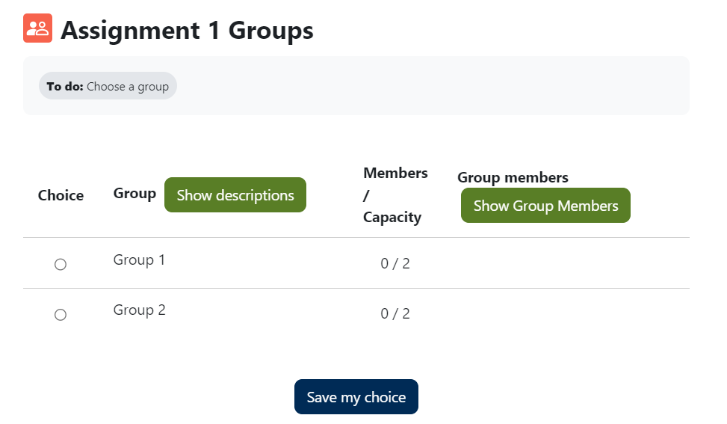
Group Choice – Student View
How to set-up Group Choice.
Student view.
Notes:
Can’t use without creating groups first.
Explain them and student view screen shot, link to hub guidance

Slide 18
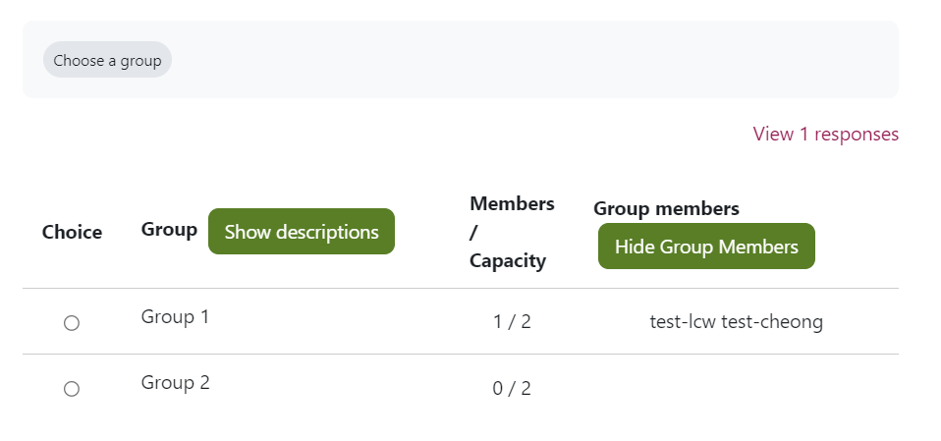
Group Choice – Teacher View
How to set-up Group Choice.
Teacher view.
Notes:
Can’t use without creating groups first.
Explain them and student view screen shot, link to hub guidance

Slide 19
Fair Allocation
Allocates students to groups based on their preferences.
Students can rate options.
Allocation is automatic, but staff can make manual changes.
Groups cannot be created before setting up this activity.
How to set-up Fair Allocation.

Slide 20
Live Demonstration

Slide 21
Fair Allocation 2
Steps:
Set-up activity.
Edit choices – set up groups. You cannot use pre-existing groups.
Allow students to rate choices.
Run Allocation Algorithm to assign students to groups.
Review allocation in “Show Allocation Overview”.
Create groups from allocation and publish the groups.
Students are now in groups.
How to set-up Fair Allocation.
Notes:
Cannot use pre-created groups. If groups have the same name it will create a new group.

Slide 22
Creating a Grouping
Notes:
Groupings can be created when doing the group upload and they can be created manually.

Slide 23
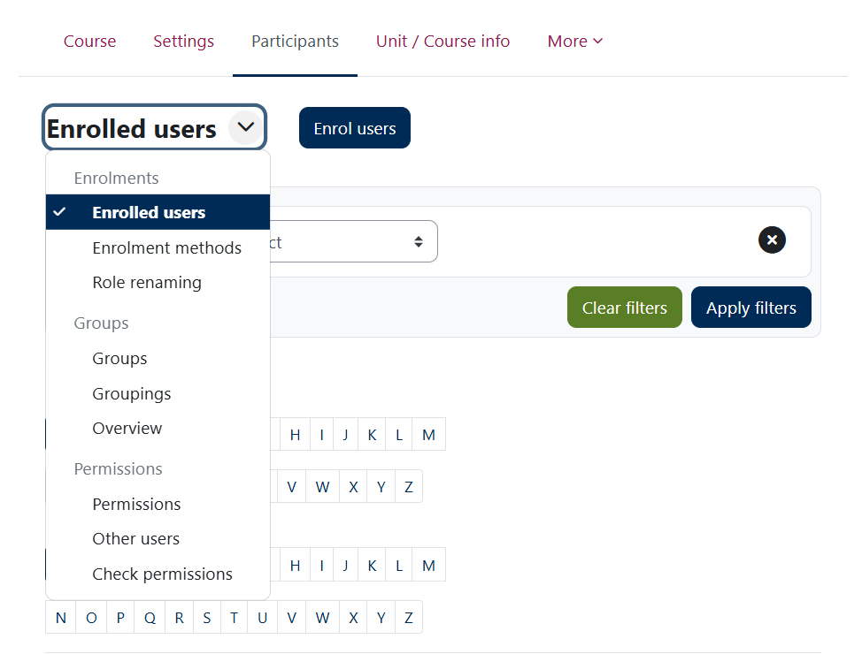
Navigating Groups & Groupings
1
Groups – Section where you can create new groups, view group membership, edit & delete existing groups
Groupings – Section where you can create new groupings, view grouping membership, edit & delete existing groupings
Overview – Section that displays an overview of groupings, groups within them and membership
2

Slide 24
Housekeeping

Slide 25
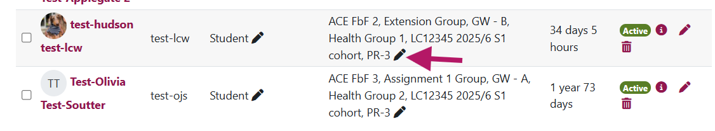
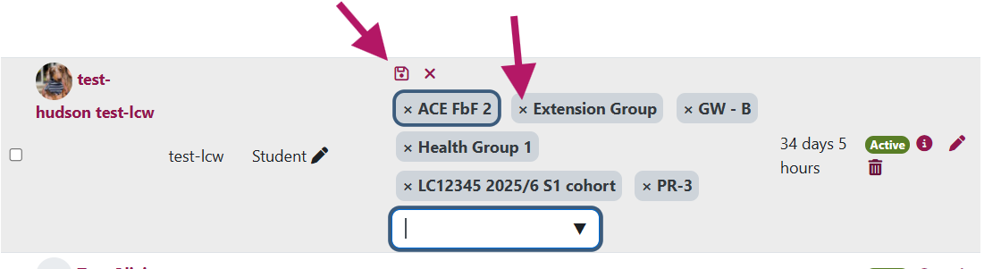
Deleting participants from groups. Option 1
1. In the Participant tab, find the student you want to remove from the group. Click the pencil next to the group(s) they belong to.
2. Click the X for the group you want to remove the participant from. Then click the floppy dish / save icon.
Notes:
Groupings can be created when doing the group upload and they can be created manually.

Slide 26
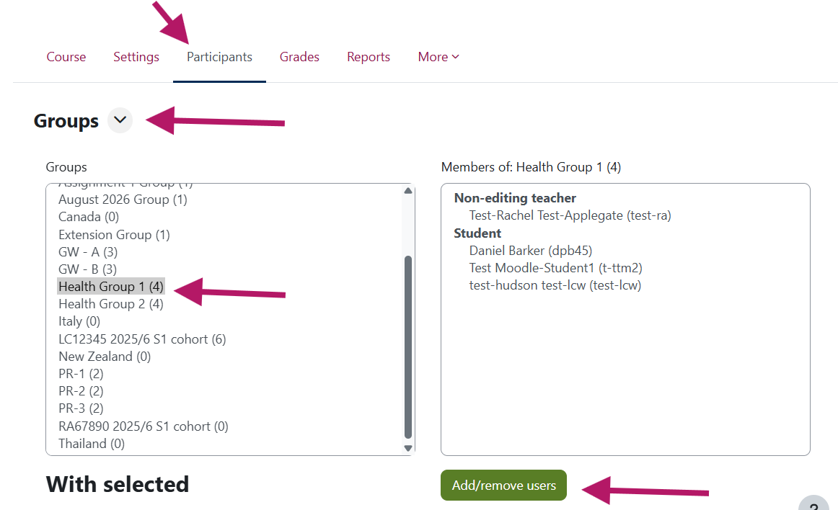
Deleting participants from groups. Option 2 – Step 1
Go to the Participants tab. Go to Groups. Select the group that you want to amend the participant list for. Then click “Add/remove users”.
Notes:
Groupings can be created when doing the group upload and they can be created manually.

Slide 27
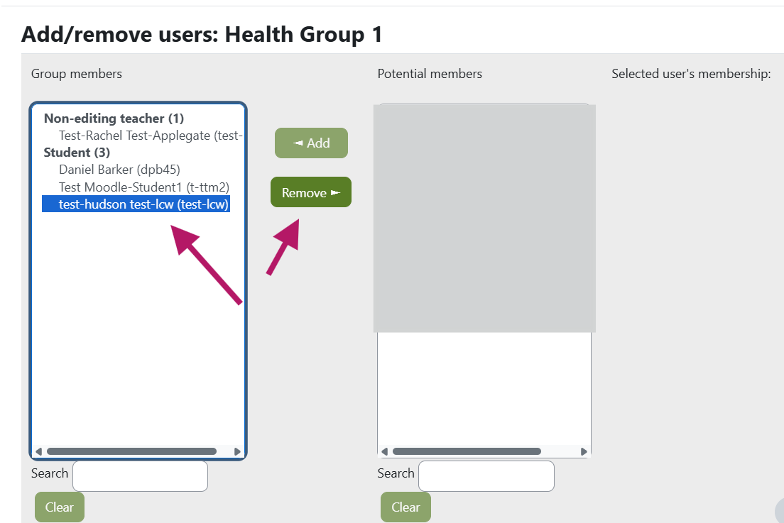
Deleting participants from groups. Option 2 – Step 2
Select the users you want to remove and click “Remove”.
Notes:
Groupings can be created when doing the group upload and they can be created manually.

Slide 28
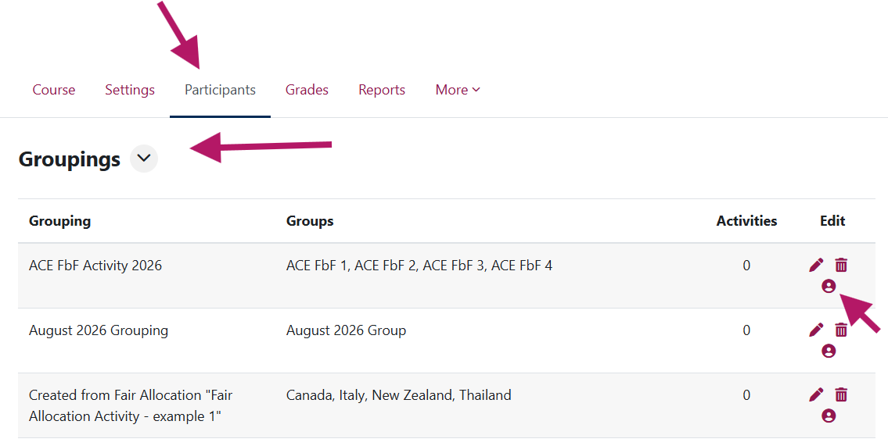
Deleting groups from groupings
Step 1
Go to the Participants tab. Go to Groupings. Click on the person icon for the grouping you want to amend.
Notes:
Groupings can be created when doing the group upload and they can be created manually.

Slide 29
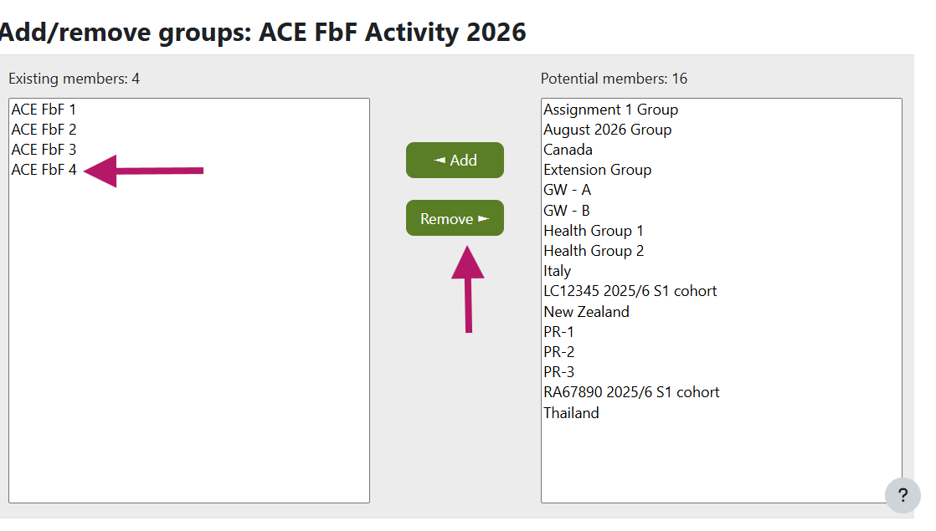
Deleting groups from groupings
Step 2
Select the group you want to remove from the grouping and click “Remove”.
Notes:
Groupings can be created when doing the group upload and they can be created manually.

Slide 30
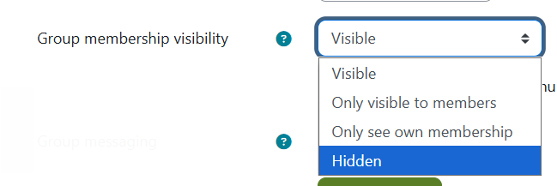
Hidden Groups
*NEW-ish* You can now create groups where membership is not visible to student participants
Notes:
These are useful if you need to have students in groups for extensions or re-assessment point submissions.

Slide 31

Groups & Groupings top tips - Extensions
Troubleshooting Groups & Groupings:
I have used groups to distinguish which students have an extension, but I don’t want other students to see these groups, how do I hide them?
Make sure you have created a “hidden” group. Please note once a group has members you cannot change the visibility so you may have to create a new group.

Slide 32

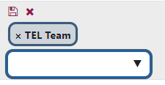
Groups & Groupings top tips – Move students between groups
Troubleshooting Groups & Groupings:
One of my students is in the wrong group, how do I move them?
The easiest way to move one student in the wrong group is to find the student in the Participants page next to the group they are enrolled in, select the pencil icon.
Next, click the x next to the group you want to remove them from and from the dropdown select the appropriate group for that student.

Slide 33
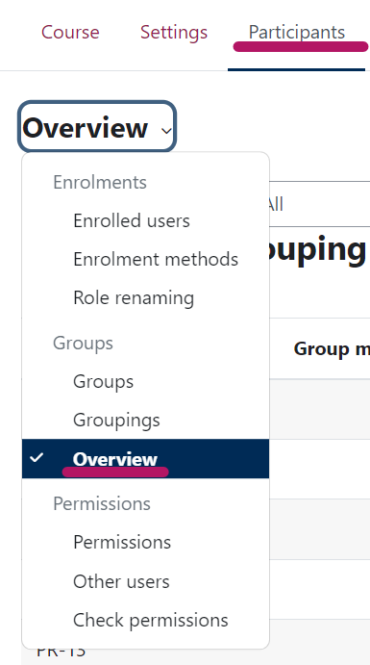
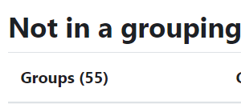
Groups & Groupings top tips - Grouping
Troubleshooting Groups & Groupings:
How do I know if my groups are in groupings?
Under Participants go to “Overview”.
At the bottom there will be a category “Not in a grouping”, which will list any groups not in a grouping.

Slide 34
Useful Resources
Learning & Teaching Hub
TEL-Bytes webinar – Using Moodle groups for learning and assessment – 13 October 2026 @ 11:15am - Sign up here
Managing Groups and Groupings guidance
Past events:
Recordings to past CLT workshops and events

Slide 35
Feedback
Thank you for attending today’s session.
Please take a few minutes to fill in our TEL-Bytes webinars: September 2026 – December 2026 feedback form.
Your responses are anonymous.
We will use the feedback to assist in the planning of future webinars and may use comments for future promotional materials.

Slide 36
Closing slide

