Slide 1

Your TEL Toolkit Overview
Warm up 💭: If you could solve one teaching challenge with technology, what would it be?
Josh Lim, Learning Technologist)
Dan Green (Learning Technologist)
Technology Enhanced Learning (TEL)
tel@bath.ac.uk
teachinghub.bath.ac.uk

Slide 2
Key ideas
Moodle is the “glue” to all learning 🏠
  Moodle spaces, enrolments, student comms
Core teaching technologies 🎥
  Panopto, Zoom, Mentimeter
How University systems connect 🔗
  SAMIS, Moodle, Panopto and assessment tools
Good setup early prevents issues later 🧭
  Training, guidance and support
Notes:
Josh

Slide 3















Tools for teaching
Moodle
Inspera
Online exams
Zoom
Panopto
Videos
Mentimeter
Polling
Inspera originality
Originality detection
H5P & Xerte
Interactive activities
Quiz
Assignment
Forum
Mahara
E-portfolio
File
Page
Book
Text & Media area

Slide 4
Key tools
Moodle
File
Page
Book
Text and Media Area
Assessment & Feedback
Moodle Assignment
Moodle Quiz
Inspera
Inspera Originality
Interactivity
Zoom
Mentimeter polling
Moodle Forum
Personal Learning
Panopto
H5P
Xerte
Mahara eportfolios

Slide 5
Moodle
Moodle is the central place for key course learning materials, activities, and communications
Moodle is a single place for students to go to
Moodle is consistent with University retention and assessment policies
Each unit has a corresponding Moodle space linked to SAMIS (Student Records System)
Moodle draws the information in, and can send grades back to SAMIS as SAMIS is the single point of truth
At Bath we use the same Moodle space for the same unit code each year
This means spaces need to be reset for each cohort
A snapshot is saved every year, so nothing should be lost, and students can refer back to it
Check out Moodle Basics - Weds 23 Sept @ 2:15
How to Reset your Moodle Space - This afternoon @ 1:15
Notes:
Dan: Moving on to some essentials for getting courses ready for teaching
We’ll start with Moodle…
Moodle course spaces are usually re-used each year, so if you’re inheriting a course space from somebody, there are some things you’ll need to do.
Enrolments should be taken care of automatically, so usually last year’s students will be automatically removed shortly before the start of term, and the new students are enrolled, just before teaching begins.
You may also find that you need to delete some old manual enrolments if someone in the past has been adding students manually, which occasionally happens…
If you need to add or remove cohorts of students, there are some instructions on the slide on how you can do this: https://teachinghub.bath.ac.uk/guide/managing-moodle-enrolments-in-s is-integration-block/
And the landing page for Moodle User Management is there too: https://teachinghub.bath.ac.uk/guide-category/course-user-manage/
If you are inheriting a course: Once a year around 31st July Moodle spaces are backed up to the Moodle Archive, and anyadditional archiving needs that fall outside of this, should be carried out locally within Faculties, so you can likely just delete old content if you want to.
3. The Getting Started with Moodle link is a downloadable PDF guide, which you can work through to get to grips with using Moodle for basic tasks.
4. For Assignment setup resources, please see the Moodle Summative Assignments link at the bottom.

Slide 6
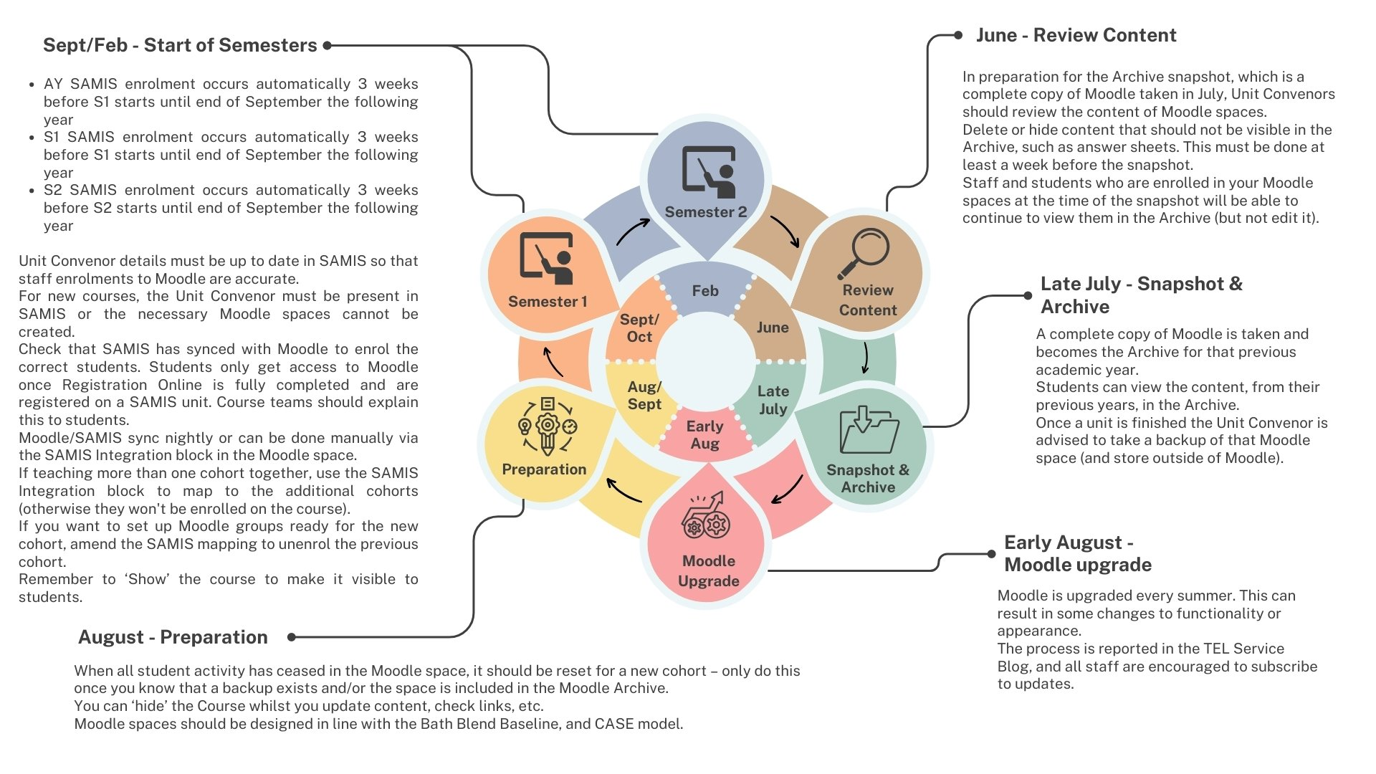
Annual cycle

Slide 7
Moodle enrolments
Majority of enrolments on Moodle come from information on SAMIS.
This is updated by programme teams in departments
Role | Enrolment | Notes
Unit convenor (Teacher+) | Automatic via SAMIS | Create activities, grade assignments. Transfer grades direct from Moodle to SAMIS
Additional staff (Teacher) | Automatic via SAMIS or manual | Create activities, grade assignments.
Students | Automatic via SAMIS | Access from 3 weeks before start of Semester
Resources
Course and User Management landing page
Managing Moodle enrolments in the SAMIS Integration block / Managing Moodle manual enrolments
Notes:
Moving on to some essentials for getting courses ready for teaching
We’ll start with Moodle…
Moodle course spaces are usually re-used each year, so if you’re inheriting a course space from somebody, there are some things you’ll need to do.
Enrolments should be taken care of automatically, so usually last year’s students will be automatically removed shortly before the start of term, and the new students are enrolled, just before teaching begins.
You may also find that you need to delete some old manual enrolments if someone in the past has been adding students manually, which occasionally happens…
If you need to add or remove cohorts of students, there are some instructions on the slide on how you can do this: https://teachinghub.bath.ac.uk/guide/managing-moodle-enrolments-in-s is-integration-block/
And the landing page for Moodle User Management is there too: https://teachinghub.bath.ac.uk/guide-category/course-user-manage/
If you are inheriting a course: Once a year around 31st July Moodle spaces are backed up to the Moodle Archive, and anyadditional archiving needs that fall outside of this, should be carried out locally within Faculties, so you can likely just delete old content if you want to.
3. The Getting Started with Moodle link is a downloadable PDF guide, which you can work through to get to grips with using Moodle for basic tasks.
4. For Assignment setup resources, please see the Moodle Summative Assignments link at the bottom.

Slide 8
Getting Moodle ready
Getting Moodle units ready
Enrolments should happen automatically….but
Add or remove SAMIS cohort mappings as needed
Tidy up course: Moodle Course and User Management
Where do I start with Moodle? and the downloadable Getting Started with Moodle guide
10 Steps to prepare for start of semester
Resources
  Moodle Guidance landing page
  Moodle Summative Assessment Workflows
  Moodle FAQs
Check out Moodle Basics - Weds 23 Sept @ 2:15
How to Reset your Moodle Space - This afternoon @ 1:15
Notes:
Moving on to some essentials for getting courses ready for teaching
We’ll start with Moodle…
Moodle course spaces are usually re-used each year, so if you’re inheriting a course space from somebody, there are some things you’ll need to do.
Enrolments should be taken care of automatically, so usually last year’s students will be automatically removed shortly before the start of term, and the new students are enrolled, just before teaching begins.
You may also find that you need to delete some old manual enrolments if someone in the past has been adding students manually, which occasionally happens…
If you need to add or remove cohorts of students, there are some instructions on the slide on how you can do this: https://teachinghub.bath.ac.uk/guide/managing-moodle-enrolments-in-s is-integration-block/
And the landing page for Moodle User Management is there too: https://teachinghub.bath.ac.uk/guide-category/course-user-manage/
If you are inheriting a course: Once a year around 31st July Moodle spaces are backed up to the Moodle Archive, and anyadditional archiving needs that fall outside of this, should be carried out locally within Faculties, so you can likely just delete old content if you want to.
3. The Getting Started with Moodle link is a downloadable PDF guide, which you can work through to get to grips with using Moodle for basic tasks.
4. For Assignment setup resources, please see the Moodle Summative Assignments link at the bottom.

Slide 9
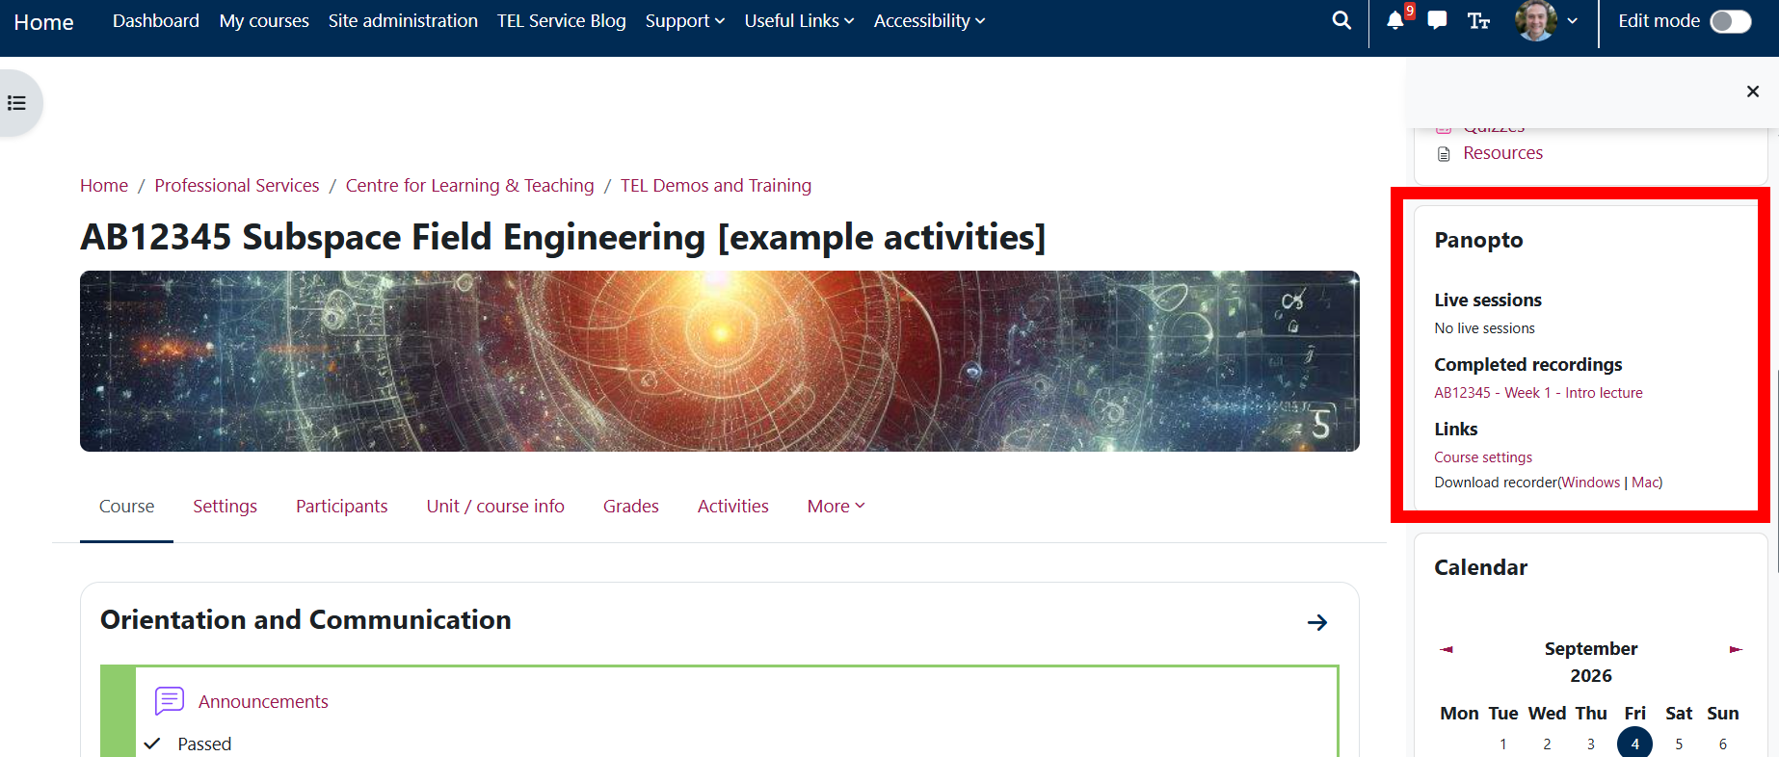
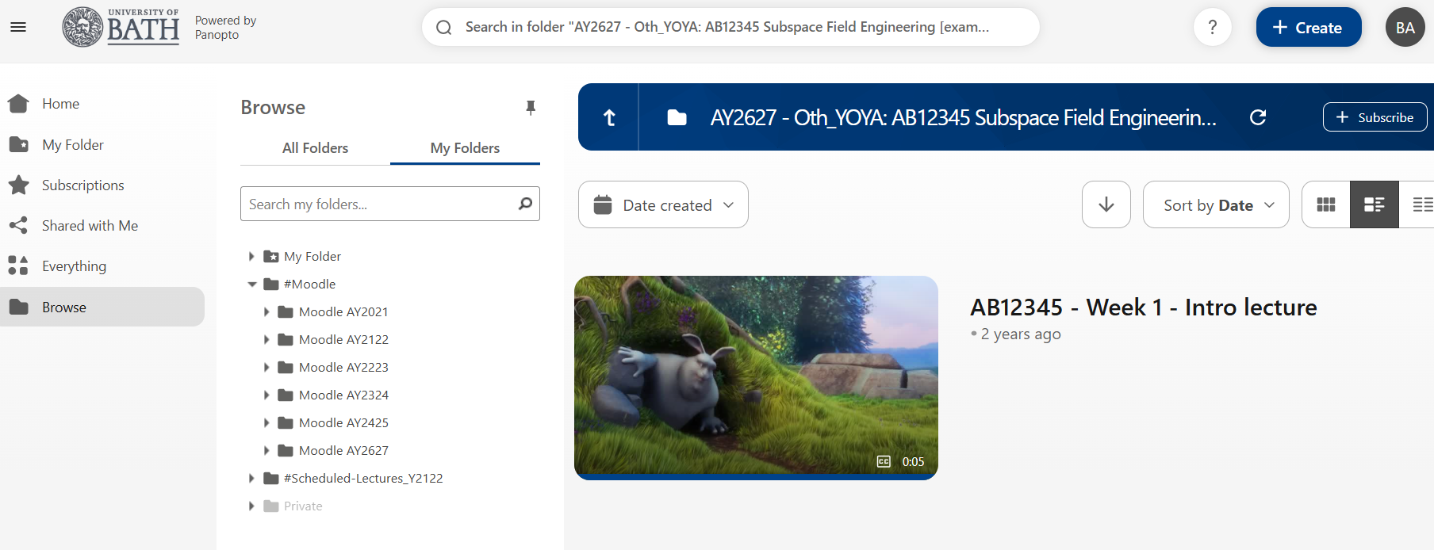
Panopto video recordings
Create: capture teaching activities and resources
Store: home for all teaching videos
Access: syncs Moodle users to Panopto
Manage: supports video retention and archiving
How to share recordings with students using Panopto and Moodle Tues – 22 Sep @11:15
Notes:
Josh

Slide 10
Working with videos
Create
Basic edits
Access
Schedule lecture recordings
Zoom meeting recordings
Record from your browser
Video upload
Cuts
Contents
Captions
Panopto block
Link/embed videos in Moodle
Sharing and permissions
Archive
  For in-room issues, contact the AV/IT Service Desk (part of DDaT)
Notes:
Schedule lecture: set and forget!
Zoom: videos automatically stored and can be easily maintained (compared to MS Teams which expire)

Slide 11
Zoom
Schedule: make Zoom meetings from Moodle students can join
Present and collaborate: Use breakout rooms, polls and live discussion
Share: recordings are stored in Panopto
Zoom is the recommended platform for teaching online classes, not Teams!
Notes:
Staff and students have a licensed Zoom account, you need to login to Zoom via single sign on to claim that account. And then make sure that was always login to Zoom via SSO, so that you’re using the UoB account.
*UG, PGT and Post graduate research who have casual teaching contracts have full accounts.
Student accounts setup by logging into Zoom via SSO – they should always be logged into Zoom via SSO if they are attending a teaching session.
Staff and students have a licensed Zoom account via their Bath single sign-on
create meetings, 500 participants, no time limit
Recordings straight to Panopto (if your email address in Moodle is your Bath one, e.g. tbr123@bath.ac.uk)

Slide 12
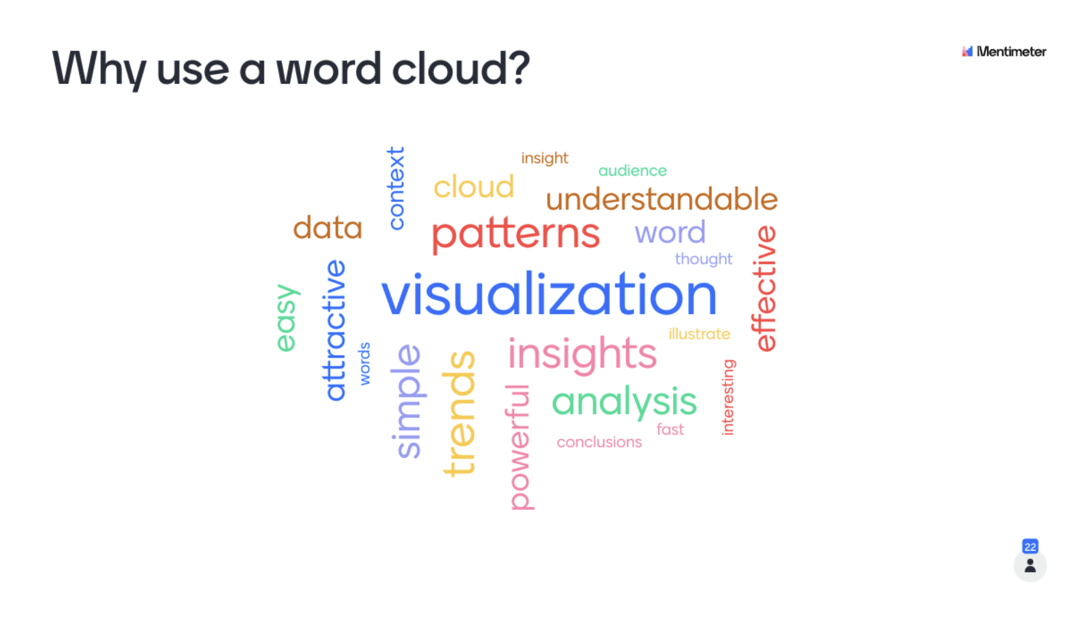
Mentimeter polling
Create: Staff/students can build interactive polls
Engage: involve every student
Review: adapt teaching
Mentimeter Guidance
👆Claim your Mentimeter account (login with SSO)
Notes:
Mentimeter is our institutional tool for polling students
You can login and claim your UoB Mentimeter account via the second link.
We then have a recommended approach to polling for you, and you can also add slides directly into your Powerpoint using the Menti powerpoint add in.

Slide 13
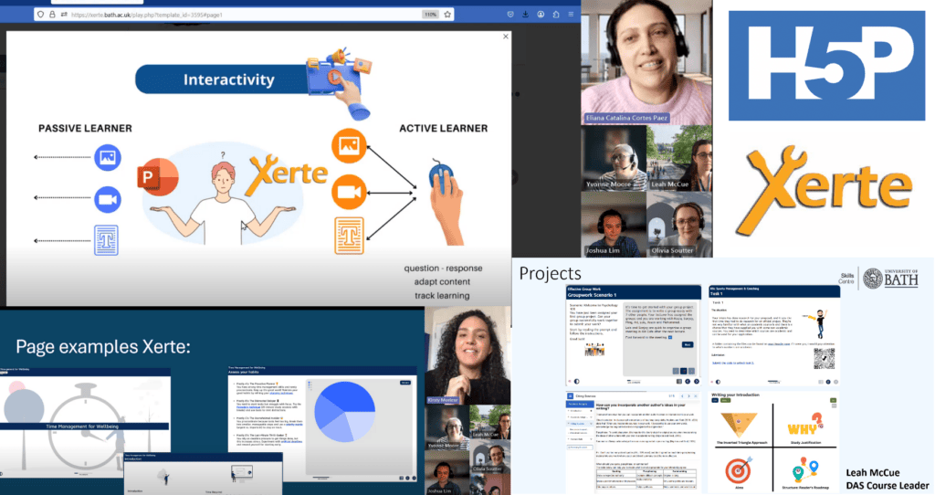
Xerte / H5P
Create: interactive learning activities, no programming.
Structure: Organise and sequence content into purposeful learning resources.
Engage: Use quizzes, multimedia and interactive content to support learning.
Review and feedback: help students to revisit taught content in their own time.
Comparing H5P and Xerte
Interactive learning: Xerte and H5P at the TEL Community of Practice meet-up

Slide 14
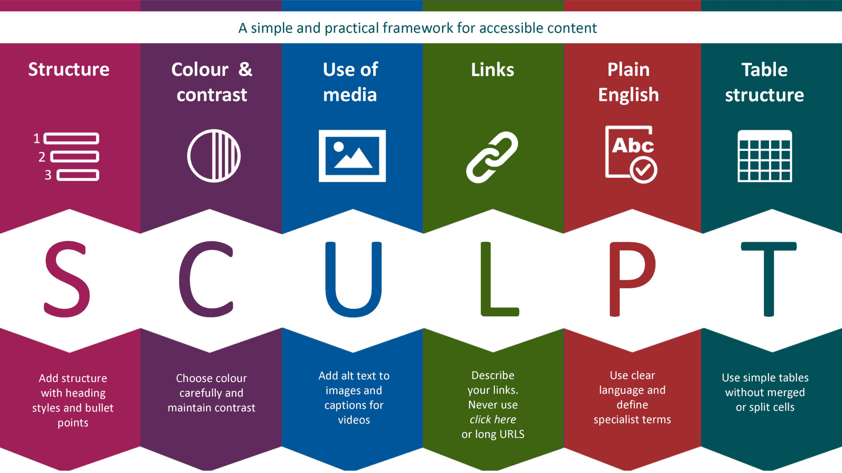
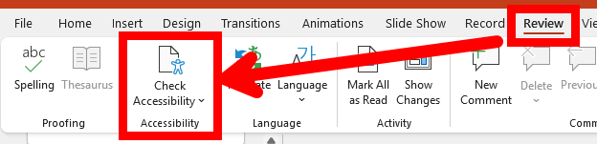
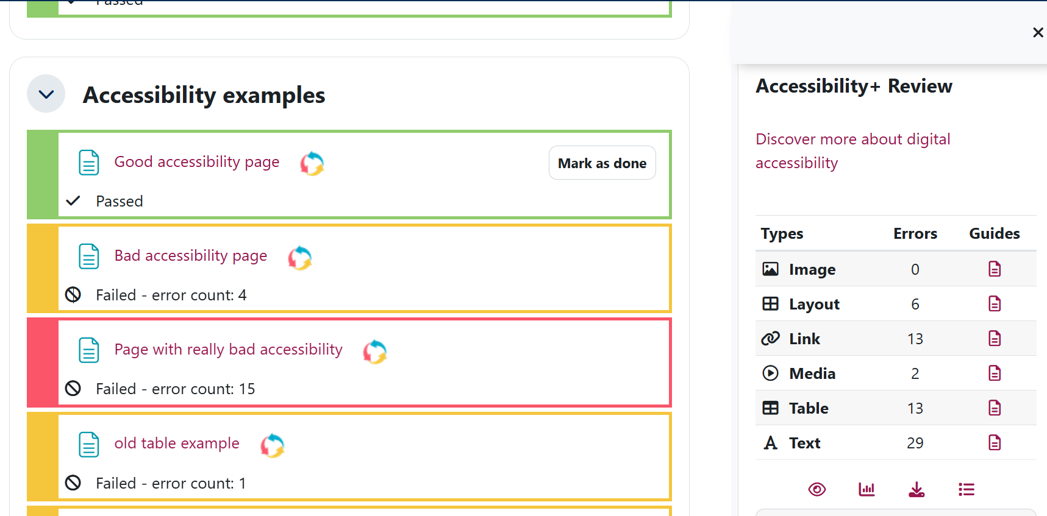
Digital accessibility
Designing your content usable by as many people as possible.
SCULPT accessibility framework
Microsoft Office Accessibility Checker
Accessibility+ Review in Moodle

Slide 15
Assessments
There are many digital tools for running / supporting assessments
Essays / Reports
Moodle Assignment
Group Peer Evaluation
Quizzes
Moodle Quiz
NUMBAS
Inspera Assessment (exams)
Inspera Assessment (exams)
Portfolios / Multi-stage
Mahara
Multimedia
Panopto
Moodle Assignment
Feedback Fruits
(E&D only)
Moodle Workshop
Feedback Fruits (E&D only)
Support
Moodle in general
Moodle Forums
Inspera Originality (similarity detection)
Feedback Centre
Resources
Technology to support assessment and feedback
Digital assessment workflows for both Summative and Formative assessments
Notes:
Dan

Slide 16
Moving marks from Moodle
So you've marked your submissions?
Grades need to go to SAMIS (Student Records system)
Moodle can pass grades using Grade Transfer (done by the Unit Convenor)
This works for:
Moodle Quiz
Moodle Assignment
Moodle Group Peer Evaluation
Feedback Fruits
Feedback should go to students, you can release this on Moodle, and students can see it in the Feedback Centre.

Slide 17
Inspera Digital Exams
The University's digital exam platform is Inspera Assessment
Exams should never be run on Moodle
Inspera is also linked to SAMIS for students and passes grades back to SAMIS
​Resources
Inspera Overview
Authoring an Inspera exam
For help contact: ​inspera-support@bath.ac.uk ​
Notes:
Inspera is a digital ex ination platform. Originally piloted in the SoM and subsequently more widely across the University.
TEL is just one of the te s that support Inspera at the university, so for any Inspera queries please email inspera-support@bath.ac.uk

Slide 18

Bath Baseline and Baseline+
Start here for advice on online teaching and effective Moodle course design, based on:
Consistency,
Accessibility,
Scaffolding &
Engagement
Bath Blend Baseline Overview
Baseline Handbook
Baseline Checklist (PDF)
Notes:
Josh: As a starting point for designing your Moodle spaces and planning online learning activities, start with the Bath Blend Baseline.
It’s a practical and short guide to planning your Moodle spaces. So please take a look at that, and maybe print the baseline checklist out and keep it on your desk

Slide 19
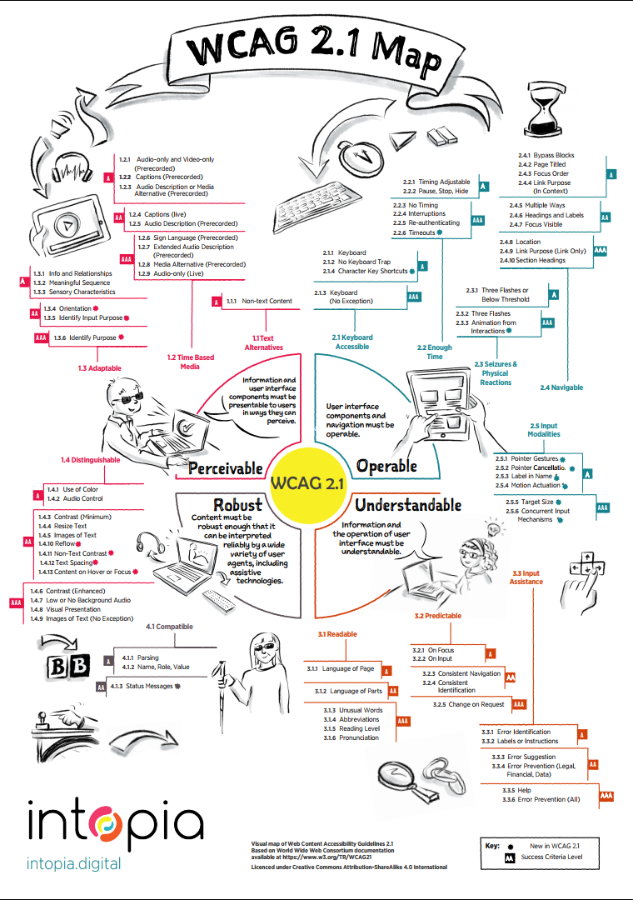
(Digital) Accessibility and teaching
Digital accessibility is about making better design and content choices for all your learners;
It is also a legal requirement.
Public Sector Bodies (Websites and Mobile Applications) (No. 2) Accessibility Regulations 2018
  Applies to all digital content
  “perceivable, operable, understandable and robust”
Equality Act 2010
  additional measures to meet specific students needs
Image source: Intopia 2019

Slide 20
Digital accessibility
Digital accessibility is about making better design and content choices for all your learners;
It is also a legal requirement.
Digital Accessibility Hub on the Teaching Hub:
Inclusive Teaching and Learning
Support for students with disabilities
Accessible Maths
Other support teams:
Assistive Technology team
Disability Service
Digital Accessibility policy

Slide 21
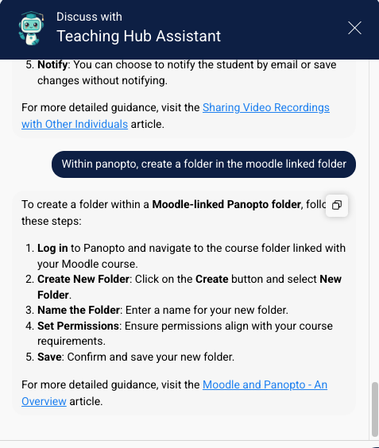
Accessing TEL Support
Learning & Teaching Hub (teachinghub.bath.ac.uk)
Intro to L&T Hub
Virtual Assistant
Events
Book 1-2-1 training
Meet the CLT
Notes:
In the first instance, please familiarise yourself with the Learning and Teaching Hub. It is a fantastic resource with a lot of useful guidance, including step by step recommended approaches on how to set up assessment activities.
Intro Video
Using Virtual Assistant
View and book forthcoming training and events
Book a 1-2-1
Meet the CLT
Intro video will familiarise you with how to use the hub…
The Virtual Assistant can provide instant step-by-step instructions for lots of your common queries…
For training and events, including past recordings of webinars, which we have quite a few of please take a look at the events and workshops pages on the Hub. These all tie in to the Academic Professional Develoent for All Staff (or APDaS) curriculum).
Book a one-to-one…
Learn more about the wider support available in the CLT…

Slide 22
September webinars
Mon | Tue | Weds | Thu | Fri
31 | 1 | 2 | 3 | 4
7 | 8 | 9 | 10 | 11
14 | 15 | 16 | 17 | 18
21 | 22 | 23 | 24 | 25
28 | 29 | 30 | 1 | 2
Moodle Basics 11:15
Introduction to digital accessibility 4:00
Using the Accessibility+ Toolkit in Moodle 4:00
Using the Accessibility+ Toolkit in Moodle 4:00
Your TEL Toolkit Overview 10:15
Web accessibility 4:00
How to reset your Moodle space 1:15
Using the Accessibility+ Toolkit in Moodle 4:00
Accessibility for Multi-Media 4:00
Your TEL Toolkit Overview 10:15
How to share recordings with students using Panopto and Moodle 11:15
Moodle Basics 2:15
Using the Accessibility+ Toolkit in Moodle 4:00
Accessibility in documents 4:00
Using the Accessibility+ Toolkit in Moodle - 4:00

Slide 23
Webinars in September
How to reset your Moodle space - 08 Sept at 1:15 - 2:00
Mahara Demonstration - refreshed user interface - 15 Sept at 1:00 - 2:00
Your TEL Toolkit Overview - 17 Sept at 10:15 - 10:45
How to share recordings with students using Panopto and Moodle - 22 Sept at 11:15 - 12:00
Moodle Basics - 23 Sept at 2:15- 3:00
Using the Brickfield Accessibility+ Toolkit in Moodle - 14 Sept at 4:00 - 5:00
Accessibility for Multi-Media - 16 Sept at 4:00 - 5:30
Using the Brickfield Accessibility+ Toolkit in Moodle - 21 Sept at 4:00 - 5:00
Accessibility in documents - 23 Sept at 4:00 - 5:30
Using the Brickfield Accessibility+ Toolkit in Moodle - 29 Sept at 4:00 - 5:00
View past events 📽️

Slide 24
Keeping up to date
TEL update monthly email
Sign up to TEL Service Blog for important updates: telbath.com
TEL Community of Practice on Teams
Sign up to the CLT blog
Notes:
Keeping up to date:
Look out for our monthly TEL Update email for timely advice and guidance, plus news of forthcoming events.
Please also sign up to the TEL Service blog for Moodle upgrade information and important updates on any issues with TEL services. So if we have issues, information on upgrades and things, that’s where we post them, so I do recommend that you subscribe to that, so you know what’s going on. The TEL Service Blog is linked from the top of every Moodle page.
Join the TEL Community of Practice on Te s to discuss ideas and projects.
Sign up the CLT blog and our TEL and CLT X feeds.

Slide 25
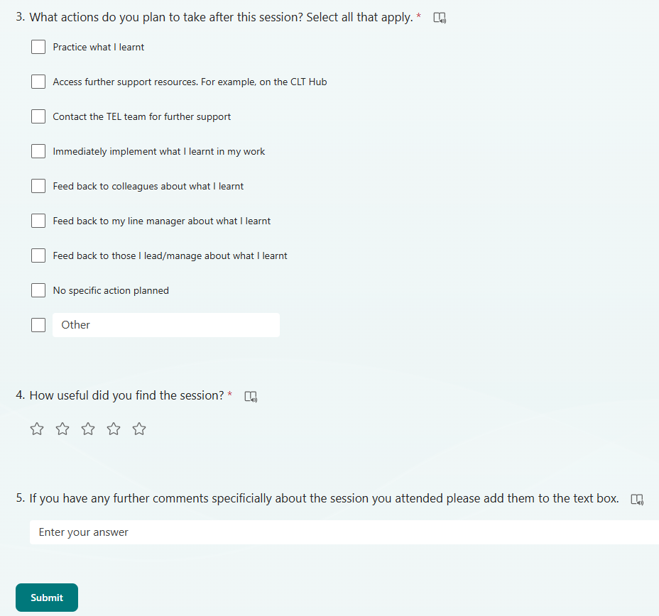
Session feedback
Please fill in our feedback form 🙏.
It takes take 2 minutes and helps our future webinar planning and delivery 😀

Slide 26
CLT closing slide

