Slide 1



THE TWO-LANE FRAMEWORK · UNIVERSITY OF BATH
GenAI in your learning and assessment
What is expected of you from 2026/27
Your name
Department or School
AY26/27
Notes:
PURPOSE OF THIS DECK
Eight to ten minutes at induction/welcome week. Students should leave knowing (1) every assessment sits in one of two lanes, (2) the assessment brief tells them which, and (3) that they remain responsible for whatever they submit.
Do not refer to 'the ABC categories. That was the 2024/25 scheme and it has been retired. Students who had it last year may raise it — the answer is simply that it has been replaced by the two lanes.
Complete the presenter and department details on this slide before presenting.

Slide 2
Every assessment is in one of two lanes
OPEN LANE
CLOSED LANE
Students have access to GenAI tools, and their use is permitted.
GenAI tools are not permitted. Assessment conditions are designed to prevent any use of GenAI.
Students remain responsible for the work they submit.
Academic integrity rules apply in full in the open lane.
Choosing not to use GenAI in the open lane is a legitimate choice.
Any use of a GenAI tool in a closed-lane assessment is a breach of assessment conditions and will be investigated as academic misconduct under Regulation 19.
This is consistent with existing rules on, for example, use of a mobile phone during an examination.
Your unit materials and assessment brief will inform you which lane your assessment is in. If it is not clear, ask before you start.
2
Notes:
The distinction is about assessment conditions. In a closed assessment the conditions physically prevent access to AI. In an open assessment they cannot, so use is authorised and the task is designed accordingly.
1. Open does not mean unrestricted. The next slide covers what still applies in terms of academic integrity.
2. Closed lane is not the same as closed book. An open-book exam in a controlled room with no device access is still a closed lane assessment.
LIKELY QUESTIONS
'How will I know which lane?' — It is stated in the assessment brief. Tell students where unit briefs live (i.e.,Moodle, unit handbook).
'What if the brief doesn't say?' — Ask the unit convenor. Do not assume.
If asked whether AI detection software will be used: the University does not use any AI detection tools to make decisions about academic integrity.

Slide 3
In the open lane, you remain fully responsible for your submitted work
1
You own the thinking
2
Errors are yours too
You are responsible for the content, the intellectual decisions, the judgement and the understanding contained in your submitted work.
You are accountable for any mistakes, omissions or inaccuracies, including any that GenAI introduced.
3
Be able to explain your work
4
Acknowledge your use
You must be able to explain, defend and critically evaluate every part of work that you submit.
Reference your use of GenAI following Library guidance and say where it shaped the work.
Be careful what you input to GenAI tools
Only upload material you hold the copyright to. Never upload confidential or commercially sensitive information — for example data given to you by a placement or industry partner — or a staff member's work without their permission.
3
Notes:
POINT 1. GenAI may support your learning, but it must not replace your thinking.
POINT 2. If an AI tool invents a reference, misreports a statistic, or misdescribes a method, the responsibility lies with the student. 'The AI said so' is not a defence and will not reduce a penalty.
POINT 3. Ask them to imagine being asked, in a lab, a tutorial or a viva, to explain a choice in their own work.
ON POINT 4. Point students to the Library referencing guidance. Link later in slides.
ON UPLOADS AND COPYRIGHT— this matters for students on placement, students working with industry data, or handling anything personal or identifiable, including staff teaching materials. The University recommends using University-supported tools. Information is available via the Skills Centre workflow pages.

Slide 4
GenAI use and academic integrity
Using GenAI in the open lane is not an offence in itself. It can, however, be the means for poor academic practice or academic misconduct.
Submitting fabricated or unchecked sources
Passing off GenAI output as your sole creation
Substituting for your thinking
Including references, quotations or data points produced by GenAI without verifying that they exist and say what you claim.
Presenting AI-generated text, ideas or analysis as though they were solely your creation.
Using AI to replace your intellectual contribution rather than to support it.
These may be investigated as plagiarism, fabrication or collusion under Regulation 19 (Academic Misconduct), which also sets out the penalties that can apply.
4
Notes:
Using GenAI in an open-lane assessment is authorised and is not misconduct. What is misconduct is the offence itself — plagiarism, fabrication, collusion — which AI can be the vehicle for. Fabricated or misrepresented references and data are the clearest examples.
Using GenAI in a closed-lane assessment is straightforwardly misconduct, because the conditions prohibited it.
Regulation 19 sets out both the process and the penalties. You do not need to walk through it here. Note that in submitting any assessment, students confirm agreement to the University's Academic Integrity Statement.
If a student asks what happens if they get it wrong by accident: the honest answer is that intent is considered in an investigation, that being able to explain your work is the best protection, and that asking beforehand is always better than guessing.

Slide 5
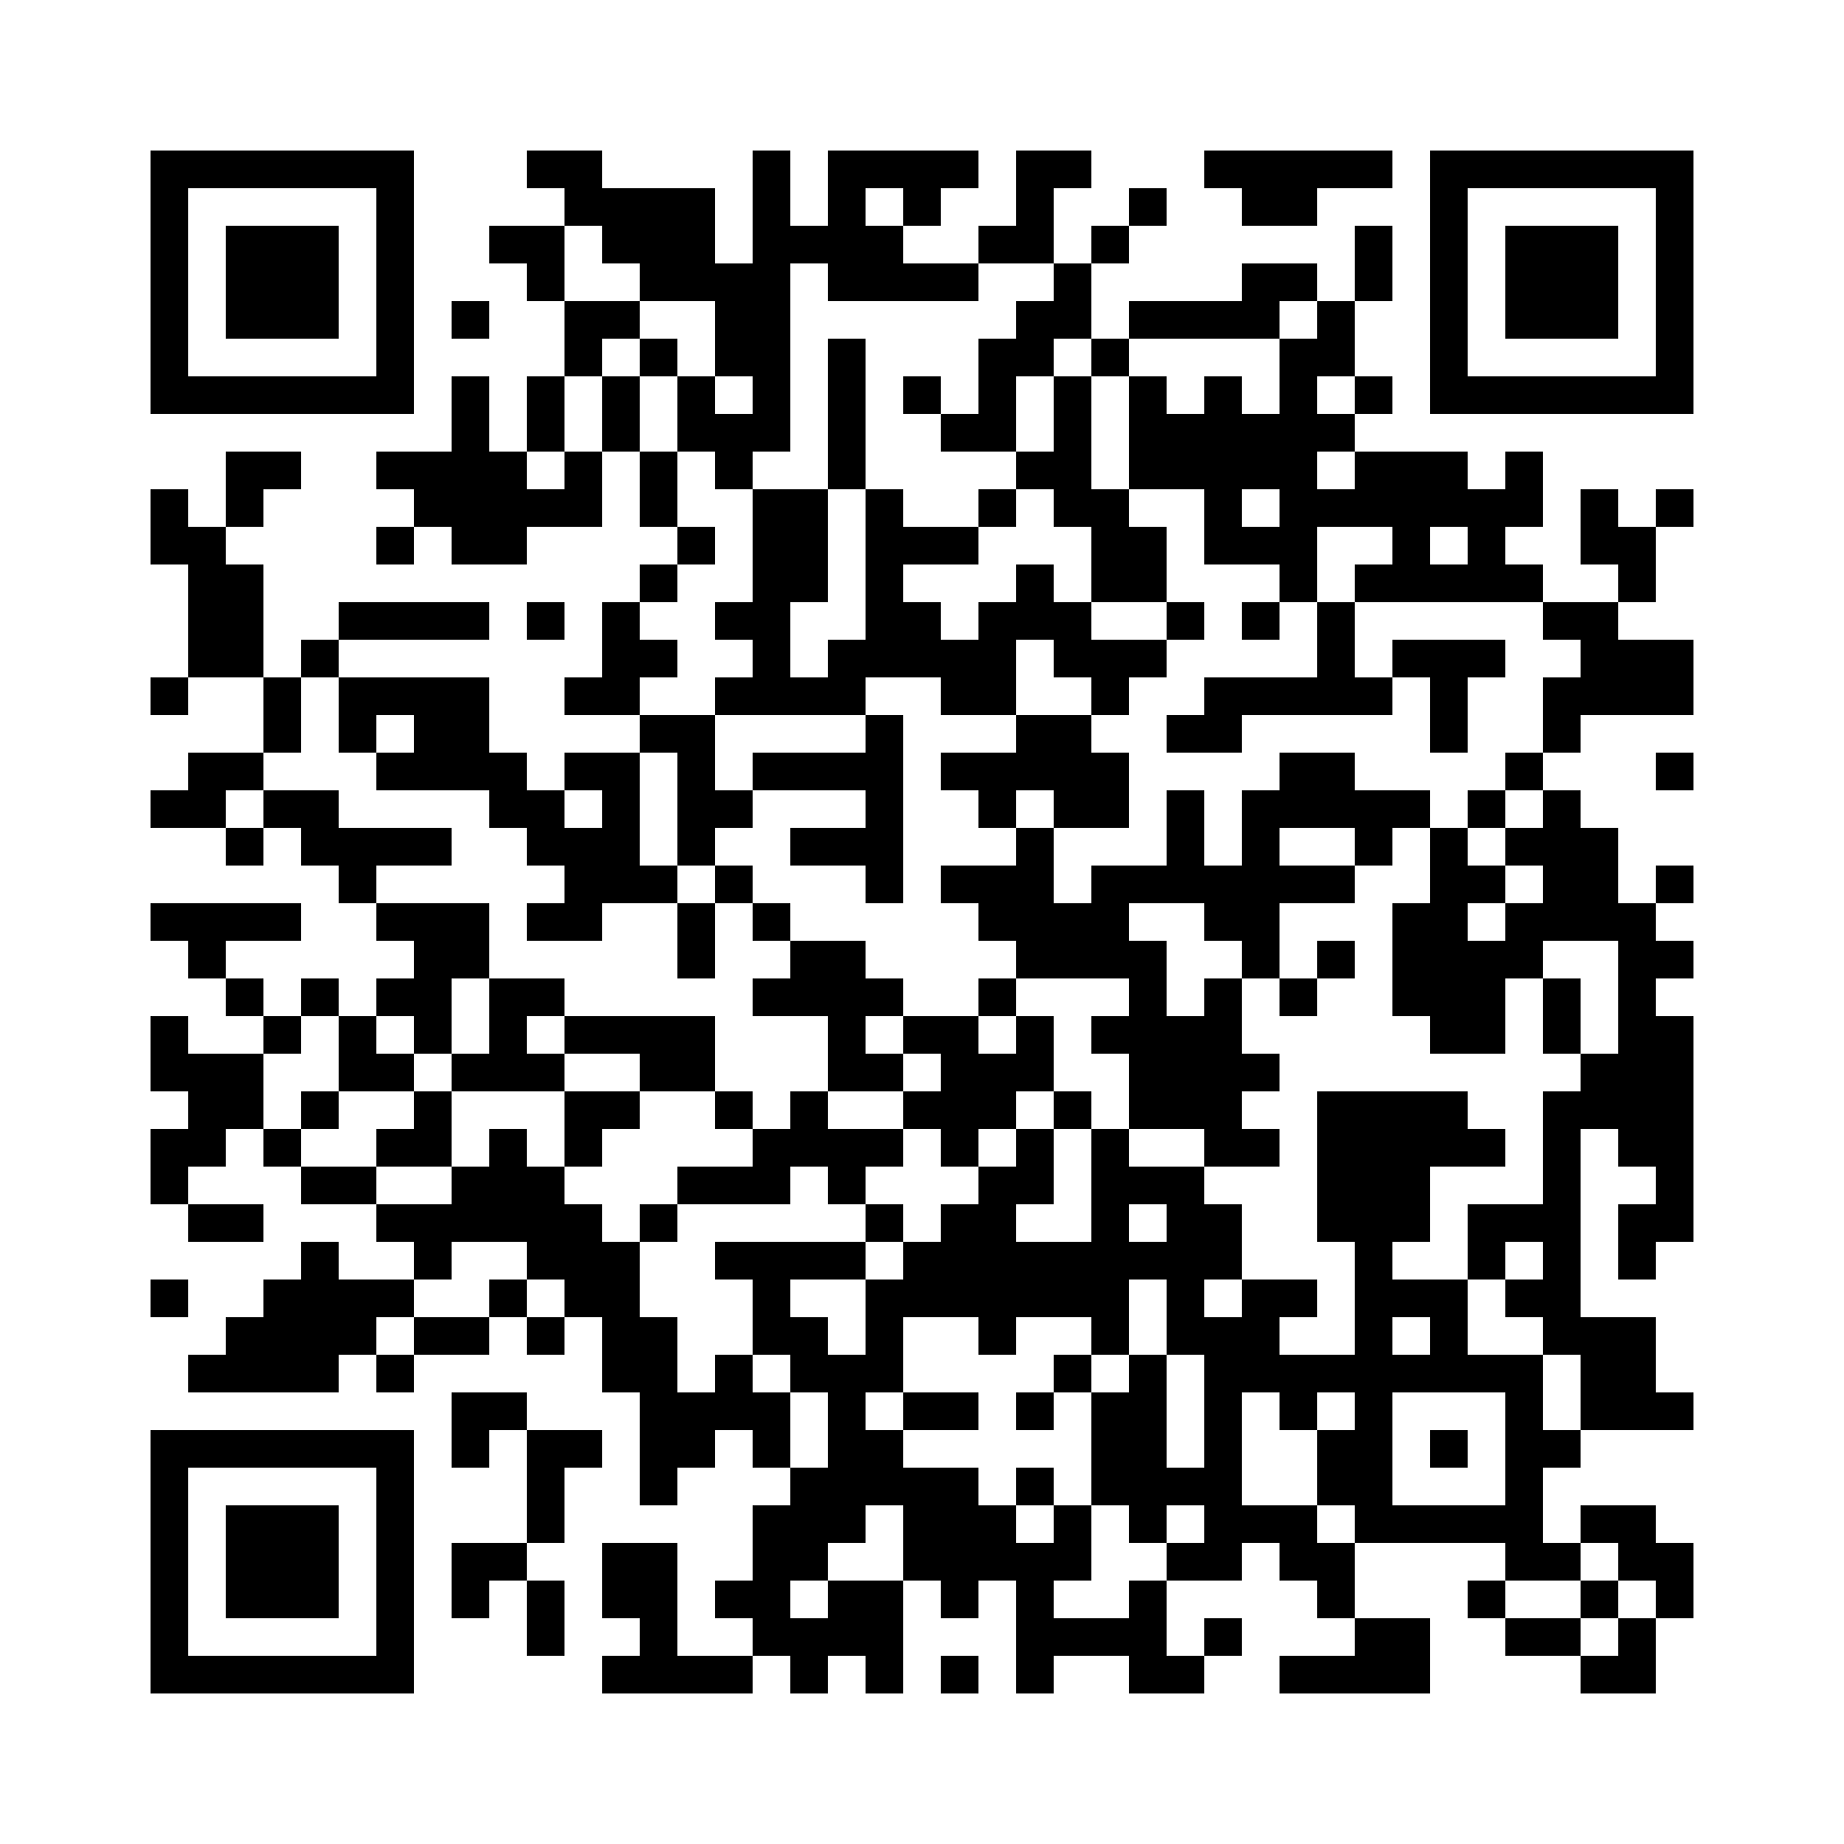
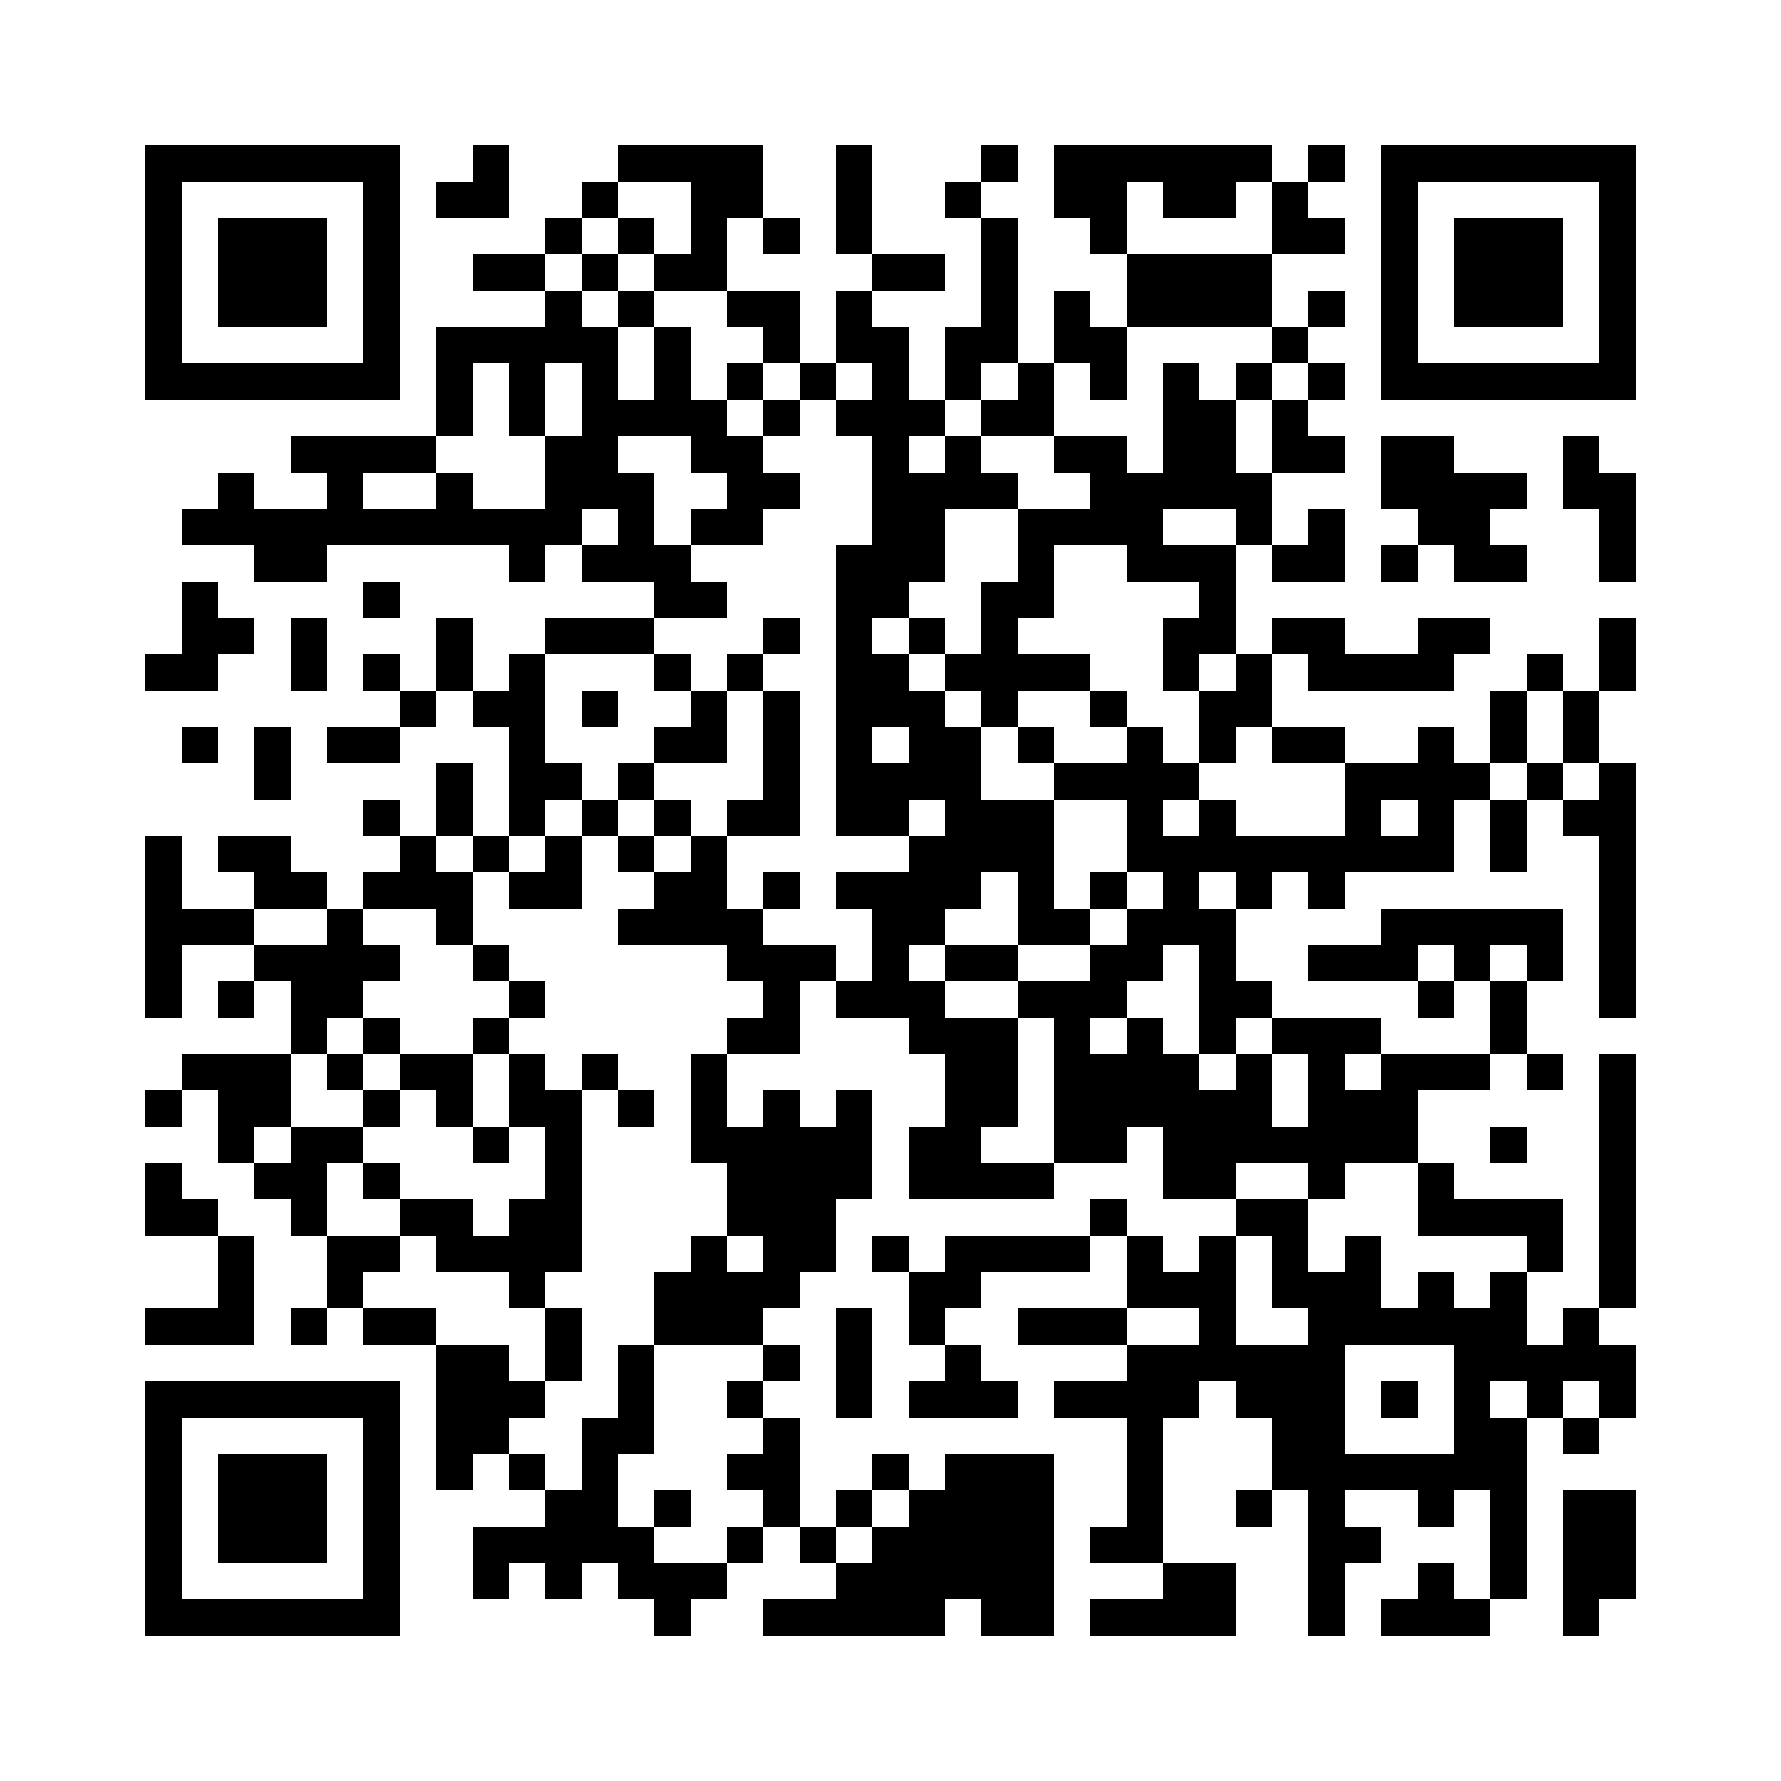
Important resources for students on GenAI
How can GenAI support my learning?
Explore the Skills Centre workflow pages, including information on supported tools:
https://unihub.bath.ac.uk/s/myskills/Workflows/Detail/264
How do I acknowledge GenAI use?
Follow the Library referencing guidance:
https://library.bath.ac.uk/referencing/plagiarism
How can I get unit-specific guidance on GenAI use?
Your unit convenor will support you to engage with GenAI responsibly and effectively where appropriate. Do not be afraid to ask for help.
Notes:
Closing slide — signposting only.

