Slide 1
How to share recordings with students using Panopto and Moodle
Tom Brunsdon (Learning Technologist) & Nigel Goldsmith (Instructional Designer)
Technology Enhanced Learning team
tel@bath.ac.uk
22nd September 2026

Slide 2
Session outline
Overview of Moodle and Panopto (15 mins)
Demo (15 mins)
Q&A (optional)
The session does not cover how to schedule recordings or how to use the audio-visual equipment in teaching rooms on campus.

Slide 3
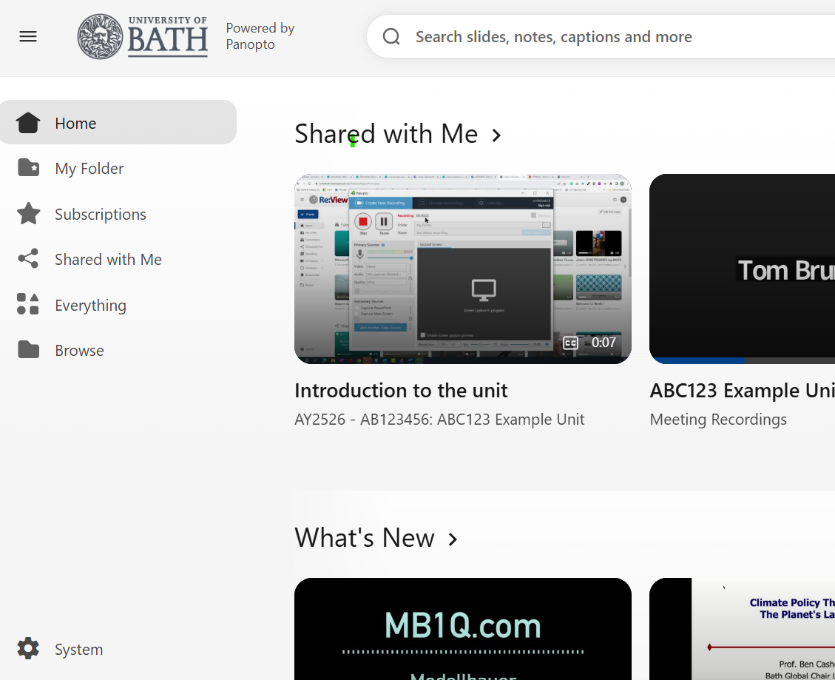
What is Panopto?
Panopto is the University of Bath’s video and audio platform.
Users can:
  Record in teaching rooms across campus.
  Record at home, on mobile, on PC, on tablet through Panopto.
  Record from Zoom directly to Panopto.
  Upload recordings to Panopto.
Staff and students log in at http://go.bath.ac.uk/review
University of Bath username and password

Slide 4
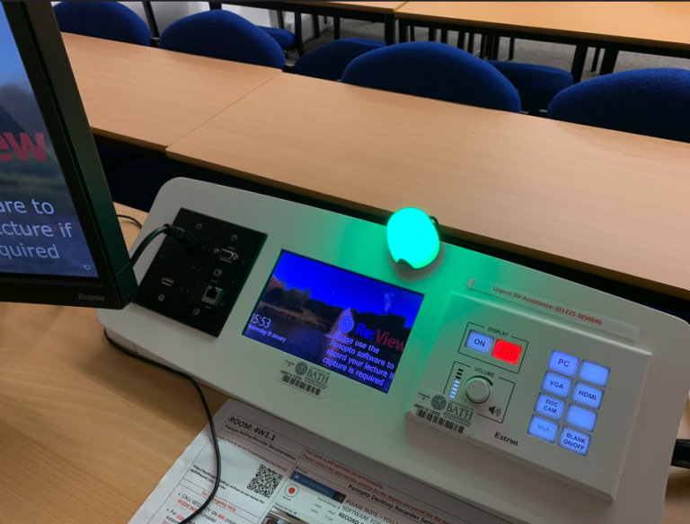
What is Panopto? (2)
The Panopto platform is administered by the DDaT.
Contact the IT/AV service desk for questions about:
  How to schedule recordings
  Lecture capture
  Recording equipment in rooms
  Technical support
DDaT’s Scheduled Lecture Recording guidance can be found on the Teaching Hub.
DDaT's Learning & Events Technology team provide training on learning space technology.

Slide 5
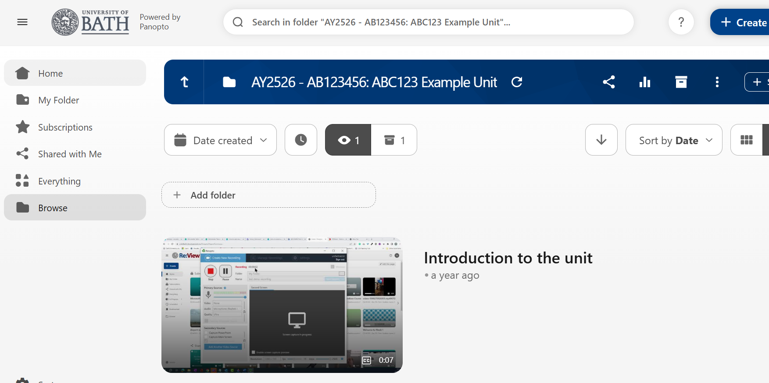
What is Panopto? (3)
The Technology Enhanced Learning (TEL) team support:
  The link between Panopto and Moodle
  Advice about using recordings for learning, teaching and assessment. tel@bath.ac.uk

Slide 6
Panopto and Moodle
How to share recordings with students

Slide 7
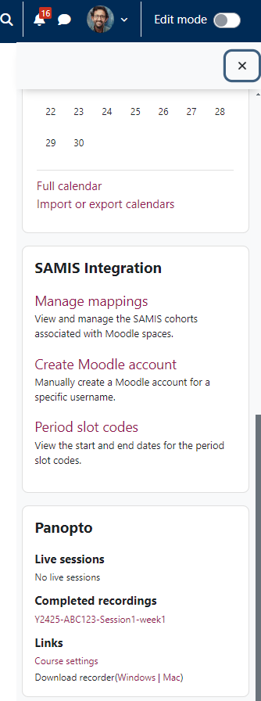
Panopto block in Moodle
All Moodle spaces have a Panopto block.
This corresponds to a folder in Panopto with the same name – we call it the Moodle-linked folder.
Recordings should be saved/moved to the Moodle-linked folder for the current academic year (AY2627).
Recordings save/moved to the Moodle-linked folder in Panopto will appear in the Panopto block in your Moodle space.

Slide 8
Why use the Moodle-linked folder in Panopto?
Integration with Moodle.
  Viewer (student) and creator (teacher) permissions are always in sync.
Moodle has a 50mb upload limit.
Panopto admins can troubleshoot issues.
  Staff leaving.
  Technical issues.
  Students losing access to recordings.
Students can access recordings from previous years.
Integrated with Zoom – no need to upload recordings.

Slide 9
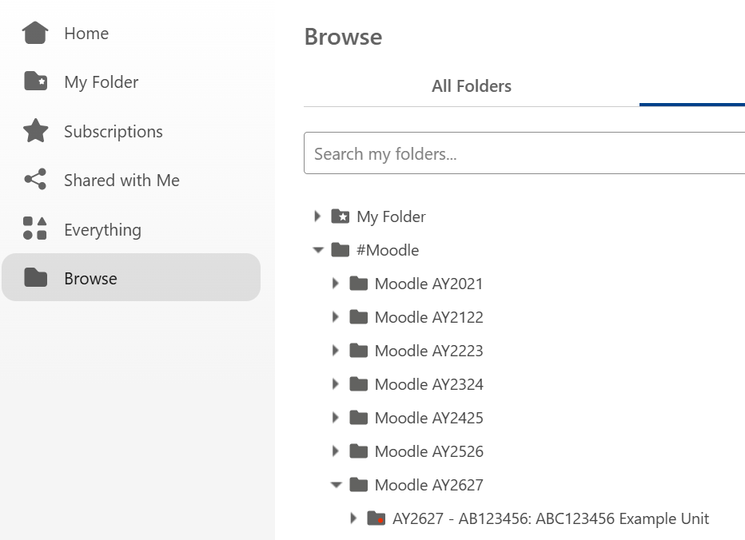
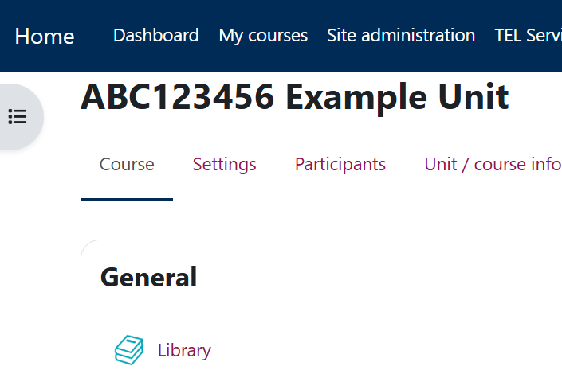
Make recordings available to students
All recordings for your current cohort should be put in a corresponding Moodle-linked folder in Panopto for the current academic year - AY2627.

Slide 10
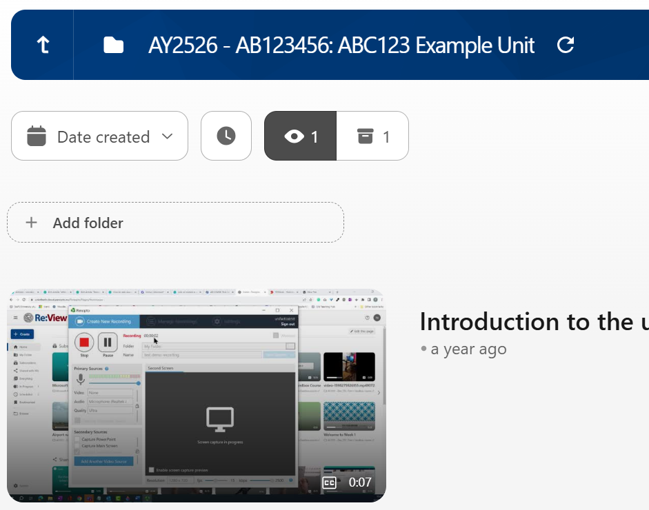
Different types of recordings
Schedule a lecture recording
Re-use a pre-recorded video from last year’s Moodle-linked folder
Move a recording from My Folder
Use Zoom to record a teaching session
Set up a folder for student video assignments
Upload a recording from outside Panopto

Slide 11
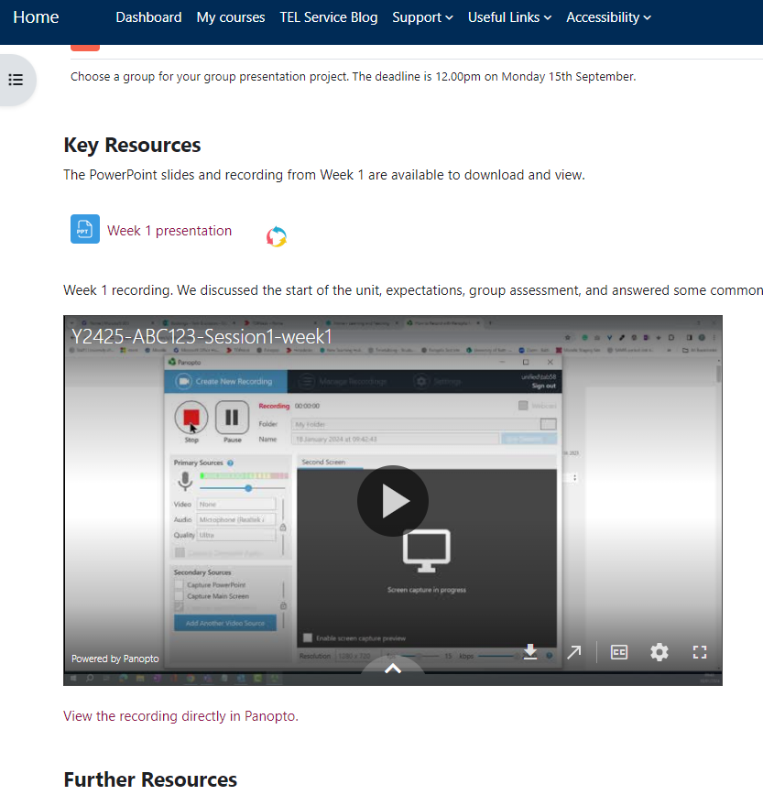
Link and embed recordings in Moodle
You can link and/or embed recordings in Moodle.
  Students can stay within Moodle.
  Link/embed content in topics for context.
  Embeds are now responsive.
  Links will persist in Moodle archive for students to revisit.
I will demo this later.
Guidance on the Teaching Hub.

Slide 12
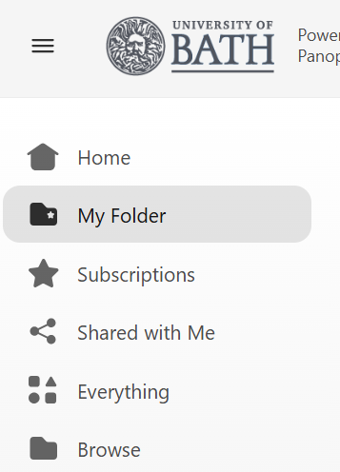
My Folder
My Folder is a private area in Panopto.
Use it for draft recordings NOT final course recordings.
Move course recordings out of My Folder and into the Moodle-linked folder.
Zoom recordings go into My Folder (in a sub-folder called Meeting Recordings).
Scheduled Lecture recordings can be saved in My Folder before editing and moving to the Moodle-linked folder.

Slide 13
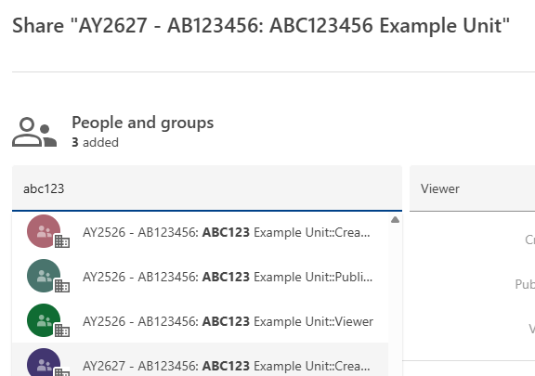
Sharing recordings between cohorts
If you need to share recordings between cohorts:
  Add recordings to one Moodle-linked folder.
  Share individual recordings, the whole folder, or a sub-folder by adding other cohort groups.
  Or copy recordings between Moodle-linked folders.
I can demo this at the end or email tel@bath.ac.uk to discuss.
Guidance Recordings for multiple Moodle spaces/Panopto folders (multi-taught/shared units).

Slide 14
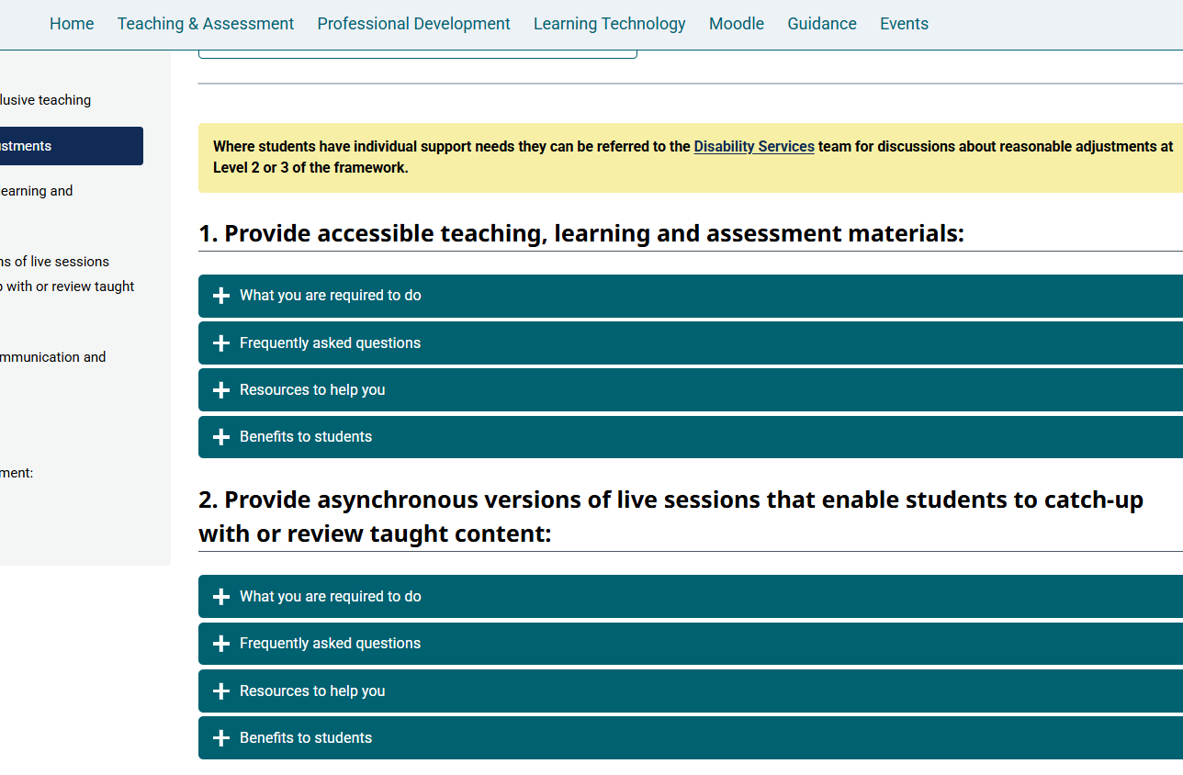
Other use cases
Contact tel@bath.ac.uk to discuss other Panopto recordings queries
  Reasonable adjustments guidance.
  Restricting access to groups of students.
  Recorded presentations and video assignments.
  Re-using recordings from previous years when previous cohorts still need access.

Slide 15
10 most common queries
Query | Likely solution
Staff/Students don’t have access to the recordings | The user isn’t enrolled on this year’s Moodle page. The recordings are in last year’s Moodle-linked folder (AY2526) and need to be moved to this year’s folder (AY2627)
Why is the Moodle-linked folder empty? Where have all of the recordings gone? | Each year a new, empty Moodle-linked folder is created for the new academic year. Moodle and Panopto – an overview.
How do I share a recording with multiple cohorts? | Create a sub-folder in a Moodle-linked folder and share it or copy a recording. Guidance.
I’ve put the recording in My Folder, how do I share it with students on Moodle page? | Move it to Moodle-linked folder Then embed/link in Moodle.
Embedded video isn’t working for students | The recordings are in last year’s Moodle-linked folder (AY2526) – move them to AY2627
How do I edit recordings? | How to edit recordings guidance
There are recordings I don’t want students to see | Restrict the availability
Questions about Scheduled Lecture recordings | Guidance is on the Teaching Hub, or contact the IT/AV Service Desk.
How do I put a recording on the Moodle page? | Move it to this year’s Moodle-linked folder. Then link or embed the recording.
I’ve recorded a narrated PowerPoint but it’s too large for Moodle | Export to a video file and upload it to this year’s Moodle-linked folder.

Slide 16
Support resources and feedback
Scheduled Lecture Recordings guidance
Moodle-linked folder guidance
All Panopto guidance
Training - how to effectively use equipment in teaching spaces.
General information/support
  CLT Hub
  Further TEL-Bytes webinars
  Email tel@bath.ac.uk
Feedback form

Slide 17
Demo
Any questions before I demo Moodle-linked folders and Panopto?
Demo
Further questions (or leave!)

