Slide 1


Moodle Basics
While we wait for everyone to join us, please share in the chat what you’d like to get out of the session today!
Get started with Moodle and learn the essentials
Webinar facilitators:
This webinar will be recorded.
Olivia Soutter, Instructional Designer
tel@bath.ac.uk
Joshua Lim, Learning Technologist
teachinghub.bath.ac.uk

Slide 2

Session Overview
Logging in and getting started
Navigating around a Moodle space
Course Settings including visibility
Adding and editing Activities

Slide 3

Intro to Moodle
What is Moodle?
It’s a VLE (virtual learning environment). An online space to:
  Share learning resources
  Guide your students through learning activities
  Communicate with your students
  Work collaboratively
  Host assessment and feedback

Slide 4
Bath Blend Baseline for Moodle
Bath Blend Baseline for Moodle
  Consistency
  Accessibility
  Scaffolding
  Engagement
Unit templates (weekly or topic format)

Slide 5
Demo 1 – Logging in and getting started
Login to Moodle
My courses (or scroll down)
Dashboard
Edit Profile
Preferences>Forum Preferences

Slide 6
Demo 2 – Navigating around a Moodle Space
Course index and block drawer
Edit mode
Tabs
Viewing participants and groups/groupings
Topics & subtopics
Note: there is a separate TEL Bytes webinar on Groups & Groupings which we’d recommend watching/attending if you have any group assignments or group work in your unit.

Slide 7
Demo 3 – Course Settings
Adding/editing a course description & course image
Course visibility
Activity completion

Slide 8
Demo 4 – Adding/editing activities
How to add an activity
Key activity types
How to edit an existing activity (and change template text)
How to add an assignment

Slide 9
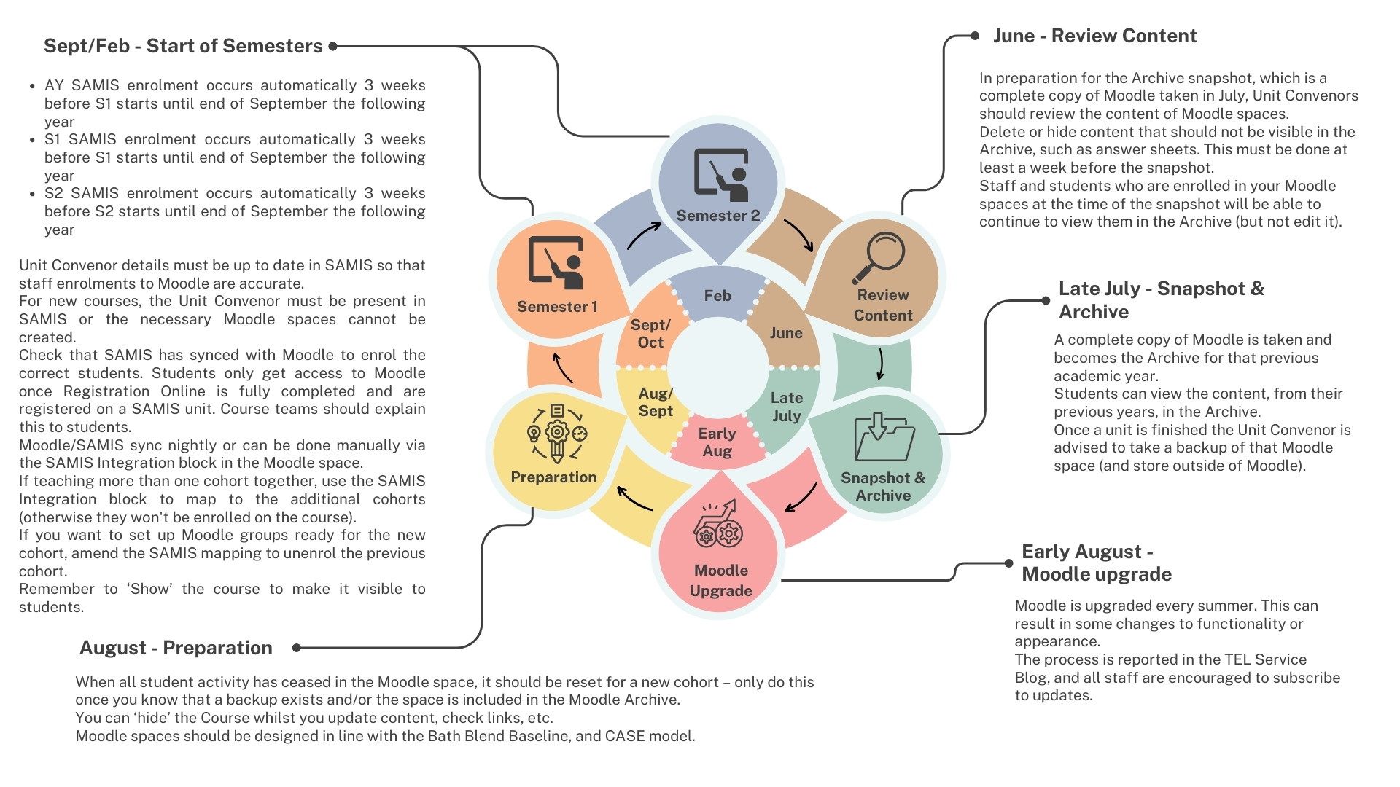
Moodle Administration Cycle

Slide 10
Useful resources
CLT self-paced resources (guided learning resources)
TEL Community of Practice (to share practice and tips)
Learning & Teaching Hub http://teachinghub.bath.ac.uk/
Book a 1-2-1 with an Instructional Designer: Book a one to one
Email queries to TEL@bath.ac.uk

Slide 11
Useful Resources - Webinars
Upcoming events:
TEL-Bytes: Your Technology Enhanced Learning toolkit overview (8 September)
TEL-Bytes: How to reset your Moodle space (8 September)
TEL-Bytes: How to share recordings with students using Panopto and Moodle (22 September)
Using the Brickfield Accessibility+ Toolkit in Moodle (7 September – also repeated weekly)
Lots more upcoming events!
Find out more on the Learning & Teaching Hub Events page
Past events:
Recordings of past CLT workshops and events

Slide 12
Keeping up-to-date
TEL Service Blog (service updates and top tips)
https://telbath.com/

Slide 13

Q&A
Time for questions!

Slide 14
Feedback
Please take 2 minutes to complete our short feedback form to help inform future webinar planning and delivery ☺

