Slide 1


How to reset your Moodle space
Please visit Learning & Teaching Hub Past Events for a recording.
Lynn Cheong-White (Instructional Designer)
Olivia Soutter (Instructional Designer)
tel@bath.ac.uk
teachinghub.bath.ac.uk

Slide 2
Session outline
Why do you need to reset your Moodle space?
The 7-steps to resetting your Moodle space
Q+As

Slide 3
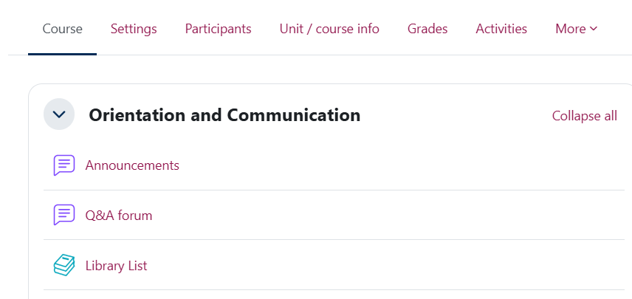
Why reset your Moodle space?
Moodle spaces at Bath are re-used each year.
Contain user data from the previous cohort (e.g. forum posts).
The start of semester is an opportunity to ‘housekeep’ more widely:
  Review content
  Update activities and resources
  Check enrolments

Slide 4
Steps to reset your Moodle space
1. Hide your Moodle space
2. Check Archive / Snaphot or backup is in place
5. Recreate activities
6. Update content
7. Show your Moodle space
4. Reset activities
3. Check enrolments
We will live demo this process later in the session.

Slide 5
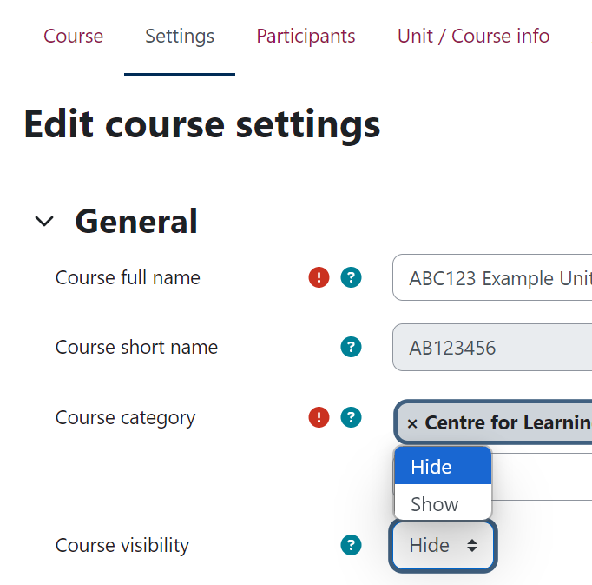
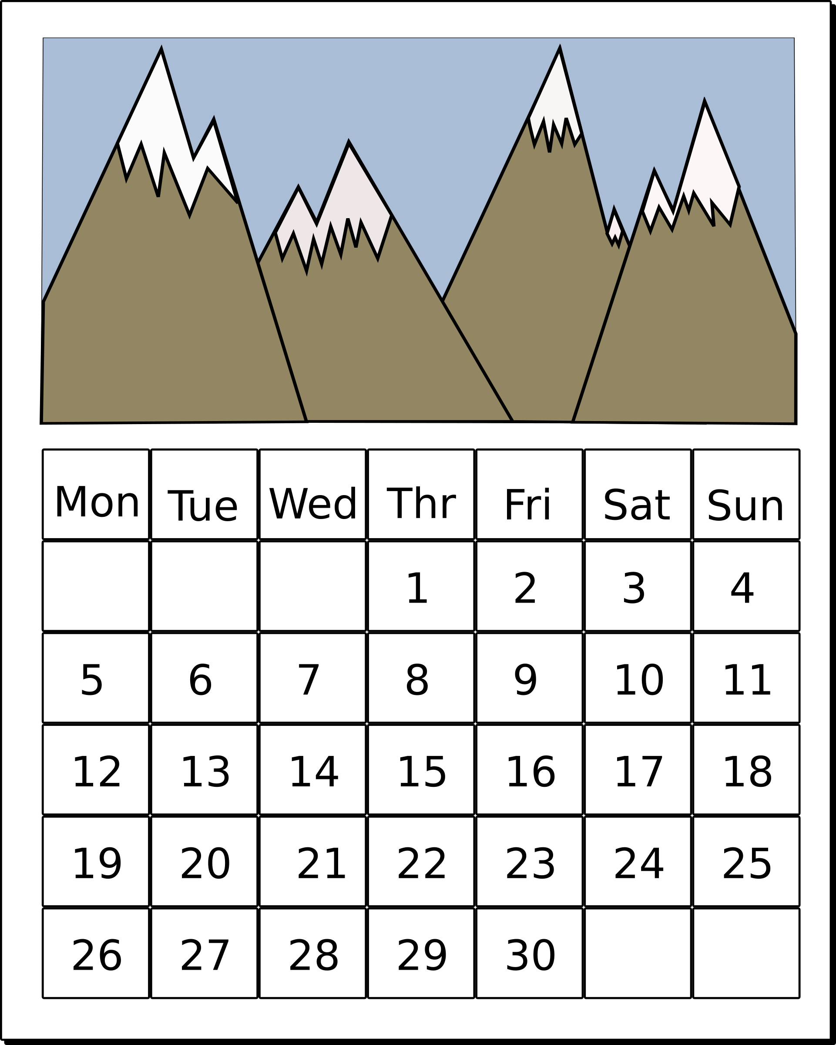
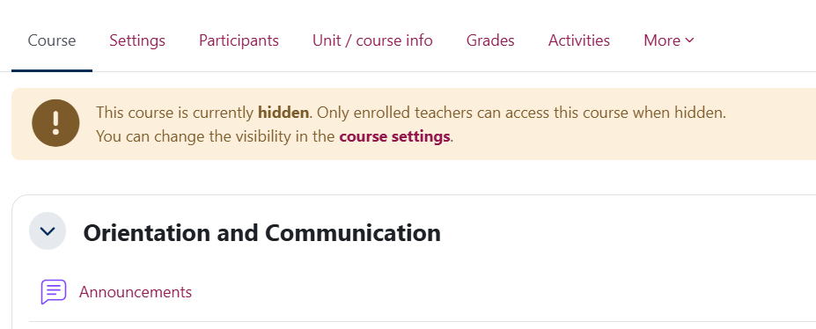
1. Hide your Moodle space
Settings > Course visibility > Hide.
Teacher+, Teachers, Non-editing teachers can still access.
Put a note in your Outlook calendar to show your Moodle space before teaching starts.

Slide 6
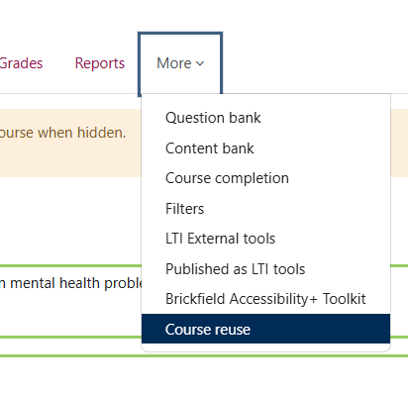
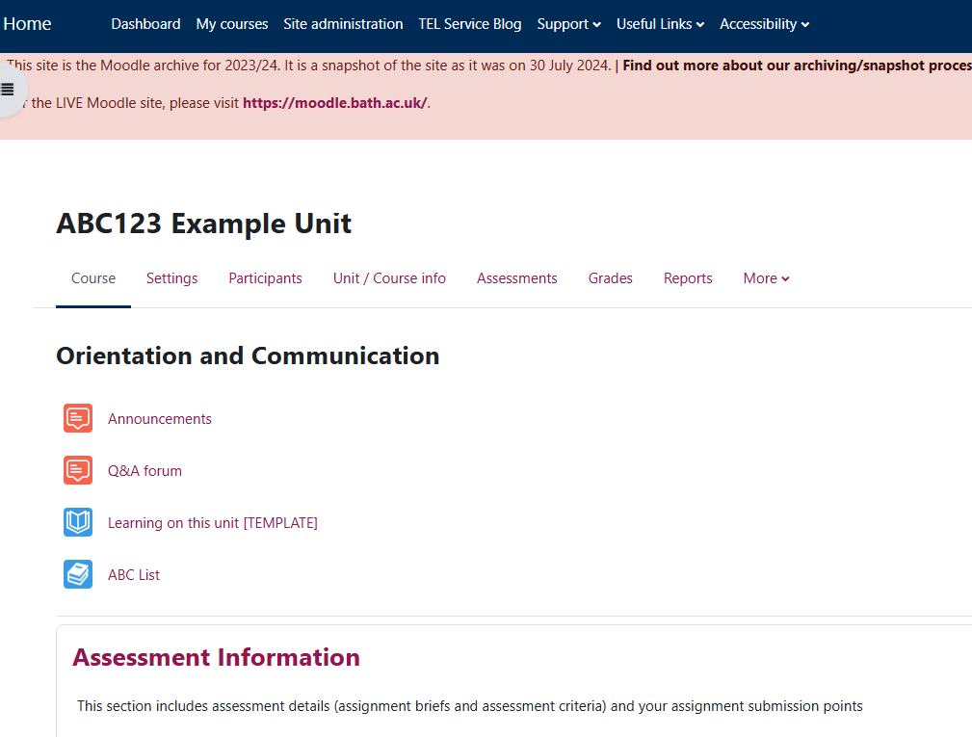
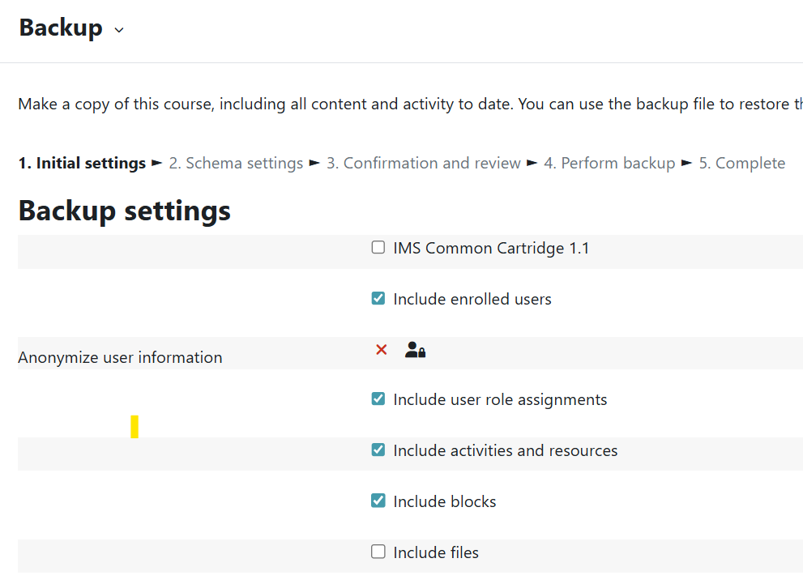
2. Check Snapshot or backup is in place
Check the Moodle archive
  Read-only snapshot of Moodle taken at end of July each year.
  For Teachers and Students who had access at the time of the snapshot.
If your unit is an exception for archiving, before you reset you may need to manually:
  Download assignments and save to a shared drive.
  Or Backup the whole Moodle space in case it needs to be restored in the future.
  If unsure, check with your department.

Slide 7
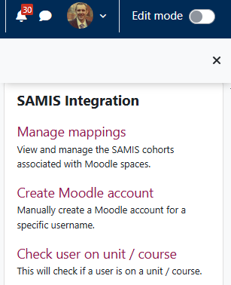
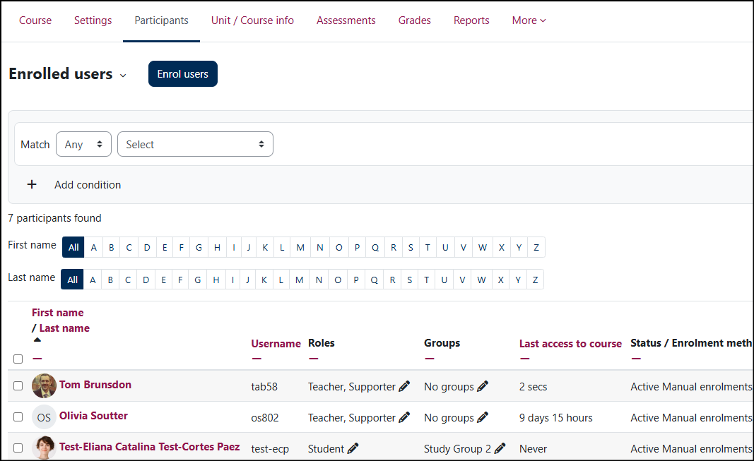
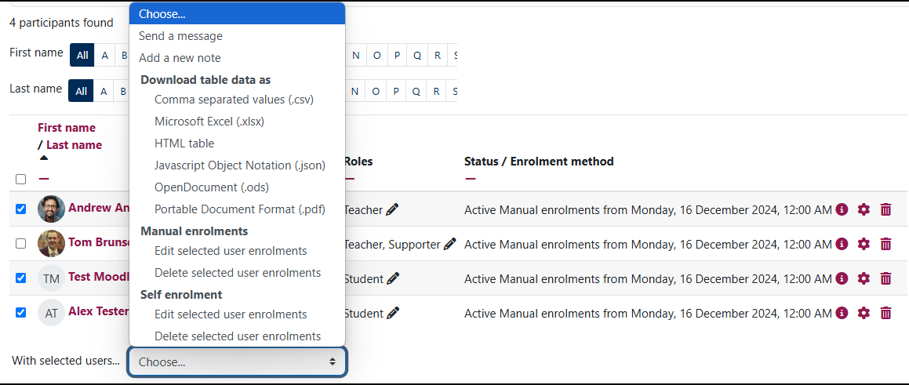
3. Check enrolments
Look at the Participants tab
SAMIS enrolled students
  Last year’s students were auto-unenrolled from 26 – 28 September 2026.
  AY2627 S1 students will be enrolled 6th September2026.
  You can edit the unenrollment date in SAMIS manage mappings if this is helpful.
Ask your Programme Admin team to add Teacher+, Additional Teachers in SAMIS.
Remove any manually enrolled or self-enrolled students/teachers who no longer require access.

Slide 8
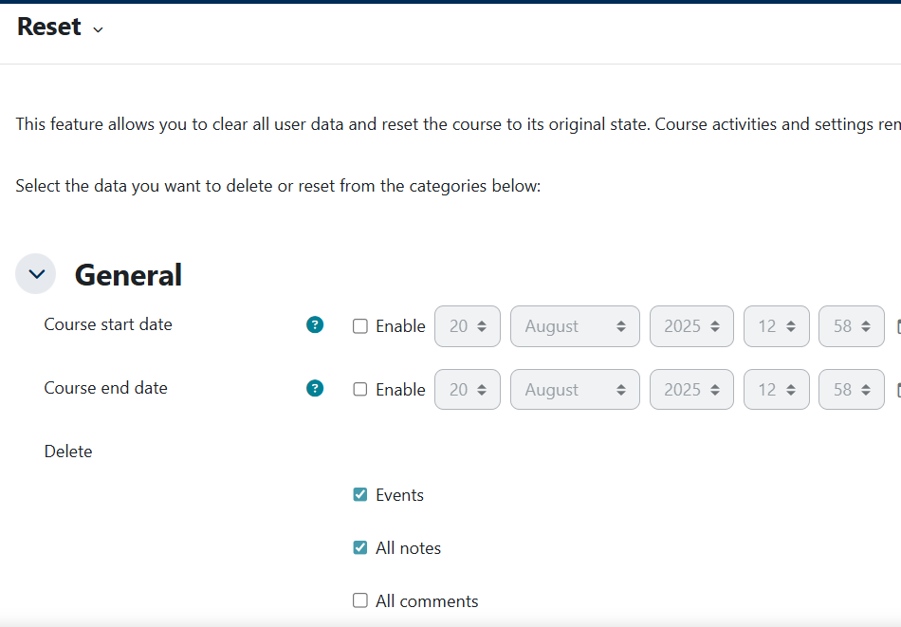
4. Reset activities
More > Course reuse > Reset
Some activities can be reset to remove past interactions – Forums and Quizzes.
Manual and self-enrolments can be reset – be careful not to unenrol yourself!
Resetting groups will remove SAMIS cohort groups too.
Resetting is final.
Reset will reset ALL the activities in that category

Slide 9
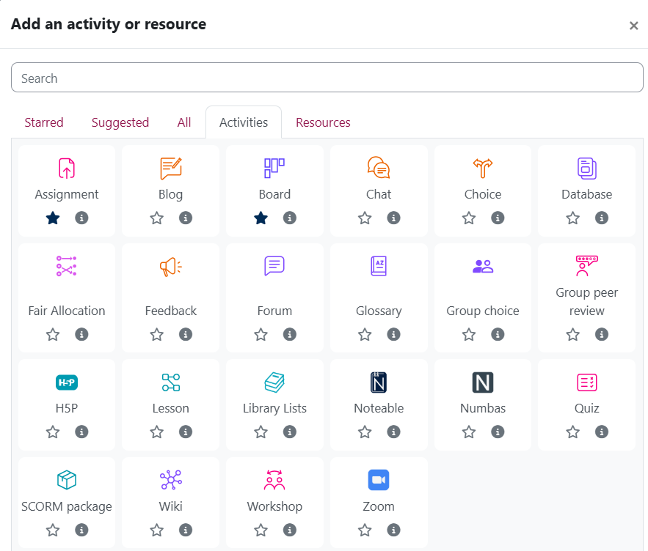
5. Recreate activities
Assignments
  Create new assignments every time to prevent errors.
Duplicate activities
  Make copies of any other activity to get a clean copy ready for the new cohort.

Slide 10
Reset, Recreate, Duplicate
Reset
All quiz data
All forum posts
Duplicate
Activities other than assignments with user data.
Recreate
Assignments
Specific quiz, forums, board, choice activities.

Slide 11
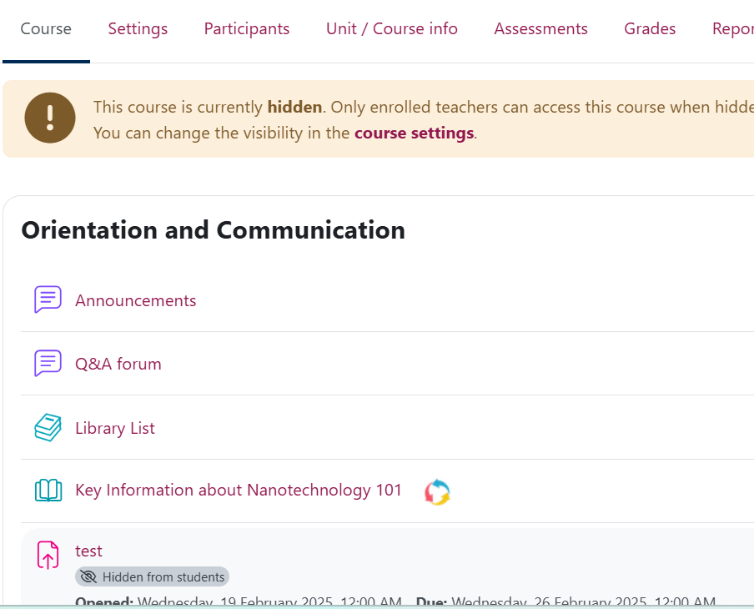
6. Update content
Update key information in the Orientation & Communication, Welcome, and Assessment topics.
Delete, hide, or update any out-of-date material.
Check links and documents are still accessible.

Slide 12
7. Show your Moodle space
When your Moodle space is ready…
Settings > Course visibility > Show.

Slide 13
Support resources and feedback
Resetting activities guide
General information/support
  Teaching Hub
  Further TEL-Bytes webinars
  Email tel@bath.ac.uk

Slide 14
Feedback
Please take 2 minutes to complete our short feedback form to help inform future webinar planning and delivery ☺

