Slide 1

Title slide
Tools for learning and teaching at University of Bath

Slide 2







Learning technologies
Tools for learning, teaching and assessment
Moodle
Virtual Learning Environment
Log in using your University
account:
username
Or
username@bath.ac.uk
Panopto
Video platform
Zoom
Video conferencing
Microsoft 365
Teams for collaboration
Documents, OneNote digital notebook
Inspera
Digital assessment
Support resources are available on the My Skills hub run by the Skills Centre
Notes:
Slides 1-3: 5 minutes

Slide 3
What is Moodle – outline
What is Moodle?
Moodle is the University’s Virtual Learning Environment
It is a web-based platform where you can:
Take part in learning activities
Communicate with staff and students
View feedback and grades
Access learning materials
Complete Assessment
Notes:
Slides 1-3: 5 minutes
Today we will focus on exploring Moodle, which acts as a Hub for your virtual learning.
Moodle is the Virtual Learning Environment used at the University of Bath. It’s a web based platform that facilitates
the delivery of content and activities to students
collaboration and communication
Assessments (including online submission of coursework assignments and plagiarism detection)
the management of online learning and teaching tasks

Slide 4
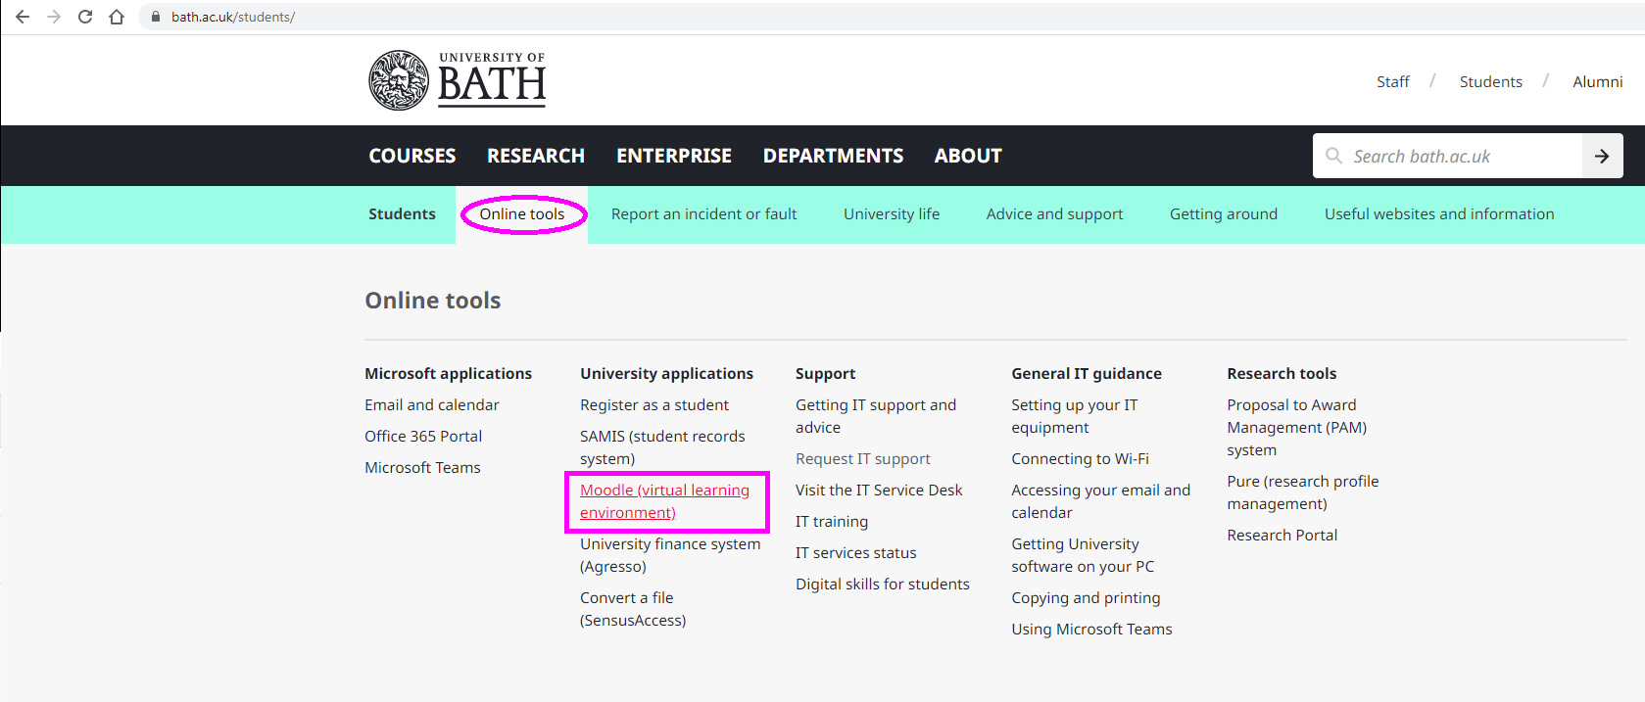
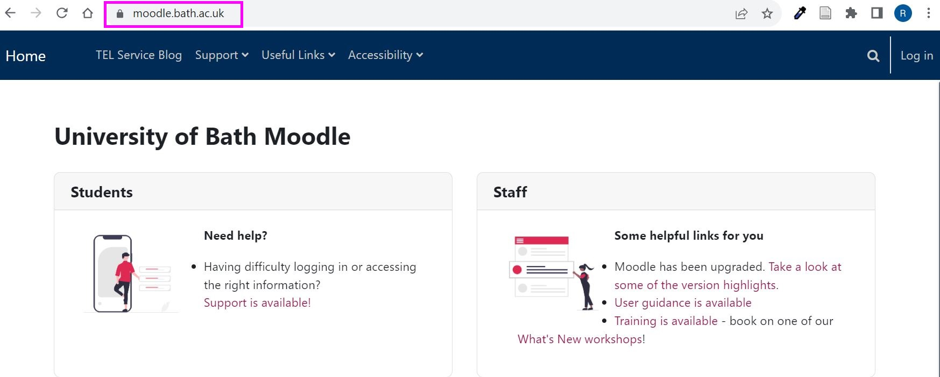
How to log in
How do I log in to Moodle?
https://moodle.bath.ac.uk
Notes:
Slides 4-7: 10 minutes
You can access Moodle using the link in the University of Bath students’ home page (www.bath.ac.uk/students)
Or you can type moodle.bath.ac.uk into your web browser
Before you can sign in to Moodle, you will need to complete your Registration Online for the academic year
To access your courses, you will need to Log in and enter your University of Bath email address (username@bath.ac.uk) and password
You will now see the Moodle Home page

Slide 5
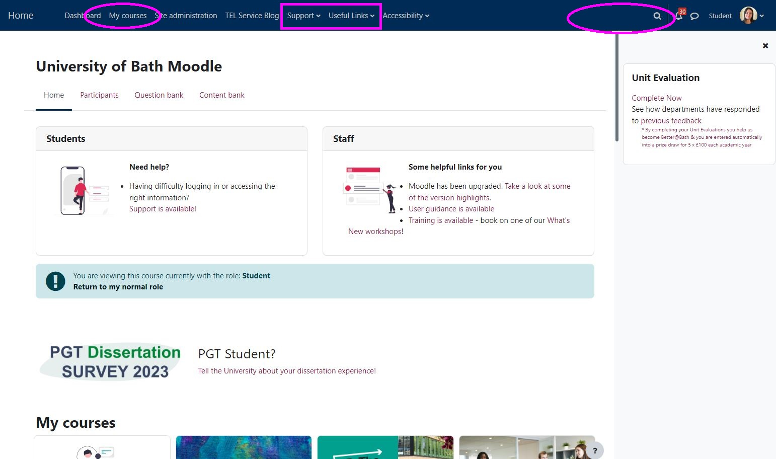
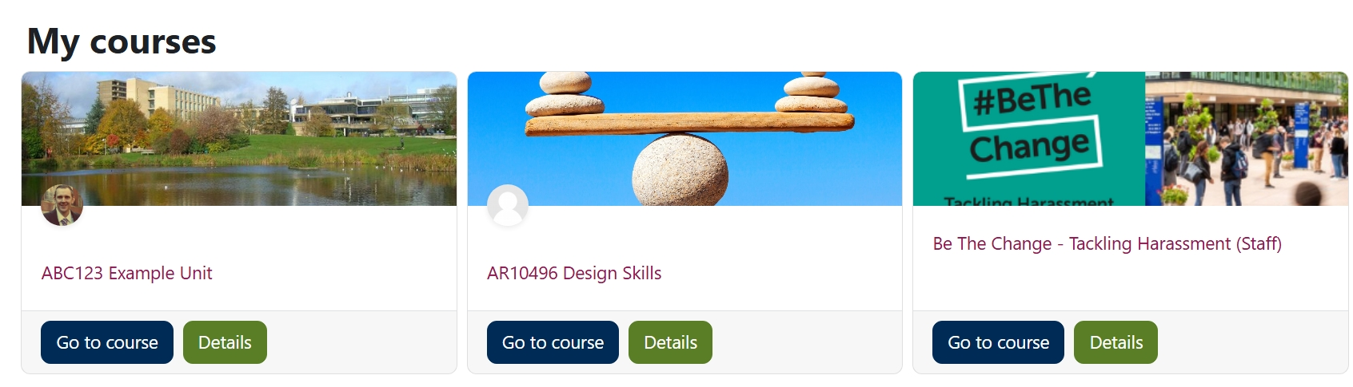
How to navigate – my courses
How do I navigate Moodle?
Scroll down the Homepage to access My courses
Notes:
Slides 4-7: 10 minutes
The first page you see when you sign in is the Moodle Home page
There are some useful options in the top toolbar, including links to support materials, and Useful Links to other frequently used services (for example the Library and My Skills Hub)
Note the link to the Moodle Archives. Each year in July, a snapshot is taken for the academic year. You can refer back to previous units of study, including assignments and feedback, by accessing the Moodle Archives. You will need to be on campus or connect via the Bath Virtual Private Network (VPN) to access the archives.
In the live version of Moodle, you can access the courses you are currently enrolled on using the My Courses list, or by scrolling down to the main part of the Moodle Home page
Click on the course title to enter the Moodle course content
You have the option to Search Courses. This will show you all the available courses within Moodle (including those you may not be enrolled on)

Slide 6
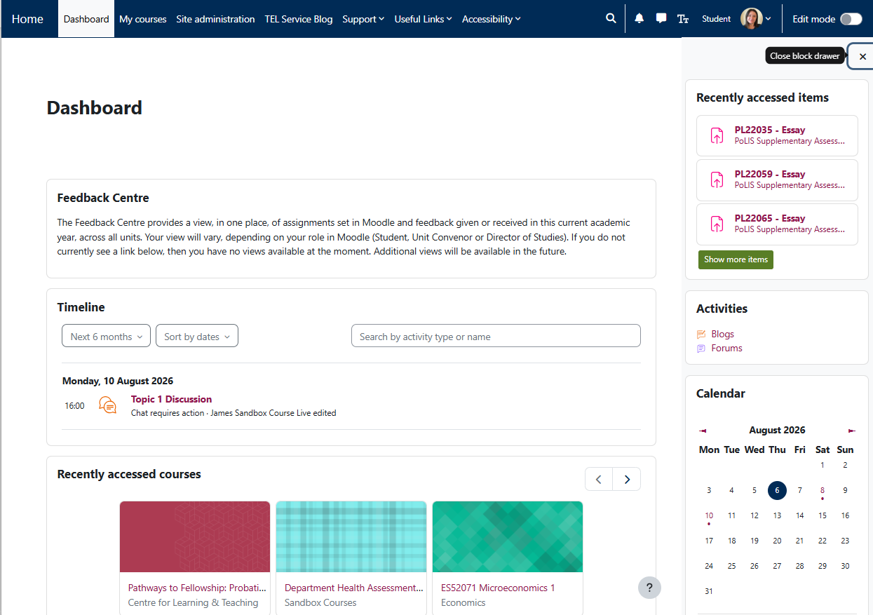
How to navigate - dashboard
How do I navigate Moodle?
Notes:
Slides 4-7: 10 minutes
From the Homepage you can navigate to your Moodle Dashboard
In the Moodle Dashboard, you will see the Feedback Centre, where you can view assignments and feedback given
The Moodle dashboard shows a Timeline with upcoming activity deadlines
You can access Recently accessed courses and items
At the top right of the screen, you can enable Edit mode
You can choose to Customise this page to include more information on your Dashboard
If you choose Add block, and Starred courses, you can ‘Star’ your courses to mark them as favourites and view these ‘Starred’ courses

Slide 7
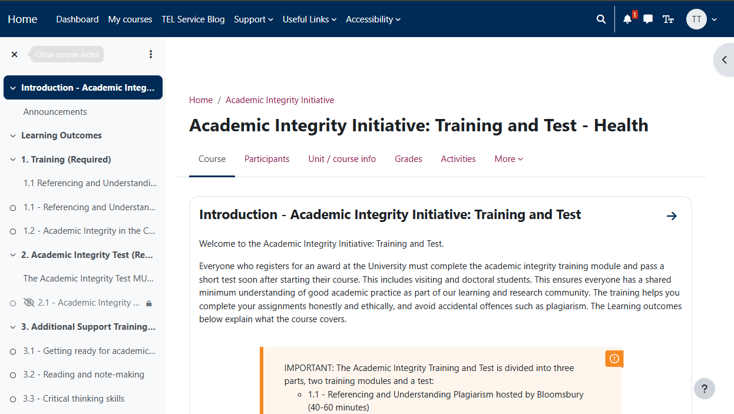
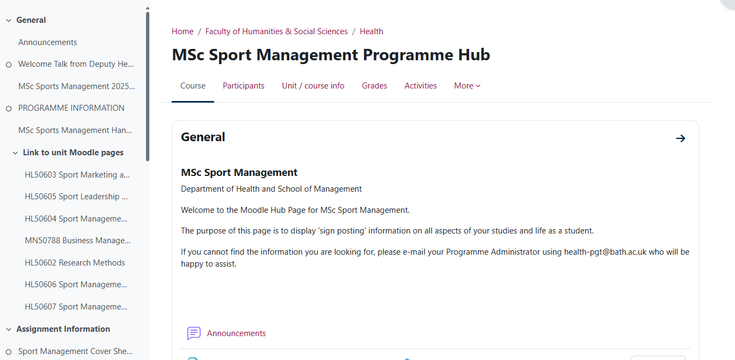
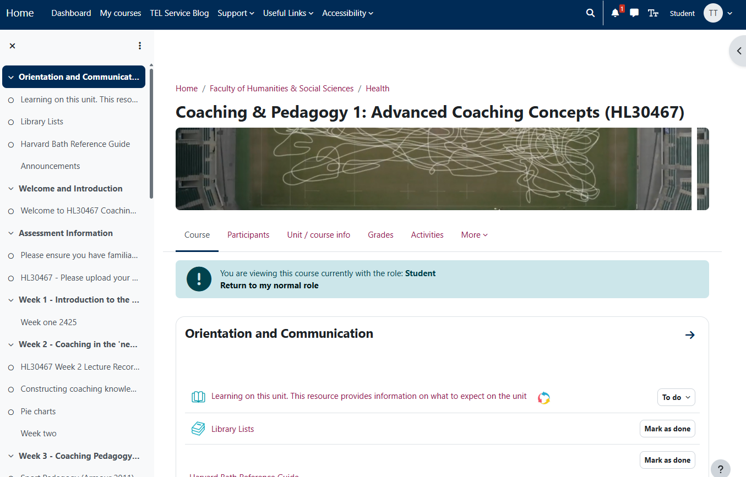
How to navigate - example Moodle spaces
What will I see in Moodle?
Example Moodle spaces
Academic Integrity Training
Programme Hub page
Unit pages
Notes:
Slides 4-7: 10 minutes
You will usually be enrolled on a number of Moodle courses.
This could include – an Academic Integrity Training and Test for your department, a Programme Hub with general information about your programme of study (and possibly induction activities), and units of study.
Your unit space will usually contain a Welcome and Information section, and other key unit information will be found at the top of the page
Open the Course Index on the left-hand side to easily navigate to key activities (e.g. assignments) or to navigate to different topics in your Moodle space
The Course Index may allow you to track completion of your activities if enabled – a green dot will indicate completed activities
Wherever you are in Moodle, you can choose to show or hide course index menu, using the menu icon in the top left of the blue toolbar. This can be helpful to make more space for the main content of the page, especially if you are working on a smaller screen
You can also choose to Open or Close the Block drawer on the right side to view additional blocks (e.g. Panopto block)
Use the Course tab at the top of each Moodle space to navigate back to the main page for each Moodle space

Slide 8
Practice Activity 1 - navigation
Time to practice - navigation
Spend five minutes to practice
Customise your Dashboard (for example add the Starred courses Block and mark your courses as favourites). Find out where to access the Feedback Centre.
Navigate your Moodle spaces to find
  Welcome and Introduction for your units
  Your Programme Handbook
  TIP: when in a Moodle course, try using the navigation menu on the left, and the breadcrumb links, to move around in Moodle
Use the Moodle menu bar to access Support and Useful links
Notes:
Slide 8: 5 minutes practice

Slide 9
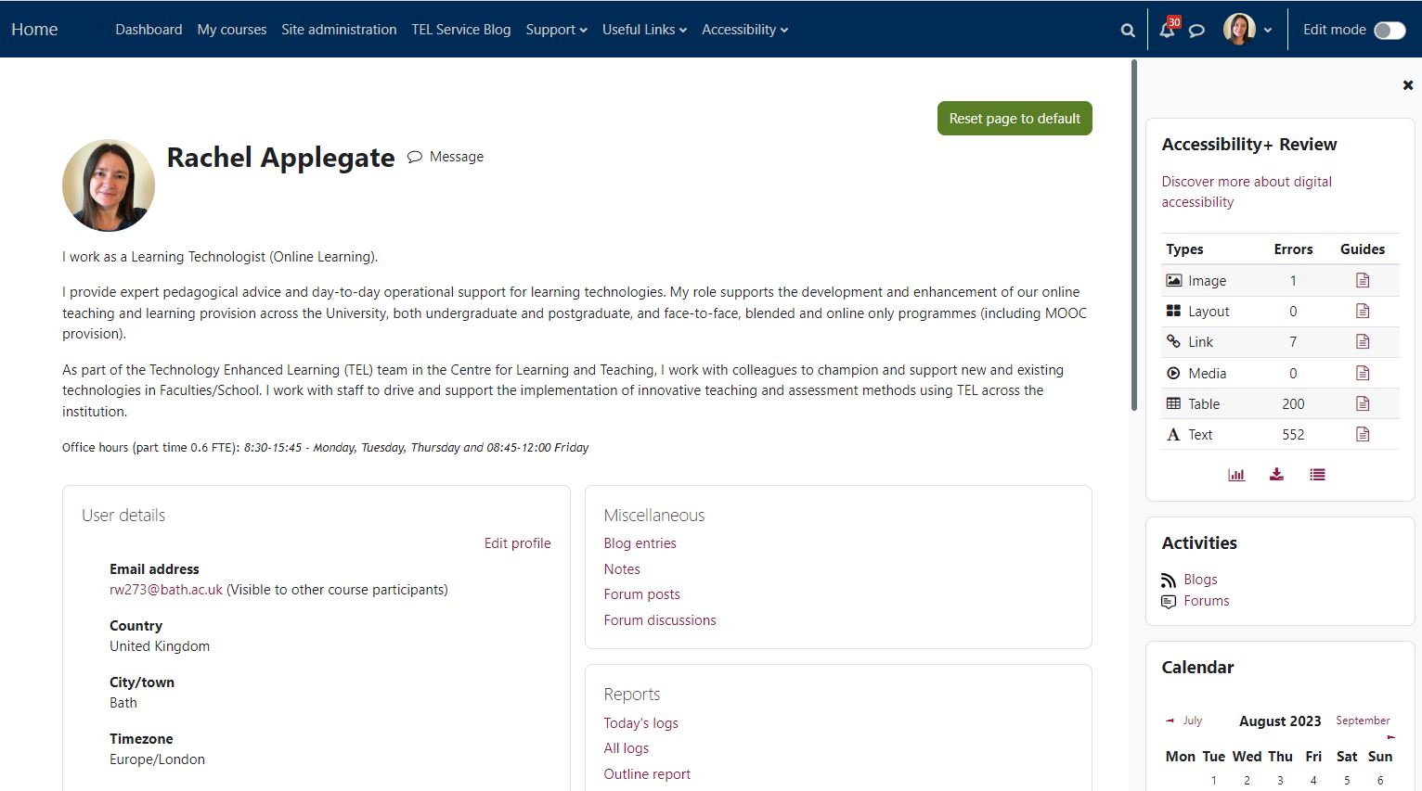
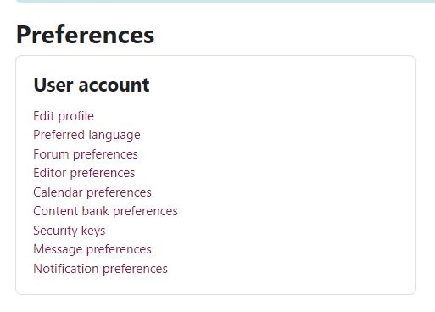
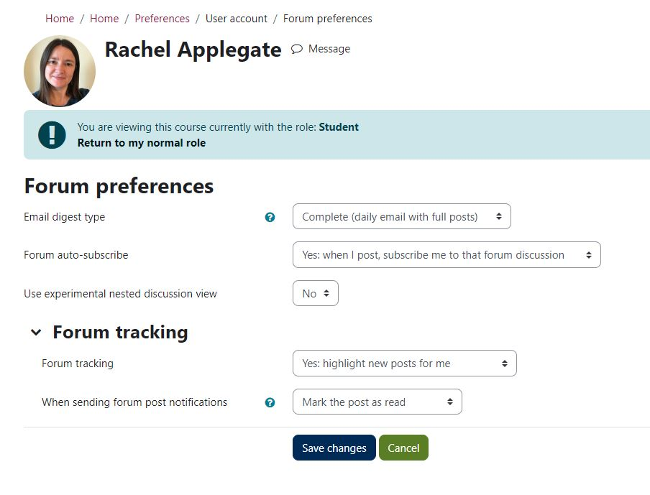
Update your profile
Update your profile
Notes:
Slide 9: 5 minutes
You can adjust your preferences to suit your needs, by editing the Preferences in your user profile
Go to your name at the top right of the screen, and choose Profile
Choose Edit Profile to add information about yourself. This is visible to other users in Moodle.
It can be very useful to add a photo – this helps to personalise discussions when you are using forums
From your Profile icon at the top right, you can select Preferences to edit preferences for the notifications you receive from Moodle forums
For your forum preferences, choose the Complete daily digest to receive a single email summarising all forum posts each day, instead of a single email every time a forum post is made. This makes sure you can keep up to date with all forum posts, but without getting overwhelmed by the number of emails

Slide 10
Practice Activity 2 – update your profile
Time to practice - update your profile
Spend five minutes to practice
Update your profile
Review your preferences
Update your forum preferences to receive a Digest
  TIP: use the daily digest option to receive a single notification at the end of each day for all forum posts
Notes:
Slide 10: 5 minutes practice

Slide 11
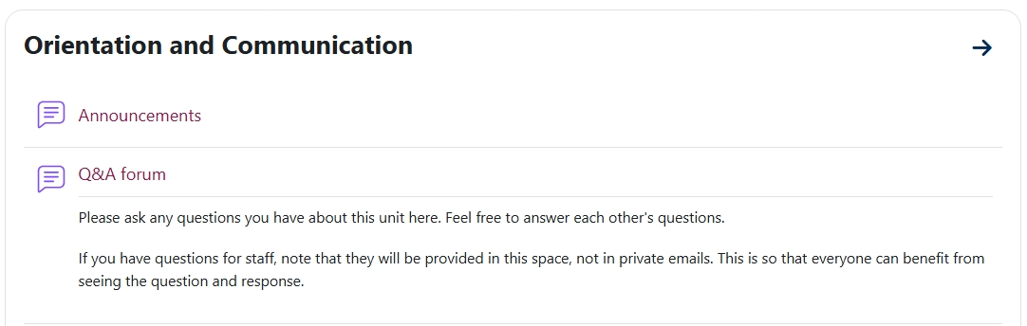
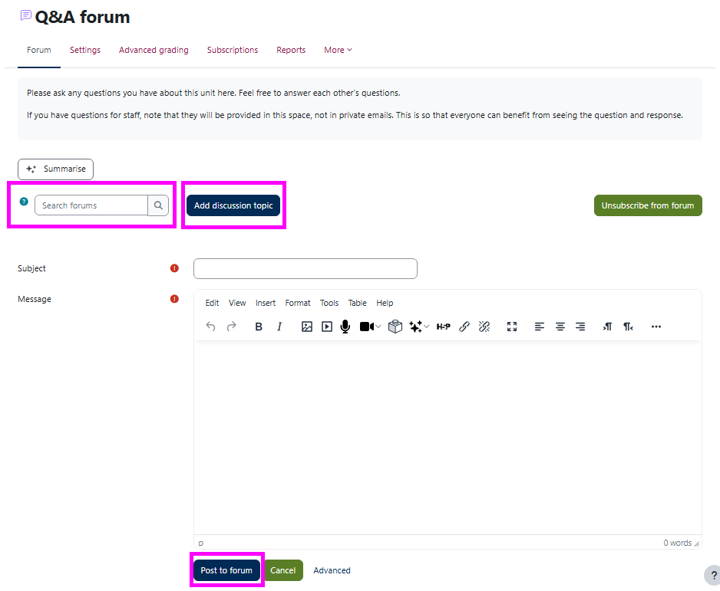
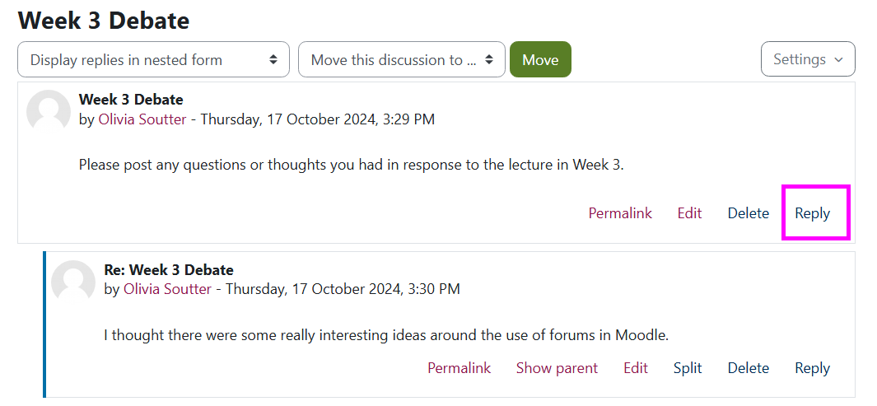
Moodle forums
Using Moodle Forums
Notes:
Slide 11: 5 minutes
Within your Moodle course, your tutor may use forums. There are different types of forum.
A News Forum may be used by staff to post updates about course news (for example reminders about assessment dates). You cannot reply to postings within a News Forum
A Discussion Forum may be set up by staff to allow you to ask questions, or to encourage discussion on specific topics beyond your lectures.
You will receive an email notification when a forum post is made, including links to the forum.
If you have set your preference to receive a Digest, you will receive one email each day with a summary of forum posts, and links to the forum discussion threads.
You will need to reply to the discussion thread within the forum, not by email, so it’s visible to everyone within your course. You can also track unread forum posts within Moodle
To post a new discussion thread…
Go to the forum, and choose
Add a new discussion topic
You need to give your posting a title (which is short but clear, and summarises the topic of your post)
Add the main content of your post in the Message section
You may be able to add an attachment
Choose Post to forum
You can also use the Search Forums option to search for key words in all forums on your course (if you don’t enter a key word, but click on the search forums icon, this will give you advanced options for searching – such as posts within a date range or by a certain person).
You can now see the post within the discussion forum itself
To reply to a discussion…
Within the post, choose Reply, type your message, then choose Post to Forum

Slide 12
Practice Activity 3 – post to a forum
Time to Practice – Post to Forum
Spend ten minutes to practice
Post to a forum – navigate to the forum provided by your programme team (e.g. icebreaker forum)
Make a post to the forum
Read and reply to at least one post from another student
  TIP: you may need to refresh your browser to view others’ posts in live time
Notes:
Slide 12: 10 minutes practice

Slide 13

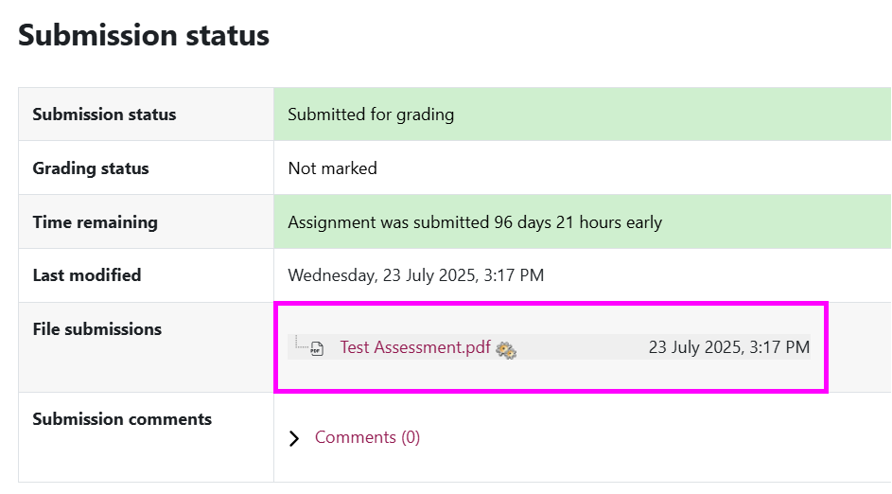
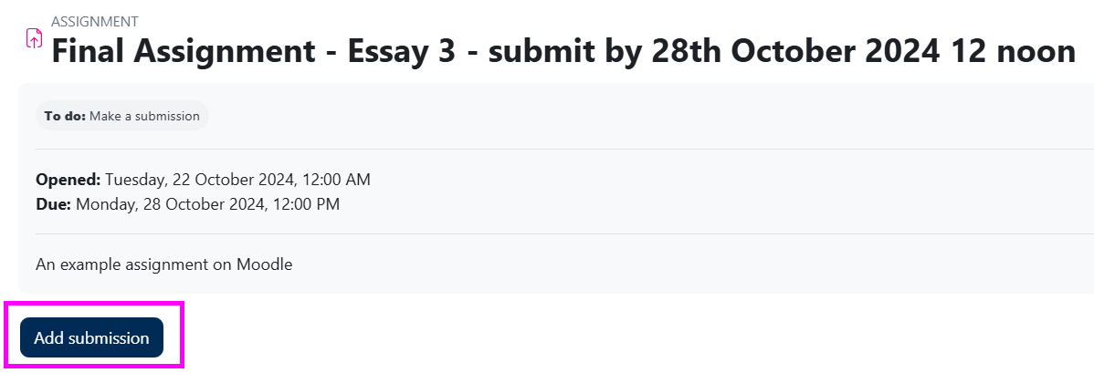
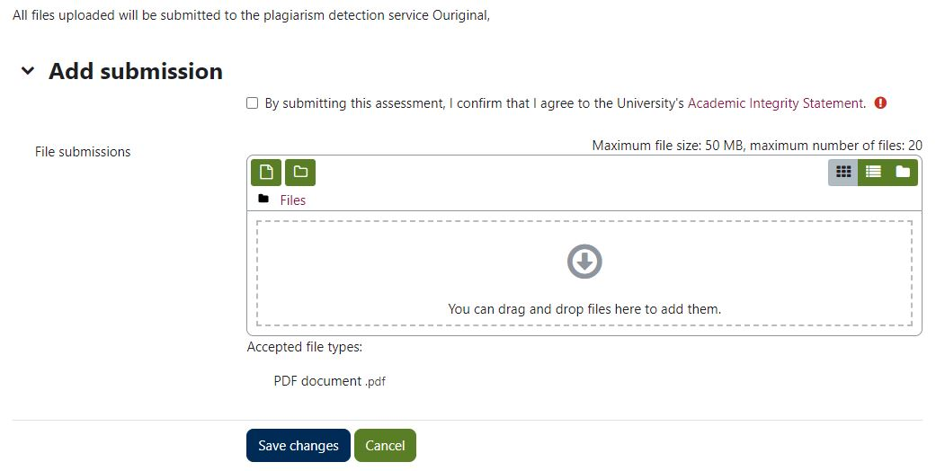
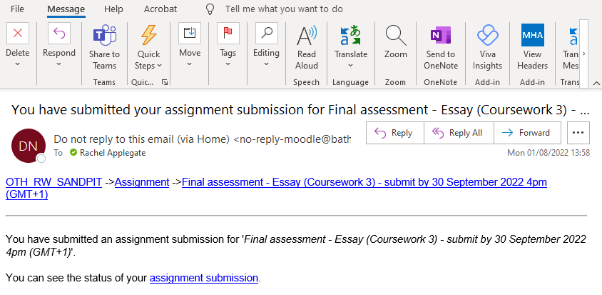
Moodle assignments
Using Moodle Assignment
Notes:
Slides 13-14: 5 minute
For some coursework, staff will ask you to upload your coursework in a Moodle assignment submission point.
You can recognise the assignment submission point with the hand in icon.
There are different requirements for different types of assignment submission, so
make sure you follow the specific instructions within your course.
You will see the assignment submission deadline under the Submission status box.
To upload your assignment file…
Go to the assignment submission point and choose Add submission
You can drag and drop the file to the File submission box, or choose Add, then Upload file and Choose file to browse to your computer
Double click then choose Upload this file. You will now see the file in the File submissions window
Choose Save changes
You can now see your uploaded file in the Submission status section
You will receive an email notification confirming your assignment has been successfully uploaded
There may be an option to Edit your submission up until the deadline (depending how your submission point is set up)

Slide 14
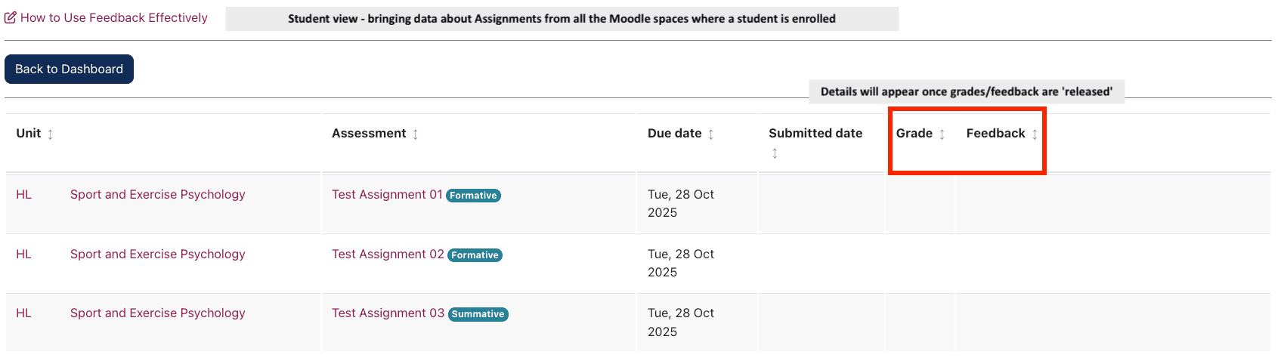
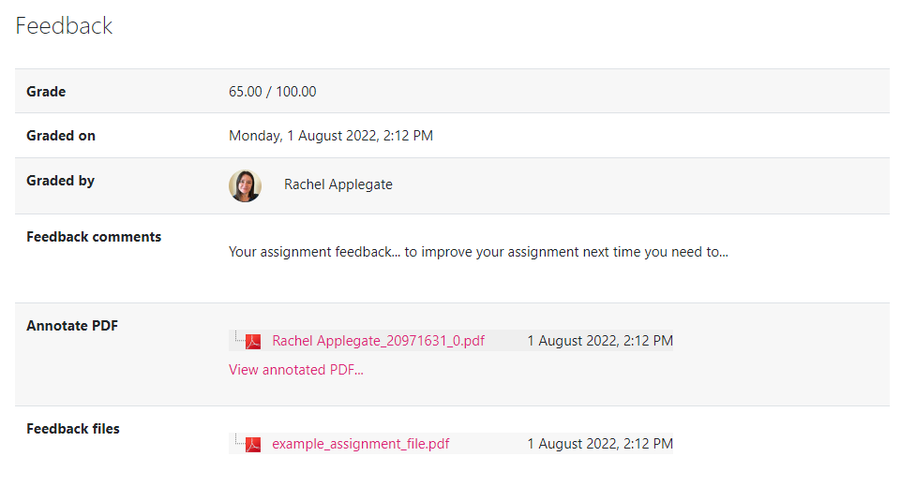
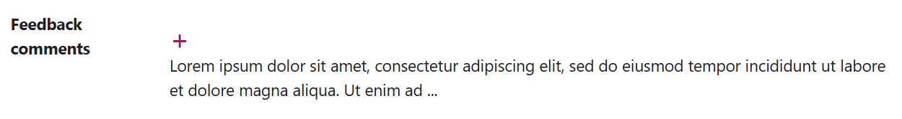
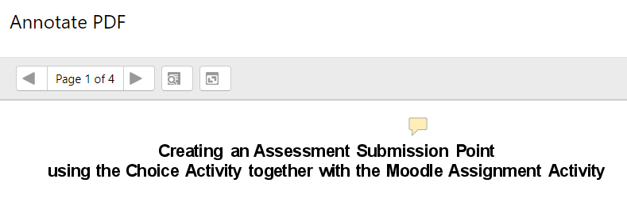
Moodle assignments - feedback
Viewing your feedback
Via the Dashboard, use the Feedback Centre for an overview of feedback across units
View feedback in your assignment submission point. Click on the ‘+’ icon to expand Feedback comments
Notes:
Slides 13-14: 5 minutes
Your tutor will notify you when your feedback is available to view. To access your feedback…
From the Moodle Dashboard, follow the link to the Feedback Centre for an overview of assignments and feedback given
Alternatively, to view feedback for an individual assignment
You will need to go back to the assignment and submission point
You will see your mark, a feedback comment and possibly an annotated copy of your assignment under your original submission (this could be an annotated PDF or a Feedback file)
You may need to Expand the feedback comment by clicking on the Plus icon
To view PDF annotations within Moodle, choose to View annotated PDF then you can choose to Expand all comments (to view all comments on one screen) or you can click on each comment to view it
Depending on how your course is set up, you may be able to see an overview of your marks for coursework submitted in Moodle in the Grades section at the top of the Moodle space
Remember that any marks or feedback posted in Moodle are available as part of your feedback to help you in your studies.
They are not formal and final until they have been approved by a Board of Examiners and a Board of Studies. Here marks are moderated and may be modified in line with University regulations.
Your final unit marks will be made available in the SAMIS Student Records system after the Board of Examiners and Board of Studies meetings.
When you have completed your units of study, you may need to refer back to the Moodle Archives to view your feedback from previous years of study. Before you graduate, you may wish to download assignment submissions and feedback for your records. You can do this by accessing each assignment submission point. The Feedback Centre provides an overview of submission points across Moodle spaces.

Slide 15
Practice Activity 4 – upload an assignment
Time to practice – Upload Assignment
Spend ten minutes to practice
Upload a file to an assignment – navigate to the assignment provided by your programme team (e.g. induction assignment)
Drag and drop or Browse to upload a file (the file will need at least 20 words of content)
Save changes
  TIP: view your submission status and check the uploaded file to make sure it opens
Notes:
Slide 15: 5 minutes practice

Slide 16
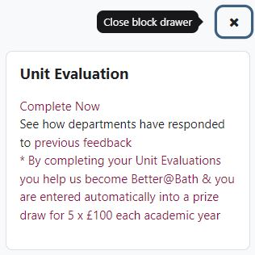
Unit evaluation
Unit evaluation
Takes place towards the end of semester
Your chance to provide anonymous feedback on curriculum, teaching and assessment
Helps us know what works well and what we can improve
Departments or programmes share the changes made in response to feedback
Notes:
Slides 16-17: 5 minutes
We have automated unit evaluation surveys that will request your feedback about each unit of study
The links to these become available toward the end of each Semester in the Unit Evaluation block in Moodle (you will see this on the homepage once you log in)
On the Moodle Homepage, open the block drawer at the top right of your Moodle homepage to view the Unit Evaluation block
You will also receive email reminders – we really want your opinions!
The surveys take 10 – 15 minutes to complete
They are accessible on tablets and smartphones as well as PCs
They are open for around 3 weeks
Unit tutors may also share informal 'check-in' or 'start, stop, continue' surveys during semester

Slide 17
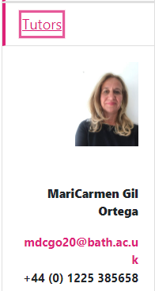
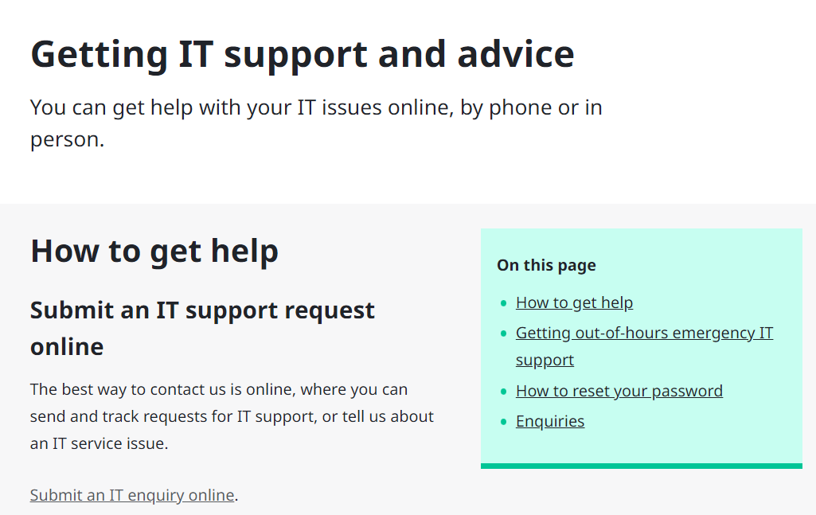
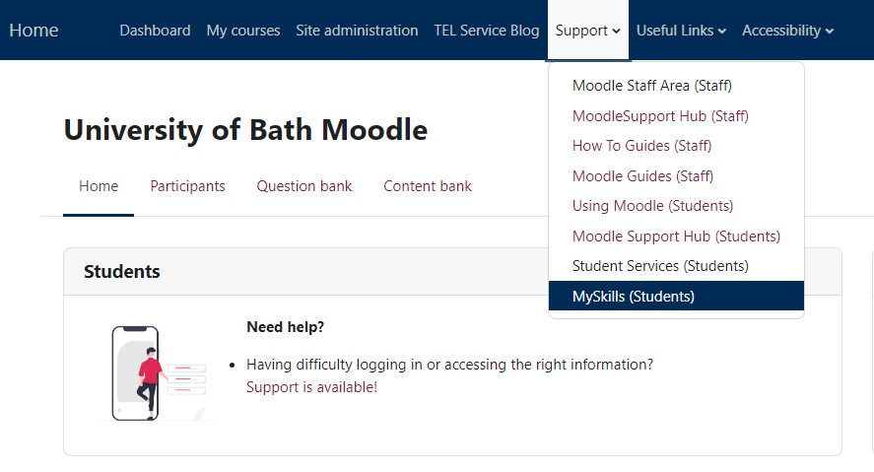
Getting help
Where to find help
In your Moodle space you will find contact details for your tutors or Director of Studies.
Follow the guidance provided to contact them for help. This is the first point of contact for help with your study materials.
Notes:
Slides 16-17: 5 minutes
If you have a question about activities or resources on your course, you should contact your tutors – this is the first place to go for help as your tutor sets up your Moodle course
In you Moodle space your tutor will explain how to get in contact – perhaps using a Moodle question and answer forum, or via email
You can access general support materials online. In the top menu in Moodle, go to Support, follow the link to My Skills (Students) – here you can find a quick guide with tutorials on how to do common tasks and activities in Moodle
If you cannot log in to Moodle, you can contact IT support who can help with issues with your account.
You must make sure you have completed Registration online first.

