Slide 1


Preparing for Moodle upgrade and archiving
Summer 2026
Lynn Cheong-White
Instructional Designer
Technology Enhanced Learning team
tel@bath.ac.uk
1st July 2026

Slide 2

Session outline
Why are we upgrading?
How to prepare yourself, your students and your Moodle space for the upgrade
How to prepare for the archive snapshot
What to do after the upgrade

Slide 3

Why are we upgrading?
An annual upgrade of Moodle is needed to ensure our site and the data stored within it remains secure.

Slide 4
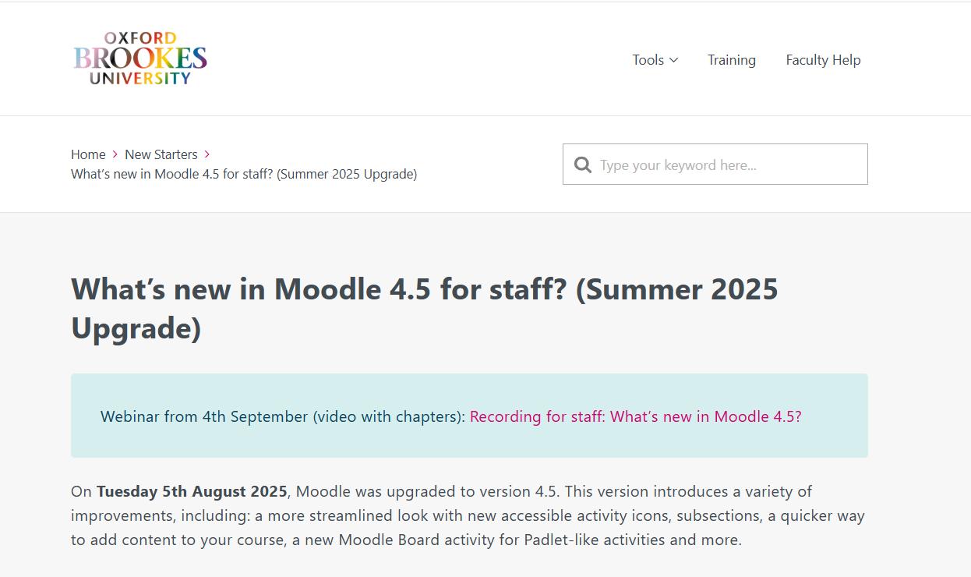
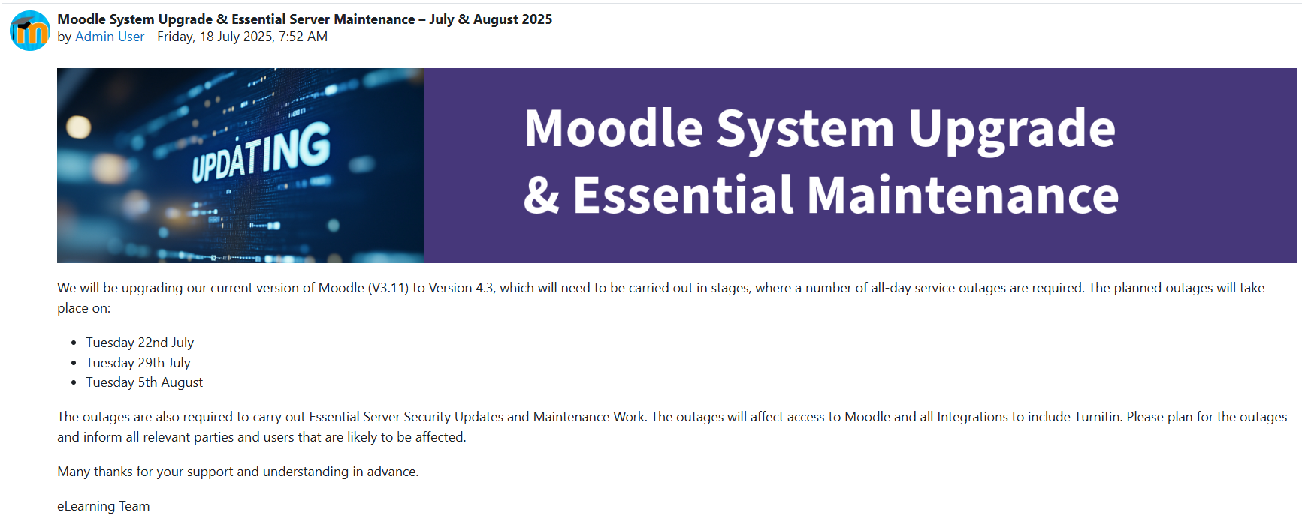
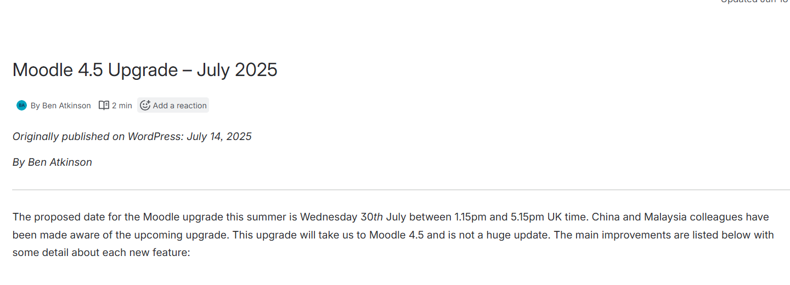
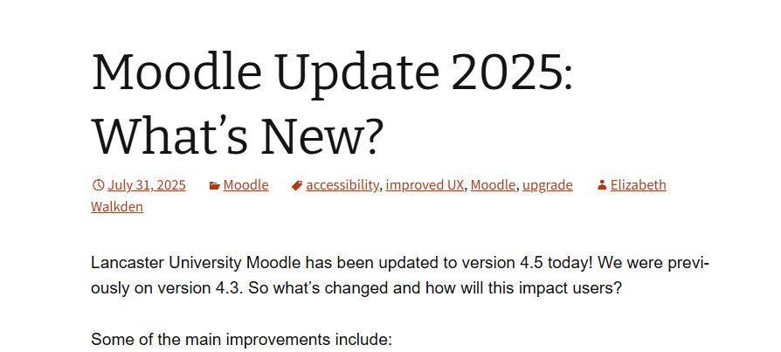
Upgrade schedule across the sector
Greater Manchester
Oxford Brookes
Lancaster
Nottingham

Slide 5


Moodle Administration cycle
Sept/Feb - Start of Semesters
June - Review Content
  AY SAMIS enrolment occurs automatically 3 weeks before S1 starts until end of September the following year
  S1 SAMIS enrolment occurs automatically 3 weeks before S1 starts until end of September the following year
  S2 SAMIS enrolment occurs automatically 3 weeks before S2 starts until end of September the following year
Unit Convenor details must be up to date in SAMIS so that staff enrolments to Moodle are accurate.
For new courses, the Unit Convenor must be present in SAMIS or the necessary Moodle spaces cannot be created.
Check that SAMIS has synced with Moodle to enroll the correct students. Students only get access to Moodle once Registration Online is fully completed and are registered on a SAMIS unit. Course teams should explain this to students.
Moodle/SAMIS sync nightly or can be done manually via the SAMIS Integration block in the Moodle space.
If teaching more than one cohort together, use the SAMIS Integration block to map to the additional cohorts (otherwise they won't be enrolled on the course).
If you want to set up Moodle groups ready for the new cohort, amend the SAMIS mapping to unenroll the previous cohort.
Remember to ‘Show’ the course to make it visible to students.
In preparation for the Archive snapshot, which is a copy of Moodle taken at the end of July, Unit Convenors should review the content of Moodle spaces.
  Delete or hide content that should not be visible in the Archive, such as answer sheets.
  Look over enrolment. Staff and students who are enrolled in your Moodle spaces at the time of the snapshot will be able to continue to view them in the Archive (but not edit it).
Semester 2
Feb
Review
Content
Late July - Snapshot &
Archive
Semester 1
Sept/
Oct
June
A copy of Moodle is taken and becomes the Archive for that previous academic year.
Students can view the content, from their previous years, in the Archive. Moodle should not be used for moderation or to store passed assessment, speak to your department for proper assessment storage guidance that is in line with University Records Retention Schedule and Data and Information management guide.
Aug/
Sept
Late
July
Early
Aug
Preparation
Snapshot &
Archive
Early August -
Moodle upgrade
Moodle
Upgrade
Moodle is upgraded every summer. This can result in some changes to functionality or appearance. Staff should prepare themselves and students that there will be no access to Moodle at this time.
The process is reported in the TEL Service Blog, and all staff are encouraged to subscribe to updates.
August - Preparation
When all student activity has ceased in the Moodle space, it should be reset for a new cohort – only do this once you know that a backup exists and/or the space is included in the Moodle Archive.
You can ‘hide’ the Course whilst you update content, check links, etc.
Moodle spaces should be designed in line with the Bath Blend Baseline, and CASE model.

Slide 6

Prepare for upgrade
Upgrade scheduled for Wednesday 29th July 2026.
Moodle will be offline all day.
Upgrade work will take place in the background.
Moodle is anticipated to be fully functional on Thursday 30th July.
Due to the scale of the work, timelines may move slightly.
We recommend that no assignment submissions, quizzes or activities on Moodle are scheduled for between Monday 27th July and Friday 31st July.

Slide 7

Assessments during upgrade
Submissions and quizzes should not be organised at this time as students like staff won’t have access to Moodle.
If students need any resources to revise, their tutors should advise them to make sure they have created offline versions of materials.
Staff should not plan on doing any marking or releasing of grades and feedback on Moodle during this period.
If an assessment is schedule for this period, you will need to arranged alternative means for students to submit.

Slide 8

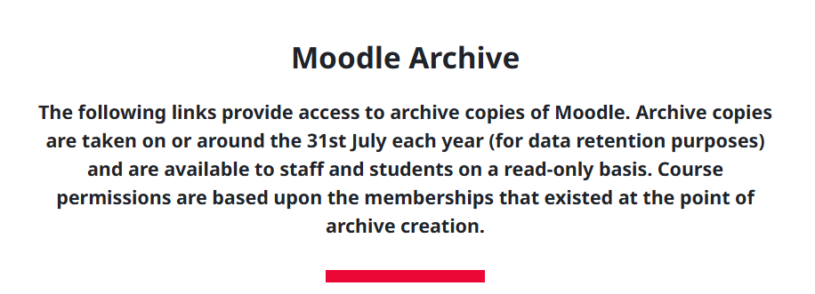

What is available during the upgrade

Slide 9

Preparing for the Moodle snapshot
Deadline to prepare for the snapshot Tuesday 28th July 2026.
A copy of a Moodle at a specific moment.
Ensure enrolment of participants is correct. Remove unnecessary participants. Add those who require archive access.
Check activities and resources have the correct visibility.

Slide 10
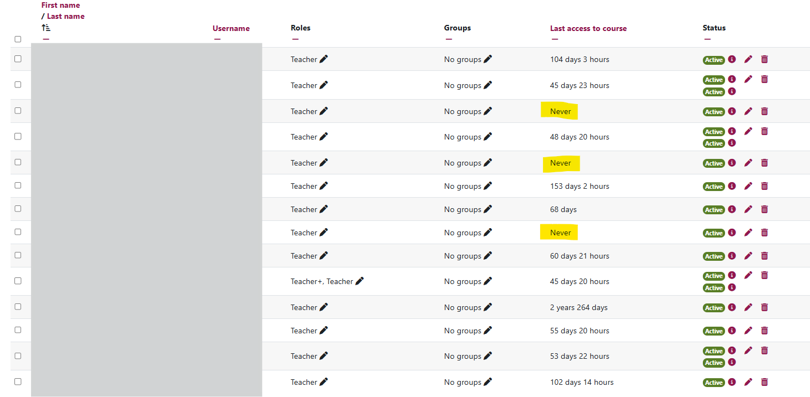
Remove unnecessary participants

Slide 11
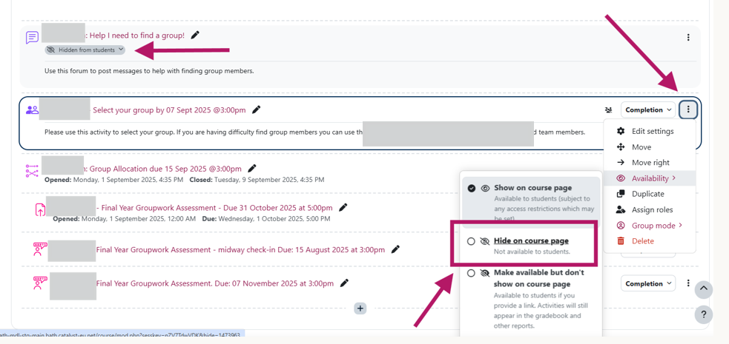
Hide activities

Slide 12
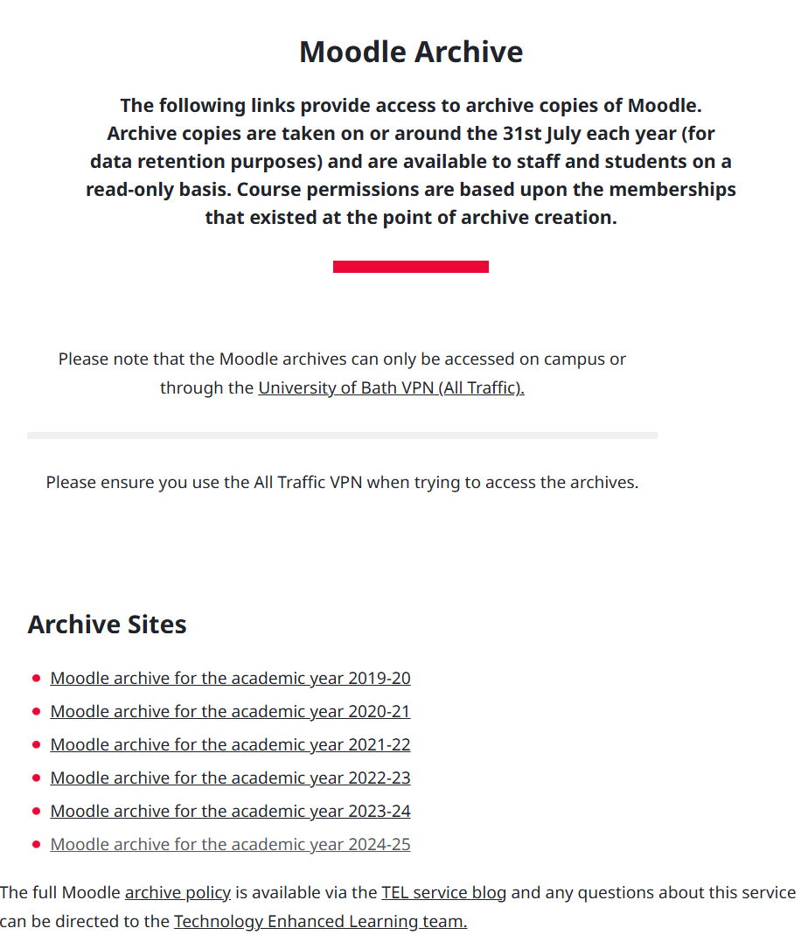
After the upgrade- The snapshot
Students and staff can access the snapshot in the archive with their UoB SSO login details and via VPN.
The archive is a snapshot of Moodle at a specific time, with proper housekeeping past assessments should be captured; however, Moodle should not be used for moderation or to store passed assessment. You should speak to your department for proper assessment storage guidance that is in line with University Records Retention Schedule and Data and Information management guide.

Slide 13

Snapshot – what isn’t captured
For AY2526 Moodle units that have active engagement and activities after 29 July 2026, this material will not be captured in the snapshot. As such students of these units should be informed by their tutors to download any materials they would like to continue having access to.
Staff may need to store materials created at this time outside of Moodle.

Slide 14
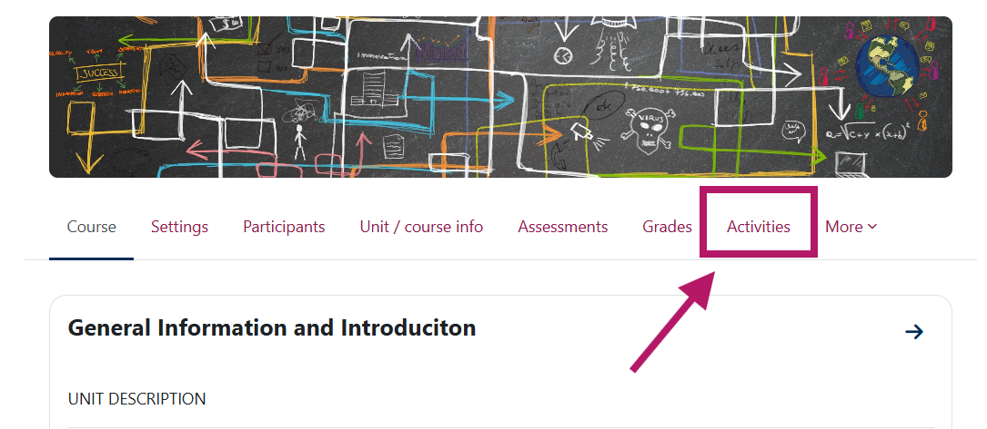
New functions in Moodle – Activities tab

Slide 15
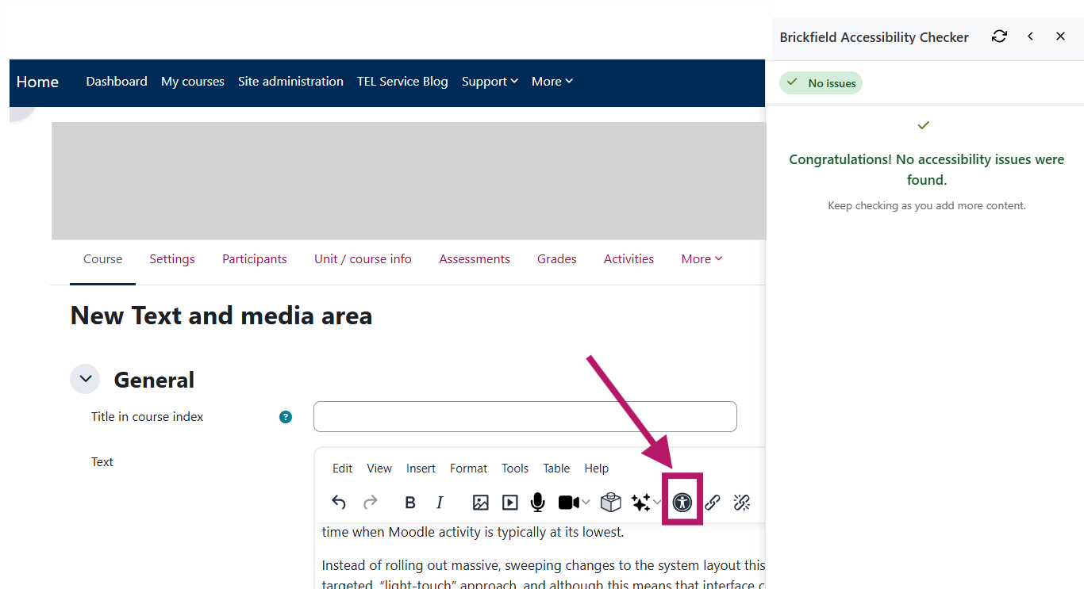
New functions in Moodle – Brickfield Accessibility

Slide 16

Post-upgrade Housekeeping
Remove any participants that will not need access to you Moodle space for the AY2627 year. Students enrolled via SAMIS cannot be un-enrolled manually. Moodle will unenroll them before the start of semester 1.
Remove any old assignments. You should not be reusing assignment activities as there can be issues so you can remove old assignments and create new ones for semester 1.
Reset any activities you want to reuse, such as forums or quizzes.

Slide 17
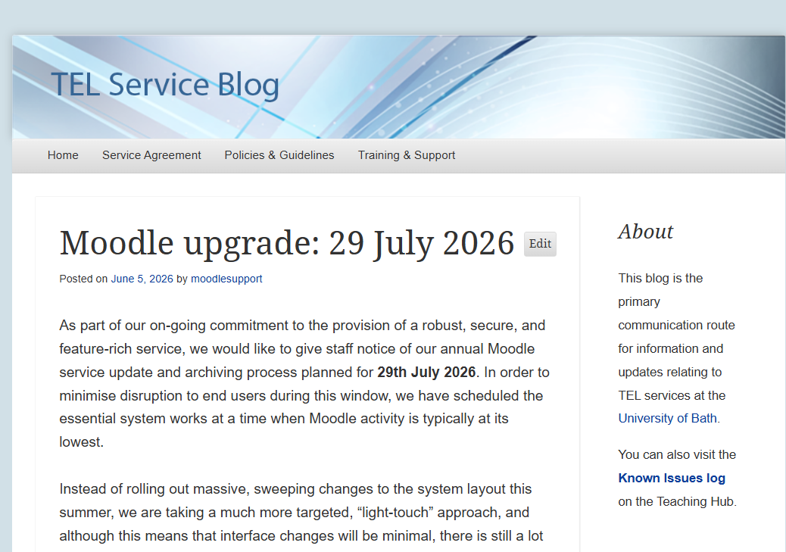
Keep up-to-date
Sign up to the TEL Service Blog for updates.

Slide 18
Support resources
Annual Moodle administration cycle overview
TEL Service Blog
Moodle Archive Practice Policy
Moodle Archive
Need additional support book a 1:1 with an Instructional Designer
Email: tel@bath.ac.uk

Slide 19
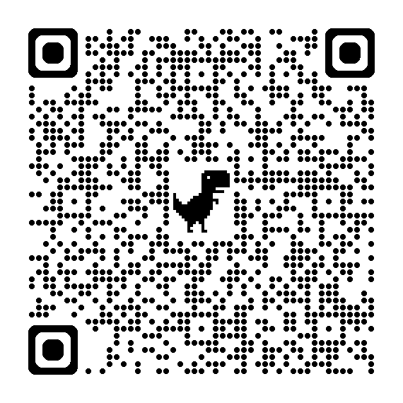
Feedback
If you have a minute, please fill out our short 5-question feedback form. Thank you!

