Slide 1
Group Peer Evaluation in Moodle
Grade Calculation
Last edit 16/7/2026

Slide 2
Algorithm overview
The group assignment is awarded an academic mark.
The final grade is made up of
  A weighted academic mark (same for all group members)
  A group peer assessment mark that is weighted by the academic mark and peer assessment
The weighting of the peer assessment scores students is based on peers scores normalised by how many marks are allocated by that reviewer (this ensures generous/ungenerous markers have a comparable effect).
There is also a weighting to take into account non-submitters do not artificially drag everyone’s mark down.
The algorithm implemented in the Moodle Group Peer Evaluation plugin is based on the open source WebPA project’s algorithm.

Slide 3
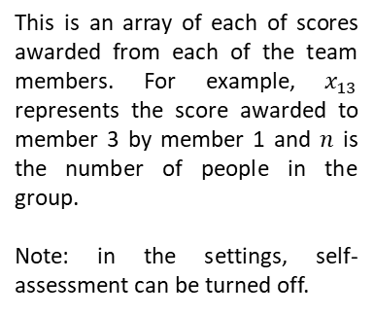
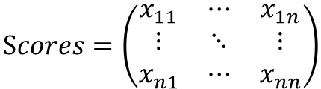
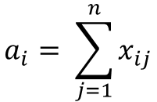

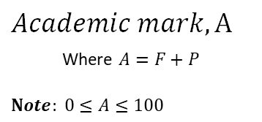
Notation and terminology
$$Academic mark, A$$
Where $A=F+P$
$$Note: 0≤A≤100$$
$$Scores=\left(\begin{matrix}x_{11} & ⋯ & x_{1n} \\ ⋮ & ⋱ & ⋮ \\ x_{n1} & ⋯ & x_{nn}\end{matrix}\right)$$
$$Total Awarded,$$
$$\left(\begin{matrix}a_{1} & … & a_{n}\end{matrix}\right)$$
$$a_{i}= \sum_{j=1}^{n}{x_{ij}}$$
This is the examiner mark for the group project before taking group weighting into consideration.
The academic mark is broken down into F, the fixed score and P, the peer assessed score. This is because in reality, it may not be desirable to adjust the entire mark by peer assessment since it could lead to a large spread of marks.
Where
This is an array of each of scores awarded from each of the team members. For example, $x_{13}$ represents the score awarded to member 3 by member 1 and $n$ is the number of people in the group.
Note: in the settings, self-assessment can be turned off.
This is an array of total sum of scores awarded by each member.

Slide 4


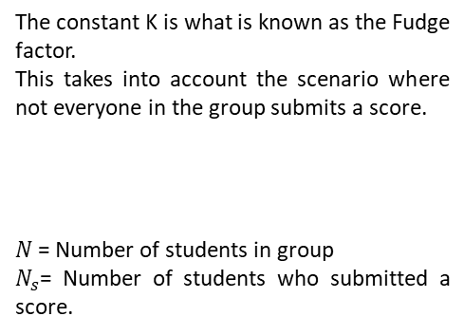
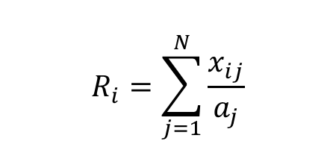
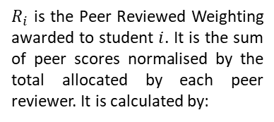
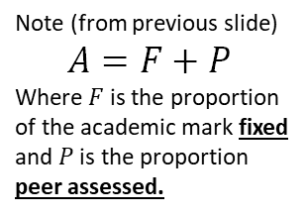
Algorithm
${Final}_{i}$ (The final grade awarded to student $i)$ is calculated as follows
$${Final}_{i}=F+(P×R_{i} ×K)$$
Note (from previous slide)
$$A=F+P$$
Where $F$ is the proportion of the academic mark fixed and $P$ is the proportion peer assessed.
The constant K is what is known as the Fudge factor.
This takes into account the scenario where not everyone in the group submits a score.
$N$= Number of students in group
$N_{s}$= Number of students who submitted a score.
$R_{i}$ is the Peer Reviewed Weighting awarded to student $i$. It is the sum of peer scores normalised by the total allocated by each peer reviewer. It is calculated by:
$$K =\frac{N}{N_{s}}$$
$$R_{i}=\sum_{j=1}^{N}{\frac{x_{ij}}{a_{j}}}$$
Note: If ${Final}_{i}>100$ the score is fixed at 100 since we can’t have marks greater than 100%

Slide 5
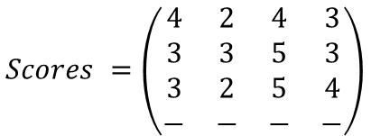
Example
There are 4 members in a group: Alice, Bob, Claire and David.*
Alice scores herself 4, Bob 2, Claire 4 and David 3.
Bob scores Alice 3, himself 3, Claire 5 and David 3.
Claire scores Alice 3, Bob 2, herself 5 and David 4.
David does not take part in peer assessing.
The academic mark awarded for the group submission is 80/100, where 25% of the final score is peer assessed.
Calculate the score for each member.
$$Scores =\left(\begin{matrix}4 & 2 & 4 & 3 \\ 3 & 3 & 5 & 3 \\ 3 & 2 & 5 & 4 \\ − & − & − & −\end{matrix}\right)$$
$$Total Awarded=a= \left(\begin{matrix}13 & 14 & 14 & 0\end{matrix}\right)$$
*In this example students are allowed to self-assess (alternatively, this option can be turned off in the Group Peer Evaluation tool).

Slide 6
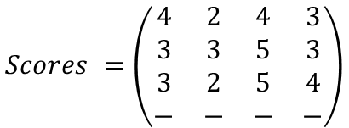
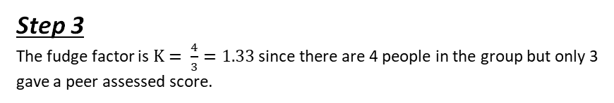
Example: steps 1-3
There are 4 members in a group: Alice, Bob, Claire and David.*
Alice scores herself 4, Bob 2, Claire 4 and David 3.
Bob scores Alice 3, himself 3, Claire 5 and David 3.
Claire scores Alice 3, Bob 2, herself 5 and David 4.
David does not take part in peer assessing.
The academic mark awarded for the group submission is 80/100, where 25% of the final score is peer assessed.
Calculate the score for each member.
Step 1
Step 2
25% of final score is peer assessed, so 20 marks are peer assessed and 60 are fixed. So F=60 and P=20.
$$Scores =\left(\begin{matrix}4 & 2 & 4 & 3 \\ 3 & 3 & 5 & 3 \\ 3 & 2 & 5 & 4 \\ − & − & − & −\end{matrix}\right)$$
Step 3
The fudge factor is $K= \frac{4}{3}=1.33$ since there are 4 people in the group but only 3 gave a peer assessed score.
$$Total Awarded= \left(\begin{matrix}13 & 14 & 14 & 0\end{matrix}\right)$$

Slide 7
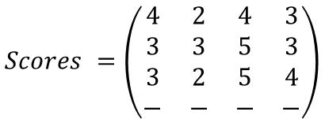
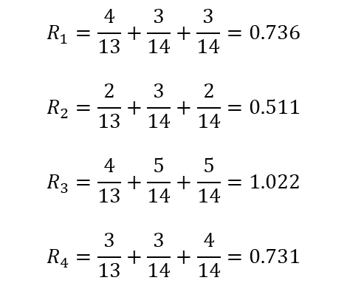
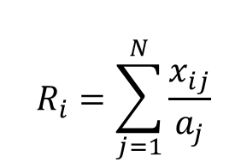
Example: : step 4
There are 4 members in a group: Alice, Bob, Claire and David.*
Alice scores herself 4, Bob 2, Claire 4 and David 3.
Bob scores Alice 3, himself 3, Claire 5 and David 3.
Claire scores Alice 3, Bob 2, herself 5 and David 4.
David does not take part in peer assessing.
The academic mark awarded for the group submission is 80/100, where 25% of the final score is peer assessed.
Calculate the score for each member.
Step 4
$$R_{1}=\frac{4}{13}+\frac{3}{14}+\frac{3}{14}=0.736$$
$$R_{2}=\frac{2}{13}+\frac{3}{14}+\frac{2}{14}=0.511$$
$$R_{3}=\frac{4}{13}+\frac{5}{14}+\frac{5}{14}=1.022$$
$$R_{4}=\frac{3}{13}+\frac{3}{14}+\frac{4}{14}=0.731$$
Calculate weighted values
$$R_{i}=\sum_{j=1}^{N}{\frac{x_{ij}}{a_{j}}}$$
$$Scores =\left(\begin{matrix}4 & 2 & 4 & 3 \\ 3 & 3 & 5 & 3 \\ 3 & 2 & 5 & 4 \\ − & − & − & −\end{matrix}\right)$$
$$Total Awarded= \left(\begin{matrix}13 & 14 & 14 & 0\end{matrix}\right)$$

Slide 8



Example: : step 5
There are 4 members in a group: Alice, Bob, Claire and David.*
Alice scores herself 4, Bob 2, Claire 4 and David 3.
Bob scores Alice 3, himself 3, Claire 5 and David 3.
Claire scores Alice 3, Bob 2, herself 5 and David 4.
David does not take part in peer assessing.
The academic mark awarded for the group submission is 80/100, where 25% of the final score is peer assessed.
Calculate the score for each member.
Step 5
Put everything into the formula
${Final}_{1}=60+20×0.736×1.33=7$9.63
Therefore
Alice scores 80%
Bob scores 74%
Claire scores 88%
David scores 78%
$${Final}_{2}=60+20×0.511×1.33=\text{7}\text{3}\text{.}\text{63}$$
${Final}_{3}=60+20×1.022×1.33=$87.25
${Final}_{4}=60+20×0.731×1.33=79.$49

Slide 9
Centre for Learning and Teaching

