Slide 1
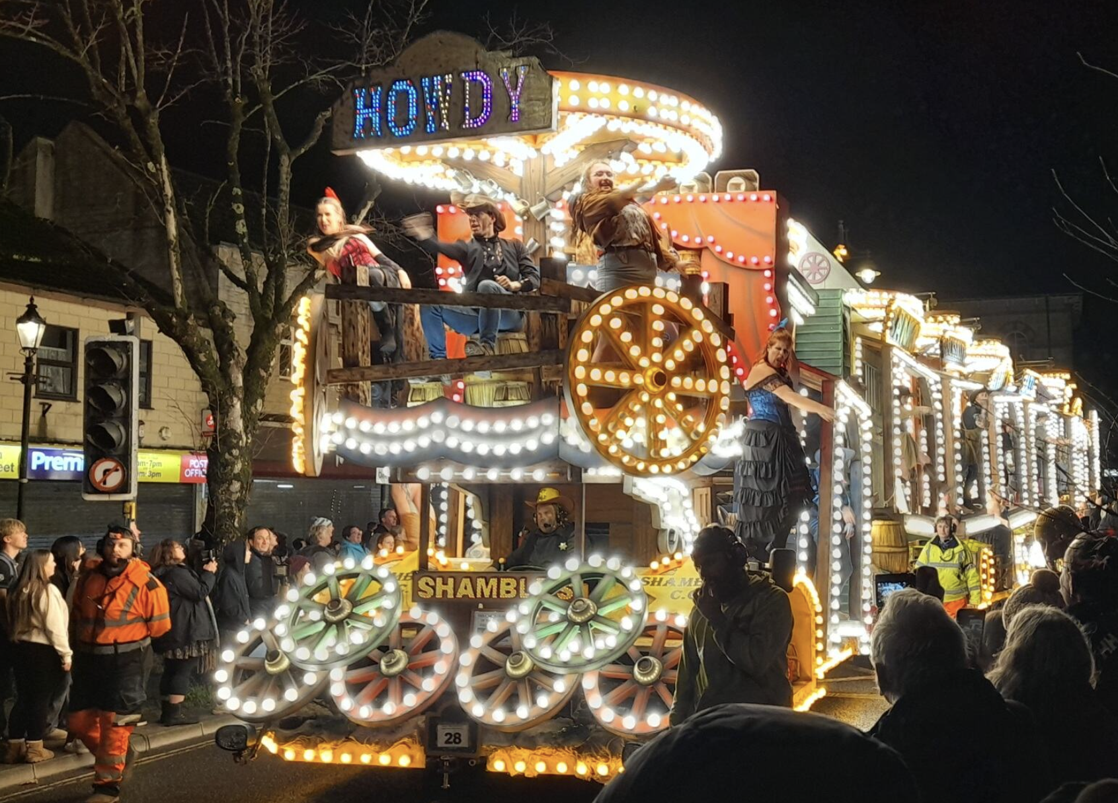

Carnival Capital: A Socio-Economic Analysis of the Midsomer Norton Illuminated Carnival
Estimated income from the night:
£73,500 to £168,000
Average
10+ hours
of volunteering per person
Average spend of
£21
per person
30
floats
What is the Midsomer Norton Carnival?
It is a key event within the community, bringing together local residents, businesses and volunteers in a long-standing cultural tradition.
Each year the event relies on volunteers to create floats and organise the event.
Our findings:
We split into 4 focus groups to conduct our research: Businesses, Volunteers, Floats, and Report writing.
Initial findings suggest that the event generates increased local trade, supports fundraising efforts, and strengthens community cohesion.
Social impacts were also significant: In the survey that was distributed to those who attended the carnival, family attendance was a common motivation for attending, cited by 57% of respondents
Future aims:
The survey that attendees answered was extremely helpful so we would like to conduct in person surveys at the next carnival to get a higher response rate.
We would also like to collect footfall data to improve the accuracy of our estimates.
Our main weakness was the lack of response from business owners. Next year we think it will be more effective if we visit the businesses in person rather than speaking to them on the phone to develop a better relationship.
"The whole show was staggering...It was wonderful to see the whole community coming together like that"

