Slide 1
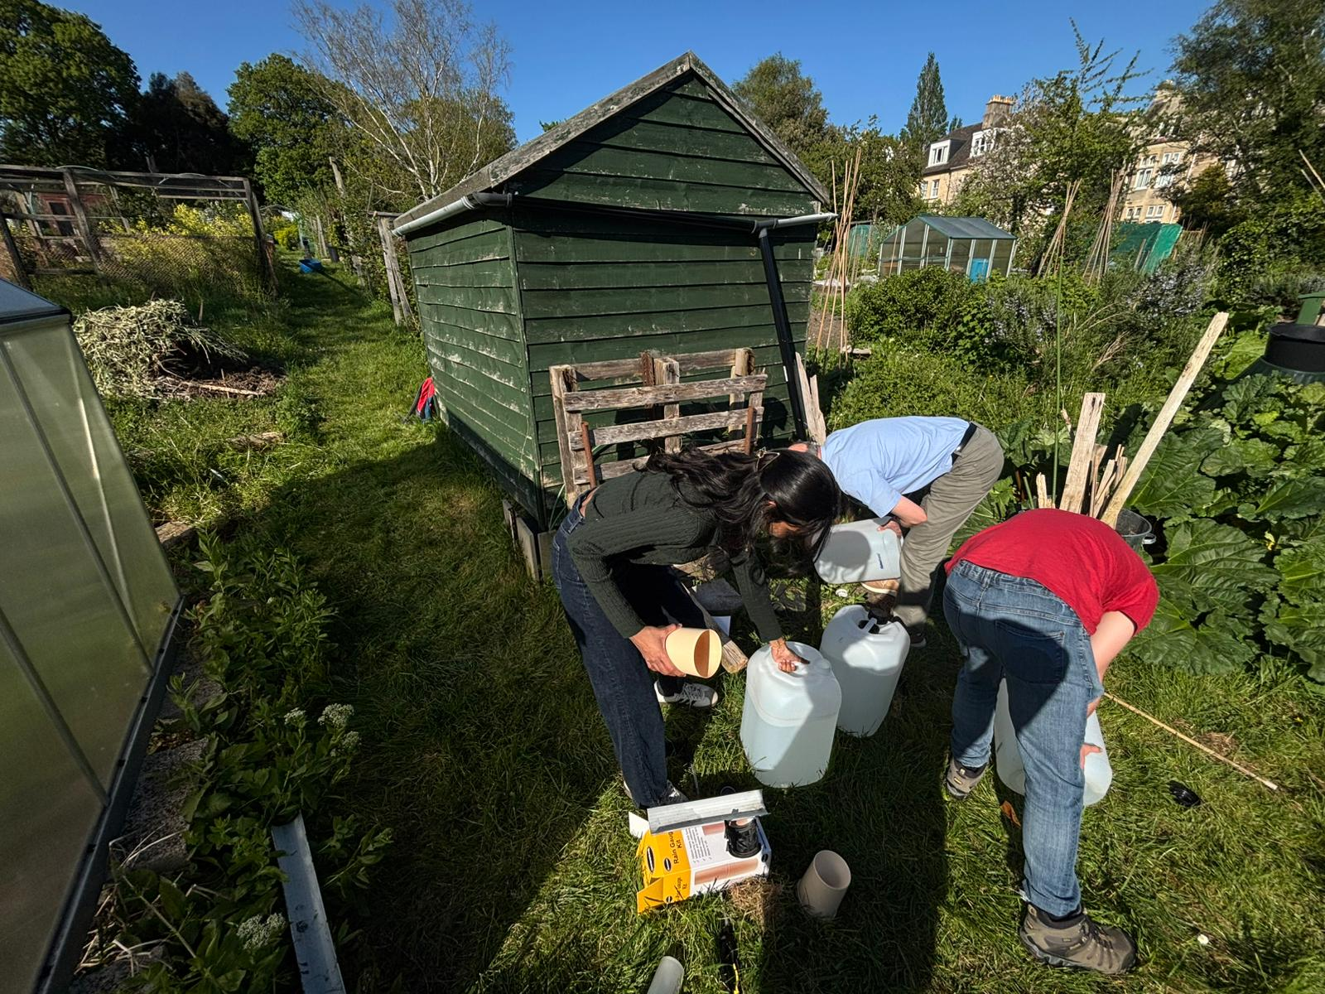
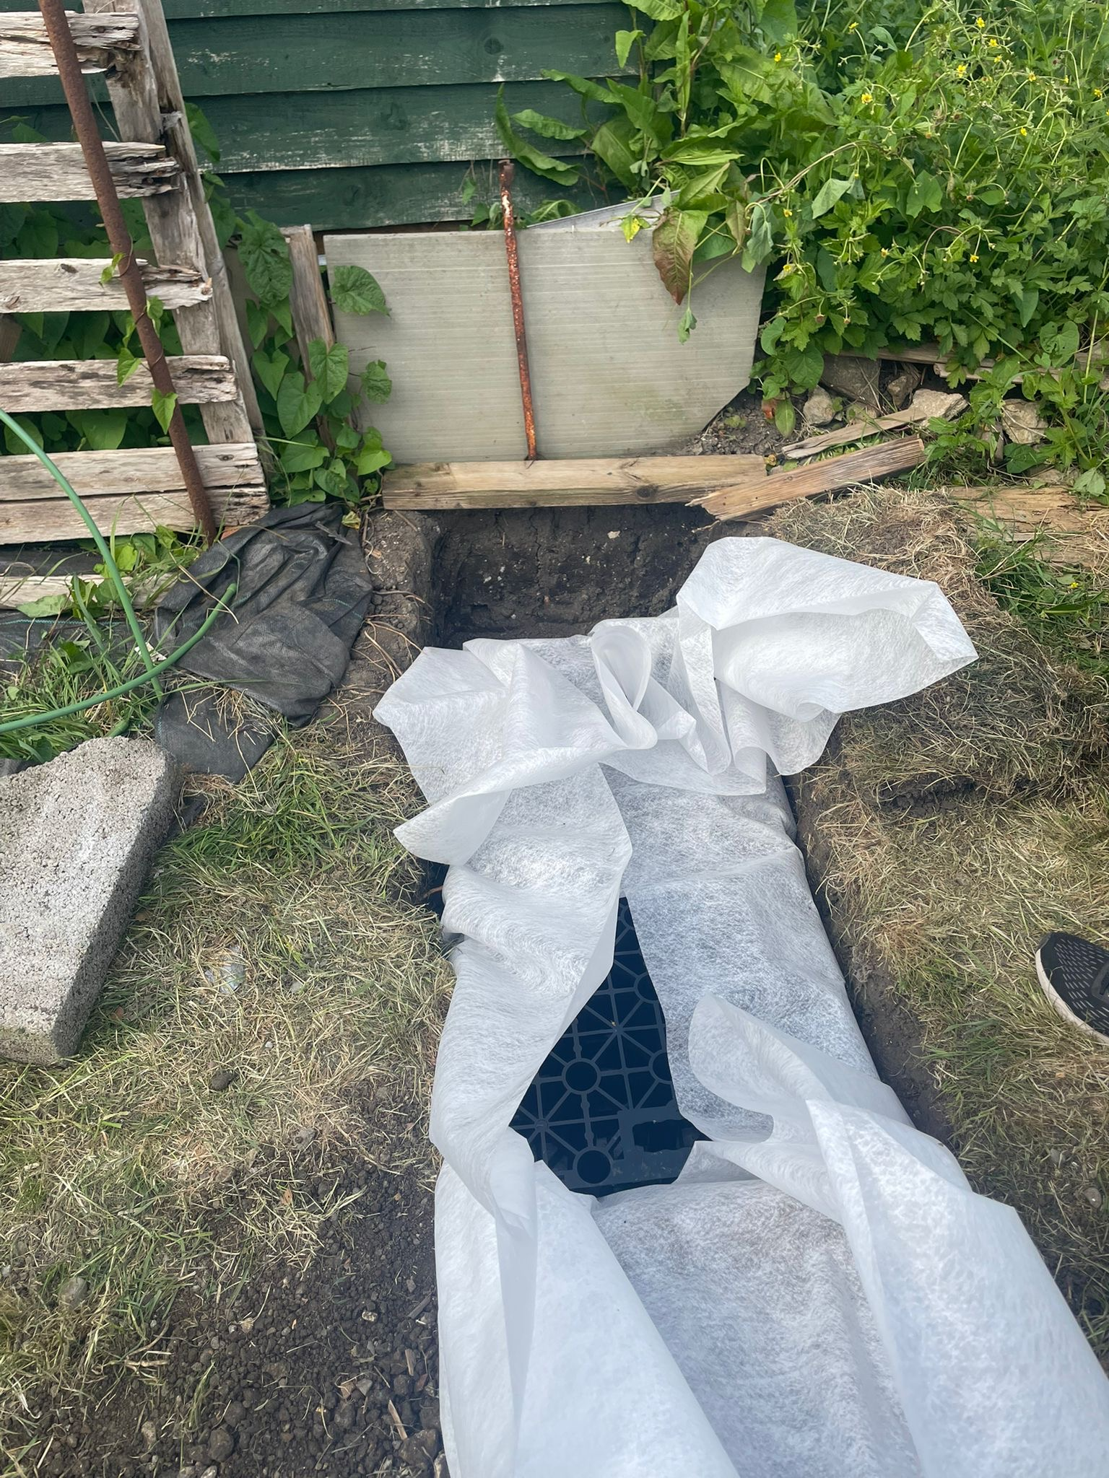
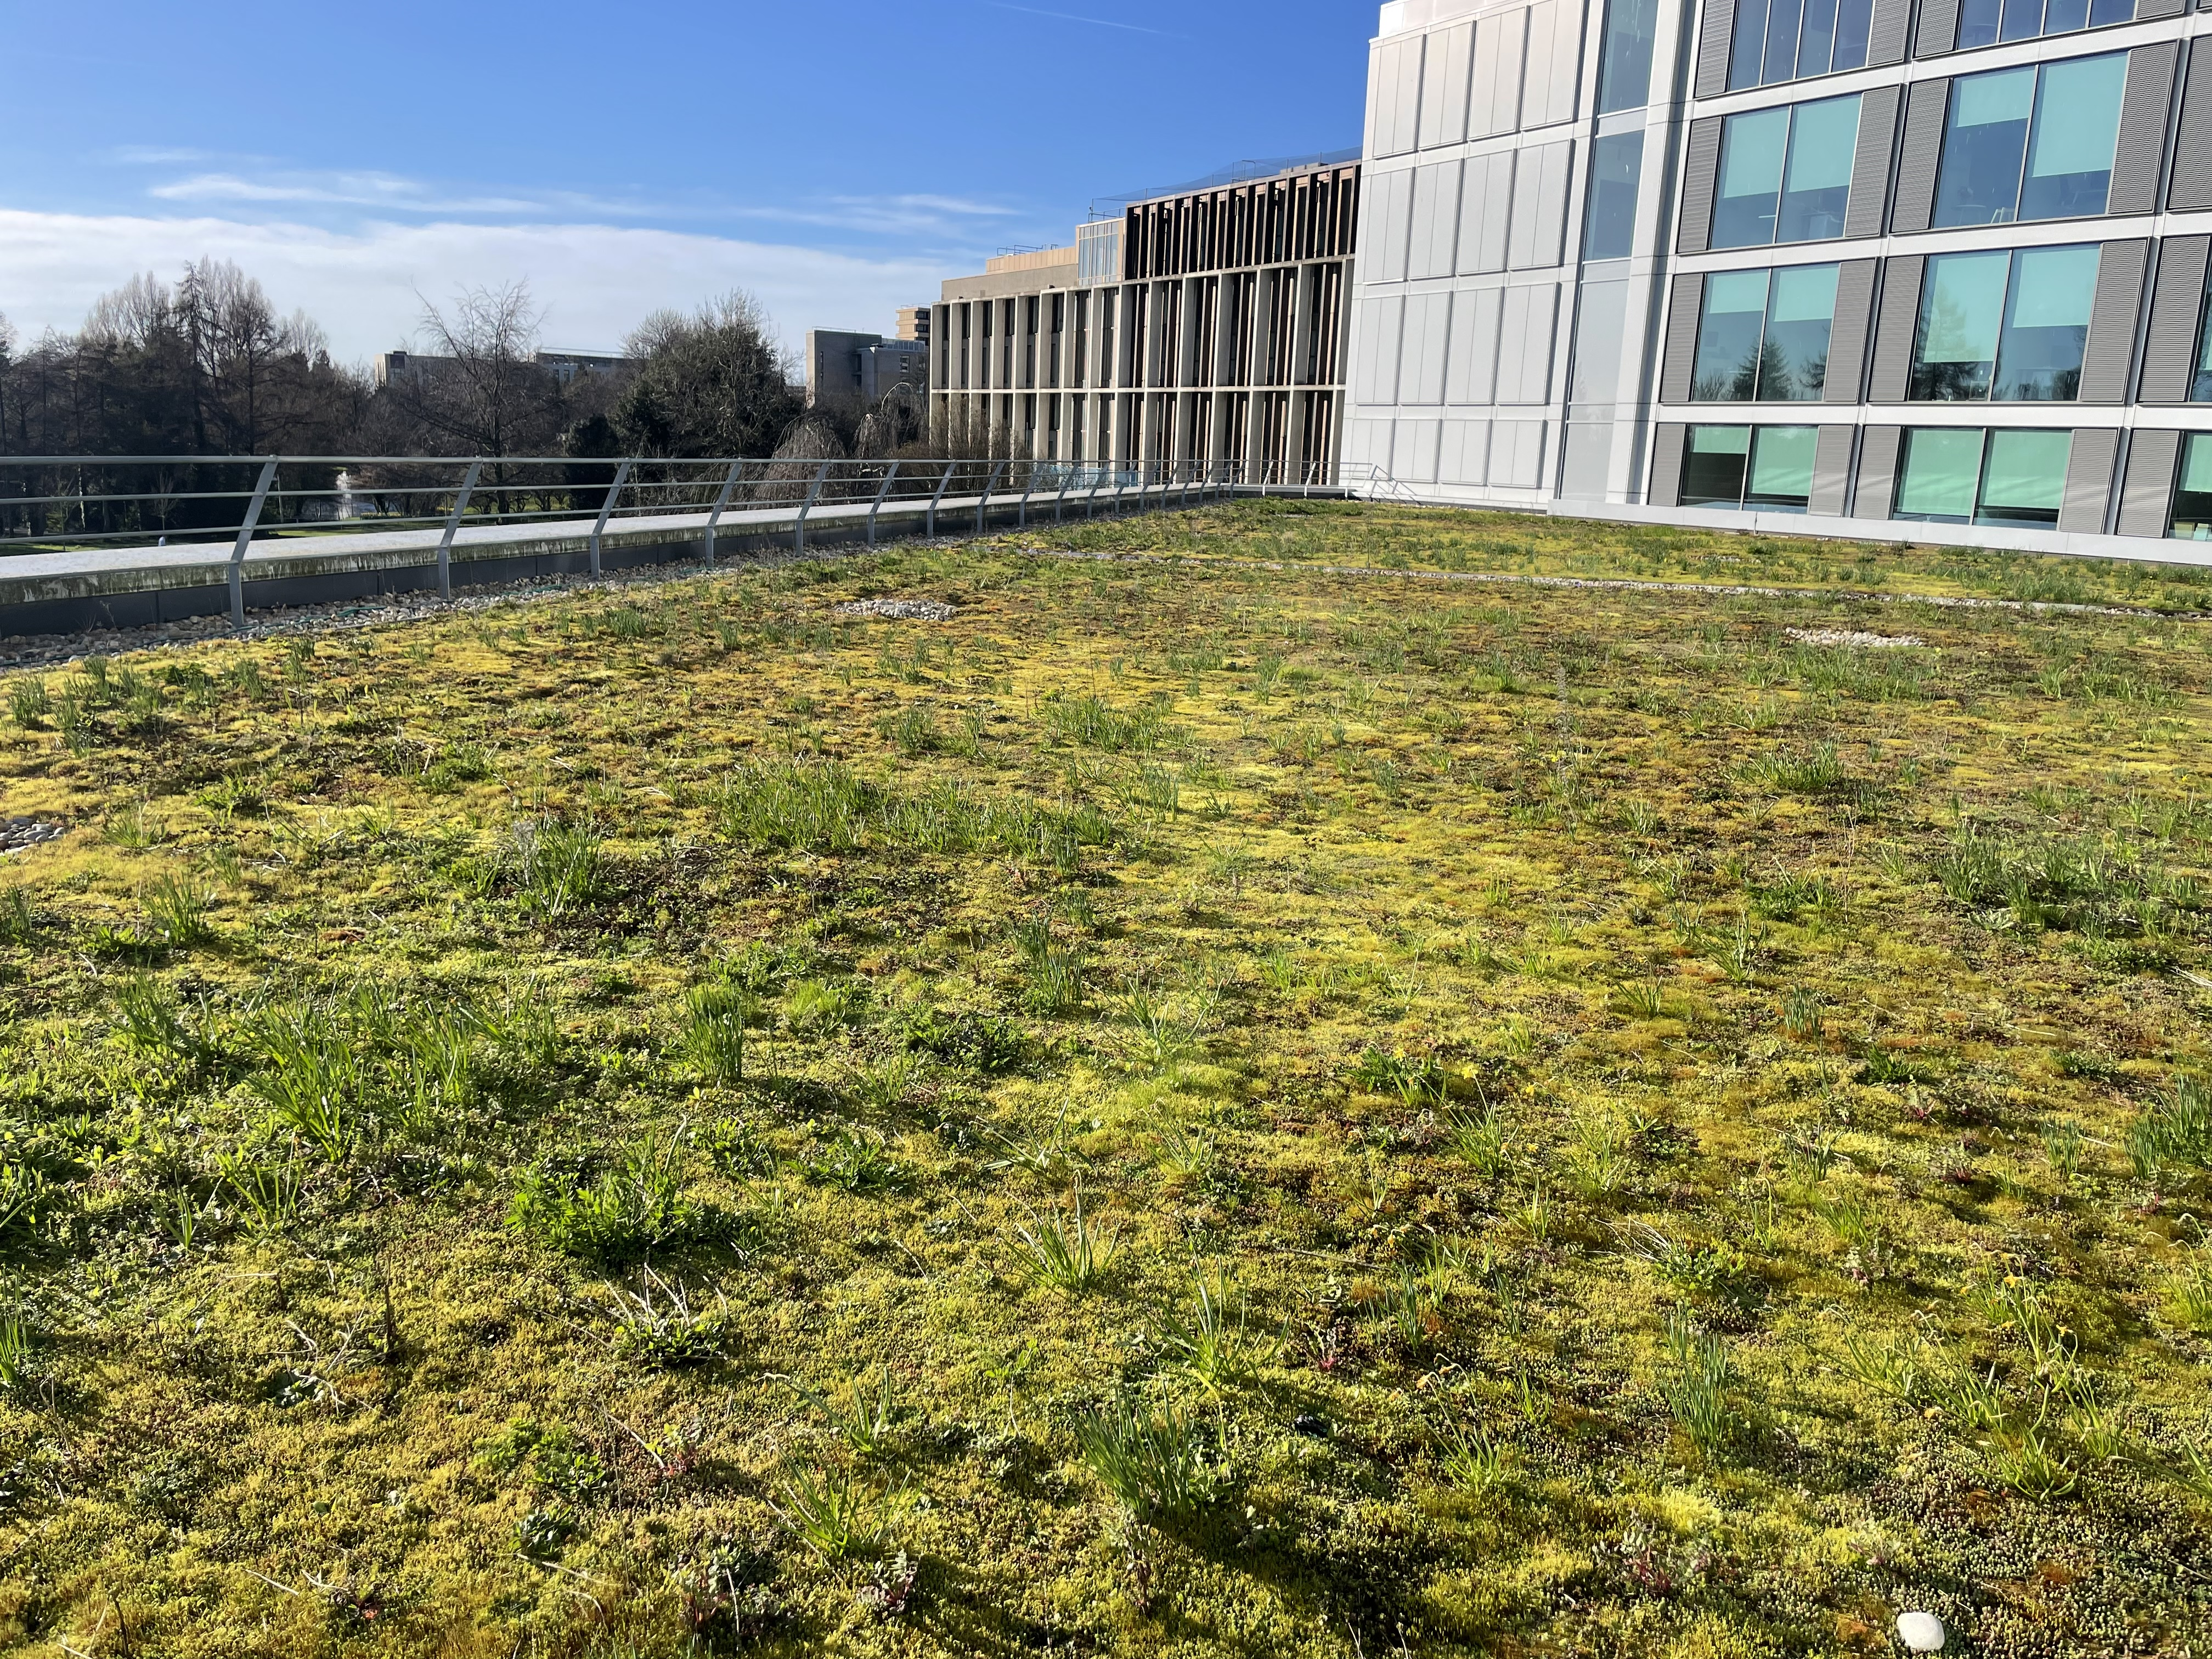
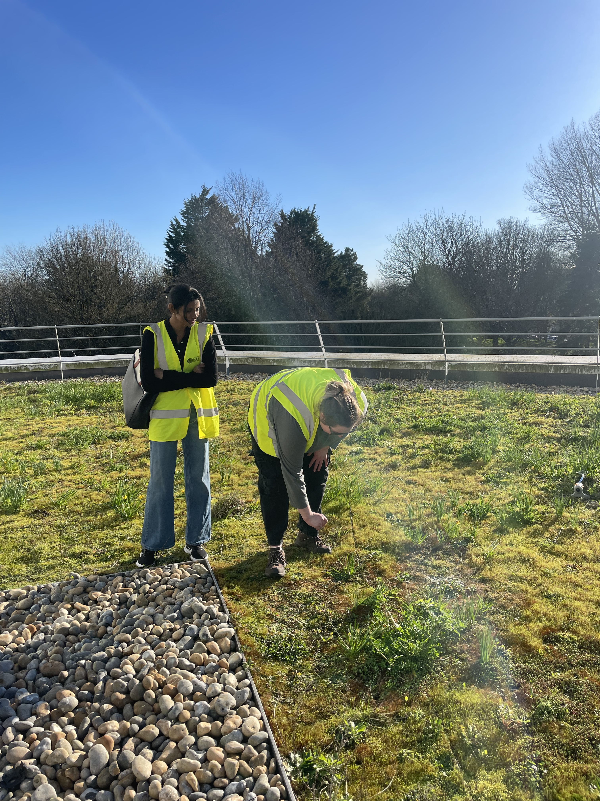
What is a 'Soakaway'?
An underground container that sequesters excess water for slow release into the soil, preventing waterlogging and flooding. They come in many forms and are often customisable and scalable, making them accessible to a wide customer base
Slow the Flow
A project focused on sustainable drainage solutions in and around Bath.
We have been looking into 2 main methods: Soakaways and Green roofing; and connecting with local charities and campus estates to understand and apply these approaches
This Year
During data collection the soakaway was empty (even after extended rainfall). We troubleshooted:
Ensured guttering was connected to funnel water on the roof of the shed into the soakaway
Last Year
Filled the soakaway directly with ~60L of water to verify water was collecting in the soakaway
Measured soakaway water level at 30 second intervals to assess the rate of flow into the soil.
The soakaway emptied within 5 minutes; we concluded the soakaway was functioning well.
We installed a plastic crate style soakaway in an allotment near the Royal Crescent.
This allows us to assess how effectively it fills with rainwater and drains into the surrounding soil.
Campus Estates and Green Roofing
Affiliations & Looking Forward
We have also been looking into green roofing. Campus estates very kindly took us to visit the one on the School of Management (10 East) and answer our (many) questions.
Transition Bath have been instrumental in establishing the allotment soakaway site. Next year, we want to collaborate further, including engaging with the public about these drainage systems
We are Avon is a group we connected with via Transition Bath. They have a network of 'River Guardians' who have strong connections to the local riverscape. Next year, we would like to continue our relationship; helping to identify and solve local issues by providing scientific consultancy.
We would like to install a soakaway serving a larger roof area, ideally here on campus. This should provide a more realistic representation of a residential-use soakaway.

