Slide 1





Moodle Basics
Get started with Moodle and learn the essentials
Webinar facilitators:
This webinar will be recorded.
Olivia Soutter, Instructional Designer
tel@bath.ac.uk
Eliana Cortes Paez, Instructional Designer
teachinghub.bath.ac.uk

Slide 2

Session Overview
Logging in and getting started
Navigating around a Moodle space
Course Settings including visibility
Adding and editing Activities

Slide 3

Intro to Moodle
What is Moodle?
It’s a VLE (virtual learning environment). An online space to:
Share learning resources
Guide your students through learning activities
Communicate with your students
Work collaboratively
Host assessment and feedback

Slide 4
Bath Blend Baseline for Moodle
Bath Blend Baseline for Moodle
Consistency
Accessibility
Scaffolding
Engagement
Unit templates (weekly or topic format)

Slide 5
Demo 1 – Logging in and getting started
Login to Moodle
My courses (or scroll down)
Dashboard
Edit Profile
Preferences>Forum Preferences

Slide 6
Demo 2 – Navigating around a Moodle Space
Course index and block drawer
Edit mode
Tabs
Viewing participants and groups/groupings
Topics & subtopics
Note: there is a separate TEL Bytes webinar on Groups & Groupings which we’d recommend watching/attending if you have any group assignments or group work in your unit.

Slide 7
Demo 3 – Course Settings
Adding/editing a course description & course image
Course visibility
Activity completion

Slide 8
Demo 4 – Adding/editing activities
How to add an activity
Key activity types
How to edit an existing activity (and change template text)
How to add an assignment

Slide 9
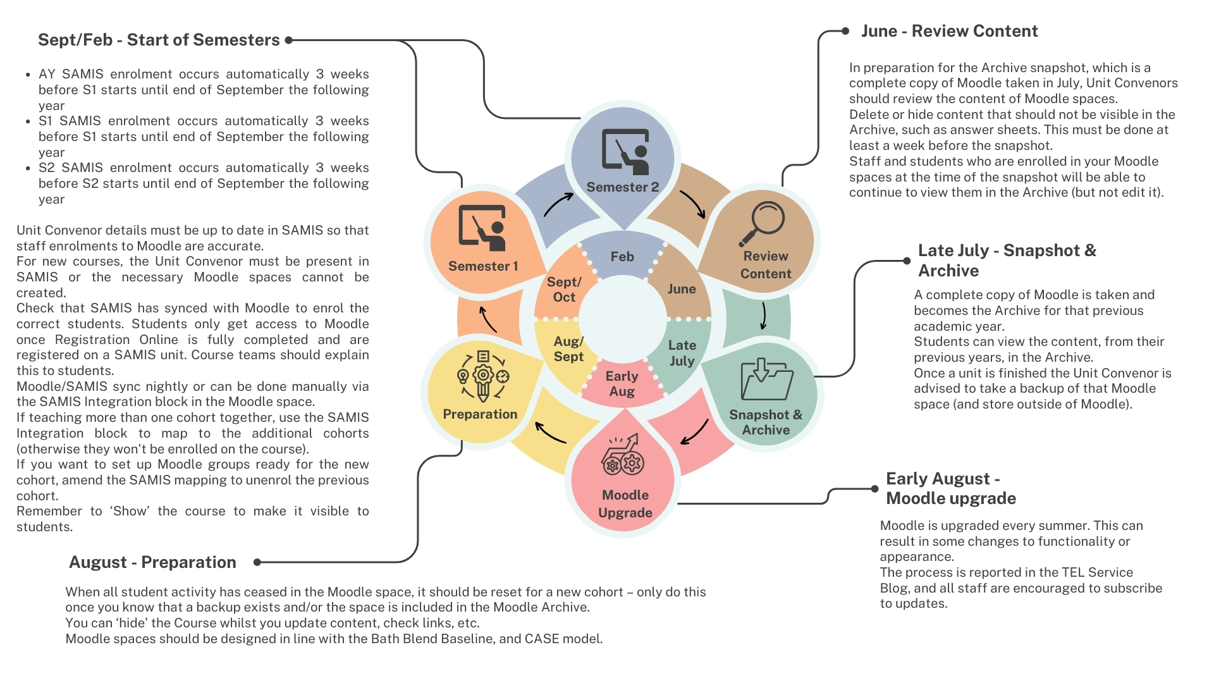
Moodle Administration Cycle

Slide 10

Useful resources
CLT self-paced resources (guided learning resources)
TEL Community of Practice (to share practice and tips)
Learning & Teaching Hub http://teachinghub.bath.ac.uk/
Book a 1-2-1 with an Instructional Designer: Book a one to one
Email queries to TEL@bath.ac.uk

Slide 11
Useful Resources - Webinars
Upcoming events:
Introduction to digital accessibility - 3.2.26 (training run by Brickfield)
Past events:
Recordings to past CLT workshops and events

Slide 12

Keeping up-to-date
TEL Service Blog (service updates and top tips)
https://telbath.com/

Slide 13

Q&A
Time for questions!

Slide 14
Feedback
Please take 2 minutes to complete our short feedback form to help inform future webinar planning and delivery ☺

