Slide 1

Releasing grades and feedback with marking workflow, and grade transfer
Nigel Goldsmith - Instructional Designer
& Paul Pinkney - Learning Technologist
tel@bath.ac.uk

Slide 2
Contents;
What is marking workflow?
Setting up and using a marking workflow
Revealing student identities
Releasing grades
Grade transfer process - overview
Grade transfer video – link shared in chat
Questions.

Slide 3
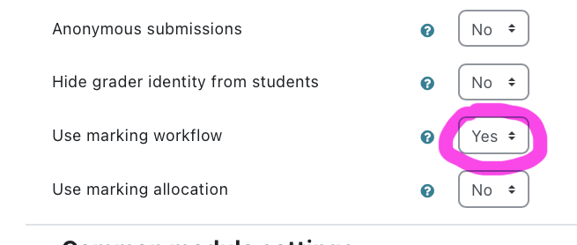
Marking Workflow
What is marking workflow?
Prevents students from seeing their grades and feedback for an assignment until the grader is ready and has performed additional steps.
Marking workflow allows you to track the progress of your marking.
Allows the marker to place student submissions into different stages of a workflow. This is particularly useful for managing process, for example, extensions.
Useful for keeping track of marking and can help with managing moderation as all markers can see the workflow state for each student.
.

Slide 4
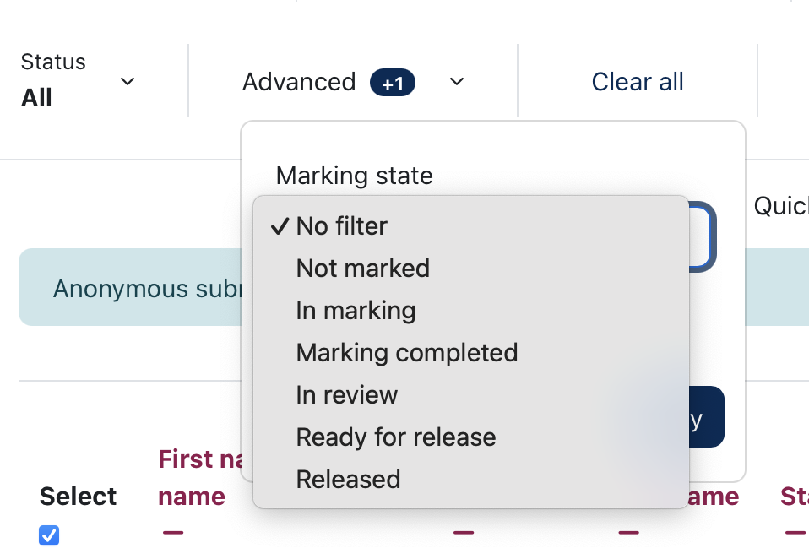
Marking Workflow
Marking workflow has 6 different states:
Not marked
In marking
Marking completed
In review
Ready for release
Released
Both students and markers can see the state of marking as the state is changed, however, students cannot see their grade or feedback until marking workflow is set to 'Released'.
.

Slide 5
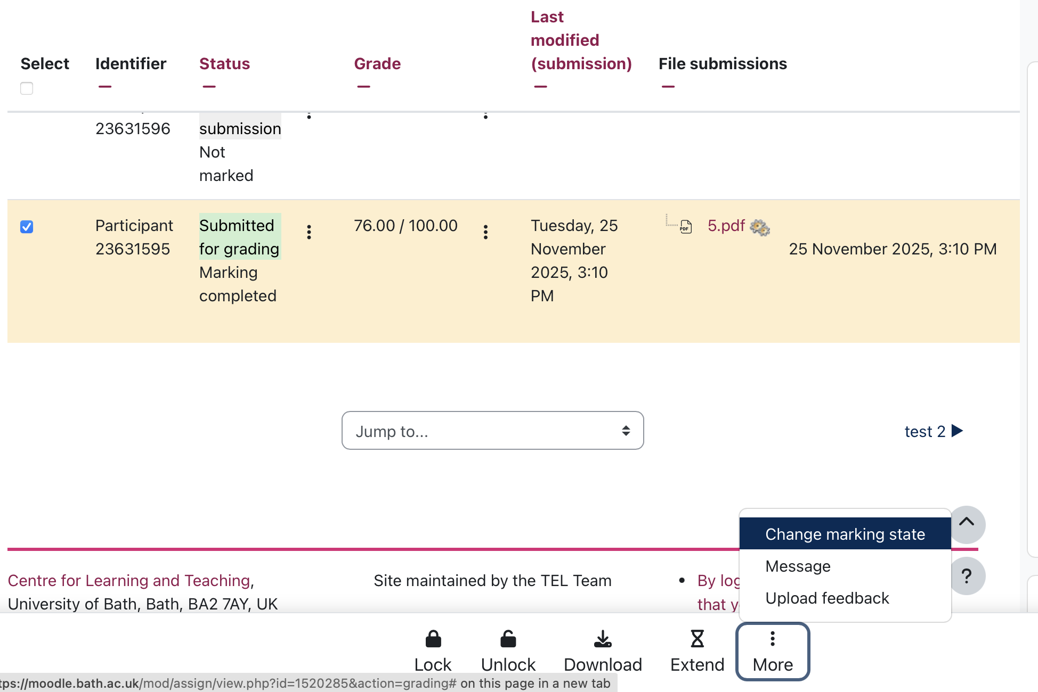
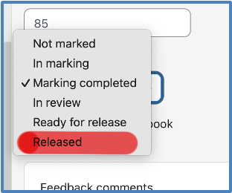
Releasing Grades
Grades can be released to students individually from the marking workflow pull-down menu or, for a number of students via the ‘change marking state’ option from the More button at the bottom of the Submissions pane.

Slide 6
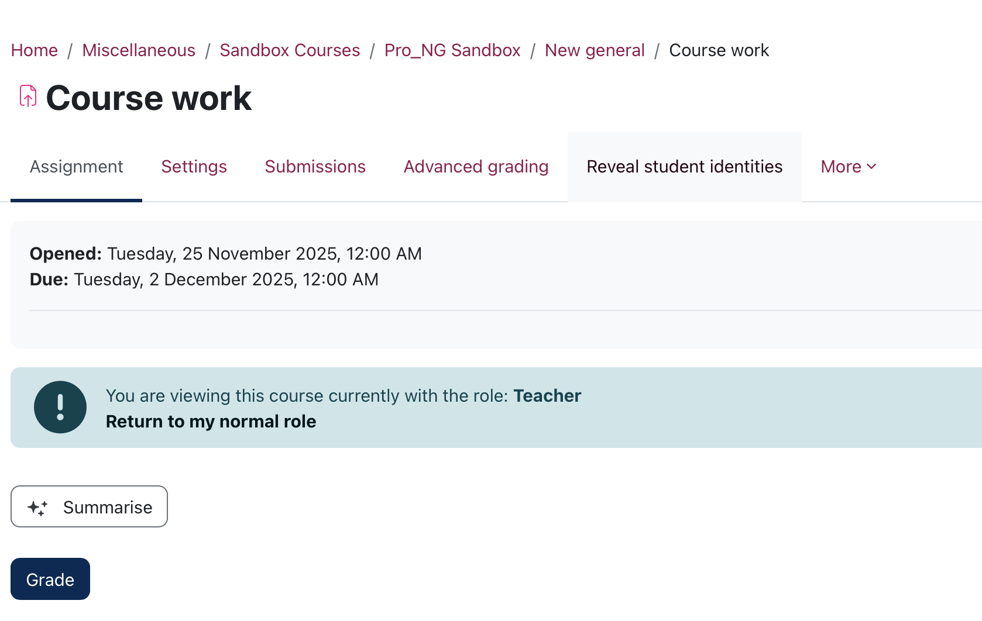
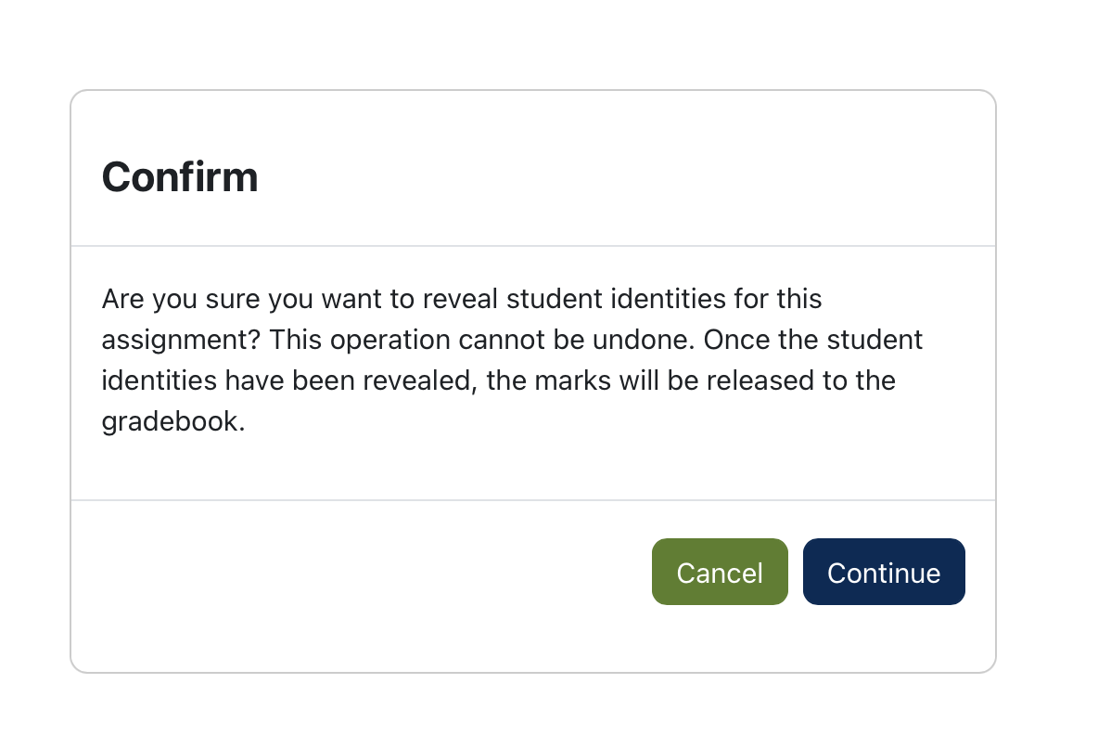
Revealing student identities
Prior to the last Moodle upgrade the marker had to lift anonymity before marks and feedback could be released to students.
Since the upgrade a marker can now release marks without revealing the student identities.
The ability to release grades without revealing student identities is particularly useful in controlling when grades and feedback are released to students in a cohort when some may have extensions.
When ready you can reveal student identities from the tab at the top

Slide 7

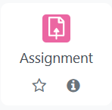
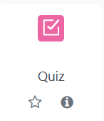
What is the Grade Transfer tool?
Grade Transfer is a Moodle tool that is available to most Moodle staff roles (Teacher +, Teacher, Administrator etc) but only the Teacher + can transfer grades.
The tool simplifies the transfer of grades from a Moodle Assignment or Quiz Activity to SAMIS.
Reduces the administrative overhead of manually moving data.
GRADES
SAMIS

Slide 8

Who can use Grade Transfer ?
Only the UC can transfer grades though other staff roles can set it up and check its status.
The key responsibilities that the UC is expected to undertake before instigating grade transfer are:
Check that the correct Moodle activity has been associated with the correct SAMIS assessment item
Ensure assessment marks are correct
https://teachinghub.bath.ac.uk/guide/grade-transfer-moodle-samis/
Once data has been transferred to SAMIS it cannot be overwritten by Moodle

Slide 9
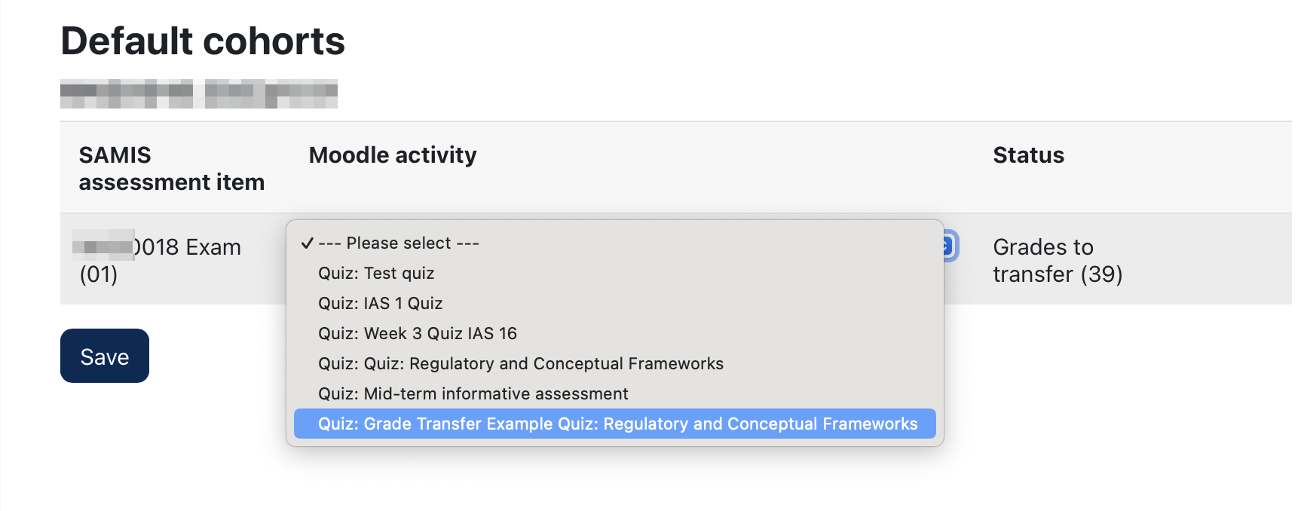

Grade transfer checklist
Make sure that there is a one-to-one relationship between the number of Moodle Assignments/quizzes created and the number of assessment items in SAMIS.
Ensure that each Moodle Assignment/Quiz has been linked to its corresponding assessment item in SAMIS.

Slide 10
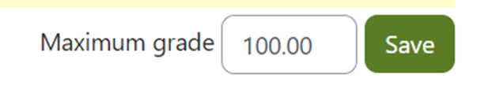
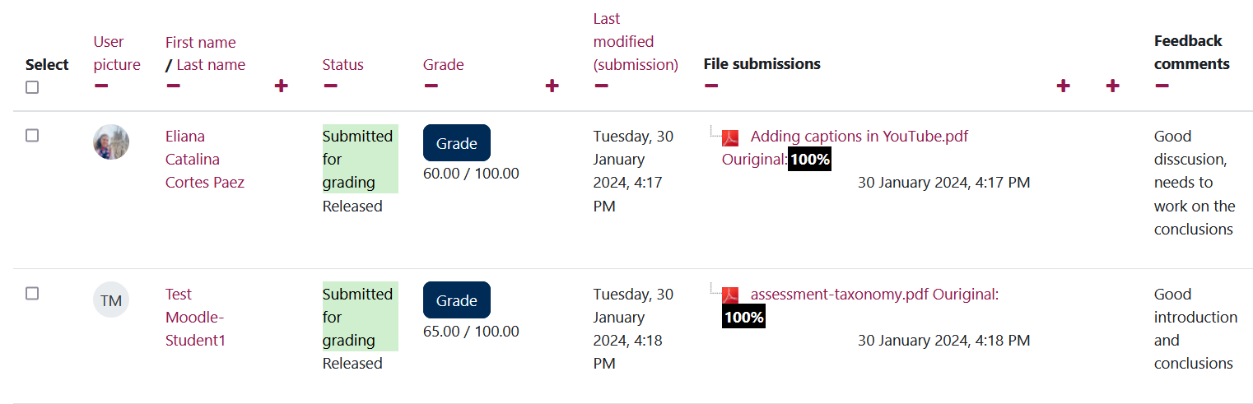
Grade transfer checklist
Ensure that the Moodle Assignment/Quiz maximum grade is set to 100.
Mark as normal.
For assignments you will need to lift anonymity and release grades and feedback to the students before grade transfer.
maximum grade in a Moodle Quiz

Slide 11
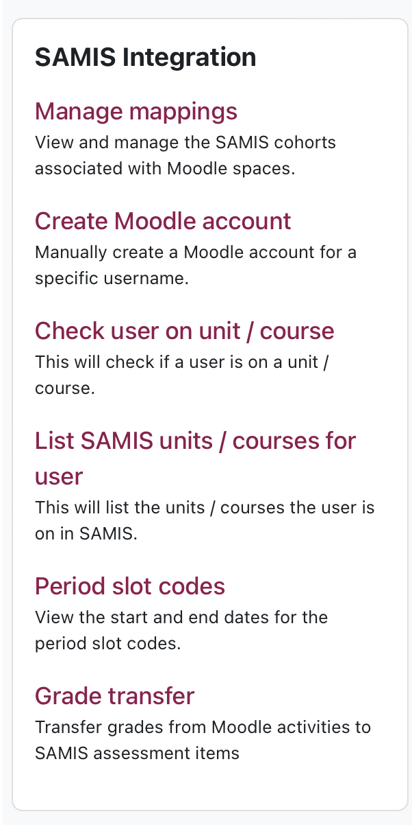
Grade Transfer in 4-steps
Step 1: Go to Grade Transfer in SAMIS Integration block in the block drawer (only visible to staff)

Slide 12
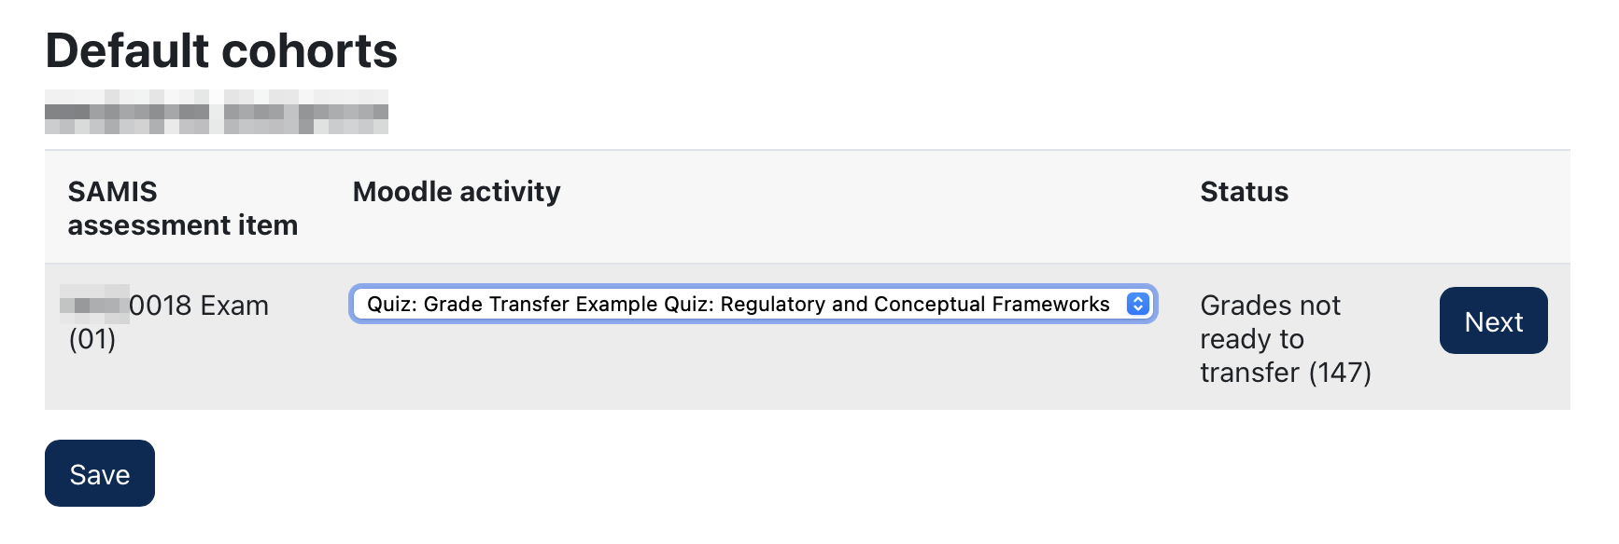

Grade Transfer in 4-steps
Step 2: Select the marked Moodle activity…
UPDATE

Slide 13
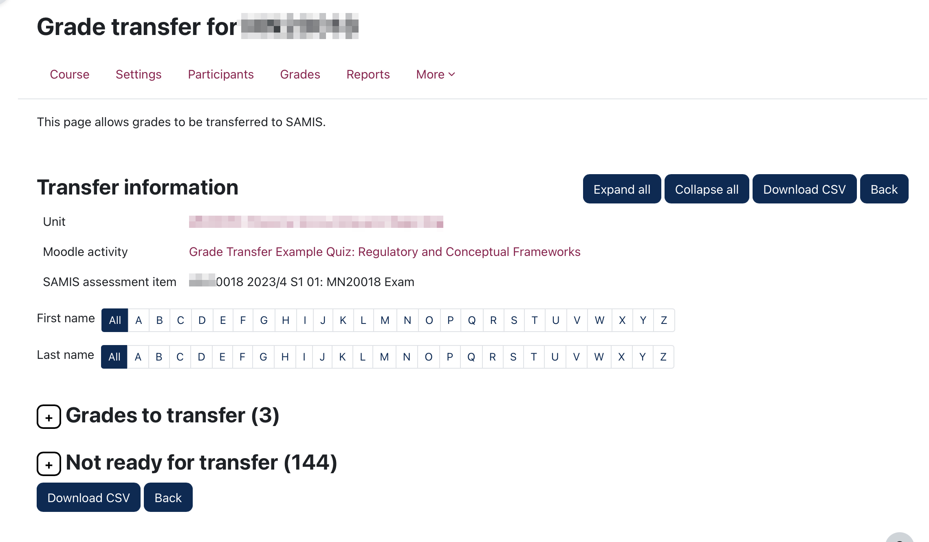
Grade Transfer in 4-steps
(still!) Step 2: Locate the grades you wish to transfer

Slide 14
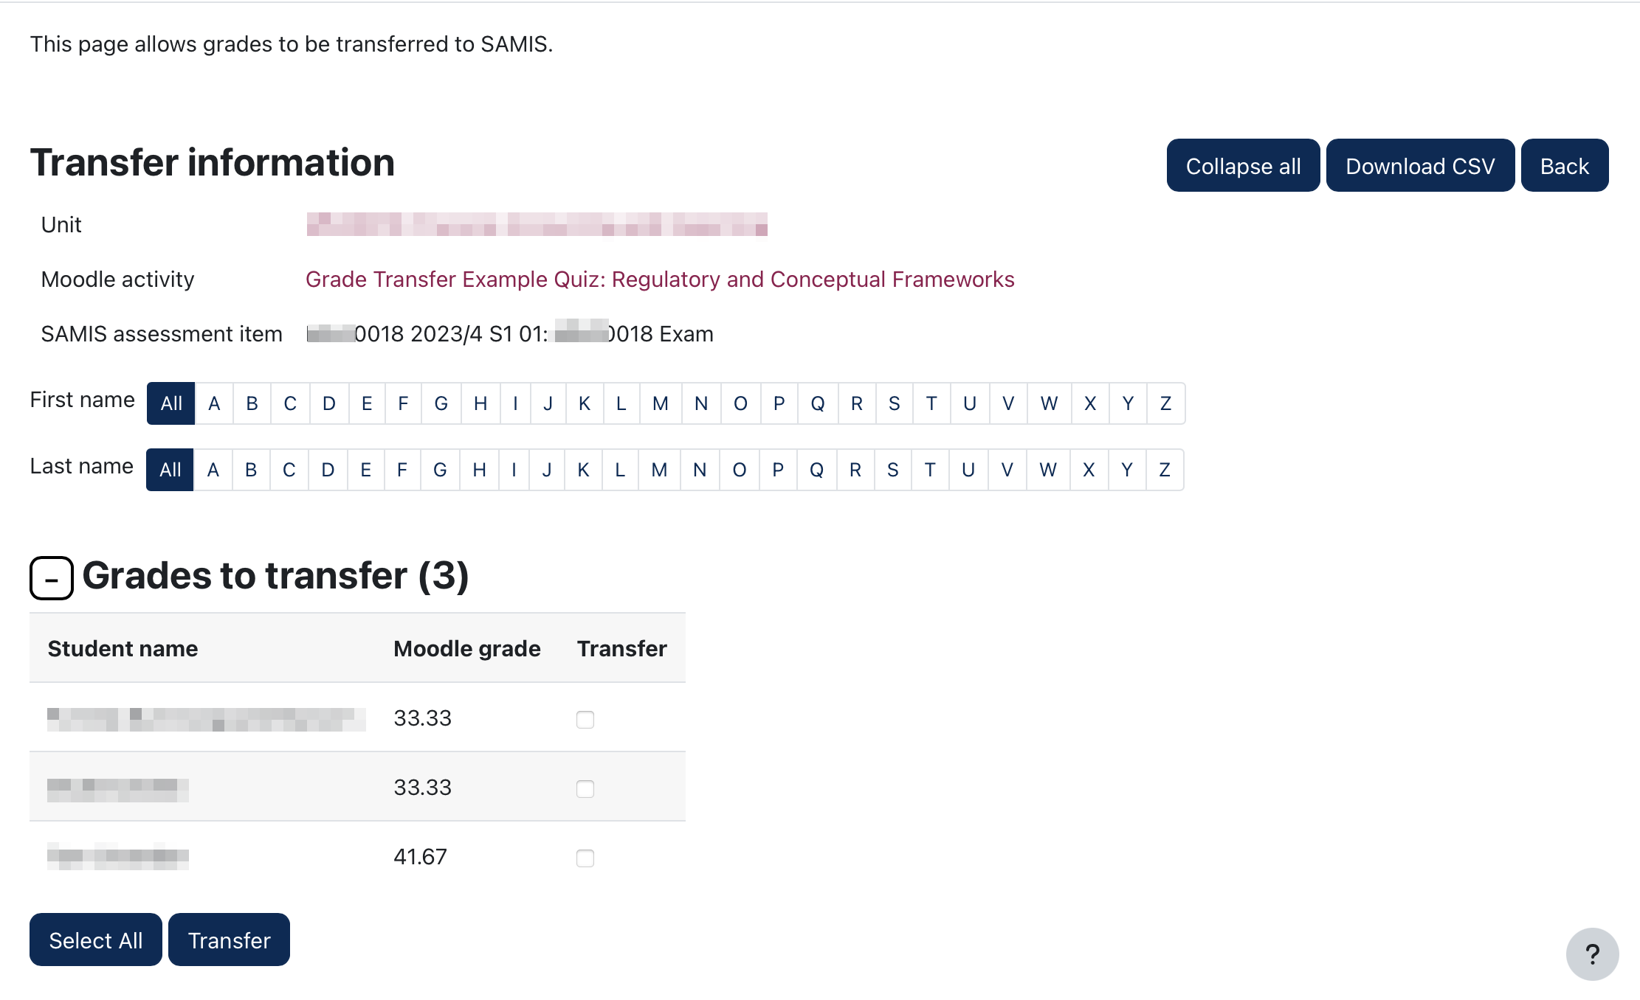

Grade Transfer in 4-steps
Select the grades you wish to transfer to SAMIS
You cannot undo or overwrite a transfer so do not do this step until you are completely happy with the grades being transferred.

Slide 15
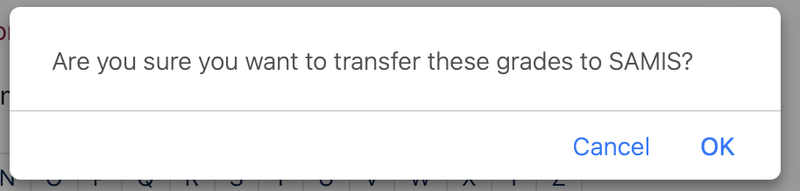
Grade Transfer in 4-steps
Step 3: Transfer grades to SAMIS
OPTIONS:
Transfer all grades at once by pressing the Select all button followed by Transfer button.
Transfer a single grade by clicking in the check box next to a student’s name and click Transfer
Transfer multiple records by selecting them via the check boxes next to the student’s name and then click Transfer
You will then be asked to confirm that you want to transfer grades.

Slide 16
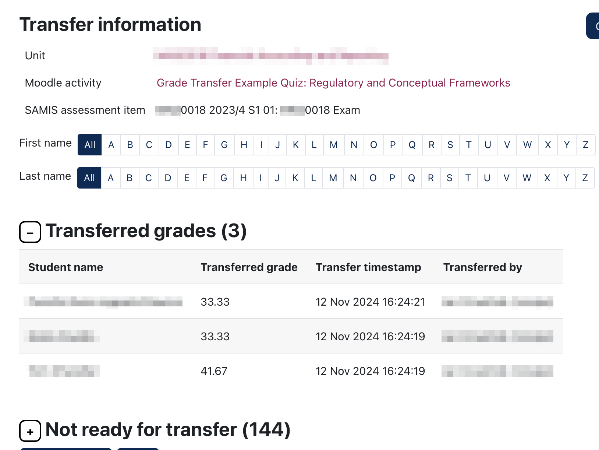
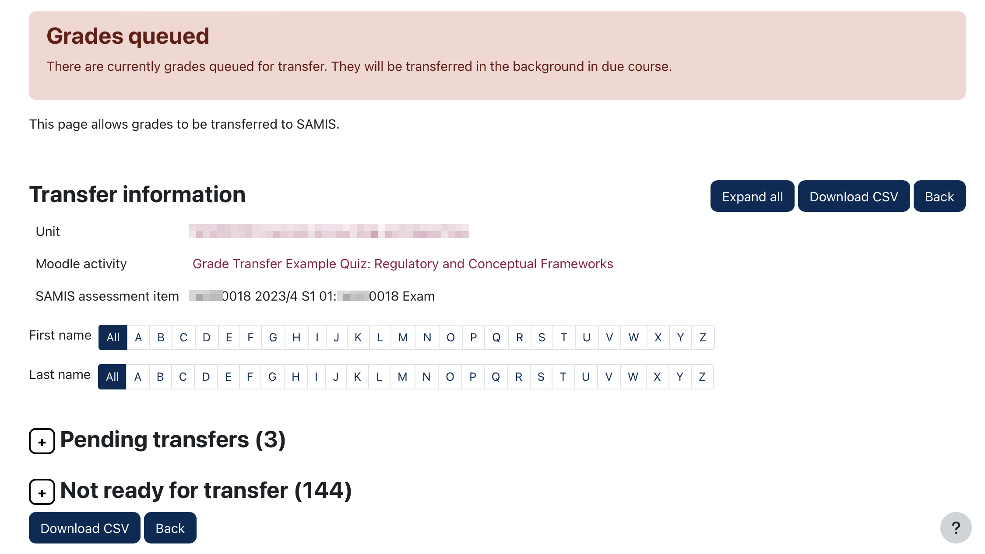
Grade Transfer in 4-steps
Step 4: Check progress of transfer
Review the summary to check that the selected grades have been added to the queue.
As soon as one or more grades have been transferred to SAMIS, this setting will become ‘locked’ – preventing it from being changed

Slide 17
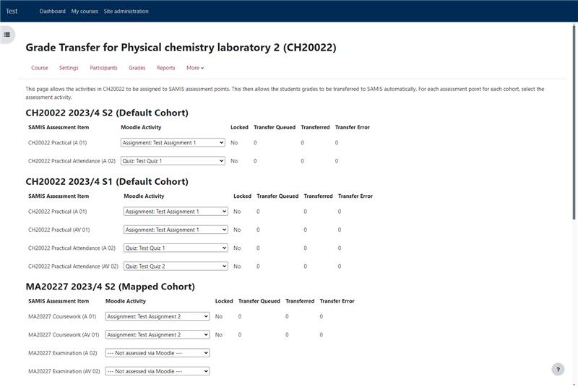
Managing grade transfer across a number of Moodle spaces
Setting up grade transfer for each assessment

Slide 18
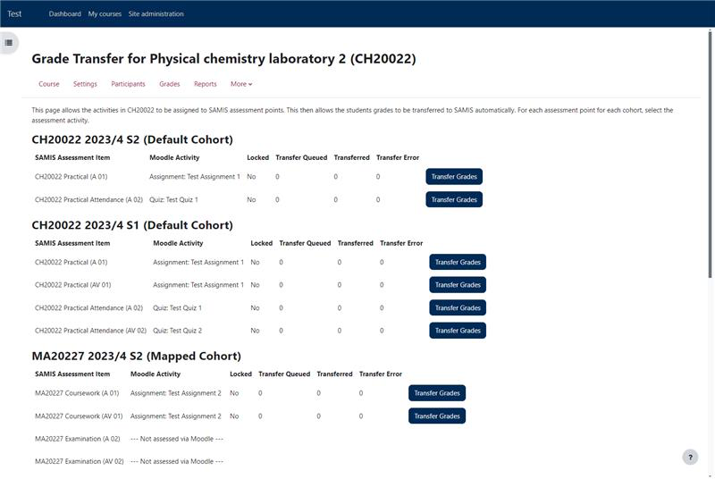
Transferring grades across a number of Moodle spaces
Managing grade transfer for a number of Moodle spaces

Slide 19


Slide 20
Grade Transfer
Grade Transfer pros and cons
Pros
There is a reduced risk of human error when transferring grades from Moodle to SAMIS.
Less time spent moving grades from Moodle to SAMIS.
Cons
Once grades have been transferred to SAMIS, they can’t be overwritten by Moodle and so if errors do arise, grades need to be manually changed in SAMIS.

Slide 21
Additional support
Screenshots and guidance from https://teachinghub.bath.ac.uk/guide/grade-transfer-what-is-it/
Screen recording of live grade transfer https://uniofbath.cloud.panopto.eu/Panopto/Pages/Viewer.aspx?id=8878dcb3-202d-4bc1-befc-b2db00f94e8e

Slide 22
tel@bath.ac.uk

