Slide 1





Using Marking Guides in Moodle
Workshop facilitators:
Please visit Learning & Teaching Hub Past Events for a recording.
Paul Pinkney
tel@bath.ac.uk
Nigel Goldsmith
teachinghub.bath.ac.uk

Slide 2



Session Outline
Intro (2mins)
Quick Overview of Assignment and Marking Guide marking method (10 mins)
Demo of Marking Guide Set up (5 mins)
Practice Task: Marking with a Marking Guide (8 mins)
Quick overview of Ranged Rubric (3 mins)
Questions and wrap up (10 mins)
For any questions, post to the Teams chat
Keep an eye on the Chat and Like to vote for your top questions
We will take as many questions as we can towards the end

Slide 3

Comparing approaches
Assessment Type:
COURSEWORK
Formative & Summative
Online marking – PDF Annotation
Marking Guide
Assignment
Rubrics
See our Moodle Assignment Guidance
Notes:
Moodle assignment is the key tool for the receipt of coursework submissions. The Assignment can accommodate a range of submission formats including:
File uploads (e.g. Essays, Reports, Dissertations or Project files
The Assignment can also be used in conjunction with other University supported tools to receive other kinds of submissions:
Video-based submissions using Panopto – so the submission goes into Panopto, but you can use the Assignment for marks/feedback
E-portfolio submissions via integration with the Mahara eportfolio tool
An Assignment can also be used to record marks and feedback for assessments that take place offline (such as a face to face presentation)
The Assignment works for individual and group submissions, so it can streamline providing group feedback.
So essentially any Assignment that you would usually just go ahead and grade with the standard 100 point scale, could instead be set up to be graded with a Marking Guide or Rubric
--------
Marking Guide and Rubrics – marking methods have some great advantages.
One key advantage is that they are very useful for grading large cohorts, because of the consistency that they provide, and I think they’re really useful for focusing your mind as a marker on the specific skills that you’re trying to assess with a particular assessment.
However, bear in mind, they do require some additional planning and set up time, in that you need to think carefully about getting your marking criteria right.
We don’t have time to cover the whole process today, but please see slides at the end of the presentation for more information and links.

Slide 4

Pros and cons – marking guide
Top tips
Refer to Faculty/School guidance on developing assessment criteria
Consider teaching team work to ‘calibrate’ marking
Share marking guide with students in advance
Comment bank defined is within marking guide set up
Marking guides can be configured as ‘templates’ to share within Department
Pros and cons
Provides quick, structured marking, with detailed criteria
Retain individual feedback comments
Flexibility for mark allocation
Predefined comments available to colleagues
Set-up work involved to define marking guide carefully
Notes:
Some pros and cons to be aware of:
From a markers point of view predefined criterion can really speed up the marking process, and if the criterion and frequently used comments are well constructed, you gain the speed without compromising the quality of feedback.
Secondly, although you have predefined criterion, you retain the ability to add personalised comments
Thirdly, because the number of marks per criterion is flexible, you can be flexible in how you award marks overall.
Fourth any predefined feedback comments can be used by all markers using the marking guide, giving consistency.
Things to be aware of:
Time and effort involved to define the marking guide and build the comments bank
Ideally, done collaboratively with colleagues
Some tips
Do refer to you Faculty/School guidance on developing assessment criteria.
Work with colleagues to create it so that you are on the same page.
Share in advance with student
Note that the frequent comments aren’t added as you are adding your feedback. You actually create those, when you create the marking guide itself.
Marking Guides can be shared across teams in Moodle

Slide 5
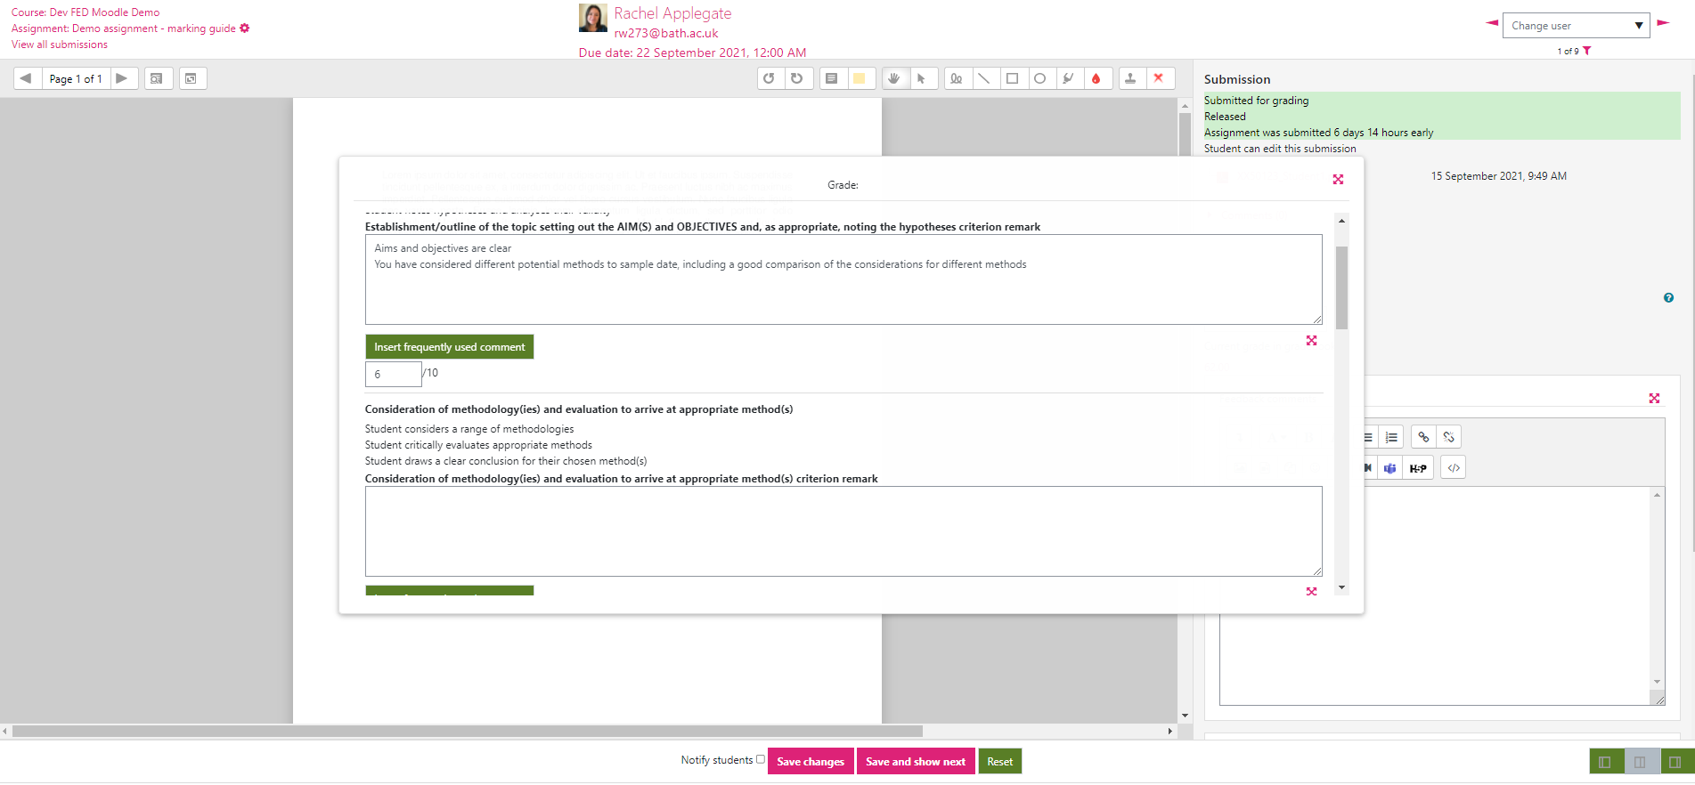
Quick view – marking guide
Predefined criteria, and marks per criterion - overall Grade is calculated.
A structured form for entering feedback comments against criteria.
Build a frequently used comment bank within your Marking Guide
Notes:
I appreciate this image is quite small but in a little while you can have a go with the marking guide yourselves in Moodle, where you’ll get a better view.
This slide shows the markers view of using it give feedback and marks. And as you can see the familiar Moodle grading window is in the background. And the Marking Guide, sits in the right hand column, underneath where you would usually input your mark. But you can pop the window out and it sits over the student submission.
It looks like a structured form, because you have your criteria, but then you can also add your feedback comments alongside those, so you can give more personalised feedback where needed.
In the example here you can see the first predefined criteria, which is in bold. And then some marking comments have been added, which are feedback on the student’s performance against that pre-defined criteria.
Now you can just type these in, as you might want to for personalised feedback. But what you can also do, is you can create a bank of frequently used comments. So when you come to do your marking, you can choose the relevant ones that you want. The comment bank is shared with any colleagues who are using the marking guide, so great for a team-based approach and for consistency.
In terms of the marks, you would set a limit for each criterions, so perhaps you make 15 marks available for a particular criteria, but you can award any number that you want up to that limit. So that helps to maintain flexibility in terms of how you apportion marks.

Slide 6
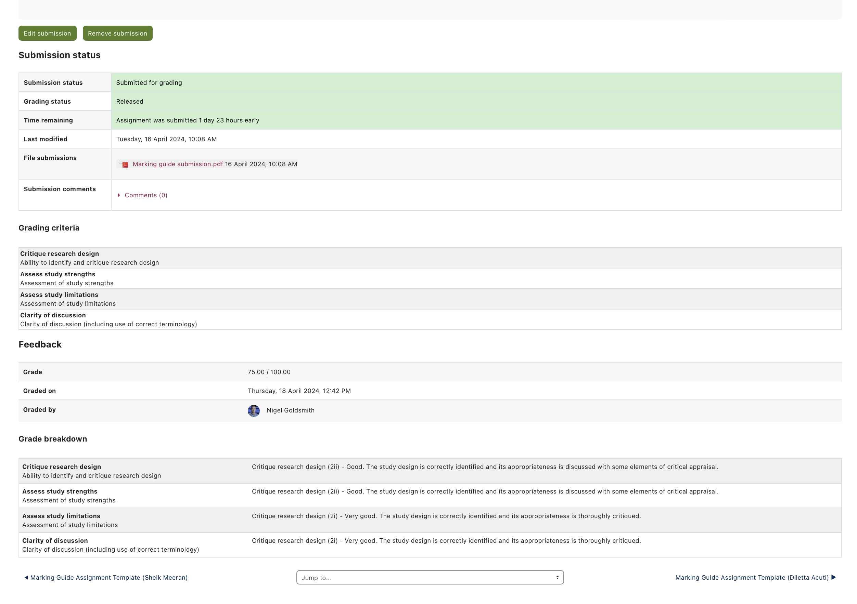
Student feedback view
Notes:
This image shows the view that students will have of their feedback if it delivered via a Marking Guide in the Assignment tool.

Slide 7
Demo – Define Marking Guide
How to set up a Marking Guide from scratch
How to set up a Marking Guide using a pre-existing version

Slide 8
Practice Task
Practice Assignment: https://moodle.bath.ac.uk/mod/assign/view.php?id=1516746
Notes:
Click into it and choose Grade to start marking your submissions.

Slide 9
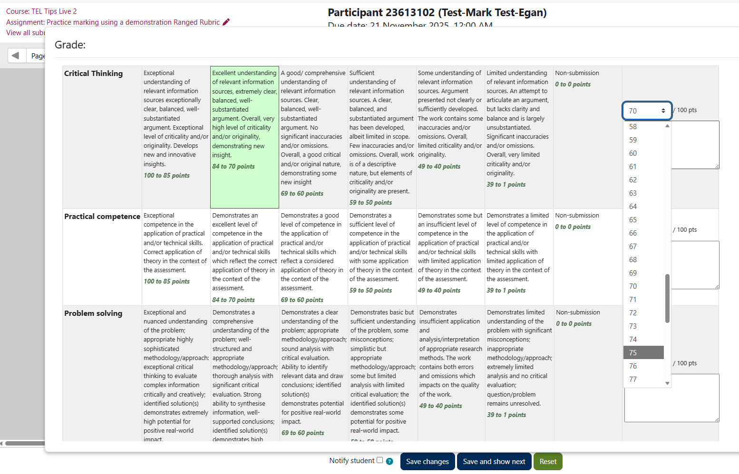
Quick view – ranged rubric
Select the level of performance for each criteria
Lowest mark in the Range is selected
Option to ‘calibrate’ the mark within the range
Option to enter a feedback comment per criteria, or an overall feedback comment
Predefined
criteria and levels of performance with range of marks per level
Notes:
This is what marking with a Ranged Rubric in Moodle looks like.
We’ve got:
Predefined criteria
Levels for each criteria, which correspond to a range
When you come to mark, you simply choose a level for each criteria. You can then select the score to ‘calibrate’ the mark within the range
You also have a space to enter a comment against each criteria (if you want to) or a summary feedback comment.

Slide 10
Pros and cons – ranged rubric
Pros and cons
Quick criteria-based marking
Helps students understand levels of performance
Can 'calibrate' marks within a range
Can add personalised comments
Set-up work involved to define rubric carefully
Scores and descriptors
Scores are pre-defined within a range
Formatting
Top tips
Refer to Faculty or School guidance on developing assessment criteria (e.g. generic or specific assessment criteria)
Rubrics can be configured as ‘templates’ to share within Department
Consider teaching team work to ‘calibrate’ marking
Share rubric with students in advance to help them understand criteria
Use in combination with personalised Feedback Comments
New Feature
Notes:
Pros:
From a marker's point of view, rubrics are a quick way to give feedback.
Because criteria can be clearly defined, they can help students understand their performance
Allow for personalised comments – so you're not losing personalised feedback just because you’re adding pre-defined criteria. So if you need to clarify something for an individual student, you can.
It’s important to make sure the feedback is specific and actionable, and using the personalised feedback comments can help to do that
Cons:
Set-up work needed to ensure rubric is carefully defined.
Scores, criteria and your level descriptors, need thinking about and referencing against University/Dept practice.
Formatting/display can be an issue – short, concise criteria and level descriptors are advisable. Limit the number of them.

Slide 11
How to find out more
Rubrics and Ranged Rubrics
Marking Guide
Case Study: Using a Rubric for Open-ended Assessment
Moodle Docs: Advanced grading methods (rubrics and marking guides)
Notes:
Advanced Grading in Moodle – this is some TEL team guidance on Rubrics and Marking guides
We’ve also included a Case Study from the University on using a rubric for open-ended assessment
And you can also see the Moodle Docs guidance, for both tools.

Slide 12

Questions
We will pick up on any unanswered questions via Teams chat
Or raise your hand if you would like to ask a question on the mic

Slide 13
Feedback
Thank you for attending today’s session.
Please take a few minutes to fill in our Feedback form
TEL-Bytes webinars: November 2025 - February 2026
Your responses are anonymous.
We will use the feedback to assist in the planning of future webinars and may use comments for future promotional materials.

Slide 14
Closing slide

