Slide 1





Using Ranged Rubrics in Moodle
Workshop facilitators:
Please visit Learning & Teaching Hub Past Events for a recording.
Rachel Applegate
tel@bath.ac.uk
Nigel Goldsmith
teachinghub.bath.ac.uk

Slide 2



Session Outline
Intro (2 minutes)
Overview of Ranged Rubrics (7 mins)
Demo 1: Ranged Rubric Set up (5 mins)
Practice Task: Marking a Rubric (8 mins)
Demo 2: Student view (3 minutes)
Reporting (2 minutes)
Quick comparison with Marking Guides (3 mins)
Q&A (15 minutes)
For any questions, post to the Teams chat
Keep an eye on the Chat and Like to vote for your top questions
We will take as many questions as we can towards the end
Notes:
As you can see it's quite a tight schedule for this intro session, so I will move along quite quickly so that we can cover what we need to. We have 15 minutes at the end for questions and further discussion
If you have questions as we go along, please post them in the Chat, and we'll try to cover as many as we can during the session, or we will send further follow up resources afterward if needed.

Slide 3

Overview - comparing approaches
Assessment Type:
COURSEWORK
Formative & Summative
Online marking – PDF Annotation
Marking Guide
Assignment
Rubrics &
Ranged Rubrics
See our Moodle Assignment Guidance and Recommended Digital Assessment Workflows
Notes:
Moodle assignment is the key tool for the receipt of coursework submissions. The Assignment can accommodate a range of submission formats including:
File uploads (e.g. Essays, Reports, Dissertations, Project Outputs, Reflective Assessment)
Individual or group submissions
It can also be used in conjunction with other University supported tools to receive other kinds of submissions:
Video-based submissions using Panopto
E-portfolio submissions via integration with the Mahara eportfolio tool
This activity can also be used to record marks and feedback for assessments that take place offline (such as a presentation)
So any Assignment that you usually grade out of 100, could instead be set up to be graded with a Ranged Rubric, Rubric or a Marking Guide
--------
These advanced marking methods have some great advantages, but they do require additional planning and set up time. Today we will focus on Ranged Rubrics, the more flexible option for using rubrics. Note that you cannot convert an existing standard rubric into a ranged rubric, you would need to build a Ranged Rubric from scratch. Later in the week we have a session about marking guides.

Slide 4
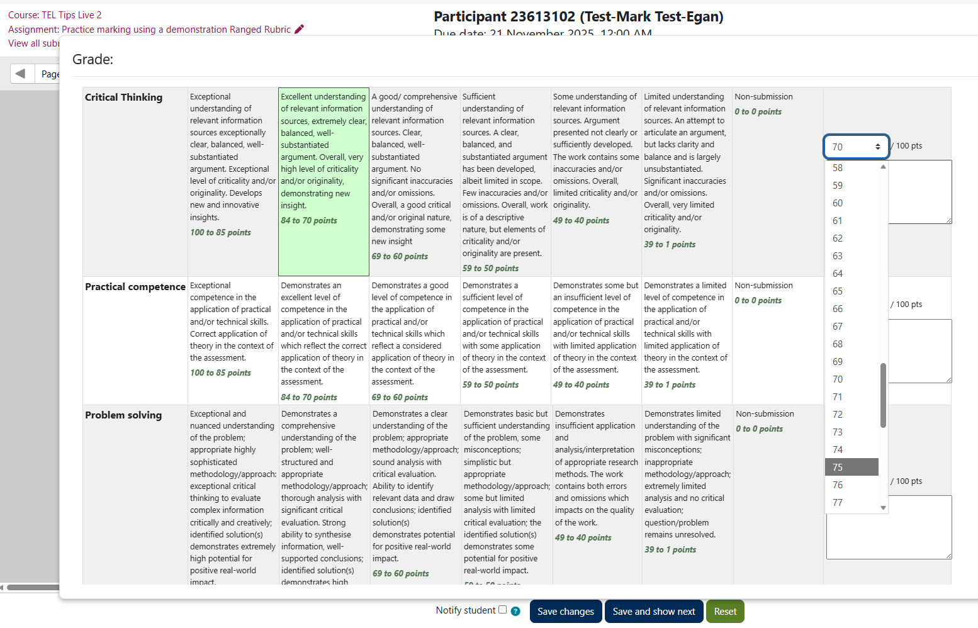
Quick view – ranged rubric
Select the level of performance for each criteria
Lowest mark in the Range is selected
Option to ‘calibrate’ the mark within the range
Option to enter a feedback comment per criteria, or an overall feedback comment
Predefined
criteria and levels of performance with range of marks per level
Notes:
This is what marking with a rubric in Moodle looks like.
We’ve got:
Predefined criteria
Levels for each criteria, which correspond to a range
When you come to mark, you simply choose a level for each criteria. You can then select the score to ‘calibrate’ the mark within the range
You also have a space to enter a comment against each criteria (if you want to) or a summary feedback comment.

Slide 5

Pros and cons – ranged rubric
Pros and cons
Quick criteria-based marking
Helps students understand levels of performance
Can 'calibrate' marks within a range
Can add personalised comments
Set-up work involved to define rubric carefully
Scores and descriptors
Scores are pre-defined within a range
Formatting
Top tips
Refer to Faculty or School guidance on developing assessment criteria (e.g. generic or specific assessment criteria)
Rubrics can be configured as ‘templates’ to share within Department
Consider teaching team work to ‘calibrate’ marking
Share rubric with students in advance to help them understand criteria
Use in combination with personalised Feedback Comments
New Feature
Notes:
Pros:
From a marker's point of view, rubrics are a quick way to give feedback.
Because criteria can be clearly defined, they can help students understand their performance
Allow for personalised comments – so you're not losing personalised feedback just because you’re adding pre-defined criteria. So if you need to clarify something for an individual student, you can.
It’s important to make sure the feedback is specific and actionable, and using the personalised feedback comments can help to do that
Cons:
Set-up work needed to ensure rubric is carefully defined.
Scores, criteria and your level descriptors, need thinking about for a couple of reasons.
Formatting can be an issue – short, concise criteria and level descriptors work best. Limit the number of them.

Slide 6
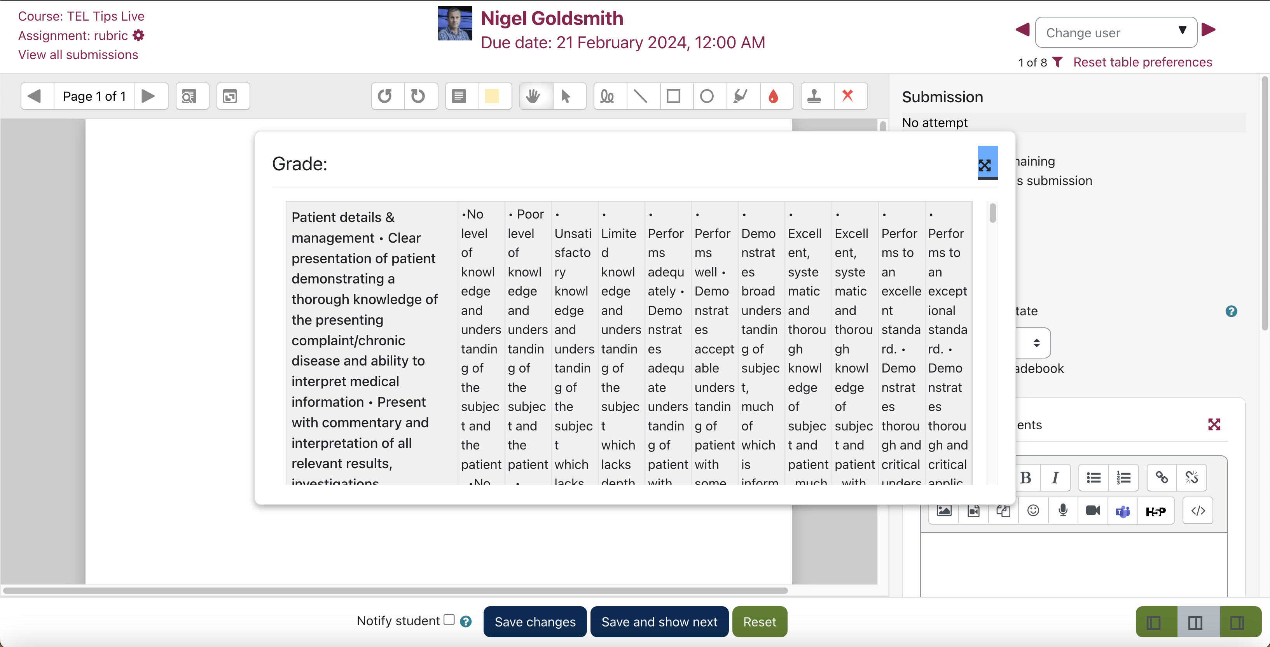
When Formatting goes bad!
Notes:
So as you can see, each criteria has lots of levels – the rubric window can’t be resized.
Also the criteria here, are not clearly entered, so they’ve have all run together.
So our advice is to use short, concise statements, with limited levels because that works best.
What you can of course do as well, when you want to share the rubric with students, is to give them a separate PDF file copy of it.
On the same theme, when you’re marking, if you pop the rubric out of its side bar, it does sit over the students submission. So if you’re marking in Moodle, have a printed copy of your rubric on your desk that you can refer to, and that makes life easier.

Slide 7

Demo 1 – Define a ranged rubric
How to set up a Ranged Rubric from scratch
How to set up a Ranged Rubric using a pre-defined version
Note: an existing Rubric (standard) can’t be converted to a new Ranged Rubric
Notes:
So I’m just going to create an Assignment as I normally would – I won’t go through those steps today.
But if I come down to the Grade settings. Under the Grading method, I’m going to choose Ranged Rubric. And now if I ‘Save and display’ this takes us into the page where we can define our ranged rubric.
Note that Ranged Rubric is a plugin, and is a separate feature from standard rubric. If you have created a standard rubric in the past, you cannot use it and convert it into a Ranged Rubric. You would need to rebuild it as a Ranged Rubric.
And we can either ‘define a new grading form from scratch’ or ‘create a new grading form from a template’.
If I define from scratch…
I can give it a name and description…
Then I can start adding criteria
I’m just going to copy some in.
At the bottom there are various options to consider for your particular assessment needs. We’ll ignore them for now and press ‘Save rubric and make it ready’ (DON’T PRESS!)
I’m actually going to abandon that, and choose a predefined rubric instead. There are various rubrics available, and if you create one as a team, we can share it on Moodle for you, so that others in the team can use it.
Once I choose that, it will tell me now that it’s ready for use. And if I click into the Assignment summary page, we can see it’s there.

Slide 8


Practice Task
Practice marking using a demonstration Ranged Rubric
(8 minutes)
TEL-Bytes: Using Ranged Rubrics and Marking Guides in Moodle (November 25)

Slide 9

Demo 2 – a student view
What does a marked assignment look like from a student view?

Slide 10
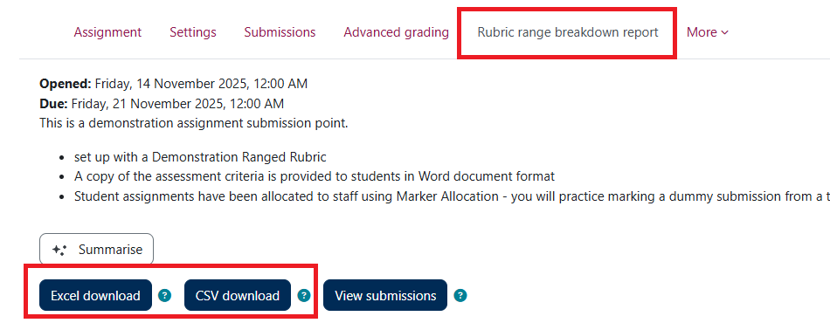
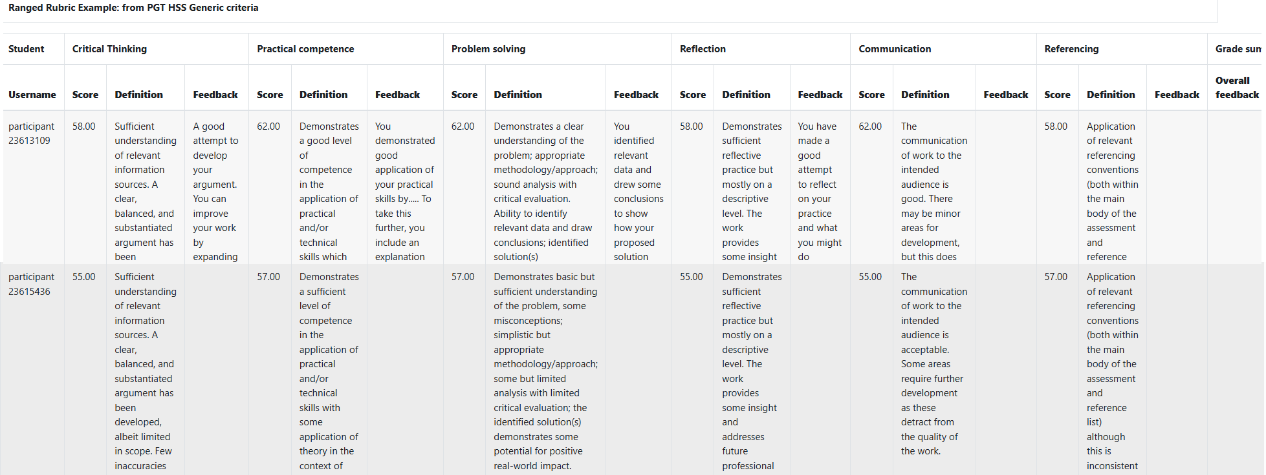
Reporting

Slide 11
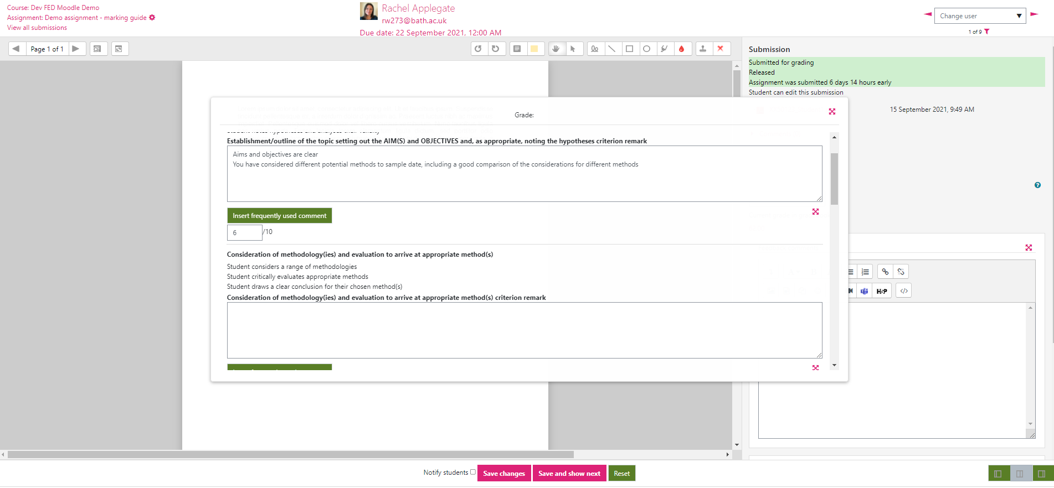
Quick view – marking guide
Predefined criteria, and marks per criterion - overall Grade is calculated.
A structured form for entering feedback comments against criteria.
Build a frequently used comment bank within your Marking Guide
Notes:
So very quickly on marking guides, which we’ll look at in our next TEL Tips Live…
Marking guides are similar to rubrics in that you have pre-defined criteria, but you apportion a maximum number of marks per criteria. So you can give exactly the mark that you want, within a range. So if you have a range of, say 0-10, you can give, 5, 6, 7 or whatever you want.
It look like a structured form, because you have your criteria, but then you can add your feedback comments against those.
An advantage it has over the rubric, is the ability to build a frequently used comments bank.

Slide 12
Pros and cons – marking guide
Pros and cons
Provides structured marking with comments
Flexibility for mark allocation
Can create a comment bank
Set-up work involved to define marking guide carefully
Top tips
Share marking guide with students in advance
Consider teaching team work to ‘calibrate’ marking
Comment bank defined within marking guide
Marking guide can be configured as ‘templates’ to share within Department

Slide 13
How to find out more
Rubrics and Ranged Rubrics
Marking Guide
Case Study: Using a Rubric for Open-ended Assessment
Moodle Docs: Advanced grading methods (rubrics and marking guides)
Notes:
Advanced Grading in Moodle – this is some TEL team guidance on Rubrics and Marking guides
We’ve also included a Case Study from the University on using a rubric for open-ended assessment
And you can also see the Moodle Docs guidance, for both tools.

Slide 14

Questions
We will pick up on any unanswered questions via Teams chat
Or raise your hand if you would like to ask a question on the mic

Slide 15
Feedback
Thank you for attending today’s session.
Please take a few minutes to fill in our Feedback form
TEL-Bytes webinars: November 2025 - February 2026
Your responses are anonymous.
We will use the feedback to assist in the planning of future webinars and may use comments for future promotional materials.

Slide 16
Closing slide

