Slide 1




Moodle Basics
Get started with Moodle and learn the essentials
This webinar will be recorded.
Webinar facilitator:
tel@bath.ac.uk
Olivia Soutter, Instructional Designer
teachinghub.bath.ac.uk

Slide 2

Session Overview
Logging in and getting started
Navigating around a Moodle space
Course Settings including visibility
Adding and editing Activities

Slide 3

Intro to Moodle
What is Moodle?
It’s a VLE (virtual learning environment). An online space to:
  Share learning resources
  Guide your students through learning activities
  Communicate with your students
  Work collaboratively
  Host assessment and feedback
Notes:
10:20 – 10:30 (10 minutes) – Introduction to Moodle (Slides 4-7)
So…what is Moodle? It’s a Virtual Learning Environment, which is essentially an online space comprising of a set of different tools for learning, teaching, admin and assessment. These are, very generally, some of the things that you can do with Moodle…
Moodle is the University’s chosen Virtual Learning Environment. It’s an open source platform which is customise for use at University of Bath.
It provides an online space to share learning resources, communicate with your students, it offers tools for collaborative working, and it’s used to support assessment and feedback.
It's important to structure your Moodle course carefully and provide clear guidance for students on what is expected and when at each stage.

Slide 4
Bath Blend Baseline for Moodle
Bath Blend Baseline for Moodle
  Consistency
  Accessibility
  Scaffolding
  Engagement
Unit templates (weekly or topic format)

Slide 5
Demo 1 – Logging in and getting started
Login to Moodle
My courses (or scroll down)
Dashboard
Edit Profile
Preferences>Forum Preferences

Slide 6
Demo 2 – Navigating around a Moodle Space
Course index and block drawer
Edit mode
Tabs
Viewing participants and groups/groupings
Topics & subtopics
Note: there is a separate TEL Bytes webinar on Groups & Groupings which we’d recommend attending if you have any group assignments or group work in your unit.

Slide 7
Demo 3 – Course Settings
Adding/editing a course description & course image
Course visibility
Activity completion

Slide 8
Demo 4 – Adding/editing activities
How to add an activity
Key activity types
How to edit an existing activity (and change template text)
How to add an assignment

Slide 9
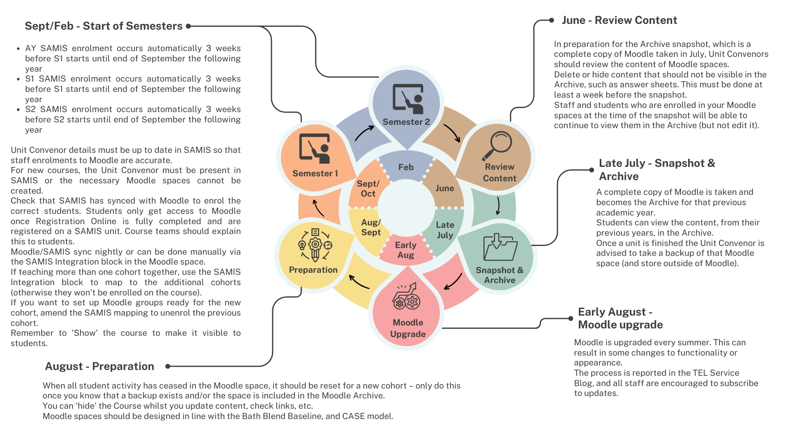
Moodle Administration Cycle

Slide 10

Useful resources
CLT self-paced resources (guided learning resources)
TEL Community of Practice (to share practice and tips)
Learning & Teaching Hub http://teachinghub.bath.ac.uk/
Book a 1-2-1 with an Instructional Designer: Book a one to one
Email queries to TEL@bath.ac.uk

Slide 11
Useful Resources - Webinars
Upcoming events:
TEL-Bytes webinar - How to reset your Moodle space
TEL-Bytes webinar - How to share recordings with students using Panopto and Moodle
Past events:
Recordings to past CLT workshops and events

Slide 12

Keeping up-to-date
TEL Service Blog (service updates and top tips)
https://telbath.com/

Slide 13

Q&A
Time for questions!

Slide 14
Feedback
Please take 2 minutes to complete our short feedback form to help inform future webinar planning and delivery ☺

