Slide 1
University of Bath
Vertically Integrated Projects
Welcome to our End-of-Semester VIP Poster and Presentation Event
^{3rd June 2025}

Slide 2
Agenda
11:30 | Welcome and Introductions
11:35 | Student Impact on Society – Brian Rutter
11:50 | VIP Posters and Questions
12:30 | VIP Awards
12:45 | Close and Thanks
Notes:
Currently 9 projects

Slide 3
Vertically Integrated Projects (VIPs) - What are they?
Innovative research and applied learning projects
Interdisciplinary, multi-level teams of students working with academic staff
Teams work proactively on issues related to the UN Sustainable Development Goals (SDGs) encouraging students to focus on global challenges, often in a local context
VIP Benefits
Make a difference! Work on innovative research and applied learning projects.
Develop your collaborative skills – gain active experience of inter disciplinary, multi-level teams.
Make lasting friends and partnerships with peers and staff.
Be imaginative – develop and communicate solutions that have real impact on sustainability issues.
Develop employability skills – planning, creativity and team working.
First University in England to be an official member of the VIP consortium, with opportunities that may arise.

Slide 4
Current Projects
TBB: Bath biodevices without borders* | Student Wellbeing*
Diversity Network | Slow the Flow - Conserving water across our region*
Carers Centre carbon reduction journey* | Open science – Hardware for microscopy
Environmental Leaders Programme* | Co-production of construction materials: working for and with the community
Widening participation and access to the University of Bath by young people from Somerset and West Wiltshire | Art on Campus: State of Disappearance *
Creating immersive training experiences in virtual reality*
Notes:
Currently 9 projects

Slide 5
Student Impact on Society A Two-Way Process
Brian Rutter
Senior Lecturer Mechanical Engineering
03/06/2025

Slide 6
High Level Purpose

Slide 7
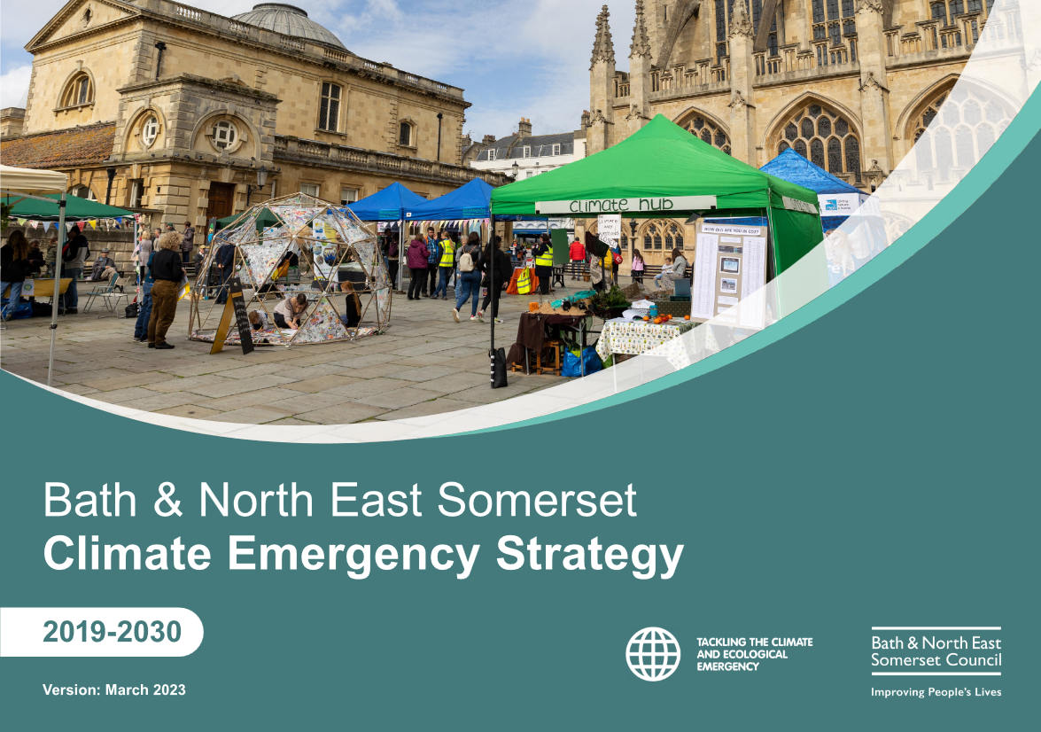
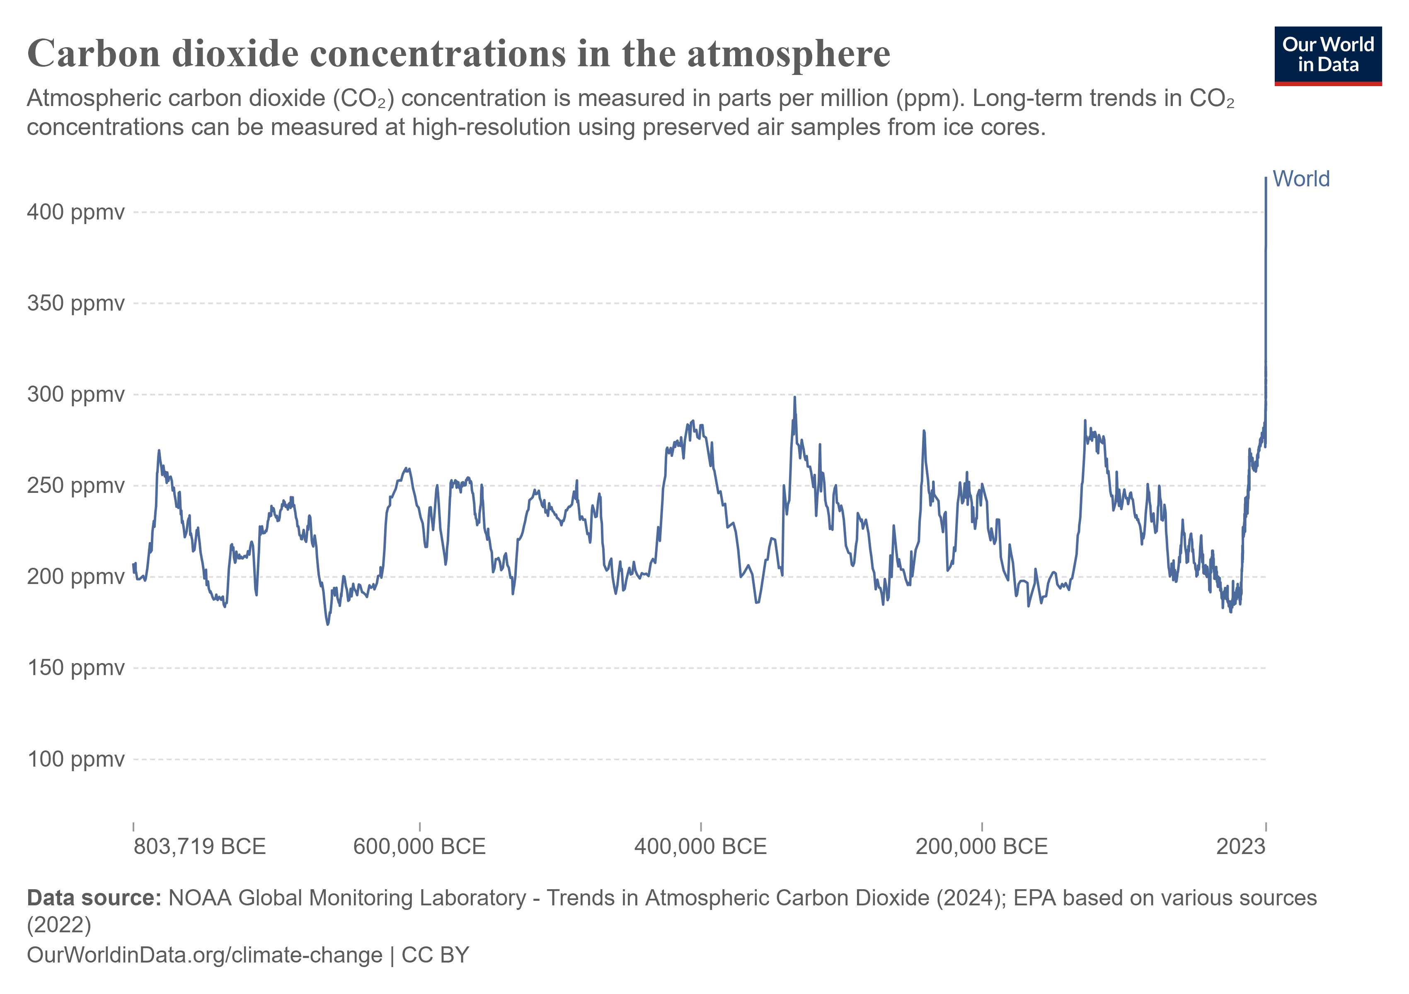
Project Background
Climate Change
B&NES Climate Emergency Strategy

Slide 8
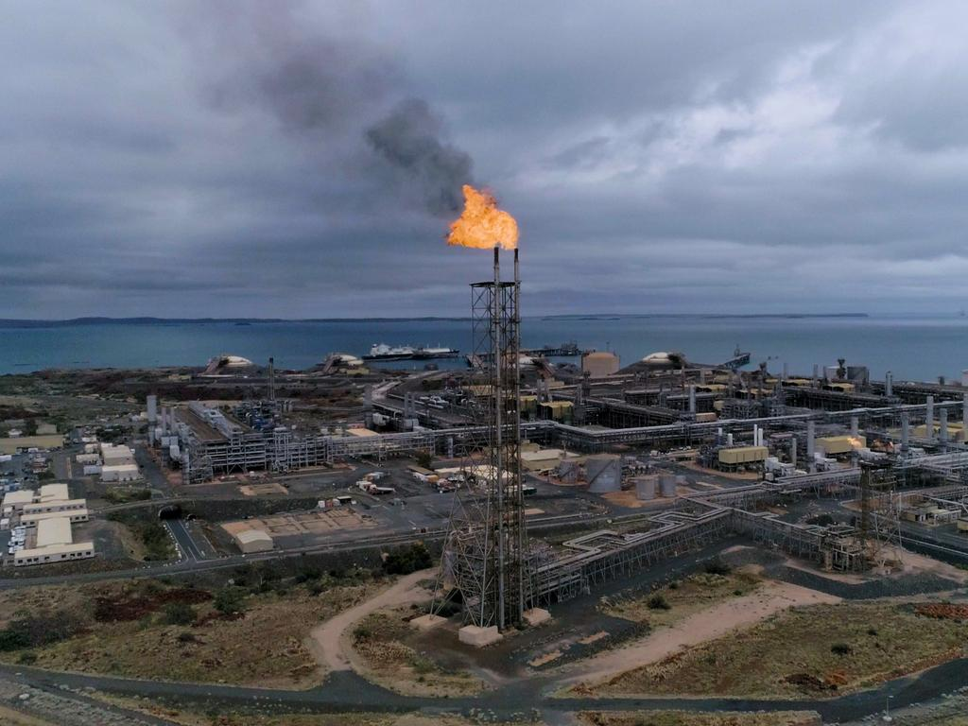
Climate Change – Humanity’s Challenge
Australia Woodside’s North West Shelf
Announcement:
Two new oil fields opening.
We could just give up …..

Slide 9
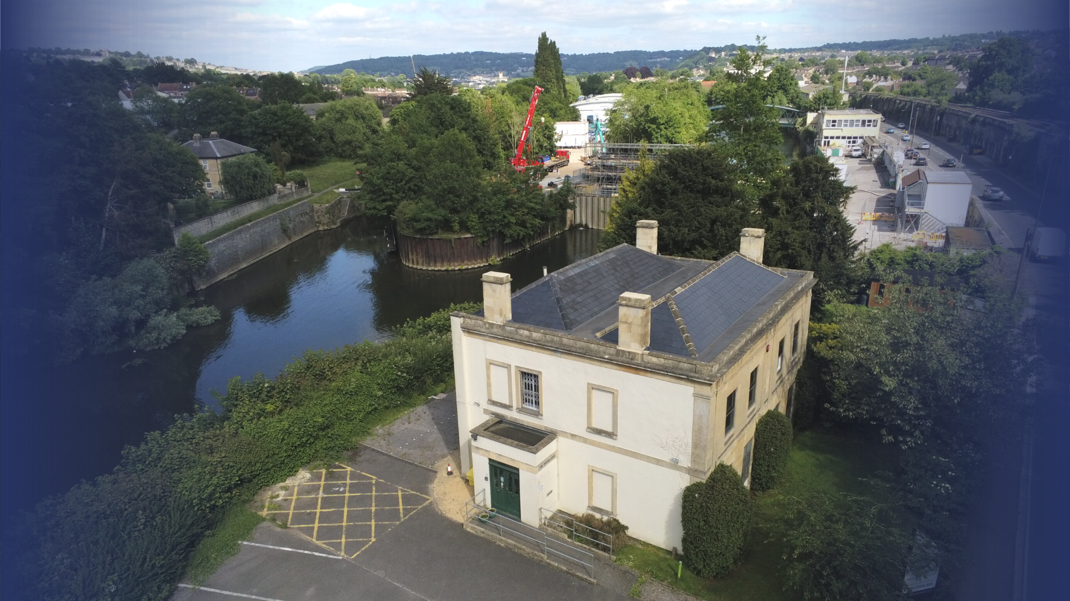
Recognised, valued and supported
The Carers’ Centre

Slide 10
Hierarchy of the Challenge
Combating climate change
Bath Carer’s Centre
Comparisons with Listed Buildings
Fundraising, Advertising and Awareness
Implementation
Data Collection and Thermal Modelling
B&NES Council
Notes:
Alex talk on this, what we concluded with Jacqui

Slide 11
Local Government Response

Slide 12
1 in 5 adults (10.6 million) are carers in the UK
6,000 people become carers every day
Reference: Carers UK 2021-22
Notes:
The Carer's centre provides wellbeing support through things like Free activities, Carer Cafés, Self-care support, Peer support, Emotional support courses. They offer a free support line as well as specific 'young carer' support.

Slide 13
What worries carers in 2024?
61% of carers feel stressed and anxious
28% are cutting back on essentials like food and heating
61% are worried about the cost of living
19% of carers on Universal Credit are using foodbanks
How much money do you think unpaid carers save the health care system in BaNES each year?
Roughly £49M yearly
Reference: https://www.carersuk.org/policy-and-research/state-of-caring-survey/
Notes:
chrome-extension://efaidnbmnnnibpcajpcglclefindmkaj/https://www.carersuk.org/media/2d5le03c/valuing-carers-report.pdf

Slide 14
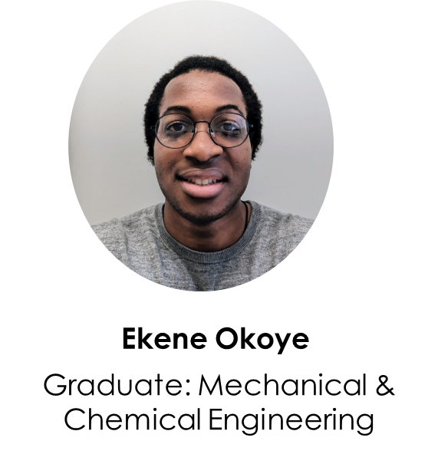
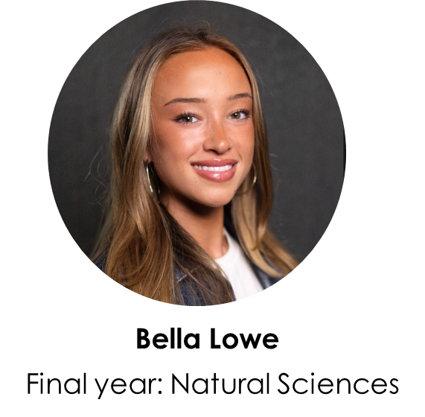
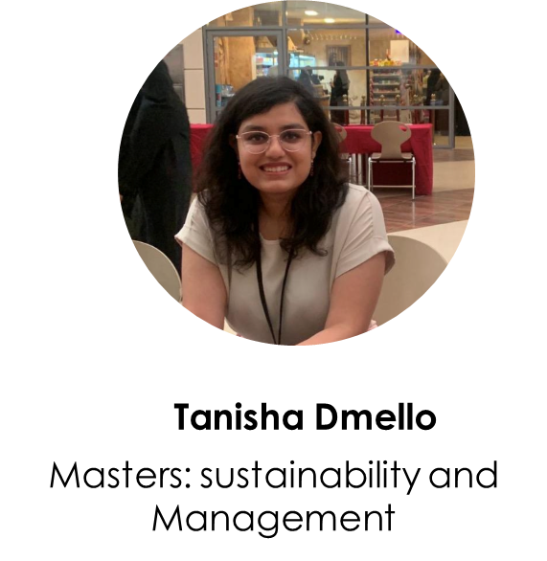
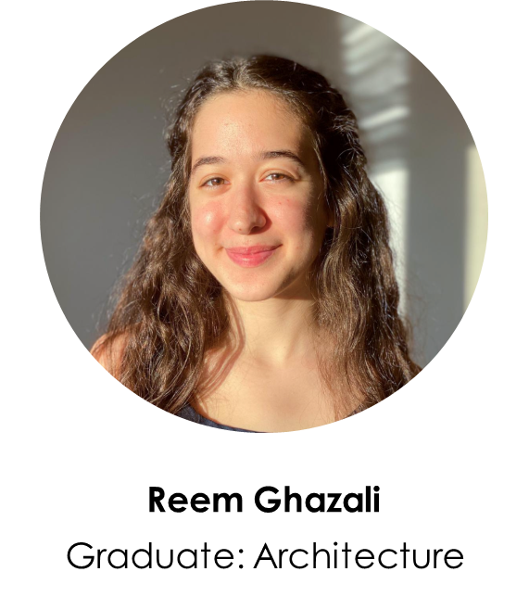
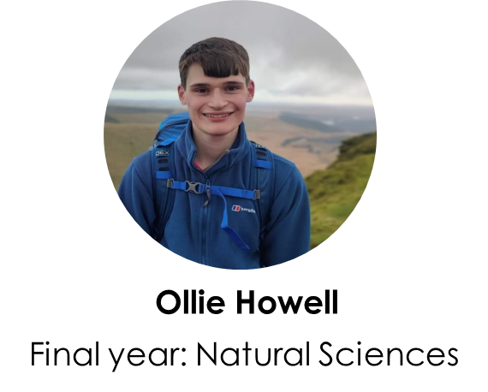
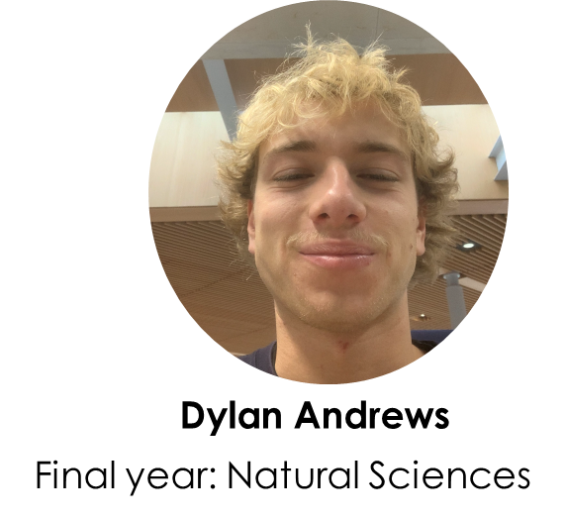
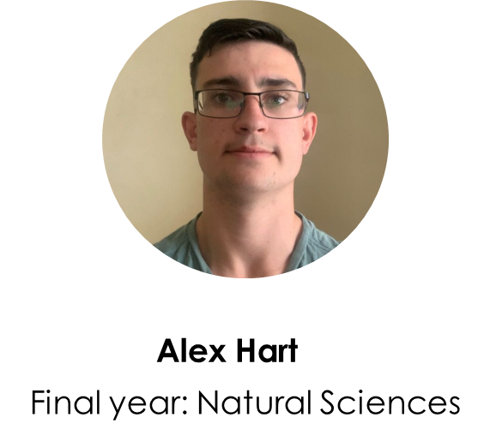
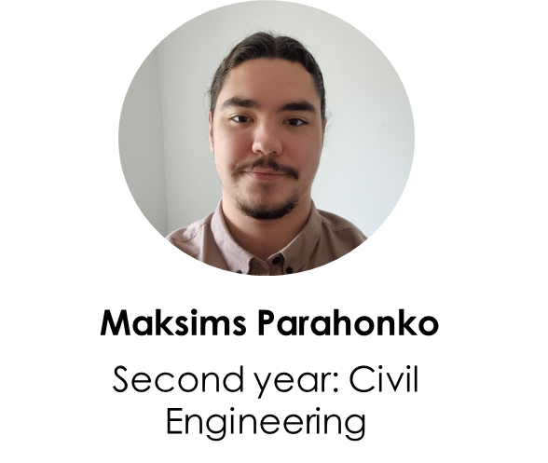
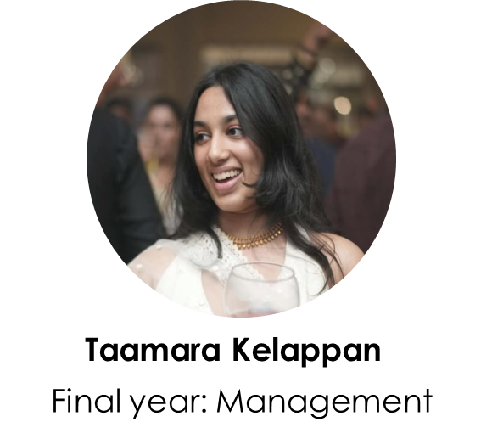
Transdisciplinary Team

Slide 15
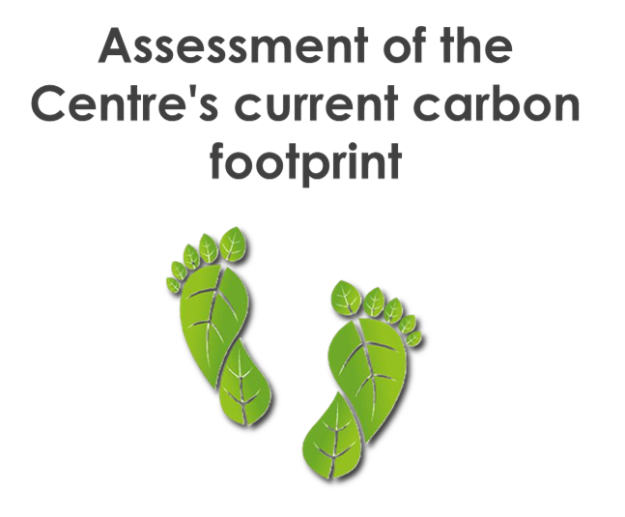
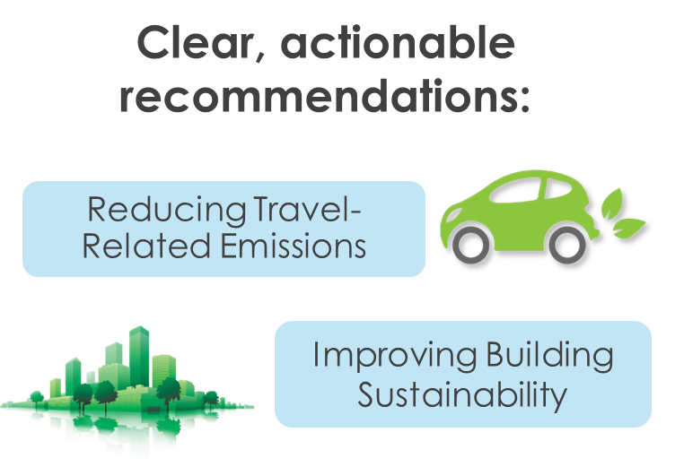
The Challenge
To maintain the centre’s funding with the local authority
Create a sustainability and carbon reduction report
Get it accepted by the authority
Create a carbon reduction implementation plan
Planning additional funding to implement the plan

Slide 16
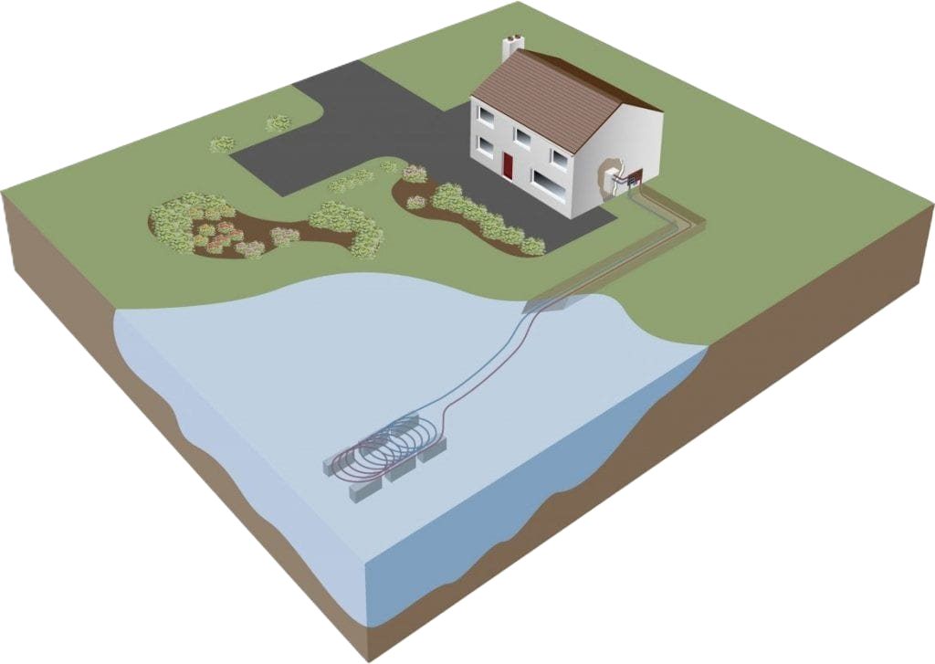
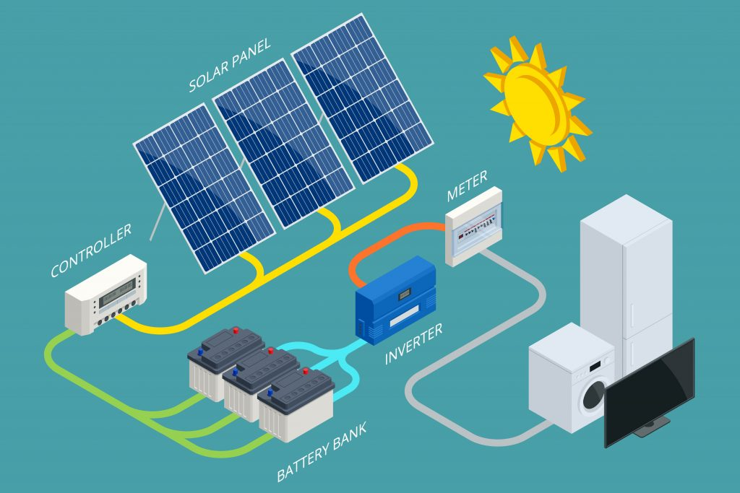
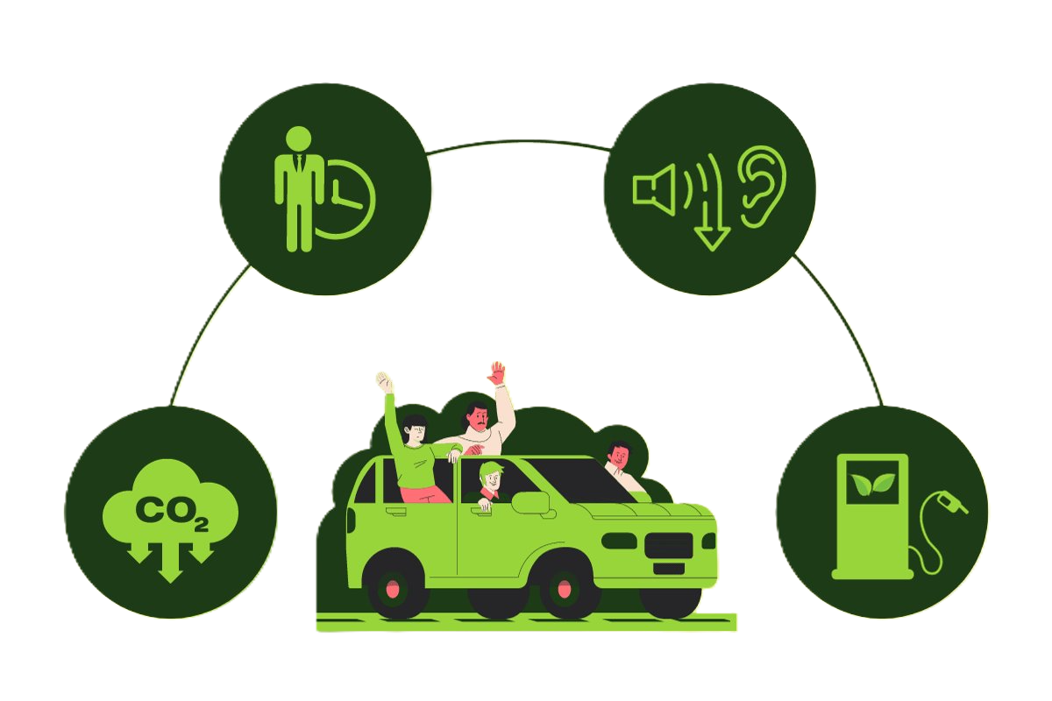
''COMPARISONS WITH LISTED BUILDINGS' TEAM' TEAM
Evaluation of the report's recommended implementations
Comparison with case studies of retrofitted Grade II buildings
Identify potential gaps & additional solutions
How others implemented solutions
How others measured effectiveness & costing
How others complied with planning permissions
Notes:
We looked at other listed buildings and how they compared, to identify what else we could implement and what existing solutions in our report we could improve – specifically looking at retrofitting cases. We emailed certain points of contact in the architecture team asking for them for any case studies they would recommend. We wanted to identify additional solutions we could implement or existing ones we could potentially reconsider, allowing us to adapt strategies based on evidence and new ideas. It ensures that no potential solution is overlooked and that existing plans are optimized for better outcomes.
We Gathered detailed information on how other retrofitting cases implemented their solutions. By examining this we can gain insights into actionable strategies. Helping to ensure the team adopts proven methods, reducing potential trial-and-error
We aimed to gain an understanding on how others measured the effectiveness of their solutions.
We wanted to analyse the costs of other retrofitting examples
Cost data provides a realistic view of financial implications, helping us to budget effectively. This ensures the feasibility of implementing sustainable solutions and avoids unexpected expenses.
We also aimed to review how other cases complied with planning permissions
By understanding how others navigated planning regulations, the team can preemptively address potential compliance challenges. This streamlines the approval process and reduces the risk of delays or rejections, making implementation smoother.

Slide 17
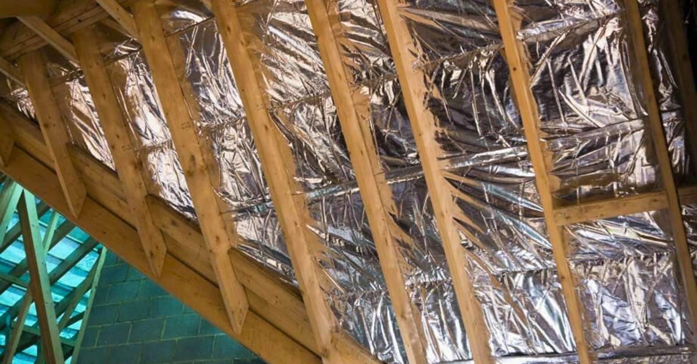
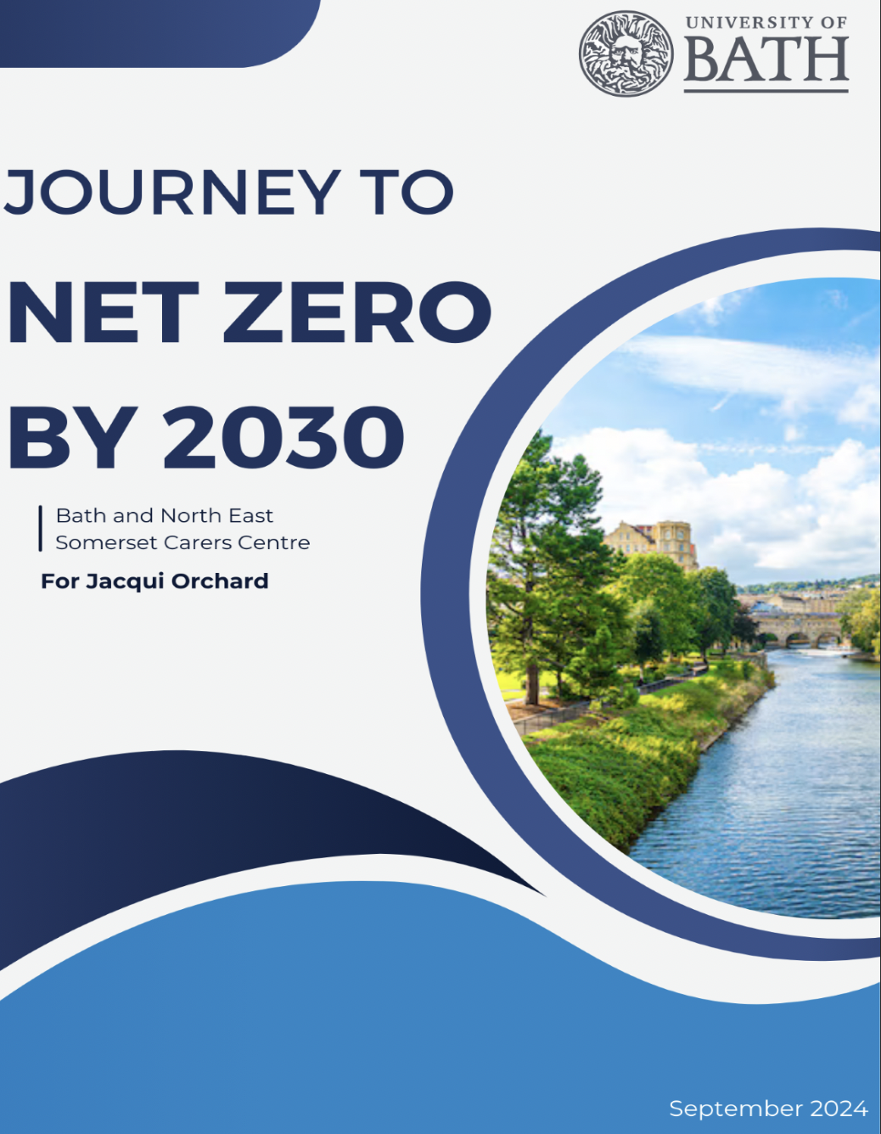
IMPLEMENTATION - DONE SO FAR
Some Solutions
Follow-up from the report
Insulation
Heritage Windows
Solar Panels
Water Source Heat Pump
Landscaping
Hybrid and Virtual Events
Open-loop | Closed-loop
Abstraction License | Environmental Permit
Requires regular Maintenace of Boreholes | Requires Loops of piping to be installed in the river
Higher flow rate meaning more energy extracted | Less efficient
Risk of freezing | Cheaper long term
Notes:
My part of the team has been focusing on the installation of the recommendations in the initial report. Myself and Tanisha have been researching the solutions suggested in the report, with a goal of creating a report on the feasibility and viability of the solutions. So far we've been investigating the financial aspects and the effect they will have on the sustainability of the building.
The first aspects we looked at were focused on making the building retain heat better. Two solutions we looked at were multifoil insulation and heritage windows. Multifoil insulation is an insulating material that is installed on top of the existing wall, making implementing it far easier and quicker, whilst still decreasing the rate heat leaves through the walls. Heritage windows also help reduce heat loss, and are the only way to reduce the heat loss through the windows, due to the building's grade 2 listing.
The next aspects we looked at were focused on energy production. We looked at solar panels and water source heat pumps. Water source heat pumps take water from the river, and extract energy from it. There's two types, closed loop and open loop. Closed keep water inside piping in the river, where as open takes water directly from the river. This means they need different licenses and have different pros and cons.
The last aspects we looked at were smaller scale solutions, these included use of the garden space, like composting, and looking into events which don’t need travel, reducing emissions from getting to the event.

Slide 18
The Outcome
For the Carer’s Centre
Sustainability report written and accepted
Fully costed carbon reduction implementation plan
Continuation of their important work
For the students
How to work collaboratively to support a societal challenge
Resolving a ‘real’ problem
To engage emotionally in societal issues
Learn and engage with carbon assessment processes
Sharing the skills for the common good of the team.
Learning new skills beyond their course
To experience communication skills including active listening, questioning, sharing, giving constructive feedback, appreciating each other, and so much more in preparation for their future careers

Slide 19
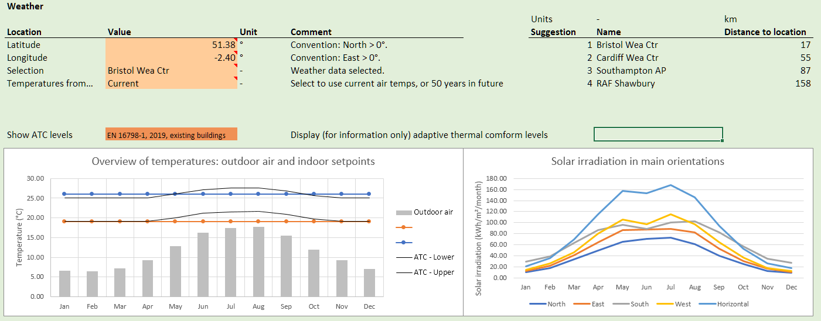
DATA COLLECTION AND THERMAL MODELLING - ACHIEVEMENTS
Focusing on thermal modeling

Slide 21
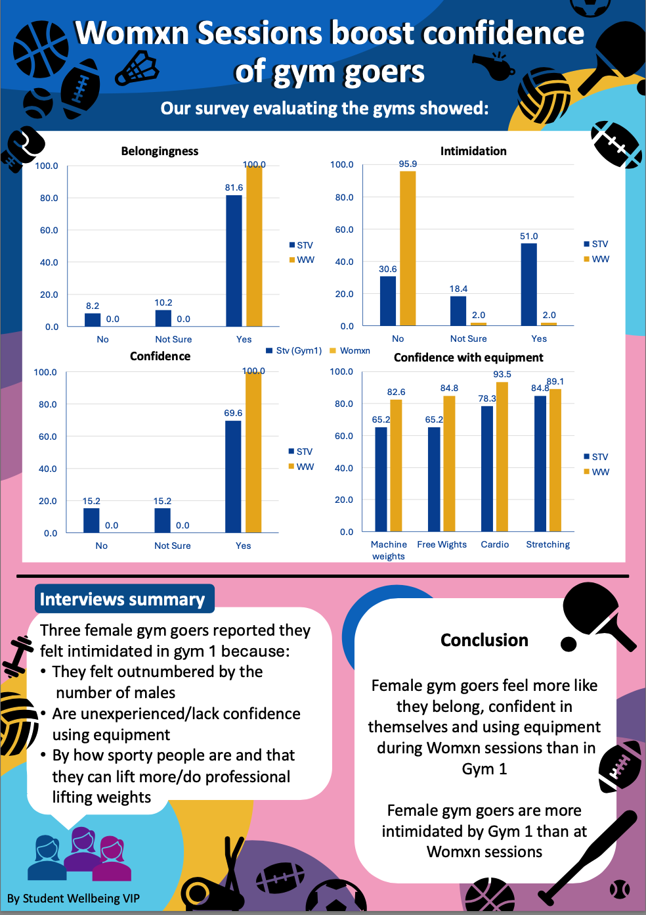
Notes:
Currently 9 projects

Slide 22
Notes:
Currently 9 projects

Slide 23
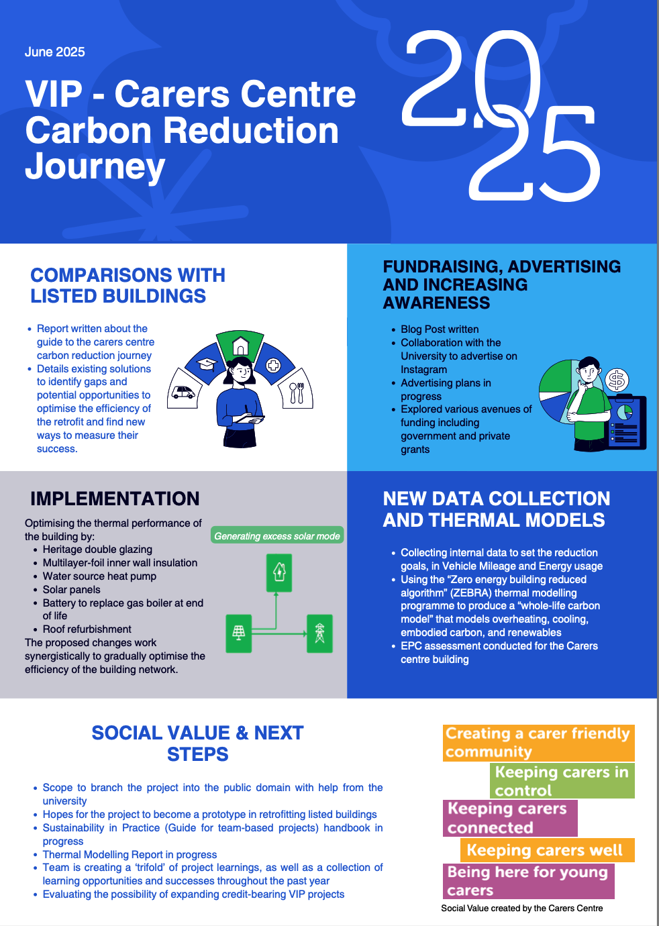
Notes:
Currently 9 projects

Slide 24
Notes:
Currently 9 projects

Slide 25
Notes:
Over the past year, our VR Bystander Intervention Training project has made significant strides across multiple fronts.
We established a formal partnership with SARSAS, a national charity, to design realistic bystander training for sexual harassment scenarios. On the technical side, our team successfully developed a fully functioning VR bar environment, built a synchronized timeline system for character actions, and conducted extensive bug testing. We also trained a scene-specific AI model that achieved an impressive 95% accuracy.
In terms of the project’s operational setup, we secured ethics approval, submitted a Research Participation Scheme application, and prepared recruitment materials. On the engagement side, we presented our work at the Bath Research Assembly, liaised with the Bath Medical Museum, and connected with the EDI team.
This project has also been a major learning opportunity in cross-disciplinary skills—spanning project management, research design, and professional outreach.
However, like any ambitious project, we faced challenges. Our biggest technical bottleneck has been the mismatch between character animations and speech timing, meaning the scene is visually complete but not quite ready for live participant testing. The core insight here is that complex integrations, like motion capture and speech sync, need to be scoped and tested early in development.
In short, we’ve built a strong technical foundation, but there’s one final hurdle to overcome before this project can truly deliver its full user experience."

Slide 26
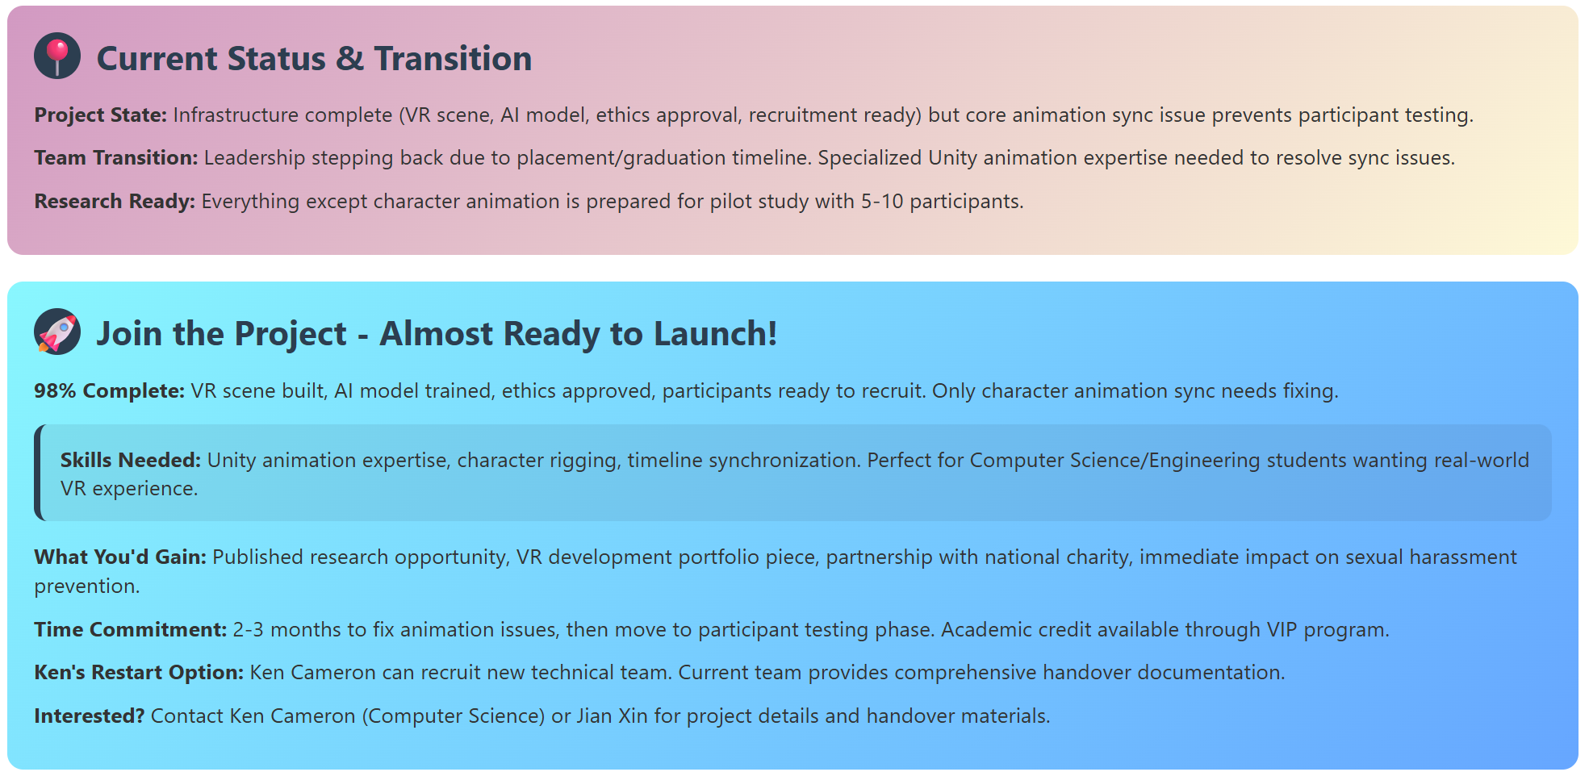
Notes:
Due to graduation timelines, our current leadership team is stepping back. We’re now looking for new contributors—particularly with Unity animation or timeline synchronization expertise—to help bring the project to completion.
We are 98% done. Fixing the animation timing is the last step before moving into participant testing.
This is an exciting opportunity for Computer Science or Engineering students to gain hands-on VR experience, contribute to publishable research, and work on a meaningful issue in collaboration with a national charity.
The expected time commitment is 2–3 months, and academic credit is available through the VIP programme.
If you're interested or know someone who might be, please reach out to Ken Cameron or Jian Xin. Full documentation and a smooth handover are ready—this project just needs the final technical push to launch."

Slide 27
Environmental Leaders Programme
Notes:
Currently 9 projects

Slide 28
Notes:
Currently 9 projects

Slide 29
Introducing the VIP Awards;
Most Effective VIP Team Award
Above & Beyond Team Member Award
Community Involvement Award
SDG Recognition Award
Most Supportive Staff Member Award

Slide 30
Most Effective VIP Team Award
A team that demonstrates outstanding collaboration, listens respectfully, and achieves goals efficiently with clear objectives, delivering impactful results through great teamwork.
Winner
Student Wellbeing

Slide 31
Above & Beyond Team Member Award
An 'Above & Beyond Team Member' is someone who consistently goes the extra mile, offering support and contributing in ways that make a positive difference to the team.
Winner
Vienne Lin

Slide 32
Community Involvement Award
This award recognises the VIP team that has actively engaged with its target community, building connections, and making a positive difference through their involvement. Community could include student community, campus community or the local area.
Winner
Carers Centre carbon reduction journey

Slide 33
SDG Recognition Award
The VIP team that has made a positive impact in supporting and working towards the UN's Sustainable Development Goals.
Winner
Environmental Leaders Programme

Slide 34
Most Supportive Staff Member Award
This award is for a member of staff who has provided encouragement, offered help and creates a positive and collaborative VIP team environment.
Winner
Richard Joiner

Slide 35
Thank you

