Slide 1
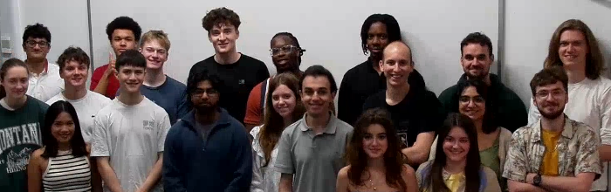
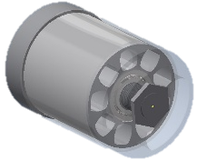


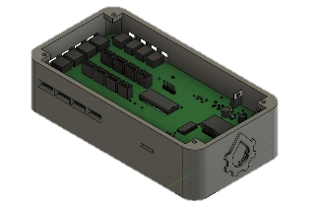
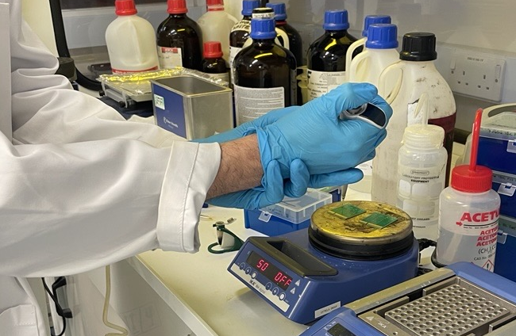
BWB: Semester 2 2024-25
Hardware
Software
Semester Progress:
Conductivity sensor analogue circuit research was completed, however, no circuits based on that research were built.
Wrote more firmware for the Oasis Development Kit
Brainstormed the chassis and flow loop for the Saline Supernova but nothing physical could be created.
Completed more research for the Energy Recovery Device for the Saline Supernova.
Made a protective box for the Oasis Development Kit for safer storage
Next semester goals:
Manufacture and test the updated design.
Research and integrate UV disinfection tubes
Challenges:
The timeline for building and testing the prototype remains unclear with difficulties in training people every semester hindering progress
Pollutant Modelling Plan:
Researched regression modelling to determine what a combination of pollutants creates and where they originate
Evaluated different modelling tools (i.e. Water Quality Analysis Simulation Program, QUAL2K Water Quality Model, Soil and Water Assessment Tool.)
Created a model overview for the W.O.R.M. (Water-pollutant Origin Regression Model)
The W.O.R.M. Progress:
River identification and source pollutant algorithm completed which allows us to predict type 1, 2, and 3 pollutions and the areas that they originate from
Satellite Imagery for Modelling:
Satellite photos can be used to understand the current shape and width of rivers which enables more accurate modelling
Obtained funding from the European Space Agency and access to their Network of Resources for Satellite Imagery
Outreach
Finance
Potential field testing visits:
Initiating plans for a possible field visit to Bangladesh at the Asian University for Women
Created 3 workshop plans and an overall timeline for a five-day fully funded trip with selected members
Industry engagement:
Obtaineda potential segment in the WWEM conference newsletter to increase engagement to understand techniques from industry experts
Starting to create an application for Prototypes for Humanity
LEAF Training completed by three members
External Funding Planning:
Currently identifying and preparing for external grant applications and other funding opportunities tailored to the team's needs.
Fund Allocation and Management:
Bought amenities for the BWB room and secured equipment we may require in the future
Implemented a detailed component order sheet to formalise and track expenditures systematically.
Sensors
Onboarding New Members:
Onboarded a new PhD Sensors lead
Created two printed-circuit-board prototypes for the pH Sensor
Completed lab training

