Slide 1
Large and Small group activities
Adam Squires
Dept of Chemistry, University of Bath
@adsquires

Slide 2
In lectures (I don’t have separate workshops)
Multiple choice questions (types of question: next slide): understand last 15 mins?
Voting:
Arrow on handout / tablet / paper; everybody hold up.
Everyone stand up. Q. Fold arms / hands behind back / hands on hips for answer A,B,C
Adding small group / peer work:
1 minute thinking about q yourself
Chat with person next to you (compare answers / help if stuck) = “Think / pair / share”
Chat with pair in front / behind; raise hands if all 4 stuck (probably needs clarification)
After voting: look around, talk to someone who disagrees with you / vote again.
Increase
If I make change X, value Y will:
Don’t know
Decrease

Slide 3
MCQs (for formative and summative)
Numerical options at end of calculation (show options AFTER they’ve done calculation)
Quantitative predictions (“increase / decrease”) (“molecule A / molecule B”)
Symmetric
NOT “which of these is the correct reason why…”
[Problems:
Good students may mis-interpret
Bad students may be able to guess]
Questions on slide number / handout; same questions on Moodle.
Advice to students: try question first THEN look at Moodle.
They liked this a lot for online (Covid year)

Slide 4
Small groups: max engagement – learn from teachers
Ask question for all students to think about / write or sketch
Pick one at random (roll a dice?)
More tips on cold-calling from Teacher Twitter. How do you phrase the question:
https://twitter.com/adsquires/status/1530848474140483586
Follow Adam Boxer
@adamboxereducation.bsky
@adamboxer1 on twitter
What to do if they don’t know? To discuss
Teacher suggestions
(1) get them to repeat / paraphrase the question?
(2) “Tell me something you *do* know”
Thoughts: explaining in advance what and why I’ll be doing these; informal, comfortable space

Slide 5
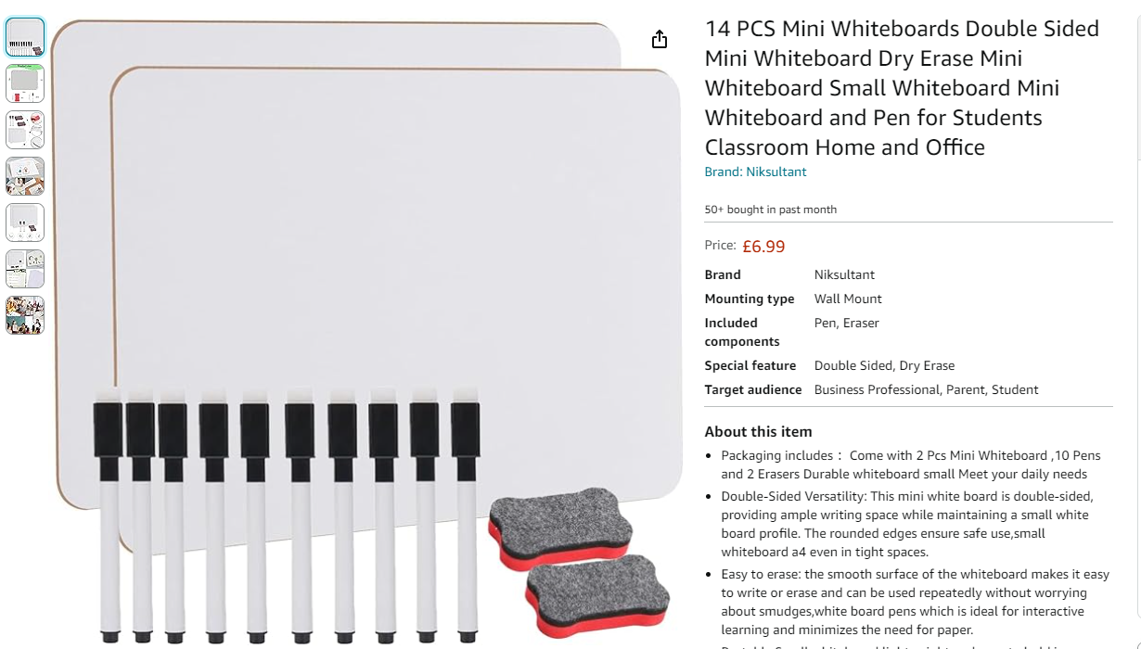
Mini-whiteboards: v familiar from school
“Write your answer; hold face down when you’ve finished; all reveal together”

