Slide 1
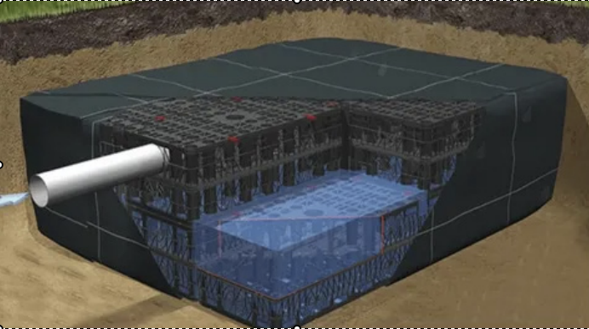
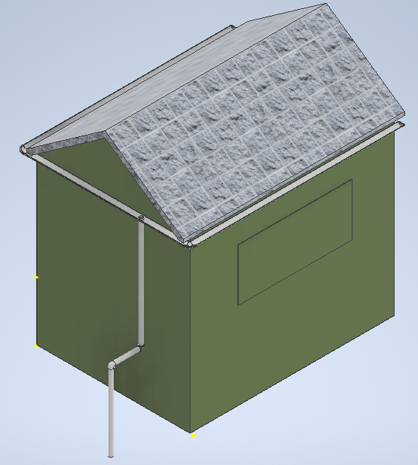
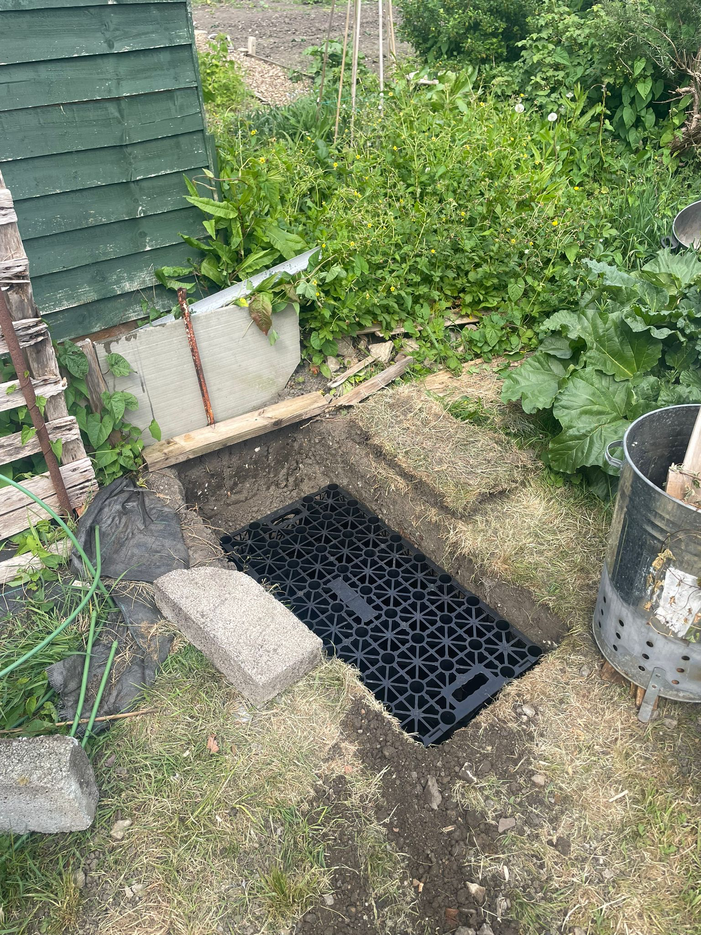
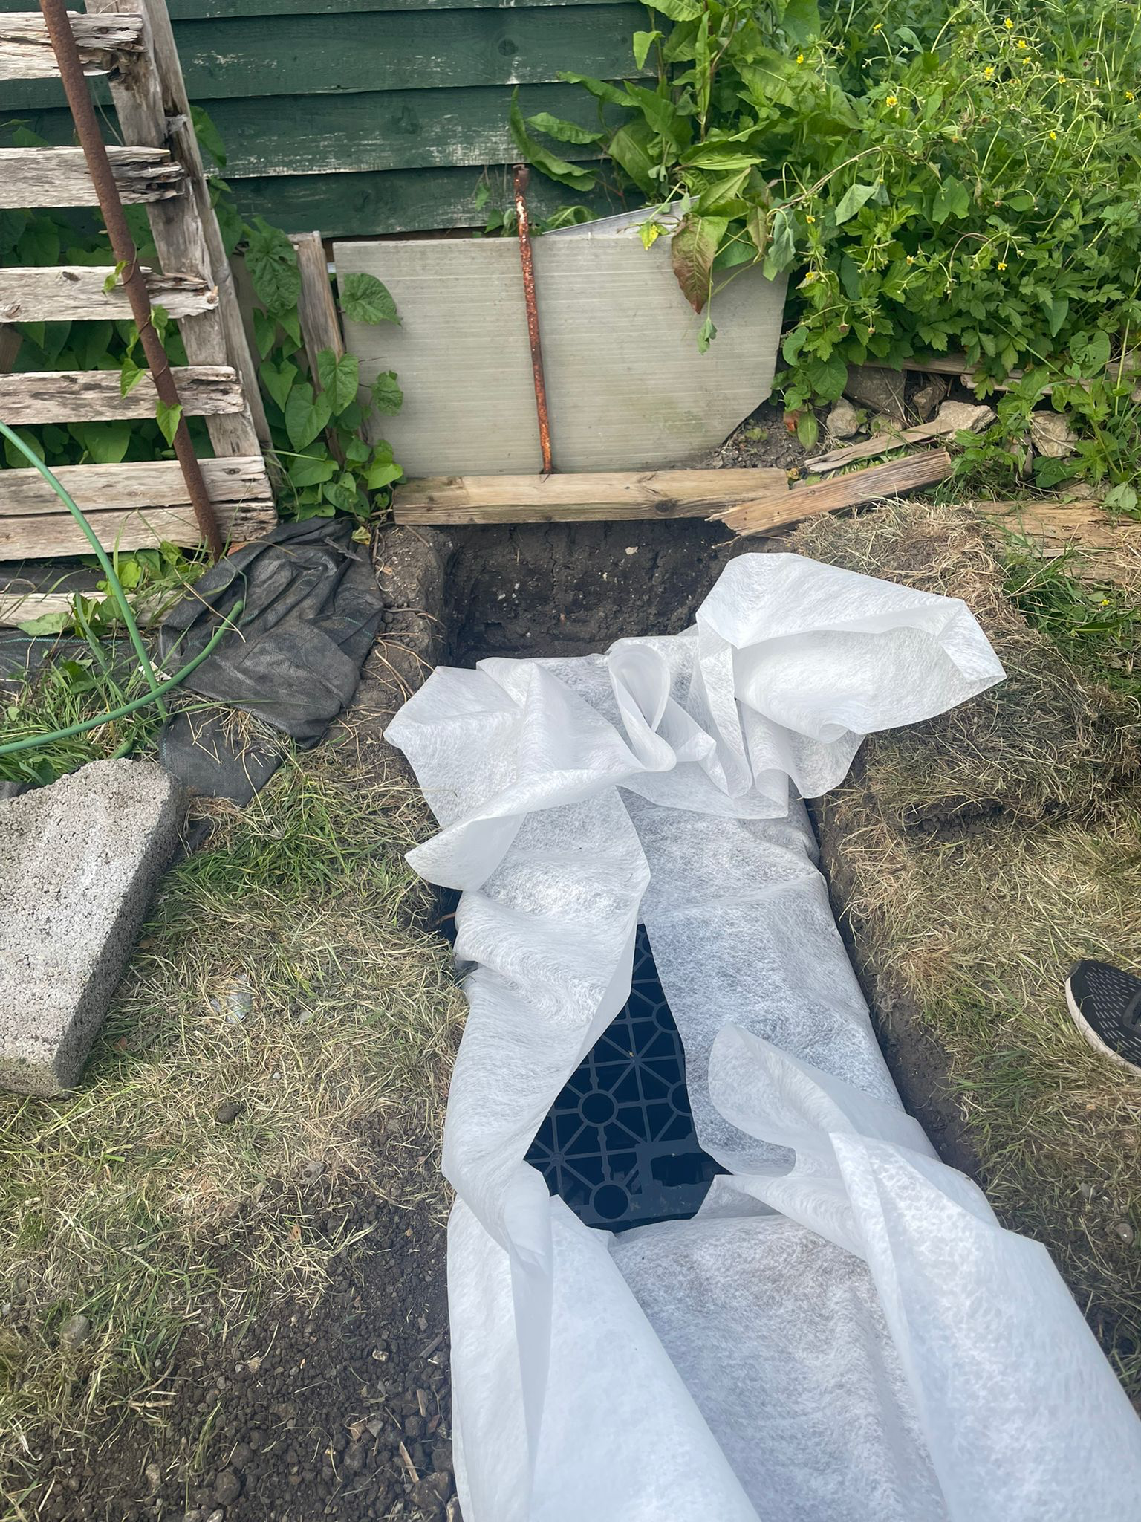

Slow The Flow
Professor Jan Hofman, Daniel Horsler, Ed O’Dell, Maurice Lee Lee and Sasha Ward
We have been looking into sustainable drainage, and how it can be used in Bath. This semester, we have chosen to focus on Soakaways, which are a form of sustainable drainage.
Soakaways:
Soakaways are underground crates, usually made of plastic, wrapped in a geotextile membrane to prevent dirt filling the inside. They can be connected to roof drains and gutters, and fill with water when it rains, then allow the water inside to seep into the surrounding soil.
Benefits:
Hold rainwater close to where it fell, rather than piping it to rivers and causing problems downstream
Reduce strain on existing drainage infrastructure
Support local ecosystems during times of low rainfall by increasing soil moisture
Cheap, and easily retrofitted to almost any building
What have we been doing?
We have installed a data collection soakaway in an allotment, which has involved:
Finding someone willing to let us install a soakaway, with the help of Transition Bath
Purchasing all necessary materials and equipment to install the crate, and set up drainage to feed it
Finding a local source of suitable weather data
Planning a methodology for measuring the volume of water inside the crate
What next?
Now that the soakaway has been installed, we can begin to collect and analyse data, allowing us to:
calculate infiltration rates and evaluate the effectiveness of the soakaway on this side
correlate roof surface area and soakaway volume
Assess how well the soakaway copes with differing rainfall events
We also hope to install more soakaways elsewhere in Bath, to provide more data points to compare, and evaluate localised differences in effectiveness

