Slide 1
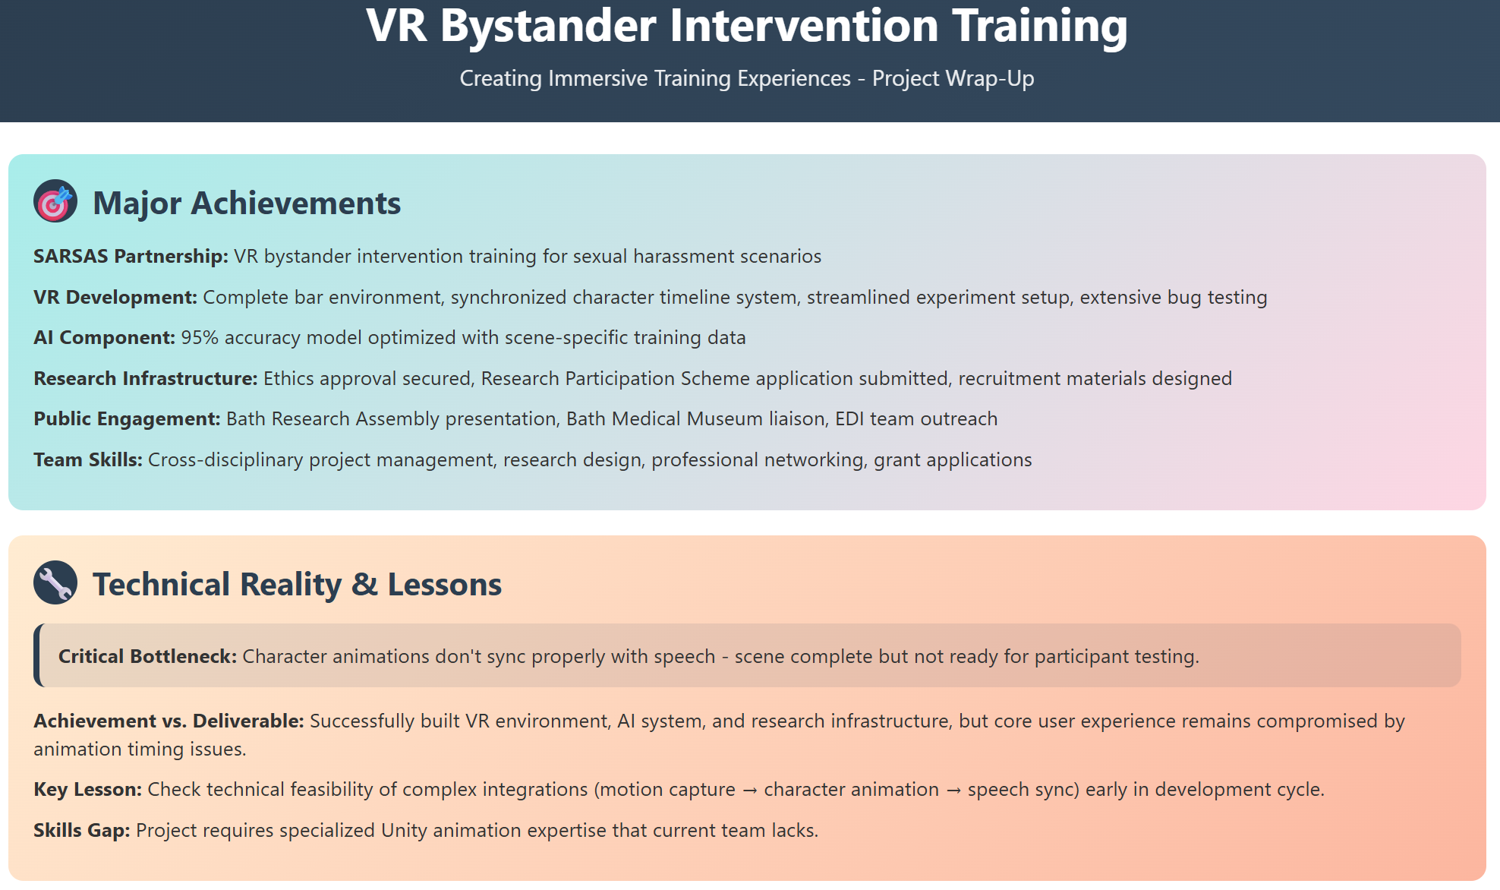
Notes:
Over the past year, our VR Bystander Intervention Training project has made significant strides across multiple fronts.
We established a formal partnership with SARSAS, a national charity, to design realistic bystander training for sexual harassment scenarios. On the technical side, our team successfully developed a fully functioning VR bar environment, built a synchronized timeline system for character actions, and conducted extensive bug testing. We also trained a scene-specific AI model that achieved an impressive 95% accuracy.
In terms of the project’s operational setup, we secured ethics approval, submitted a Research Participation Scheme application, and prepared recruitment materials. On the engagement side, we presented our work at the Bath Research Assembly, liaised with the Bath Medical Museum, and connected with the EDI team.
This project has also been a major learning opportunity in cross-disciplinary skills—spanning project management, research design, and professional outreach.
However, like any ambitious project, we faced challenges. Our biggest technical bottleneck has been the mismatch between character animations and speech timing, meaning the scene is visually complete but not quite ready for live participant testing. The core insight here is that complex integrations, like motion capture and speech sync, need to be scoped and tested early in development.
In short, we’ve built a strong technical foundation, but there’s one final hurdle to overcome before this project can truly deliver its full user experience."

Slide 2
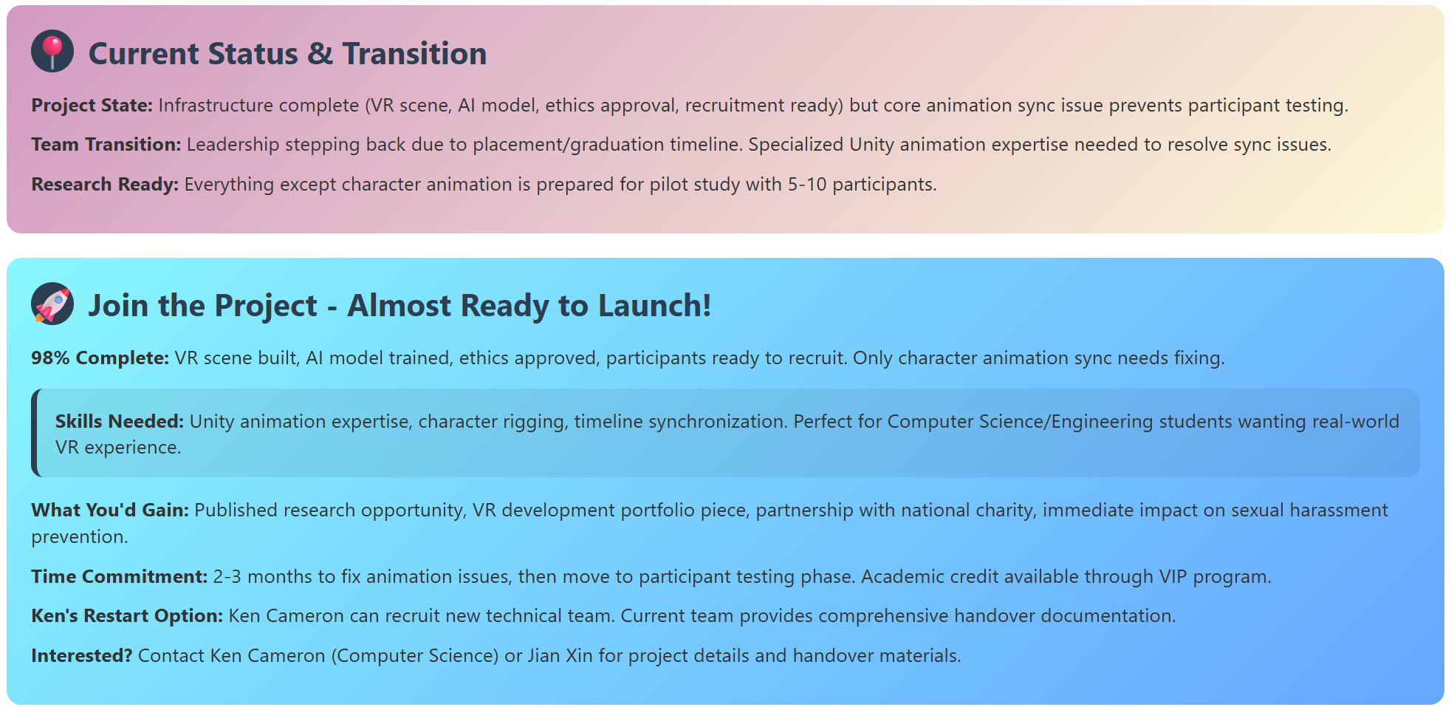
Notes:
Due to graduation timelines, our current leadership team is stepping back. We’re now looking for new contributors—particularly with Unity animation or timeline synchronization expertise—to help bring the project to completion.
We are 98% done. Fixing the animation timing is the last step before moving into participant testing.
This is an exciting opportunity for Computer Science or Engineering students to gain hands-on VR experience, contribute to publishable research, and work on a meaningful issue in collaboration with a national charity.
The expected time commitment is 2–3 months, and academic credit is available through the VIP programme.
If you're interested or know someone who might be, please reach out to Ken Cameron or Jian Xin. Full documentation and a smooth handover are ready—this project just needs the final technical push to launch."

