Slide 1
Fictional Narratives as Learning Aid in Mathematics
Mason Pember

Slide 2
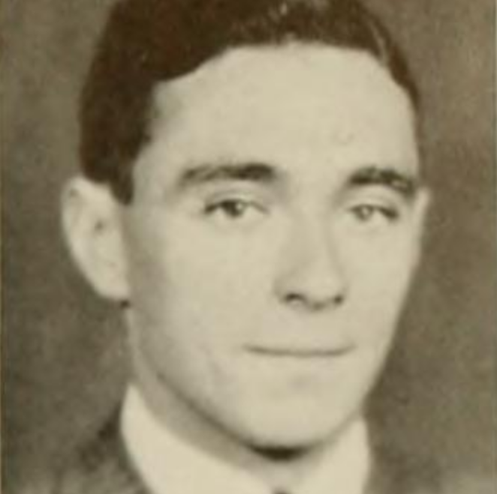
Bruner’s Two Modes of Thought
Paradigmatic | Narrative
Mathematics | Literature
Statistics | History
Sciences | Law
 | Medicine

Slide 3
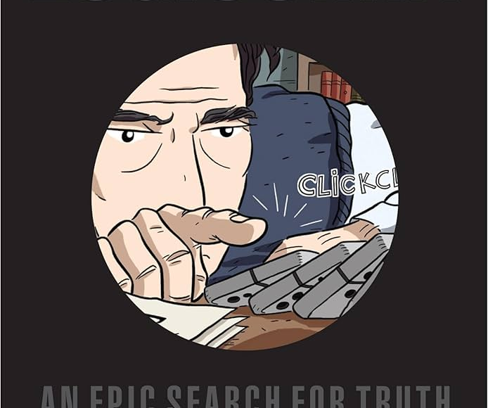
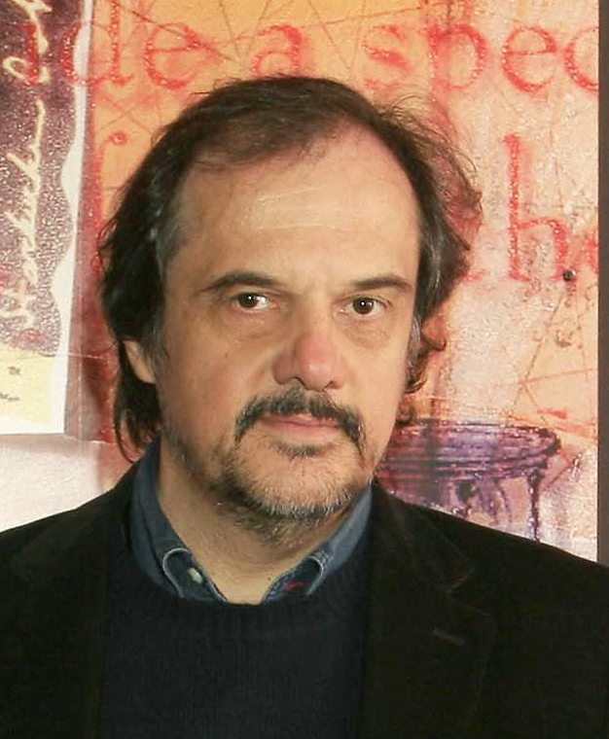
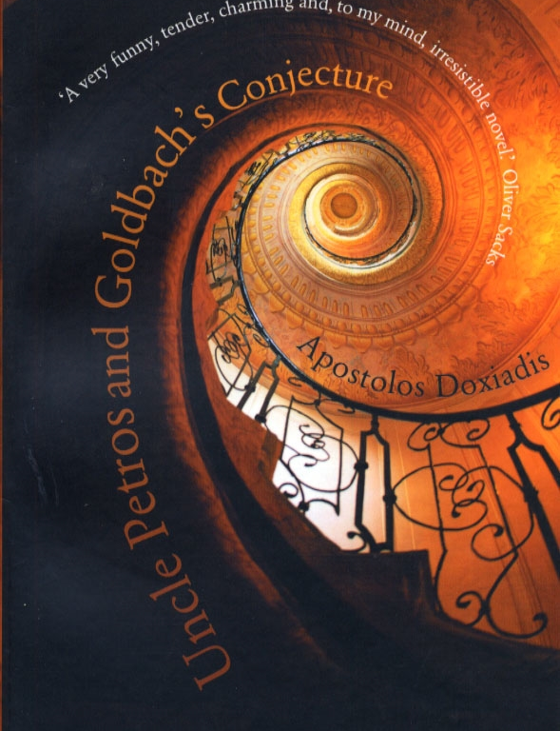
Embedding mathematics in the soul: narrative as a force in mathematics education
“Save time for narrative, use it to embed mathematics in the soul.”

Slide 4
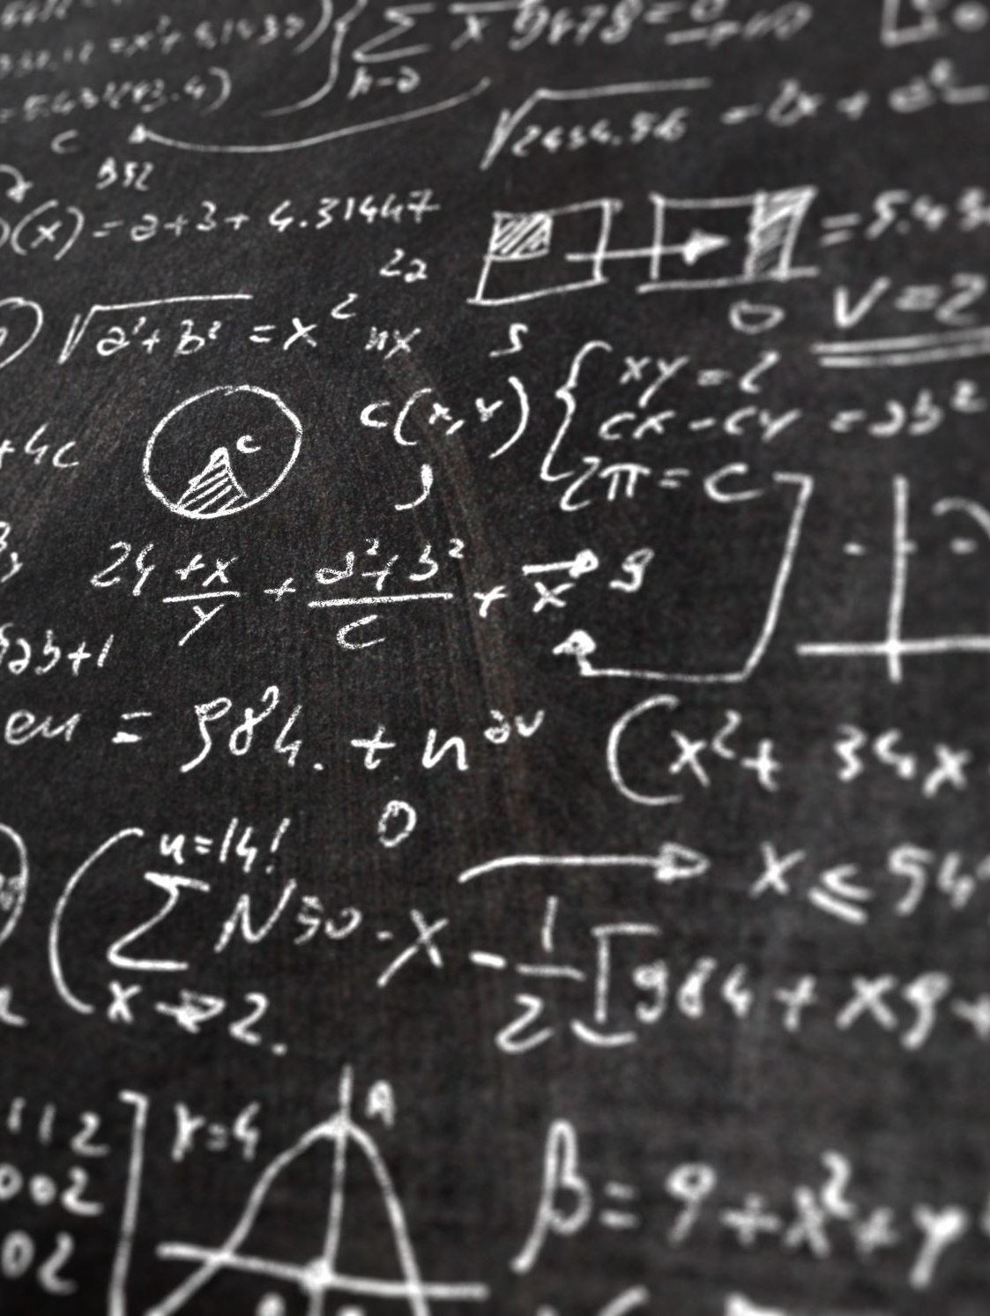
Life-long learning
University of Bath’s Strategy for driving excellence in education : “…enrich and enhance the efficient delivery of established courses in a manner that encourages life-long learning.”
Riessman (1993) notes that narratives provide “memory storage devices, which help us structure experience and organise memories”.

Slide 5
Group Theory: a novel

Slide 6
Group theory: a novel
200-page novella to accompany the unit Group Theory
Each chapter corresponds to each lecture of the course
Told from multiple student perspectives, it will promote inclusivity whilst also highlighting current welfare issues
2025/2026 cohort will receive the novella and be asked for feedback on its effectiveness as a learning aid

Slide 7
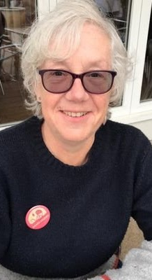
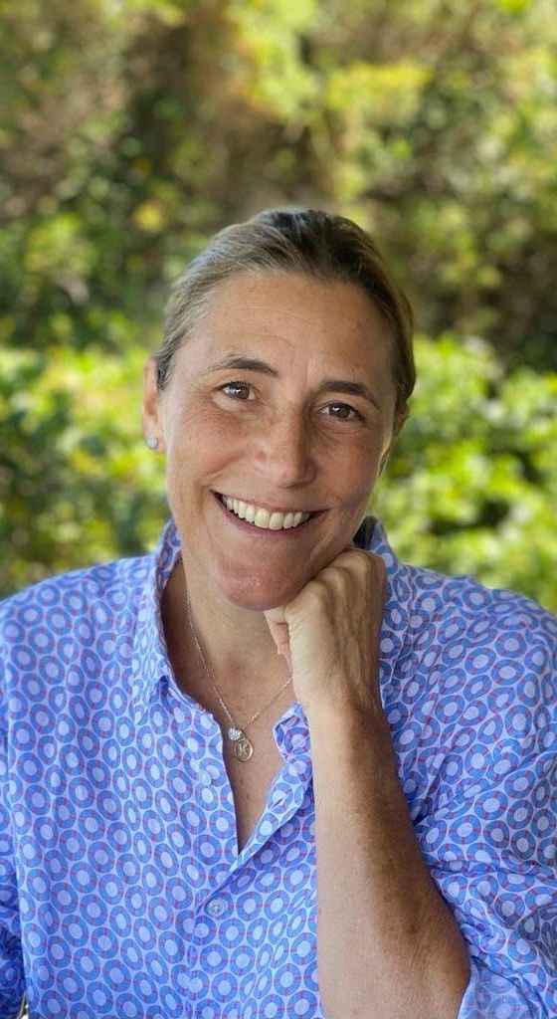
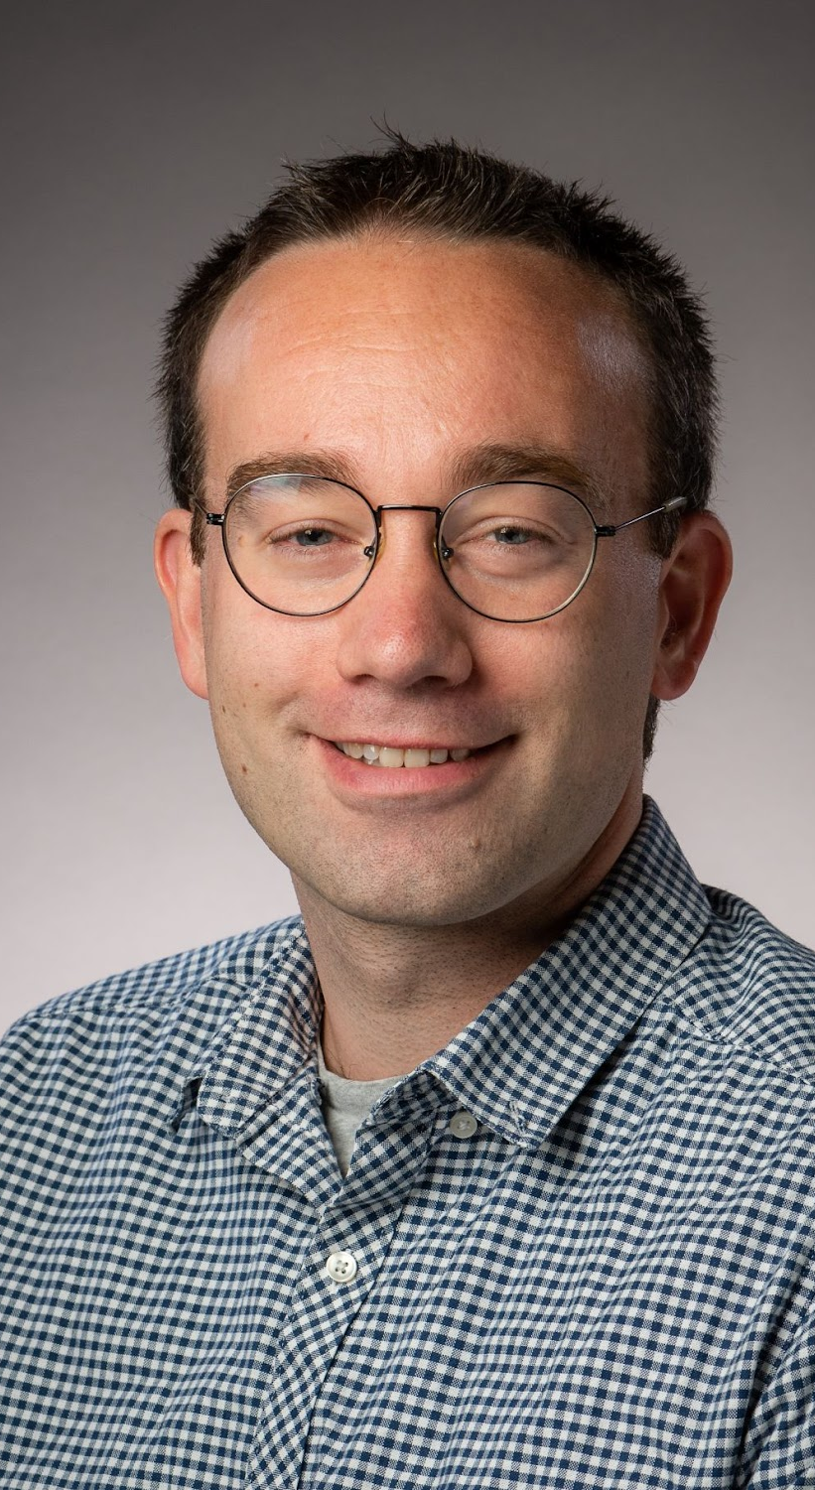
People
Gayle Letherby
Kara Gnodde
Keerat Singh
Mason Pember

Slide 8
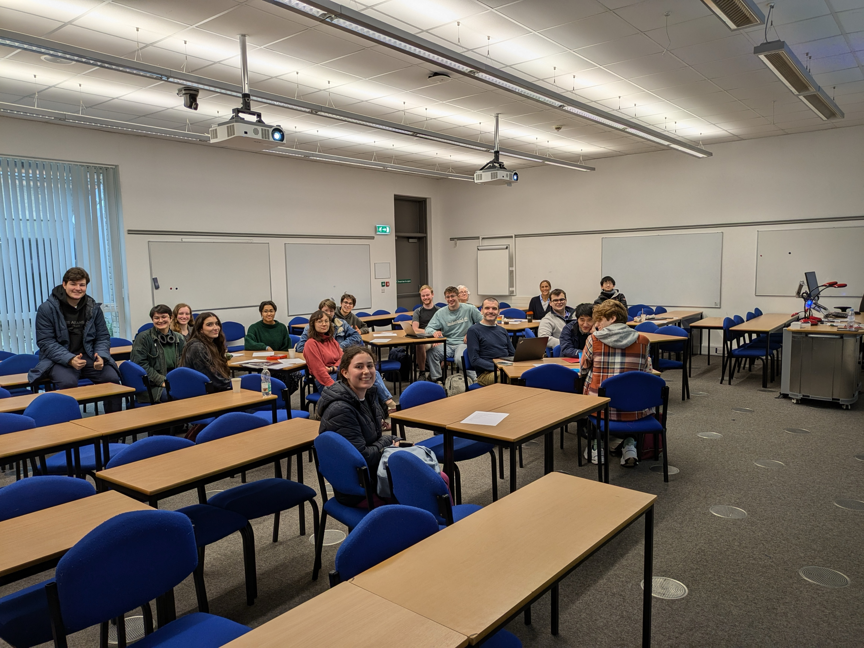
Creative Writing In Mathematics
Two-Day Workshop
Kara Gnodde: Narrative fiction can make mathematical concepts more accessible and memorable.
Gayle Letherby: Let's get creative.
Mason Pember: Mathematical Poetry.

Slide 9
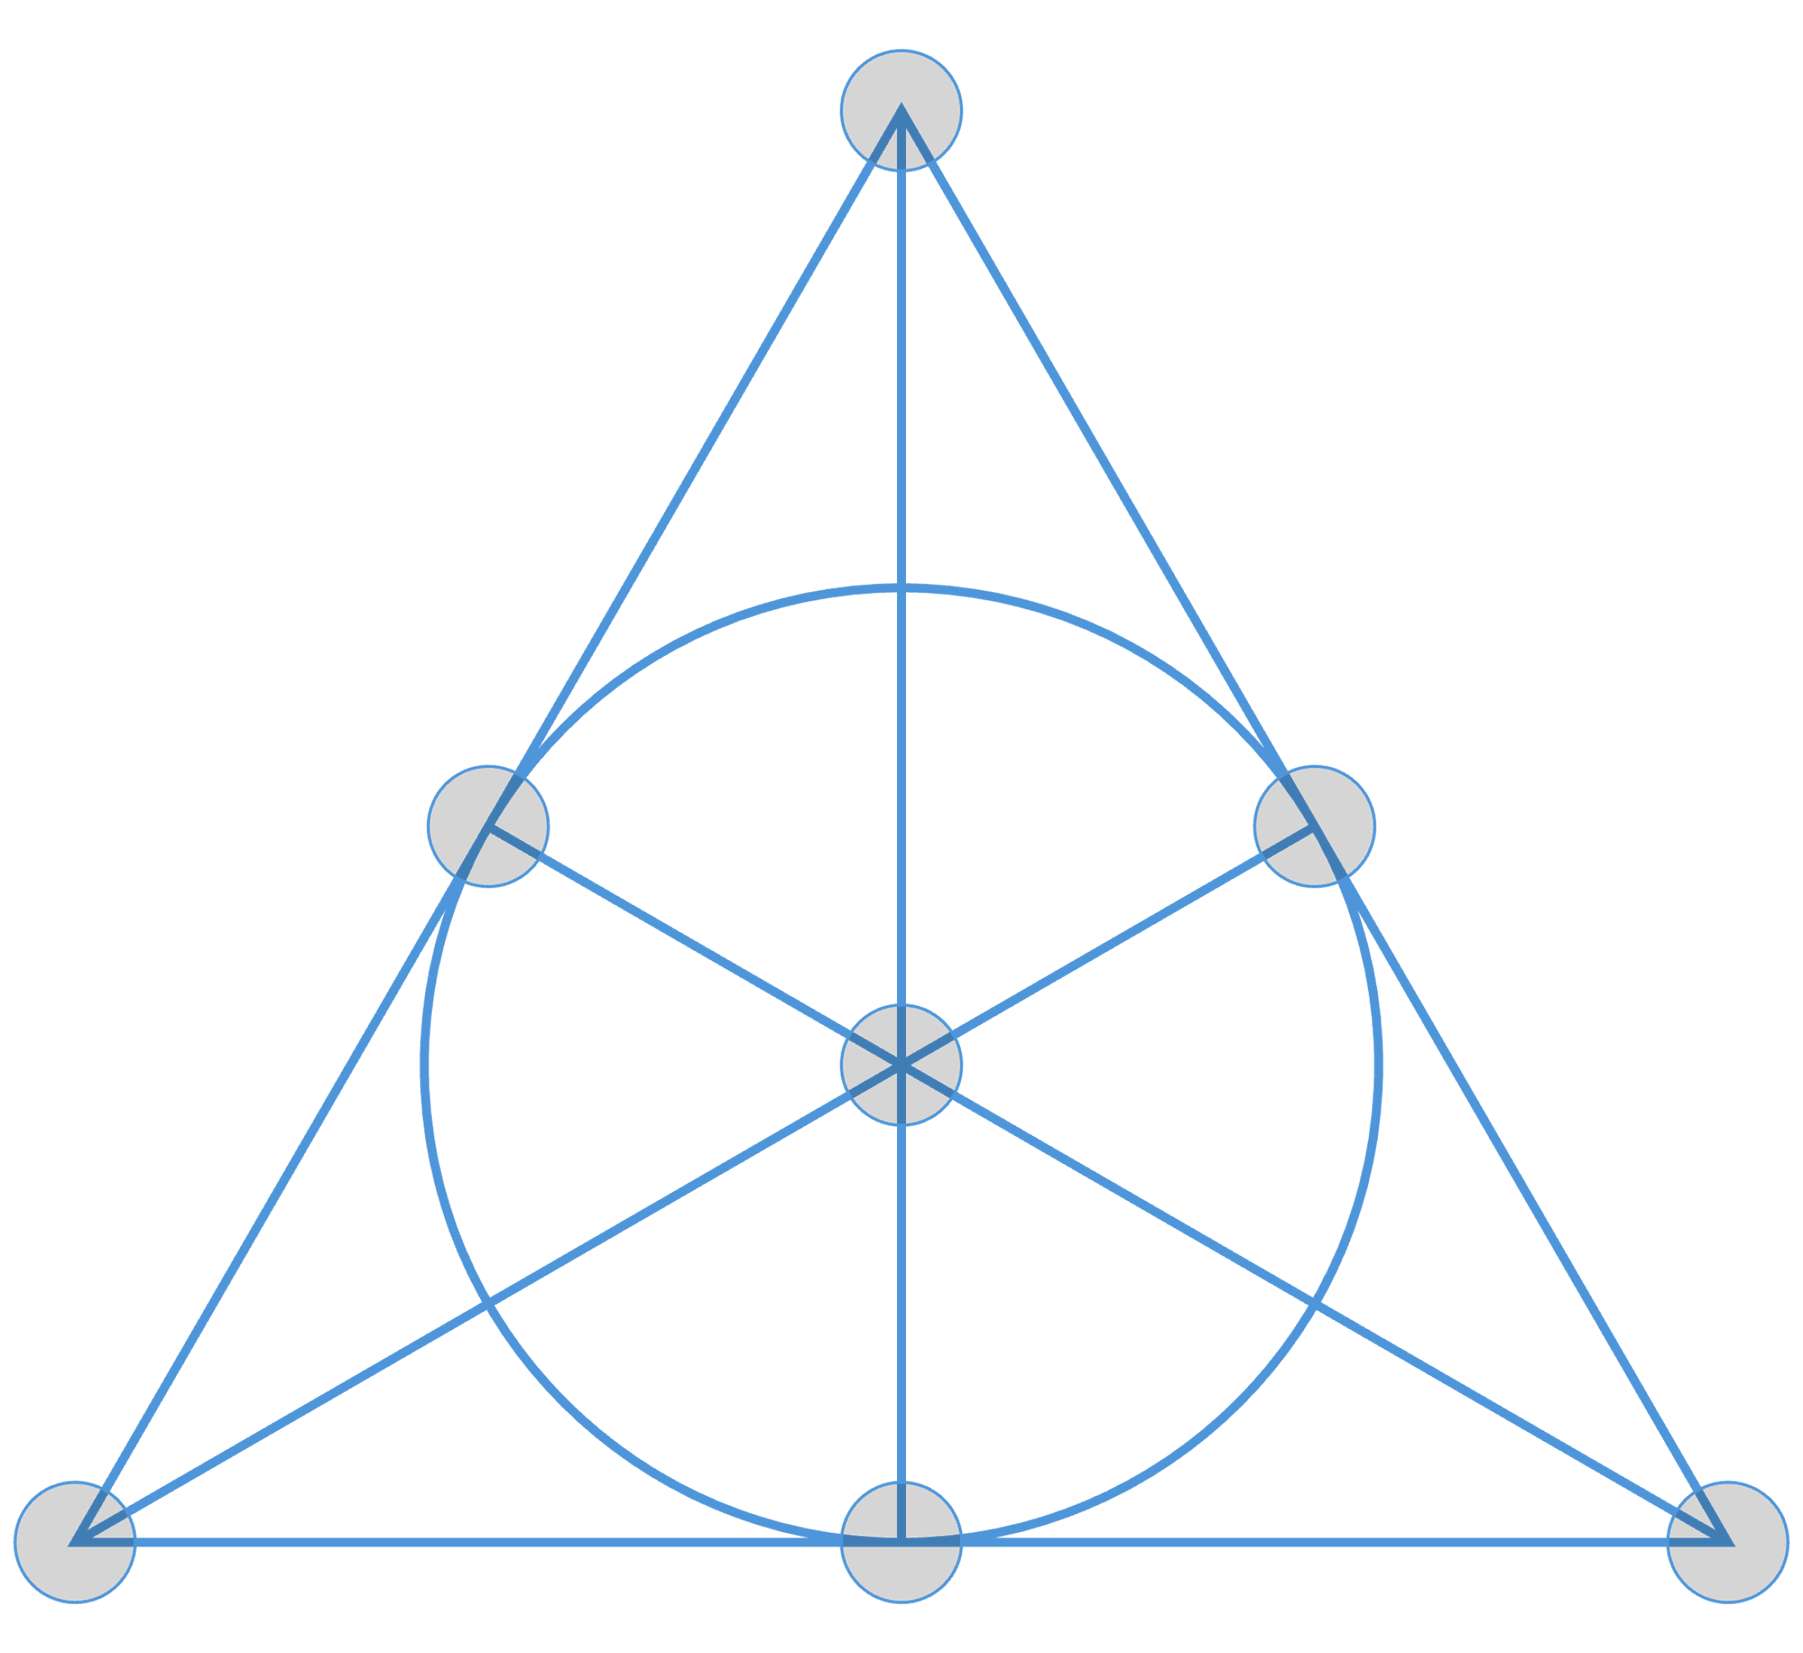
Fano plane
Every pair of points lie on exactly one line
Every pair of lines intersect in exactly one point

Slide 10
Fano fiction*
Passing
Clocks change back,
back through time.
Change time round.
Clocks time passing,
passing back round.
Passing through change,
through round clocks.
Time
Round
Through
Clocks
Change
Back
*Concept developed by Sarah Hart

Slide 11
Activity
Create your own Fano fiction

Slide 12
Links
MathsThroughStories.org
Journal of Humanistic Mathematics
Graphic Novels can Teach Mathematics (Audrey Nasar)

Slide 13
Thanks for listening!!

