Slide 1
Making human learning visible
Abby Osborne
Robert Eaton
Richard Mason
Liz Haynes
Steph Kamffer
in a world of invisible AI
Hanalie Adendorff
Sonja Strydom
Helping Students Develop Critical Thinking Skills
EduFest, 3rd June 2025
A QAA Collaborative Enhancement Project

Slide 2
invisible AI
human learning
Notes:
Our approach to thinking really centres around two interlinked observations:
1. The idea that GenAI will become increasingly ‘invisible’ as it becomes embedded in workplaces, and everyday life, objects, processes. Think calculators. Think cashless payment.
The ability to discern where human learning and machine learning intersect will become harder.
With consequences for how we approach teaching and assessment.
2. There is a need to make human learning visible. We feel this is a crucial moment – and opportunity – to do so.

Slide 3
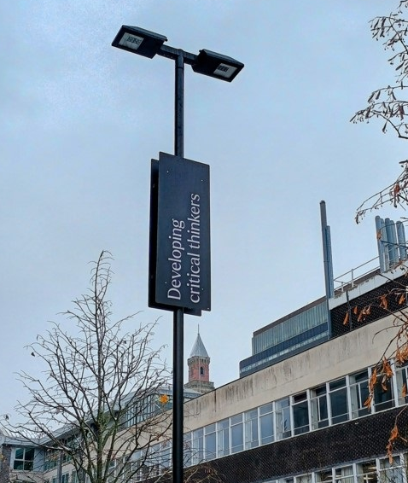
The importance of critical thinking…
increasingly cited as one of the most significant attributes our graduates will need when considering the intersection between human and GenAI learning (Okolie et al, 2022)
…but what is it?
Notes:
We have focused in on ‘critical thinking’.
I think we will all recognise critical thinking as something that is pervasive across HE.
Articulated everywhere from learning outcomes to marking criteria to… campus lampposts!
Bath Employers’ survey 2024 asked which skills and attributes would become most important over the next 5 years: over 400 employers, ‘critical thinking and problem-solving’ received by far the largest agreement (50%).
And particularly, GenAI is a major influence on this attention on critical thinking as a key skill or attribute. When we talk about keeping human learning visible in the age of GenAI, then critical thinking is going to be central to this.
Yet…there remains a real lack of clarity and consistency in what is meant by critical thinking.
We’ve observed this when working with staff.
This reveals the complexity and nuance behind the term.
Which is significant if we are thinking about the importance of critical thinking, and how we seek to equip and enable our students to be critical thinkers – in their studies and future lives. So on that question – this would be good opportunity to head to our menti and see what you have said about it…

Slide 4
Notes:
Share Menti slide results from previous conference presentation.

Slide 5
Our approach…
Phase 1:
Interviews with colleagues across a range of disciplines.
Thematic networks analysis.
Co-creation of critical thinking framework.
Phase 2:
Staff workshop on critical thinking.
Classroom interventions.
Student surveys and student and staff focus groups.
Phase 3:
GenAI prompt tool.
Wider dissemination.
human
learning
Notes:
We think critical thinking is a key ‘lense’ through which to make human learning visible.
In the context of the growth of GenAI, our ability to keep critical thinking in view is even more essential.
How are we going about this at Bath?
Our first step involves listening.
Guiding staff to intentionally design and implement interventions that will scaffold the development of critical thinking skills for their students.

Slide 6
Critical thinking framework
Critical Clarity:
Explicit articulation.
Critical thinking as a process or sequence of related actions.
Critical Context:
Learning outcomes - where students are on their learning journey.
Specific application i.e. is critical thinking being used to consider a theory, process, an article or students’ own beliefs or assumptions?
Critical Capital:
Barriers students may face when engaging in critical thinking.
critical clarity
critical capital
critical context
Notes:
Most useful in specific context at unit level
But also relevant at course and department level to help develop shared language- baris example
Each area has number of pre-populated cards/blanks

Slide 7
Interventions used by staff
Focus on barriers to critical thinking e.g. information overload.
'Slow' learning.
Focused application.
Separation of critical thinking and writing.
Practising skill in familiar or everyday context.

Slide 8
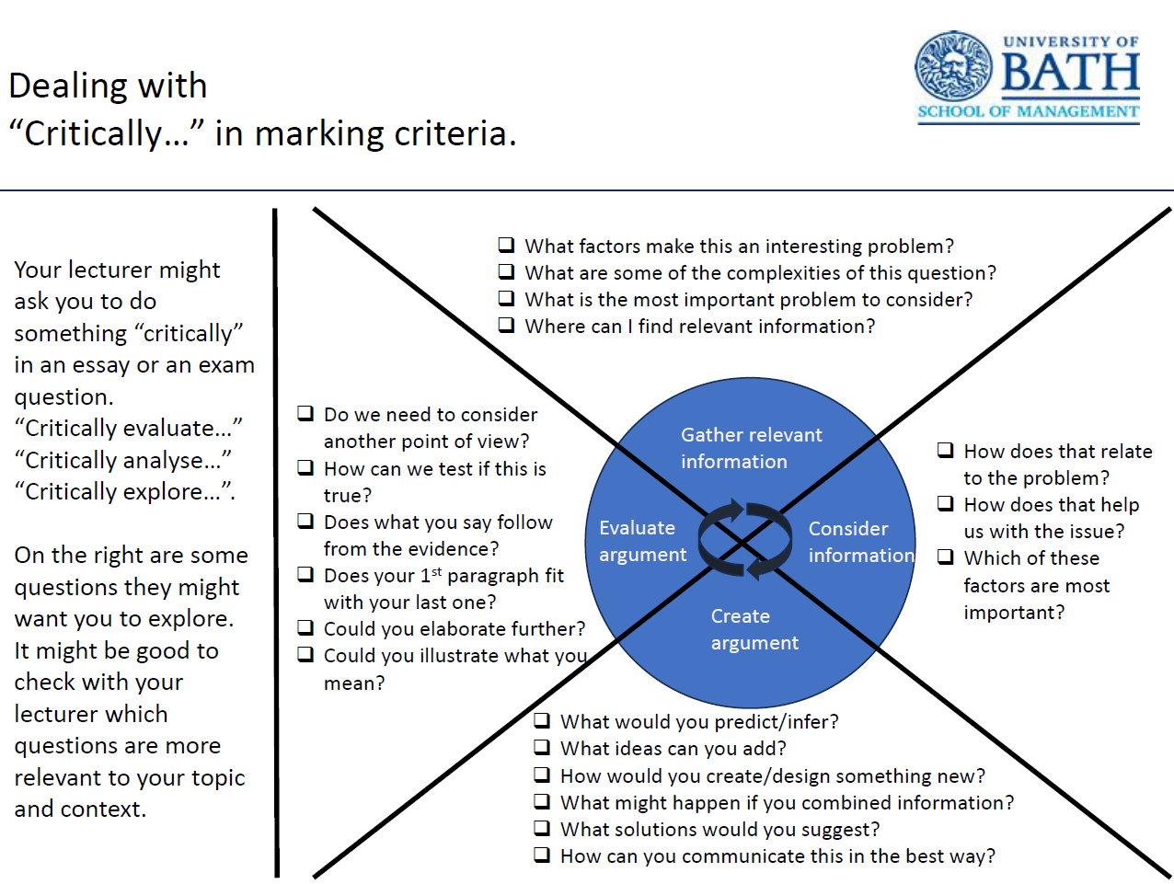
Baris Yalabik (School of Management)
Past work samples.
Students improve samples based on model.
Some benefits
Needs better adoption
Now on SoM big screen and TVs!

Slide 9
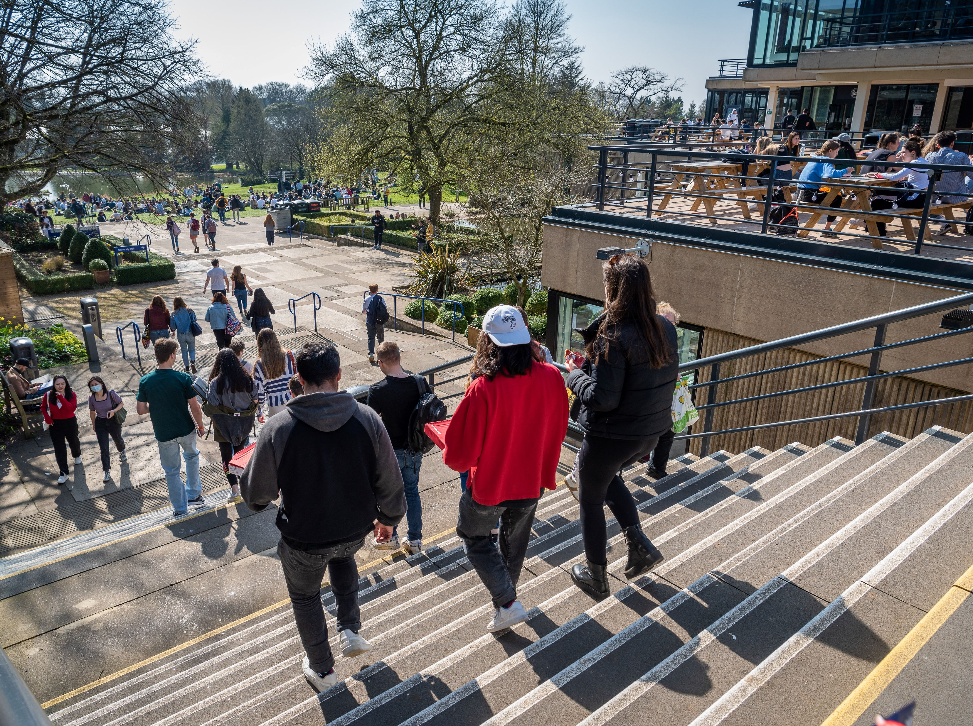
International perspectives

Slide 10
Initial findings: student surveys
A majority of students reported that:
Critical thinking skills are valued by employers and will be important to their lives after University.
Critical thinking skills are more important than ever in an age of Generative AI.
However:
They were less confident in accessing useful resources to support development of critical thinking skills.
Students had some difficulties with inconsistency in the language used across units and within courses.
Notes:
Findings/observations so far:
Often, these conversations might be the first significant time that colleagues have had to reflect on ‘critical thinking’ (reinforces the need to bring back under the magnifying glass and into focus).
Bridging the general and the specific.
Thinking about the common barriers that our students face in understanding/applying critical thinking (or, alternatively, where they show strengths) are key ways to into practically bridging the gap between abstract and concrete.

Slide 11
Initial findings: staff focus groups
Staff noted that:
Beyond outputs: prioritise critical thinking as process.
Teach how: explicit instruction & tools; build on core knowledge.
Student empowerment crucial:
'[students] initially thought that if something was published (a textbook or paper), it was established fact.'
Thinking critically can feel risky for students:
"...there's this fear of going off track..."; "critical thinking is seen as a luxury."
Create safe spaces for open discussion and for 'getting it wrong'; critique vs criticism.
Analyse real-world examples; connect to employability:
"...if an LLM can do this, they're not going to get the job. Students must think about what they are contributing."
Notes:
Findings/observations so far:
Often, these conversations might be the first significant time that colleagues have had to reflect on ‘critical thinking’ (reinforces the need to bring back under the magnifying glass and into focus).
Bridging the general and the specific.
Thinking about the common barriers that our students face in understanding/applying critical thinking (or, alternatively, where they show strengths) are key ways to into practically bridging the gap between abstract and concrete.

Slide 12
Our hopes and expectations
visible AI
critical thinking
invisible AI
human learning
Notes:
Recap:
We feel that whilst GenAI is visible right now, anticipating its increasingly invisible nature in work and learning is important to keep in mind.
Critical thinking – which despite its pervasiveness remains often lacks clarity – is a key way through which to bring human learning to the surface.
Understanding why CT is so important, and growing our shared sense of what it actually is, will be key to equipping staff and students to work together in this space.

Slide 13
Keep in touch
Making human learning visible
in a world of invisible AI
Contact: Abby Osborne aro22@bath.ac.uk
Scan for project news and updates

