Slide 1
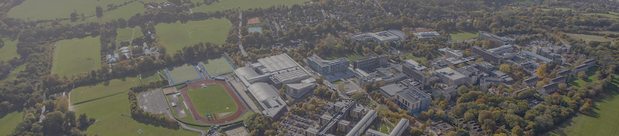







ENVIRONMENTAL LEADERS PROGRAMME
PROGRAMME AIMS
  Worked towards a Level 3 leadership qualification in partnership with the Leadership Skills Foundation through developing our own project: creating a campus biodiversity audit plan. ​
  an online learning component developed in collaboration with WWF and RSPB.

Slide 2
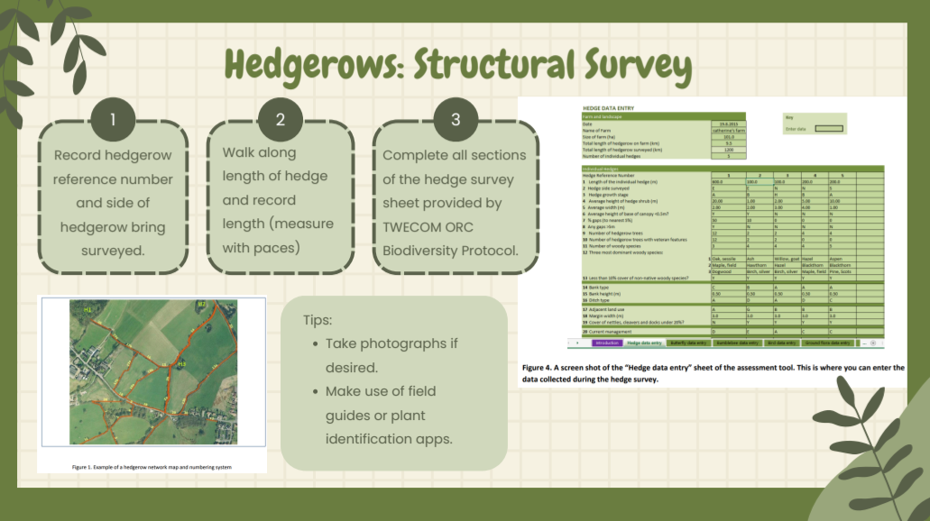
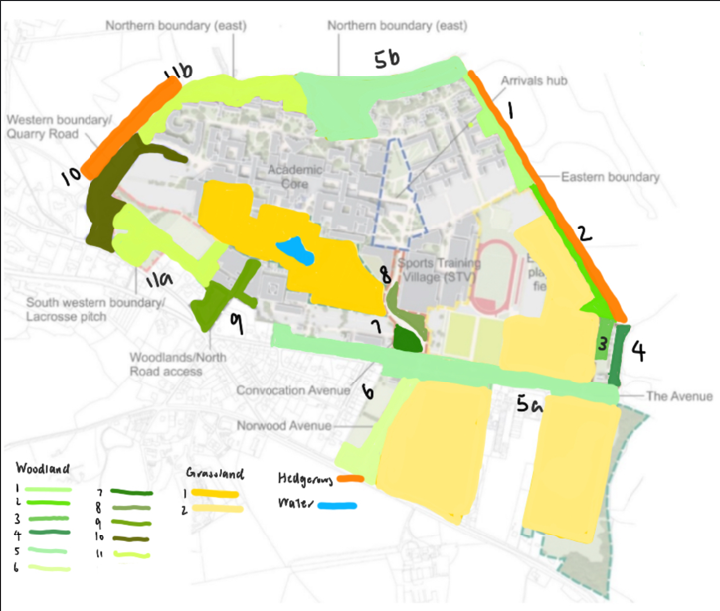
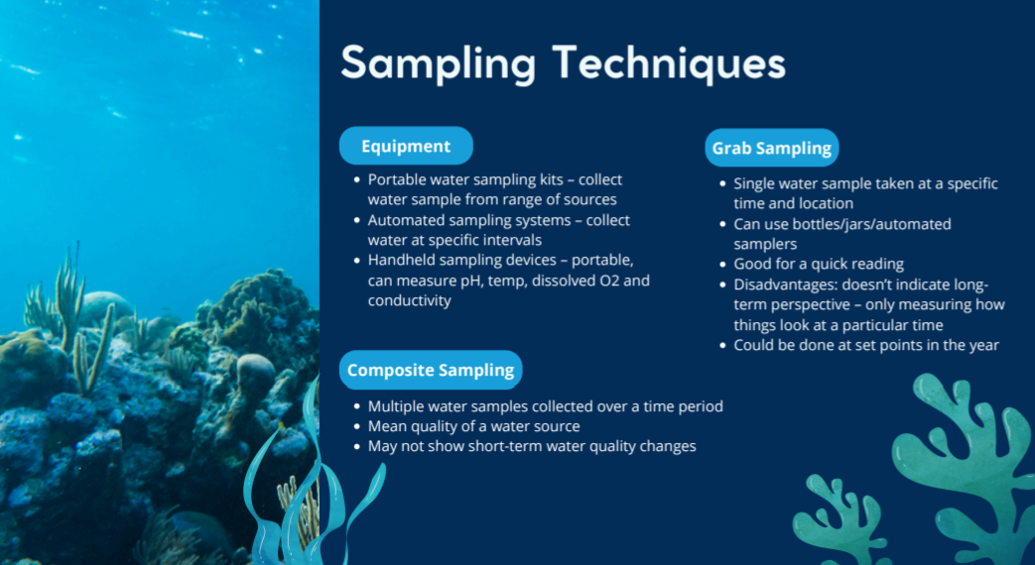
LEADERSHIP QUALIFICATION
BIODIVERSITY AUDIT PLAN
Aims:
Designed to empower students through a mix of online learning and practical experience
Builds leadership capacity while tackling real-world environmental challenges.​
Learning outcomes:​
Develop leadership, teamwork, communication and confidence through applied activities​
Build environmental awareness aligned with global goals​
Encourage positive action in communities​
Aims:
Create practical resources to help future student groups carry out biodiversity audits across campus
Support long term biodiversity protection and student engagement with nature.​
Key Outputs:​
Step-by-step PowerPoint audit guide​
Word document with research sources​ and methods
Campus habitat map with defined biodiversity zones​

