Slide 1
H&SS Faculty SEED Teaching Development Fund Proposal Inclusive approaches to developing self, peer, and AI-assessment approaches.
Dr Joy Cranham
Dr Hannah Hoggarth
Jo Charles
Dr MariCarmen Gil Ortega

Slide 2
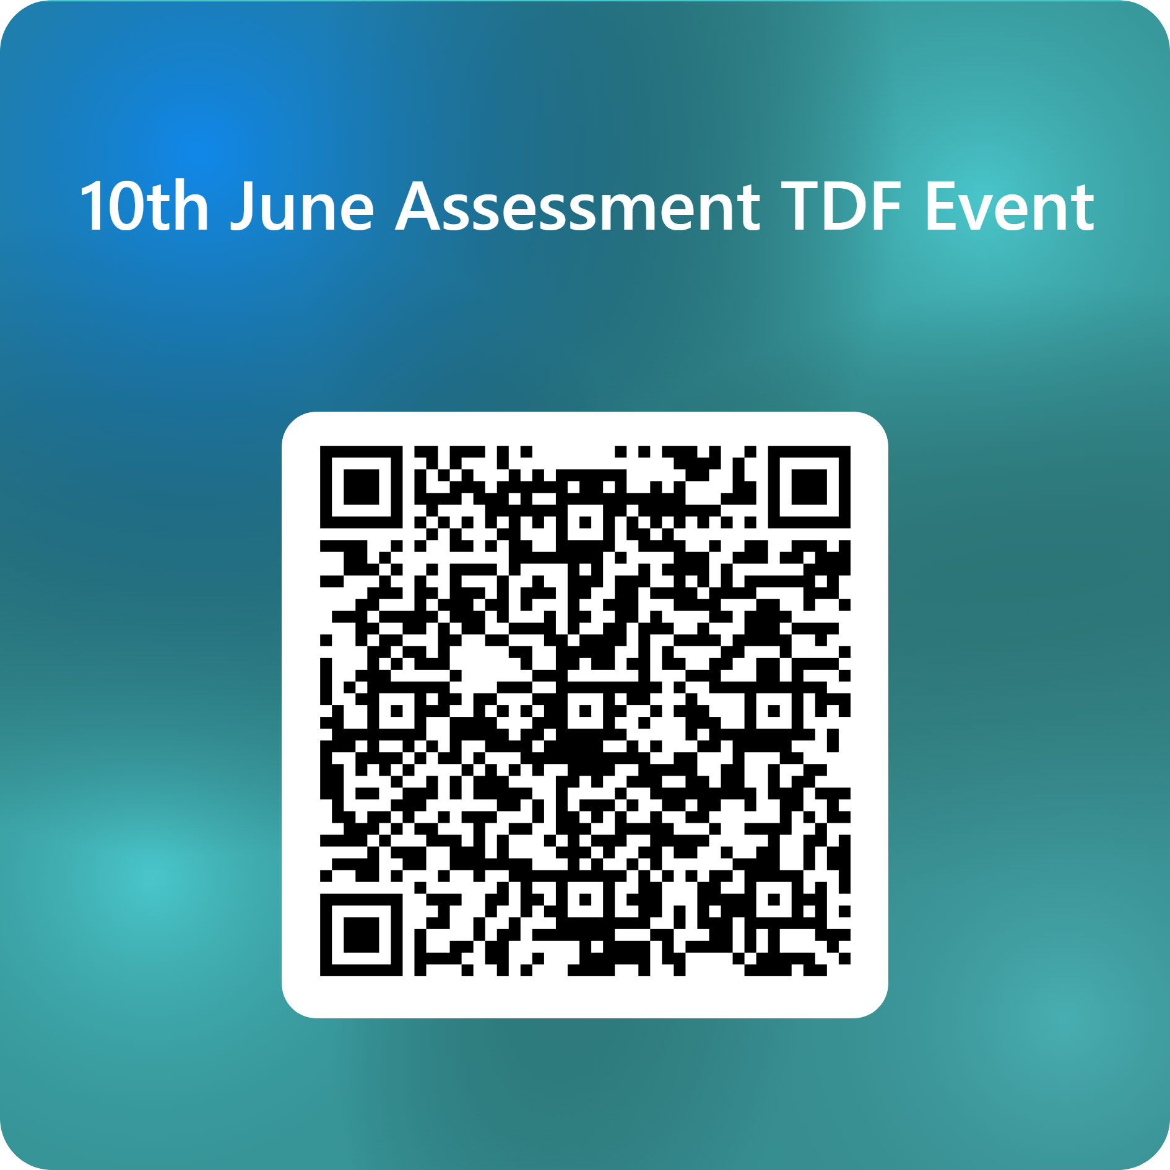

Slide 3
Aims of the project: exploring formative assessment practices in the undergraduate Education with Psychology course
To empower undergraduates to use self, peer, and AI-based evaluation methods to enhance their academic performance.
Notes:
The pedagogical practices associated with Assessment for Learning illuminates the important role self and peer assessment can perform in aiding the development of critical thinking and enhances students’ familiarity with both the criteria for success and the content being covered (Gonzalez-Perez, et al., 2022). Furthermore, these approaches offer students behaviours that aid them identifying themselves as autonomous learners (Nieminen, 2024). Additionally, the aid the development of communicative and cooperative skills.

Slide 4
Project processes
One semester with Year 1 Undergraduate students in Education with Psychology
Students engaged in the following three assessment processes:
Self, peer and AI-based assessment
We co-created evaluation forms and carried out reflections of these different strategies
Students developed a guide for students and lecturers on how to engage effectively with different forms of assessment to enhance learning and experiences

