Slide 1
PGT Writing Cafés
Leah McCue
Digital and Academic Skills

Slide 2
How can we support PGT students with academic writing and create a sense of community?

Slide 3
Project Aims
Increase awareness and reach of support.
Create a welcoming environment for best practice sharing.
To facilitate scaffolding and peer review.
To ensure accessibility, inclusivity, employability, and academic skills are interwoven throughout this provision.
Provide a model that can be adapted/replicated.
Notes:
Provide a model that can be adapted/replicated for remote learning PGT and on campus UG students.

Slide 4
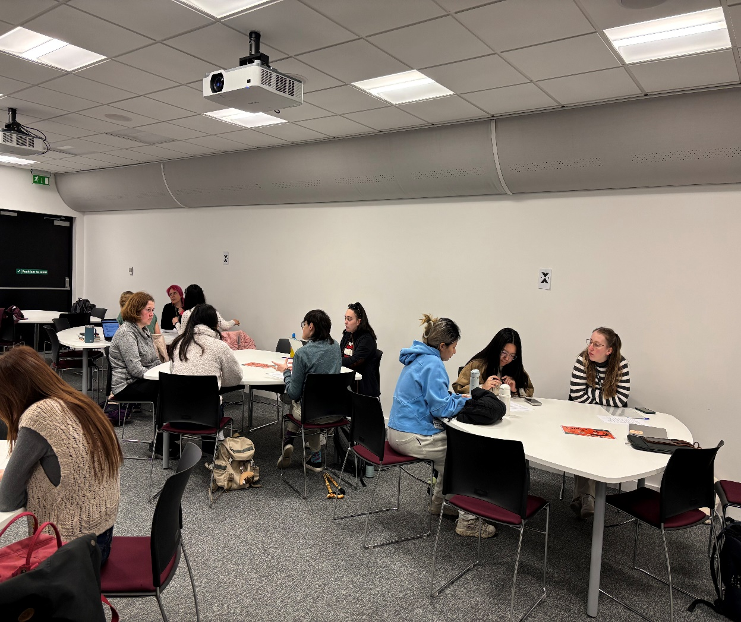
The Writing Café
How do they work?
PGR Writing Guides.
Facilitating.
Signposting.
Monthly events.
Changing topics.
MySkills sign-ups.

Slide 5
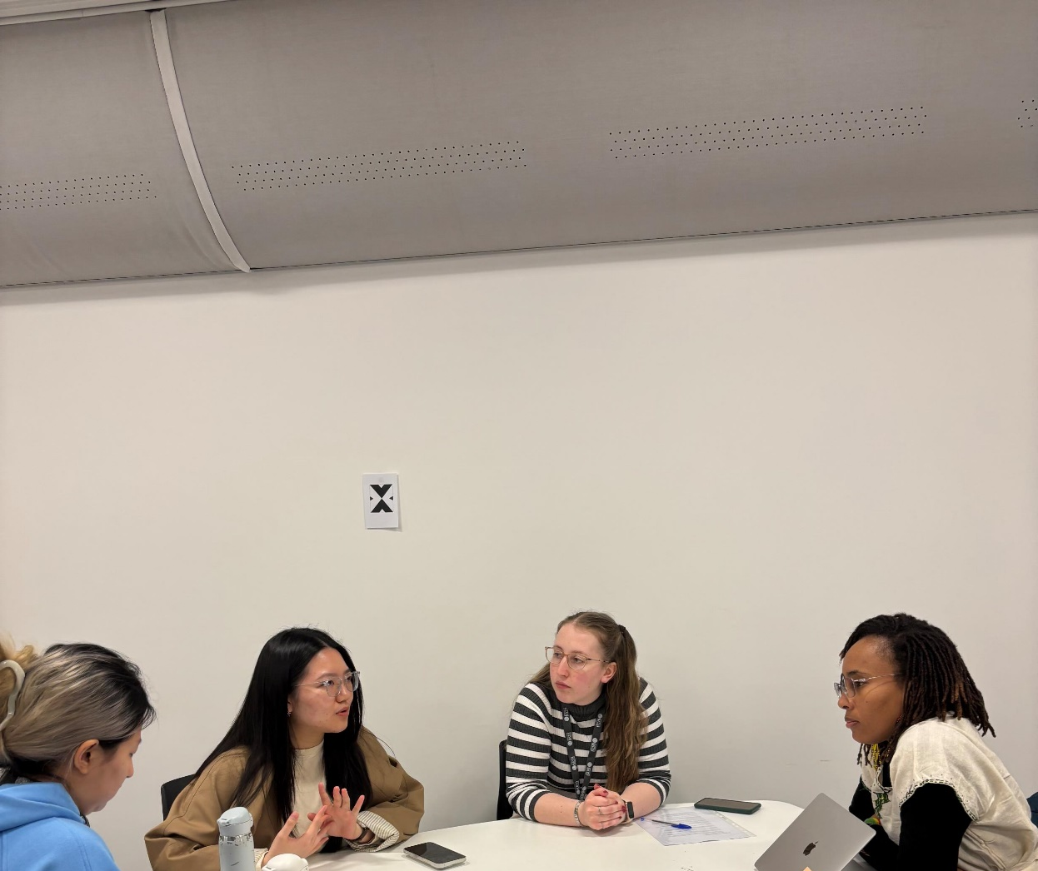
Project Challenges
PGR Writing Guide Recruitment.
Limitations to support.
E.g., Subject-specific queries.
Demand vs. attendance.

Slide 6
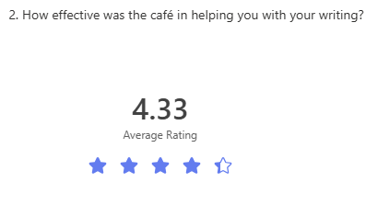
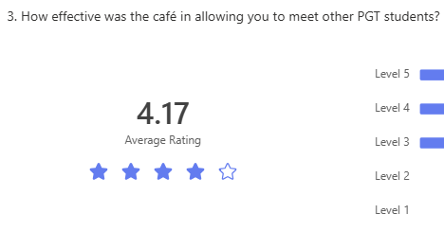
Feedback

Slide 7
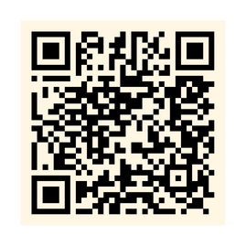
Writing Café Promo
Writing Café
Exclusively by PGR students,
for PGT students.
Improve your writing skills and
build connections with fellow students.
Find out more on MySkills:
Notes:
Show if the June café is going ahead.

Slide 8
Digital and Academic Skills
Digital and Academic Skills
Get the most out of your studies
Scan the QR code to start your skills development journey today!
Enhance your personal and professional development with Skills for Success workshops.
Customise your learning experience with personalised tutorials.
Get support with assessments and exam skills.
Upskill at your own pace with self-access online resources through MySkills.
unihub.bath.ac.uk/s/myskills

