Slide 1
Best team in support of student learning award
Team:
Jo Charles
Rhiannon Edwards
Gail Forey, Ed Mason and Lucy Noble

Slide 2
Goals
Enhance assessment understanding
Promote a shared language around assessment
Ensure clarity regarding assessment criteria and performance standards

Slide 3
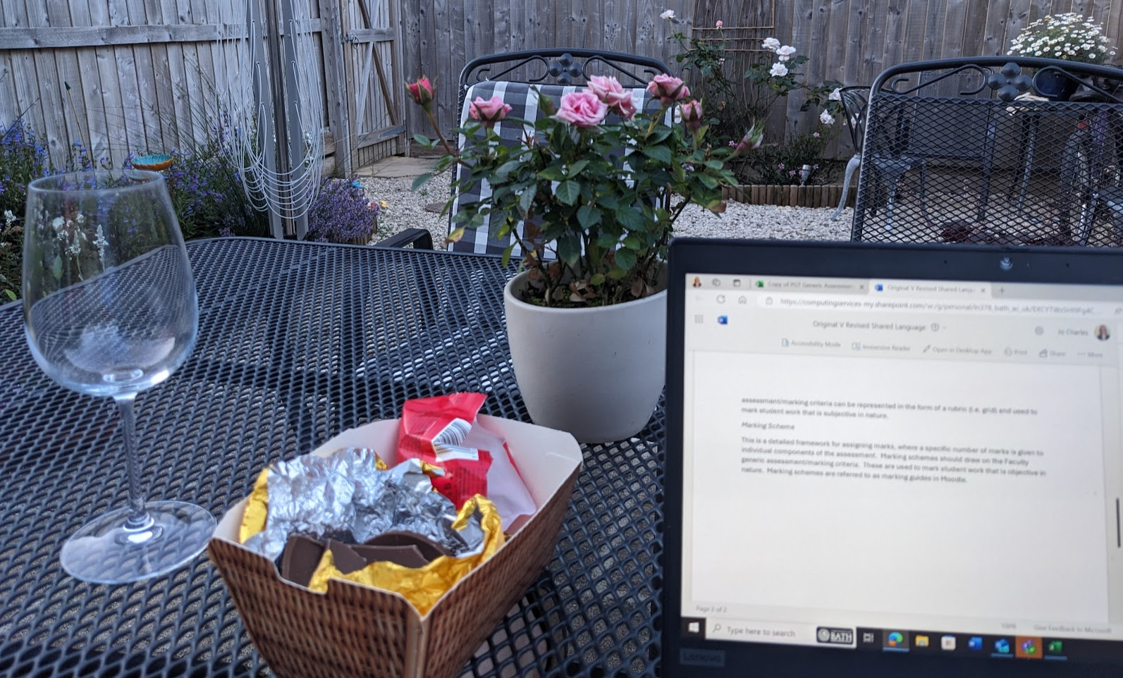

Slide 4
How?
Collaborate approach
Faculty–wide consultations including DoS/DoT discussions and DoT away days
Co-creation with staff and students
Workshops
Focus groups
Task and finish groups

Slide 5
What have we achieved?
Faculty-wide assessment brief
Generic Postgraduate Assessment Criteria
Exemplars of specific assessment criteria and implementation workshops
Generic Undergraduate Assessment Criteria
Recognition of ‘best practice’ in various university reports (EAB,UEB, EQSC)

Slide 6
What next?
Advance HE conference presentation July 1st 2025:
Enhancing Assessment Literacy: The Development of Shared Assessment Language and Faculty Level PGT Generic Assessment Criteria
Review both the PG and UG assessment criteria after implementation and feedback

Slide 7
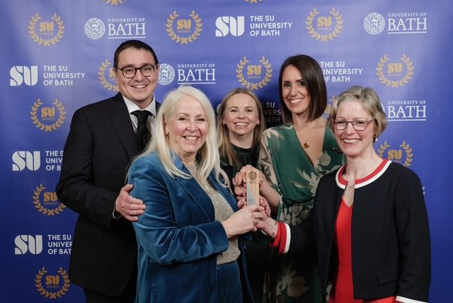
Thank you!
“It’s fantastic working with such a great team of dedicated, insightful, warm and generous people!
I feel very lucky to be working with you all!”

