Slide 1
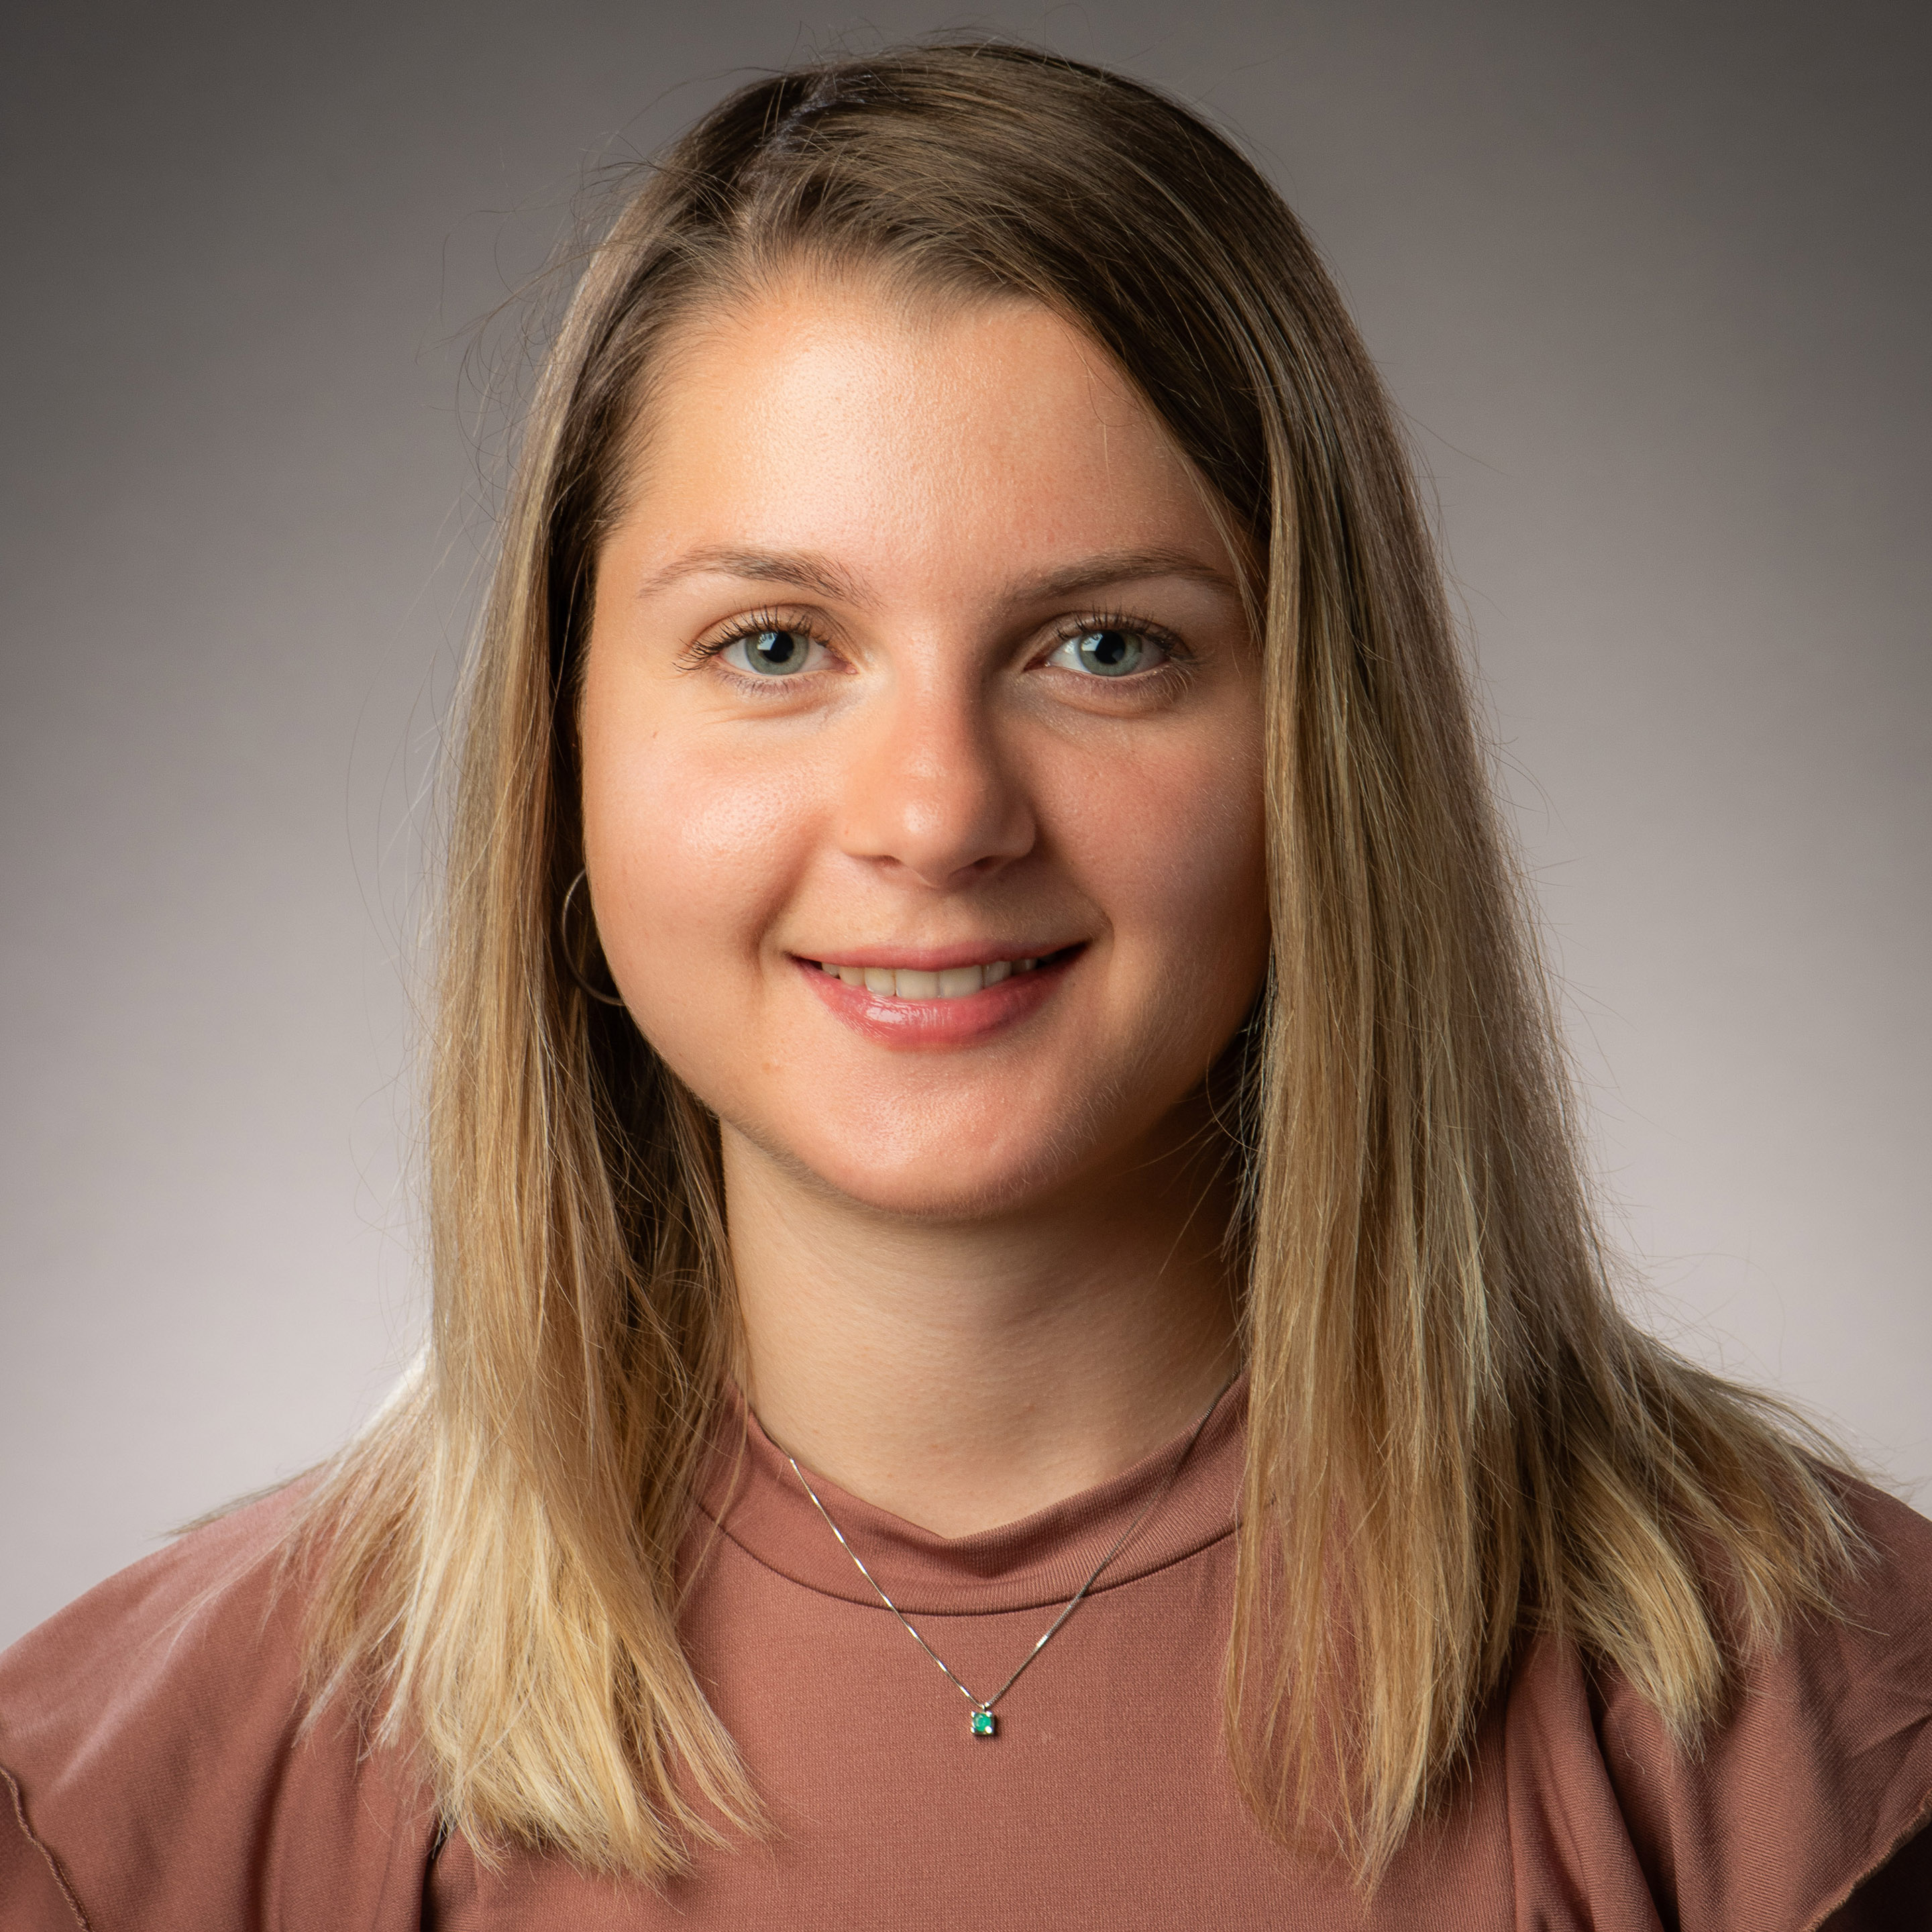
Alessandra Guiliani, Department of Psychology, Associate Fellow

Slide 2
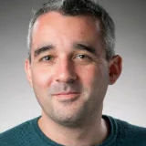
Peter Manning, Department of Social
and Policy Sciences, Senior Fellow

Slide 3
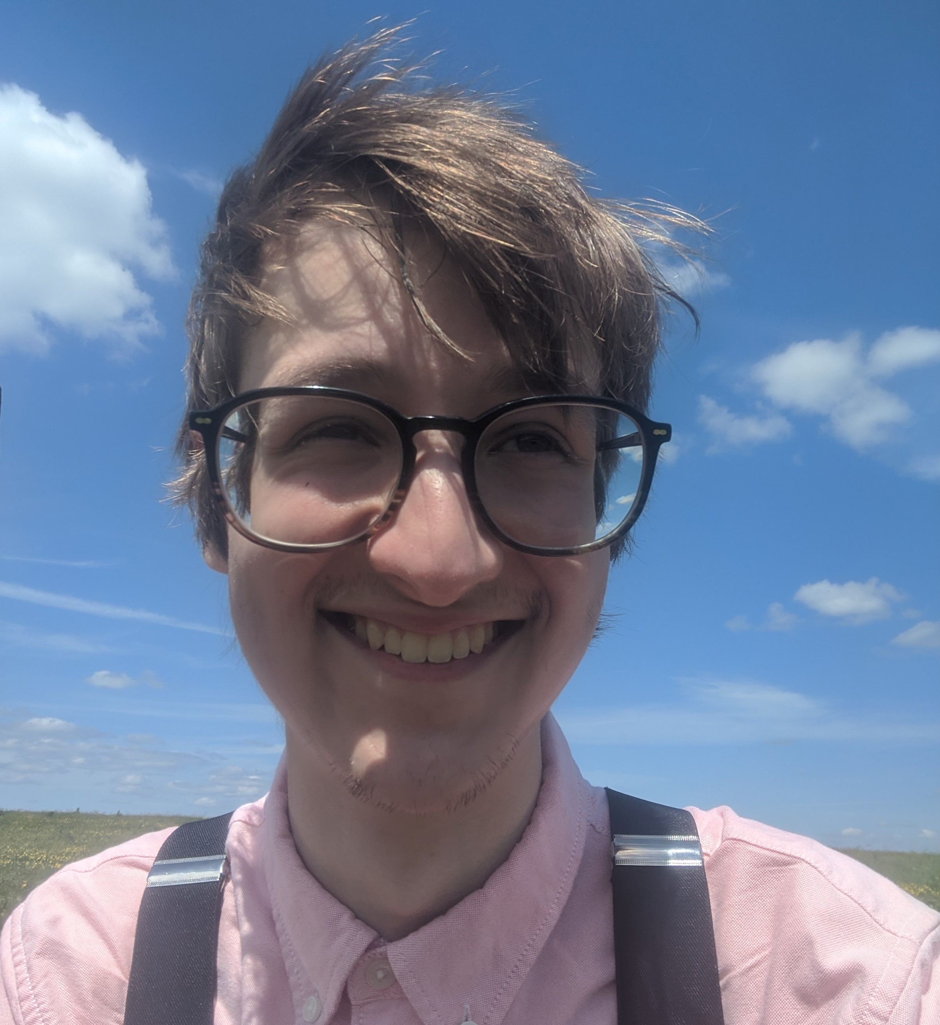
Patrick Taylor, Department of Chemistry, Associate Fellow

Slide 4
FHEA awarded – Experiential Pathway
“I won’t lie — it took me a while to get started on my FHEA application. Maybe it was writing paralysis, just trying to find the time, or any other excuse (and I gave many excuses throughout the process!). What finally got me going was building a support community around me. In fact, that became the most beneficial and rewarding part of the whole process because I know this community I built isn't going anywhere. I now know who I can turn to when I’m struggling with my teaching — people who will listen without judgement, and who can offer support or guidance when I need it. That network is something I’ll carry with me well beyond the application.”

Slide 5
Polly Winfield, Department of Social
and Policy Sciences, Fellow

Slide 6
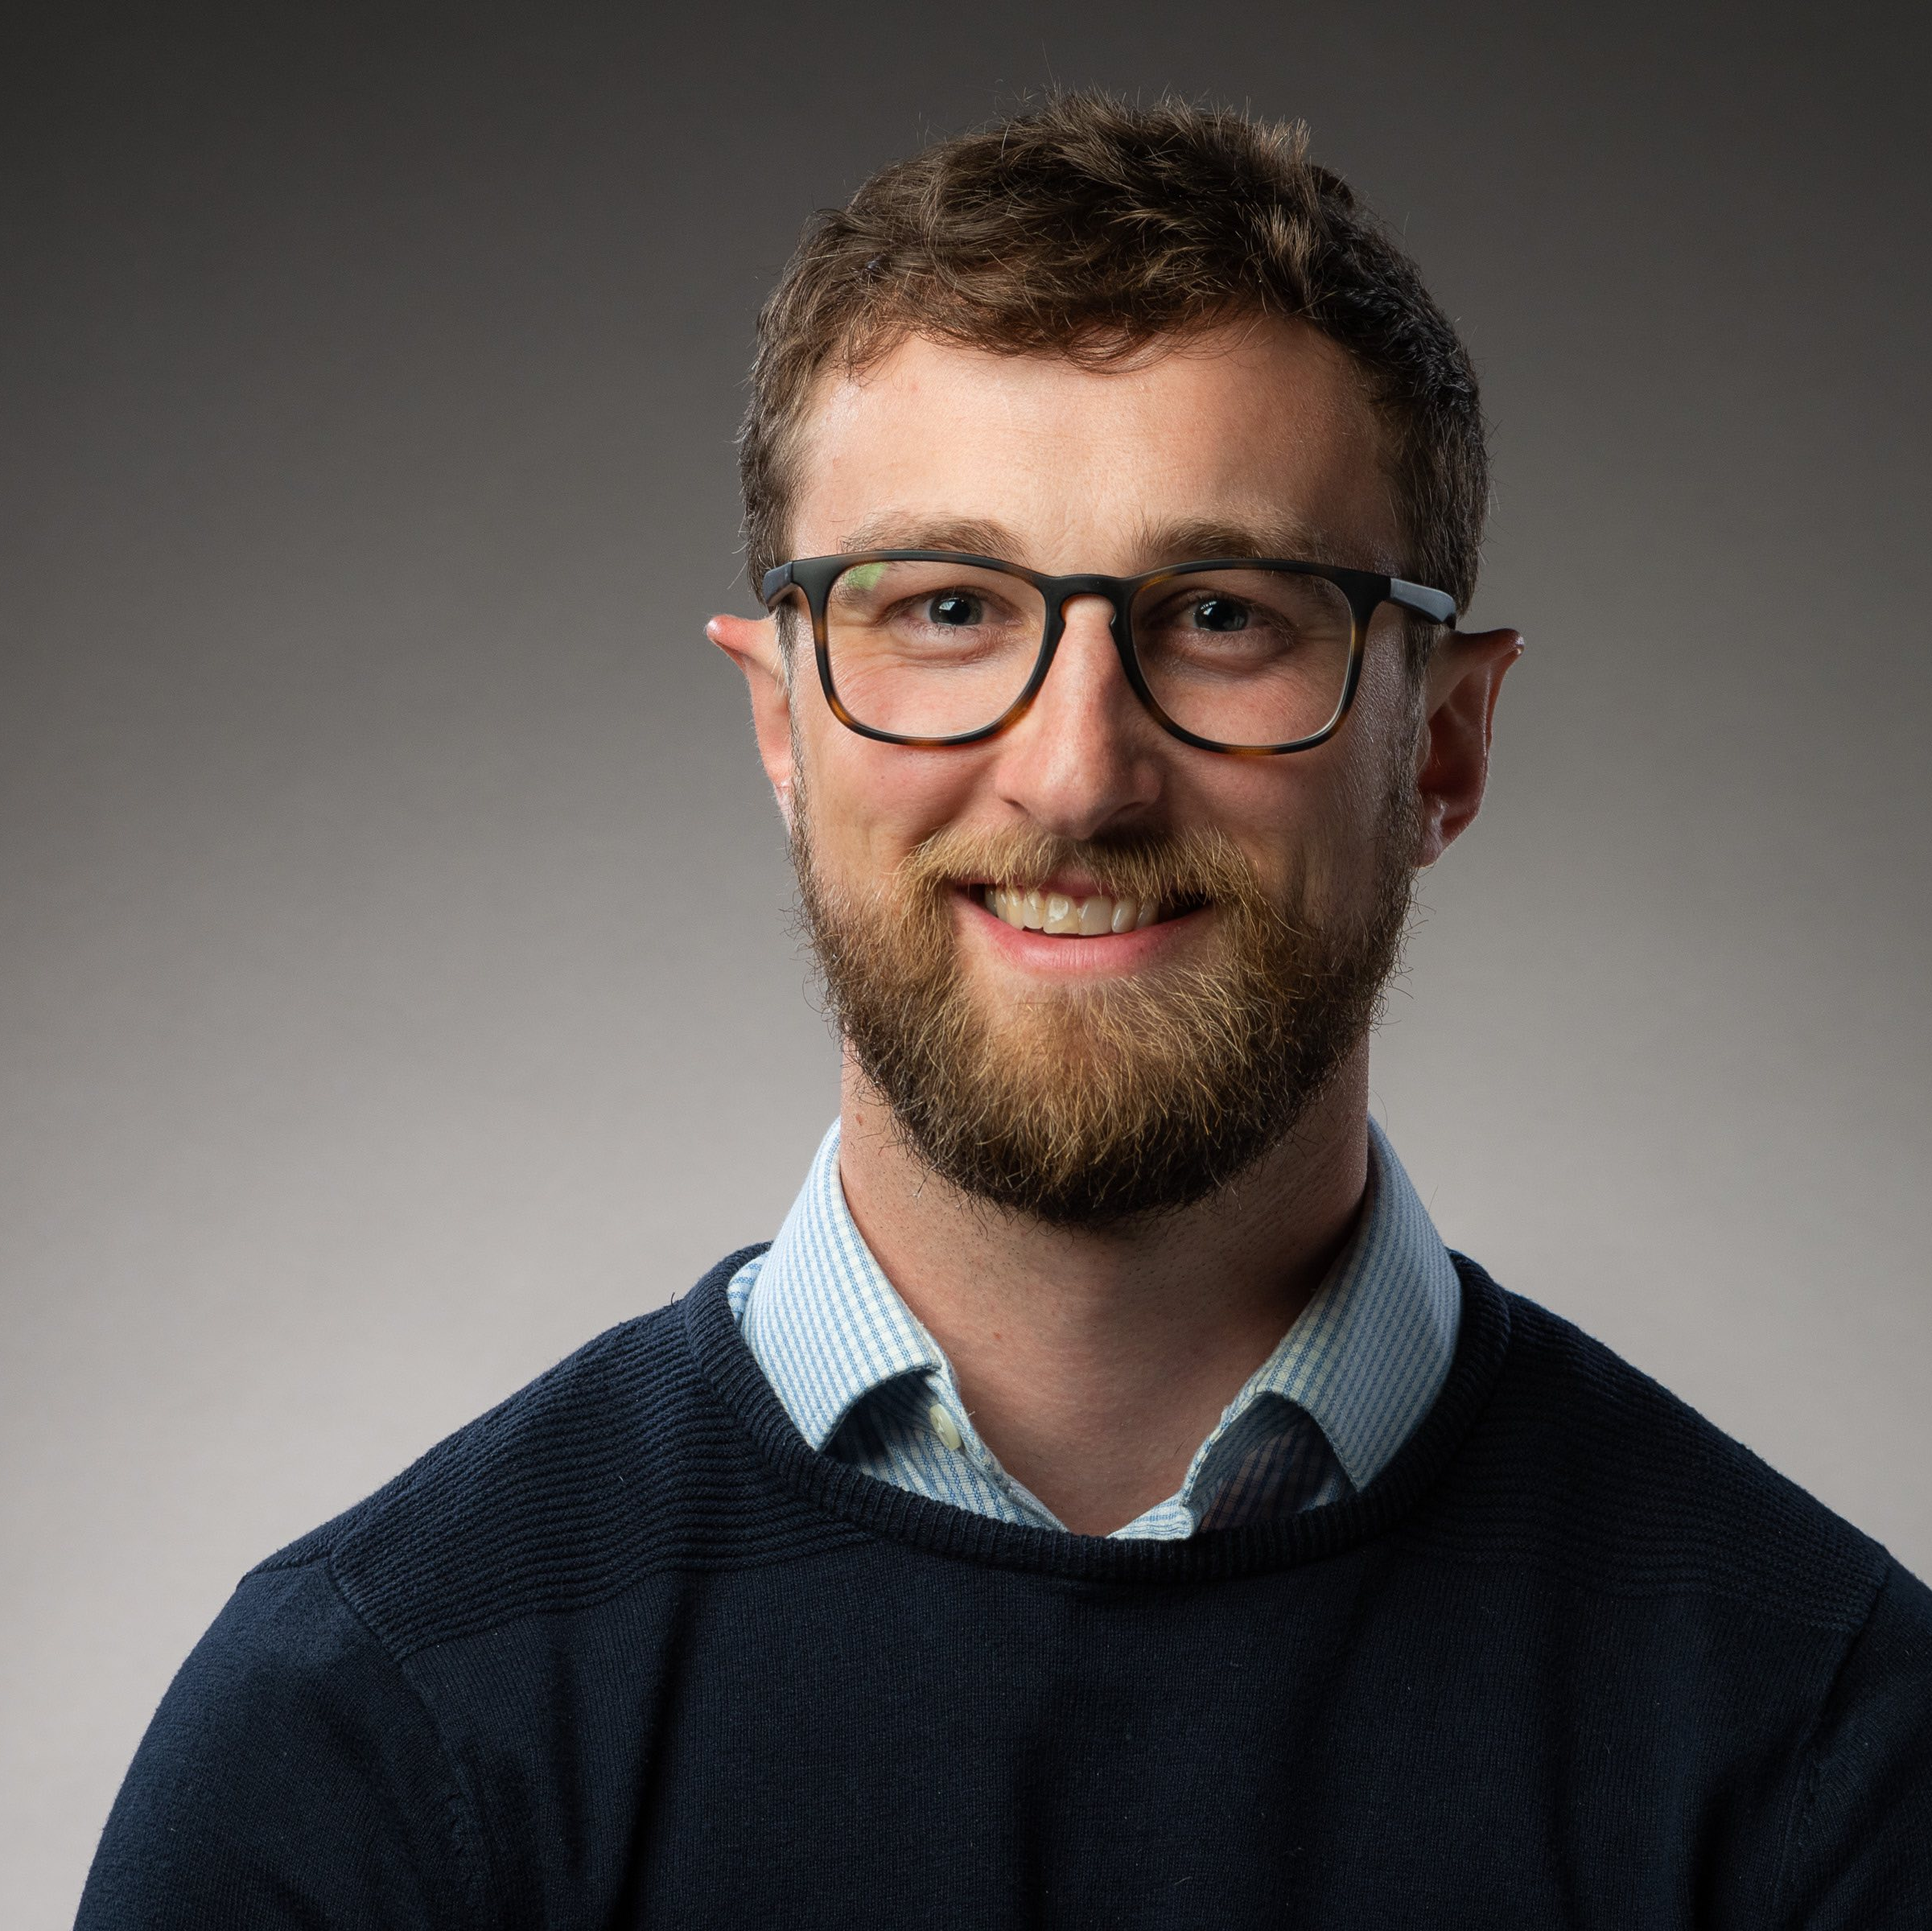
Stephen West, Department for Health, Fellow

Slide 7
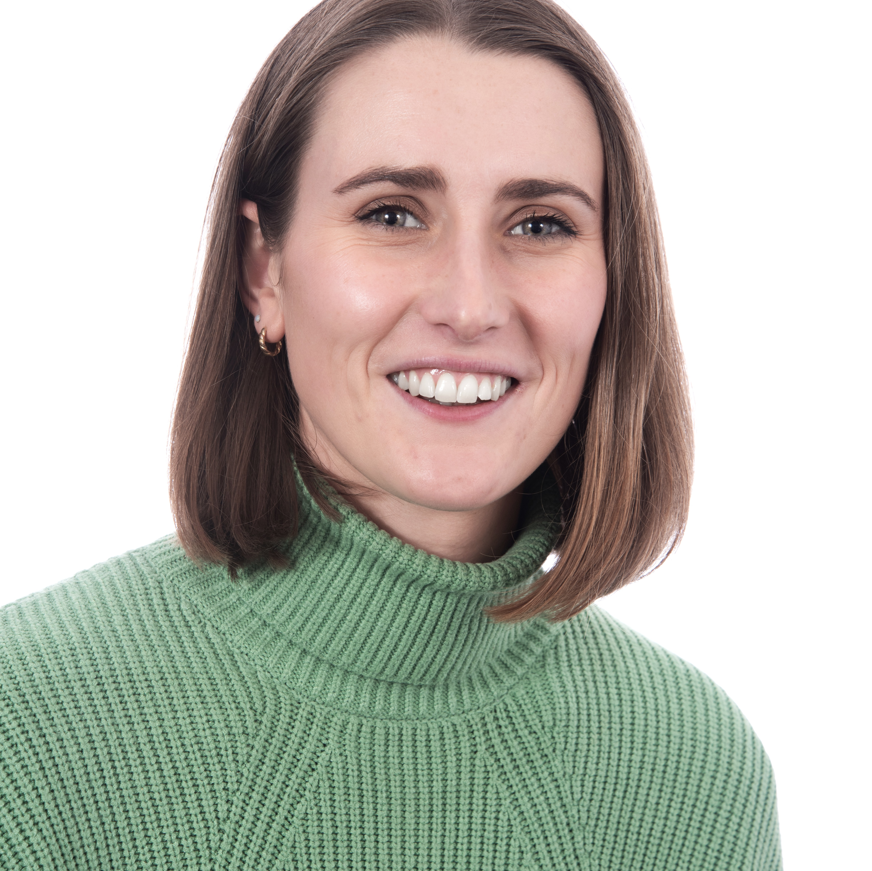
Georgina Wart, Department for Health, Fellow

Slide 8
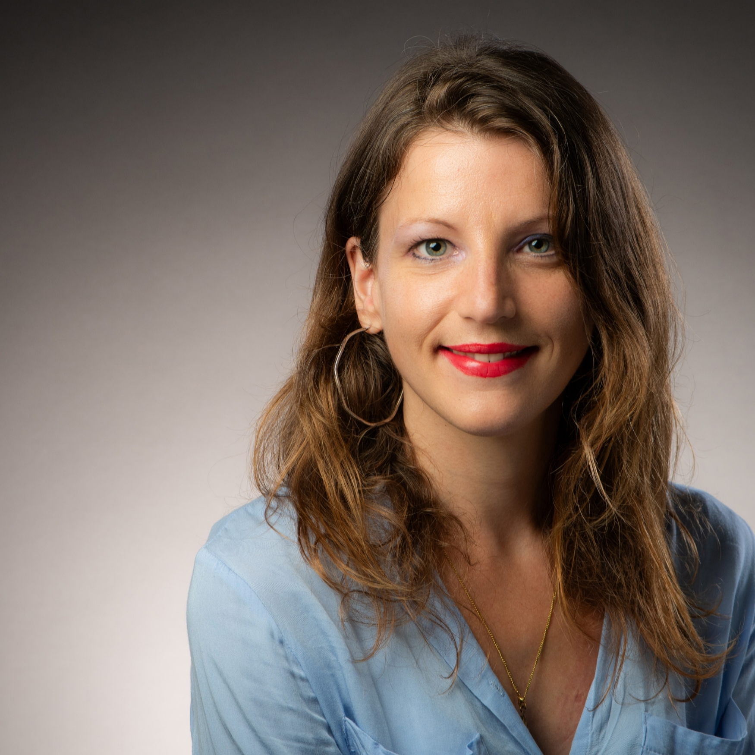
Lucy-Anne Katgely, Department of Politics, International Studies
and Languages, Fellow

Slide 9
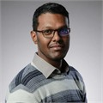
Sanjay Nagarajan, Department of Chemistry, Fellow

Slide 10
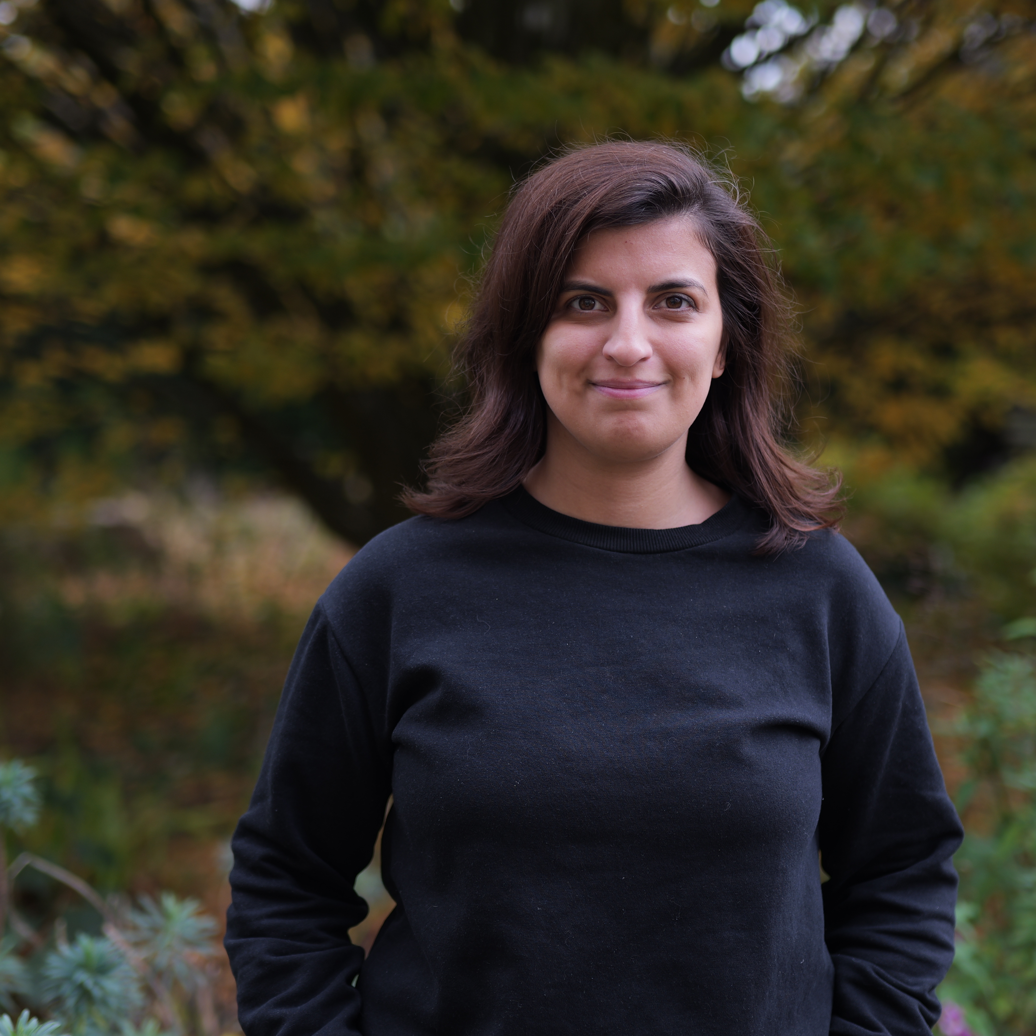
Valeria Cascione, Department of Architecture & Civil Engineering, Fellow

Slide 11
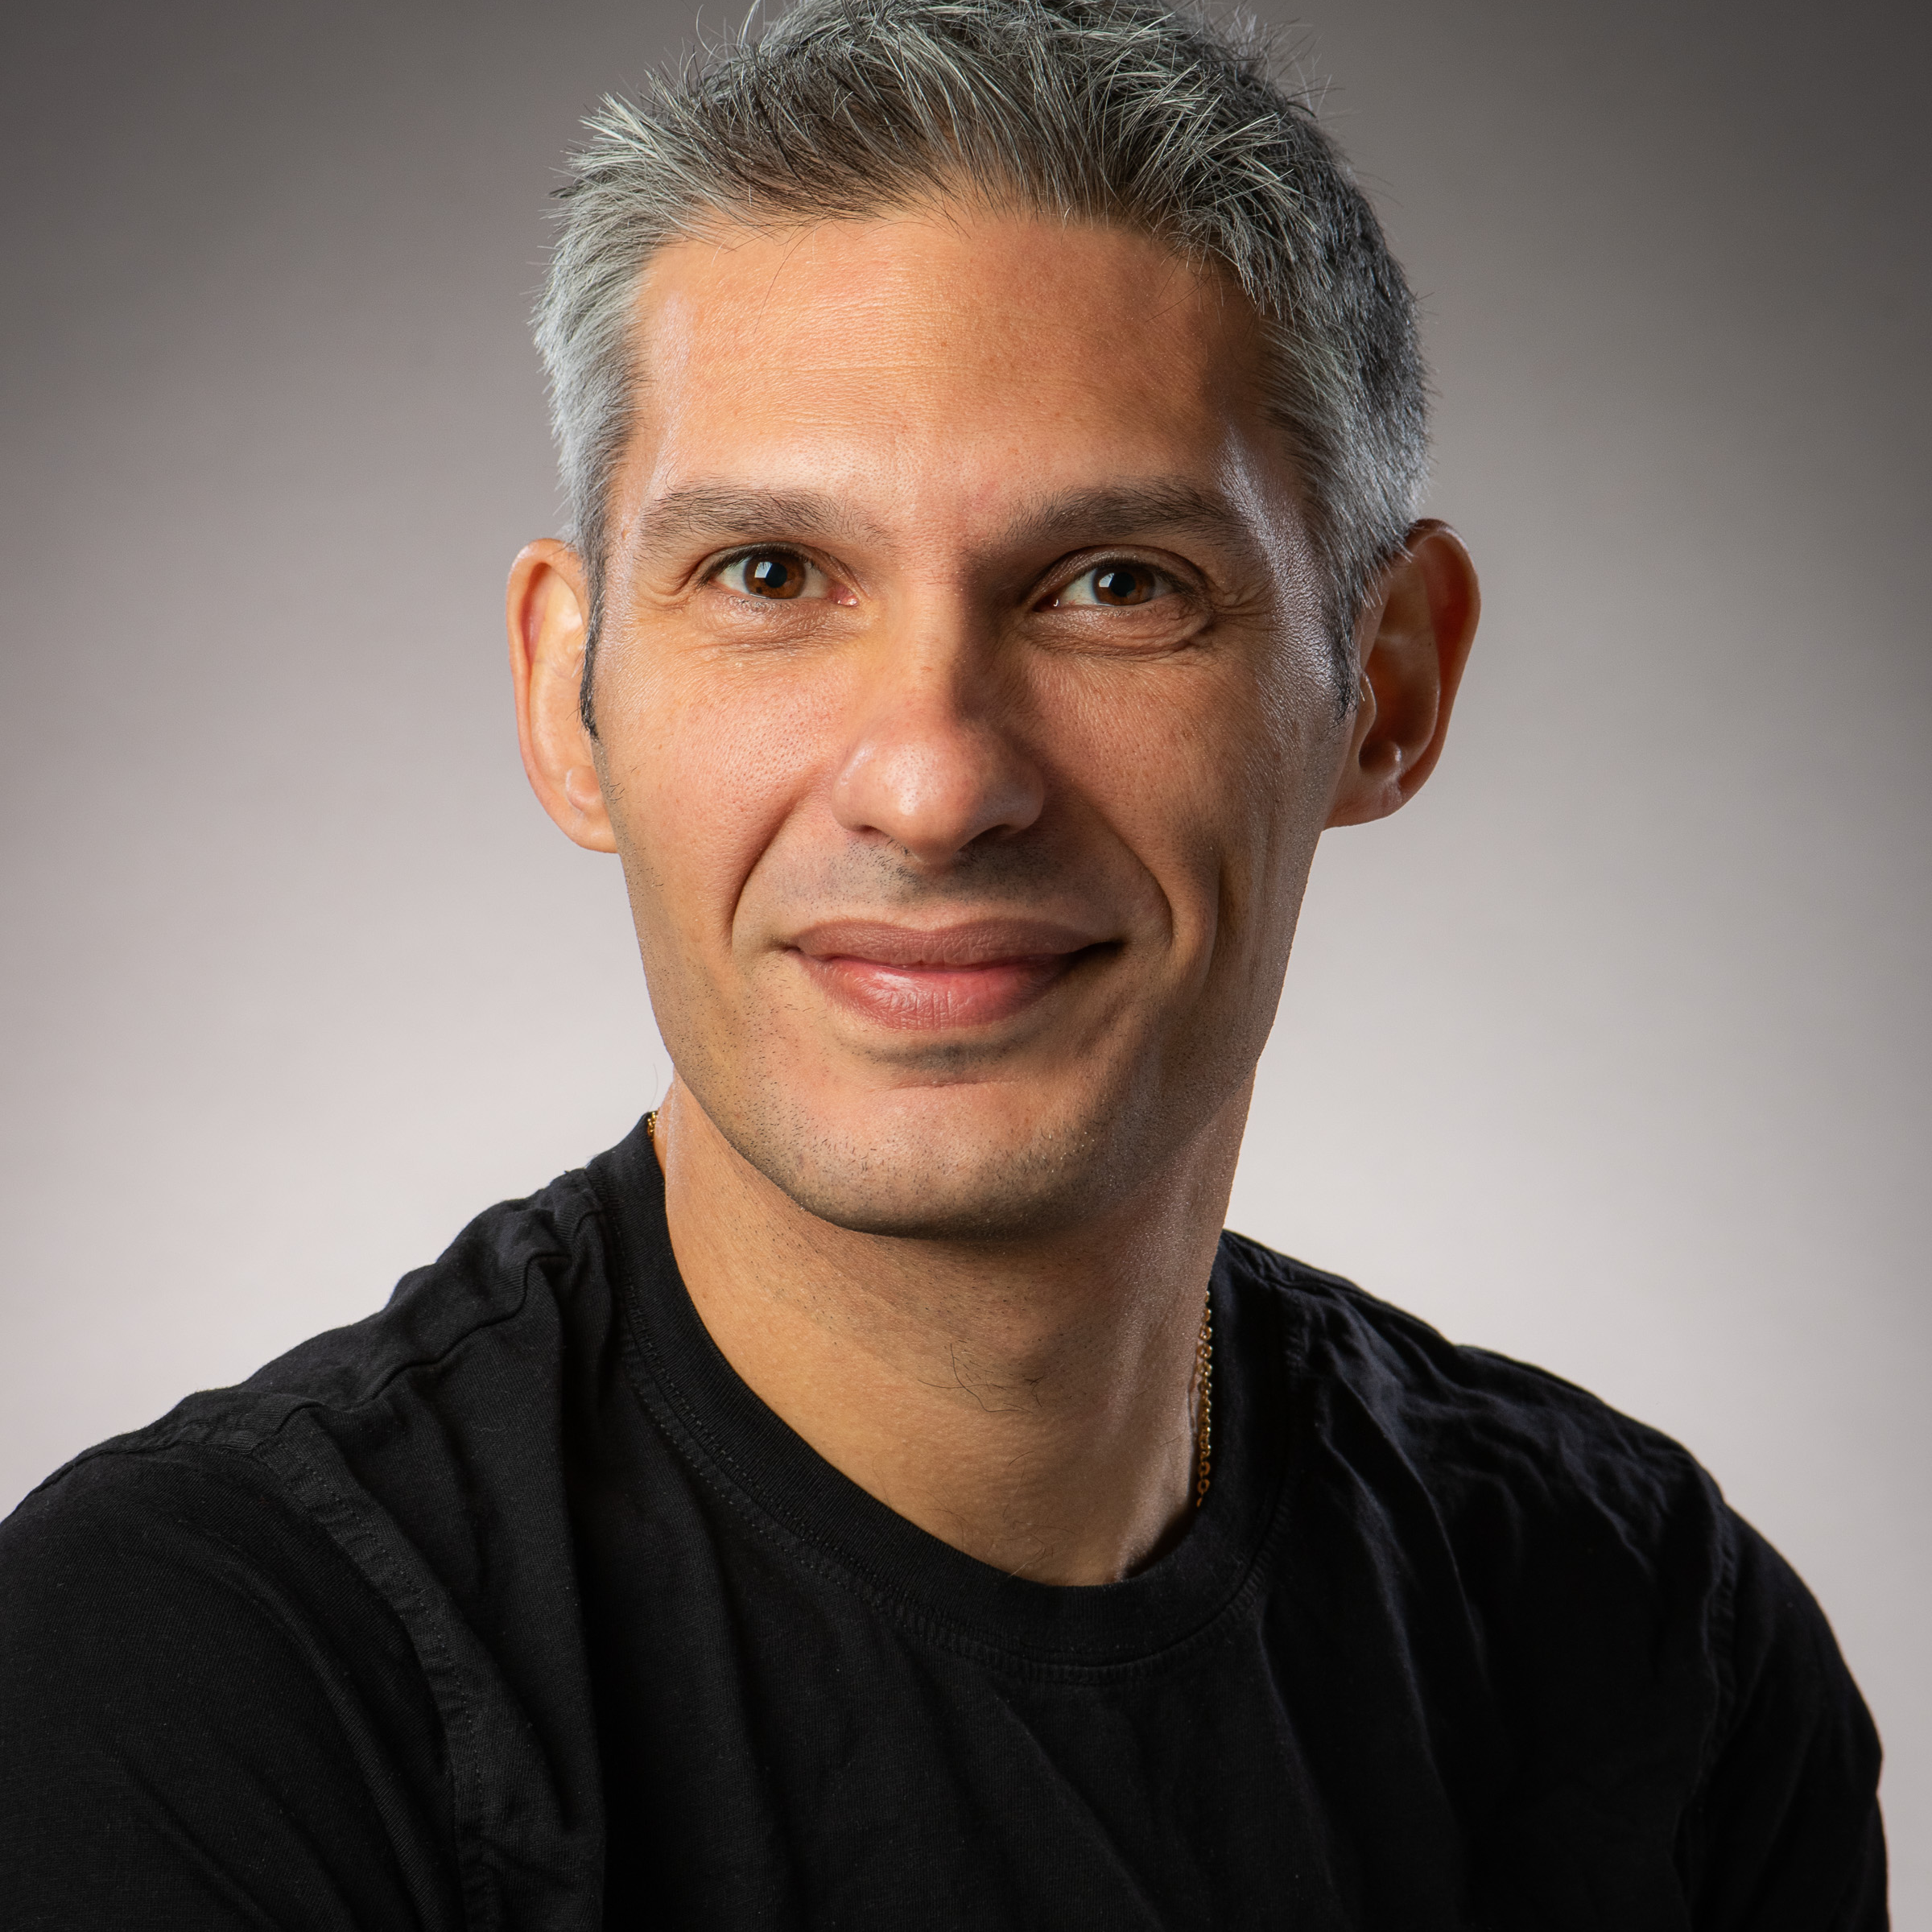
Antonio Pellegrino, Department of Mechanical Engineering, Fellow

Slide 12
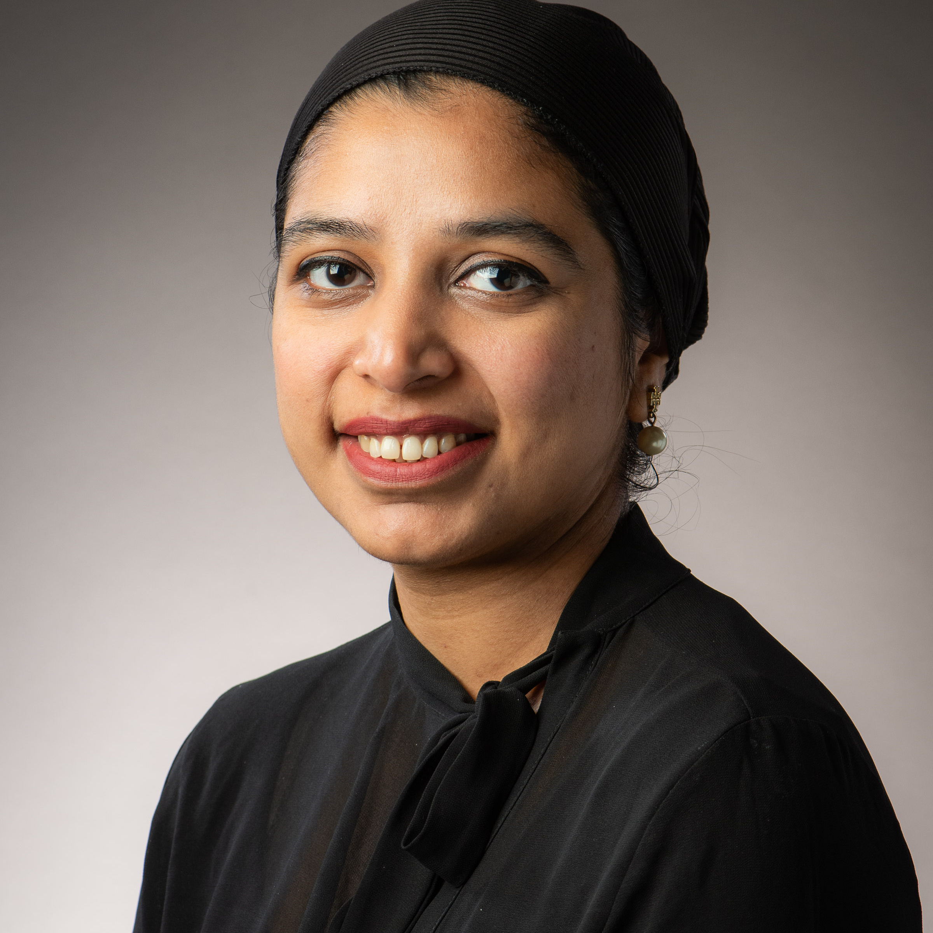
Fareena Noor Malhi, Department of Economics, Associate Fellow

Slide 13
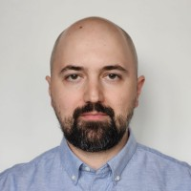
Aykut Tamer, Department of Mechanical Engineering, Fellow

Slide 14
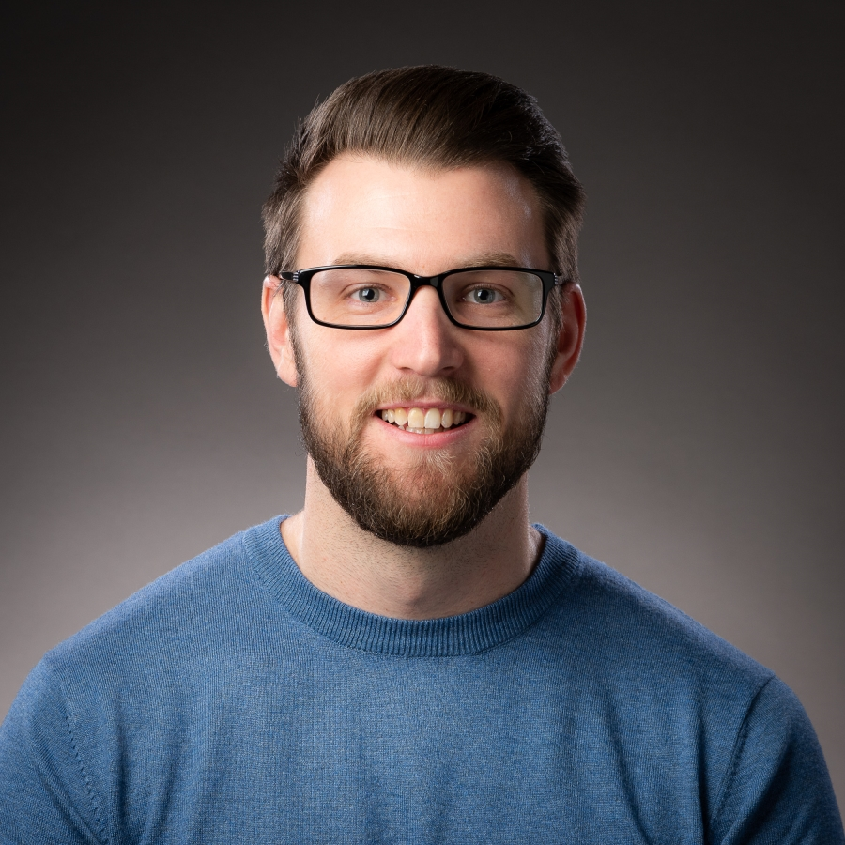
Adam Brazil, Department for Health, Senior Fellow

Slide 15
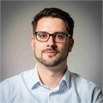
Matthias Ehrhardt, Department of Mathematical Sciences, Fellow

Slide 16
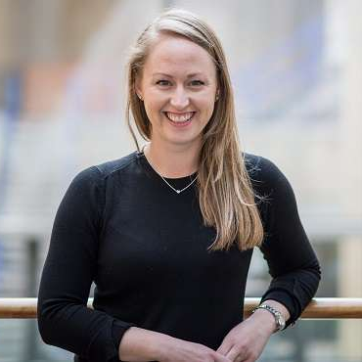
Christina Keating, Department of Computer Science, Fellow

Slide 17
Evi Papadaki, Skills Centre, Fellow

Slide 18
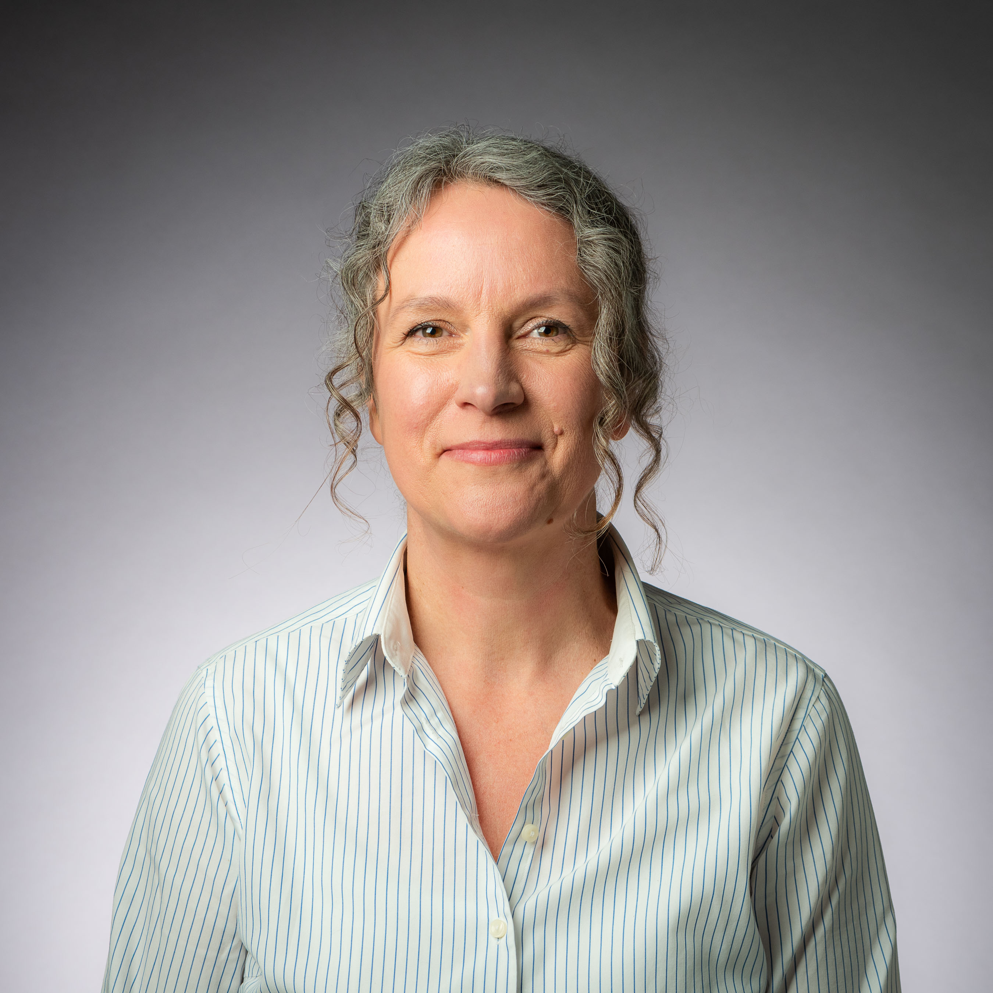
Tina Skinner, Department of Social
and Policy Sciences, Senior Fellow

Slide 19
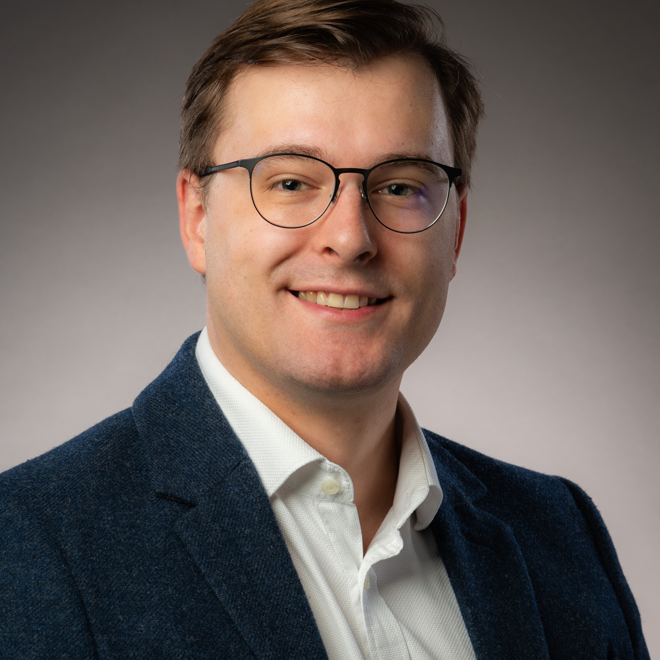
Robin Groleau, Department of Life Sciences, Fellow

Slide 20
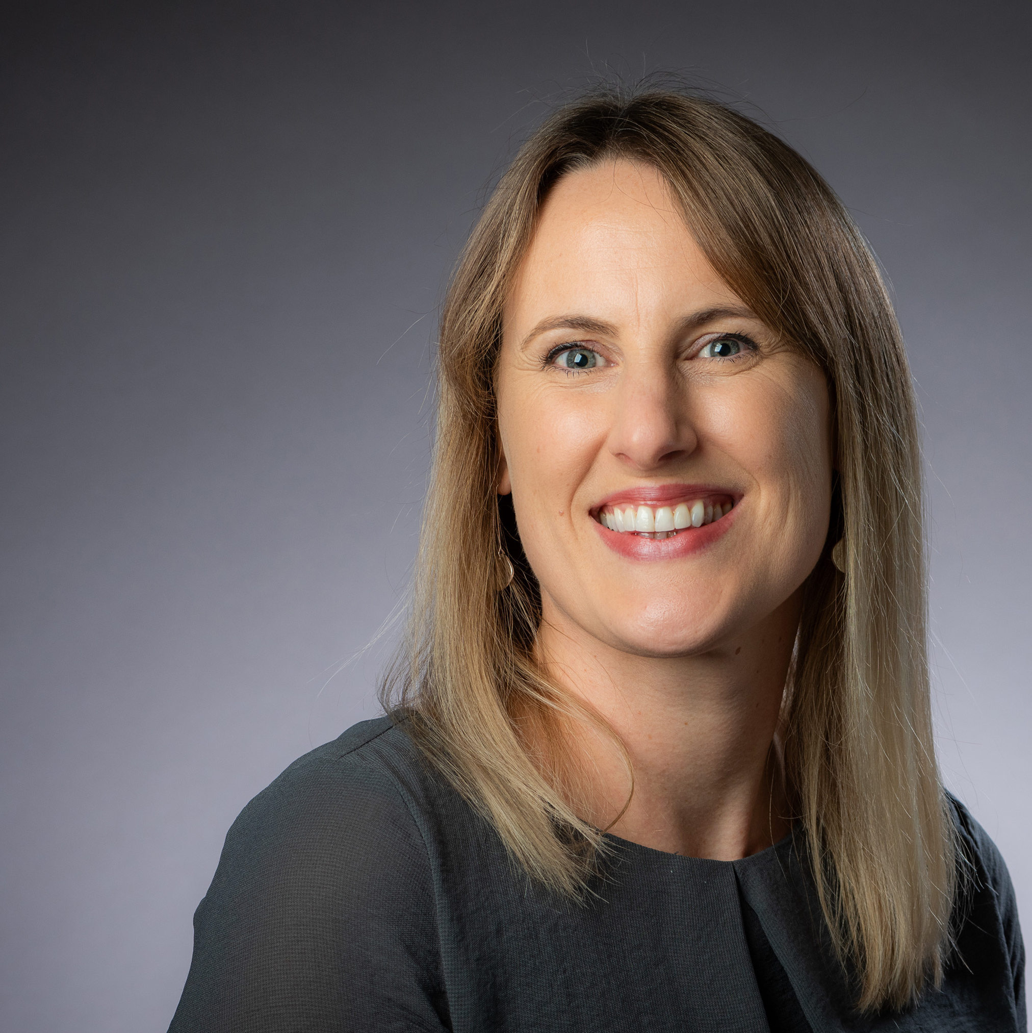
Rachel Evans, Department of Psychology, Fellow

Slide 21
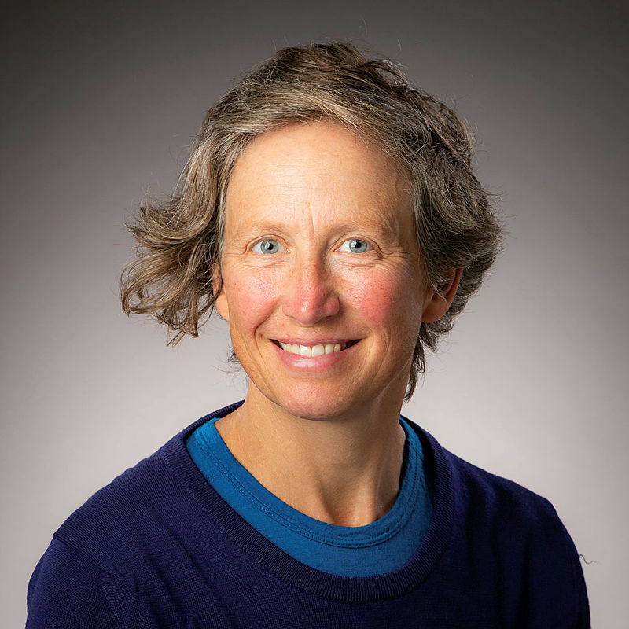
Elies Dekoninck, Department of Mechanical Engineering, Senior Fellow

Slide 22
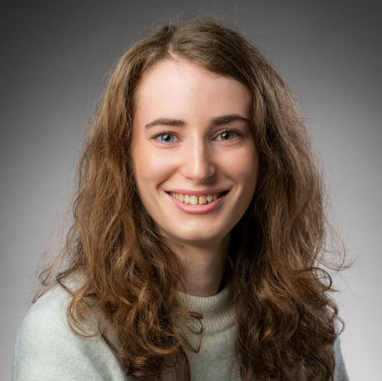
Sarah Dance, Department of Psychology, Associate Fellow

Slide 23
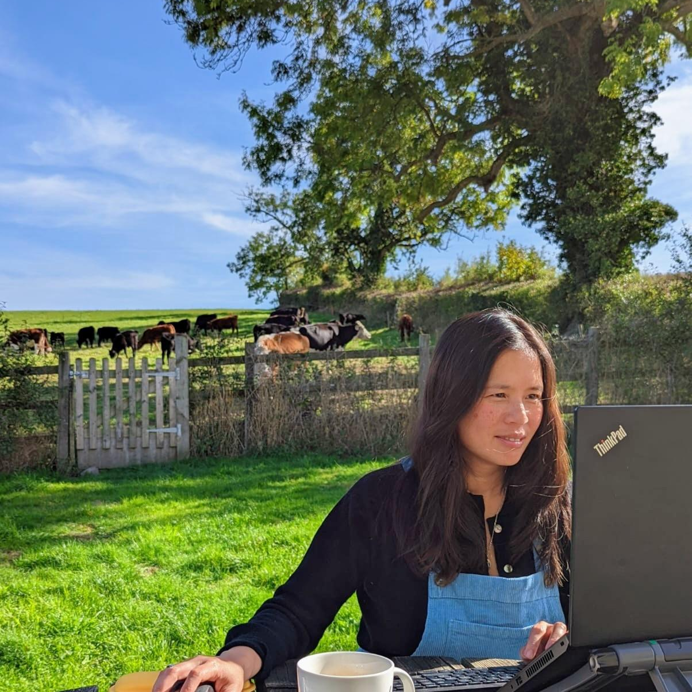
Lynn Cheong-White, Centre for Learning & Teaching, Fellow

Slide 24
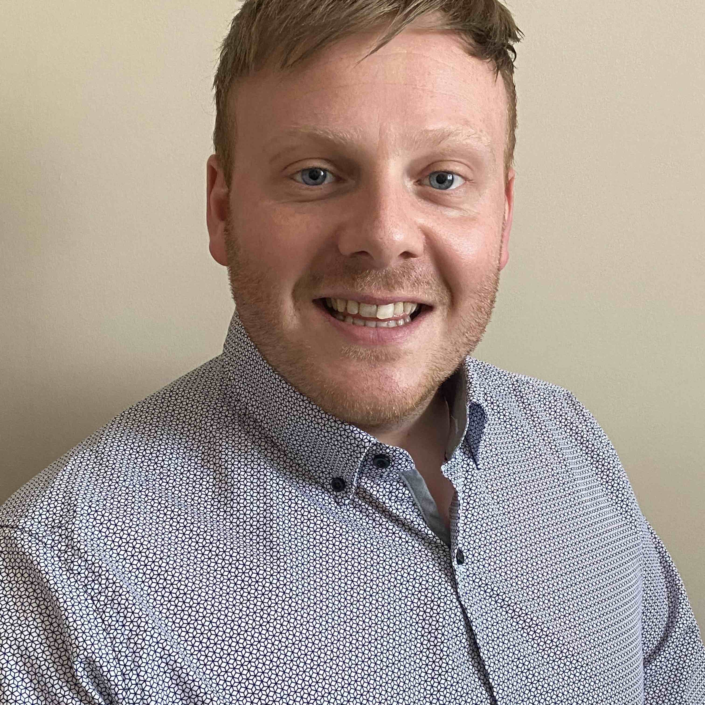
Scott Lovell, Department of Life Sciences, Fellow

Slide 25
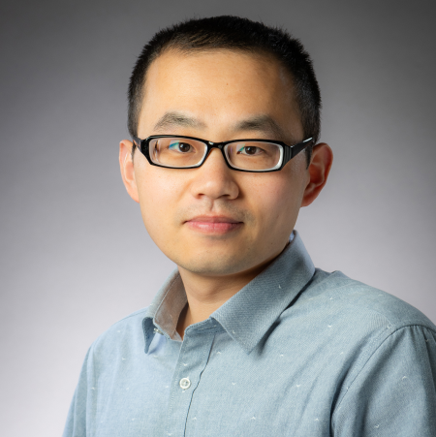
Hao Yuan, Department of Mechanical Engineering, Fellow

Slide 26
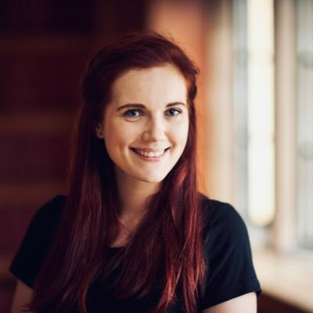
Helen Kowalewska, Department of Social
and Policy Sciences, Fellow

Slide 27
Yi Ling Ong, School of Management, Fellow

Slide 28
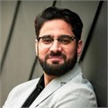
Touseef Mir, Department of Politics, Languages and International Studies, Fellow

Slide 29
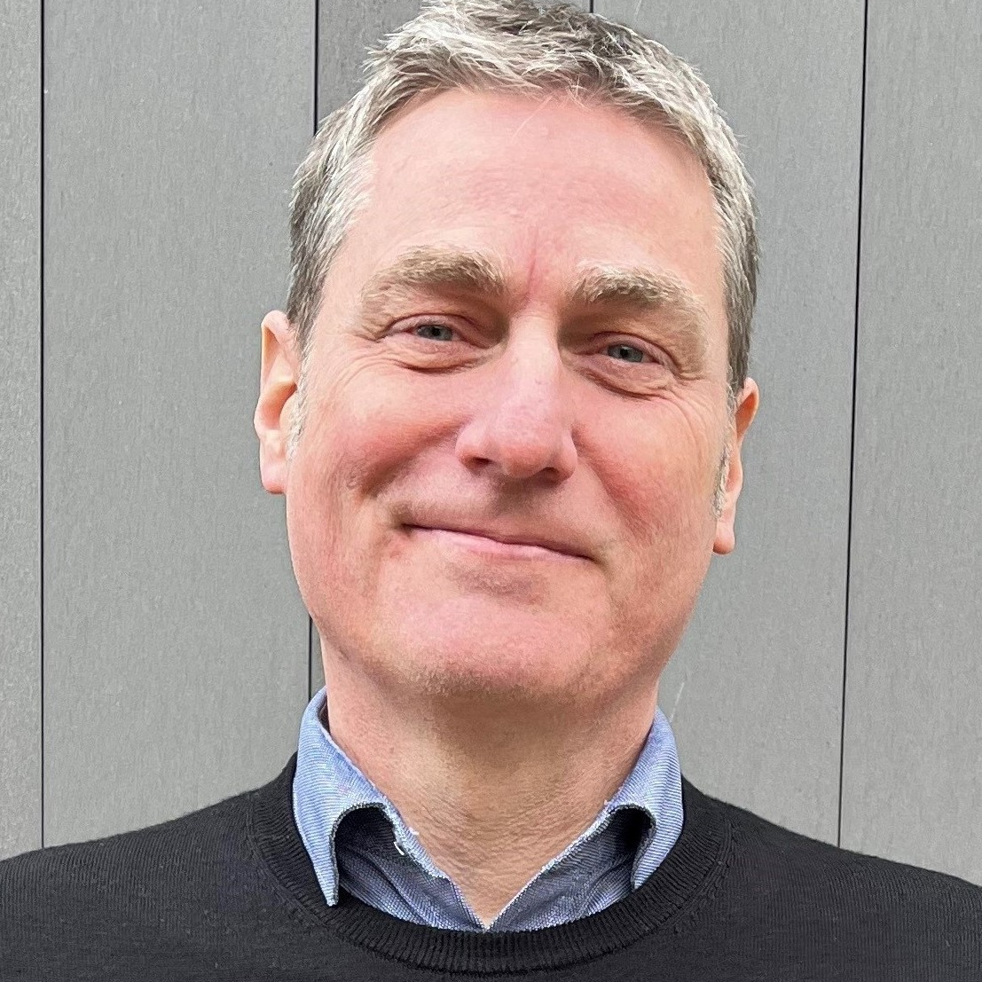
David Busby, Skills Centre, Senior Fellow

Slide 30
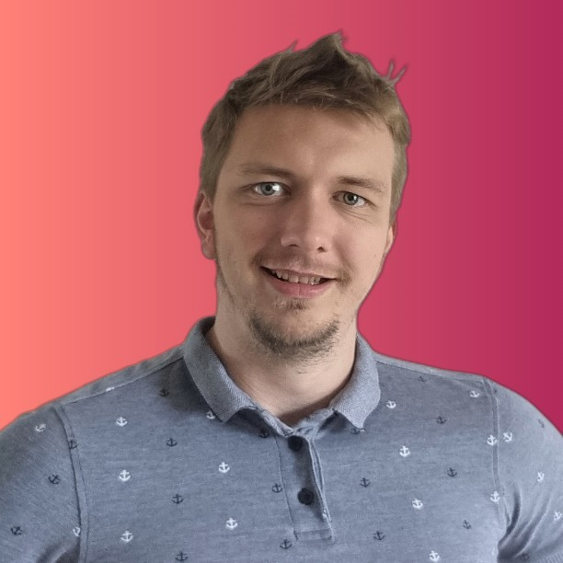
Andrew Barnes, Department of Computer Science, Fellow

Slide 31
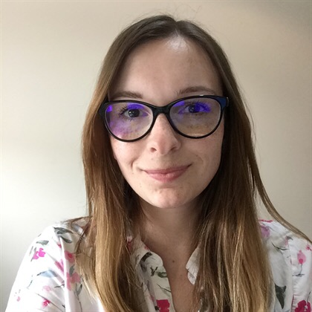
Katie Weatherley, Department of Life Sciences, Fellow

Slide 32
Anna Stearn, Department of Chemistry, Associate Fellow

Slide 33
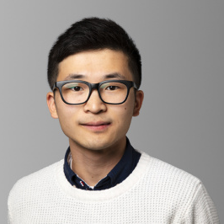
Kyungbo Han, Department of Economics, Fellow

Slide 34
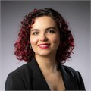
Stefania Esposito, Department of Mechanical Engineering, Fellow

Slide 35
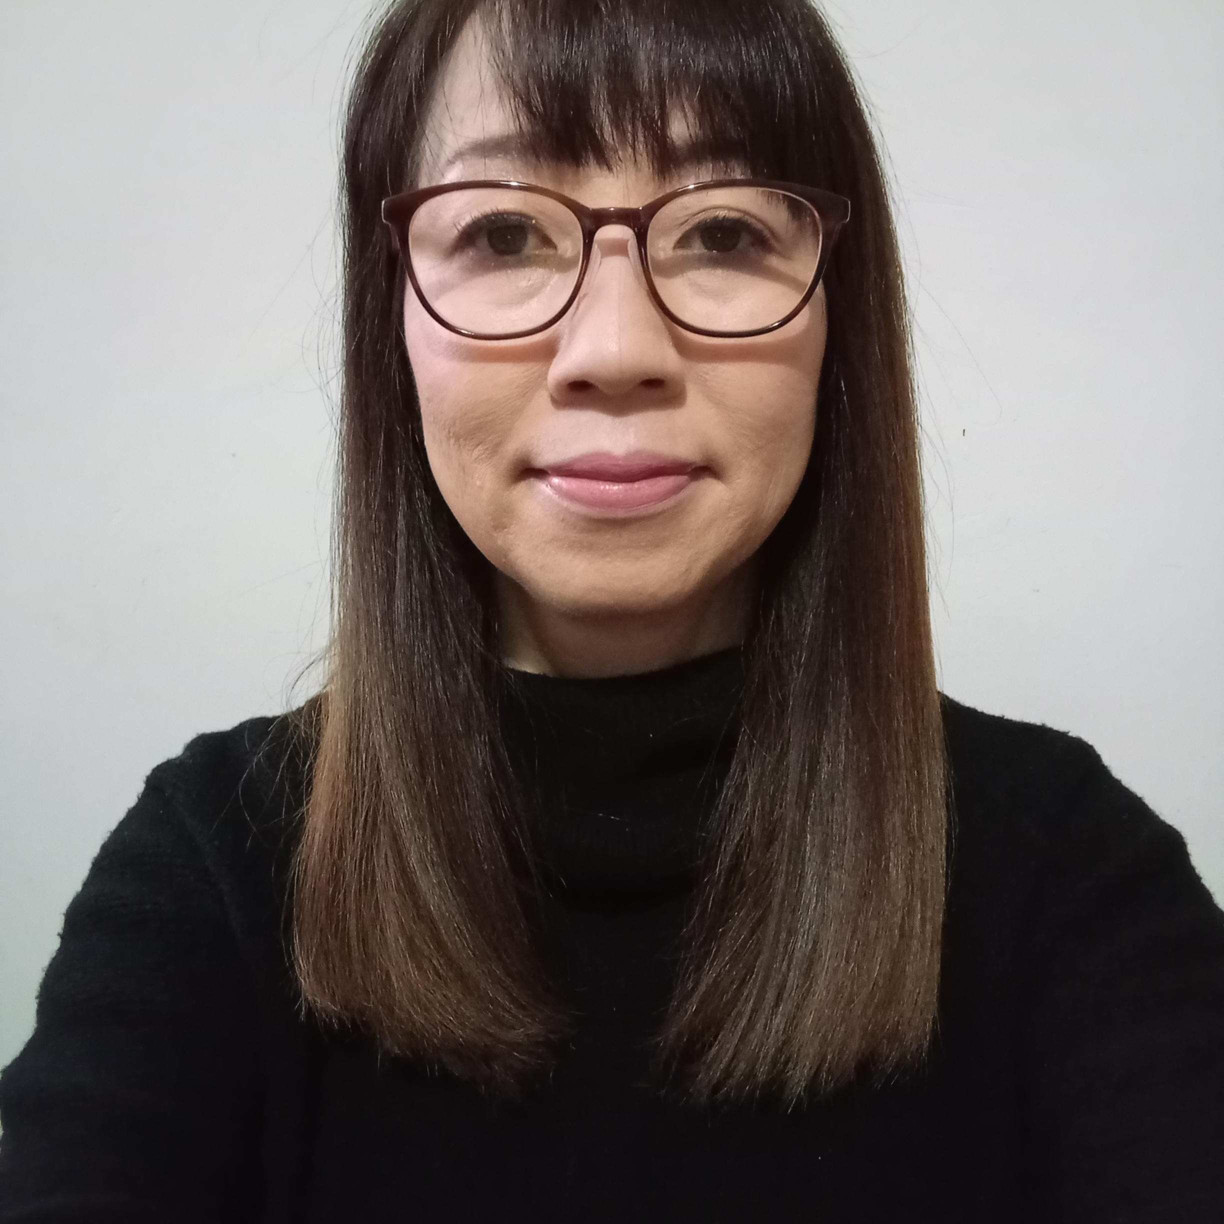
Satoko Suzui, Skills Centre, Fellow

Slide 36
Zhichun Fu, Department of Electronic and Electrical Engineering, Associate Fellow

Slide 37
Daniela De Angeli, Department of Computer Science, Fellow

Slide 38
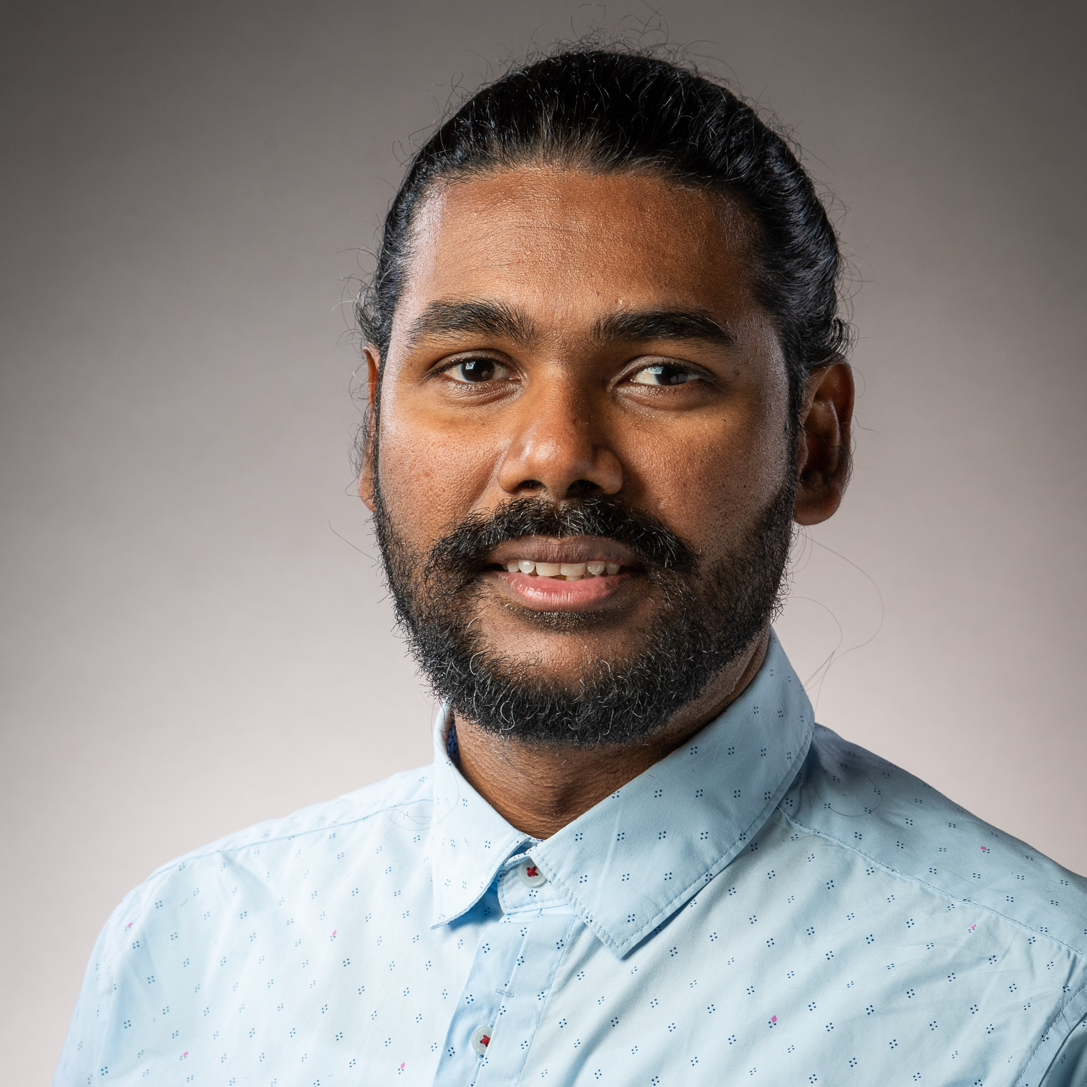
Thiyagaraja Waradas, Department of Social
and Policy Sciences, Fellow

Slide 39
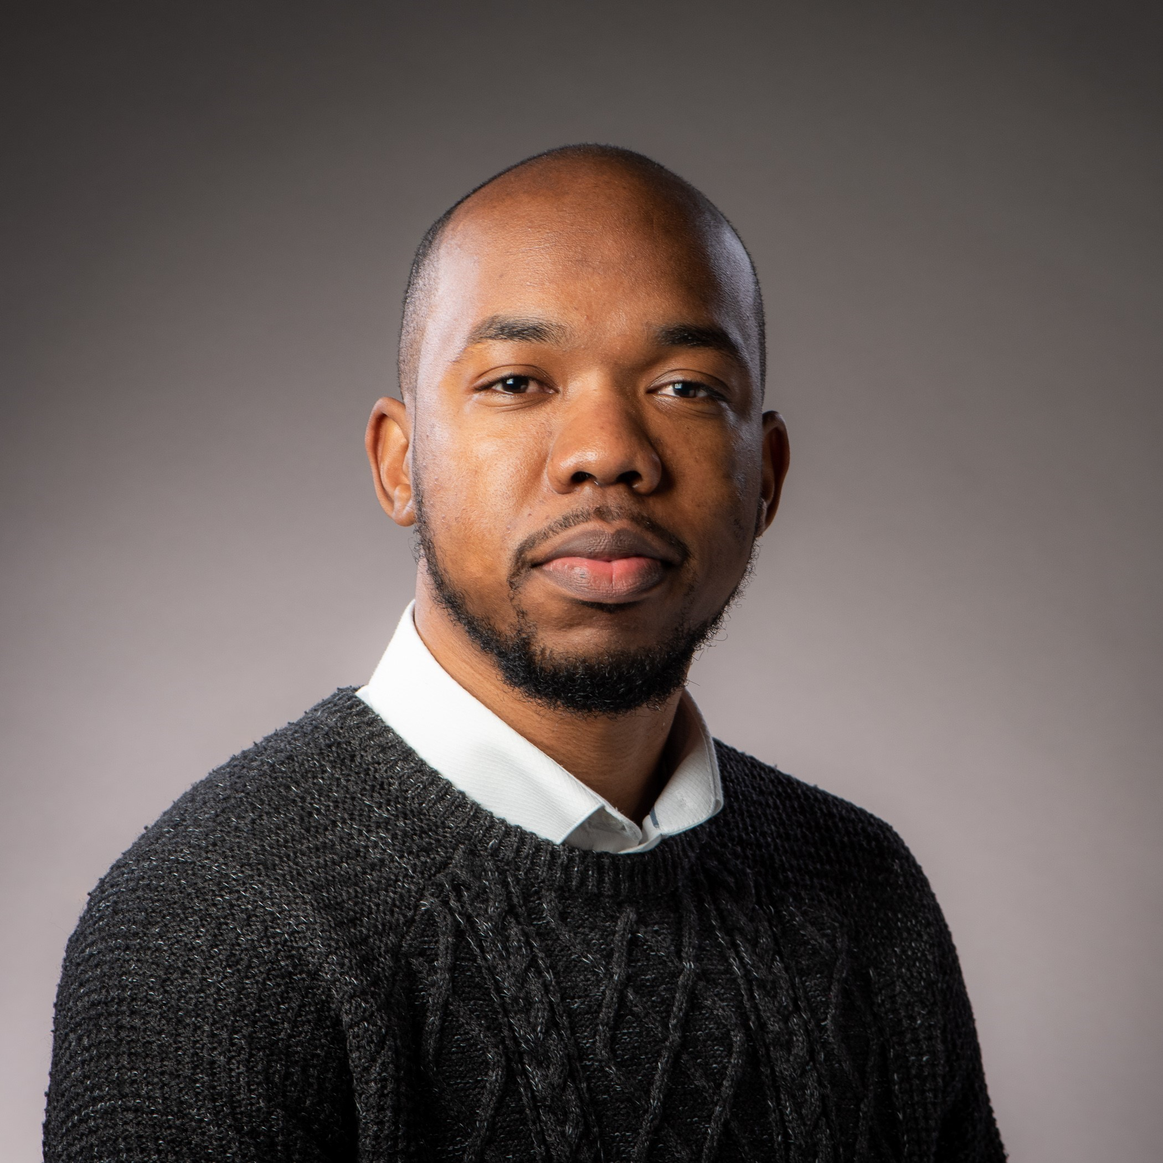
Sanjae King, Department of Electronic and Electrical Engineering, Assoicate Fellow

Slide 40
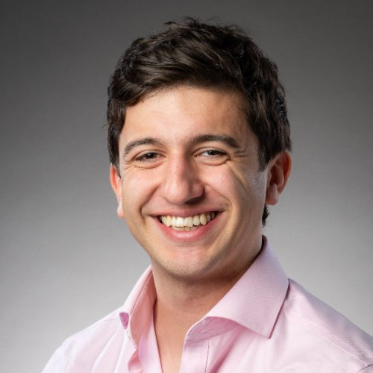
Ollie Hanton, Department of Computer Science, Fellow

Slide 41
Pankhuri Agarwal, School of Management, Associate Fellow

Slide 42
Thomas Burnett, Department of Mathematical Sciences, Fellow

Slide 43
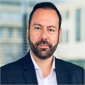
Chris Dimos, School of Management, Fellow

Slide 44
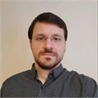
Dorian Florescu, Department of Electronic and Electrical Engineering, Associate Fellow

Slide 45
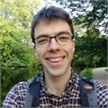
James Foster, Department of Mathematical Sciences, Fellow

Slide 46
Goni Lee, Department of Social and Policy Sciences, Associate Fellow

Slide 47
SFHEA awarded – Experiential Pathway
“Applying for the fellowship was an excellent opportunity for me to reflect critically around the support I provide for students and colleagues, which in turn helped me identify the importance of taking a student first approach to every aspect of my work. This was a highly developmental process for me because by critically reflecting on the impact of what I do I was encouraged to articulate that equity, inclusion and access are the keystones to success with skills development in my work”

Slide 48
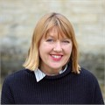
Sarah Gibson, Department of Architecture and Civil Engineering, Fellow

Slide 49
George Harrington, Department of Chemistry, Fellow

Slide 50
AFHEA awarded – Experiential Pathway
“The fellowship process has been deeply rigorous and rewarding. It encouraged me to think about my teaching pedagogy alongside elements of diversity, curriculum development, and student engagement. Writing the application itself was a great learning experience. It helped me reflect not only on what I have done so far but also on how I would like to improve my teaching in the future.”

Slide 51
Runan Zhang, Department of Mechanical Engineering, Fellow

Slide 52
Tianchu Lu, Department of Electronic and Electrical Engineering, Associate Fellow

Slide 53
FHEA awarded – Experiential Pathway
In terms of my experience, I was fully supported by my FHEA champion in my department, and was reassured by the opportunities to go to 1:1 sessions to support with writing the application. The timescale from start to finish made the application manageable with a full teaching load during semester time.

Slide 54
Habib Rostami, Department of Physics, Fellow

Slide 55
Pavlos Memelaou, Department of Electronic and Electrical Engineering, Associate Fellow

Slide 56
Thomas Holt, Department of Mathematical Engineering, Associate Fellow

Slide 57
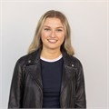
Kseniya Stsiampkouskaya, School of Management, Fellow

Slide 58
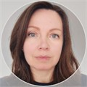
Jana Sajdakova, Department of Mechanical Engineering, Fellow

Slide 59
FHEA awarded - Probationer Pathway
"Not only does PHEAF provide valuable advice on teaching and student support, but it also creates an opportunity for exchanging experiences and building a community of new staff members across departments and faculties."

Slide 60
Jennifer Maher, Department for Health, Fellow

Slide 61
FHEA awarded – Probationer Pathway
“Becoming a Fellow of the HEA feels like a milestone in my academic career and a recognition of my efforts to improve my teaching. The experience has made me more reflective in my approach and introduced me to valuable tools for enhancing inclusivity and engagement, which I’m excited to continue developing.”

Slide 62
Rosie Marshall, Department of Life Sciences, Fellow

Slide 63
Mihika Chatterjee, Department of Social and Policy Sciences, Fellow

Slide 64
AFHEA awarded – Experiential Pathway
"Achieving Associate Fellowship of the HEA during my PhD journey has been a gratifying milestone. It allowed me to reflect on my teaching practices and enhance my skills in supporting student learning, even while balancing the demands of doctoral research. I am proud to join a community that values educational excellence and look forward to applying these experiences to my future academic and professional endeavours."

Slide 65
Gabriel Huland, Department of Policitcs, Languages and International Studies, Fellow

Slide 66
Dilara Bural, Department of Social and Policy Sciences, Fellow

Slide 67
SFHEA awarded – Experiential Pathway
“The opportunity through the Senior Fellowship scheme to take stock and reflect on how my teaching practice has supported colleagues was really valuable. I know that my approach to teaching and leadership will benefit from this going forward. The Academic Development and CLT teams provide support for staff through the process – I would encourage any colleagues interested in SFHEA to get in touch with them.”

Slide 68
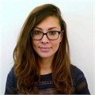
Guiseppina Pisignano, Department of Life Sciences, Assoicate Fellow

Slide 69
Crescent Jicol, Department of Computer Science, Fellow

Slide 70
FHEA awarded – Probationer Pathway
"the journey through the fellowship is an extremely helpful one for me to refresh the underlying practices and philosophies of learning. I have had the most supportive facilitators and environment provided by the CLT team."

