Slide 1
Sport and Social Change: enhancing public engagement skills through film
Professor Emma Rich
Department for Health

Slide 2
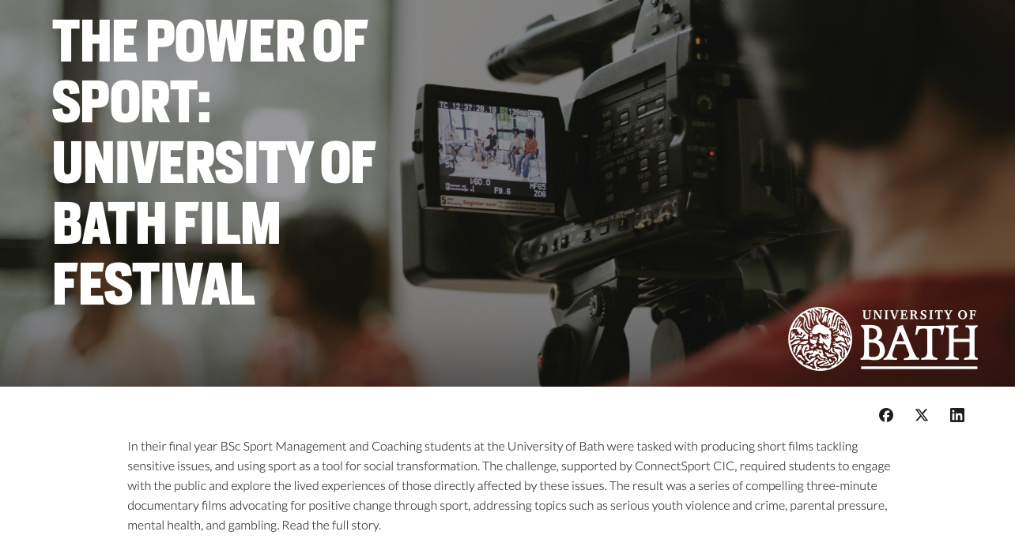

Slide 3
Background
Academic Context
Course Evolution
BSc Sport and Social Sciences – BSc Sport Management and Coaching
'Advanced seminar in sport health and social sciences' to 'Sport and Social Change'
TDF Project 2023-4
Public Participation Benefits
'Campaign for change' film festival: examining film as a method for assessing student work focused on public engagement and positive social impact Professor Emma Rich and Dr Harry Bowles (DoS)
Public participation can result in deep learning for students with positive impacts on the public who participate (Nowell et al., 2024)
Project Structure
Future Development
Worked in groups to develop a social campaign film to tackle contemporary social issues
Pilot – Review, evaluation of pedagogical process (student interviews), work with real publics 2024-2025
Scaffold student learning

Slide 4
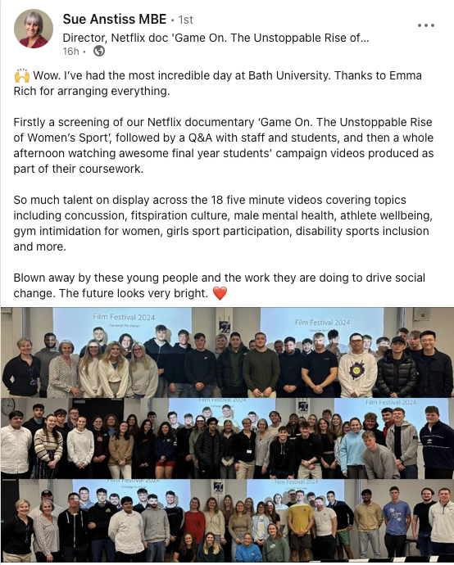
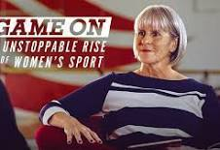
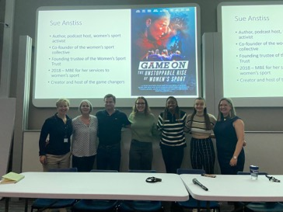
Documentary Screening and Q&A Sue Anstiss
Author, film maker, podcaster and presenter
Game On available on NETFLIX is a powerful documentary that explores the recent growth in women’s sport and its impact across society.
Panel discussion - included students
Feedback from Sue

Slide 5
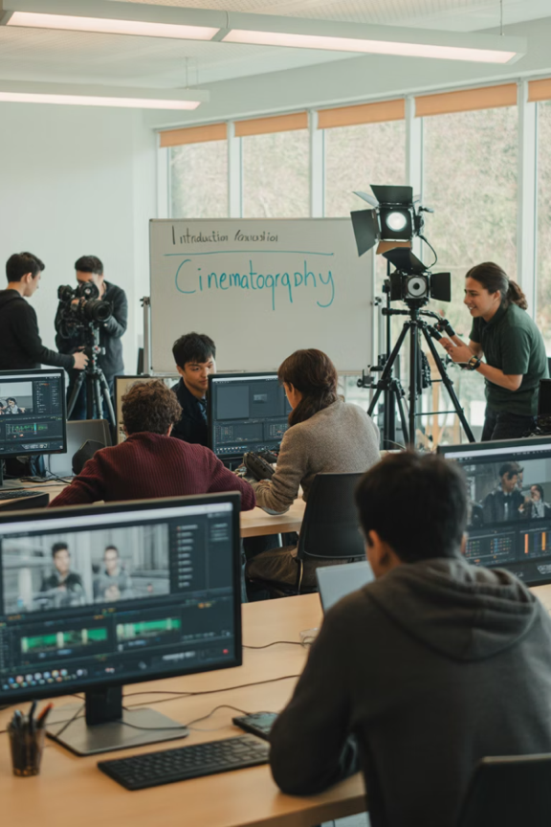
2024-2025 Sport and Social Change
Theoretical Foundation
Anchored in the theory of change
Educational Support
Workshops, Tutorials and Lectures – How to guides, lectures, videos, group tutorials
Digital toolkits e.g. capcut
Expert Assistance
Academic and Digital Skills team—Ana Bertolossi, Kirsty Morlese, Femke Davis, and Aneesa Zafar—who provided the students with resources to develop their filmmaking skills, including filming, editing
Copyright and fair use guidance and resources - Tom Pace
Film/documentary lecture – Phil Chamberlain (Tobacco Control Research Group
Structured Process
Workshops and tutorials
Step by step project framework (concept, engagement, storyboard, script making, filming, editing, feedback)
Templates and planning tools – e.g. storyboard

Slide 6
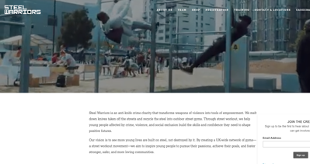
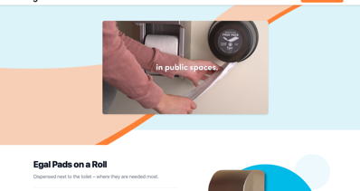
Collaborations
Worked in parternship with different publics and create real world impact – collaborations facilitated by Belinda Moore (placements), Emily Salvidge (Sport@Bath) and Emily Richards (Strategic Engagement). collaborations

Slide 7
ConnectSport Partnership
About ConnectSport
Leadership
ConnectSport is a not-for-profit Community Interest Company (CIC) which works in partnership with UK Universities to increase awareness and investment for overlooked and underfunded local charities and sport for development organisation
Simon Lansley, Managing director
Guest talk on sport for development and film
Sharing Platform
Access
Students and different publics shared (e.g. LinkedIn)
Available here: https://connectsport.co.uk/campaign/power-sport-university-bath-film-festival

Slide 8
Reflections..
Educational Value
Professional Development
Bridges gap between knowledge and impact
Professional value (particularly non-placement)
Student engagement
1
Strengthens employability and networking
Enhances communication and critical thinking
Social Impact
Student Growth
Promote civic responsibility and social awareness
Support diverse student learning/development
Reinforce role of UoB – public good

Slide 9
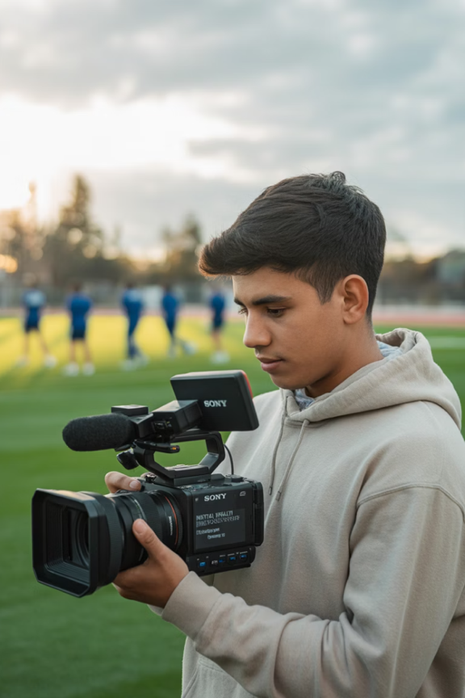
Student Testimonial
"It was a great learning experience, allowing us to be creative and offering freedom in how we approached the project. Collaborating with professional companies was a highlight. I believe these films will raise awareness of the issues we tackled, and that was our ultimate goal."
- David Hodgson who worked on Men, Mental Health, and sport – A collaboration with Bath City FC
Creative Learning
Students appreciated the freedom to approach the project in their own way
Professional Collaboration
Working with real companies was highlighted as a valuable experience
Social Impact
Raising awareness of important social issues was the ultimate goal

Slide 10
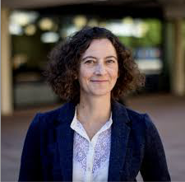
Partner Testimonials
Emily Richards, Head of Strategic Engagement
Niamh D'Arcy, UK Head of Sales and Growth at Pads on a Roll
Project Highlight
Students worked with Pads on a roll to produce a campaign film Tackling stigma: Menstruation, sport and period poverty – A collaboration with EGAL Pads on a Roll
"Many of our partners are small grassroots organisations without the resources to produce this type of content. These collaborations have not only benefited students but also given organisations fresh insights and ideas. This initiative required students to develop entirely new skills, supported by tutorials and short guides on production, sound, and editing from the university's digital team. The films will live beyond the classroom."
"Working with University of Bath students has been a highlight for us. Their enthusiasm, creativity, and professionalism were remarkable. The film they delivered was exceptional, bringing our mission to life in a way that was deeply moving and perfectly aligned with our values. We are immensely proud to have partnered us with such talented individuals."

