Slide 1
Empathy maps for planning and reflection

Slide 2
Empathy and reflection
"Teachers who are encouraged to engage in reflective practice can gain new insight of their practice" (Farrell, 2016, p.223).
Empathetic reflection involves acknowledgement of the emotion of both self and others involved in the event (Marathe & Sen, 2021).
“An empathy map is a tool that assists a person to understand the perspective of others” (Chen & Tsai, 2024, P.2).

Slide 3
Empathy mapping
Affective reflection – to understand the feelings of others
Process of visualization used to articulate what is known about a particular type of user/situation.
It externalizes knowledge about participants in learning to:
create a shared understanding of participant needs
aid in planning and decision making

Slide 4
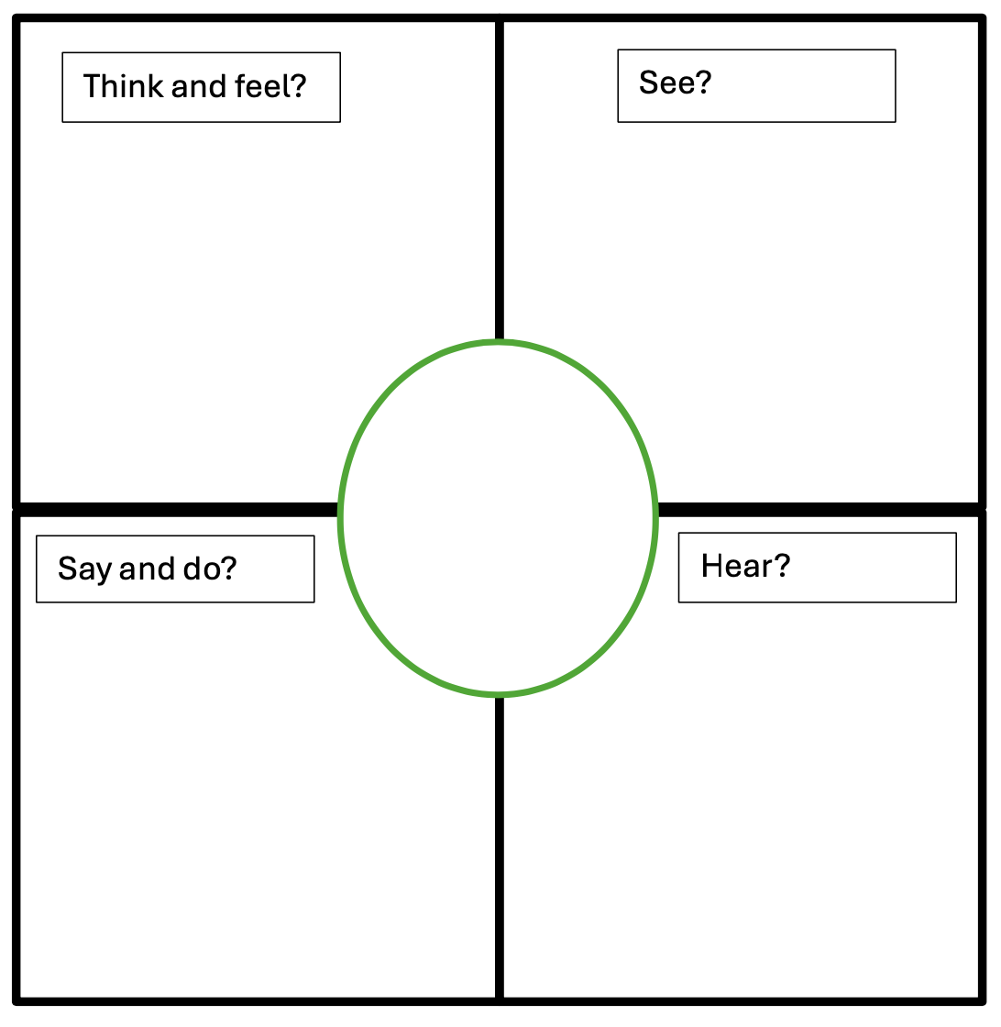
Design principles of empathy mapping
See = What are other students doing? What is happening around them? Why?
Hear = What are people saying? What is positive/negative? Why?
What do they say about this? What actions do they take? Why?
What might they think about this? How does this make them feel? Why?
Students
Gains: wants, needs, goals and measures of success.
Pains: fears, obstacles, difficulties, and frustrations?

Slide 5
Example map: planning forEduFest
Gains:
I want the practical nature to be clear.
Hearing how this could be used is a level of success
Pains:
Tendency to talk too much
Time might be an issue
There may be no questions

Slide 6
Uses of empathy maps
“… could be helpful to explore possible positives and negatives of new processes”
“It's a good way to identify weak areas or areas I've either skimmed over or not noticed. ”
“I think the empathy map would help me to specifically identify needs or where opportunities might be being missed.”
“it could be used for identifying the teachers' CPD needs. ”
Notes:
As a planning / reflection tool.
As a teaching observation instrument.
To reflect on individual or specific groups of students.
To reflect on overall provision or service.
To reflect on user engagement with marketing / comms.
To reflect on how a team may appear to partners.

Slide 7
References and links
Abha M., & Sen, A., 2021 Empathetic reflection: reflecting with emotion, Reflective Practice, 22:4, 566-574
Chen MC, Tsai MC., 2024. Applying team-based learning combined with empathy map to improve self-directed learning skills. BMC Nurs. 23(1):683
Farrell, T.S., 2016. Anniversary article: The practices of encouraging TESOL teachers to engage in reflective practice: An appraisal of recent research contributions. Language teaching research : LTR [Online], 20(2), pp.223–247
Links
Connecting with students
Updated Empathy Map Canvas
Empathy mapping in teaching

