Slide 1
How to be interactive in large group teaching
Dr Cressida Lyon
cl2255@bath.ac.uk

Slide 2
Some ideas that I have tried …
Flipped / blended learning to allow time in class for:
Quizzes / Online polling (Mentimeter)
Problem-based learning
Game based learning
→ Team Based Learning (TBL)

Slide 3
Flipped / blended learning
“using around 20 mins of prelearning per week were very useful and I feel I learnt the best from this format”
Students complete pre-learning before class
Allows time in class for quizzes / problem-based learning / games etc
“I really like how Cressida used a 20 minute pre-learning video to accompany the lecture, so that we had time to go over a case study and check understanding.”

Slide 4
Quizzes
“Using quizzes was really good to keep the focus during sessions”
Turning Point / Mentimeter / Kahoot etc
Use questions that check understanding rather than recall
“I really enjoyed the use of the quizzes, I found them a great way to check my knowledge and to make lectures more interactive”

Slide 5
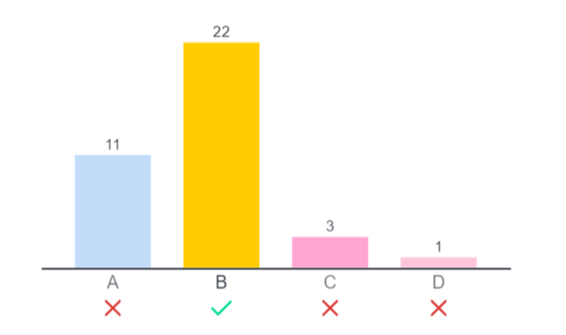

Slide 7
Problem based learning
“The small case study exercises at the end of each of lecture were valuable in helping me understand fully the content that I had just learned.
Case studies
Data interpretation
Group discussion / think-pair-share
Use whiteboard / padlet / Menti to log class discussion
“I enjoy the active learning within the lecture to help back up my understanding.”

Slide 8
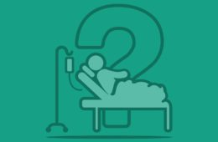
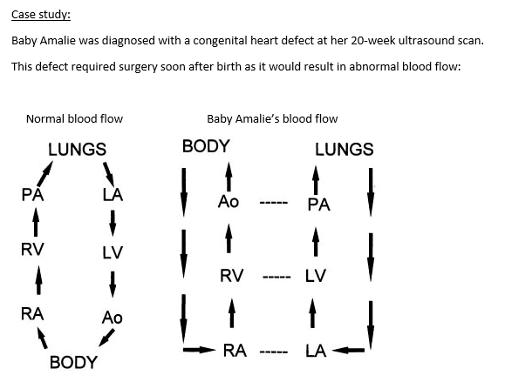
Group task: case study
What would the result be of this abnormal blood flow?
What symptoms might this cause when the baby is born?
What is this congenital defect called?
What preoperative interventions can help stabilize the patient?
What is the most likely surgical option for baby Amalie?

Slide 9
Data interpretation
Research into targeted treatment for triple negative breast cancer (TNBC) is ongoing. Mutations in the PI3K/Akt signalling pathway are common in TNBC. The PI3K pathway is an important intracellular signalling pathway, which results in the expression of genes linked to proliferation and apoptosis in cancer cells. Therefore, inhibiting this pathway has potential as a treatment approach for patients with TNBC with PI3K mutations.
However, PI3K inhibitors have shown limited therapeutic effectiveness in TNBC, and the reasons for this lack of efficacy are not well understood.
Wang et al. (2022) discovered that MAPK4 expression is higher in TNBC patient samples and cell lines. The authors explored whether increased MAPK4 expression could explain the lack of efficacy of PI3K inhibitors in treating TNBC.
In groups, students answer
Quiz questions
Discussion based questions
Future directions
Consolidates understanding and applies knowledge.

Slide 10
Games
MCQ or case-study based board games (working in teams)

Slide 11
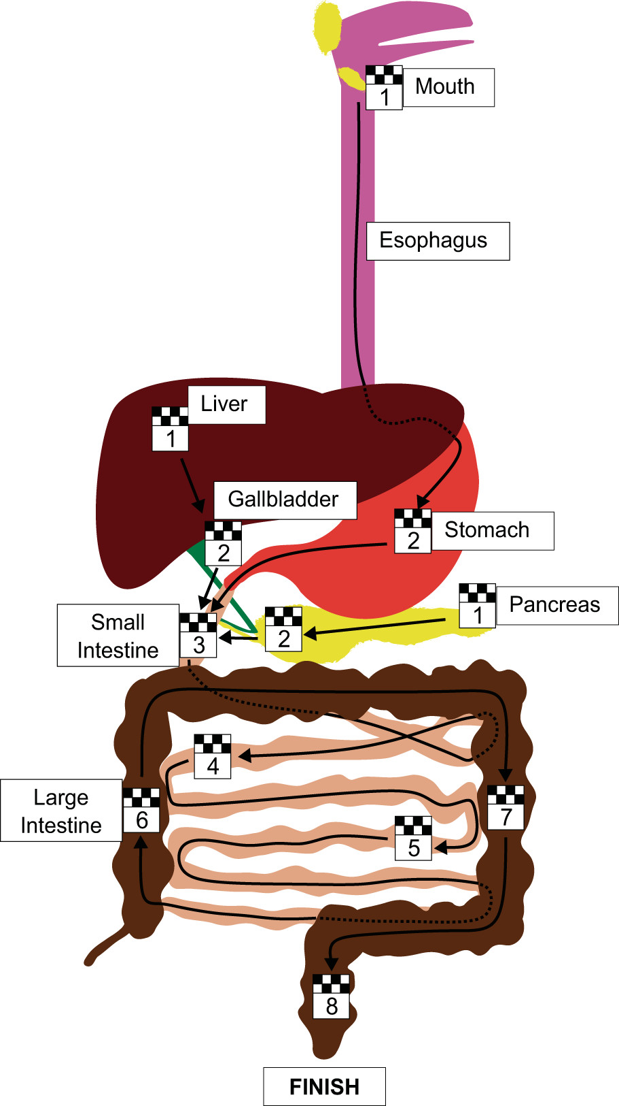
Team task: The gut game!
The Gut Game is an interactive game in which correct answers will move you around the board. Incorrect answers will give you another question.
Working in teams, you will need to answer questions about the pancreas and / or the gastrointestinal tract.
If >80% of the team get the answer correct, you can move on through
The first team to "exit" the GI tract at the rectum are the winners!
The first question is - where would you like to start your journey of digestion?
The mouth / oesophagus or the pancreas?
Paschoal de Campos et al (2020), Advances in Physiology Education, 44: 444–447

Slide 12
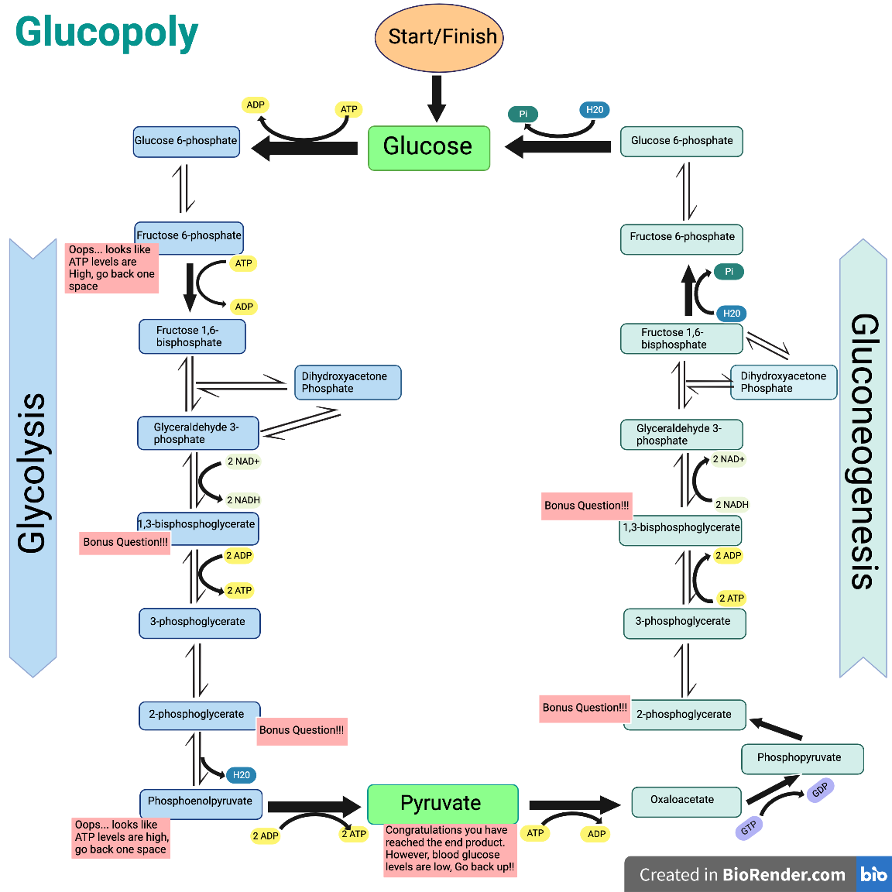
Glucopoly: teaching glucose metabolism to first years

Slide 13
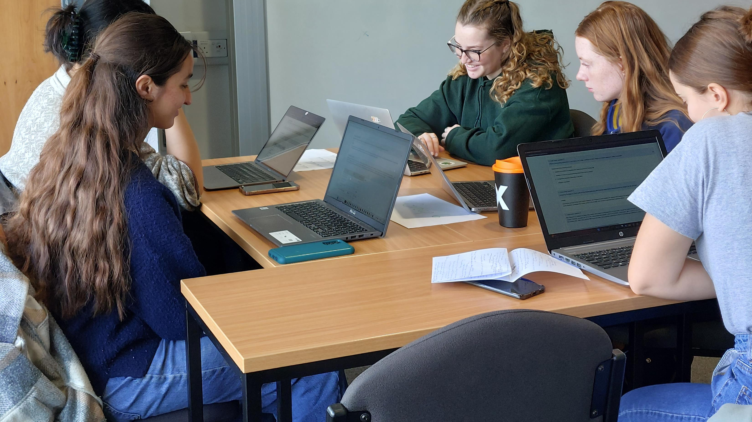
Team Based Learning (TBL)
Piloted in 23/24
In 24/25, the Biomedical Sciences cohort was taught using TBL (two 5 credit units).
“Although the team based learning sessions took some time to get used to, they provided us valuable time to discuss problems with lecturers and discuss lecture topics among ourselves.”

