Slide 1
Moodle Admin Essentials:
Managing the administrative side of your Moodle space
Workshop facilitators:
This workshop will be recorded.
Lynn Cheong-White
tel@bath.ac.uk
Olivia Soutter
teachinghub.bath.ac.uk

Slide 2
Session Overview
Enrolling Participants
Course Settings
Managing Groups & Groupings
Housekeeping
Notes:
Enrolling Participants
By the end of the session:
You will know how to enrol participants.
You will know how to troubleshoot common enrolment issues.
Course Settings
By the end of the session:
You will know how to hide and show your Moodle space and how to check if your Moodle space is linked to SAMIS.
You will know how to troubleshoot common course setting issues.
Groups and Groupings
By the end of the session:
You will know how to manage existing groups.
You will know how to manage groupings.
You will know to troubleshoot common groups and grouping issues.
Housekeeping

Slide 3
Enrolling Participants

Slide 4
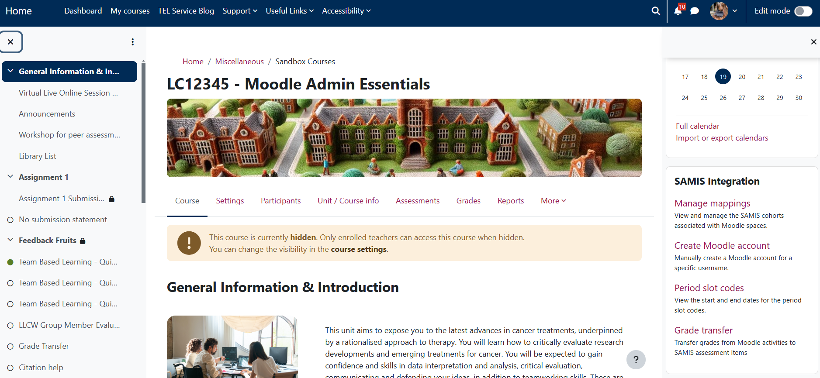
Enrolling Participants
1. Enrol via SAMIS

Slide 5
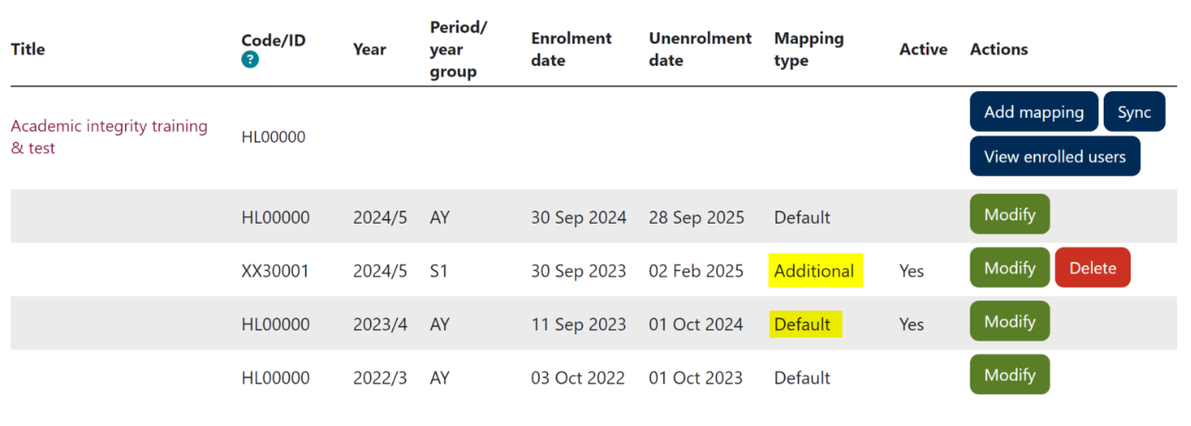
Enrolling Participants
1a. Enrol via SAMIS automatically
Notes:
https://teachinghub.bath.ac.uk/guide/managing-moodle-enrolments-in-samis-integration-block/
https://uniofbath.cloud.panopto.eu/Panopto/Pages/Viewer.aspx?id=00dc536a-35bb-4b42-a17b-b1f500f9f574

Slide 6
Enrolling Participants
Recording: Introducing the new SAMIS integration on Moodle [20:25]
Managing Moodle enrolments in the SAMIS Integration block

Slide 7
Enrolling Participants
Troubleshooting SAMIS Mapping:
Cohort isn’t pulling in from SAMIS.
Cohort won’t pull through earlier than 3-weeks before the semester.
Cohort won’t pull in if a Unit Convenor isn’t listed on SAMIS.
Last year’s cohort is still on the Moodle Space.
Moodle does not remove automatically added cohorts until the day before the new semester.
Unenrolment method may have been set to “Specific” or “Manual” with dates in the future.

Slide 8
Enrolling Participants
Troubleshooting SAMIS Mapping:
A student has been added on SAMIS but isn’t showing up on the Moodle Space.
Moodle syncs with SAMIS once every weekday morning. If the student has just been added to SAMIS you can:
Wait 24-hours until the next automatic sync.
Manually sync the course.

Slide 9
Enrolling Participants
Troubleshooting SAMIS Mapping:
The SAMIS code is listed in the mapping, but the students aren’t enrolled in the Moodle space.
Check that the unenrolment date for that mapping hasn’t passed. If it has you will need to update the unenrolment date.

Slide 10
Enrolling Participants
2. Individual Participants not via SAMIS
Notes:
To be shown live.
You can add individual participants (such as other teaching staff) by going to the Participants tab.
Shoe how to enable Self-enrolment (including password and automatic unenrolment date).
Test-ojs

Slide 11
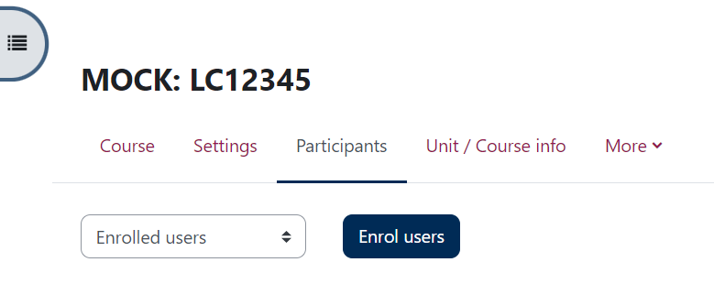
Enrolling Participants
2. Individual Participants not via SAMIS
Notes:
Participants you would enrol this way: 1. Other teachers
2. Programme Admins
3. DoS.
4. Those that aren’t listed in SAMIS but need access to the space.
Participants you wouldn’t enrol this way:
1. Students. Students should be enrolled via SAMIS. Enrolling them manually this way can cause issues later as you will need to remember to unenroll them.

Slide 12
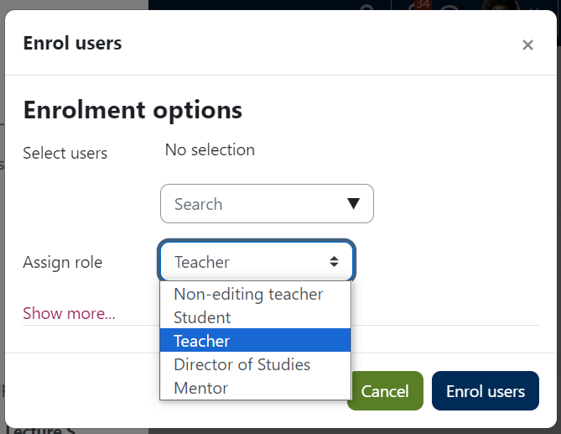
Enrolling Participants
2. Individual Participants not via SAMIS
Add the name of the person you want to enrol.
Ex. lcw56
Select the role you want them to have.
Enrol the user.

Slide 13
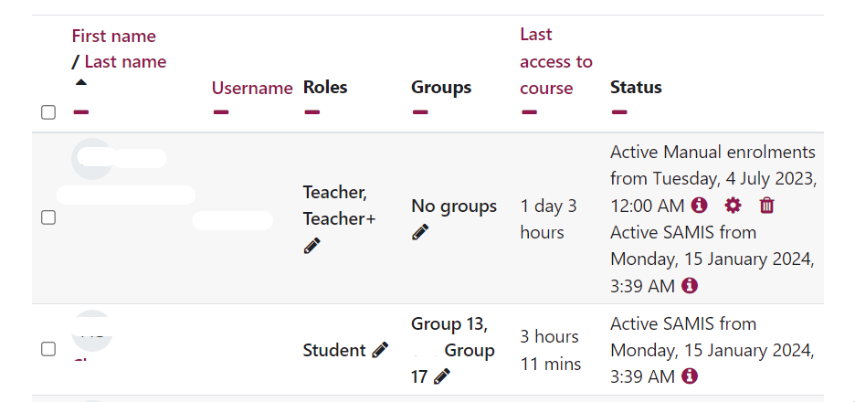
Enrolling Participants
2. Individual Participants not via SAMIS
Notes:
The first person has been enrolled twice. Once manually as a Teacher and then via SAMIS as the Teacher +/Unit Convenor.

Slide 14
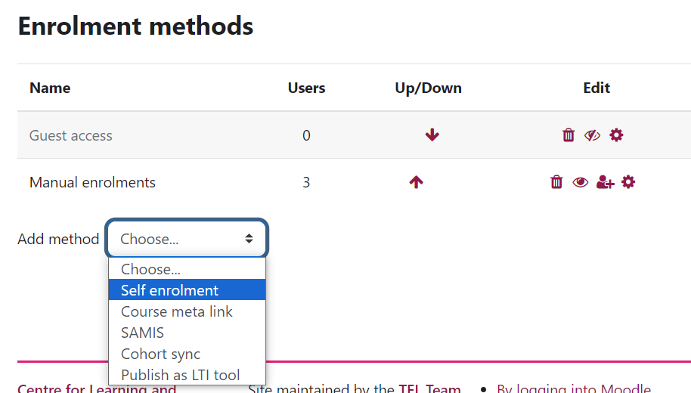
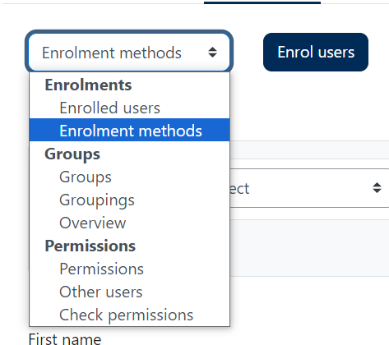
Enrolling Participants
3. Self-enrolment
Notes:
You normally wouldn’t set-up a SAMIS course for self-enrolment as students are enrolled via SAMIS, but for certain Moodle spaces like Placement spaces you may want to set-up Self-enrolment.
You can set it up to allow a password to enrol and you can set-up an unenrolment date which is helpful for housekeeping.

Slide 15
Enrolling Participants
Troubleshooting Enrolment:
The person I’m trying to enrol is external to the University of Bath.
Moodle can only be accessed through the UoB Single Sign-on. If the participant is external, you will need to speak to DD+T to issue them a temporary UoB username.

Slide 16
Enrolling Participants
Troubleshooting Enrolment:
The person I’m trying to enrol doesn’t appear when I search for them.
The person is already enrolled in the Moodle space. Check the list of participants to ensure someone else didn’t already enrol them.
The person has never logged into Moodle. New users will need to log into Moodle to activate their account.

Slide 17
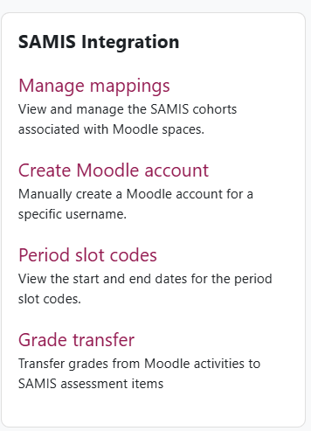
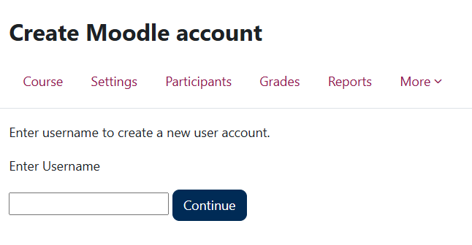
Enrolling Participants
Adding a new user into Moodle:
Ex. lcw56
Notes:
Once you have done this and the person has logged into Moodle, you should be able to enrol them onto your Moodle space.

Slide 18
Enrolling Participants
Troubleshooting Enrolment:
A student has contacted me because they cannot access Moodle.
Students will not have access to the Moodle unless all their fees are paid. Check that all their documentation for enrolment is completed. If it is, contact IT about their account.

Slide 19
Course Settings

Slide 20
Course Settings
Notes:
To be shown live.
To amend course settings go to the Settings tab.

Slide 21
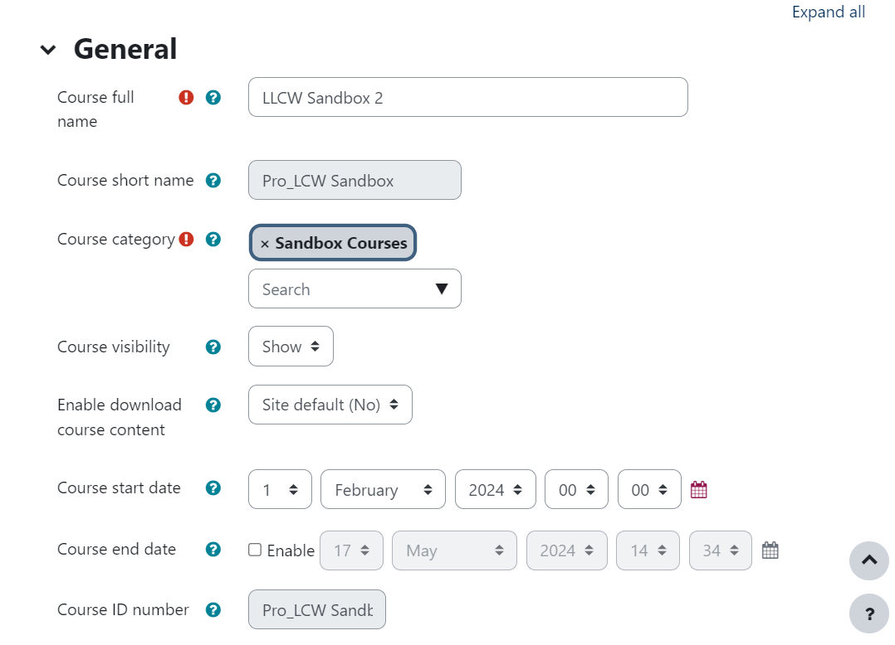
Course Settings
Notes:
Course Full name – Can be changed
Course short name – cannot be changed. The short name is how SAMIS identifies the Moodle space and shares information with it.
Course visibility - If on “hide” that means students cannot see it. Only Teachers will be able to see hidden courses.
Course start date – always good to reset this to the start of the semester, especially if you are using a Weekly template.
Course format – Weekly v. Topic

Slide 22
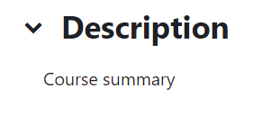
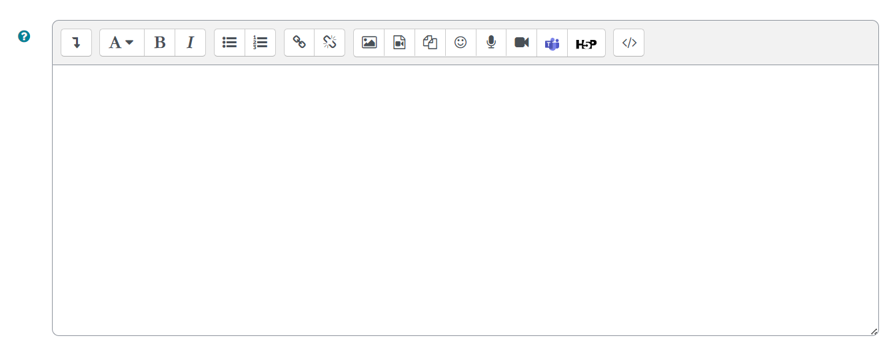
Course Settings
Notes:
Course summary - You can add the course description from the handbook. This will appear on the Moodle homepage.
Course image – You can upload an image that will appear on the Moodle homepage and the top of the Moodle space.

Slide 23
Course Settings
Troubleshooting:
Students cannot see the Moodle space.
If the student is enrolled and listed as a participant but cannot see the Moodle space it may be because the space is hidden. You will need to go into the Course Settings and change the visibility from “Hide” to “Show”.

Slide 24
Course Settings
Troubleshooting:
My students are not automatically enrolling from SAMIS to my Moodle space.
If you have already checked that the issue isn’t with the enrolment of the students, then it may be that the Moodle space is not linked to the correct SAMIS code. Check the Course ID number corresponds to the SAMIS code. If it does not, you will need to find the corresponding Moodle space.

Slide 25
Course Settings
Troubleshooting:
My Moodle Space is highlighting the wrong week.
If your Moodle space is set-up in a weekly format you will need to ensure your Course Start Date is correct.

Slide 26
Groups & Groupings

Slide 27
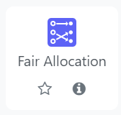
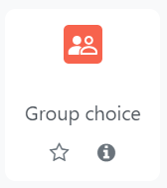
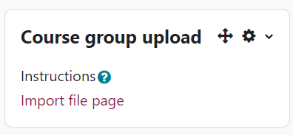
Groups & Groupings
Creating groups in Moodle
Notes:
Different ways to add students in groups. You could add them from teacher choice or student choice. There will be a workshop in the Autumn on creating groups or if you can email tel@bath.ac.uk.

Slide 28
Groups & Groupings
Recording: TEL Bytes – Using Moodle groups and groupings-15OCT24 [31:53]

Slide 29
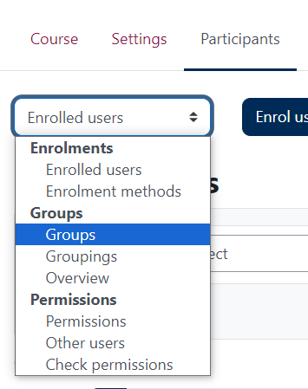
Groups & Groupings
Managing Groups
Notes:
Show live.
Go to Participants and from the drop down choose “Groups”.

Slide 30
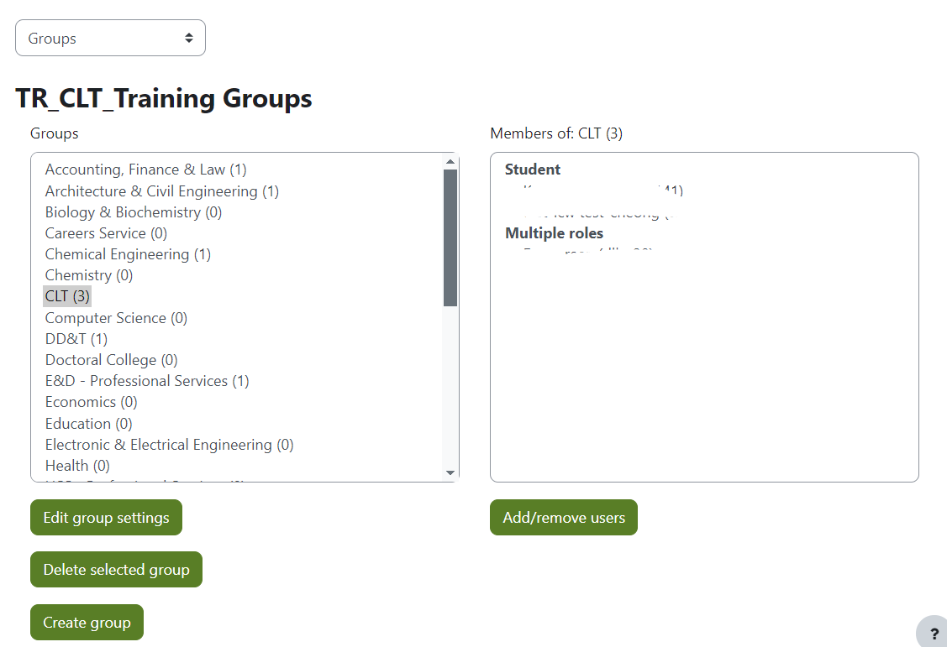
Groups & Groupings
Managing Groups
All the groups that exist in the Moodle space with the number of participants enrolled.
The members of the group you selected.

Slide 31
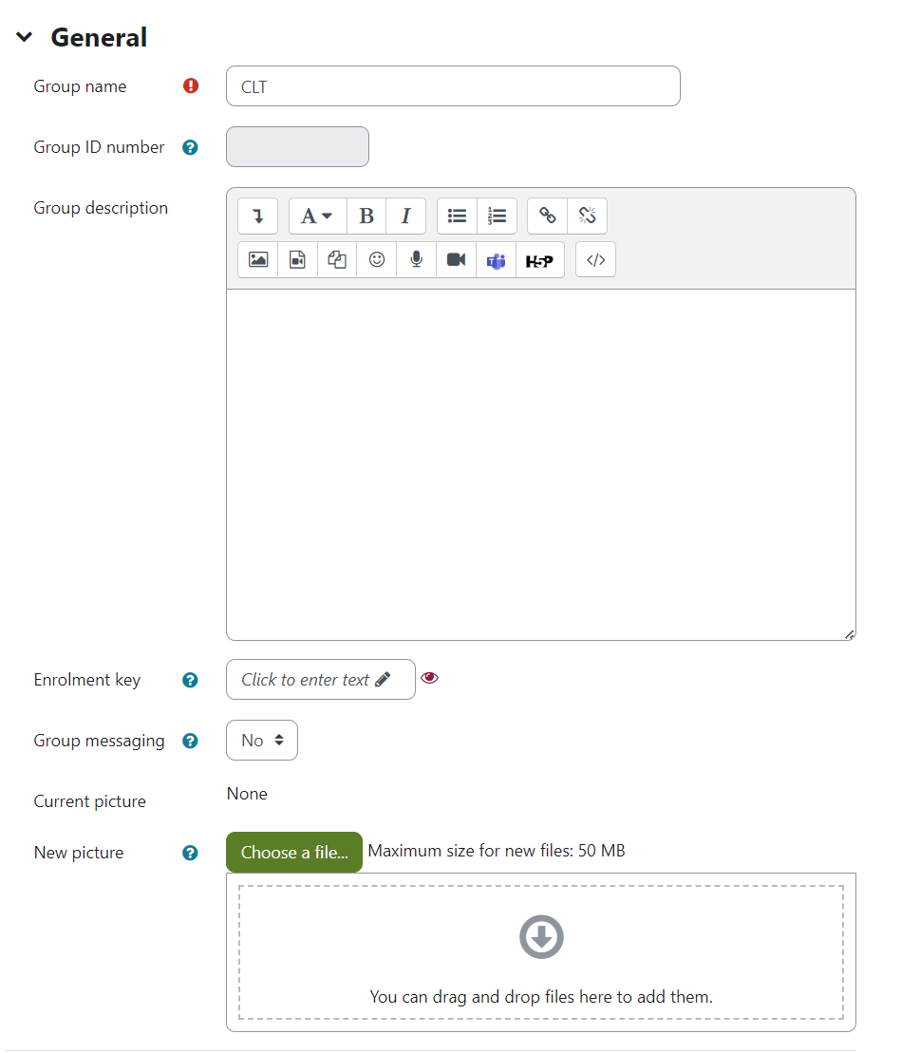
Groups & Groupings
Notes:
Allows you to edit the group name, add a description and add a group picture.

Slide 32
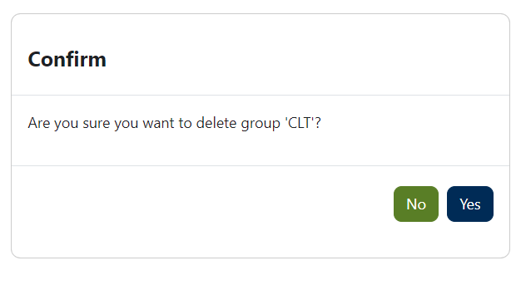
Groups & Groupings
Notes:
Allows you to delete the selected group. Doing this means any participants in that group will remain enrolled in the Moodle space, but no longer belong to that group.

Slide 33
Groups & Groupings
Notes:
This will allow you to create a new group in the Moodle space.

Slide 34
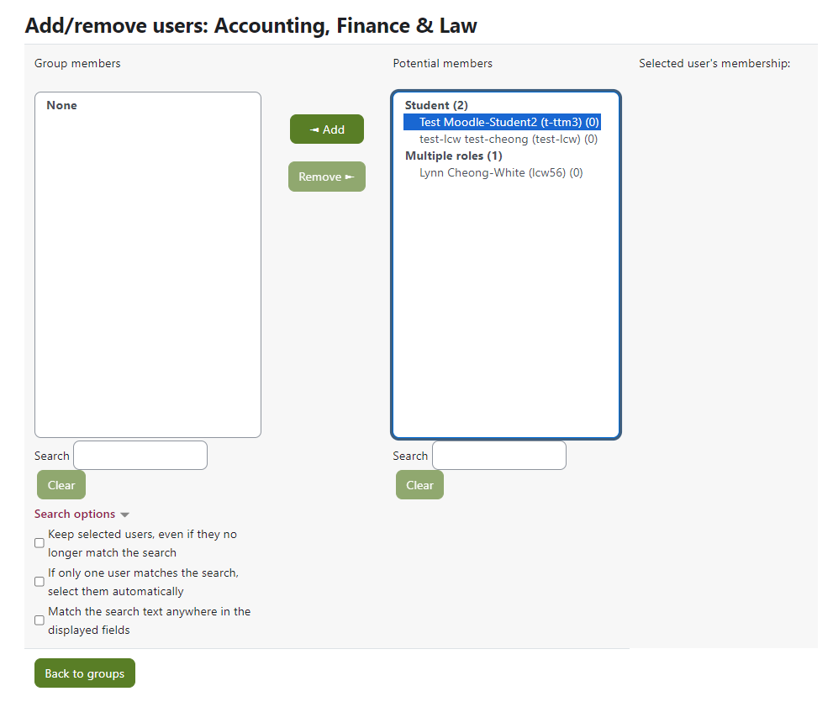
Groups & Groupings
Notes:
This allows you to add participants to a group or remove participants from a group.

Slide 35
Groups & Groupings
Notes:
You can see which groups in the specific Moodle space the student belongs to on the main Participants page. Please note: the Participants page only shows groups for that unit, you will not be able to see what groups the students belong to in other units.

Slide 36
Groups & Groupings
Assignment Grouping
Group 1
Group 1
Group 2
Group 2
SAMIS Grouping
LC12345 2024/5 S1 cohort
LC12345 2024/5 S1 cohort
LC12345 2024/5 S1 cohort
LC12345 2024/5 S1 cohort
Notes:
Yours students now belong in two different groups. When you try to do any group activity Moodle will not know which set of groups you want to use. This is when you use groupings.

Slide 37
Groups & Groupings
Groupings
Grouping | Group
SAMIS Grouping | AB12345
Assignment | Group 1, Group 2, Group 3, Group 4, Group 5
Notes:
This allows you to add participants to a group or remove participants from a group.
Your Moodle space will automatically put SAMIS mapped students into a SAMIS grouping.
Along with this automatic group you want students in groups for an assignment.
In this situation Moodle has already created a grouping for the SAMIS group, but you will want to create a grouping to house your assignment groups.
When creating your assignment under Group submission settings you can now select the correct Grouping for student groups and be assured the right groups are we chosen for the activity.

Slide 38
Groups & Groupings
Groupings
Grouping | Groups
SAMIS Grouping | AB12345
Assignment 1 | Group 1, Group 2, Group 3, Group 4, Group 5
Assignment 2 | Group A, Group B, Group C, Group D, Group E
Notes:
Your course has 2 or more group assignments (i.e. Assignment 1 and Assignment 2).
The students will be in different groups for the different assignments (Groups 1, 2, 3, 4 and 5 for the first assignment, and Groups A, B, C, D, and E for the second assignment). So that Moodle knows which groups members to put together for which assignment you will need to allocate the correct groups to a grouping for the assignment.
When creating your assignment under Group submission settings you can now select the correct Grouping for student groups and be assured the right groups are we chosen for the activity.
This allows you to add participants to a group or remove participants from a group.

Slide 39
Groups & Groupings

Slide 40
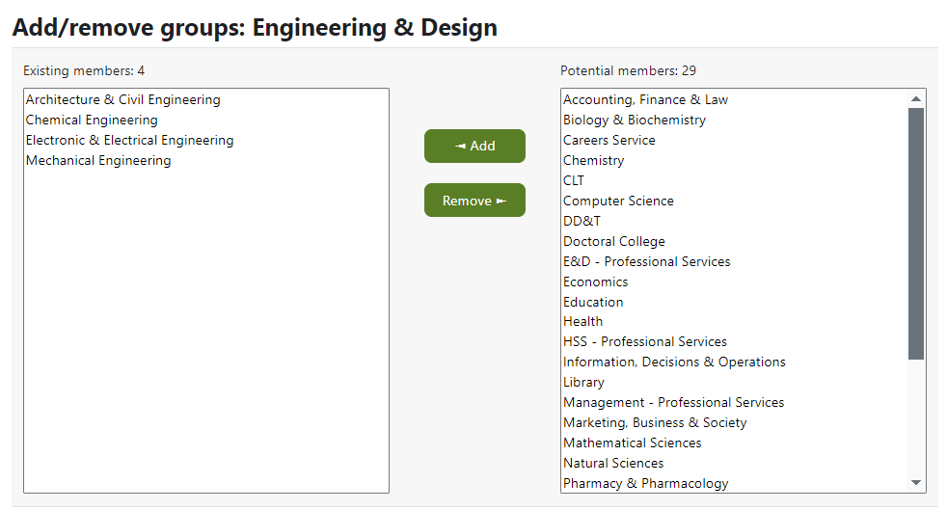
Groups & Groupings
Groups already in the grouping.
Groups not in the grouping.
Notes:
Highlight the group you want to add/remove and click the appropriate “add” or “remove” button.

Slide 41
Groups & Groupings
Warning: You must put your groups into groupings otherwise Moodle will not know which groups to use to allocate marks and feedback.

Slide 42
Groups & Groupings
Troubleshooting Groups & Groupings:
I have used groups to distinguish which students have an extension, but I don’t want other students to see these groups, how do I hide them?
There isn’t an easy way to hide groups in Moodle. The advice is to give your extension groups a non-descript name so that it is inconspicuous.

Slide 43
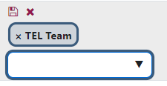
Groups & Groupings
Troubleshooting Groups & Groupings:
One of my students is in the wrong group, how do I move them?
The easiest way to move one student in the wrong group is to find the student in the Participants page next to the group they are enrolled in, select the pencil icon.
Next, click the x next to the group you want to remove them from and from the dropdown select the appropriate group for that student.

Slide 44
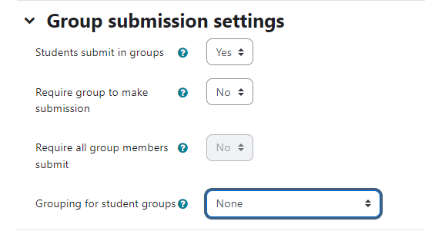
Groups & Groupings
Troubleshooting Groups & Groupings:
Students belong to more than one group; how do I get Moodle assignment to know which groups I want to mark?
Remember to put your groups into groupings. When setting up your assignment, as well as setting up “students submit in groups”, select the appropriate “Grouping for student groups”.

Slide 45
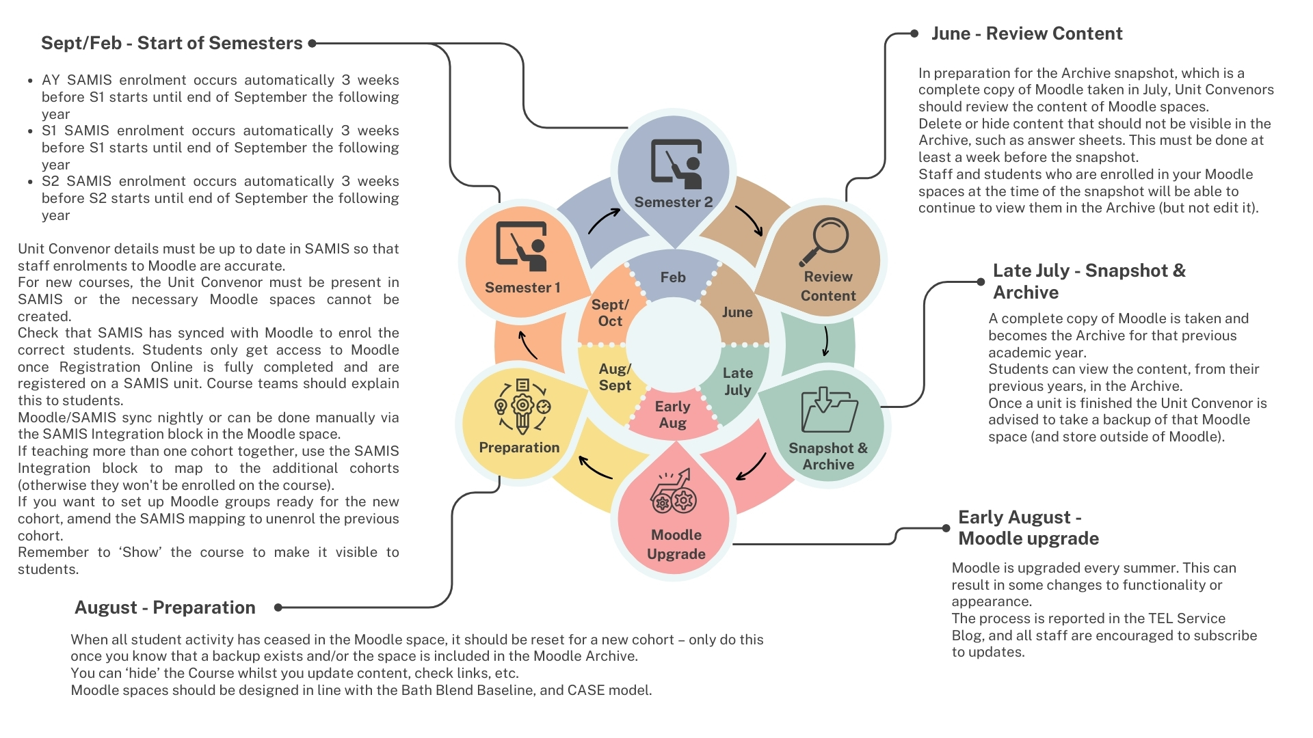
Moodle Administration Cycle

Slide 46
Start of Semester - Housekeeping
Create new quizzes and assignments
Reset forums and wikis, check settings are still appropriate
Re-assess naming conventions (sensible names and not too long)
Moving resources between sections
Import resources and activities
Photo by RDNE Stock project: https://www.pexels.com/photo/boxes-used-for-segregating-things-at-home-8581413/
TEL-Bytes webinar – How to reset your Moodle space
Notes:
Hide the course (by clicking on the settings tab at the top)

Slide 47
Useful Resources – Enrolling Participants
Managing Unit Convenor/Teacher+ Enrolments
Recording: Introducing the new SAMIS integration on Moodle [20:25]

Slide 48
Useful Resources – Course Settings
Editing your Moodle space
TEL-Bytes webinar - How to reset your Moodle space

Slide 49
Useful Resources – Groups and Groupings
Managing Moodle Groups and Groupings
Creating Groupings
Recording: TEL Bytes – Using Moodle groups and groupings-15OCT24 [31:53]

Slide 50
Useful Resources - Recordings
Past events:
Recordings to past CLT workshops and events

Slide 51
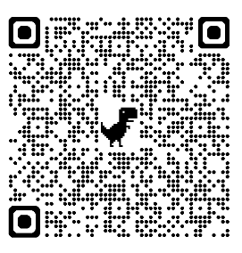
Feedback
Thank you for attending today’s session.
Please take a few minutes to fill in our Workshop feedback form. Your responses are anonymous. We will use the feedback to assist in the planning of future webinars and may use comments for future promotional materials.

Slide 52
Closing slide

