Slide 1
How to reset your Moodle space
This session will be recorded
Tom Brunsdon (Learning Technologist) and Olivia Soutter (Instructional Designer)
Technology Enhanced Learning team
tel@bath.ac.uk
15th January 2025

Slide 2
Session outline
Reset a Moodle space overview (15 mins)
Demo (15 mins)
Q&A (optional)
The recording and slides will be uploaded to the Teaching Hub past events page after the session.

Slide 3
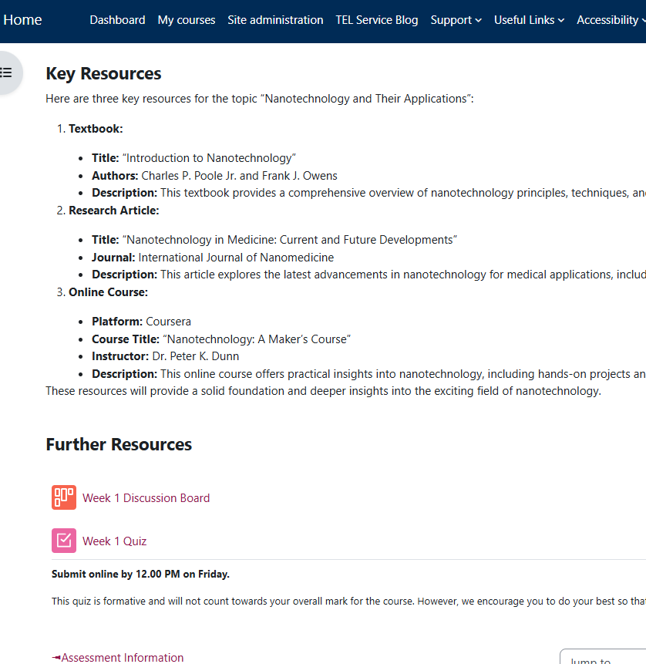
Why reset your Moodle space?
Moodle spaces at Bath are re-used each year.
They will contain user data from the previous cohort (e.g. forum posts).
The start of semester is an opportunity to ‘housekeep’ more widely:
  Review content
  Update activities and resources
  Check enrolments

Slide 4
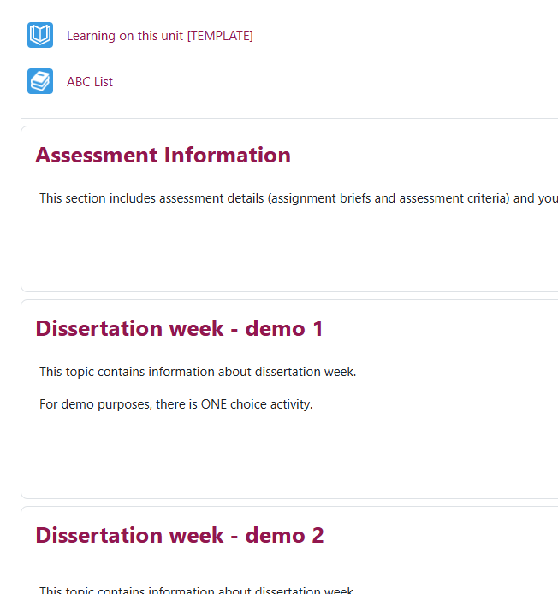
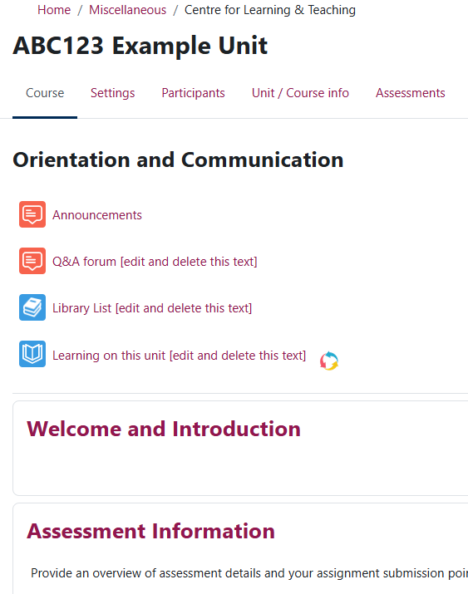
Important
This webinar focusses on resetting a Moodle space previously used in semester 2 last year.
Used for S2 in 2023-24
Reuse for S2 from February 2025
Assessment and teaching for 2023-24 completed

Slide 5
Steps to reset your Moodle space
1. Hide your Moodle space
2. Check archive or backup is in place
5. Recreate activities
6. Update content
7. Show your Moodle space
4. Reset activities
3. Check enrolments
We will live demo this process later in the session.

Slide 6
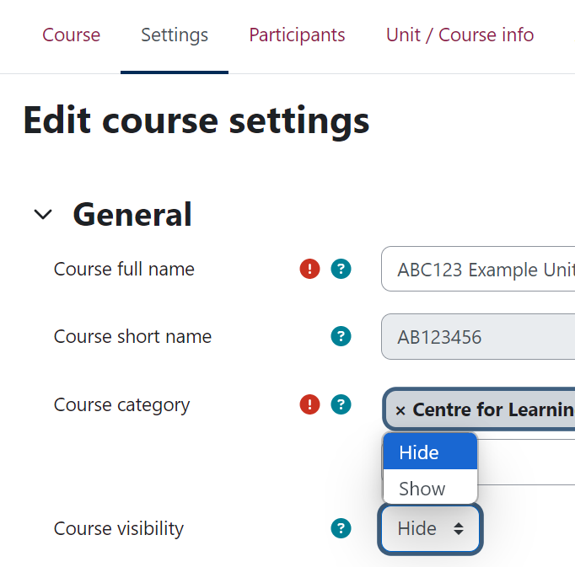
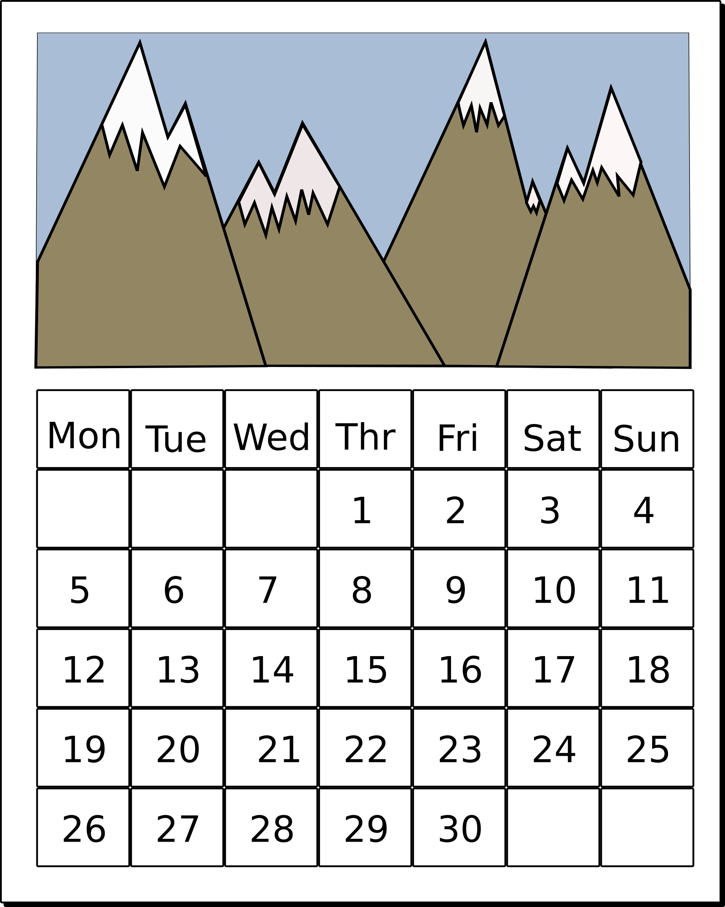
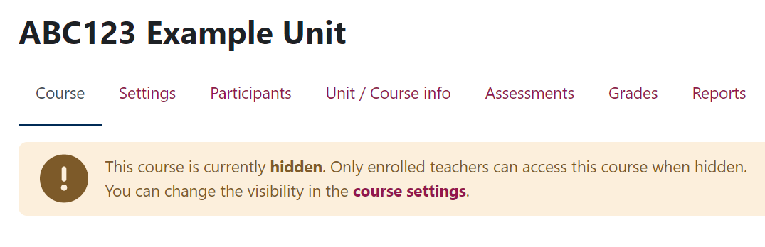
1. Hide your Moodle space
Settings > Course visibility > Hide.
Teacher+, Teachers, Non-editing teachers can still access.
Put a note in your Outlook calendar to show your Moodle space before teaching starts.

Slide 7
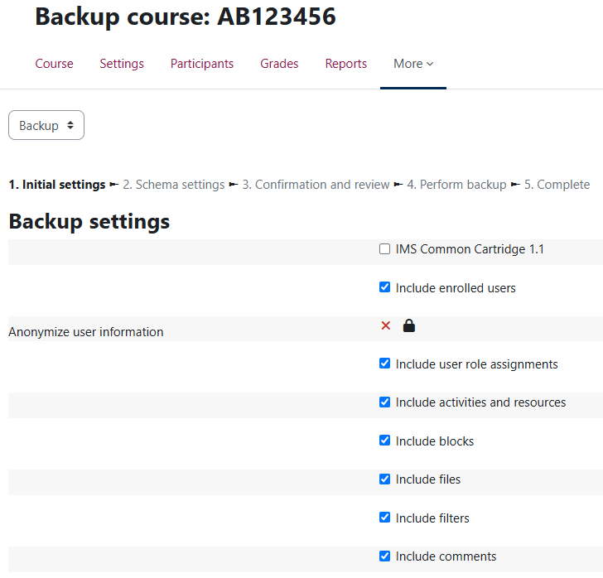
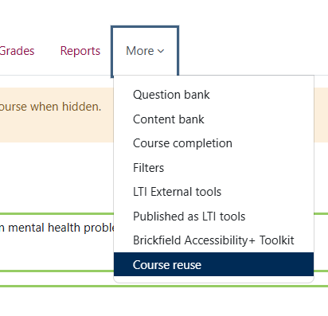
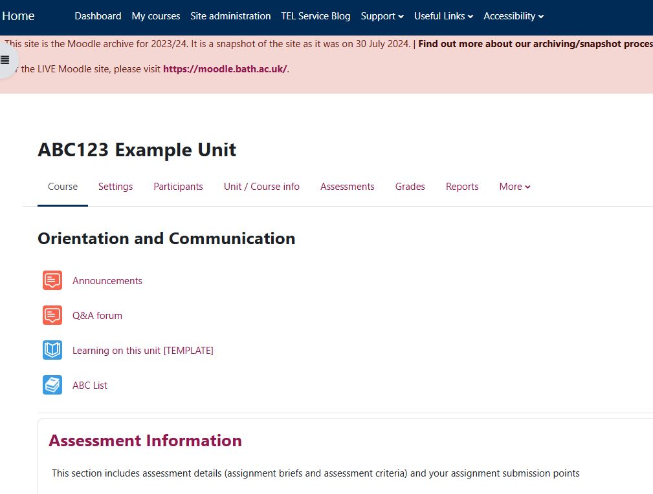
2. Check archive or backup is in place
Check the Moodle archive
  Read-only snapshot of Moodle taken at end of July each year.
  For Teachers and Students who had access at the time of the snapshot.
If your unit is an exception for archiving, you may need to manually:
  Download assignments and save to a shared drive.
  Or Backup the whole Moodle space in case it needs to be restored in the future.
  If unsure, check with your department.

Slide 8
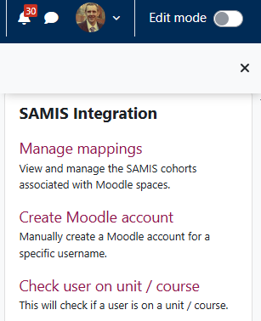
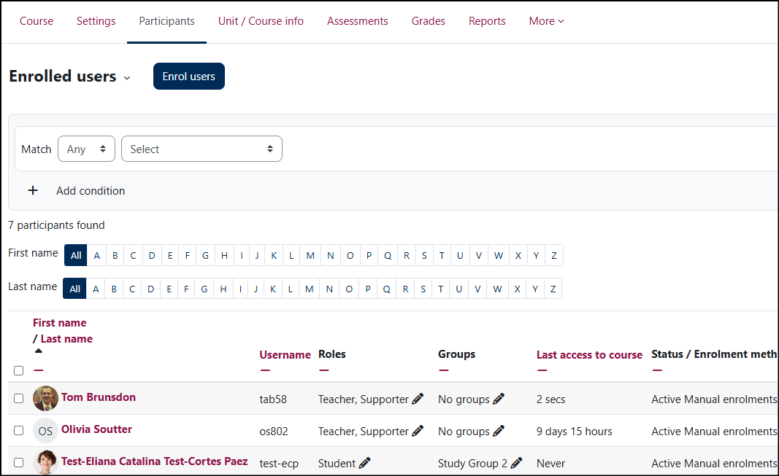
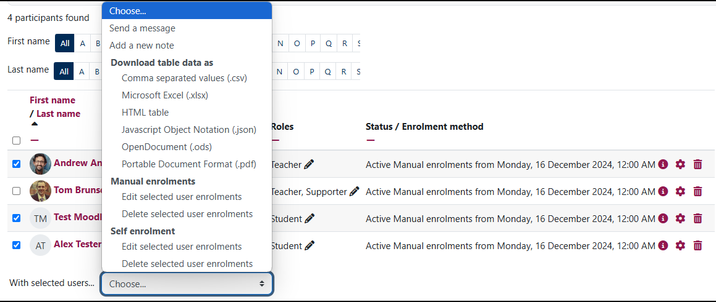
3. Check enrolments
Look at the Participants tab
For Semester 2 units:
  Last year’s students should have been auto-unenrolled in September.
  This year’s students were auto-enrolled from SAMIS on 13th January.
  You can edit the unenrolment date in SAMIS manage mappings if this is helpful.
Ask your Programme Admin team to add Teacher+, Teachers in SAMIS.
Remove any manually enrolled or self-enrolled students/teachers who no longer require access.

Slide 9
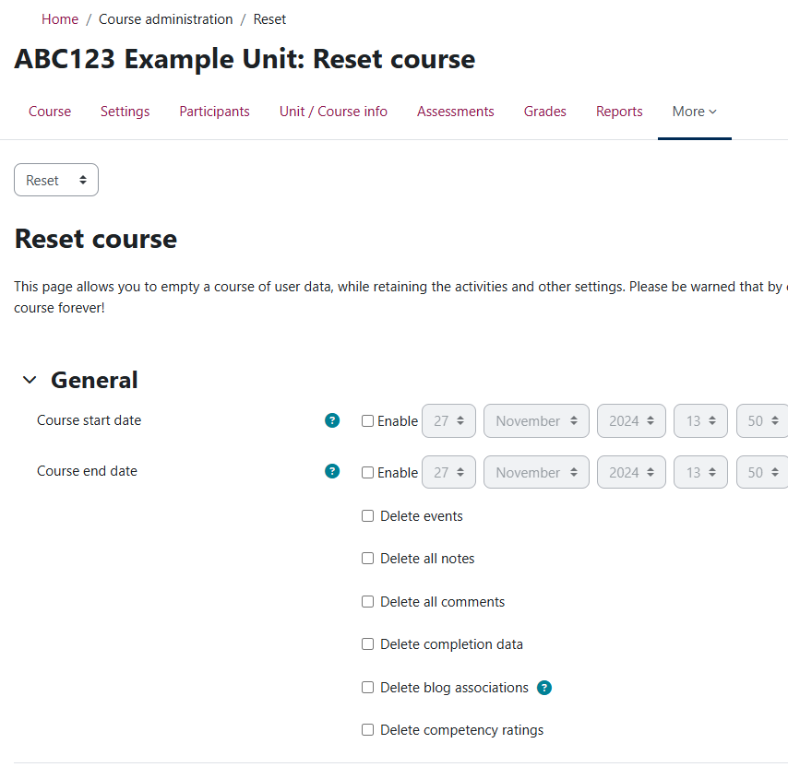
4. Reset activities
More > Course reuse > Reset
Some activities can be reset to remove past interactions – Forums and Quizzes.
Manual and self-enrolments can be reset – be careful not to unenrol yourself!
Resetting groups will remove SAMIS cohort groups too.
Resetting is final.

Slide 10
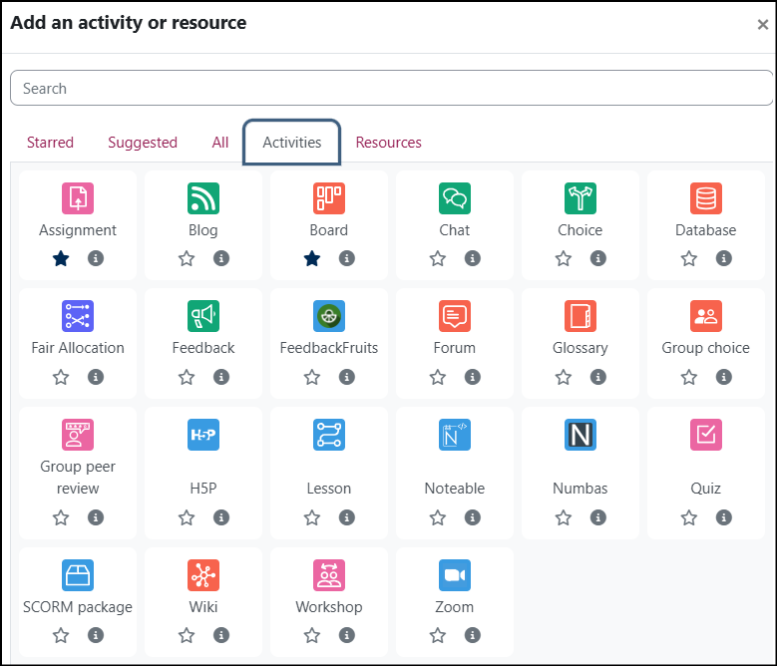
5. Recreate activities
Assignments
  Create new assignments every time to prevent errors.
Duplicate activities
  Make copies of any other activity to get a clean copy ready for the new cohort.

Slide 11
5. Recreate activities (2)
Reset
All quiz data
All forum posts
Duplicate
Activities other than assignments with user data.
Recreate
Assignments
Specific quiz, forums, board, choice activities.

Slide 12
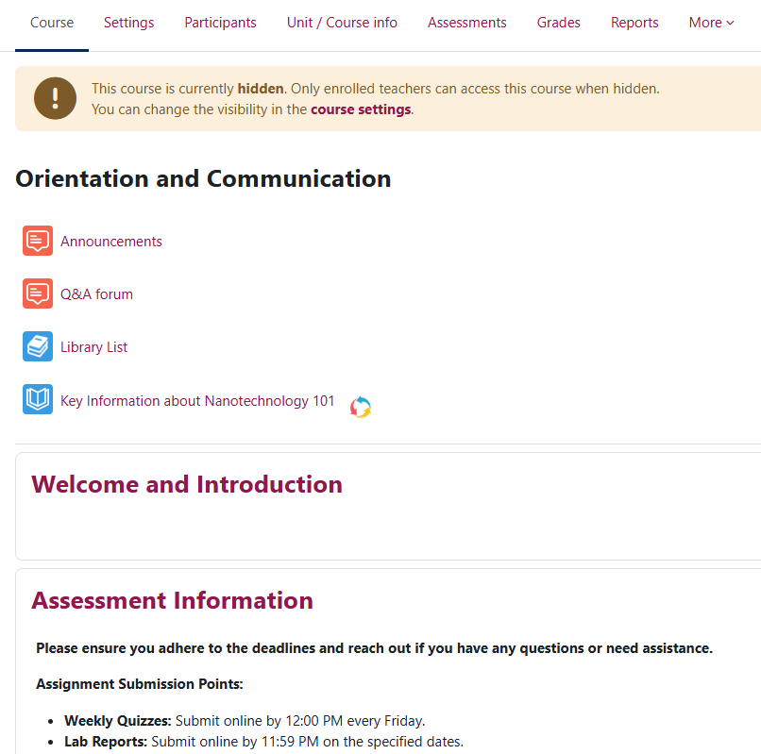
6. Update content
Update key information in the Orientation & Communication, Welcome, and Assessment topics.
Delete, hide, or update any out-of-date material.
Check links and documents are still accessible.

Slide 13
7. Show your Moodle space
When your Moodle space is ready…
Settings > Course visibility > Show.

Slide 14
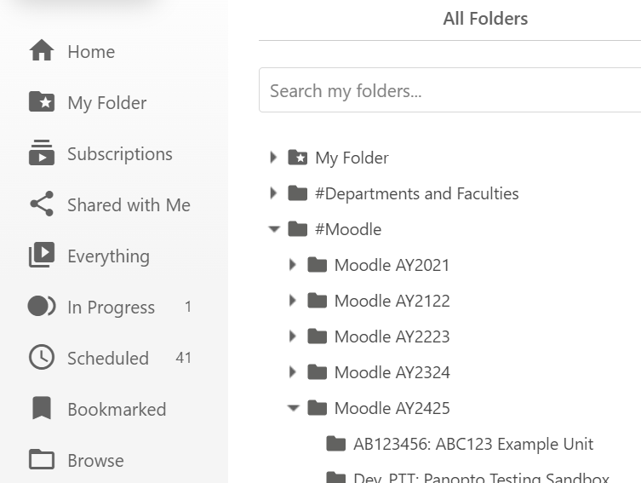
Bonus slide – Panopto folder
A new, empty Moodle-linked folder in Panopto has been created for the AY2425 academic year.
Guidance on Teaching Hub.
Webinar – How to share recordings using Panopto and Moodle. 27th January.

Slide 15
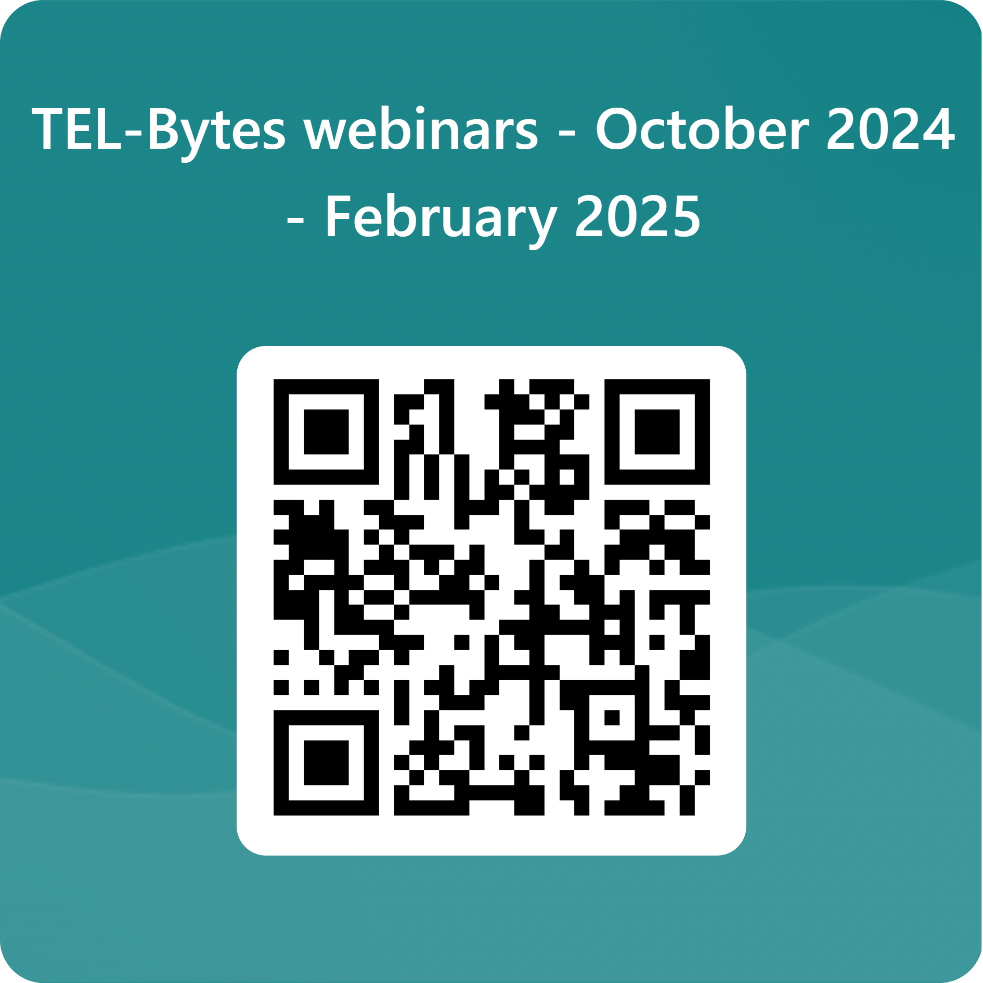
Demo, support resources and feedback
Any questions before we demo the process on Moodle?
Resetting activities guide
General information/support
  Teaching Hub
  Further TEL-Bytes webinars
  Email tel@bath.ac.uk
Feedback form

