Slide 1
Setting up a Moodle Quiz
This session will begin shortly. It may be recorded. Please check you are happy with your video / audio settings.
Mark Egan / Josh Lim
tel@bath.ac.uk
November 2024

Slide 2
Welcome and introductions

Slide 3
Overview
Quiz notification form
Create questions in the question bank
Settings for the quiz activity
Add questions
Preview the quiz
Next steps and Q&A
Guidance on the Hub: Moodle - Quiz (summative) and Moodle - Quiz (formative)

Slide 4
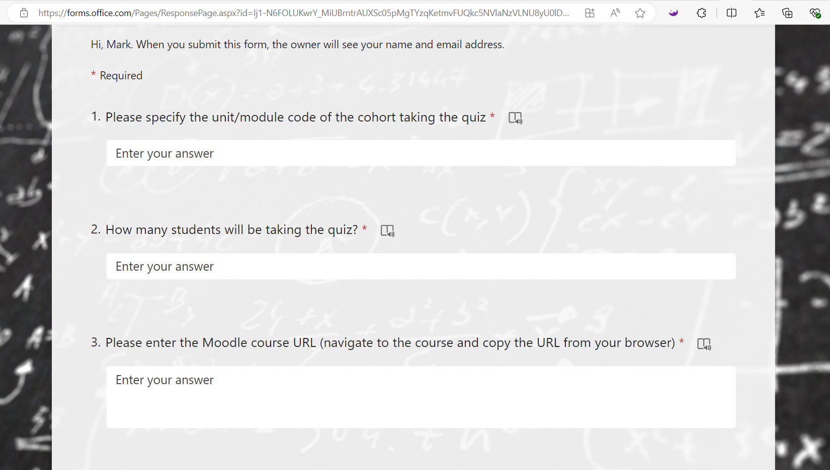
1. The quiz notification form
Complete the Quiz Notification Form at least seven days before the quiz.
This helps to allocate resources and minimise system issues.

Slide 5
2. Create questions in the question bank
Create questions in the Question Bank rather than authoring questions directly in a Moodle Quiz activity.
Benefits:
Organisation: Categorise and subcategorise questions for easy management, similar to folders.
Reusability: Easily reuse questions across different quizzes and courses.
Version Control: Track question versions and statuses for quality assurance.
Demo →
Notes:
At this point switch to live demo

Slide 6
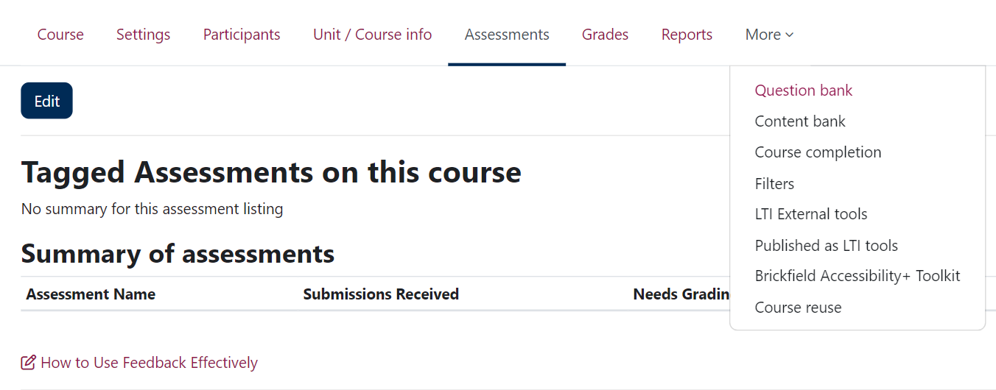
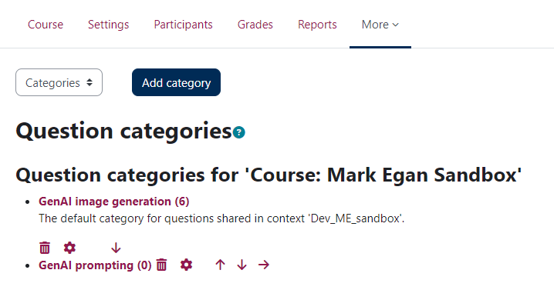
2. Create questions in the question bank

Slide 7
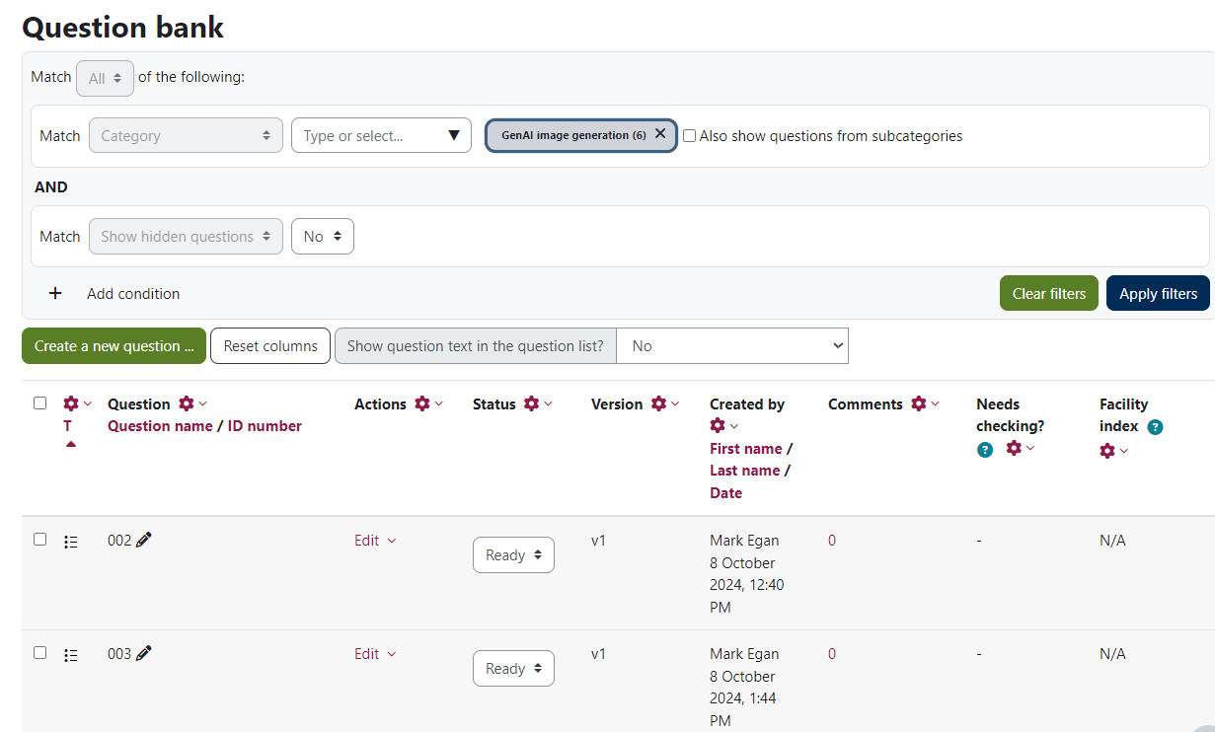
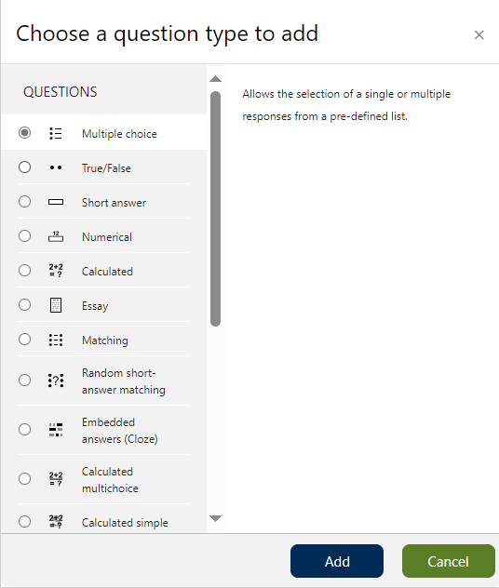
2. Create questions in the question bank

Slide 8
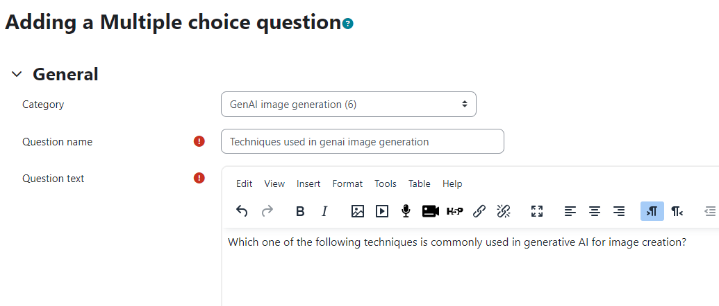
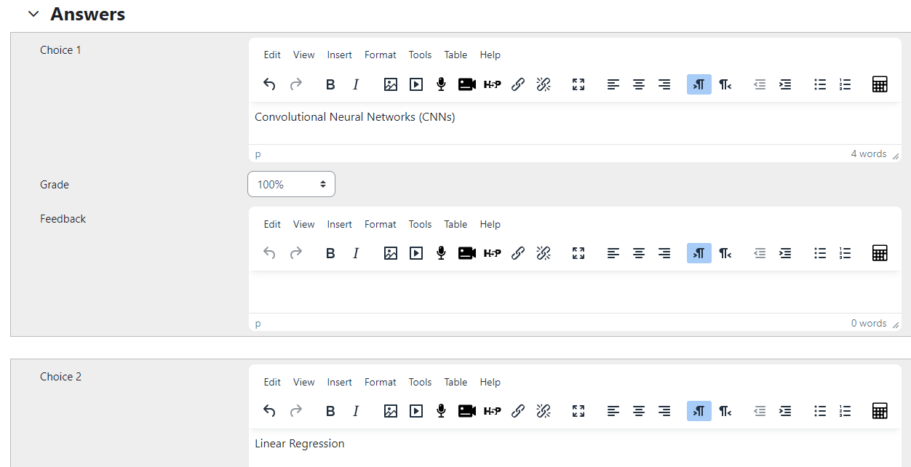
2. Create questions in the question bank

Slide 9
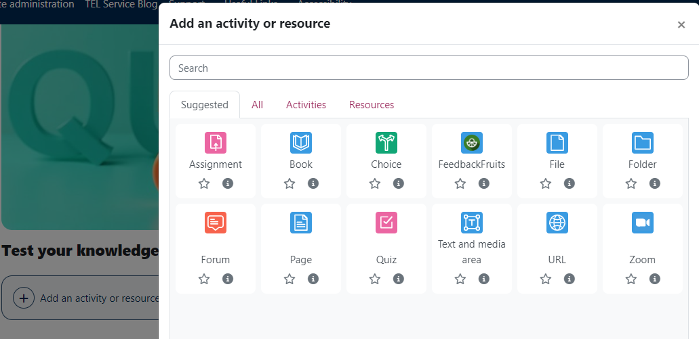
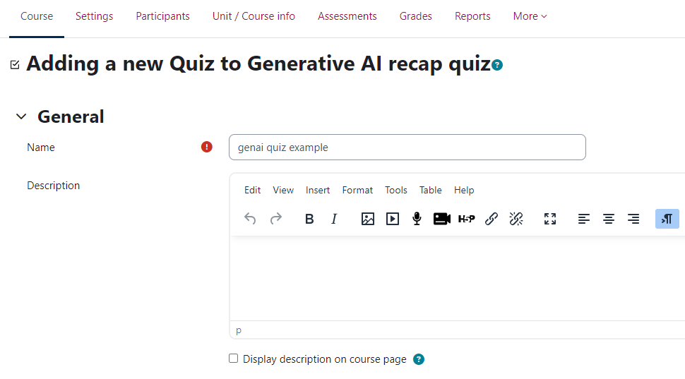
3. Create a quiz activity

Slide 10
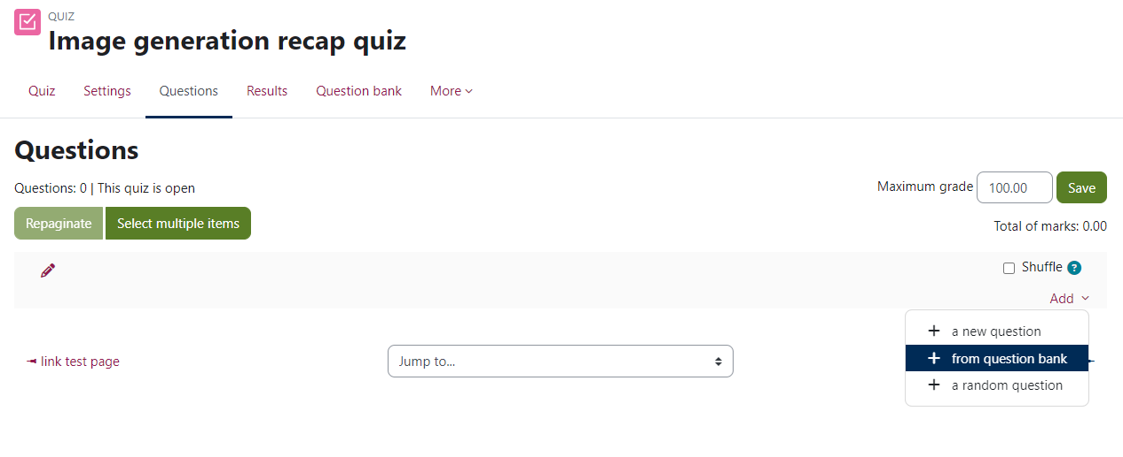
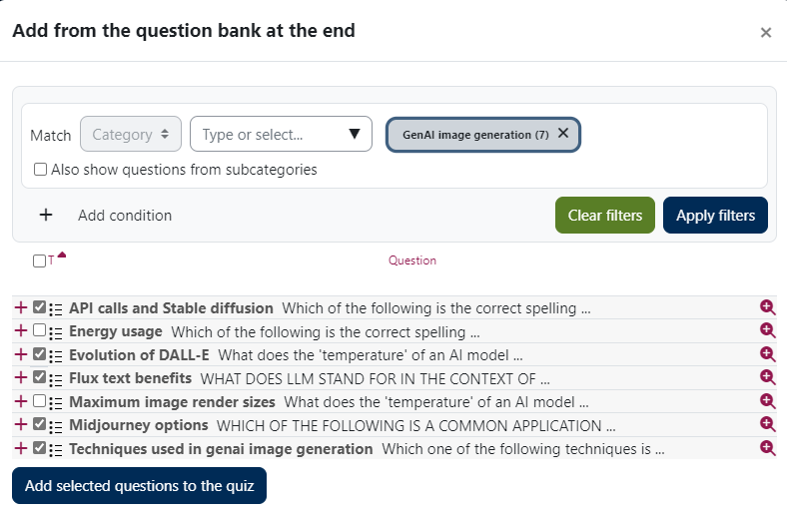
3. Create a quiz activity

Slide 11
3. Create a quiz activity – Review options
Summative quiz → Uncheck all options

Slide 12
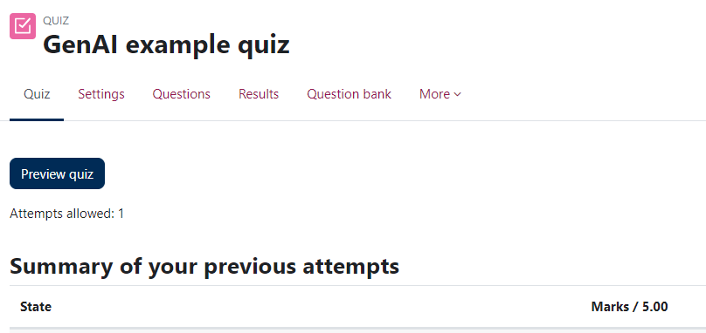
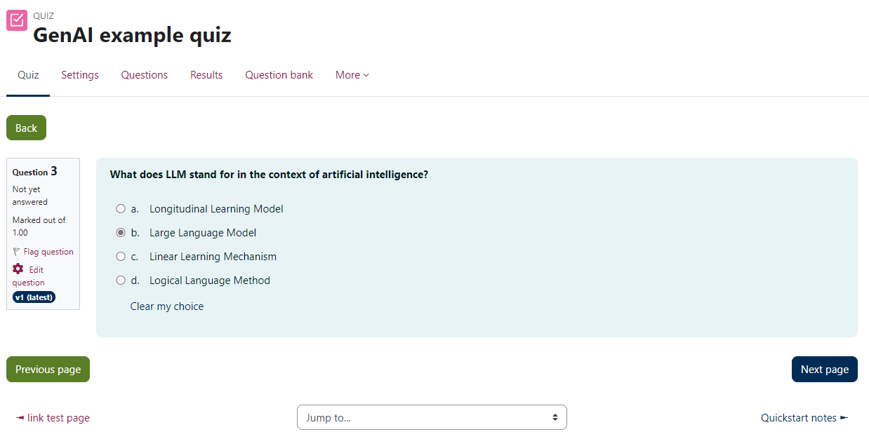
Preview a quiz

Slide 13
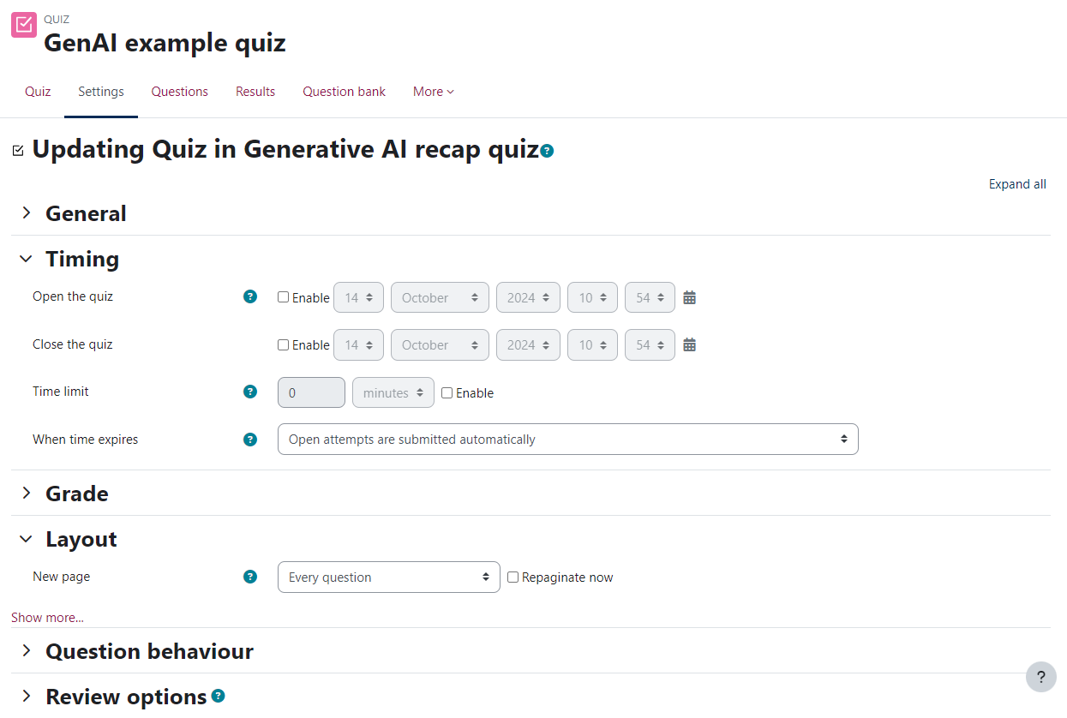
Next Steps
Work through the quiz SETTINGS and adjust quiz opening / closing times, question layout and the feedback options etc:

Slide 14
Online help resources
Articles on the Teaching Hub:
Intro to the Moodle Quiz Question Bank
How to set up a Moodle Quiz
Moodle - Quiz (summative workflow)
Moodle - Quiz (formative workflow)
How to write effective multiple choice questions

Slide 15
Q&A

Slide 16
CLT closing slide
Produced by
Centre for Learning & Teaching
in conjunction with
Technology Enhanced Learning Team
2024 - This work is licensed under a Creative Commons Attribution-NonCommercial-NoDerivatives 4.0 International License

