Slide 1
The Learning and Teaching Hub Quick Reference Guide
User Roles
Logging in
Subscribers – UoB staff, who can log in to book onto events, or manage their bookings.
Authors – CLT staff who can create, edit and publish events, pages and articles. Some permissions are restricted (e.g. ability to upload new plugins) but seek advice from a Hub Admin if you need additional permissions.
Admin - nominated TEL staff, who will oversee the management of the Hub.
There is a Staff Login link on the top right, or logging in can take place at https://teachinghub.bath.ac.uk/wp-admin
The site uses the Microsoft login, requiring your Bath email and password.
(No) Blog
The WordPress blog is not to be used in the Hub site. Blogging should happen in the CLT or TEL blogs. The content of those blogs can be displayed in the site via use of an RSS block. Visit the blog (searching by category/tag if required) and add /feed to the end of the URL. Use this new URL in the RSS block.
Pages and Articles
The WordPress site content is split into Pages (for general information) and Articles (for instructional information). The Article pages are managed by a Knowledge Base plugin, that allows the content to be organised by categories, with automatic TOC and related links added to the content. If your content does not fit into an existing category, seek advice from a Hub admin.
Customisation
Events
If authors require some content that requires additional customisation (e.g. a new plugin), please seek advice from a Hub Admin. Only Admins should add new plugins: Mark Egan, Yvonne Moore, Marie Salter
Events can be created for in-person or online events. Online event ‘join’ links are not displayed on the site (to avoid spammers) and are instead included in confirmation emails to participants. Reminder emails are sent 7 days before event. Important to include a concise ‘excerpt’ for display elsewhere in the site. Only UoB staff can book onto events. External bookings should be managed via email. Cancelled events will notify users by email. Emails may go to Junk folder first time. Please use detailed instructions.
Administration
The hub WordPress site is hosted by WP Engine. We have a Production site (the ‘live’ site) and a Staging site (a copy for testing).
The hub needs regular maintenance (updates to WordPress, plugins, theme etc.) and the process involves:
Updates tested on Staging environment (a copy of the main site)
Updates on ‘live’ to take place at a less busy time (Tues before 9:00, Friday after 17:00). A message should be placed in the CLT team to communicate when updates occur.
Event Bookings
Booking details of participants can be viewed and exported (to Excel) for use as a register. Staff can book an event only once. Booking data can be exported to Excel for training analysis (e.g. analysis bookings according to role, department, faculty.
Search
Editing
There are three separate search functions (due to plugins being used).
These two search pages and articles:
the main site (i.e. Pages)
the Guidance area
This searches events:
Events page
The ‘results’ pages display differently due to the different functionality being used.
The sites uses ‘blocks’ to manage the content on the page. Use the block panel on left of page (select Document Overview) to move/delete content, as it allows you to pinpoint the specific content you need.

Slide 2
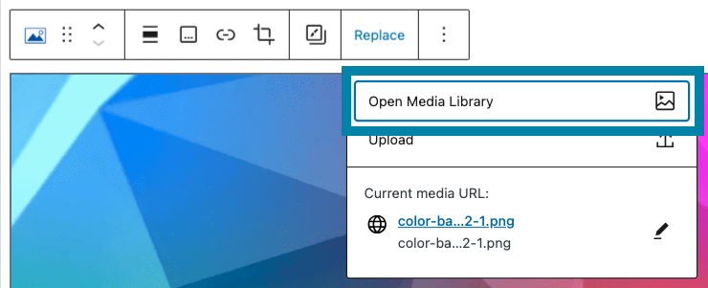
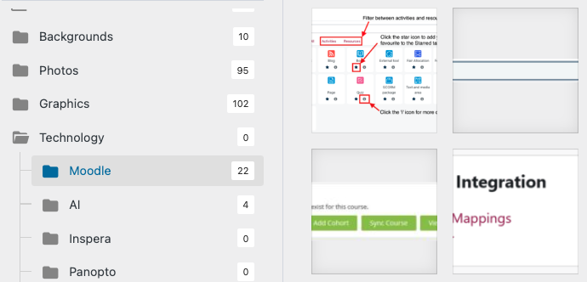
The Learning and Teaching Hub Quick Reference Guide
Consistency - Design
Accessibility - Colours
Design templates should be used to give a consistent look and feel. These can be added from the teaching hub design library when editing a page or article.
Use for headings, tabs, video embed, accordions, banners, images etc.
Accessible CLT colour scheme embedded in hub ‘theme’: White: #FFFFFF
Brown: #6B4F00 Red: #9B2C42
Dark teal: #006170 Black: #202329
Dark grey: #505A62
Use these colours when colour is needed (where practical).
Consistency - Content
Accessibility - Headings
To ensure content produced by different teams does not duplicate or contradict please check the site when creating new content. (e.g. Case studies). Please add links to related content, to make it easier for readers. Use consistent terminology/taxonomies. E.g. assessment taxonomy and acronyms and jargon.
Page and article heading are by default (in HTML) created as <h1>. Any subsequent headings should follow in order: <h2>, <h3> etc. In articles, the headings become the TOC so think carefully about the descriptive nature (key terms) and length (concise).
Consistency - Fonts
Accessibility - Images
The hub uses a default ‘font family’ and font sizes, which removes the need to manually change how text looks. For making text highlights (e.g. to make an important point stand out) use the Note box design template.
To ensure images have alt-text attached to them, for use and re-use, images should be added via the Media Library, and the alt-text added at that point (and not directly on the page). Images should be uploaded to the appropriate folder for ease of searching later.
Navigation
The top navigation menu does not have any drop-down menus, and therefore links to ‘collections’ of pages should be built into those top-level landing pages. Remember the aim is to maintain an uncluttered, easy to navigate site.
Centre for Learning and Teaching

