Slide 1
Introducing Mahara

Slide 2
What is Mahara?
Mahara is an e-portfolio technology platform
It allows you to build a web-based portfolio of digital material
It allows you to share your portfolio with others (including people external to the University)
It allows you to take your portfolio with you when you complete your course

Slide 3
Logging in
You can find a link to the Mahara platform in the Useful Links menu in Moodle
Or you can go directly to mahara.bath.ac.uk
Log in with your University of Bath username and password

Slide 4
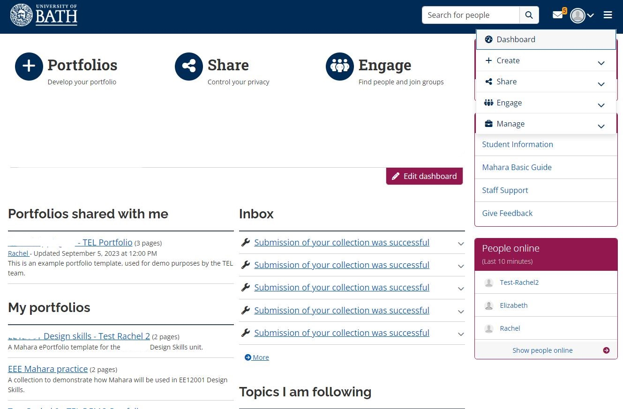
Orientation
Inbox
Profile & Preferences
Find your messages
Main Menu
Create
Create
Manage pages and collections
Create or upload content
Style your portfolio
Manage pages and collections
Create or upload content
Style your portfolio
Short cuts to Main Menu items
Share
Share
Share with others for feedback
Share with others for feedback
Engage
Make friends or join groups
Dashboard
Manage
Keep track of Mahara activity
Edit to suit your needs
Export your portfolio

Slide 5
Copying a template
You can copy a template created to help you get started
Select Main Menu > Create > Portfolios and click Copy > Collection
Find the relevant template and click Copy Collection
Add your name to the Collection title and click through the settings and Save
[If using a SmartEvidence Framework ensure it is selected in settings]
Return to your Portfolios to see the template listed there

Slide 6
Building your portfolio
Add pages
Edit Pages
Add content (through ‘blocks’)
Text, images
Files
Embedded web content (e.g. videos)
Plans, journals
Design a skin (a theme that determines the display of your portfolio)
Font styles, colours, backgrounds etc.

Slide 7
Editing pages and blocks
When you select a Page, it is displayed to you as a web page. To edit the content, click the Edit (pencil) icon to the right.
You can then add items (from blocks) by choosing the Add (plus) icon.
You can either drag a block or select the block position to add it to the page.
When you have positioned your block, you can choose the Content type.
Choose Show more to see more content type options (e.g. text, image, journal entries).
To view any changes, click the Display (monitor icon) link on the right.
When you edit the content in a Block (select the Quick Edit for the block), choose Save before you navigate away from the editing view

Slide 8
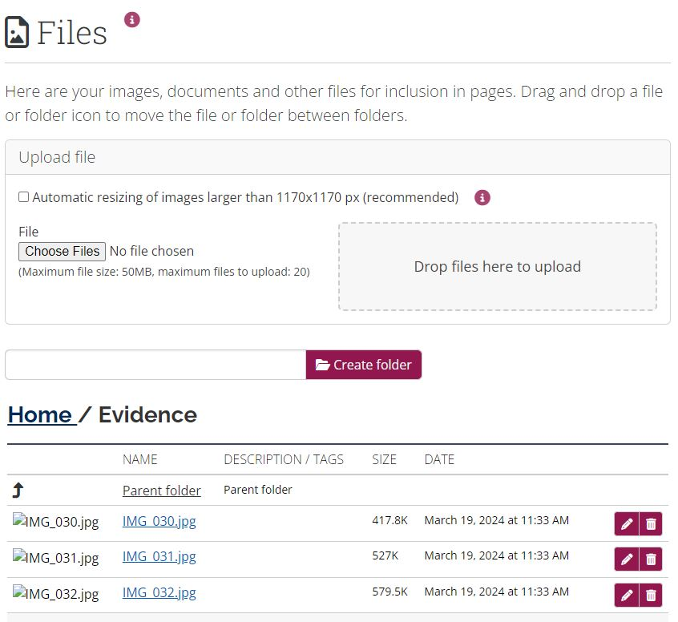
Managing files and images
When adding files or images to your portfolio pages, remember to browse to My Files to select an existing file. Do not upload multiple copies of the same file or image for different portfolio pages, as this may use up your storage quota.
Click on the main menu icon, expand the Create section, and select Files.
Click on Choose files and browse to the files on your local device or drag and drop files onto the grey box to upload
When the file(s) have uploaded, click on the pencil icon to edit the details of the file.
Change the name to something recognisable, give it a description if you think this will be useful. You can use tags to help organise your content.
You can create folders to organise your content.
Use the move icon to order your content into folders.

Slide 9
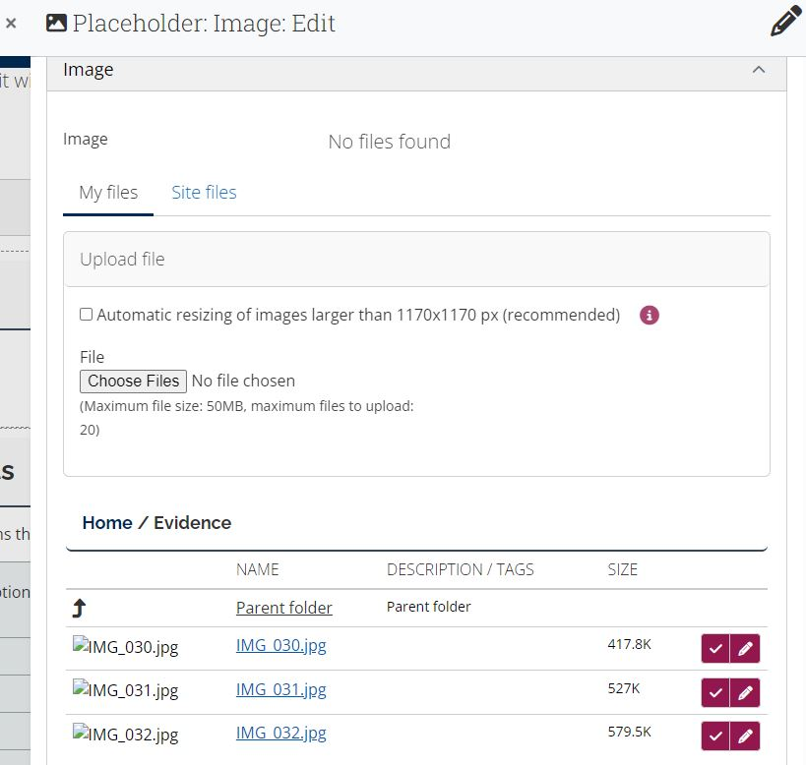
Add an image to a page
When adding files or images to your portfolio pages, remember to browse to My Files to select an existing file. Do not upload multiple copies of the same file or image for different portfolio pages, as this may use up your storage quota.
Turn on editing on a page using the pencil edit icon at the top right.
Click and drag the drag to add a block icon from the top right-hand side of the page to the appropriate location on the page. Existing blocks will move to make space.
A window will appear from the right. Click on the Image block in the list.
Edit the block title if required.
Click on the Image drop-down to select an image that you have already uploaded to the Files area (or upload an image directly if you have not used the image in your portfolio before).
Click on the tick icon to the right of the image you want to add.
Click Save and the image you have chosen will appear on the page.

Slide 10
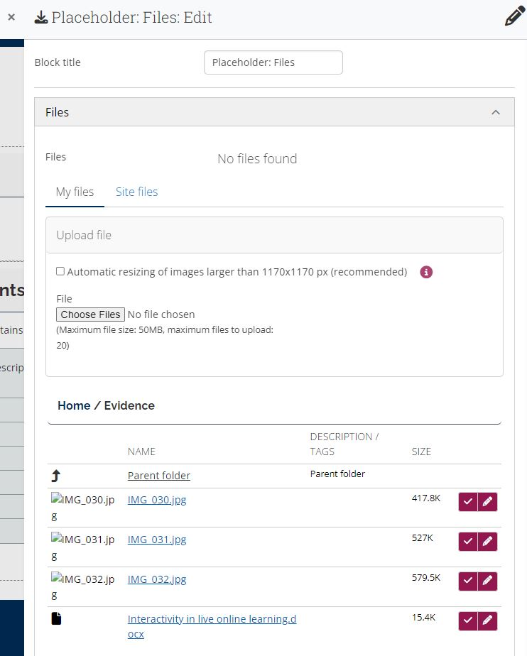
Add a file to a page
When adding files or images to your portfolio pages, remember to browse to My Files to select an existing file. Do not upload multiple copies of the same file or image for different portfolio pages, as this may use up your storage quota.
Turn on editing on a page using the pencil edit icon at the top right.
Click and drag the drag to add a block icon from the top right-hand side of the page to the appropriate location on the page. Existing blocks will move to make space.
A window will appear from the right. Click on the File(s) block in the list.
Edit the block title if required.
Click on the Files drop-down to select one or more files you have already uploaded, or to add a new file directly (this will be stored in the Files section as above).
Click on the tick icon to the right of the file(s) you want to add.
Click Save and the file(s) you have chosen will appear on the page as a list in the File(s) block.

Slide 11
Add video to a page
To display video content in an e-portfolio, you should store videos in a suitable location as advised by staff (e.g. Panopto) and embed them within the Mahara e-portfolio. If you upload video files in Mahara (e.g. mp4 file) this can very quickly use up the storage quota.
When working with video, use a suitable naming convention for your video resources.
To embed a video within a portfolio page
in Panopto, copy the Embed code for the recording
in Mahara, go to the portfolio page and add a Text block
at the top left of the text editor, toggle the toolbar to show full list of buttons
switch to html view using the Source code button
paste the Embed code into the text editor
Save to display a preview of the embedded video
Save the Text block to display it on the portfolio page

Slide 12
Mapping your work to the learning criteria
A Smart Evidence Framework allows students to map evidence against the standards. This can help you keep track of and reflect on your skills as they develop over time.
When your portfolio is mapped to a SmartEvidence framework you can show your Tutor where your work maps to the learning criteria by adding Annotation blocks
To map your Portfolio to the SmartEvidence framework, go to Create to access your portfolio(s). Select More options (three dots icon). Choose Edit. Under SmartEvidence framework, choose the framework that you want to associate with your portfolio (as per your tutor's instructions)
The framework overview page at the front of your portfolio will record your mapping decisions, ready for your Tutor to assess them
To map your work to the SmartEvidence framework, visit the relevant Portfolio Page where you demonstrate evidence of your skills
Add a block on the relevant page and select the Annotation block. Drag and drop to position the block as indicated in the page template (so your Annotations appear together on the page).
Select the standard for which you are providing evidence. Write the Annotation statement and Save.
If you navigate back to the framework overview page, you will see the standard has been flagged as Ready for Assessment on the relevant page
A staff member will be able to assess your work against the mapped criteria, once you have shared the portfolio with them

Slide 13
Sharing your portfolio
You can share your portfolio with Tutors, peers or people outside the University
For Tutors/ Peers
Main Menu > Create > Portfolios
Select the padlock icon on your Collection to manage access to your work
Change the access by selecting a Person who you want to share with [if using a SmartEvidence framework, staff members with the Staff role in Mahara will be able to assess your work]
For External people
Click the button to create a Secret URL
The generated URL (web link) can be shared with others

Slide 14
Submitting your portfolio to Moodle
You can (optionally) save your Page or Collection to a timeline (to create a time stamped version just before you submit), from the three-dot menu on each page.
Visit your Moodle space and navigate to the Assignment submission point.
Select the relevant portfolio (page or collection), click the check box to confirm your agreement with the University's Academic Integrity Statement, then click Save Changes.
Within Mahara, your original portfolio remains available for editing.
Within Mahara, you can view your submitted portfolio, by selecting the Show submitted portfolios check box, and clicking Search. The submitted portfolio displays the submitted date and time and is not editable.
Once your tutor releases grades and feedback, you can visit the assignment submission point to view the results and overview feedback.

Slide 15
Exporting your portfolio
Before you leave the University and lose access to Mahara you can download (export) your portfolio work
It can then be viewed offline (clicking the index.html file to view in a web-browser) or
The .leap2a file can be imported into another e-portfolio platform (if it supports the Leap2A format)

