Slide 1

Designing your Moodle Spaces for Effective Learning
This session is delivered by members of the TEL Team.
tel@bath.ac.uk
Summer 2024

Slide 2

Session Overview
Introduction to CASE
Consistency
Scaffolding
Engagement
Accessibility
Moodle Space Activity
Wrap-Up
Q&A
45mins

Slide 3

Consistency
Accessibility
Scaffolding
Engagement
Notes:
CASE Model
There are four key themes to our model for thinking about effective blended delivery, Consistency, Accessibility, Scaffolding and Engagement.
They are distilled from the wider research, experience, and good practice in blended learning and teaching.

Slide 4
Why Use CASE in Moodle?
Effective use can:
Help reduce workload for staff
Help reduce barriers to learning and cognitive load for students
Improve student navigation
Improve student engagement
Moodle: Valuable platform to support learning
Learning Environment: Primary online study environment
Flexible: Design in a way that works for you
Templates: A good starting point – see Bath Blend Baseline Moodle Templates
Notes:
Help reduce workload for staff – if students know where to find key information and they know where to look to find the answers to their questions, this can help to reduce the number of queries coming in from students across multiple platforms
Help reduce cognitive load for students - minimises unnecessary scrolling
Improve student navigation – again students know where to find key course information, they know exactly where to find all the assessment information, things like that
Improve student engagement – helps to build a sense of community in the online space

Slide 5
Consistency
Using a template is a great starting point
Ensure your template is fully populated, including;
Essential course information
Orientation and communication
Books (learning on this unit)
Assessment and feedback
Weekly/topic content
Between Courses:
Discuss and agree a teaching-team-wide approach
Within Courses:
Ensure a consistent use of headings and naming conventions
Keep weekly/topic summaries succinct and include a similar level of information throughout the Moodle space
Include a short introduction for each week/topic
Notes:
Using a template helps to implement a CASE structure within your Moodle space.
Consistency between courses:
Team wide approach
Consistency within courses:
Headings
Topic
Introductory paragraph helps students understand what they can expect from each topic before clicking through to the page.

Slide 6
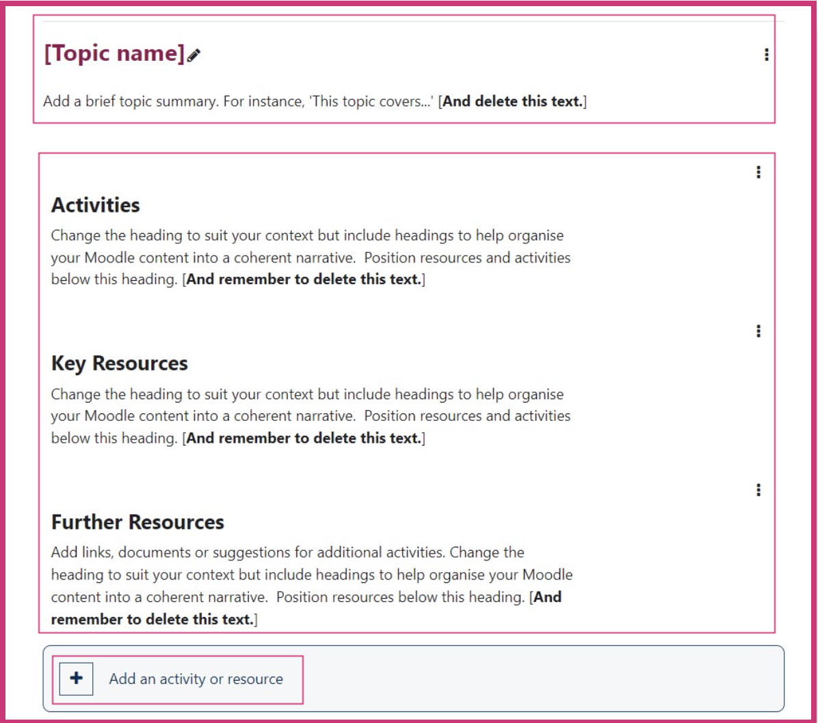
Scaffolding
Between Courses:
Discuss and agree a teaching-team-wide approach
Within Courses:
Ensure resources are accompanied by instructional guidance i.e. what/when/how
Clearly identify between Recommended Reading and Further Reading
Use a clear, easily navigable structure
Make use of Folders and Pages
Notes:
Identifying things such as Recommended Reading and Further Reading is something that students have consistently fed back that they find really useful, it helps them manage their workload and helps them to understand the expectations for each lecture or seminar, for example.

Slide 7
Engagement
Between Courses:
Discuss and agree a teaching-team-wide approach
Within Courses:
Set expectations – explain how you intend to use Moodle and how you expect students to engage with the content
Ensure it is clear how staff and students will communicate – update contact information/preferences and office hours
Forums help boost engagement and are a great way to disseminate information quickly
Make use of a variety of resources for students to read/listen to/watch
Notes:
Set expectations and make use of forums

Slide 8

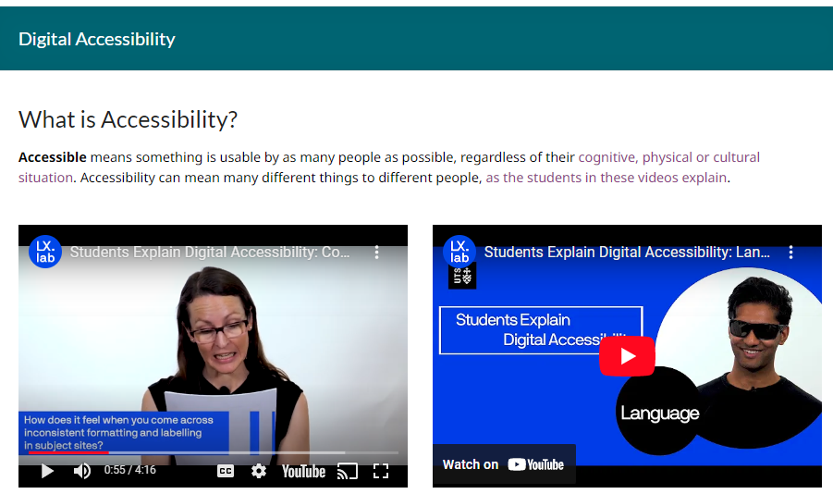

How to think about digital accessibility?
Tips:
Be aware of common digital barriers
Create, rather than remediate.
Carelessly created resources can disable people.
Inclusive teaching benefits all learners, not just those with specific 'labels’.
Watch Students Explain Digital Accessibility

Slide 9
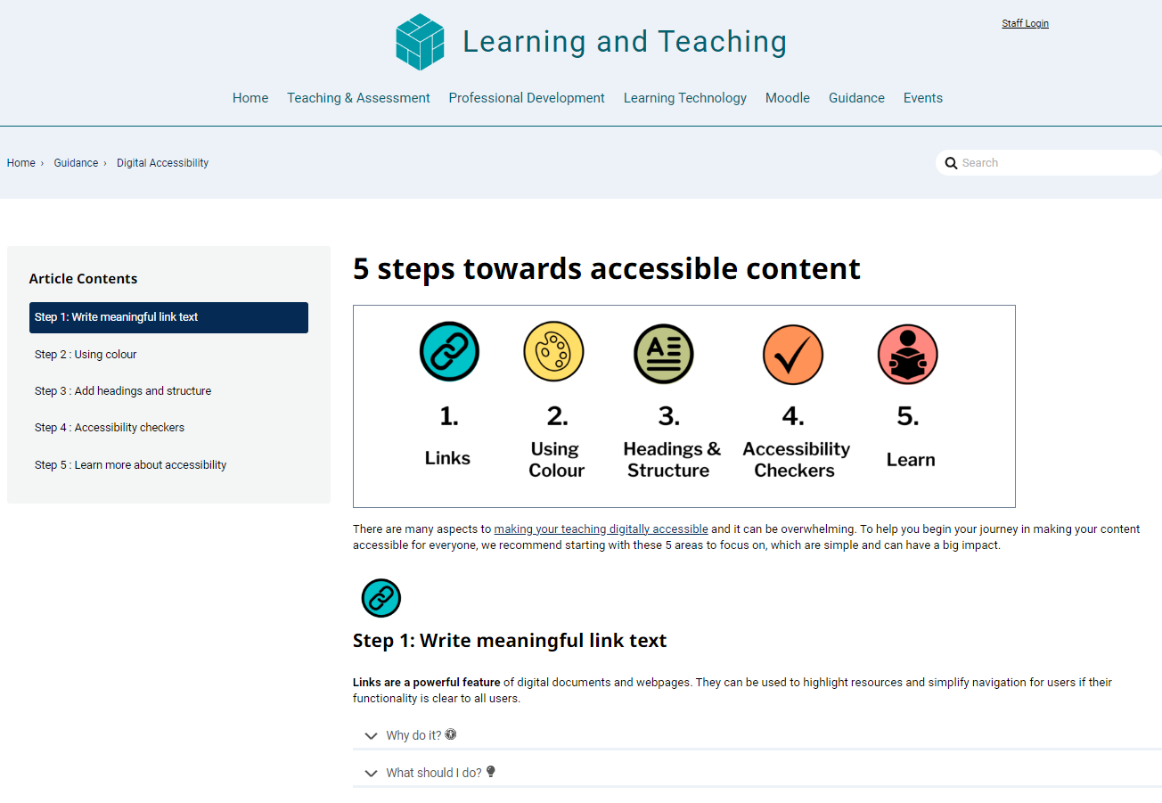
Accessibility
1. Meaningful Links
2. Using Colour
3. Add headings and structure
4. Use Accessibility Checkers
5. Learn about Accessibility
5 steps towards accessible content

Slide 10
Checklist for Designing Moodle Spaces
Consistency
Do topics/weeks have the same level of information present throughout?
Is key information presented consistently (in line with the wider course/departmental approach)?
Has a consistent naming convention been agreed and used for uploaded files?
Accessibility
Have errors displayed in the Accessibility+ heat map been corrected?
Has the accessibility of uploaded resources been considered (e.g. Power Point slides)?
Have images been labelled with alt. text?
Scaffolding
Is there a clear, easily navigable structure?
Are resources such as ‘key reading’ and ‘additional reading’ clearly identified?
Are resources accompanied by instructional guidance?
Engagement
Is it clear to students how and when they are expected to engage with the Moodle content?
Is it clear how staff and students will communicate (i.e. contact information/preferences)?
Are there resources for students to read/listen to/watch?

Slide 11
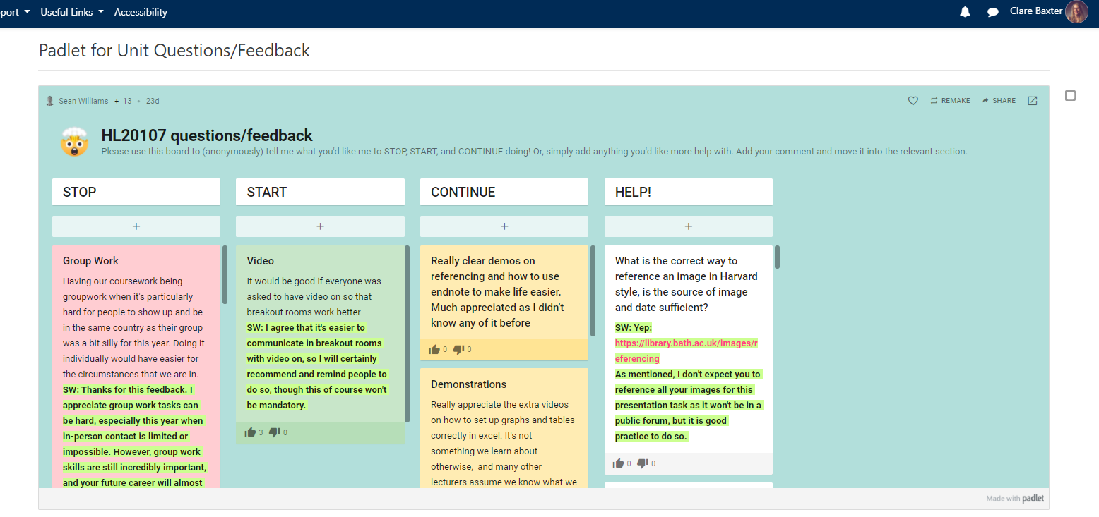
Activity: Example Moodle Spaces
The Global Politics of Cyberspace
Advanced Clinical Assessment
Advancing Research Design & Statistics
Questions to Consider:
What scaffolding is evident?
What is the most effective method of engagement here?
What might you do differently?
10 minutes
10 minutes
Shared with permission from Dr A. Barrinha & Dr S. Williams

Slide 12
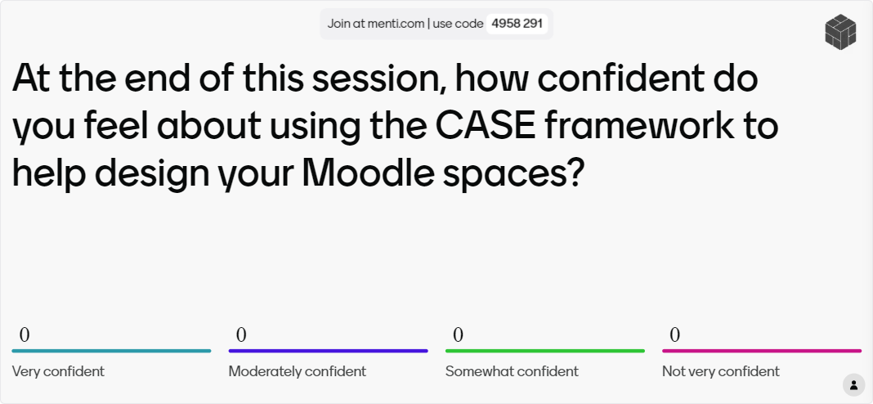
Confidence Check
https://www.menti.com/al3vgcq2qykn
Notes:
At the end of this session, how confident do you feel about using the CASE framework to help design your Moodle spaces?
Very confident / moderately confident, somewhat confident, not very confident

Slide 13
Further Resources
Book a 1:1 with an Instructional Designer
See our Teaching Hub guidance
Moodle Template Hub page
Populating Your Moodle Space Guide
Bath Blend Baseline Handbook
Request a Moodle Review
Self-paced resources
Email tel@bath.ac.uk

Slide 14



CLT closing slide
Produced by
Centre for Learning & Teaching
in conjunction with
Technology Enhanced Learning Team
2024 - This work is licensed under a Creative Commons Attribution-NonCommercial-NoDerivatives 4.0 International License

