Slide 1
Preparing for Moodle upgrade and archiving
Summer 2024
This session will be recorded
Tom Brunsdon & Dan Green (Learning Technologists)
Technology Enhanced Learning team
tel@bath.ac.uk
12th June 2024

Slide 2
Session outline
Moodle upgrade
New features in Moodle 4.3
Moodle archive
Next steps
Supporting resources
Q&A (optional)

Slide 3
Moodle upgrade overview
An annual upgrade of Moodle is needed to ensure our site and the data stored within it remains secure.
Moodle has been upgraded every year at the same time since 2007.
Always last week of July/first week of August
Moodle usage audited
Least disruptive time on Moodle
No clash with supplementary exams
Same time every year - allows those impacted to make adjustments
A read-only instance is made available – students may need to revise
Not a major upgrade like last summer

Slide 4
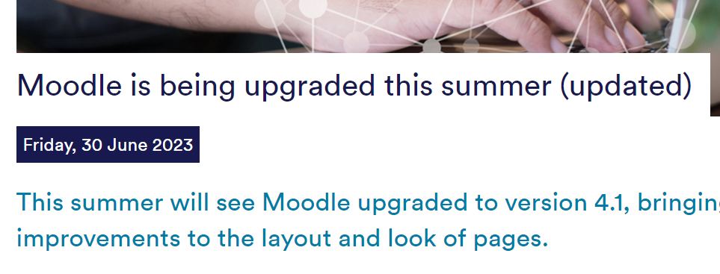
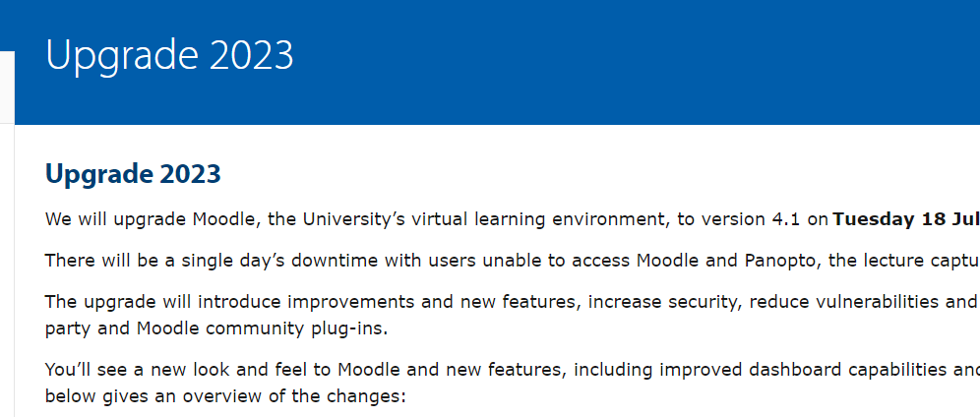
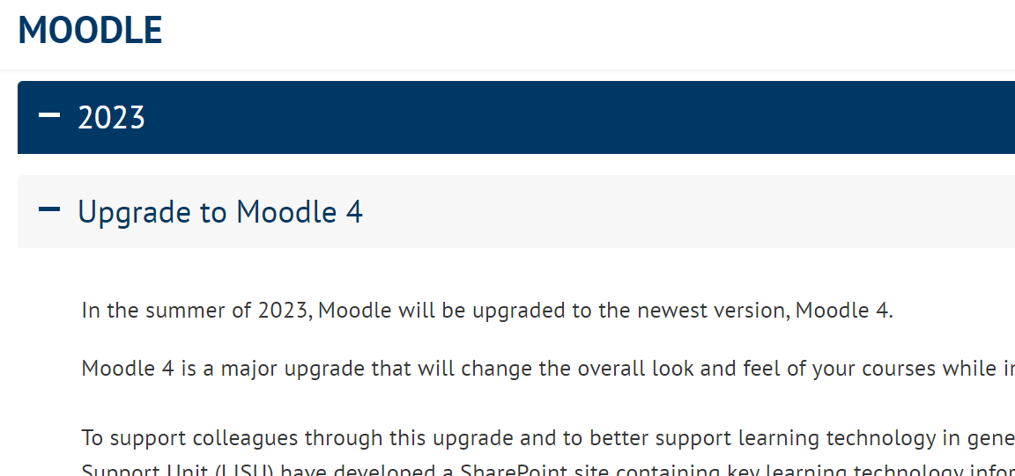
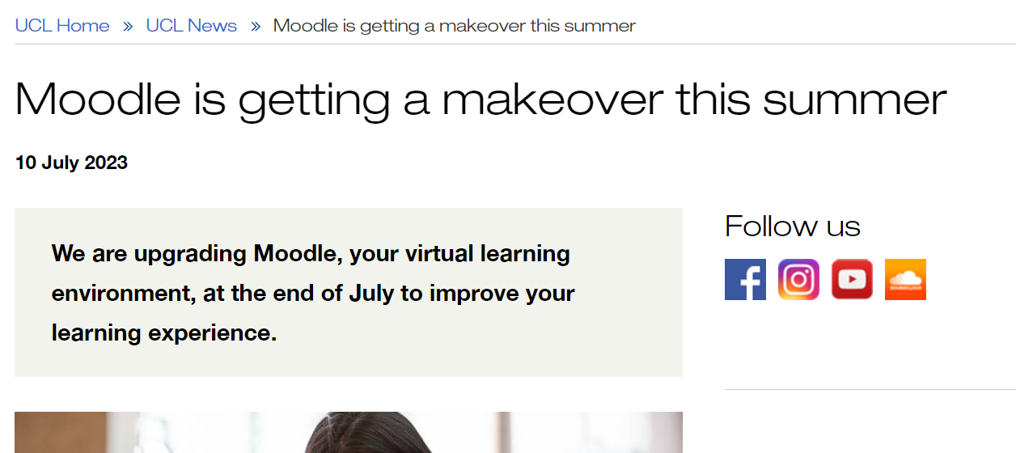
Examples from other Universities
Nottingham
Cambridge
UCL
Glasgow

Slide 5
When is the Moodle upgrade?
Tuesday 30th July | Wednesday 1st August | Thursday 2nd August | Friday 3rd August
AM – Moodle offline
Existing Moodle read only
Existing Moodle read only
Upgraded Moodle operational
PM – Existing Moodle back online (read only)
Due to the scale of the project, there may be some movement in timescales during the week.

Slide 6
During upgrade week
When Moodle is offline
No Moodle access for everyone.
No access to learning activities, Quiz, Assignments, Forums etc.
Can access Re:View (Panopto) recordings from Re:View directly at http://go.bath.ac.uk/review
When Moodle is read-only
Staff/students can view resources.
Can download resources, e.g. files.
Cannot participate in interactive activities.
Can’t post to a forum.
Can't answer a quiz.
Can't submit an assignment.
Can access Re:View (Panopto) recordings from Re:View directly or Moodle.
Cannot create new user accounts.
When upgraded Moodle fully operational
Can use Moodle as normal.
New functionality available in Moodle.

Slide 7
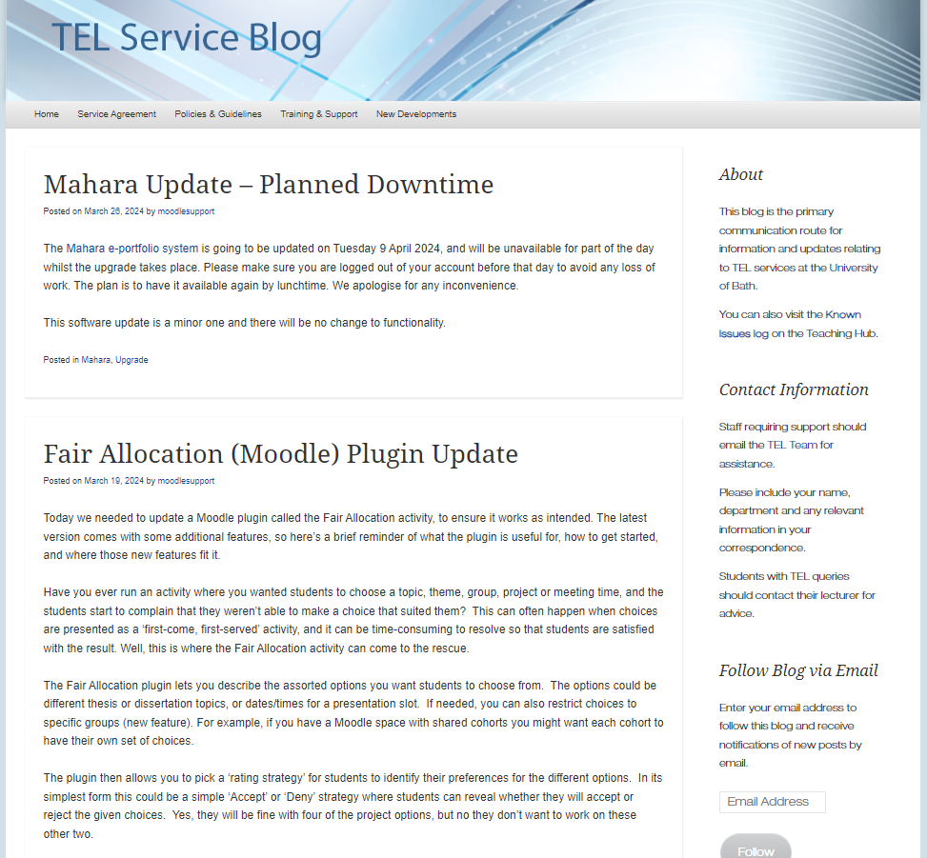
Moodle upgrade updates
Sign up to the TEL Service Blog for updates

Slide 8
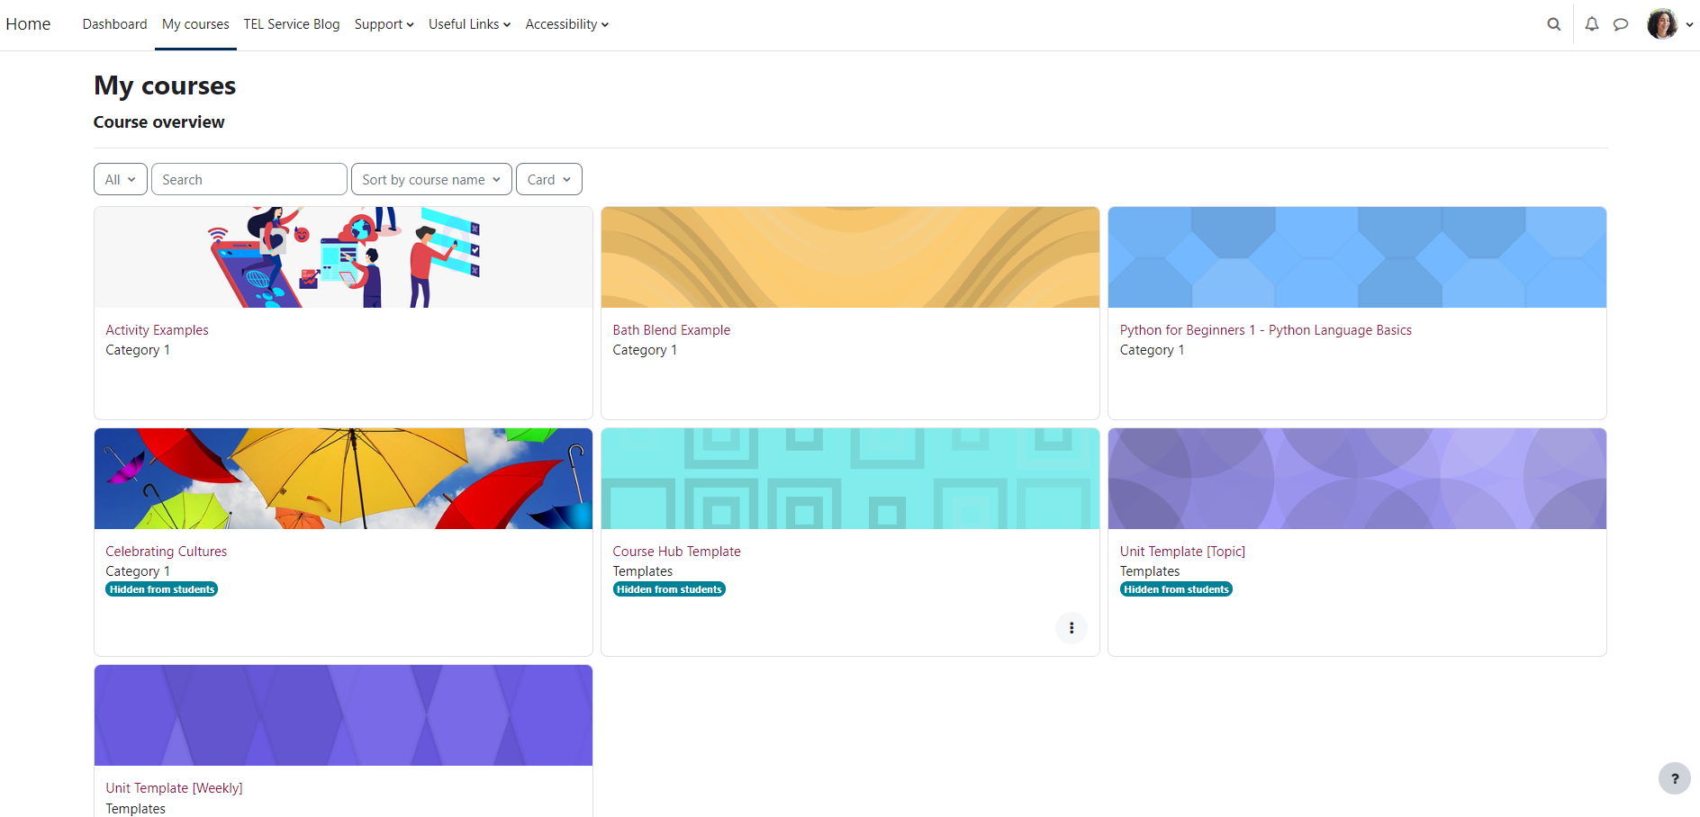
New Moodle functionality
Blog post – New in Moodle 4.3
Moodle demo site – upgraded site coming soon

Slide 9
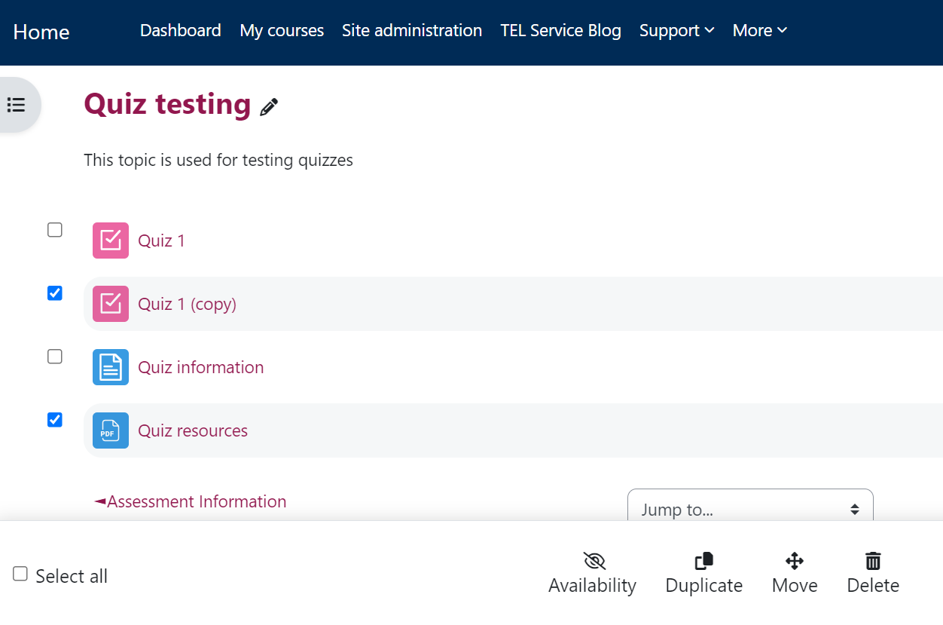
New functionality - Bulk actions
Hide, duplicate, move, or delete items in bulk
Activities
Resources
Topics.

Slide 10
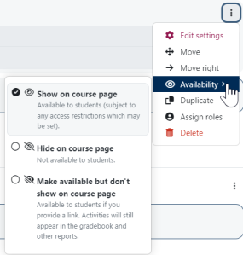
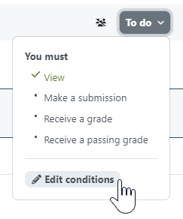
New functionality - Updated activity cards
Simpler interface
Quicker access to activity completion, restriction, and group settings.

Slide 11
Moodle archive

Slide 12
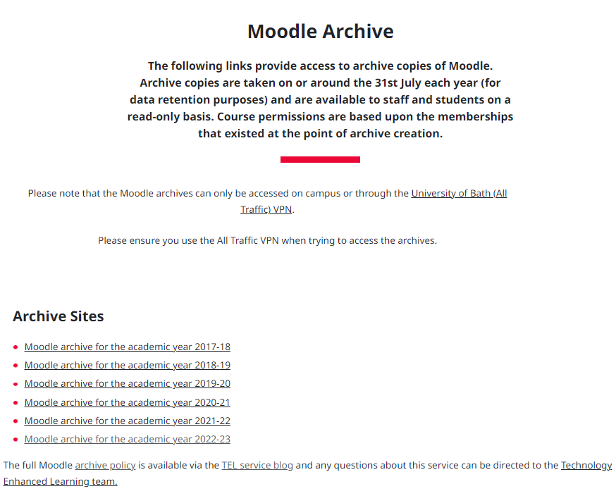
What is the Moodle archive?
A snapshot of Moodle taken (on or around 31st July each year) by the TEL Team before the start of Moodle upgrade.
Read-only.
Accessed on campus or via All Traffic VPN at http://moodle-archive.bath.ac.uk
Can be accessed by staff/students currently studying/employed at Bath with IT accounts.
6 years of archive.
This year's snapshot will be taken on Monday 29th July. We advise taking any actions by Friday 26th July (last working day before upgrade)

Slide 13
Purpose of the Moodle archive
To supplement (but not replace) existing processes for the local archiving of assessed student work.
Allows students to access their previous learning materials and activities as required.
Enables the University to respond to queries relating to user activity via activity logs.
Functions as a historic backup in the event of inadvertent or deliberate course removal or modification.
Roles and content should not be modified in the Moodle archive.
Think of it as a snapshot of a point in time in Moodle – not a full archive of everything. It would be impossible to find a time in the University calendar to guarantee to capture everything!

Slide 14
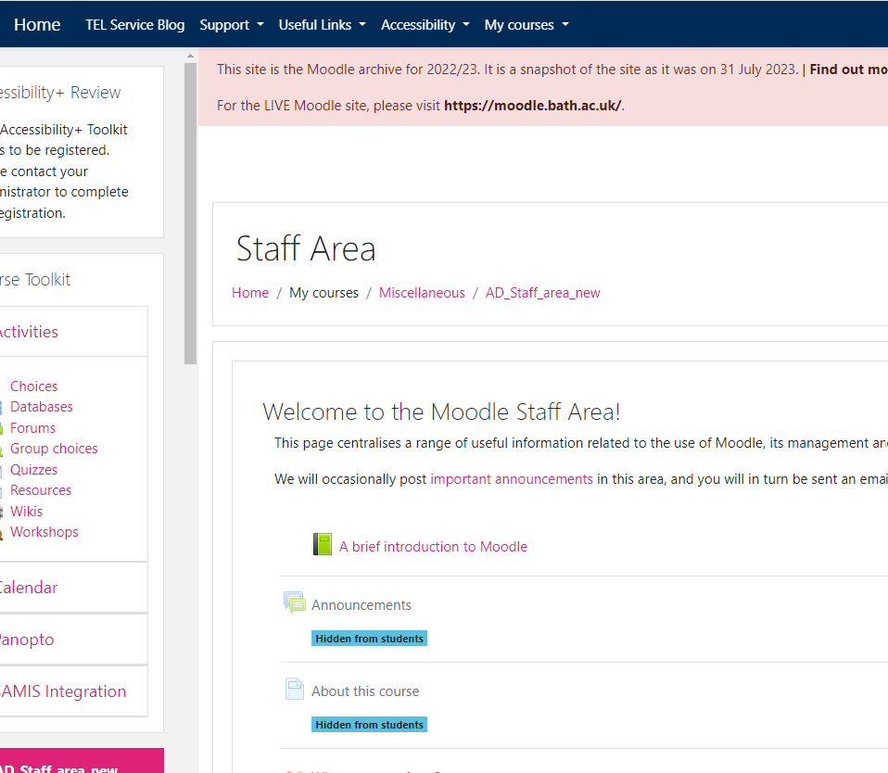
What will be visible in the Moodle 2023-24 archive?
For students
Visible Moodle spaces they are enrolled on
Visible activities/resources on 29th July when the snapshot is taken.
For teachers
Visible and hidden Moodle spaces they are enrolled on
Visible and hidden activities/resources on 29th July when the snapshot is taken.
Read-only. E.g. You can view forums but not post on them.

Slide 15
What won’t be visible in the Moodle 2023-24 archive?
Any hidden activities/resources won't be available to students.
Any assessments submitted and feedback given after 29th July.
They may be in the 2024-25 archive if not removed before end of July 2025.
Any Moodle spaces a user wasn't enrolled on at the time the snapshot is taken won't be visible.

Slide 16
Viewing the Moodle archive – common scenarios
A former student
A member of staff who is taking over as Unit Convenor on MA123456 next year wants to view the materials from the previous year (they didn't have access to the unit previously)
A former member of staff
A new member of staff employed on 15th September 2024 after the archive snapshot is taken
A 2nd year student wants to view their 1st year Moodle spaces for revision
A member of staff has lost a PowerPoint presentation they uploaded to a Moodle space several years ago

Slide 17
Next steps
Ask a Teacher to enrol you if you think you need access to a particular Moodle space before Friday 26th July, otherwise you won't have access in archive.
Hide anything that should not be visible to students in the archive by Friday 26th July.​
Tell students to download copies of assessments or documents before they graduate if they need them.​
Save/download local copies of assessments:
In line with University retention policies.
Ask your department for more information.
Assessments submitted after the archive snapshot is taken won't be stored in the 2023-24 archive. Plan to save local copies before students are unenrolled.
Pass this information to colleagues in your department.

Slide 18
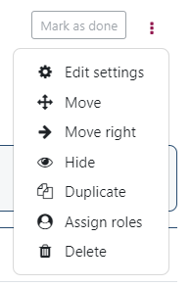
How to hide topics and activities/resources
Turn editing on > Use the three-dot menu

Slide 19
Support resources
Moodle upgrade
Moodle demo site - upgraded site coming soon
Moodle upgrade new functionality blog post
TEL Service blog
Moodle archive
Moodle archive (access on campus or via All Traffic VPN)
Moodle Archiving Practice Statement
Computing account closure for graduating students
General information/support
CLT Hub
Further TEL-Bytes webinars
Email tel@bath.ac.uk

