Slide 1

Introduction to Generative AI
using Microsoft Copilot
This version of the presentation has been created for the Teaching Hub and may not include recent changes to the interface.
Reviewed Oct 2026

Slide 2

Welcome and introduction

Slide 3

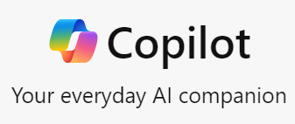
Objectives
Open Copilot at m365.cloud.microsoft and initiate simple requests
Generate text-based responses and request amendments
to AI-generated answers
Generate images
Upload a file to use as a source
Review ‘Teach’ and ‘Agents’ functionality
Copilot is regularly updated and feature availability is not guaranteed.
For the latest updates see Microsoft’s Copilot Blog:
https://www.microsoft.com/en-us/microsoft-copilot/blog/

Slide 4
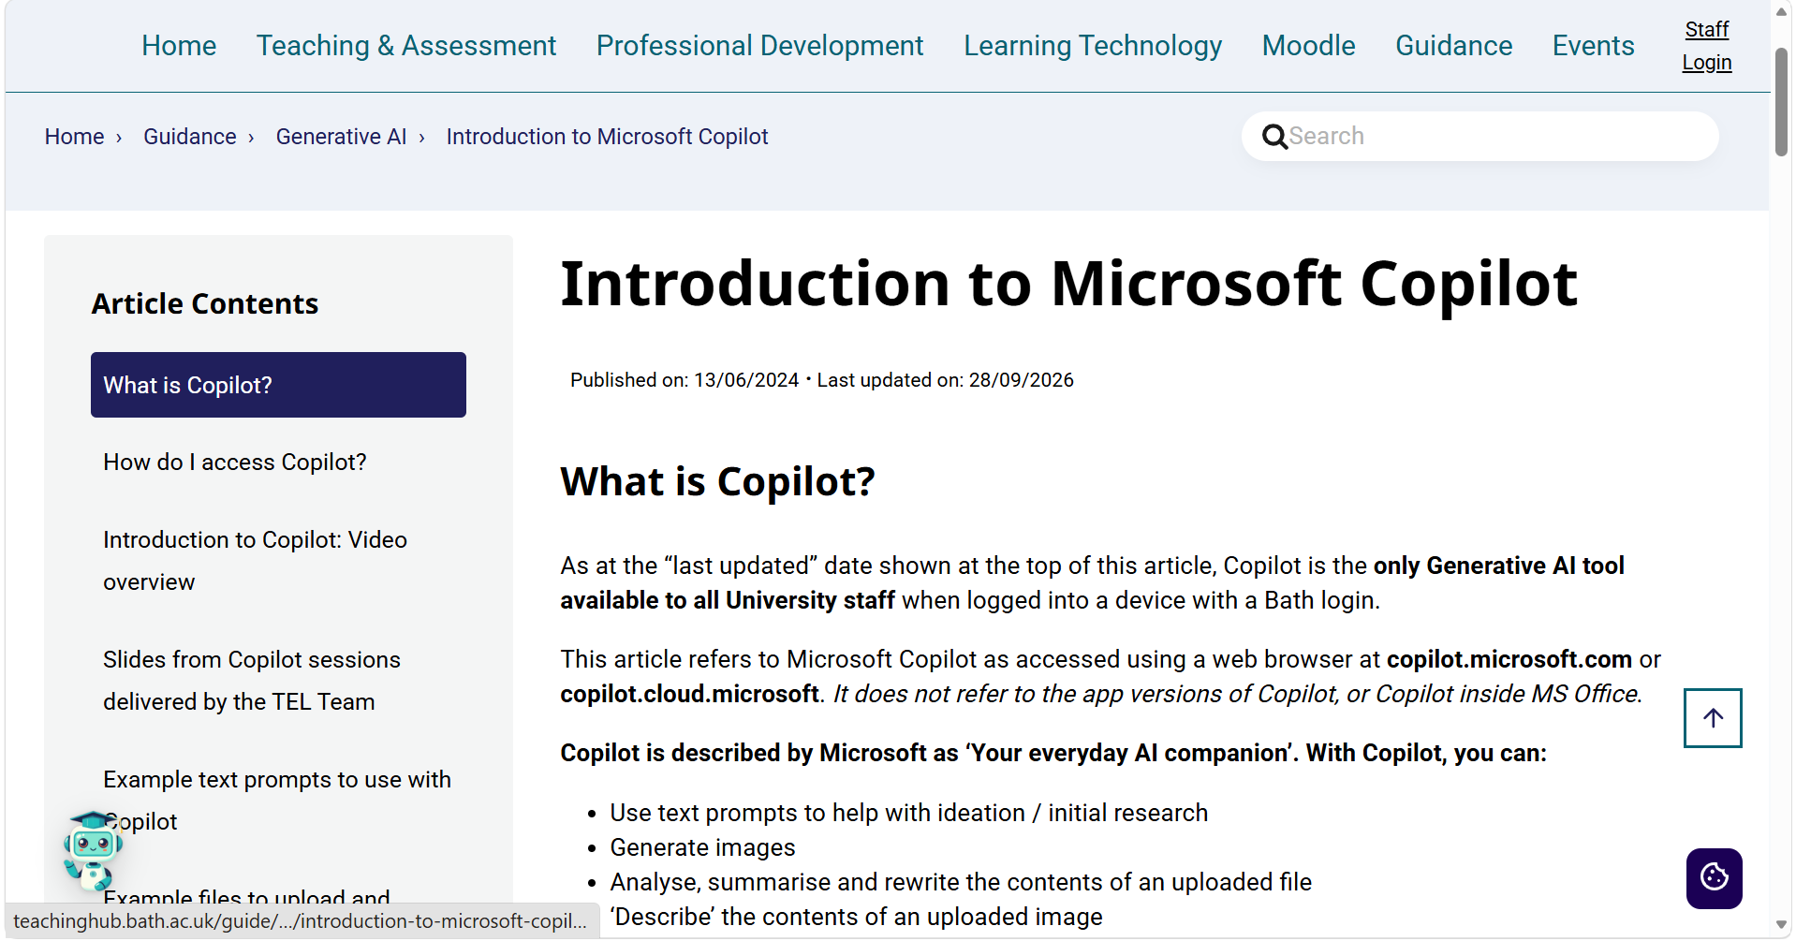
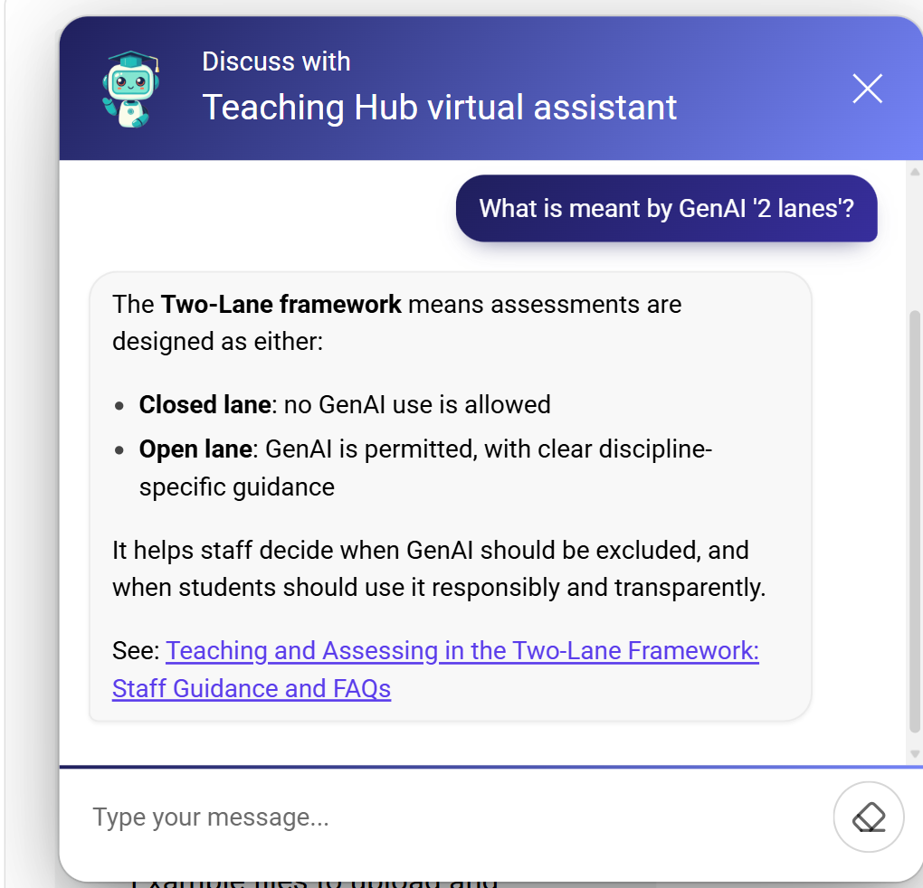
Copilot information on the Hub
Introduction to Copilot
Use the Virtual Assistant to ask questions about GenAI at Bath

Slide 5
Why Copilot?
It’s currently the only Generative AI tool available to all staff and students at the University of Bath.
It is ‘safe’ to use. When logged in, your interactions with Copilot are not shared outside of the University and are not used as a source of data to add to existing AI models.
Other AI tools are not officially supported by the University.
For general guidance see the Generative AI section of the Teaching Hub: Generative AI - Learning and Teaching (bath.ac.uk).

Slide 6
Generate text responses
Example prompts to try:
‘Create a lesson outline to introduce the most popular models of memory to university students studying psychology’
‘Suggest five points to include in a personal reference for a student who…’
‘Create three multiple choice questions for a short quiz for undergraduates about…’
Ask the AI to refine its responses:
‘Simplify your response to make the questions suitable for a first-year undergraduate at a UK University.’
‘The lesson outline must focus on [x]. Remove the information about [y].’
‘Offer four possible answers for each quiz question. Every answer must be plausible.’

Slide 7
Generate images
Example image prompts to try (from general to specific):
‘A square icon of a light bulb representing the concept of ideation’
‘The main characters from To Kill a Mockingbird talking about the events unfolding.’
‘Paparazzi-style long lens photos of citizens of Pompeii in 79BC reacting to the eruption of a volcano. Ordinary people. Market traders. Families. Historical. Photojournalism.
‘Create an Art Deco-inspired pattern with repeated fan-like shapes. The design should use bold, symmetrical lines in metallic gold, radiating from the centre of each fan, set against a rich, dark brown background. The pattern should have a luxurious and geometric aesthetic typical of the 1920s Art Deco style. ‘

Slide 8
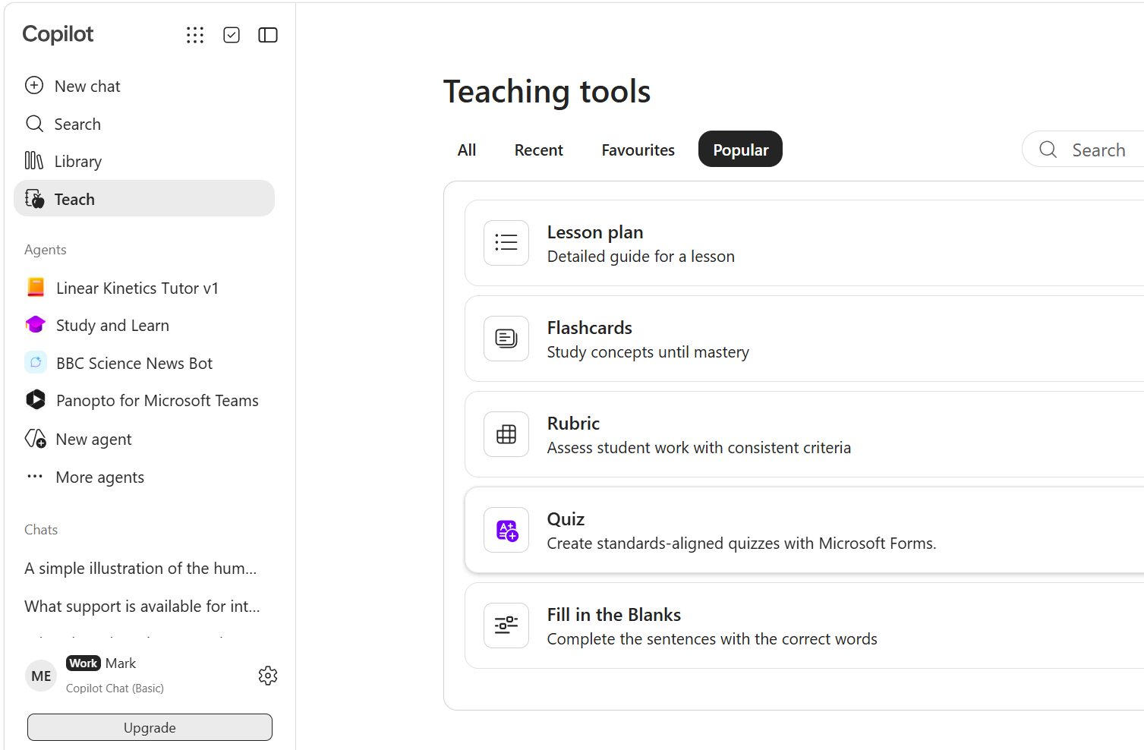
Review Copilot’s Teaching Tools
Select ‘Teach’ in the panel on the left.
Select a tool (E.g. ‘Lesson plan’ or ‘Rubric’ to review the available options.
Advisory: these tools appear to be quite basic and may be of limited use.

Slide 9
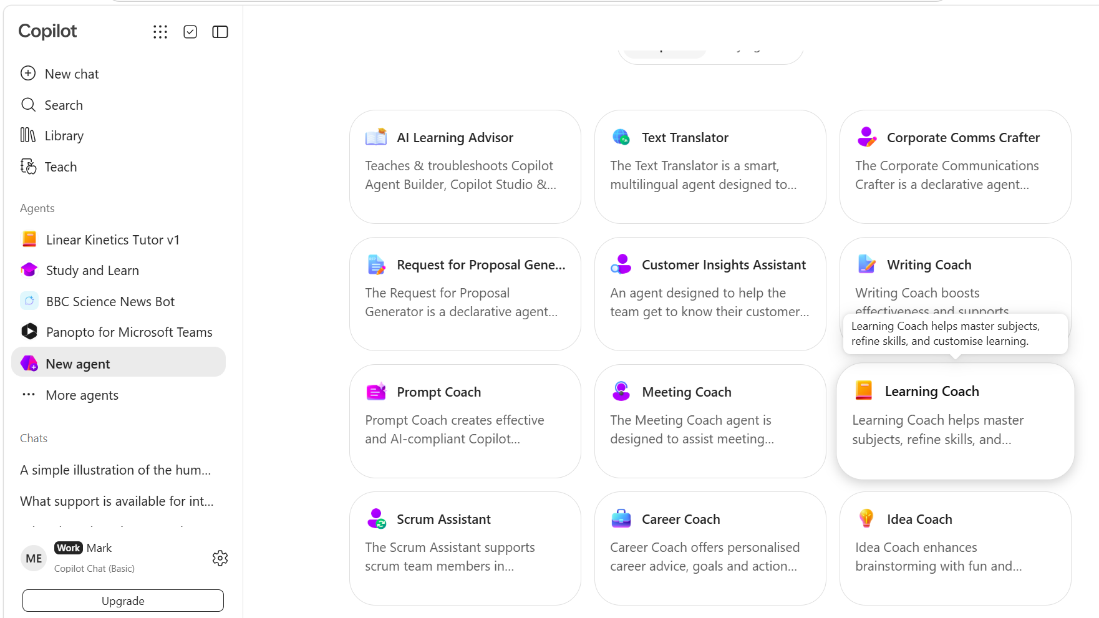
Create an Agent
Select ‘New agent’ in the panel on the left.
Select an existing Agent template (E.g. ‘Learning Coach’.)
Upload source files and add relevant URLS. Edit the prompt then create and test the Agent.

Slide 10
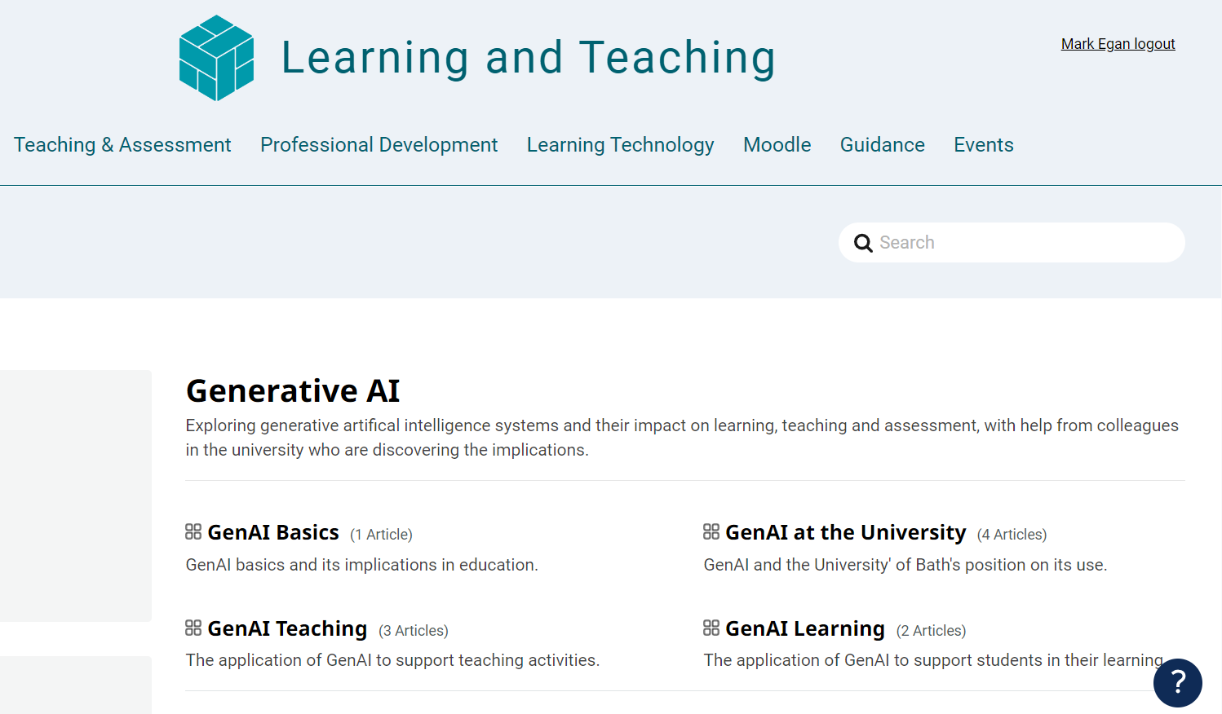
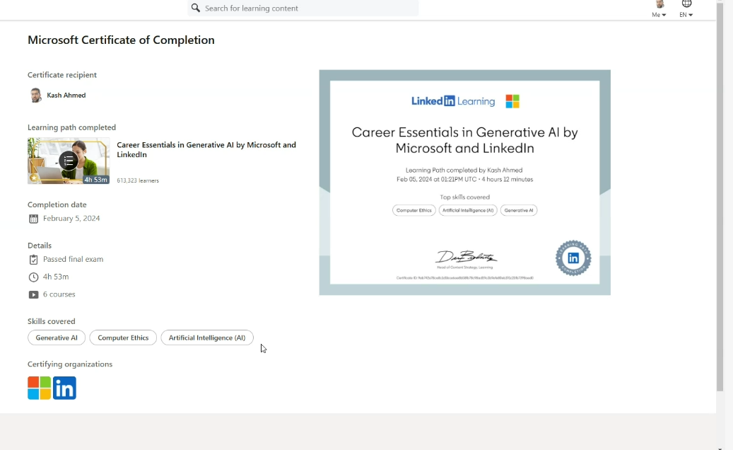
Other resources / Online courses
Copilot resource from Microsoft:
Get better results with Copilot prompting - Microsoft Support
Generative AI help articles on the Hub
Generative AI - Learning and Teaching
Self-paced resources
Generative AI at the University of Bath
Short videos created by the Skills Centre
Generative Artificial Intelligence (GenAI) (bath.ac.uk)
LinkedIn Learning: E.g. ‘Career
Essentials in Generative AI’:

Slide 11



CLT closing slide
Produced by
Centre for Learning & Teaching
in conjunction with
Technology Enhanced Learning Team
2026 - This work is licensed under a Creative Commons Attribution-NonCommercial-NoDerivatives 4.0 International License

