Slide 1
Introduction to Generative AI
using Microsoft CoPilot
This version of the presentation has been created for the Teaching Hub and may not contain recent changes.
Reviewed Mar 2025

Slide 2
Welcome and introduction

Slide 3
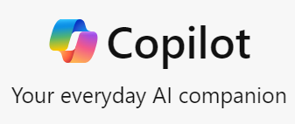
Objectives
Open Copilot at copilot.microsoft.com* and initiate simple requests
Generate text-based responses and request amendments to AI-generated answers
Generate images
Overview Copilot’s file upload functionality
Copilot is in development and feature availability is not guaranteed. For the latest updates see Microsoft’s Copilot Blog:
https://www.microsoft.com/en-us/microsoft-copilot/blog/

Slide 4
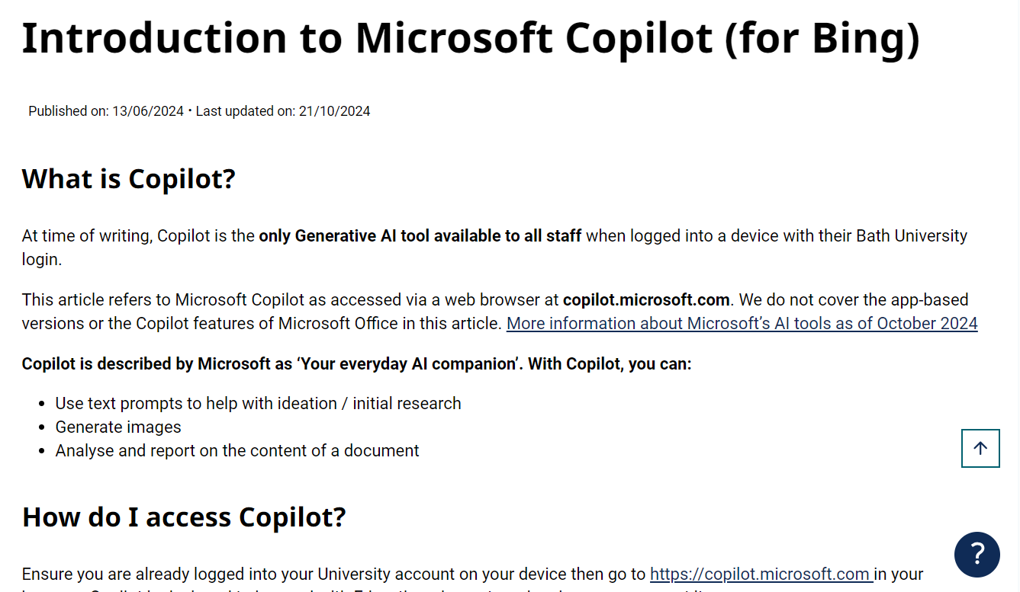
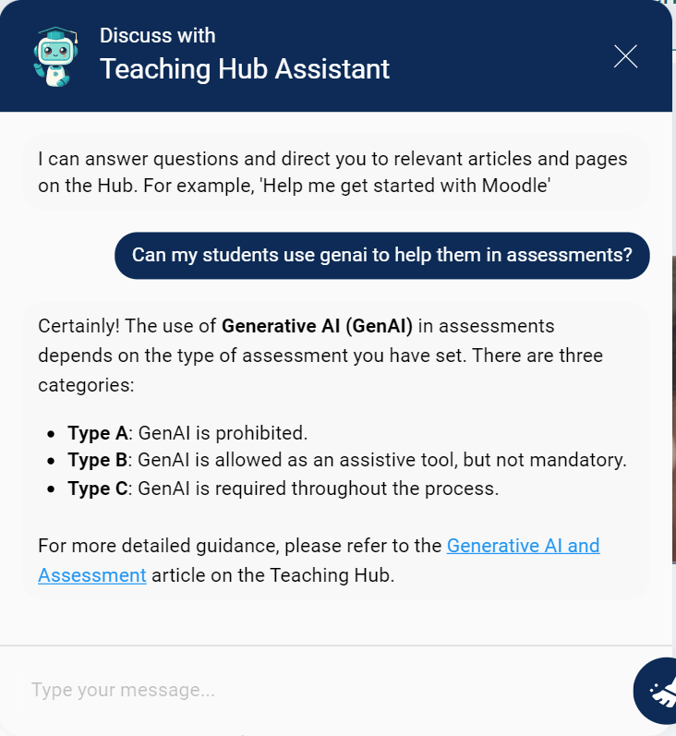
Copilot information on the Hub
Introduction to Copilot (for Bing) - Learning and Teaching (bath.ac.uk)
Use the Virtual Assistant to ask questions about GenAI at Bath

Slide 5
Why Copilot?
It’s currently the only generative AI tool available to all staff and students at the University of Bath. The University has been successful in a funding bid for supporting teaching with AI. More information to follow.
It is ‘safe’ to use. When logged in, your interactions with Copilot are not shared outside of the University and are not used as a source of data to add to existing AI models.
Other AI tools are not officially supported by the University. For general guidance see the Generative AI section of the Teaching Hub: Generative AI - Learning and Teaching (bath.ac.uk).

Slide 6
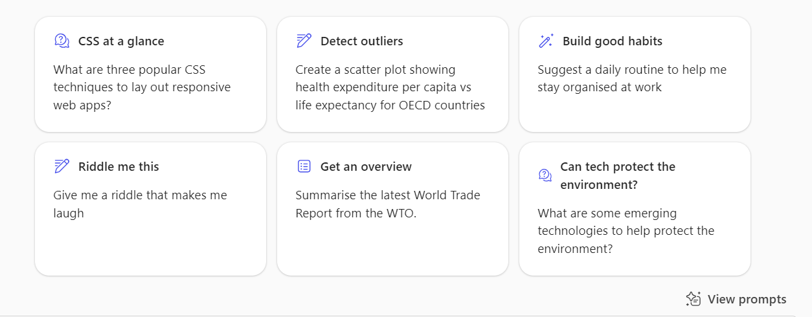
Open Copilot and try it out
Try Copilot’s suggestions and check it is working as expected:
Every time you start a new ‘chat’, it is added to the list of recent chats on the right to return to as needed. An individual chat can be deleted by hovering over it, clicking on the three dots and selecting ‘Delete’.

Slide 7
Generate text responses
Example prompts to try:
‘Create a lesson outline to introduce the most popular models of memory to university students studying psychology’
‘Suggest five points to include in a personal reference for a student who…’
‘Create three multiple choice questions for a short quiz for undergraduates about…’
Ask the AI to refine its responses:
‘Simplify your response to make the questions suitable for a first-year undergraduate at a UK University.’
‘The lesson outline must focus on [x]. Remove the information about [y].’
‘Offer four possible answers for each quiz question. Every answer must be plausible.’

Slide 8
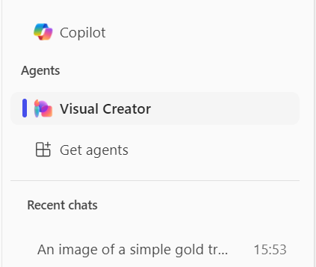
Generate images
Example image prompts to try (from general to specific):
‘A square icon of a light bulb representing the concept of ideation’
‘The main characters from To Kill a Mockingbird talking about the events unfolding.’
‘Paparazzi-style long lens photos of citizens of Pompeii in 79BC reacting to the eruption of a volcano. Ordinary people. Market traders. Families. Historical. Photojournalism.
‘Create an Art Deco-inspired pattern with repeated fan-like shapes. The design should use bold, symmetrical lines in metallic gold, radiating from the centre of each fan, set against a rich, dark brown background. The pattern should have a luxurious and geometric aesthetic typical of the 1920s Art Deco style. ‘

Slide 9
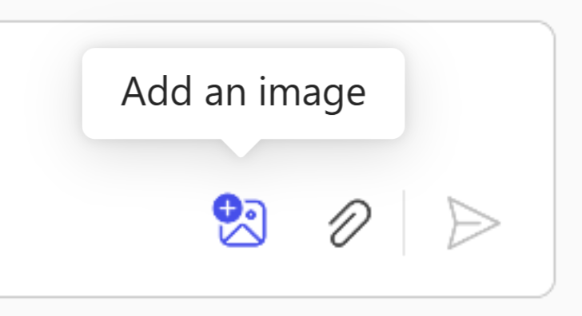
Analyse an existing image
Click on the ‘Add an image’ button to upload an image from your device, then enter a prompt to extract information about it:

Slide 10
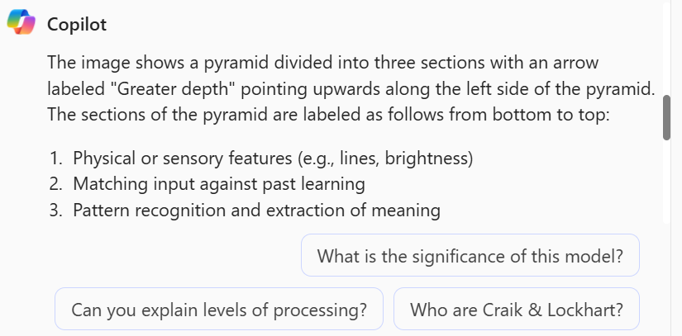
Analyse an existing image
Prompt: ‘Describe this image’

Slide 11
Use a file as a data source
Copilot can use the information stored in common files (E.g. Word or Excel) as a source of data to question and analyse. Audio files are not supported.
E.g: Upload a rubric stored in a PDF file. Prompt Copilot with: ‘A student received the following scores…Suggest some general feedback points in the voice of a helpful, supportive tutor’.
Upload and analyse stats in an Excel worksheet. Prompt Copilot with: ‘List the top 15 most visited pages on the Teaching Hub between 1 September and 31 December inclusive’.

Slide 12
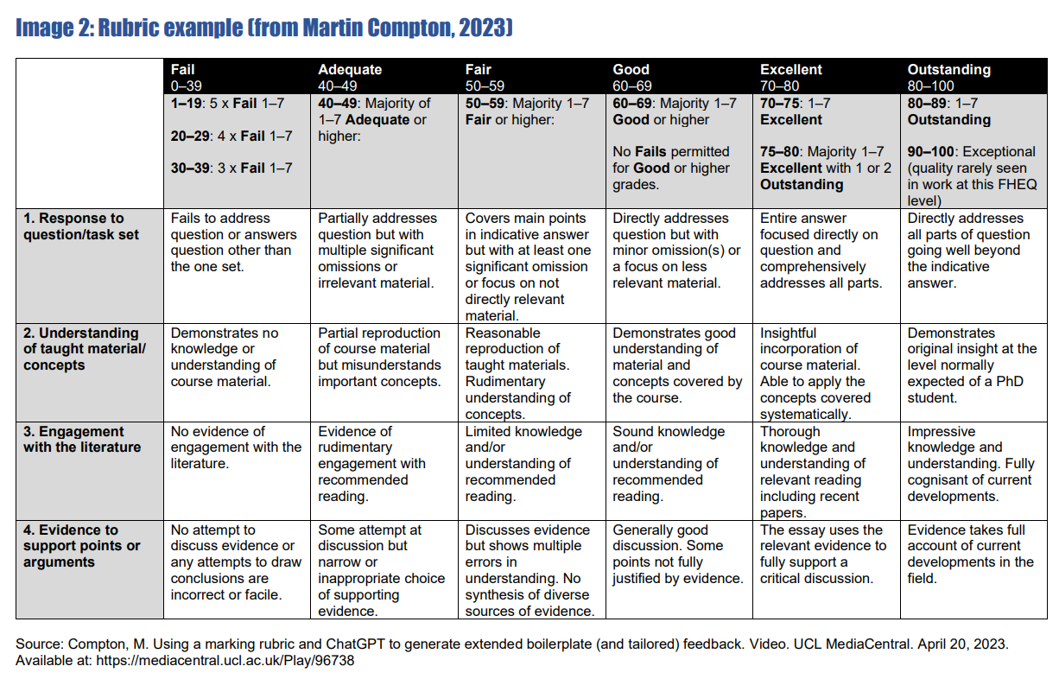
Use a file as a data source

Slide 13
Use a file as a data source
Text prompt used:
'Create a feedback message to a student who scores 53 overall and is weak at supporting their points or arguments’. Provide extra detail about they can improve supporting their points or arguments.'

Slide 14
Use a file as a data source
Example response from Copilot (1 of 2)
Dear [Student’s Name],
I hope this message finds you well. Let me begin by acknowledging your effort in completing the assignment. Your overall score of 53 falls into the ‘Fair’ category, which means there is room for improvement.
Strengths:
You managed to cover the main points outlined in the indicative answer, which is commendable.
Areas for Improvement:
However, where you need to focus your attention is in supporting your points or arguments. Here are some specific steps you can take to enhance this aspect of your work:
Provide Evidence: When making a claim or presenting an argument, back it up with evidence. This could be in the form of data, examples, or references to authoritative sources. Evidence adds credibility to your points and strengthens your overall argument. >>>

Slide 15
Use a file as a data source
Reasoning and Logic: Take the time to explain the reasoning behind your points. Why do you believe what you’re saying? How does it connect to the broader context or topic? Clear and logical reasoning helps convince your reader of the validity of your arguments.
Counterarguments: Anticipate potential counterarguments and address them. Acknowledge opposing viewpoints and explain why your perspective is stronger. This demonstrates critical thinking and a deeper understanding of the subject matter.
Avoid Generalizations: Be specific in your supporting details. Avoid vague statements like “everyone knows” or “it’s common knowledge.” Instead, provide concrete examples or specific data to illustrate your points.
Action Steps:
Review the rubric carefully, paying special attention to the ‘Supporting arguments’ criterion. Consider revisiting your assignment and incorporating the suggestions above.
Improvement is a process, and every effort counts. Seek additional guidance if needed and keep refining your skills.

Slide 16
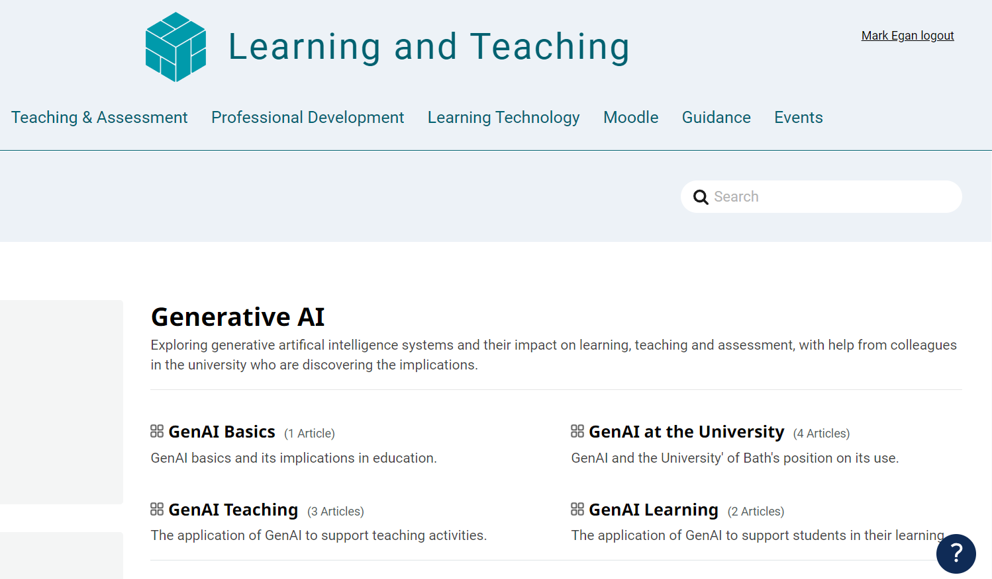
Other resources / Online courses
Copilot resource from Microsoft:
Get better results with Copilot prompting - Microsoft Support
Generative AI help articles on the Hub
Generative AI - Learning and Teaching
Self-paced resources
Generative AI at the University of Bath
Short videos created by the Skills Centre
Generative Artificial Intelligence (GenAI) (bath.ac.uk)
LinkedIn Learning: E.g. ‘Career Essentials in Generative AI’:

Slide 17
CLT closing slide
Produced by
Centre for Learning & Teaching
in conjunction with
Technology Enhanced Learning Team
2024 - This work is licensed under a Creative Commons Attribution-NonCommercial-NoDerivatives 4.0 International License

