Slide 1


University of Bath
Vertically Integrated Projects
Welcome to our End-of-Semester VIP Poster and Presentation Event
^{14th May 2024}

Slide 2
Agenda
11:15 | Welcome and Introductions
11:20 | VIP Posters and Questions
11:50 | Open discussion
12:00 | Thanks and Close
Notes:
Currently 9 projects

Slide 3
Current Projects
TBB: Bath biodevices without borders | Student Wellbeing
Students for Sustainable Food | Slow the Flow - Conserving water across our region
Carers Centre carbon reduction journey | Open science – Hardware for microscopy
InterPromoting an age-friendly community | Co-production of construction materials: working for and with the community
Widening participation and access to the University of Bath by young people from Somerset and West Wiltshire | Understanding the challenge of solving Mathematical Olympiad problems with AI
Creating immersive training experiences in virtual reality
Notes:
Currently 9 projects

Slide 4
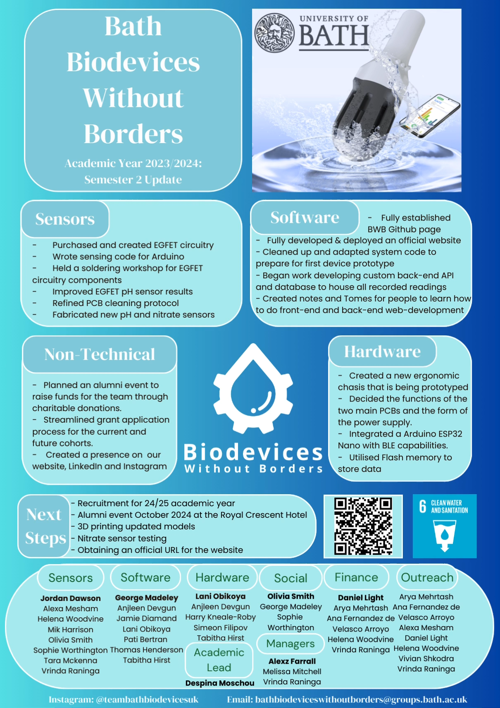
Notes:
Currently 9 projects

Slide 5
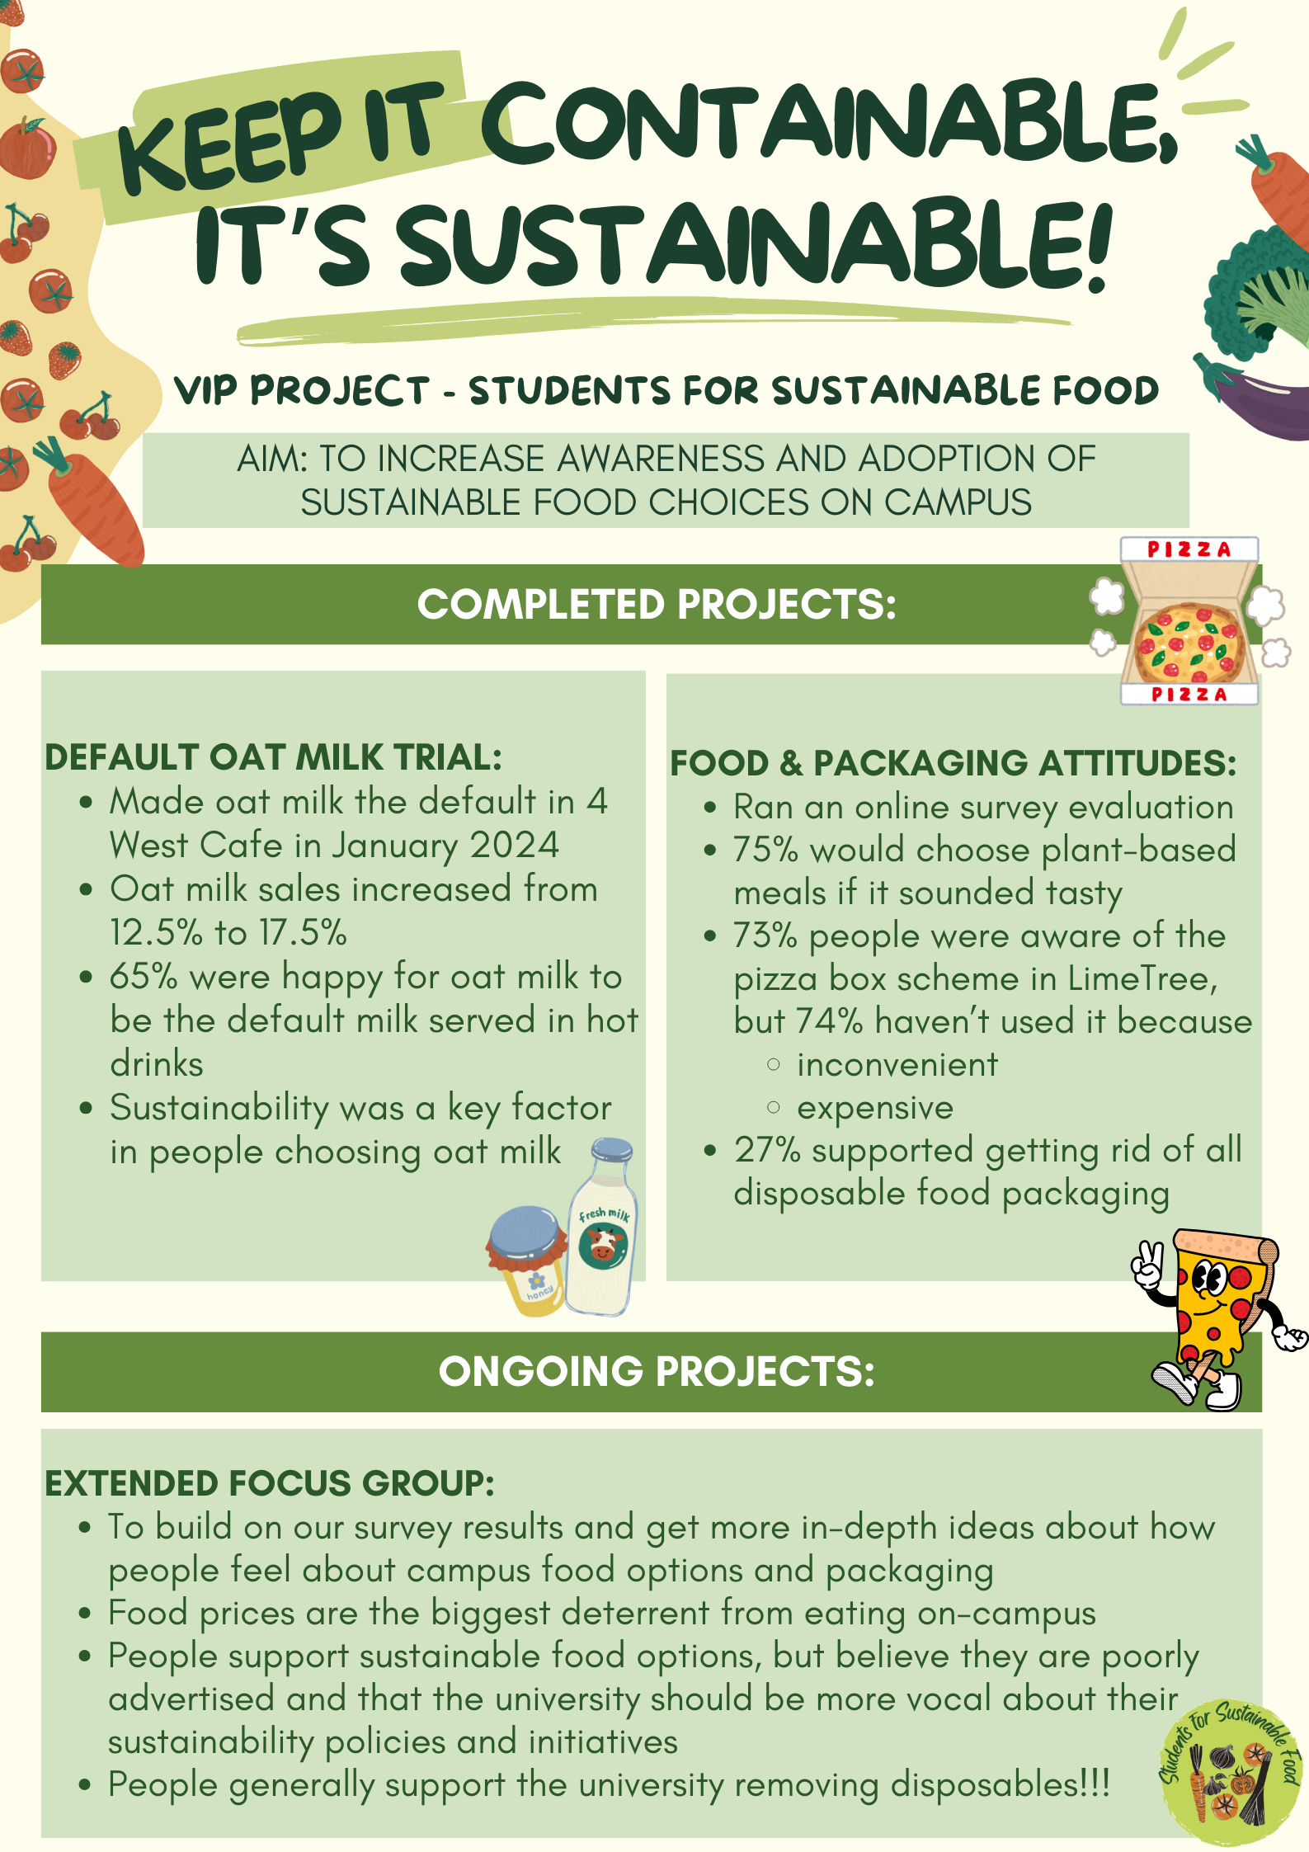
Notes:
Currently 9 projects

Slide 6


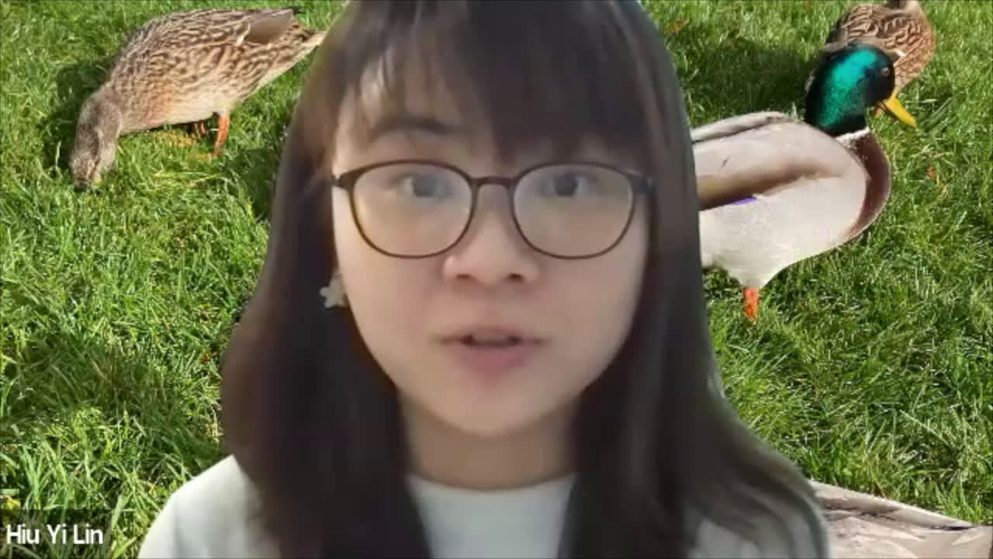
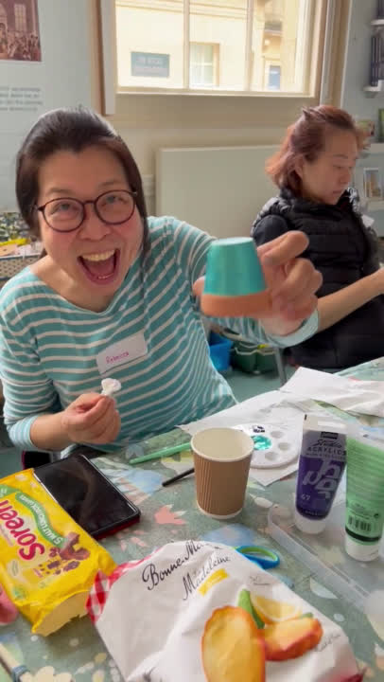
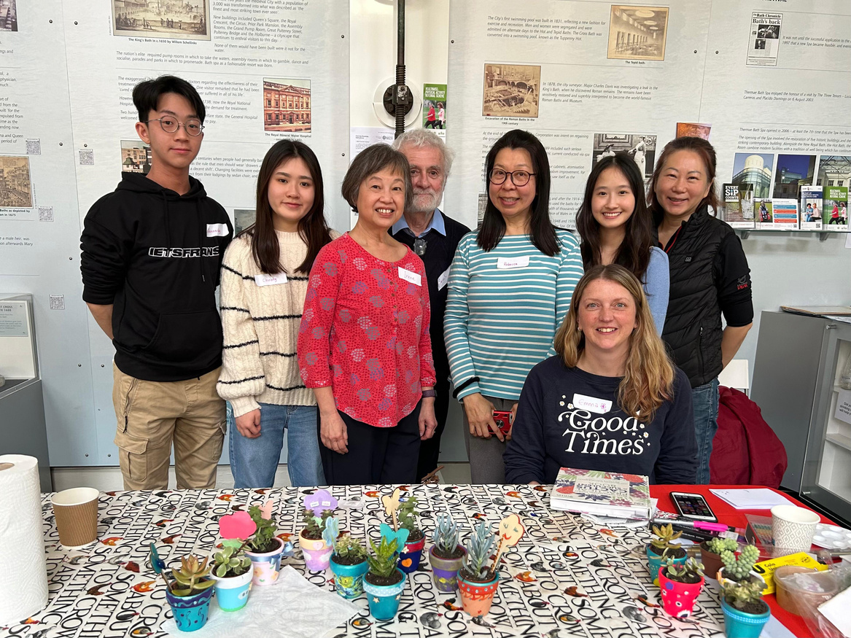
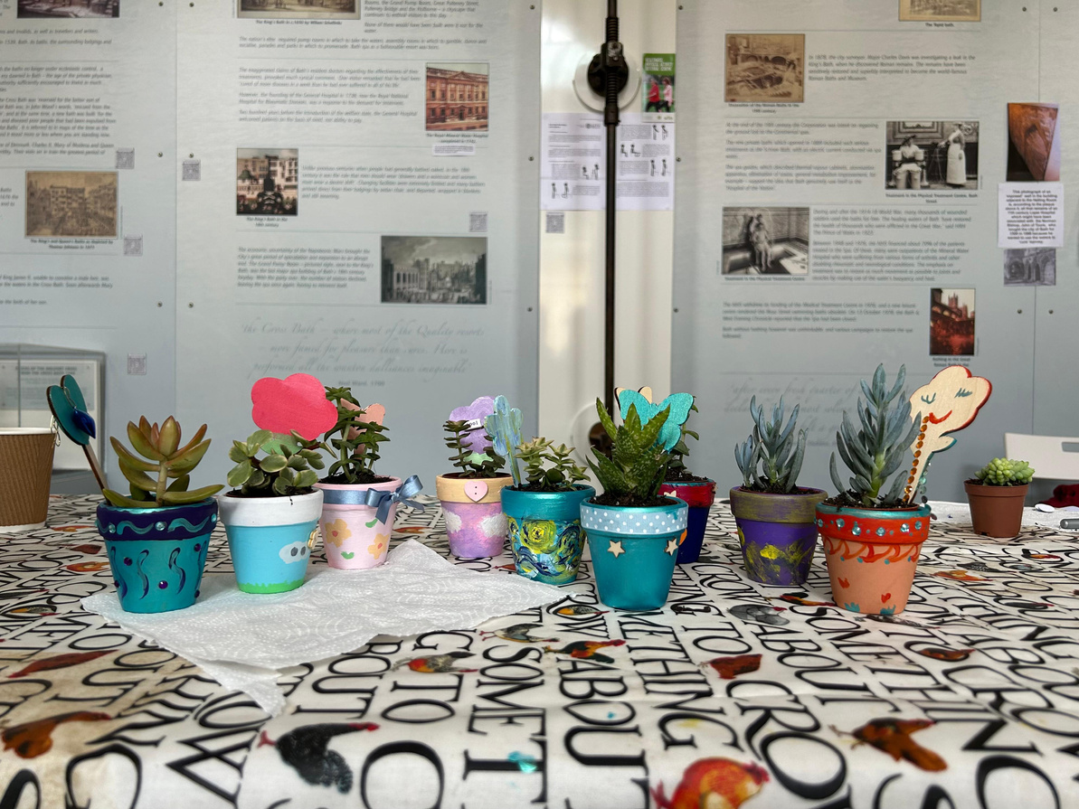
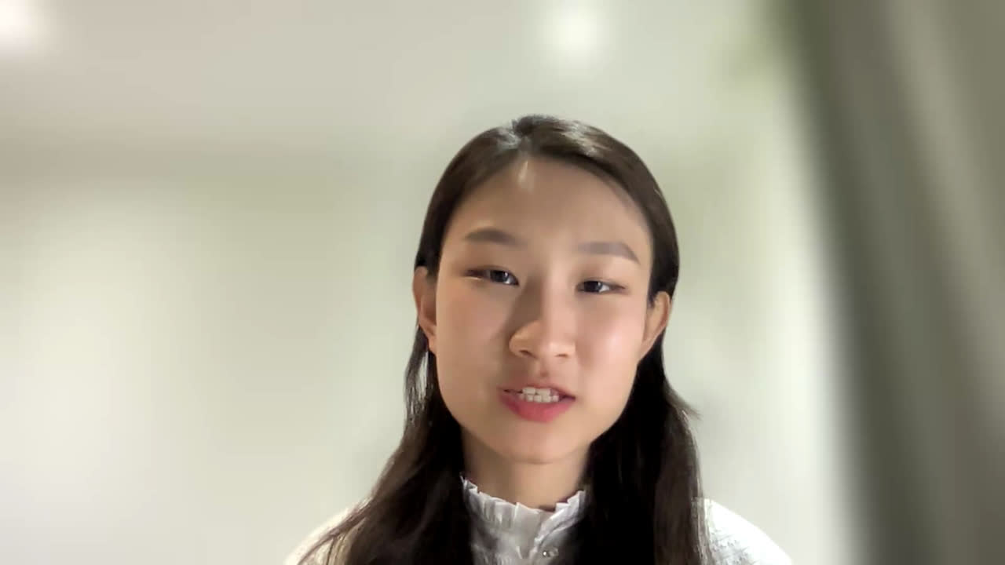
Gardening sessions at the Bath Medical Museum
  One session on 11 April
  Upcoming session on 17 June
AGE-FRIENDLY VIP
Vienne Lin, Rachel Lin, Jiachen Yuan, Fiona Gillison
  Brief introduction of our VIP
  This year’s initiative - Activity sessions at the BMM
Quotes from the participants:
  “It was engrossing, fun, and very satisfying.”
  “I really enjoyed it all, and it took my mind off some major worries I have at the moment.”
  Reasons for organising activity sessions that bring together younger and older adults
Acknowledgment: We would like to thank the support from the VIP Fund.

Slide 7
Carers Centre Carbon reduction Journey
Notes:
Currently 9 projects

Slide 8
Notes:
Currently 9 projects

Slide 10
Notes:
Currently 9 projects

Slide 11







An evaluation of the Women/Womxn Sessions at the University of Bath
VIP Project 2023-2024​

Slide 12


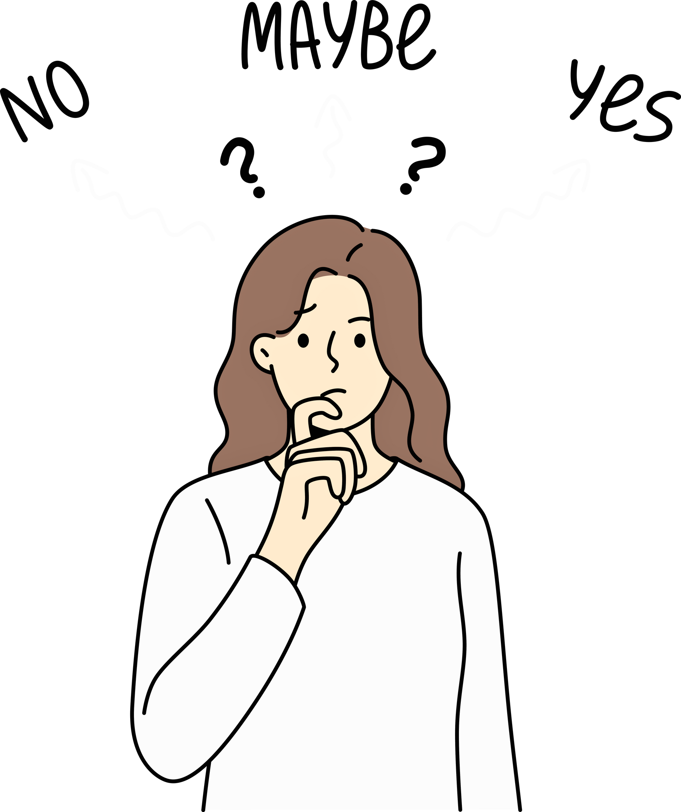

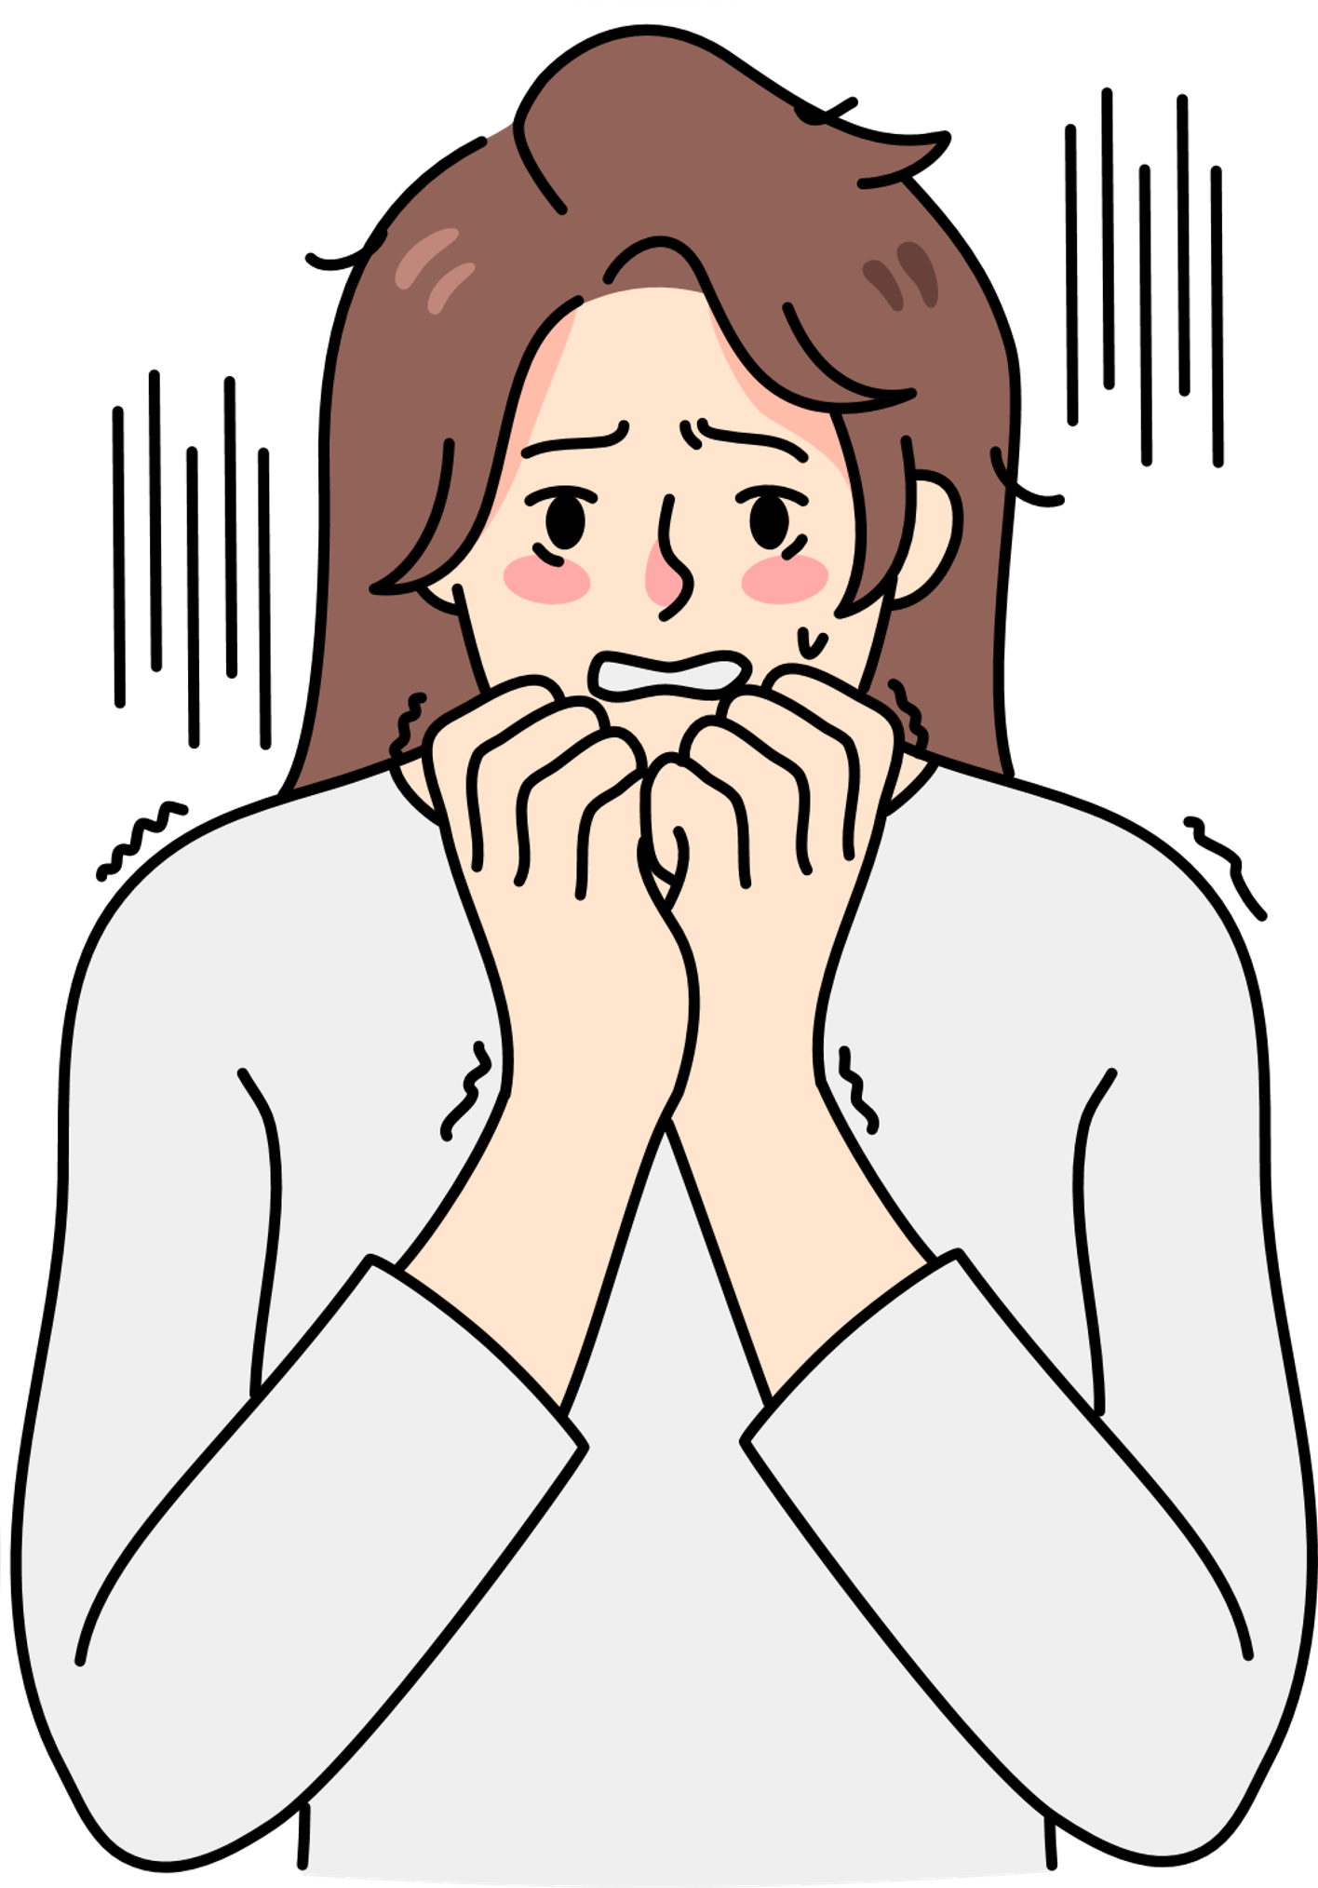
Women/Womxn Sessions ​

Slide 13

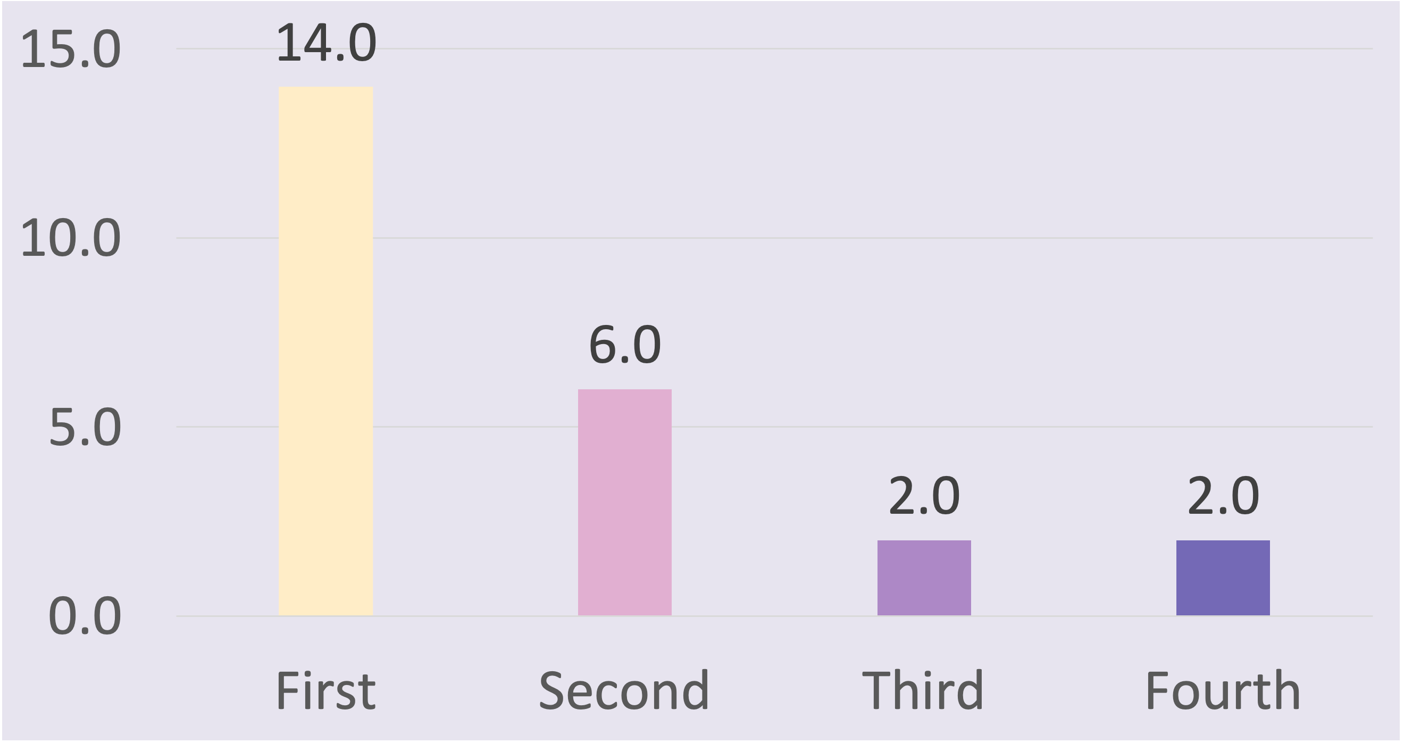
Demographics

Slide 14

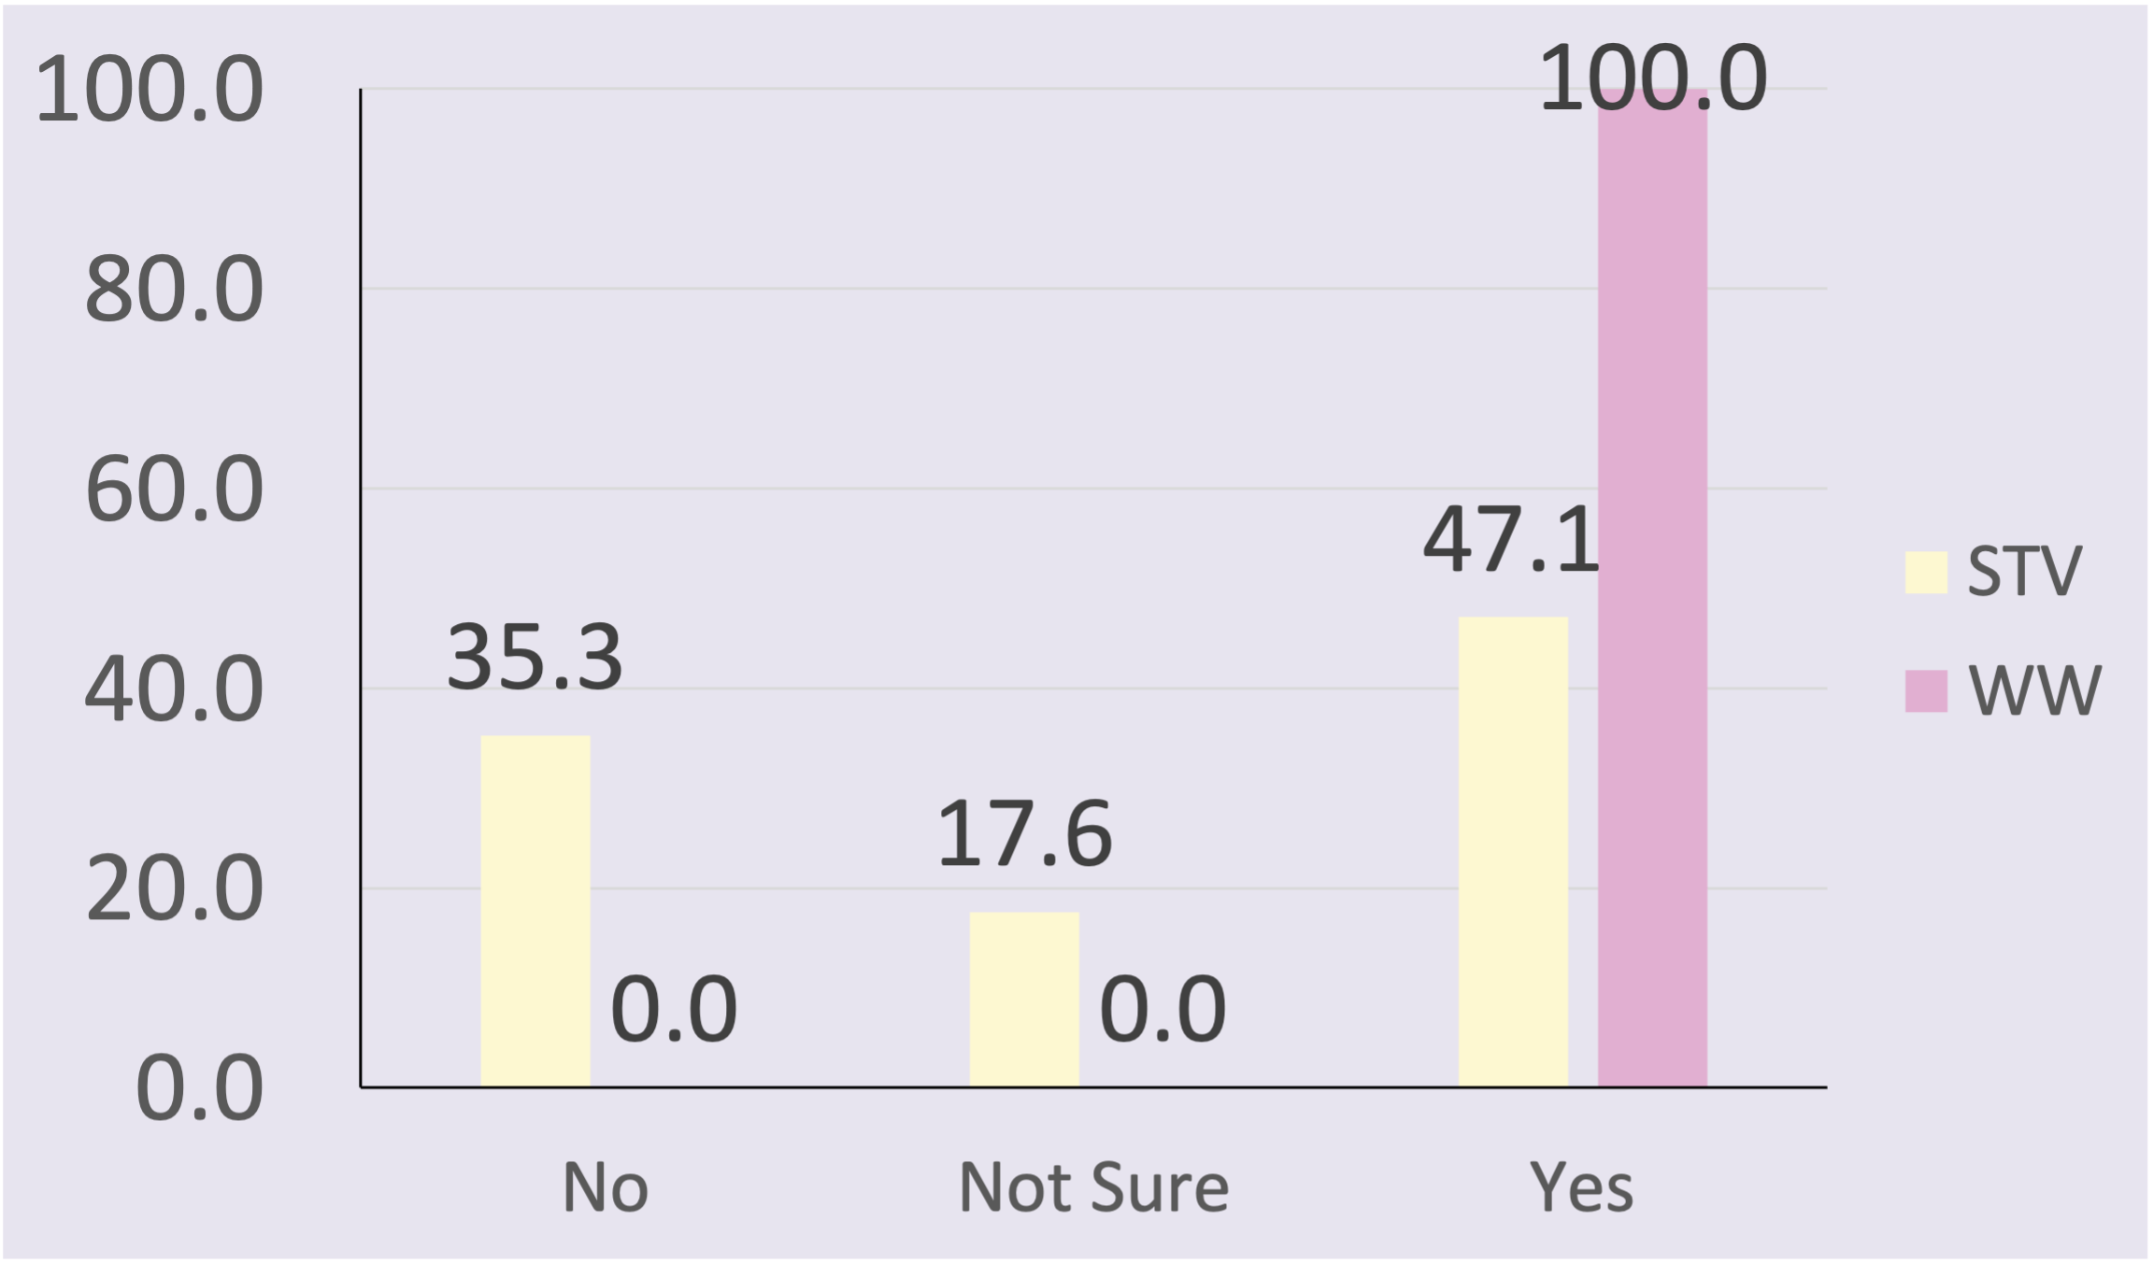
Belongingness

Slide 15
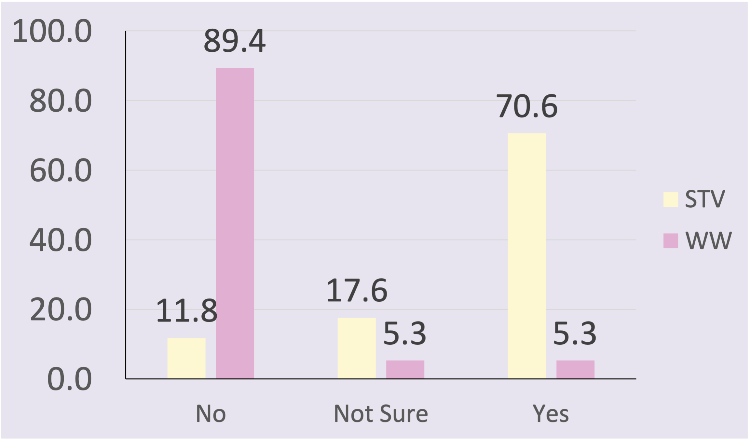
Intimidation

Slide 16
Womxn Comments ​
“A great idea for women to feel more confident in the gym.”
Notes:
Here are some of the comments we gathered from our participants which included them thinking womenx session is a great idea for women to feel more confident in the gym.

Slide 17
Womxn Comments ​
“Love them!”
Notes:
Thye love the session

Slide 18
Womxn Comments ​
“Really like the support we get during these sessions, making me feel comfortable and relaxed.”
Notes:
And they really like the support they receive as it made them feel comfortable and relaxed

Slide 19
Womxn Comments ​
“They are very good - but quite busy! I felt really comfortable when I went. Felt more confident asking people for help/getting it wrong. I also felt much more comfortable wearing whatever I liked.”
Notes:
One participant mentioned the women x session is a bit busy but still feel comfortable going nonetheless. As they felt more confident in asking for help and comfortable in wearing whatever they liked

Slide 20
Womxn Comments ​
When it is womxn only I feel much less uncomfortable, and I feel more confident to take up machines as I am fairly new to the gym.
Notes:
Another participant mentioned they feel less uncomfortable and more confident even though they are new to the gym. All these positive commonest showcasing the women x session is good at making participants feel comfortable and boost their confidence.

Slide 21
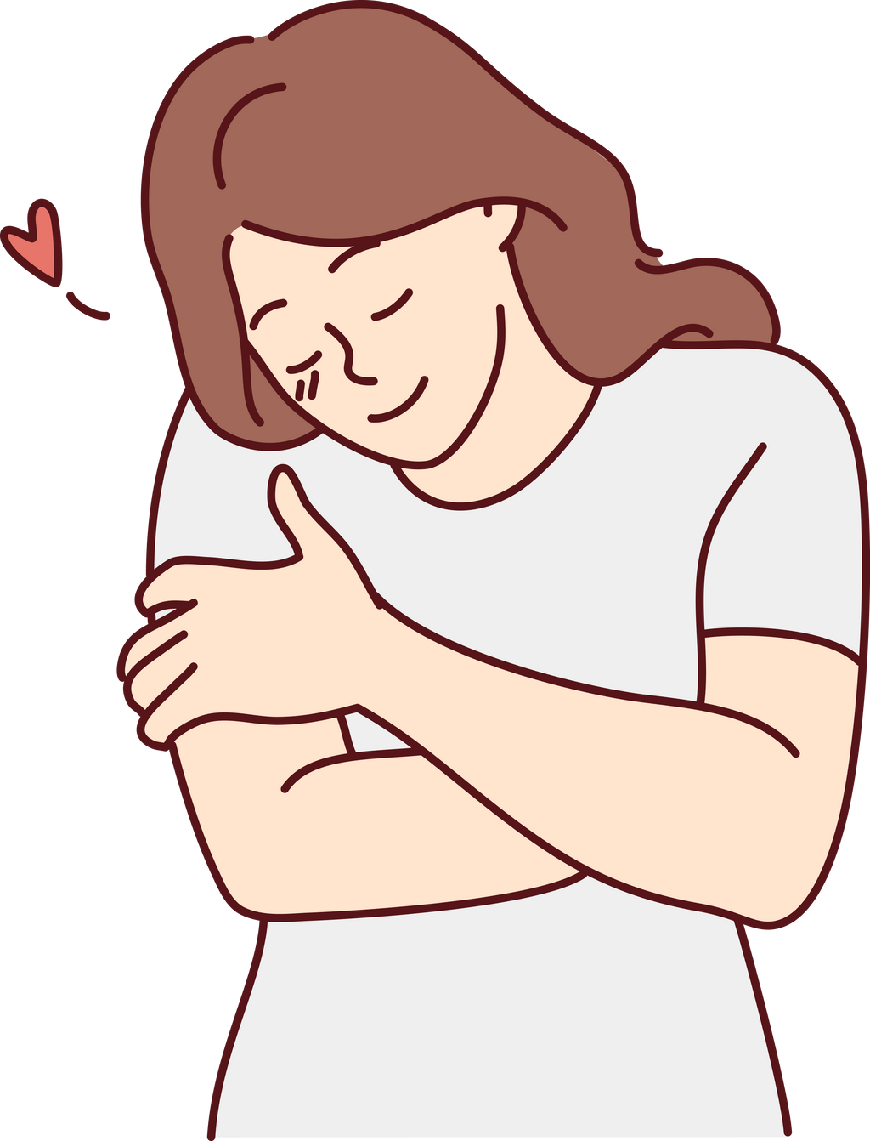
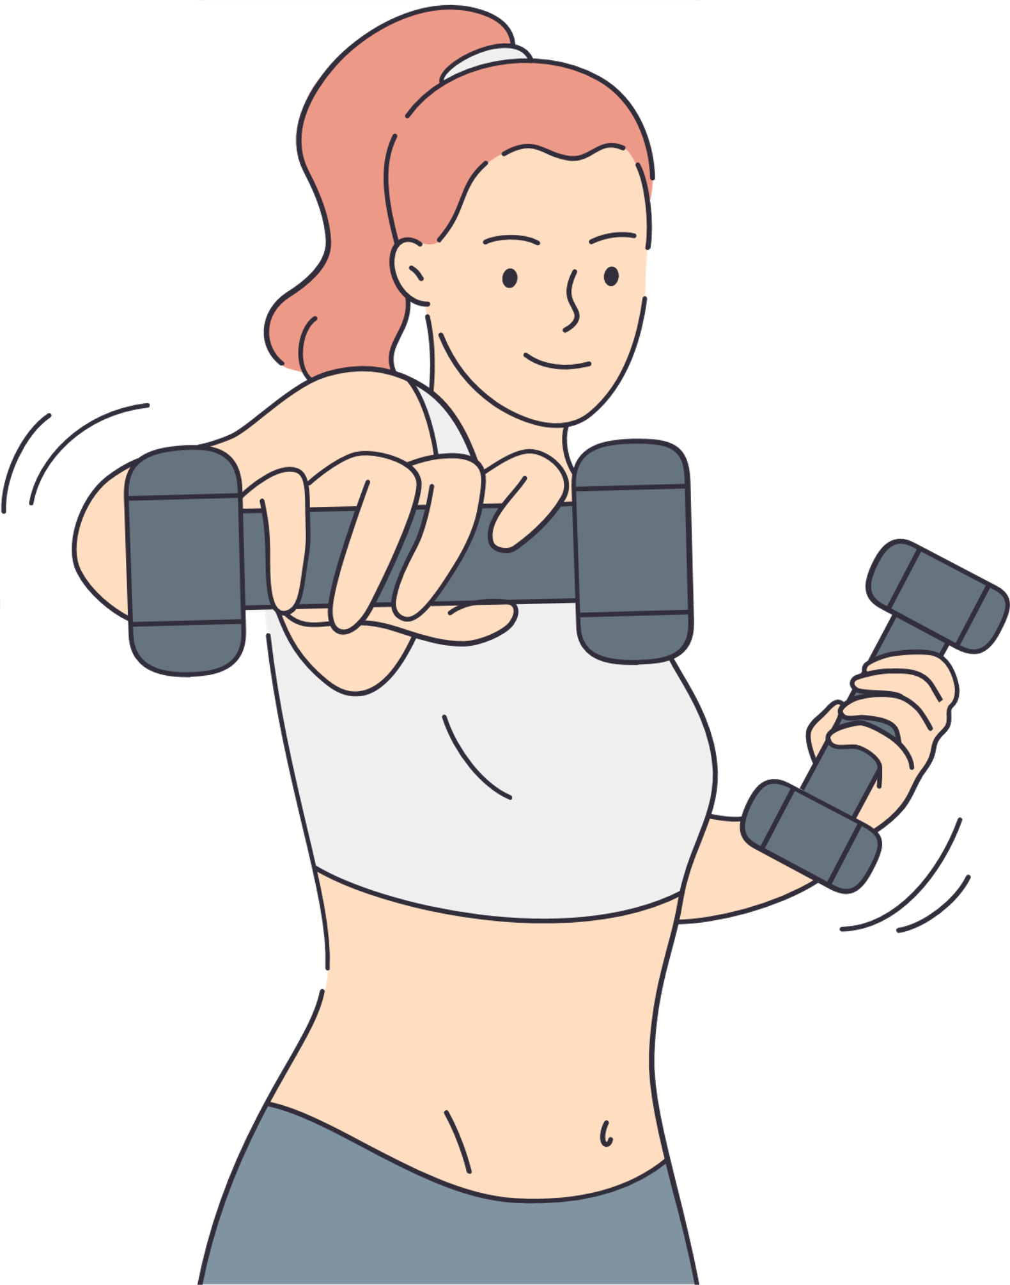
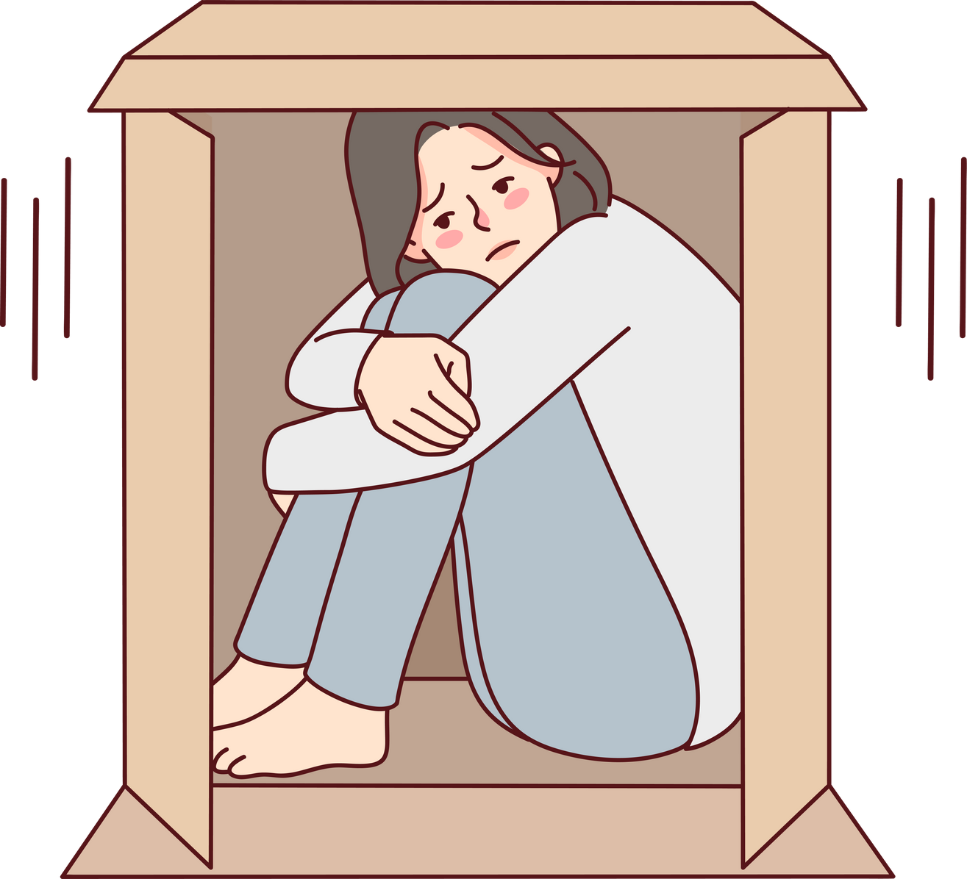
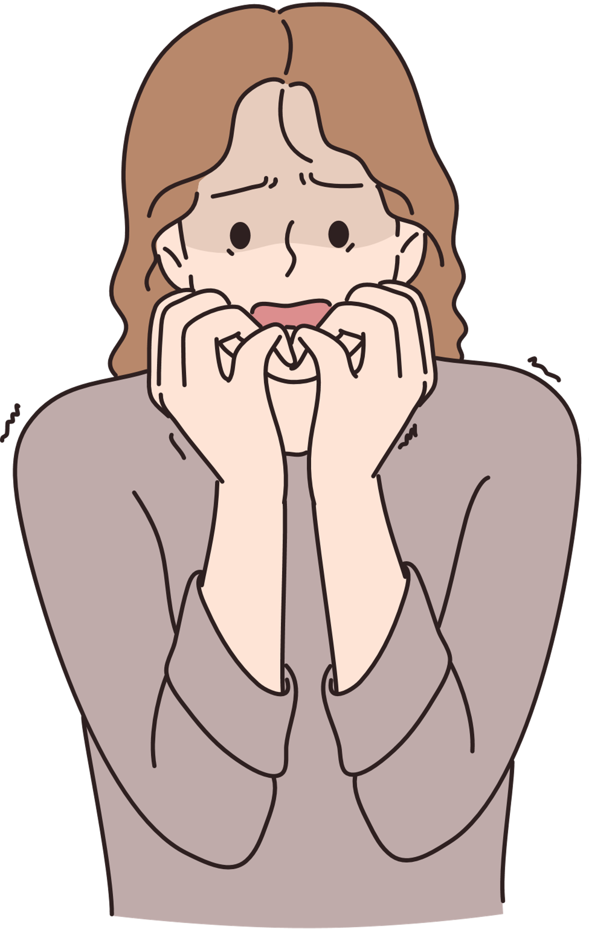

Conclusion ​
Women/Womxn sessions
STV

Slide 22
Conclusion ​
Women/Womxn sessions
STV

Slide 23
Conclusion ​
Women/Womxn sessions
STV

Slide 24
Any other questions and open discussion
Thank you

Slide 25

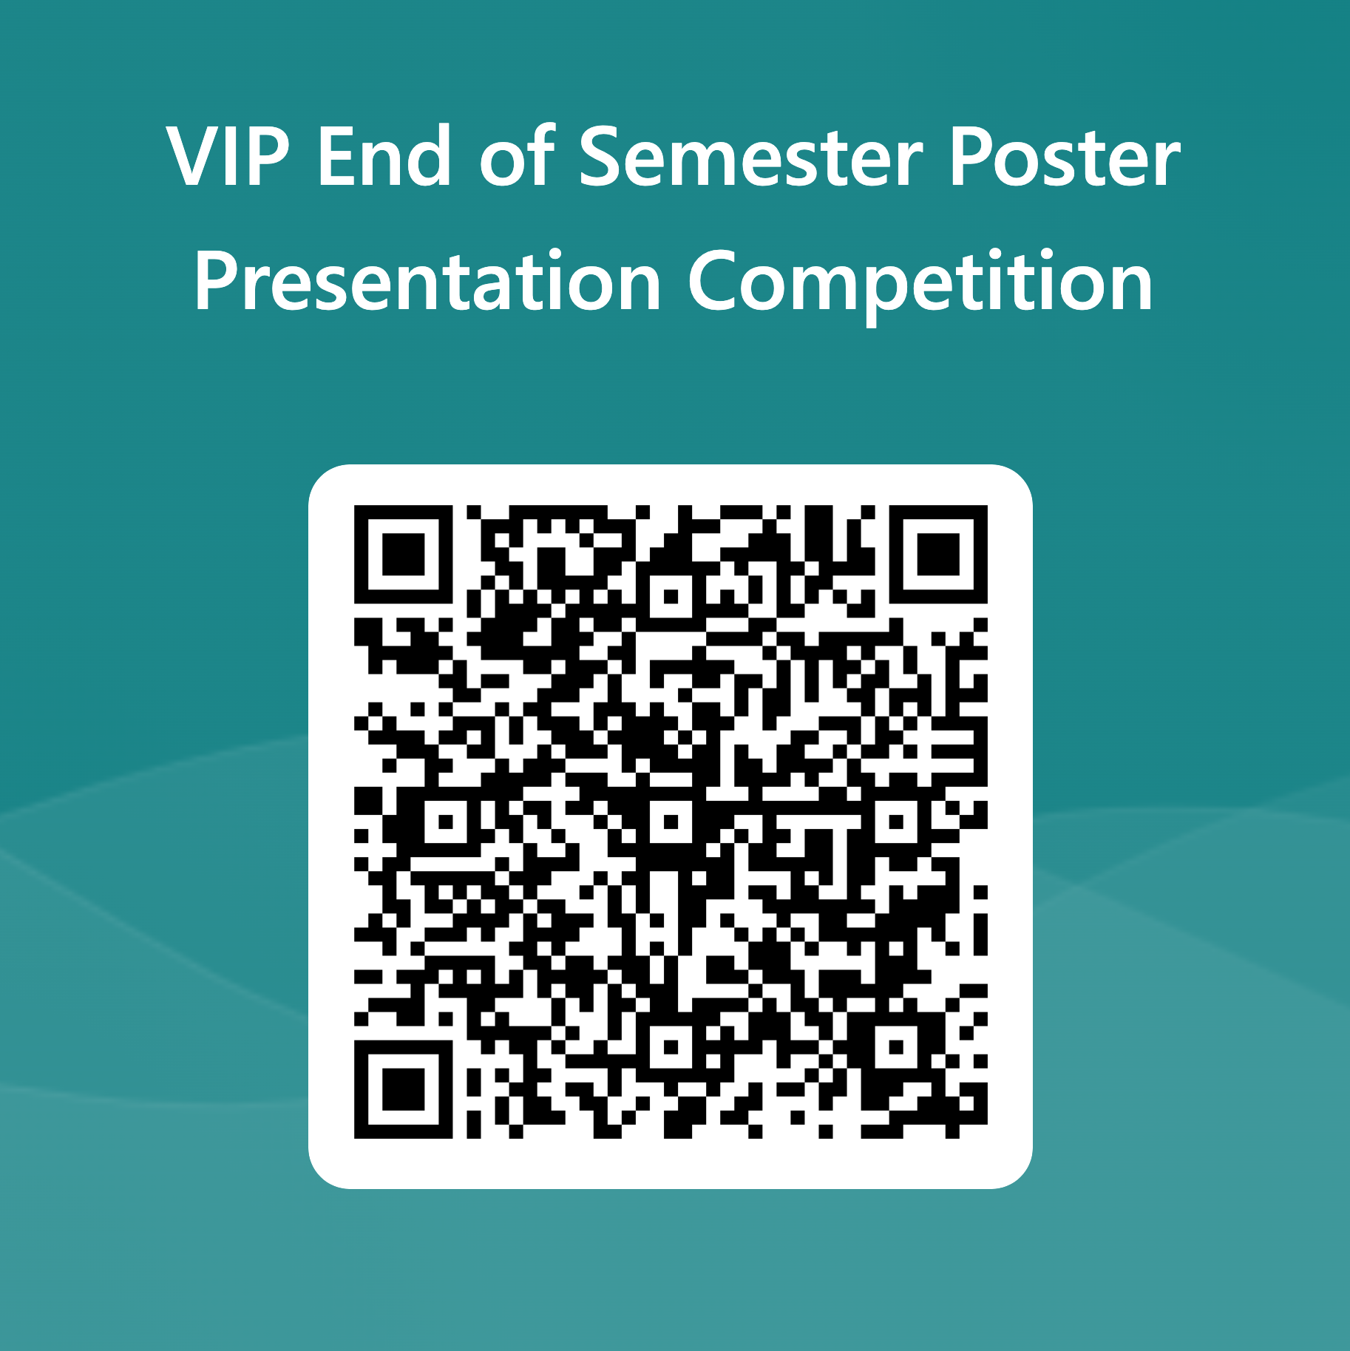
VIP
End of Semester Posters
Please vote for your favourite presentation / poster

