Slide 1
VDDE portfolio software
Steve Flower
chssef@bath.ac.uk

Slide 2
Virtual Drug Design Exercise
Team-based learning exercise
Open ended (very!)
Final Year Undergraduate Chemistry for Drug Discovery (8 sessions)
MSc Drug Discovery (5 sessions)

Slide 3
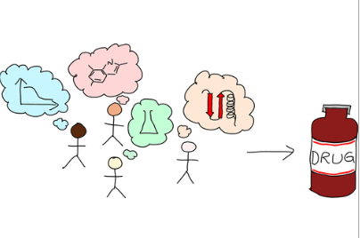
A Multidisciplinary Team-Based Classroom Exercise for Small Molecule Drug Discovery
Charlotte A. Dodson, Stephen E. Flower, and Mark Thomas
J. Chem. Educ. 2023, 100, 9, 3320–3332
https://pubs.acs.org/doi/full/10.1021/acs.jchemed.3c00066

Slide 4
Very, very time consuming!!!
Weekly: Each team submit 4 new molecules – no constraints – infinite variety!
Requires:
Generation of physicochemical data for 16-20 molecules
Need to dock their compounds against the protein targets
Each molecule: data from >5 different web-based predictors and 3 software packages

Slide 5
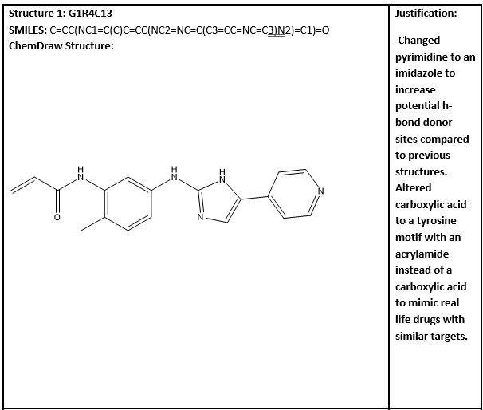
Student submission

Slide 6
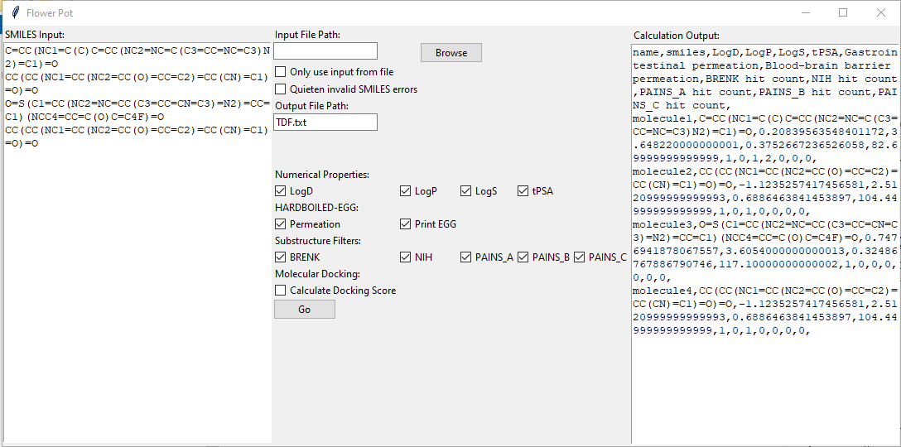
Software output

Slide 7
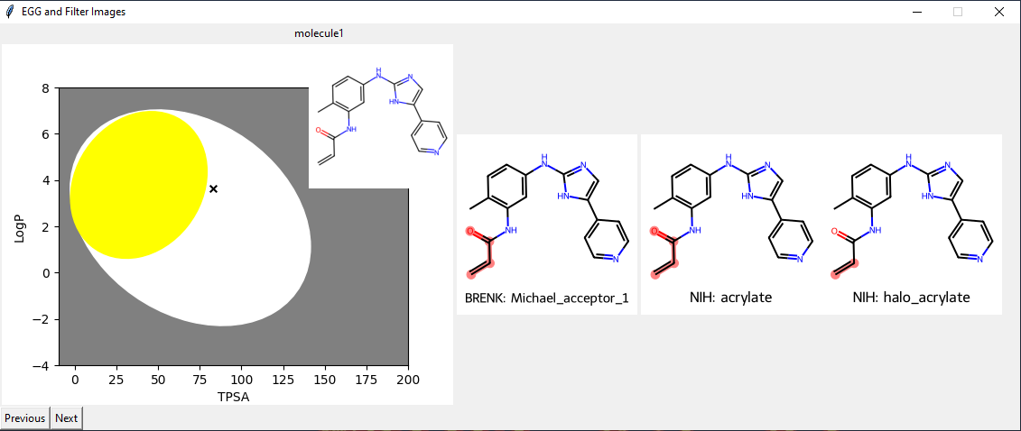
Hard boiled eggs and toxins

Slide 8
Summary
Software development: Patrick Taylor and Toby Lewis-Atwell
Have developed early-stage software to predict physicochemical data
Huge time savings!
Next steps:
Refine model
Automate docking and assay data

