Slide 1
Moodle Quiz
Reviewing and Releasing Results
Josh Lim, Eliana Cortes - TEL Team
TEL-Bytes Webinar
7th May 2024
tel@bath.ac.uk
Welcome! Please join in and post your questions in the chat or ask them at the Q&A at the end of the session.

Slide 2
Aims for today’s workshop
To review important features about reviewing and releasing results in Moodle quizzes
Identify how to access further guidance and support
Notes:
Aims workshop

Slide 3
Session Overview
Intro - checklist
User overrides
Review Quiz Attempts
Regrading
Release
More support and Q&A
Quiz
Notes:
To review important features about reviewing and releasing results in Moodle quizzes
Identify how to access further guidance and support
Into – before grading (quiz set up)
Steps to add user overrides
Review quiz attempts
Regrading and release

Slide 4
Quiz Setup Checklist
Complete the Quiz Notification Form
Create Questions in the Question Bank
Create the Quiz Activity
Add questions to the Quiz (and Preview)
See Moodle – Quiz (summative workflow)
Notes:
Check list
Importance to notify the TEL using the form
Create questions
Set up the quiz activity (timings, number of attempst, review settings).
Add questions to the quiz

Slide 5
4a.Overrides
When to use it?
DAP adjustments
Extensions/ Additional attempt (mitigations)
What can you do?
For individual or a group:
add extra time,
change the quiz open or close time,
amend a quiz time limit,
change the number of attempts
Notes:
Basic uses of override . This is the best alternative instead o creating multiple quizzes, allows to

Slide 6
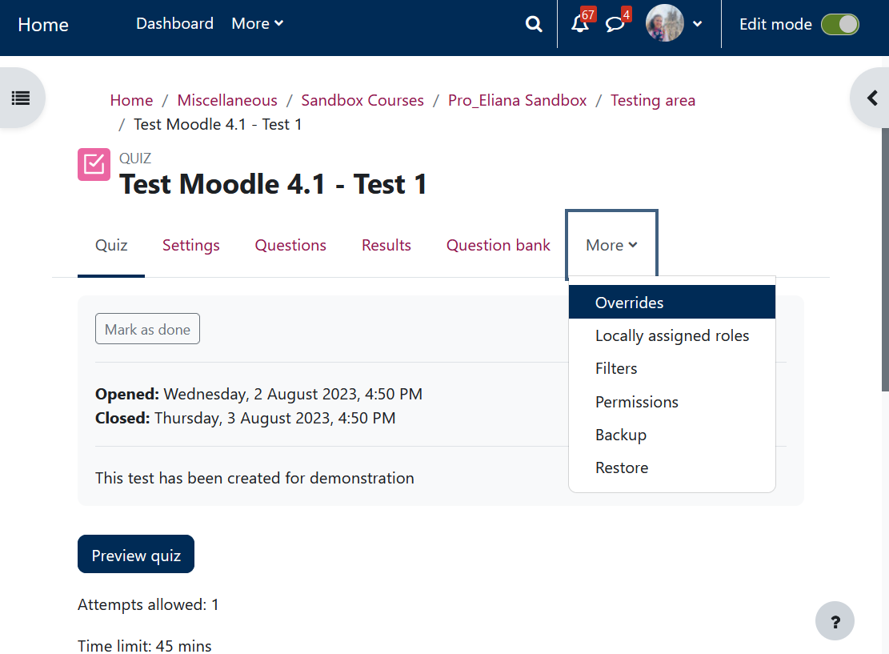
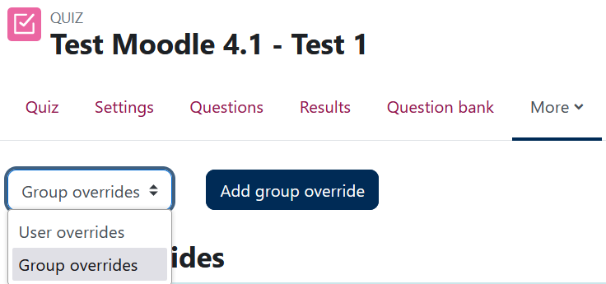
4a.Overrides - Select
More info about Managing Moodle Groups and Groupings
Remember
Name your extension groups with sensible names
Notes:
Indicate how to find the overrides menu and the two options available . Mention that prior to group override must be created the groups and the names need to be sensible avoid names like DAPs students, mitigations, so on

Slide 7
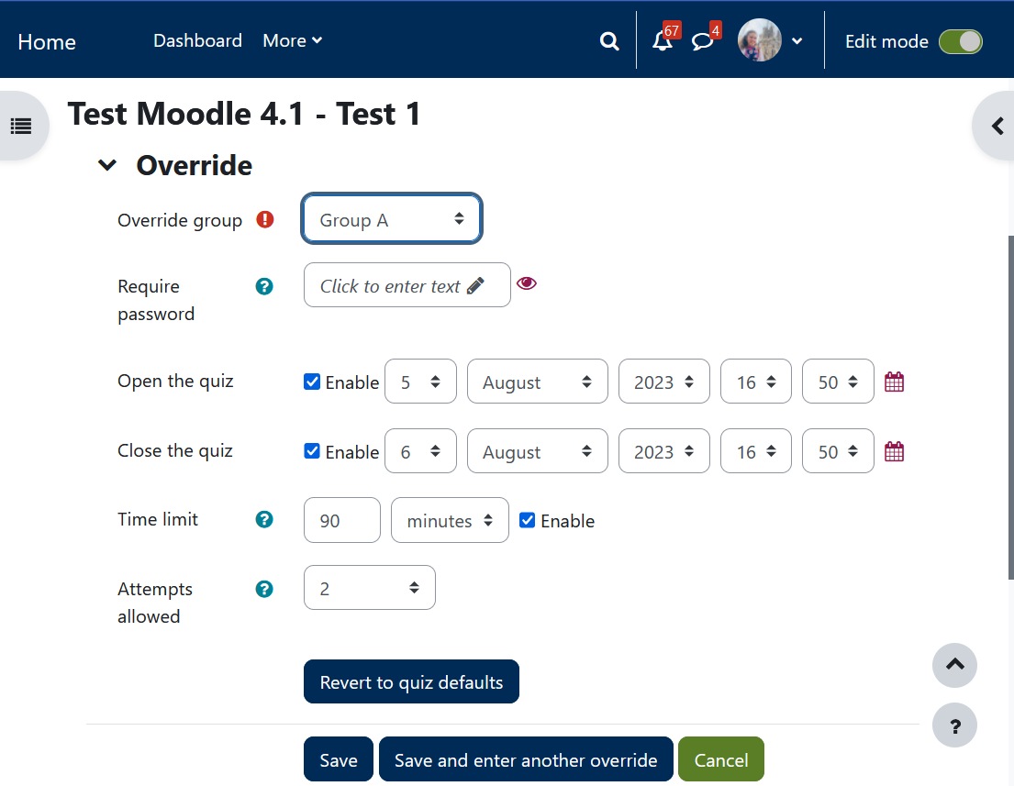
4a. Overrides – Settings
Extend/change the window time of the quiz
1
1
2
Add extra time
2
3
3
Add attempts
Notes:
Explain the differences between open-close quiz and time limit (common ticket at top desk)

Slide 8
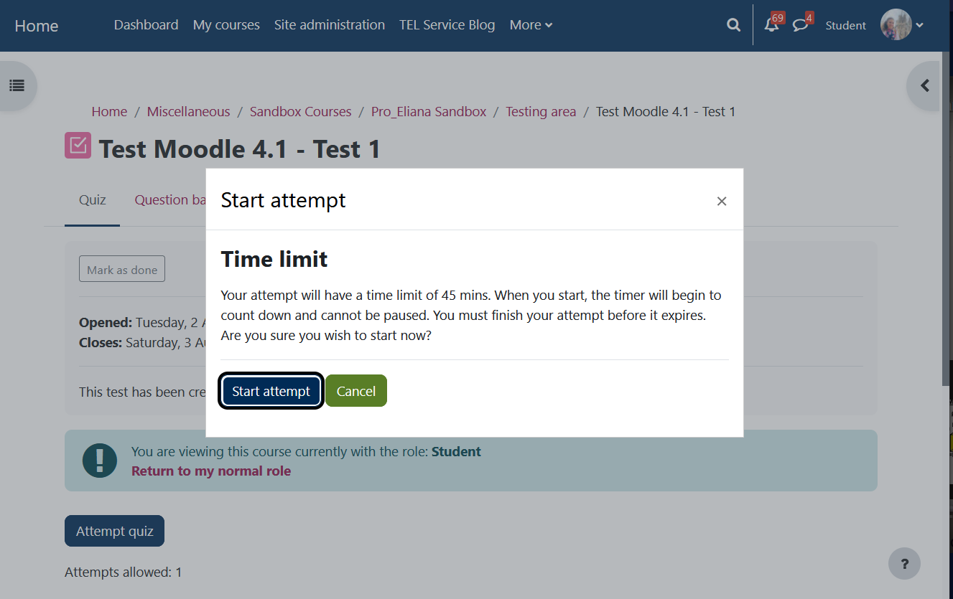
5.Run the Quiz
In case of technical issues, students can take a screenshot and contact you by email.
They can also receive support from IT-helpdesk

Slide 9
6. Review attempts (Demo)
It is advised to review the quiz attempts to identify errors
Marking essays. If you have used the essay question type, you will need to manually grade the response.
Notes:
https://moodle.bath.ac.uk/mod/quiz/view.php?id=1315516
View responses table
View question + Individual comment/mark override
Update mark scheme > Dry run regrade > regrade
(Manually mark – essay save for questions if intersted)

Slide 10
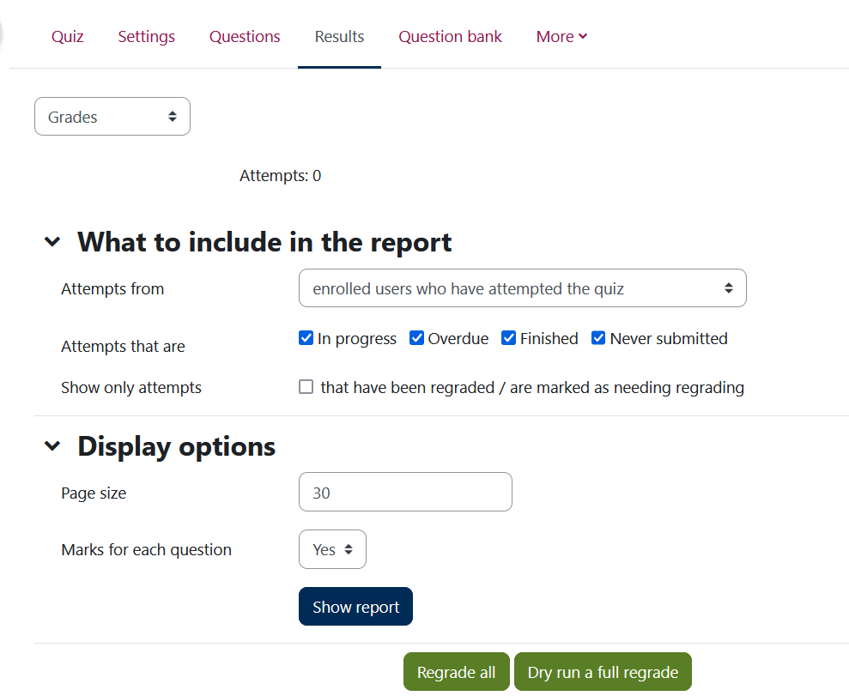
6a. Regrading Demo
B
A
Regrading
Dry run a full regrade
Regrade all
B
Manual grading- essay type questions
A
Notes:
Quiz with an essay question for grading: https://moodle.bath.ac.uk/mod/quiz/view.php?id=1332141

Slide 11
7. Distributing grades
More info: Releasing grades and feedback with marking workflow and grade transfer- 02/05/2024 , 10:15 AM - 10:45 AM

Slide 12
Summary & Feedback
Please take one minute to fill in this MS feedback form. Your responses are anonymous.
More resources:
Moodle – Quiz (summative workflow)
How to set-up a Moodle Quiz
How to release grades and feedback
Grade Transfer – what is it?

Slide 13
Rights slide
Produced by
Centre for Learning & Teaching
in conjunction with
Technology Enhanced Learning
2024 - This work is licensed under a Creative Commons Attribution-NonCommercial-NoDerivatives 4.0 International License

