Slide 2
Introduction to Generative AI
using Microsoft CoPilot for Bing.
Mark Egan / Nigel Goldsmith
tel@bath.ac.uk
EduFest version
May 2024

Slide 3
Why Copilot for Bing?
This is the only generative AI tool available to all staff and students at the University of Bath.
It is ‘safe’ to use. When logged in, your interactions with Copilot are not shared outside of the University and are not used as a source of data to add to existing AI models.
Other AI models / tools are not supported by the University at this time. For general guidance see the Generative AI section of the Teaching Hub: Generative AI - Learning and Teaching (bath.ac.uk).

Slide 4
Objectives
Open Copilot and initiate simple requests
Generate text-based responses and request amendments to AI-generated answers
Generate images
Overview Copilot’s ‘Notebook’ and file upload functionality
Copilot for Bing is in development. Feature availability is not guaranteed.

Slide 5
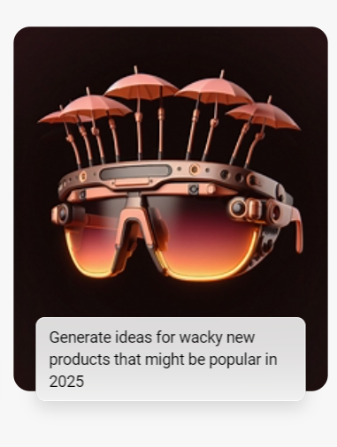
Open Copilot and try it out
Use CoPilot’s suggestions and check it is working as expected.
Use the ‘New topic’ button to try additional examples.

Slide 6
What does this do?
Click to visit a ‘referenced’ site
Copy the current response | Export the response (E.g. To Word) | Speak the response
A single ‘conversation’ can include up to 30 AI responses, after which you must start a new topic

Slide 7
Generate text-based responses
Example prompts:
‘Create a lesson outline to introduce the most popular models of memory to university students studying psychology’
‘Suggest five points to include in a personal reference for a student who…’
‘Create three multiple choice questions for a short quiz for undergraduates about…’
Ask the AI to refine its responses:
‘Simplify your response to make the questions suitable for a first-year undergraduate at a UK University.’
‘The lesson outline must focus on [x]. Remove the information about [y].’
‘Offer four possible answers for each quiz question. Every answer must be plausible.’

Slide 8
Generate images
Example prompts:
‘Create an image representing the concept of human memory in relation to how the brain works’
‘A square icon of a light bulb representing the concept of ideation’
‘Draw a SWOT analysis grid’
You can UPLOAD an image by clicking on the icon shown and request information about it. This can be useful to improve accessibility (including labelling images or creating ALT text) or extract text from text-based images including slides.

Slide 9
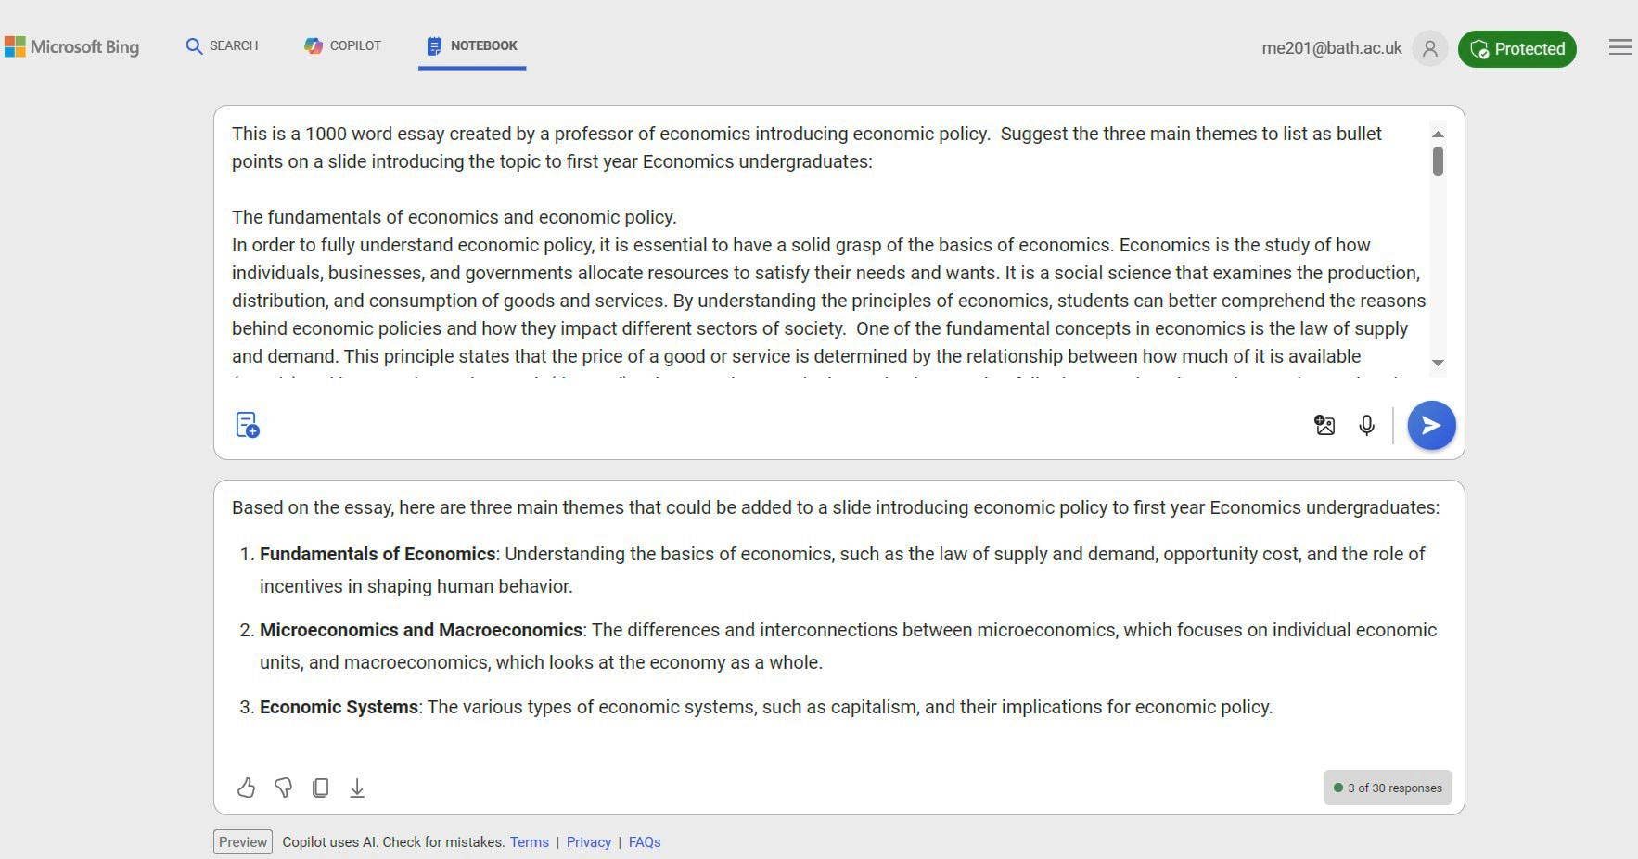
Copilot Notebook
Copilot Notebook is an interface for working with long-form text and iterating your prompts to improve the responses:

Slide 10
Copilot Notebook
Benefits of using Notebook (rather than the ‘chat’ interface)
The character limit in Notebook is 18,000 characters, significantly more than the chat interface, so you can work with entire essays or papers.
Your prompt remains in place so is easier to edit. Notebook retains the context of the previous answer, allowing you to adjust the prompt without ‘losing’ the original text. This is helpful for tasks which require many iterations (E.g. Generating and optimising code).

Slide 11
Use a file as a data source
Copilot can use the information in common types of file (E.g. Word, Excel) as a source of data to be questioned and annotated.
Examples:
Upload a rubric stored in a PDF file. ‘A student received the following scores…Suggest some general feedback points in the voice of a helpful, supportive tutor’.
Upload an Excel file. ‘Summarise the purpose of this spreadsheet and tell me the top three..’

Slide 12
Use a file as a data source
Text prompt used:
'Create a feedback message to a student who scores 53 overall and is weak at supporting their points or arguments’. Provide extra detail about they can improve supporting their points or arguments.'

Slide 13
Use a file as a data source
Response from Copilot (1 of 2)
Dear [Student’s Name],
I hope this message finds you well. Let me begin by acknowledging your effort in completing the assignment. Your overall score of 53 falls into the ‘Fair’ category, which means there is room for improvement.
Strengths:
You managed to cover the main points outlined in the indicative answer, which is commendable.
Areas for Improvement:
However, where you need to focus your attention is in supporting your points or arguments. Here are some specific steps you can take to enhance this aspect of your work:
Provide Evidence: When making a claim or presenting an argument, back it up with evidence. This could be in the form of data, examples, or references to authoritative sources. Evidence adds credibility to your points and strengthens your overall argument. >>>

Slide 14
Use a file as a data source
Reasoning and Logic: Take the time to explain the reasoning behind your points. Why do you believe what you’re saying? How does it connect to the broader context or topic? Clear and logical reasoning helps convince your reader of the validity of your arguments.
Counterarguments: Anticipate potential counterarguments and address them. Acknowledge opposing viewpoints and explain why your perspective is stronger. This demonstrates critical thinking and a deeper understanding of the subject matter.
Avoid Generalizations: Be specific in your supporting details. Avoid vague statements like “everyone knows” or “it’s common knowledge.” Instead, provide concrete examples or specific data to illustrate your points.
Action Steps:
Review the rubric carefully, paying special attention to the ‘Supporting arguments’ criterion. Consider revisiting your assignment and incorporating the suggestions above.
Improvement is a process, and every effort counts. Seek additional guidance if needed and keep refining your skills.

Slide 15
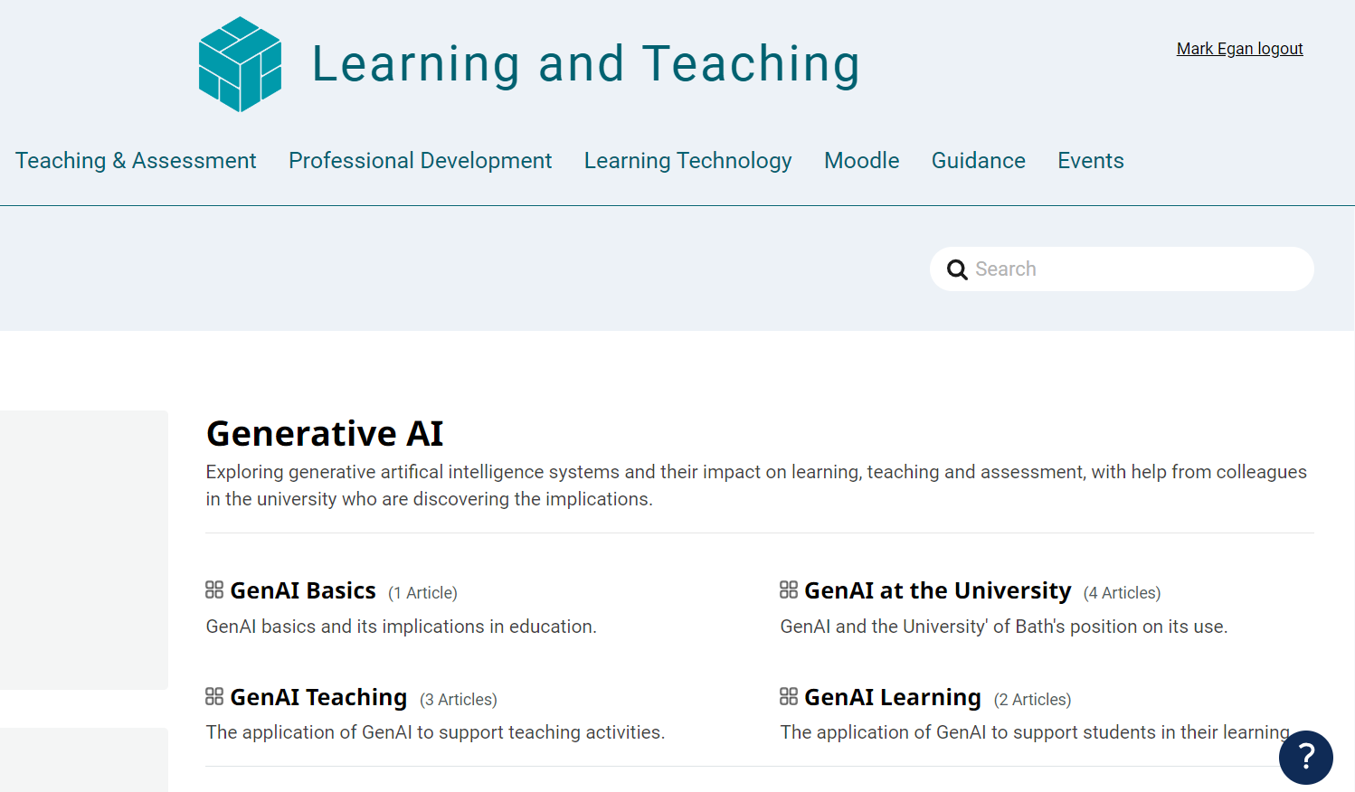
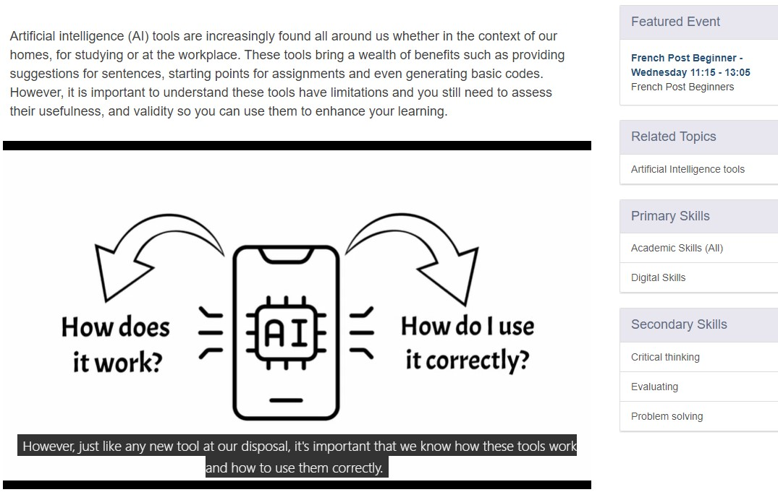
Resources
Resources on the Teaching Hub:
Generative AI help articles:
Generative AI - Learning and Teaching (bath.ac.uk)
Beginner resources including introductory videos:
Generative AI in Learning & Teaching - Learning and Teaching (bath.ac.uk)
Workshop support page with additional examples and links to external resources Introduction to Copilot for Bing: Downloadable Resources
Short videos created by the Skills Centre
Generative Artificial Intelligence (GenAI) (bath.ac.uk)
Online self-paced resources
In development and planned for release in June.

Slide 16
CLT closing slide
Produced by
Centre for Learning & Teaching
in conjunction with
Technology Enhanced Learning Team
2024 - This work is licensed under a Creative Commons Attribution-NonCommercial-NoDerivatives 4.0 International License

Slide 17
chatgpt
midjourney
bard
gemini
dall-e
copilot
stable diffusion
firefly
mubert
soundverse
runway
wolfram alpha
Classroom Session
May 2024

