Slide 1
Developing Technical Competencies via Independent Study Guidelines
Dr Moody Alam
Director of Studies (UG Year 3, 4 & 5)
Department of Computer Science

Slide 2
The Graduates’ Skills Gap
The gap between university graduates’ skills and employer expectations is well documented[1].
For Computer Science: [2] highlights this gap as “misaligned (priorities)” between academia and industry.
Employers identifying:
“A lack of soft skills and insufficient technical knowledge in graduates”.
Graduates complaining:
“The technical skills taught were not the most appropriate for finding work”.
“A lack of certain technical skills was a barrier to them getting a job”.
“The hands-on work experience was more valuable than the course itself”.

Slide 3
The Top-down Approaches
Top-down Approach:
Curriculum transformation and/or updating curricula/units.
Incorporating competency frameworks.
Accreditation.
Placements/Internships/Graduate training programmes.
Challenges:
Fast-paced and rapidly evolving technological landscape – accelerated in the era of AI technologies and AI-based tools.
Not practical for academia to incorporate such rapid changes into its curriculum.
Resource-intensive process.
No baseline for technical skills/tools and levels of technical proficiency expected.

Slide 4
A Bottom-up Approach: Independent Study Guidelines
A bite-size, task-based, “guided but independent” study approach which provides guidelines on skills, tools and required level of proficiencies expected from graduates.
Benefits:
Acknowledgement/raising awareness among students[3].
Provides structure/clarity to a part of notional/independent learning (1200 hours for UGs).
Informal and can be updated quickly/frequently, unlike updating modules/courses.
Signposts to free online tutorials/resources - not requiring the development of costly resources.
Technical skills should not assume “that our over-worked faculty is equipped to teach students the ever-changing landscape of software tools in CS discipline”. ISGs inspire independent learning, not requiring academics to be trained constantly[3].
Potential to improve OUEs/NSS/PTES scores and graduates’ employability.
Notes:
The CS industry addresses the challenge of up-skilling their employees whereby yechnical competencies are assessed by proficiency/hands-on experience.
In some medical-related disciplines "Day 1 competency“ used. For example, the Royal College of Veterinary Surgeons outlines what a qualified surgeon would be doing on Day 1 of their work.

Slide 5
Examples of
Independent Study Guidelines

Slide 6
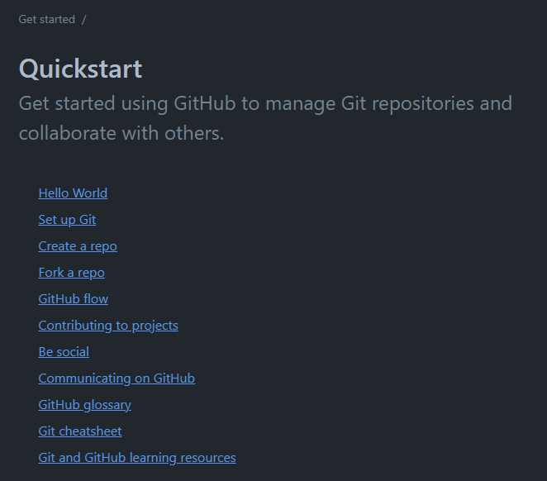
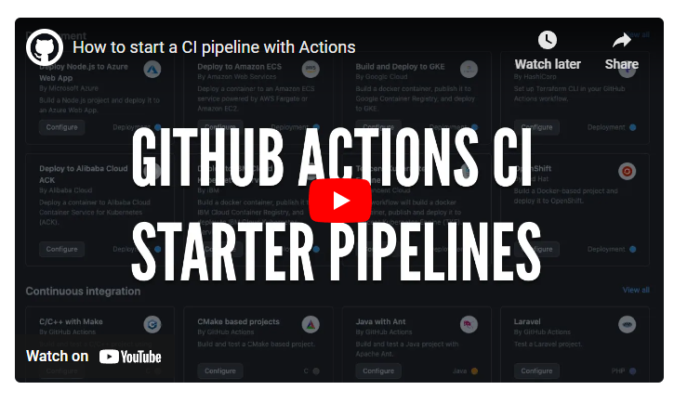
Independent Study Guidelines – CM20314
Skill | Setting up and using code repositories
Tool | GitHub
Tasks | Basic Level: -Setup a repo on GitHub -Fork a repo on GitHub Intermediate Level: -Use GitHub Flow to perform task(s) x,y,z. Pro Level: - Use CI/CD to perform task(s) x,y,z.
Resources | https://docs.github.com/en/get-started/quickstart
Independent Study Guidelines: A prototype of a task-based approach to developing technical competencies for working with code repositories with various “levels of proficiency”.
Independent Study Guidelines can signpost students to freely available online resources which eliminates or reduces the need for developing resources.
Source: https://docs.github.com/en/get-started/quickstart

Slide 7
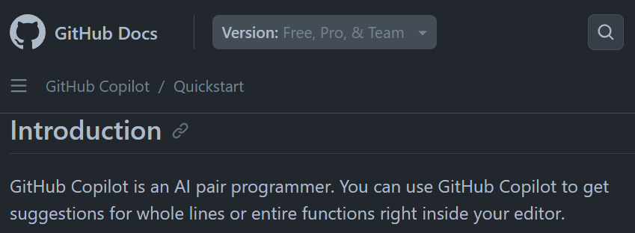
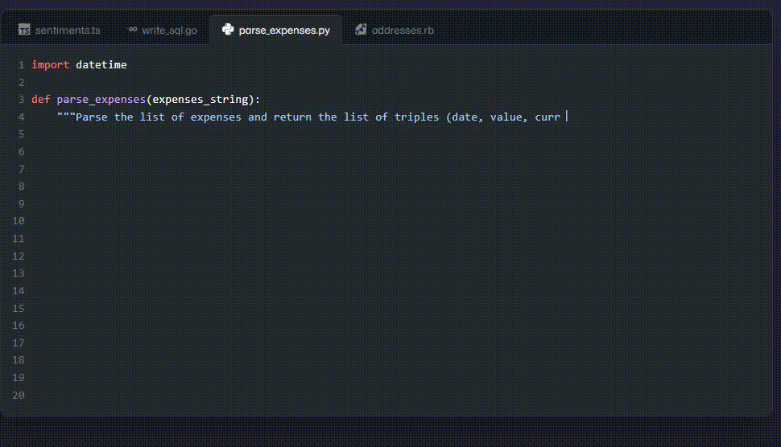
Skill | Use AI-powered code generation
Tool | AI Co-Pilot (Code GPT / GitHub)
Tasks | Basic Level: - Set up AI Co-pilot in an IDE - Use Co-Pilot to explain a piece of code (e.g. function). Intermediate Level: - Use Autocompletion (AI-based) for task(s) x, y, z (e.g., loops or entire functions) Pro Level: - Generate automated test cases
Resources | https://github.com/features/copilot
Prompt
Independent Study Guidelines: A quick prototype example of a task-based approach to developing technical competencies for using AI-powered code generation and test case generation.
Source: https://github.com/features/copilot

Slide 8
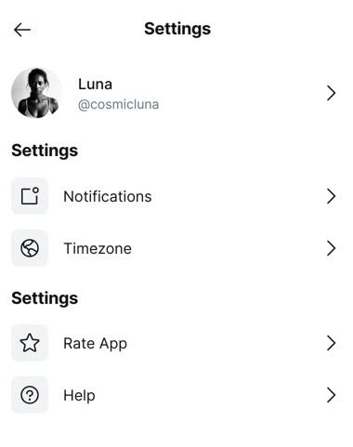
Prompt
Skill | Mobile UI Prototype generation via GenAI
Tool | Galileo AI or Dribble
Tasks | Basic Level: - Generate one prototype UI design. Intermediate Level: - Convert your sketches and/or wireframes into UI designs. - Explore variants of your design (colour themes, fonts). Pro Level: Use Galileo-AI to make changes to existing designs.
Resources | https://www.usegalileo.ai/ https://dribbble.com/
Independent Study Guidelines: A quick prototype example of a task-based approach to developing technical competencies for UI testing using GenAI-based tools.
Source: https://www.usegalileo.ai/d/cbd9496a-e5c4-42a0-a665-dd9e40765b23

Slide 9
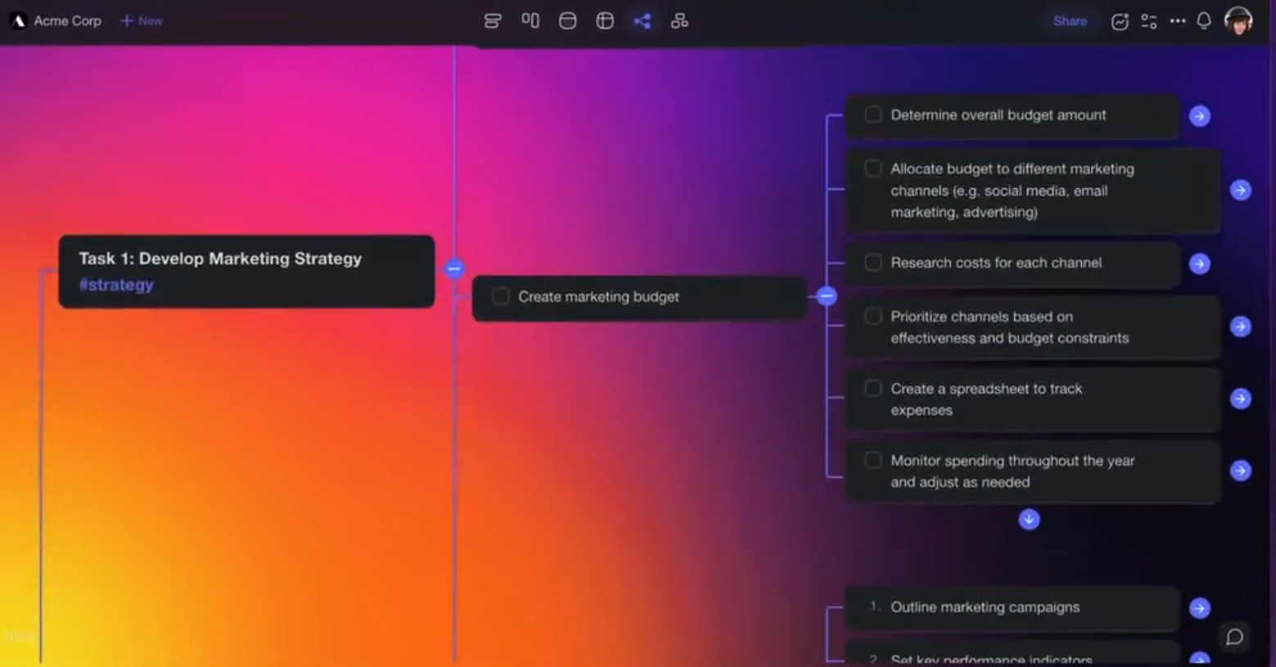
Skill | Using GenAI-powered Project Management
Tool | Taskade GenAI
Tasks | Basic Level: - Create a top-level project management plan for project Intermediate Level: - Generate sub-tasks for all stages of software development life cycle (SDLC) Pro Level: - Generate and integrate sub-tasks into Jira or other tools.
Resources | https://help.taskade.com/en/collections/8400799-taskade-ai
Prompt
Independent Study Guidelines: A quick prototype example of a task-based approach to developing technical competencies for software project management using GenAI-based tools.
Source: https://help.taskade.com/en/collections/8400799-taskade-ai

Slide 10
Collaboration Opportunities
Independent Study Guidelines can be used in other academic disciplines.
Happy to collaborate and pilot in other departments.
A collaborative project across departments will potentially be an excellent candidate for Bath’s Shape Teaching Development Fund (max £3,000 – Feb 2025)
Funding Opportunities:
Acquired: Bath’s Teaching Development Fund (Seed) – Nov 2023
Submitted: Council of Professors and Heads of Computing (CPHC) – March 2024
Planned: Bath’s Teaching Development Fund (Seed) – 28th June 2024
Planned: Teaching Development Fund (Shape) (max. £3,000)– Feb 2025
Notes:
Submitted: Collaborative Project Idea to Pedagogical Research Network (PedR) – April 2024

Slide 11
Questions?
References:
[1] QS, “The Global Skills Gap in the 21st Century,” QS Intelligent Unit, 2018.
[2] N. Shadbolt, “Shadbolt review of computer sciences degree accreditation and graduate employability,” London: BIS, 2016.
[3] D. M. Arya, J. L. C. Guo, and M. P. Robillard, “Properties and Styles of Software Technology Tutorials,” IEEE Transactions on Software Engineering, vol. 50, no. 2, 2024.

