Slide 1
Personal Tutor of The Year
Dr Gwen Scott
Department of Life Sciences

Slide 2
Outline
Background and experience
Approach to tutoring
Student Feedback

Slide 3
Experience
Tutor for 3 years
Undergraduate students
Taught postgraduate students
Senior tutor for Pharmacology group

Slide 4
Approach to Tutoring
Friendly and approachable
Spend time getting to know the students
Try to understand each students individual needs

Slide 5
In this office, I believe

Slide 7
Student Feedback
Gwen consistently goes above and beyond to ensure we can meet both as a tutor group and individually, always offering a range of times that suit us and booking somewhere on campus. In these tutor meetings she provides a reassuring environment and always appears approachable and respectful which makes it easy (and enjoyable!) to talk to her.
It is tutors like Gwen that enable Bath to have a high student satisfaction when it comes to mental health and stress where she makes it her aim to ensure every student and staff alike can talk to her freely and is always happy to give up her free time to make herself available for anyone. Gwen has been an integral part of enjoying my time here in bath and we believe the award alone would not be enough to show our appreciation for what she does for my peers and I.

Slide 8
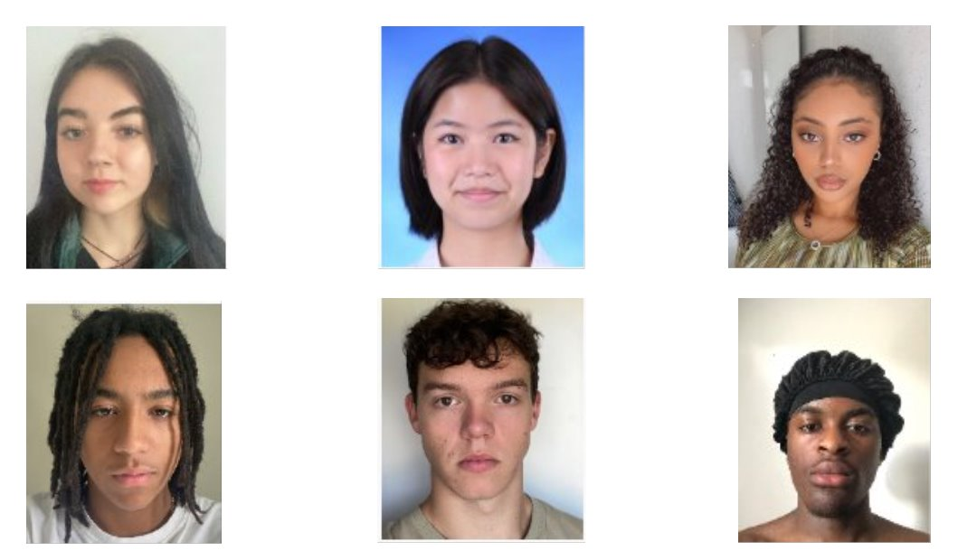
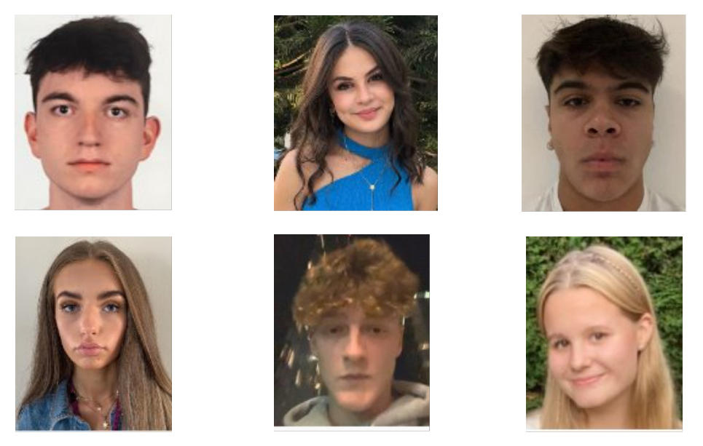
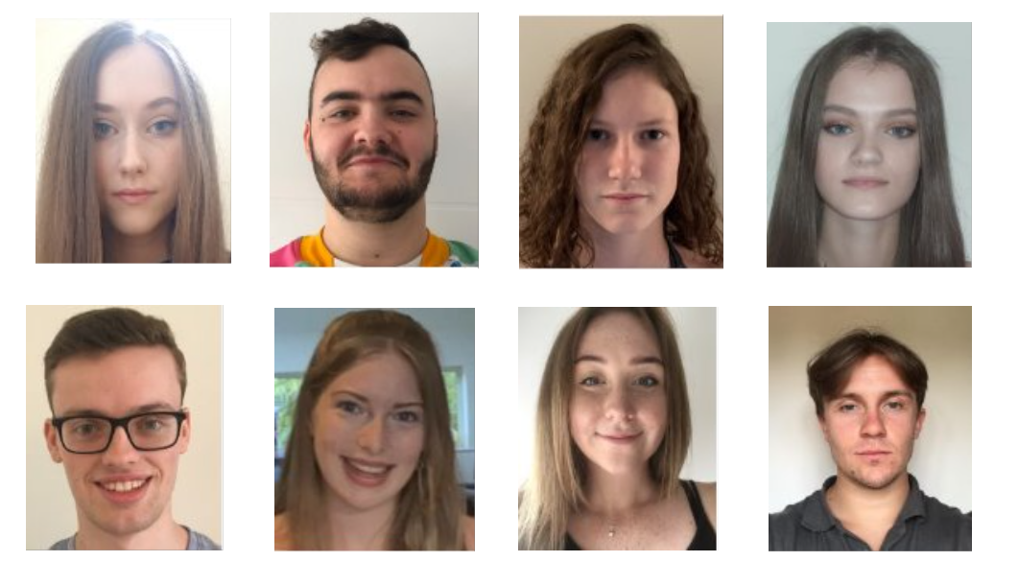
Thanks!

