Slide 1
EXPLORING PGwT TEACHING PRACTICES: A QUALITATIVE STUDY
Bayaz Mamadova, Dan Zhao, Gail Forey, Monia Mtar, Gan Shermer, Philip Shields, Elena Minelli, Trevor Grimshaw & Jo Charles
EduFest
University of Bath
14th May 2024
Notes:
Gail

Slide 2
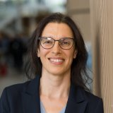
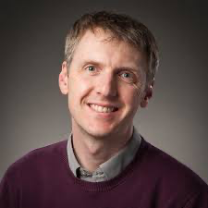
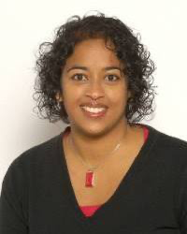
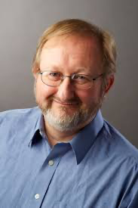
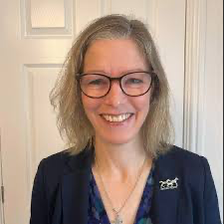
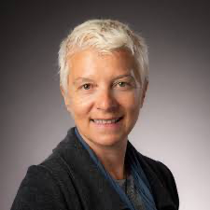
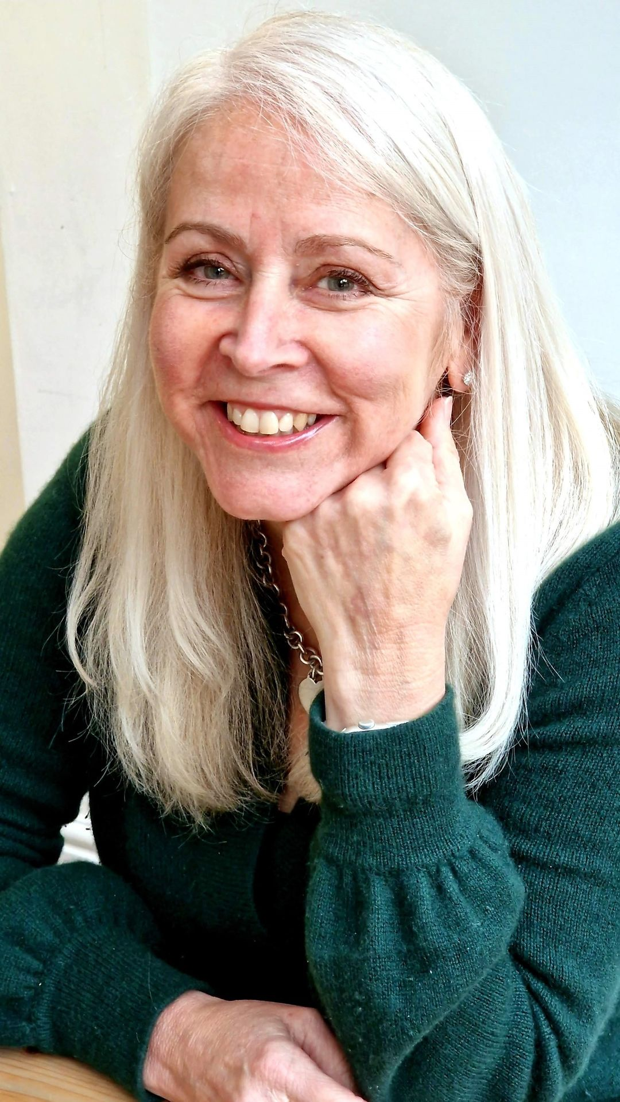
TDF Project Team
Monia Mtar
Phillip Shields
Gan Shermer
Trevor Grimshaw
Jo Charles
Elena Minelli
Gail Forey
Bayaz Mammadova
Dan Zhao
Notes:
Gail

Slide 3
Outline
TDF Projects
Purpose of the study
Methodology
Best practices: Staff & PGwTs
Conclusion
Notes:
Gail

Slide 4
Shape TDF – Focusing on University
TDF Projects
Seed TDF – Focusing on HSS Faculty
Seed TDF – Focusing on Postgraduates who Teach (PGwTs)
Shape TDF – Focusing on PGwTs across the University
Notes:
Gail

Slide 5
Purpose of the Study
Exploratory study aimed at understanding the experiences of PGwTs across various academic departments.
Understand PGwTs:
Effective teaching
Challenges faced
Areas needing enhancement.
To improve:
Training
Support
Pedagogy
Teaching and Learning

Slide 6
Methodology
Methodology
Qualitative Research Approach
Strength in capturing rich, descriptive narratives of PGwTs across various disciplines.
Methodology
Focus groups and follow-up interviews - explore PGwTs' experiences and teaching philosophies.
Benefits of Qualitative Insights
Allows PGwTs to express their perspectives in their own words.
Provides a detailed understanding of the nuanced challenges they face.
Outcome
Insights gained are essential for developing tailored support strategies to meet the needs of PGwTs in the dynamic HE environment.
Notes:
Bayaz The qualitative approach, involving focus groups and follow-up interviews, was chosen for its strength in capturing the rich, descriptive narratives of Graduate Teaching Assistants (PGwTs) across disciplines. This methodology allows for an in-depth exploration of PGwTs' experiences, teaching philosophies, and the nuanced challenges they encounter. It provides a platform for PGwTs to voice their perspectives in their own words, offering a more personal and detailed understanding of their roles, which quantitative methods might not fully capture. The insights gathered are crucial for developing tailored support strategies that cater to the specific needs of PGwTs within the dynamic environment of higher education.

Slide 7
Best Practices Across Departments
Best Practices Across Departments from PGwT’s Perspective
Flexibility and Adaptability in Teaching
Peer Support and Resource Sharing
Rewarding Teaching Experiences and Personal Development
Notes:
Bayaz

Slide 8
Flexibility and adaptability in teaching
PGwTs have developed various strategies to engage students effectively and have found that adapting their teaching style to students' needs is crucial​​​​​​.
Adapting Teaching Methods to Student Needs
Ice-breakers
Oxford-style debates
Feedback forms
Use of Technology and Innovative Tools in Teaching
"I would go around the classroom and just like individually ask the students if they had any questions."
"I used to sometimes on purpose just mention... 'I also struggled to understand this.'... It's like, well, the teacher is also human like us."
Notes:
Bayaz Effective Teaching Strategies: GTAs have developed various strategies to engage students effectively. These include dedicating time to students, showing genuine interest in their understanding, and using practical examples to relate to theoretical concepts. GTAs have found that adapting their teaching style to students' needs, such as recognizing different mathematical abilities, is crucial​​​​​​. Adapting Teaching Methods to Student Needs:
GTAs tailor their teaching methods based on student needs and course requirements. This includes sharing personal research experiences to make the material relatable and using different platforms for shy students​​. The findings suggest the following best teaching practices observed in different departments:
Ice breakers were mentioned as a way to establish rapport with students
Oxford style debates were mentioned as a way to foster discussions
Furthermore, consistent Stop/Start/Continue feedback forms are effective methods to engage students and promote active learning, as well as using digital tools like Padlet for student questions to enhancee communication and interaction in educational settings. The findings in this section suggest that establishing rapport with students fosters a positive learning environment and enhances the overall teaching experience. Further it emphasizes the importance of using ‘ice-breaker’ and informal feedback techniques to check in on how students are feeling about the course.
Use of Technology and Innovative Tools in Teaching:
The use of technology, like Google Forms and Padlet, for collecting feedback and facilitating anonymous questions, indicates an innovative approach to engaging with students and enhancing their learning experience​​.

Slide 9
Peer support and resource sharing
PGwTs highly value support and feedback from more experienced peers. The sharing of teaching techniques, resources, and insights into effective practices contributes significantly to improving teaching quality.
Shadowing experienced peers
Pairing with peer mentors
Peer-led discussions
Marking calibration workshops
Group Chats
“I felt like that was the most useful feedback that I got, really, […] because I feel like they’re going through the same experience as I am or they have just gone through it. So they've got really good practical tips that you could just adopt as they are”
Notes:
Bayaz The findings emphasize that GTAs highly value support and feedback from more experienced peers, especially in departments with strong face-to-face interaction. The sharing of teaching techniques, resources, and insights into effective practices contributes significantly to improving teaching quality. This theme underscores the significance of fostering a supportive community among GTAs to enhance their teaching abilities and overall experience.
Feedback from peers plays a crucial role in improving teaching practices for GTAs in most departments, however some departments report stronger need for better support structures, clearer communication regarding contracts and responsibilities, and the value of peer interactions
Shadowing experienced GTAs, pairing with mentors, GTA-led discussions and marking calibration workshops help align grading practices and expectations. Group chats with other GTAs foster collaboration and resource sharing.

Slide 10
Rewarding Teaching Experiences and Personal development
Rewarding Teaching Experiences:
Student progression
Teaching with confidence
Benefits to their own research work
Personal development
Increased self-awareness in teaching practices
Improved adaptability to different teaching scenarios​​.
"Because [the experiments] can be directly linked to my work... when things go slightly wrong and we need to fix things that's always useful information.”
"Getting negative feedback is not necessarily a bad thing... It's still a big challenge and instead of just complaining about it... I found a solution."
Notes:
Bayaz Rewarding Teaching Experiences and Impact on Personal Research: GTAs find teaching rewarding, especially when they see students progress and understand concepts. This is particularly satisfying when GTAs can teach concepts they are confident in and see the direct impact on students' understanding. Some GTAs also find that their teaching experience directly benefits their own research work, particularly when the teaching content aligns with their research area​​
Personal Development:
Challenges and Personal Development: GTAs face various challenges, including managing large groups, adapting to different student needs, and dealing with negative feedback. Overcoming these challenges contributes to their personal growth and development as educators. GTAs learn to be adaptable, develop their teaching methods, and learn from both positive and negative experiences​​​​. Working as a GTA contributes to increased self-awareness in teaching practices and improved adaptability to different teaching scenarios​​.

Slide 11
Best Practices Across Departments
Best Practices Across Departments from Academic staff Perspective
Marking for First Year Undergraduates
Marking with a clear criterion
Notes:
Dan
Marking for First Year Undergraduates
PGwTs in multiple departments primarily lead seminars and undertake the task of marking assignments for first-year undergraduates. This arrangement is due to the fact that the performance of first-year undergraduates does not affect their final transcripts. As a result, this approach reduces stress for PGwTs and provides them with valuable opportunities to enhance their marking skills, particularly advantageous for those with aspirations of pursuing academia post-graduation.
e.g.
Participant HOD 2:
They are mainly responsible for first year undergraduate seminars and the marking, again, part of the reason for that is first year marks don’t count, so it gives the PGwTs little bit more, for safety net and it’s less stressful.
Marking with a clear criterion
Several participants emphasize the importance of providing PGwTs with a clear marking criterion to ensure accuracy and consistency in evaluations. It is worthy to note that some lecturers assume PGwTs possess the necessary knowledge to mark coursework effectively, but in reality, many PGwTs lack clarity in this aspect.
e.g.
Participant DOL&T 1:
Yeah, I think I would like our PhD students to develop more skills in this respect because again, we might take for granted that the PhD student knows how to mark a piece of coursework. And even if we give them a marking criterion. Probably that's not very clear. Um, so it would be good if again lecturers. Would provide more guidelines to their PhD students on how to Mark and provide feedback to students. So sometimes we had inconsistency in marking across different teaching assistants because of this and students querying why? Why my feedback is so different than my friend’s feedback. So, to try to homogenise a bit the quality of marking.
Regular Meetings
Several departments have implemented a practice of organizing informal meetings or discussions with PGwTs on a regular basis, which proves to be highly advantageous. It is worthy to note that the effectiveness of informal gatherings in promoting open dialogue and facilitating the exchange of valuable insights among participants.
e.g.
• Participant SL 1:
In the Department of Education, they told me about the good practice that happened in psychology that they had coffee mornings, and those informal chats were really, really helpful. Observations of PGwTs’ Teaching Activities
Several participants highlight the effectiveness of the observation approach in enabling PGwTs to identify areas for improvement. Additionally, it provides unit convenors and PGwT coordinators with valuable insights into the instructional strategies employed by PGwTs during student sessions. This reciprocal exchange of information is viewed as a mutually beneficial strategy that fosters the professional development of PGwTs and enhances understanding of teaching practices.
e.g.
Participant SL 3:
And then we do like a 45 minute debrief afterwards as well. So basically, you sort of go through the feedback and you say, well, this was good, that was good. This that's a, this is how you might have dealt with that, something like that. So, you can give them, you know, feedback on what you've done and also, they can answer questions as well.

Slide 12
Good Practice: Marking Responsibilities
PGwTs in departments primarily
lead seminar
mark first-year UG assignments
Marking Y1:
Reduces stress for PGwT (doesn’t affect S’s final award)
Gaining marking experience for future work in HE
Marking Criteria
Importance of clear marking criteria
Ensure accuracy and consistency
Can’t assume PGwTs possess the necessary knowledge about marking
Many lack clarity & experience
Notes:
Dan

Slide 13
Marking with clear criteria
We might take for granted that the PhD student knows how to mark a piece of coursework. And even if we give them a marking criterion. Probably that's not very clear. Um, so it would be good if lecturers provide more guidelines to their PhD students on how to Mark and provide feedback to students. So sometimes we had inconsistency in marking across different teaching assistants because of this and students querying why? Why my feedback is so different than my friend’s feedback. So, to try to homogenise a bit the quality of marking. (Academic 1)
Notes:
Dan

Slide 14
Best Practices Across Departments
Best Practices Across Departments from Academic staff Perspective
Regular Meetings
Observations of PGwTs’ Teaching Activities
Notes:
Dan
Marking for First Year Undergraduates
PGwTs in multiple departments primarily lead seminars and undertake the task of marking assignments for first-year undergraduates. This arrangement is due to the fact that the performance of first-year undergraduates does not affect their final transcripts. As a result, this approach reduces stress for PGwTs and provides them with valuable opportunities to enhance their marking skills, particularly advantageous for those with aspirations of pursuing academia post-graduation.
e.g.
Participant HOD 2:
They are mainly responsible for first year undergraduate seminars and the marking, again, part of the reason for that is first year marks don’t count, so it gives the PGwTs little bit more, for safety net and it’s less stressful.
Marking with a clear criterion
Several participants emphasize the importance of providing PGwTs with a clear marking criterion to ensure accuracy and consistency in evaluations. It is worthy to note that some lecturers assume PGwTs possess the necessary knowledge to mark coursework effectively, but in reality, many PGwTs lack clarity in this aspect.
e.g.
Participant DOL&T 1:
Yeah, I think I would like our PhD students to develop more skills in this respect because again, we might take for granted that the PhD student knows how to mark a piece of coursework. And even if we give them a marking criterion. Probably that's not very clear. Um, so it would be good if again lecturers. Would provide more guidelines to their PhD students on how to Mark and provide feedback to students. So sometimes we had inconsistency in marking across different teaching assistants because of this and students querying why? Why my feedback is so different than my friend’s feedback. So, to try to homogenise a bit the quality of marking.
Regular Meetings
Several departments have implemented a practice of organizing informal meetings or discussions with PGwTs on a regular basis, which proves to be highly advantageous. It is worthy to note that the effectiveness of informal gatherings in promoting open dialogue and facilitating the exchange of valuable insights among participants.
e.g.
• Participant SL 1:
In the Department of Education, they told me about the good practice that happened in psychology that they had coffee mornings, and those informal chats were really, really helpful. Observations of PGwTs’ Teaching Activities
Several participants highlight the effectiveness of the observation approach in enabling PGwTs to identify areas for improvement. Additionally, it provides unit convenors and PGwT coordinators with valuable insights into the instructional strategies employed by PGwTs during student sessions. This reciprocal exchange of information is viewed as a mutually beneficial strategy that fosters the professional development of PGwTs and enhances understanding of teaching practices.
e.g.
Participant SL 3:
And then we do like a 45 minute debrief afterwards as well. So basically, you sort of go through the feedback and you say, well, this was good, that was good. This that's a, this is how you might have dealt with that, something like that. So, you can give them, you know, feedback on what you've done and also, they can answer questions as well.

Slide 15
Communities of Practice
Every month we have a catch-up session where we discuss what's going right, what's going wrong, tips, questions, things like that. And then throughout the year, we are run certain workshops on particular issues. So, for example, I've had workshops on how to deal with difficult topics. So, what if someone says something sexist or something racist or what you have to teach something that is (Academic 2)
Regular informal meetings
Promoting open dialogue
Facilitating the exchange of valuable insights
Notes:
Dan

Slide 16
Observations - PGwT’s
And then we do like a 45 minute debrief afterwards as well. So basically, you sort of go through the feedback and you say, well, this was good, that was good. This that's a, this is how you might have dealt with that, something like that. So, you can give them, you know, feedback on what you've done and also, they can answer questions as well. (Academic 3)
Observations:
Enable PGwTs to identify areas for improvement
Provides unit convenors and PGwTs coordinators valuable insights into PGwT’s instructional strategies
Exchange of information - beneficial to the mutual understandings of pedagogy
Notes:
Dan

Slide 17
Tailored Training Courses for PGwTs
One department offers 10-11 week PGwT tailored training courses
Valued by staff and PGwTs
Equips PGwTs with essential skills, e.g. marking, delivering seminars, handling challenging situations, etc.
We have the accredited course that we do in the first semester. That’s quite helpful, there is a series of lectures that we give, around nine or ten. And they are about lots of different aspects of teaching and marking, and guidance on how they get support as well. (Academic 3)
Notes:
Dan

Slide 18
Supporting AFHEA Applications
One Dept set up a support for PGwTs to apply for AFHEA
Organised workshops,
Q&A sessions
Peer reviews for PGWTs AFHEA applicaitons
But many PGwTs don't know about the AFHEA
1 Department 12 AFHEA
Awarded since Jan 2021

Slide 19
Top Tips from one PGWT
Notes:
Bayaz

Slide 20
Identified Areas for Improvement
Identified areas for improvement
Structured guidelines and training for PGwT roles
Enhanced Communication and Guidelines for Responsibilities
Accessible and Well-Organized Resources
Notes:
Bayaz
The Need for Better Structured Support and Training:
There is a recurring mention of the need for more structured support and training for GTAs. This includes a desire for clearer guidance on teaching strategies, lesson structuring, and content delivery​​. In some departments there is a need for specialized training on effective methods for handling challenging students, conflict resolution, and managing sensitive issues that may arise during teaching sessions. Equipping GTAs with these skills can enhance classroom dynamics and create a more inclusive learning environment.
Streamline contract procedures, ensuring clarity in employment terms and conditions. Simplify the process of logging working hours, whether through fractional or zero-hour contracts, to avoid administrative burdens on GTAs.
Enhanced Communication and Guidelines for Responsibilities:
The feedback process appears to be mostly informal, with GTAs valuing spontaneous and direct feedback from students and peers. Formal evaluation mechanisms are less frequently mentioned, indicating potential areas for improvement in GTA support systems​​​​. Organize routine meetings between GTAs and department heads, allowing open discussions about challenges, improvements, and overall experiences could be beneficial. These discussions can foster a collaborative atmosphere and create a platform for voicing concerns.
Establishing clear and consistent communication channels between unit convenors and GTAs has been mentioned across departments. A need for developing detailed guidelines for marking criteria, expectations for grading, and responsibilities within each unit have also been mentioned. This would help avoid confusion, ensure uniformity in grading, and reduce complaints about final grades. Implement a formalized system for observing GTA sessions by experienced educators or unit convenors. Provide constructive feedback and guidance based on these observations to enhance teaching techniques, address challenges, and foster continuous improvement.
Accessible and Well-Organized Resources:
Developing a centralized online repository of teaching resources, including sample lesson plans, assessment templates, and technological tools would ensure that GTAs have easy access to these resources, saving them time and effort in curriculum preparation. Develop standardized marking schemes, especially for complex tasks like lab sessions or essays. Provide GTAs with clear rubrics and exemplars to ensure consistent and fair grading. Centralize resources and materials for teaching to assist GTAs in delivering high-quality sessions.

Slide 21
Conclusion
Initial Conclusion
Balancing teaching autonomy: Encourage innovation & development through structured support
Enhance communication channels – Strength Unit Convenor, DoS & PGwT communication
Call to Action: Adopt best practices from across campus using evidenced based strategies
These are exploratory findings: Shape TDF to follow
Notes:
Bayaz
1. Promote Autonomy: Encourage innovation and personalization in teaching.
Ensure Structured Support: Maintain consistency and clarify expectations.
In our exploration, the balance between autonomy in teaching and structured support emerged as pivotal for PGwT success. Autonomy fosters innovation and personalization in teaching, while structure ensures consistency and clarity in expectations.
Effective communication stands as the cornerstone for supporting PGwTs, with a clear need for more robust channels.
This study serves as a call to action for academic departments to implement the best practices seen across various departments, enhancing the learning and teaching experience through informed, evidence-based strategies.
Findings should be treated with caution as this is an exploratory study and a larger scale SHAPE TDF is currently being conducted building on this seed project

Slide 22
Next Steps…
PGwT Shape TDF - ongoing Study:
PGwT survey – 120+ responses
Staff survey – currently underway (please respond!)
Interviews & data collection with colleagues across campus
More data insights and recommendations to follow…
Notes:
Bayaz

Slide 23
Thank you! Any questions?
Notes:
Bayaz, Dan & Gail

