Slide 1
Towards
a student-centred
pedagogy
Dr Robert Grover
Director of Studies BSc Architecture
Department of Architecture and Civil Engineering
University of Bath
Dr Robert Grover, University of Bath rjg21@bath.ac.uk

Slide 2
Some principles
Meaningful collaboration with students
Assessment as learning
A culture of support
Dr Robert Grover, University of Bath rjg21@bath.ac.uk

Slide 3
1. Meaningful collaboration
Multiple ways of feeding back
OUEs
Course conversations
Anonymous reporting
SSLC
Informal conversations
Student curriculum team
Supporting student led events (helping make it happen)
Decolonise Architecture Festival
Paperspace magazine
Additional lectures
Architecture annual
Dr Robert Grover, University of Bath rjg21@bath.ac.uk

Slide 4
2. Assessment as learning
Eliminating threat
Self-assessment
Work assessed collaboratively with students and tutors
Agency and trust
Demystifying assessment
Synoptic learning
Project based learning
Clear relevance
Dr Robert Grover, University of Bath rjg21@bath.ac.uk

Slide 5
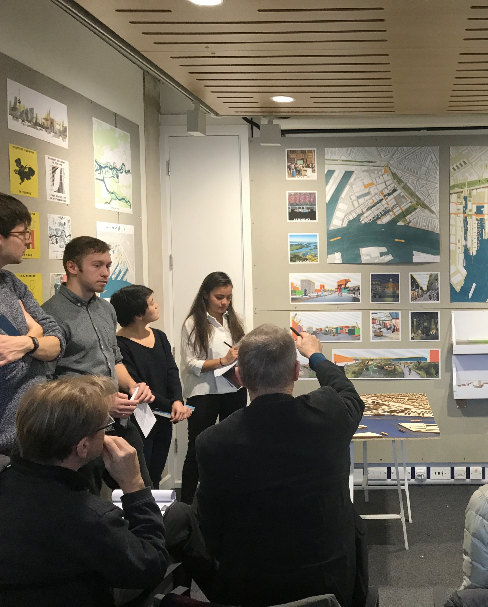
3. A culture of support
Challenging power dynamics (tutor and student)
Tutors’ awareness of their power
Empowering students to challenge this
Consistent and positive messaging
Enabling students to produce their best work (not the best work)
Structural changes to support students
Deadlines
Placements
Dr Robert Grover, University of Bath rjg21@bath.ac.uk

Slide 6
Any questions?
Dr Robert Grover, University of Bath rjg21@bath.ac.uk

