Slide 1
Creation of a model, learner-focused, technology-integrated resource package to improve the student journey in health professions education
Tim Rennie
Director of Taught Postgraduate Programmes (AP3T)

Slide 2
Our situation
Postgraduate
Clinical (work-based practice model)
Part-time study (practicing pharmacists)
Usually/Mostly online
4 academic teams (mix of sectors and topics)

Slide 3
Our challenge
Engaging with students
Work-based supervision
Workshops
Excellent resources (hiding light under bushel)
Seamless training journey
Integrated technology solutions

Slide 4
Opportunities
Pooling experience + existing tools
Creation of e-Learning Coordinator (0.4FTE)
TDF funds = ‘internship’ + software licenses
Existing bespoke resources (pdf)

Slide 5
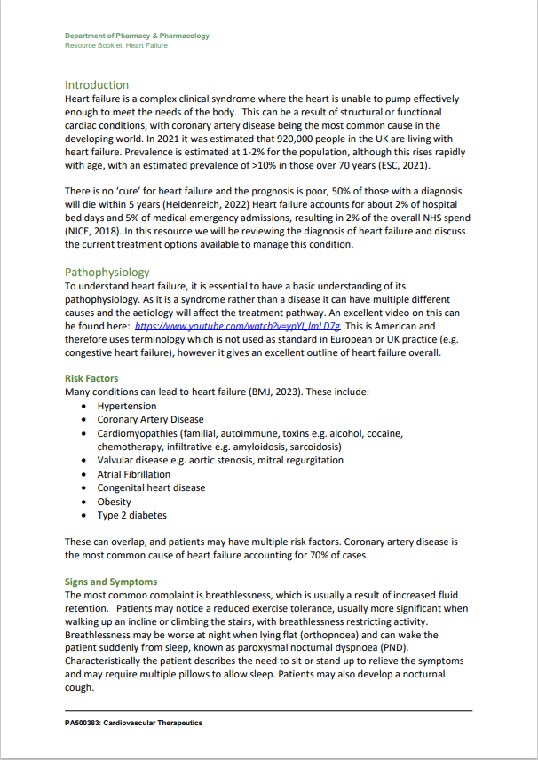
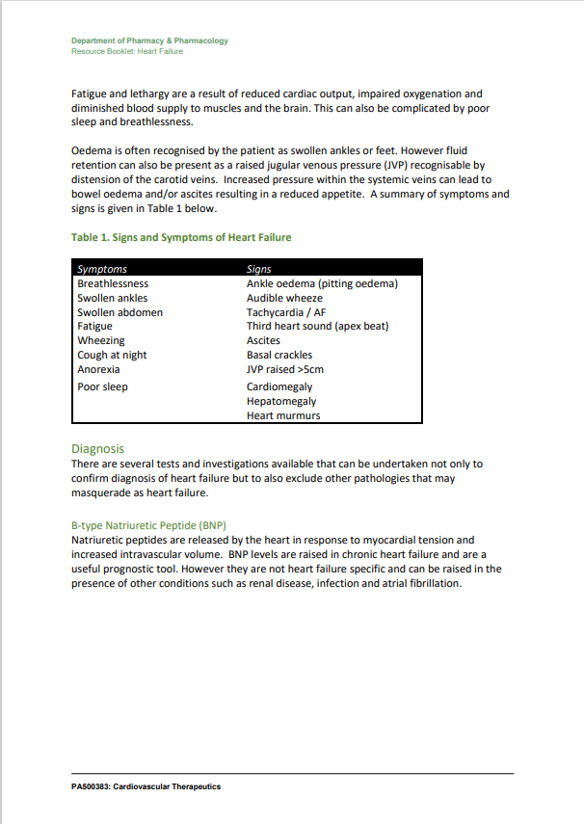

Slide 6
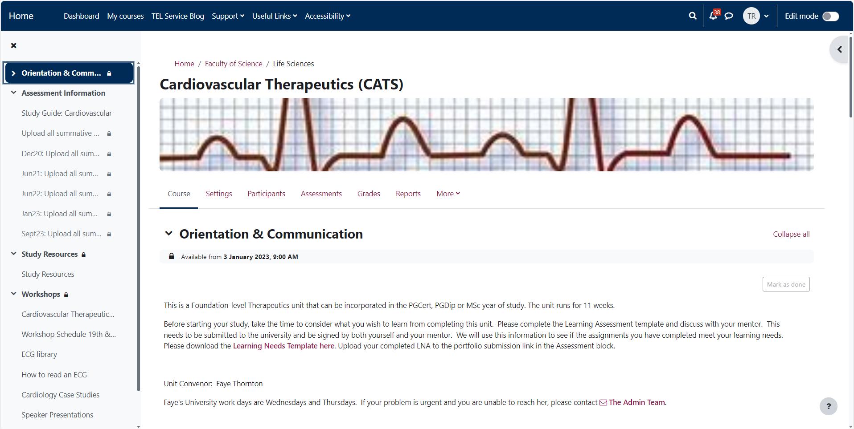

Slide 7
What we did
Testing the waters…
Establish an integrated team + meetings (academic + tech + intern)
Created systems for development of resources
Developed resources
Share, share, share (team, dept, Uni, wider collaborators)
Sought feedback

Slide 8
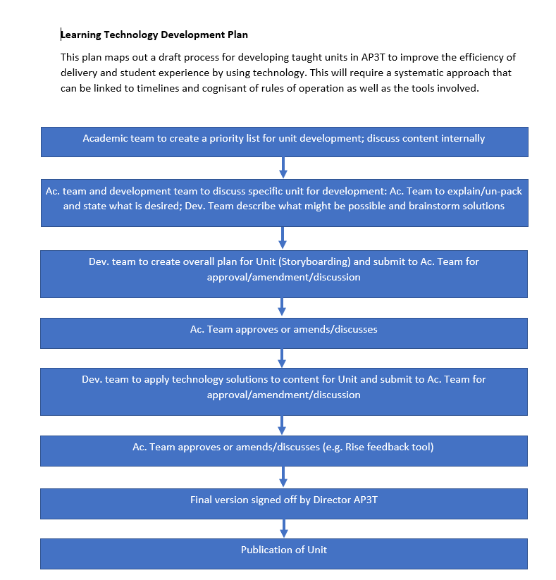
Systems / process

Slide 11
Examples (while we were waiting!)
Managing Polypharmacy and multimorbidity:
Xerte: https://xerte.bath.ac.uk/play.php?template_id=947
Articulate: moodle.bath.ac.uk/mod/scorm/player.php?a=1334&currentorg=articulate_rise&scoid=4069&sesskey=exuwIMjUFw&display=popup&mode=normal

Slide 12
And…
Professional Skills for Medicines Optimisation:
https://rise.articulate.com/share/dxvt_cMIe6wY2oAF-TsarmQGst25oAFA

Slide 13
And…
Leadership in Health
Leadership in Health - Overview | Rise 360 (articulate.com)
Course: Leadership in Health | Home (bath.ac.uk)
(included Camtasia)

Slide 14
And…
Pharmaceutical Public Health
https://360.articulate.com/review/content/23cec49a-e8b7-40fb-a94d-def38d87d933/review
Included content development by intern

Slide 15
Feedback and lessons
Ongoing…
Generally positive
Balance: One size fits all vs. creative innovation
Additive rather than replacing – suiting the learner
How to handle lengthy resources?
Balancing academic and technical input
Rate of development
Emerging collaborations; funding applications; further developments (initial ambition!)

Slide 16
Thank you! (twr32@bath.ac.uk)
Acknowledging:
Tom Ash
Anna Spencer
Greg O’Kane
Kerry Street
Sally-Ann Prater
Sarah Jones

